Slide 1
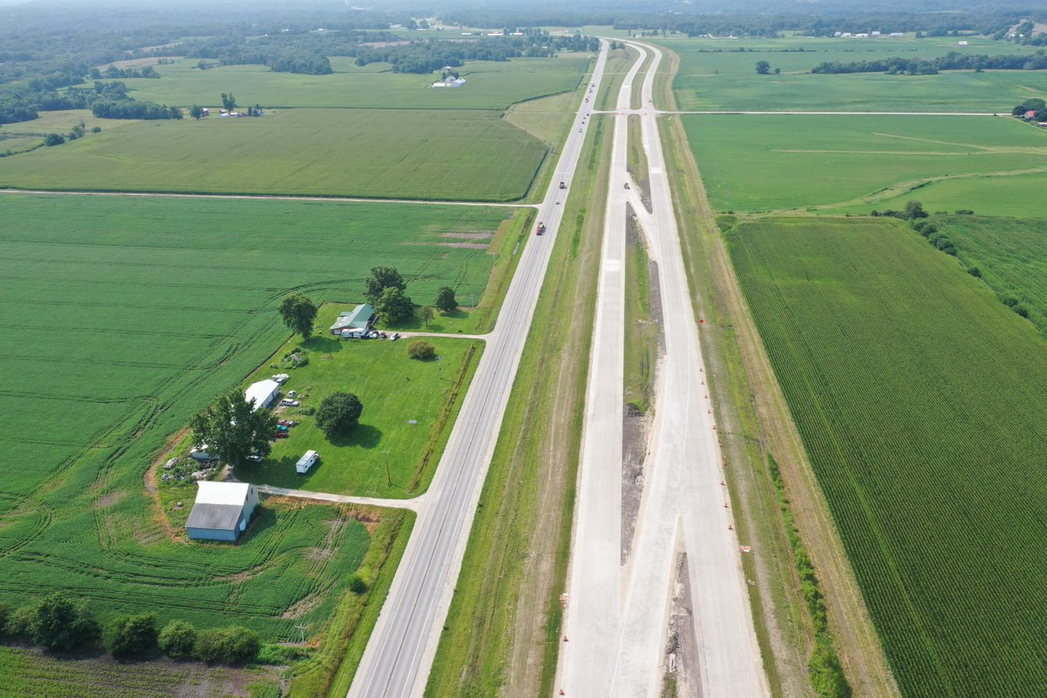

DISTRICT 5
Upcoming Projects

Slide 2

Bob Younie
District Engineer
Steve McElmeel
Assistant District Engineer
Darrick Bielser
District Construction Engineer
Beau Burgher
EOT (Permits) - Central
Bryan Archer
District Utility Coordinator
Liz Finarty
Res. Construction Eng.
Chariton
Kyle Hardin
Construction Tech Supvsr.
Chariton
John Doe
John Doe
manager
manager
Kenny Cooper
EOT (Permits) - East
Austin Burgett
EOT (Permits) – West
Christy Vanbuskirk
Res. Construction Eng.
Fairfield
Anthony Blint
Construction Tech Supvsr.
Fairfield
John Doe
John Doe
John Doe
John Doe
manager
manager
manager
manager

Slide 3
Other District Staff
Jared Klein
Staff Engineer - Fairfield
Bob Porter
District Maintenance Manager
Jared Roberts
Staff Engineer - Fairfield
Chris Kukla
District Planner
Ryan Freitag
Staff Engineer - Fairfield

Slide 4
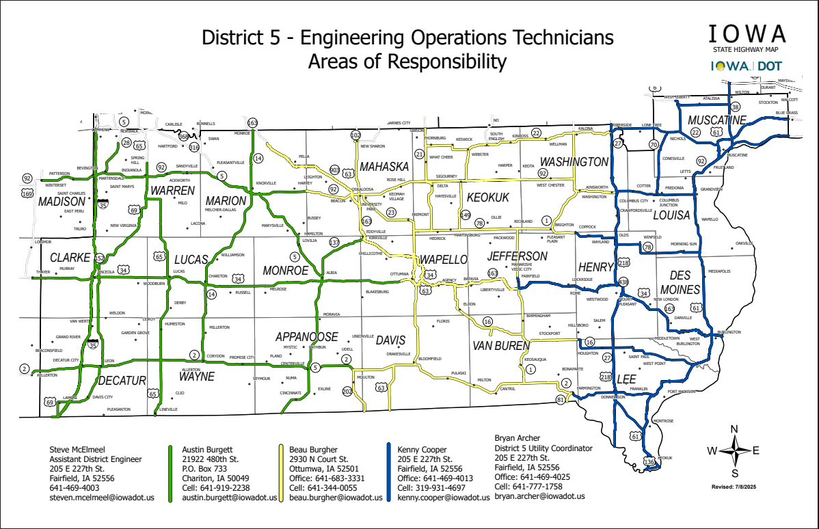

Slide 5
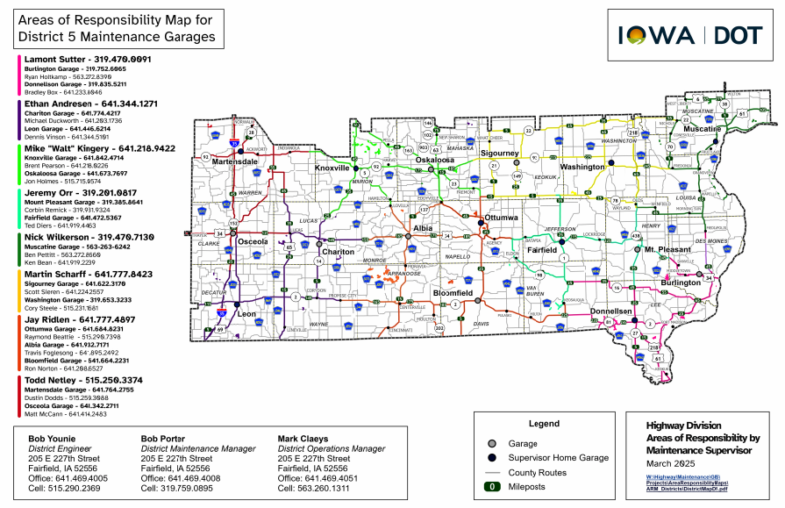

Slide 6
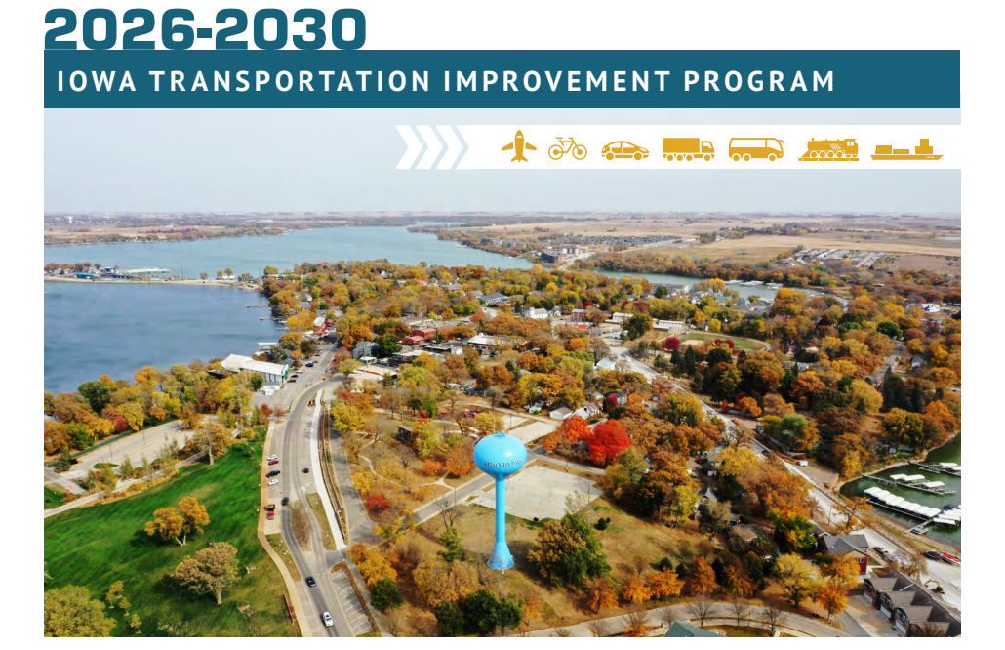

Slide 7
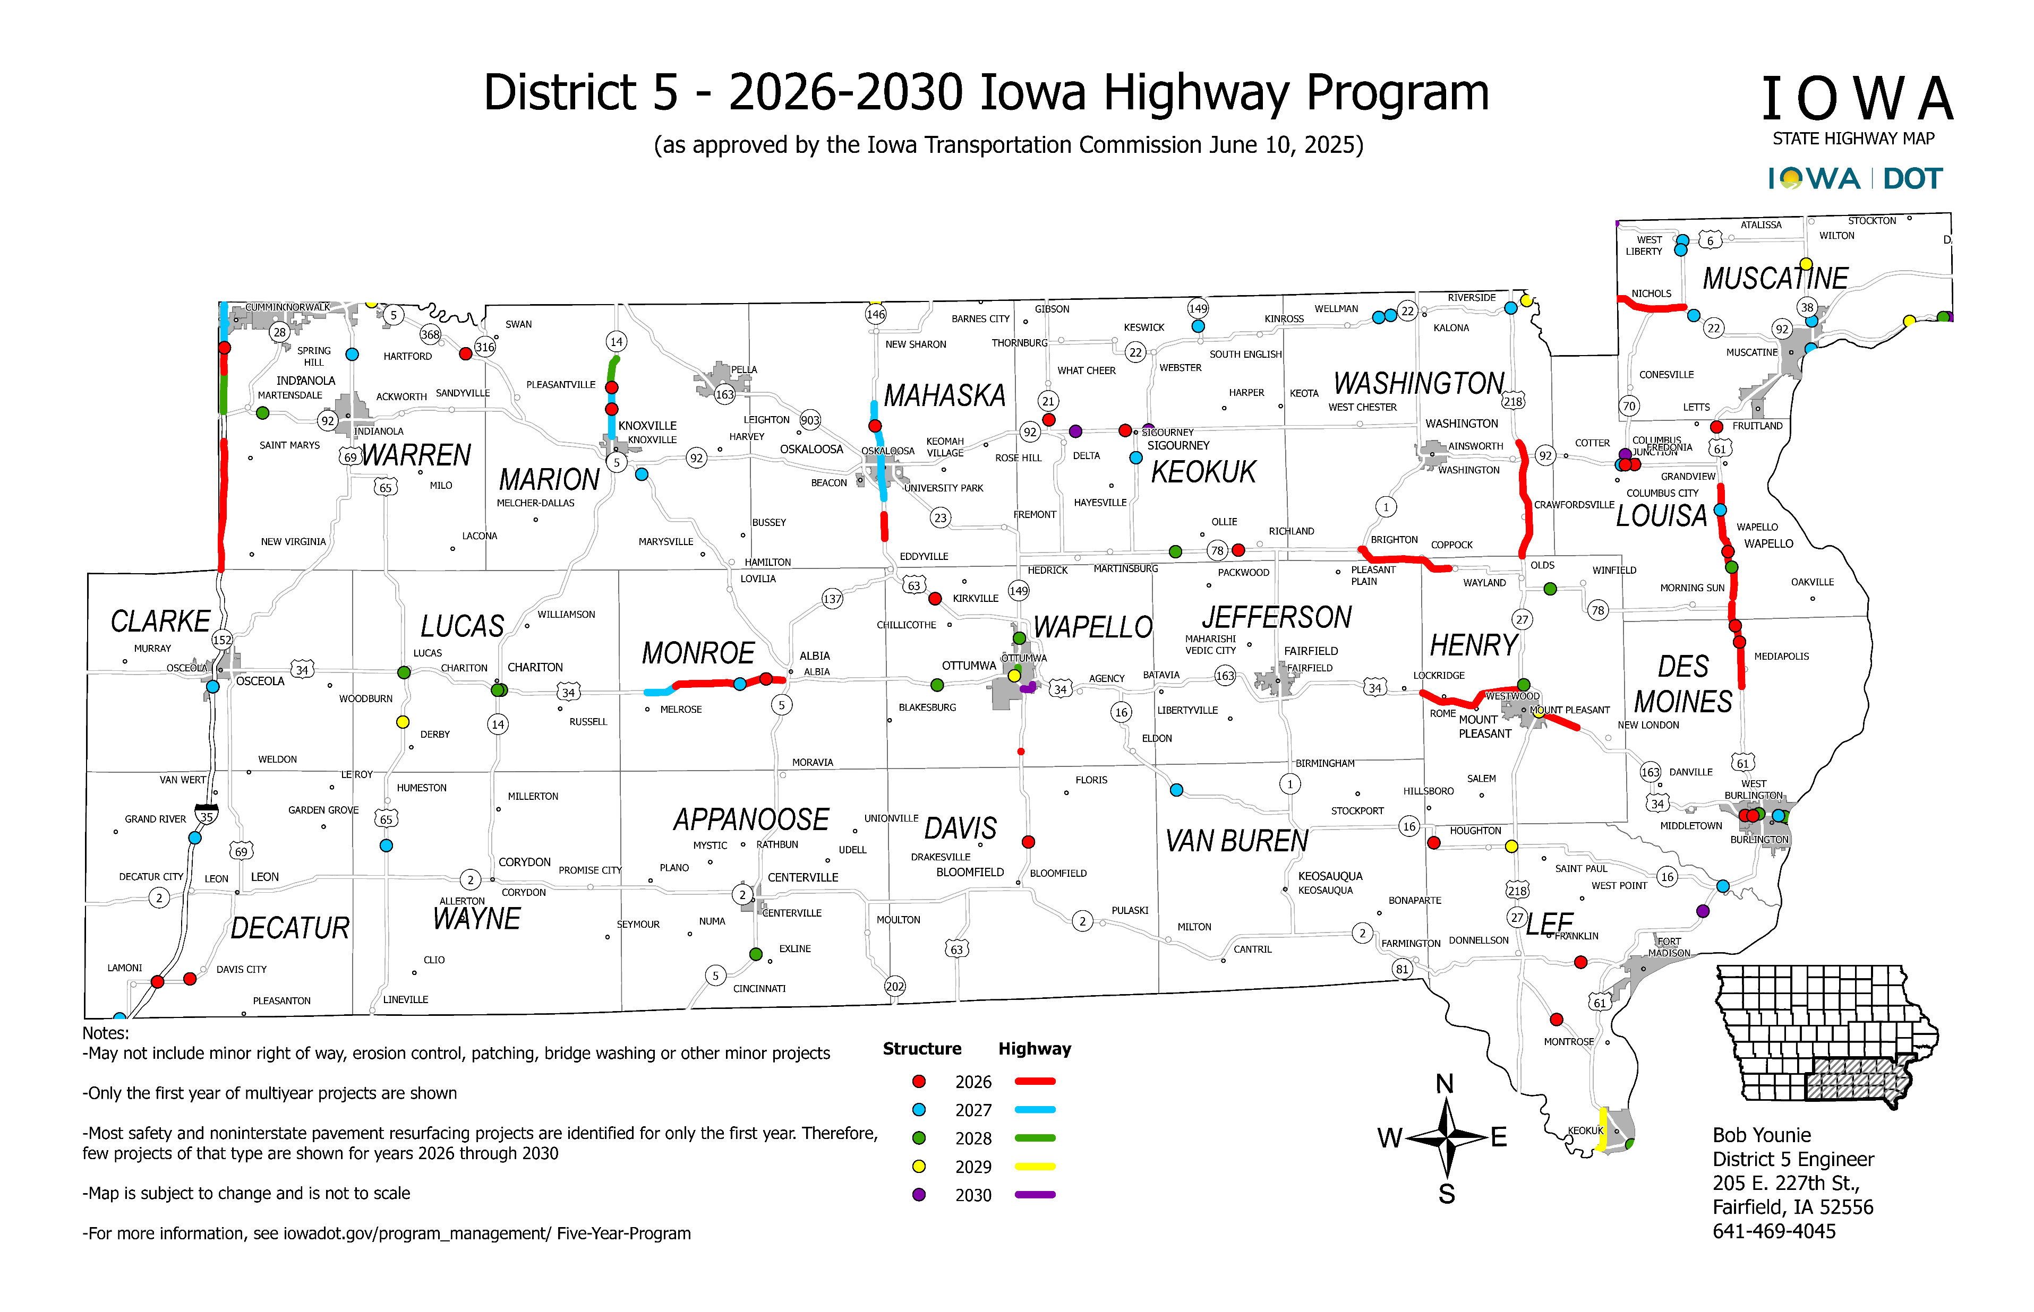

Slide 8
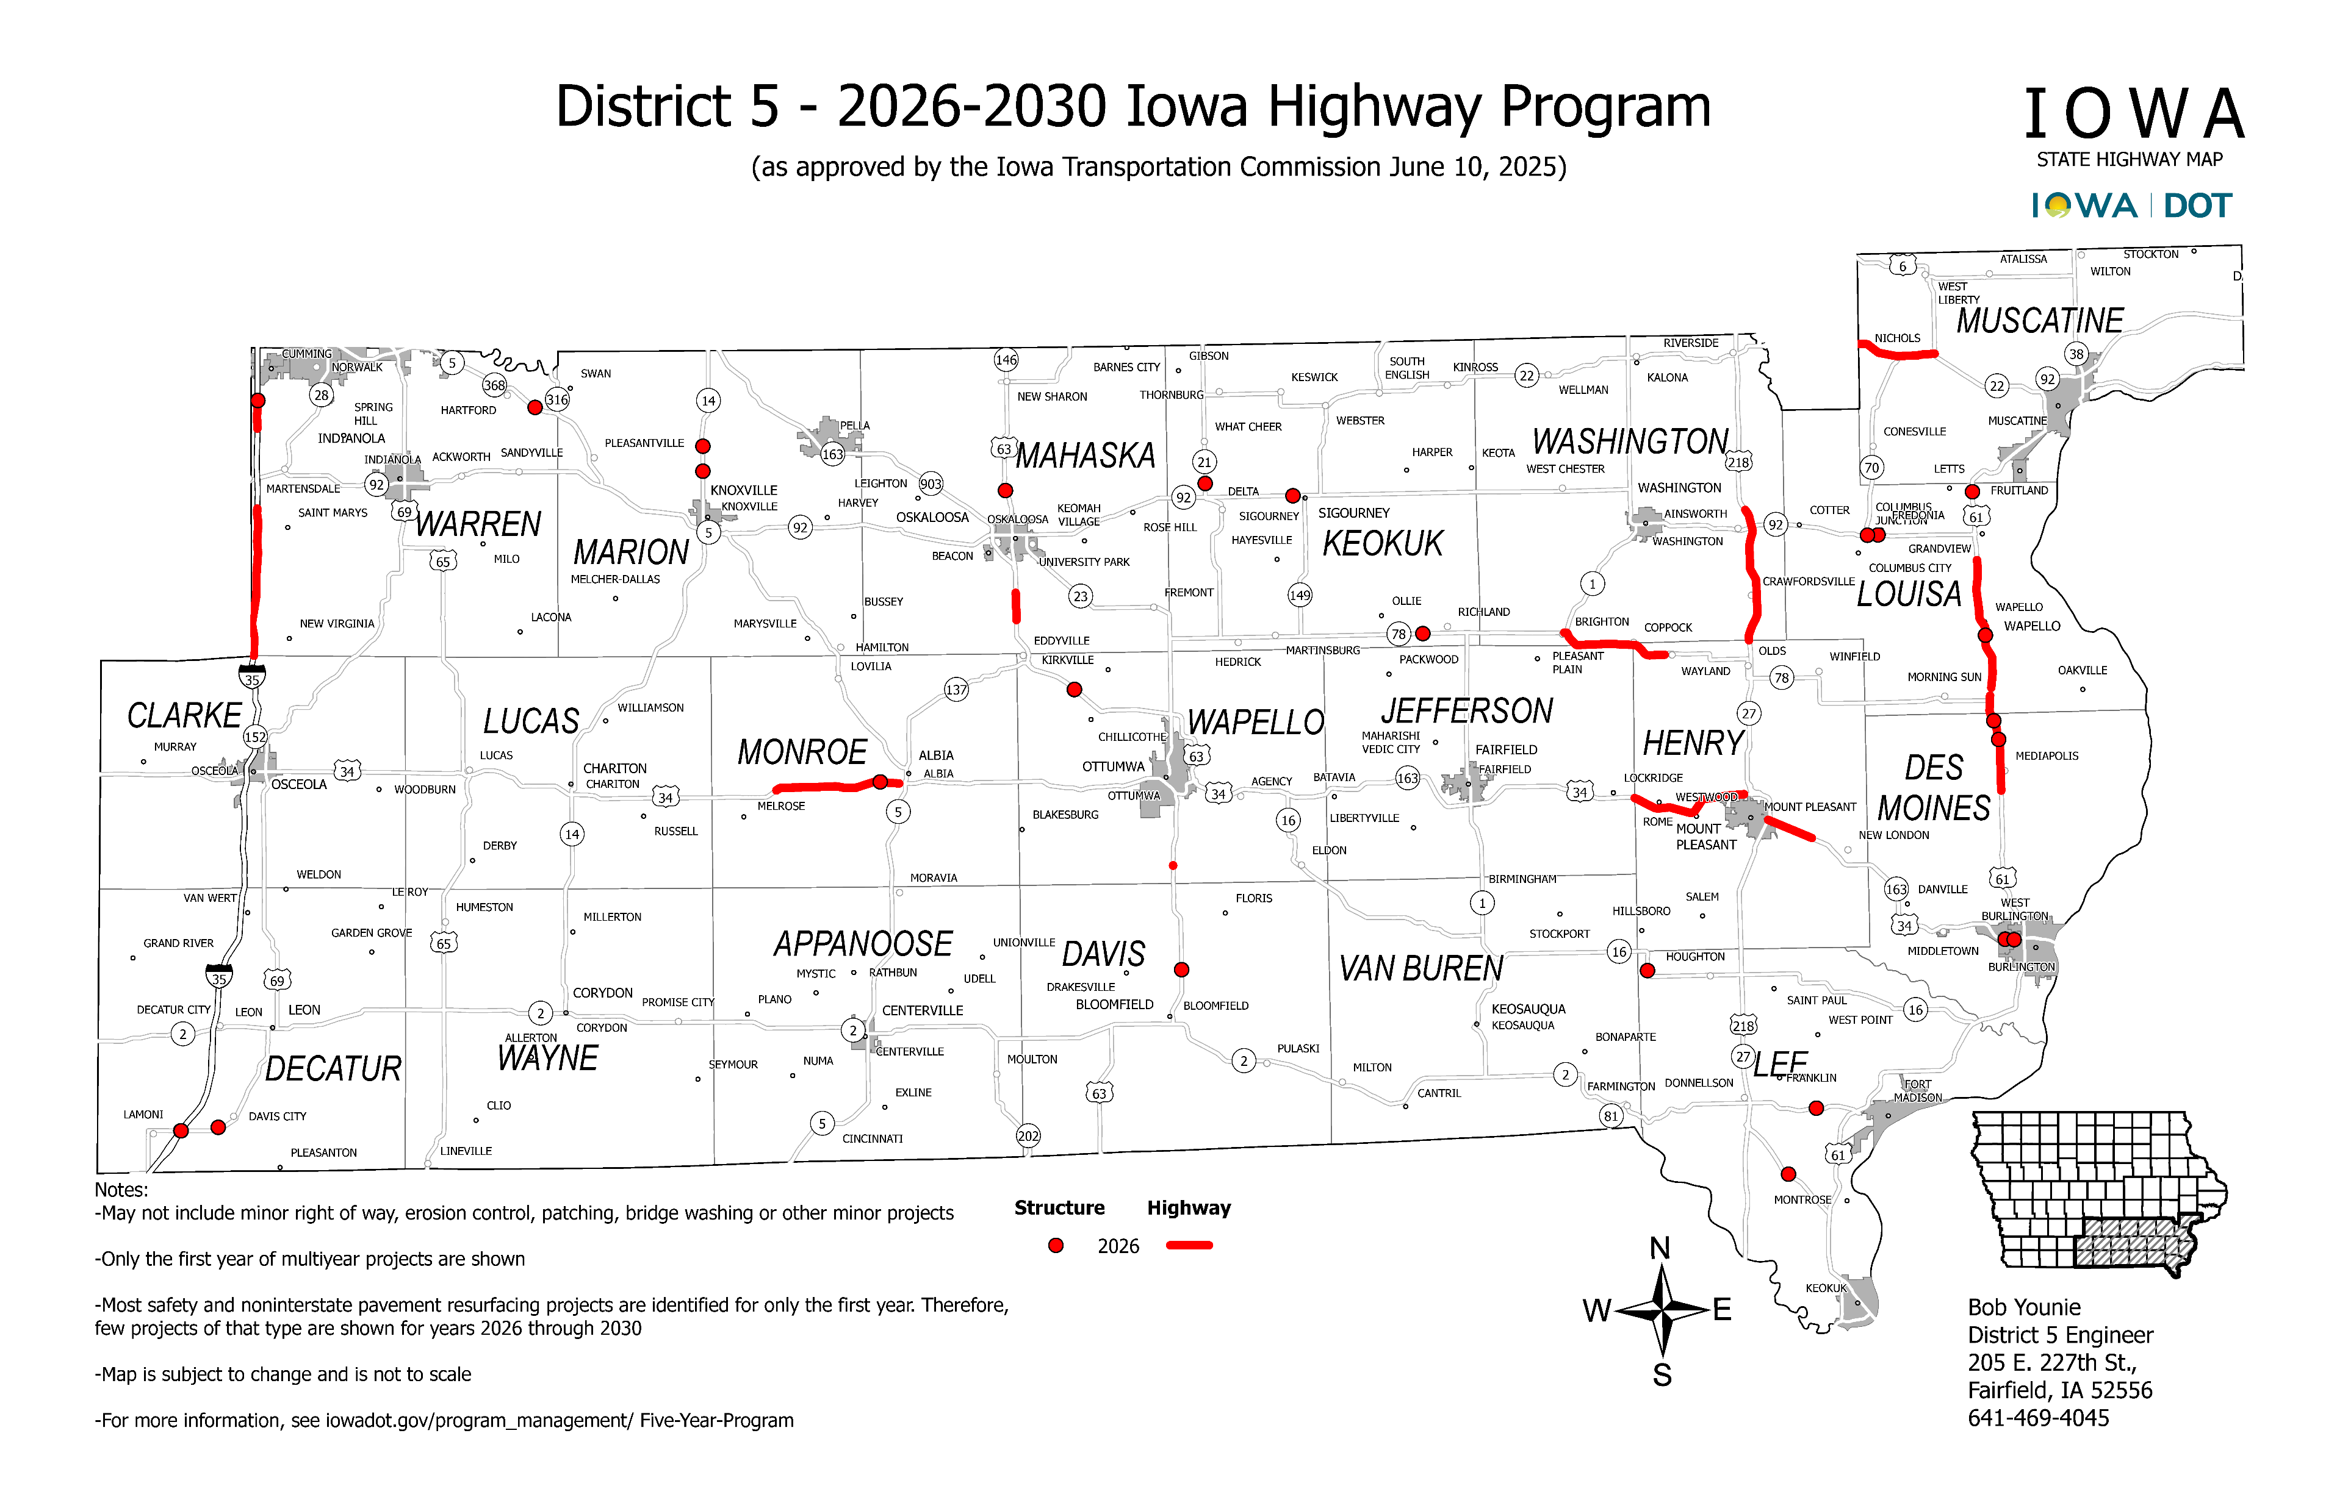

Slide 9
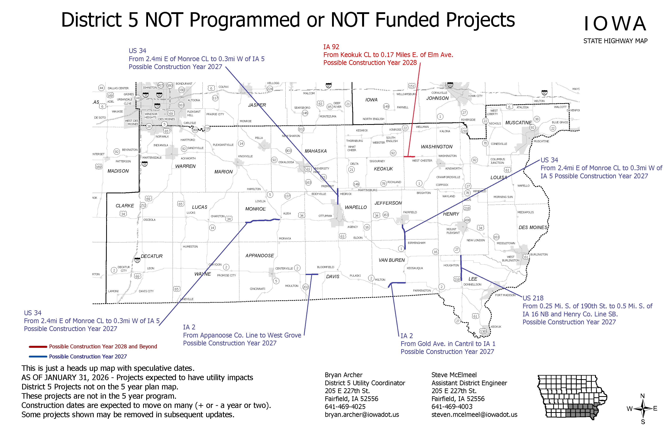

Slide 10

THANK YOU FOR YOUR TIME AND ATTENTION
Contact Information

