Slide 1
Point25 Process Who/Why/What/When
For Utility owners, designers, and contractors.
Bryan Bradley, P.E. State Utility Engineer
800 Lincoln Way 515-239-1014
Ames, Iowa 50100 bryan.bradley@dot.iowa.gov
Notes:
I get to go first so you are still awake.
Coffee
Cookies

Slide 2
Point25 – WHY?
Trouble right here in River City 19th century
Late 19th century - Early 21st century
Utilities and DOT got together
Frustrations
Notes:
Before my time at the DOT
Best and Brightest of both worlds

Slide 3
Point25 – What is that?
Point 25 refers to Iowa Administrative Code 761-115.25 through 761-115.30
Iowa Administrative Code IAC is written to implement the IOWA CODE – It is Law
115.25 to 115.30 - Added to the IAC 2002
Iowa Administrative Code
Transportation Department [761] Section
Chapter 115 is Utility Accommodation –
Cover general information for placement, adjustment, maintenance in, on, above, or below
Process should be called Point 25/30.

Slide 4
Point25 – What is that?
Utility companies and the DOT worked together to solve problems in the relocation process when there are conflicts with IA DOT projects.
761—115.25(306A) Utility facility adjustments for highway improvement projects. Rules 115.26(306A) to 115.30(306A) establish administrative procedures for utility facility adjustments made necessary by state highway improvement projects. The purpose of these procedures is to adjust utility facilities with minimal delays or added expense. Rules 115.26(306A) to 115.30(306A) apply to all state highway improvement projects with the following exceptions:
1. Projects the department develops on an accelerated schedule.
2. Projects with no anticipated utility adjustments.

Slide 5
Point25 – (Parts 1-3) Costs
761—115.25(306A) Utility facility adjustments for highway improvement projects.
115.25(1) Should the department be responsible for the cost of a utility facility adjustment required for highway work, the department shall not pay for any betterment that results in an increase in the capacity of the facility or for any other adjustment not required by highway construction. The department is entitled to receive credit for the accrued depreciation on replaced facilities and the salvage value of any materials or parts salvaged and retained or sold by the utility owner.
115.25(2) Adjustment costs for which the department is responsible shall be paid on a cost reimbursement basis.
115.25(3) If adjustment of an existing utility facility occupying the right-of-way is required due to highway construction, the utility owner shall adjust the facility without cost to the state and, whenever possible, in advance of the highway work.

Slide 6
Point25 – How to implement?
Set up U-dates/events to trigger communication between DOT and Utilities
General description of 5 prescribed actions:
DOT Utility
Preliminary plans to utility Replies if in the area or not
Actual Plans to the utility Replies if affected and plans
Final plan to the utility Replies with permit plans
Notice to proceed w/relocation Relocate before letting if possible
Notice in contract documents Contractor bid per documentation
Exceptions: accelerated schedule or no anticipated utility adj.

Slide 7
Point 26 (step1)
716-115.26(306A) Notice of Project
115.26(1) Determining affected utilities. The department shall make a reasonable effort to determine what utility facilities are located within the project limits of a state highway improvement project by researching permit files, through field investigations or contacts with one-call locating services, and through contacts with local government units.

Slide 8
Point 26 (step2)
716-115.26(306A) Notice of Project
115.26(2) Notifying utilities. The department shall identify by name the owner of each known utility facility that is located within the project limits. The department shall send to each utility owner a notice of the improvement project, including the route number of the highway, the geographical limits of the project and a general description of the highway work to be done.

Slide 9
Point 26 (step3)
716-115.26(306A) Notice of Project
115.26(3) Responding to notice. The utility owner shall:
a. Within seven calendar days after the date of the notice, reply to the department, acknowledging receipt of the notice.
b. Within 90 calendar days after the date of the notice, provide to the department information about its utility facilities that are in the vicinity of the improvement project, including the name of any company that has utility facilities which coexist with the utility owner’s facilities. The utility owner shall reply regardless of whether or not it has facilities in the project’s vicinity.

Slide 10
Point 26 (step1-3) – U02
716-115.26(306A) Notice of Project
Notice of Project is IADOT event U02
Happens after the field exam
Plans 30% complete
Alignments chosen and difficult to change
Typically more than 3 years before letting

Slide 11
Point 27 (step1)
761—115.27(306A) First plan submission, preliminary work plan and agreement.
115.27(1) First plan. The department shall submit its first plan to the owner of each known utility facility within the project limits. The first plan shall contain information the owner needs in order to design and lay out the adjustment of its utility facilities, including the placement of adjusted or additional facilities, within the project limits.

Slide 12
Point 27 (step2)
761—115.27(306A) preliminary work plan
115.27(2) Preliminary work plan. Within 90 calendar days after the date the department submits its first plan, the utility owner shall provide to the department a preliminary work plan.
a. The preliminary work plan shall include the following:
(1) A narrative description of what work the utility owner will do.
(2) A drawing showing the present and proposed locations of the utility owner’s facilities in relation to the highway plan.
(3) Whether the work is dependent on work by another utility owner.
(4) Whether the work can be done prior to highway construction or must be coordinated with the highway contractor.
(5) The number of working days required to complete the work.
(6) A list of permits and approvals the utility owner is required to obtain from governmental agencies and railroad companies for the work, and the expected time schedule to obtain them.

Slide 13
Point 27 (steps 3-4)
115.27(3) Department review of preliminary work plan. The department shall review each utility owner’s preliminary work plan to ensure compatibility with utility accommodation permit requirements, the plans for the highway improvement project, and the construction schedule.
115.27(4) Conflict between preliminary work plans. When requested by the utility owners or when the department determines there is potential for conflict between preliminary work plans, the department shall schedule a coordination meeting. All affected utility owners shall attend the meeting to coordinate their work plans. The department may allow a utility owner an additional 30 calendar days to submit its preliminary work plan if coordination is required with other utility owners.

Slide 14
Point 27 (step 5)
115.27(5) Acceptance of preliminary work plan. The department shall notify the utility owner of the department’s acceptance of the utility owner’s preliminary work plan.
A. If the preliminary work plan is not acceptable to the department, the department shall notify the utility owner that the plan is not acceptable and provide a detailed explanation of the problem.
B.The utility owner shall submit a revised preliminary work plan to the department within 30 calendar days after its receipt of notice from the department that the plan was not acceptable.
C.The department shall review the revised preliminary work plan. If the work plan is acceptable, the department shall notify the utility owner of the department’s acceptance of the plan.
D.If the work plan is still not acceptable, the process set out in 115.27(5)“a” to “c” shall be repeated.

Slide 15
Point 27 (step 6)
115.27(6) Agreement.
a. The department shall enter into an agreement with the utility owner if the adjustment is eligible for reimbursement.
b. The agreement by itself does not constitute a permit nor does it grant permission to occupy the primary highway right-of-way. The utility owner is responsible for obtaining a utility accommodation permit prior to commencing work within the right-of-way. The agreement will then be attached to and become part of the permit.

Slide 16
Point 27 (steps 1-6) - U03
761—115.27(306A) First plan submission, preliminary work plan and agreement.
First Plan submission is IADOT event U03
Happens after the ROW plans complete
Plans 60% complete
Alignments/ Need Line/ Cross Sections/ ROW design done
Typically more than 2 years before letting

Slide 17
Point 28 (step 1)
761—115.28(306A) Second plan submission, final work plan and permit application.
115.28(1) Second plan. After the final public information meeting, the department shall submit its second plan to the owner of each known utility facility within the project limits. The second plan shall show any additional plan information or design changes the owner needs in order to complete its design and layout for the adjustment. The department shall clearly identify to the utility owner the differences between the first and second plans.

Slide 18
Point 28 (step 2)
115.28(2) Final work plan and permit application. Within 60 calendar days after the date the department submits the second plan, the utility owner shall provide to the department a final work plan.
a. The final work plan shall include the anticipated starting date for the utility owner’s work within the primary highway right-of-way.
B. A completed application for a utility accommodation permit must accompany the final work plan for work within the primary highway right-of-way. The work plan by itself does not constitute a permit nor does it grant permission to occupy the primary highway right-of-way.
c. When requested by the utility owner, the department may allow additional time to complete the final work plan if the second plan requires extensive modifications to the preliminary work plan.
d. If there are no changes to the preliminary work plan, the utility owner need only notify the department that the preliminary work plan is now the final work plan.

Slide 19
Point 28 (steps 3-4)
115.28(3) Department review of final work plan. The department shall review each utility owner’s final work plan to ensure compatibility with utility accommodation permit requirements, the plans for the highway improvement project, and the construction schedule.
115.28(4) Acceptance of final work plan. The department shall notify the utility owner of the department’s acceptance of the utility owner’s final work plan.

Slide 20
Point 28 (step3 3-4)
115.28(4) (continued)
a. If the final work plan is not acceptable to the department, the department shall notify the utility owner that the plan is not acceptable and provide a detailed explanation of the problem.
b. The utility owner shall submit a revised final work plan to the department within 30 calendar days after its receipt of notice from the department that the plan was not acceptable.
c. The department shall review the revised final work plan. If the work plan is acceptable, the department shall notify the utility owner of the department’s acceptance of the plan.
d. If the work plan is still not acceptable, the process set out in 115.28(4)“a” to “c” shall be repeated.

Slide 21
Point 28 (steps 1-4) – U04
761—115.28(306A) Second plan submission, final work plan and permit application.
Second Plan submission is IADOT event U04
Happens after the review of utility plans DOT plans are now 90% complete
Any Modifications to the Alignments/ Need Line/ Cross Sections/ ROW design done
Typically start 8 months before letting

Slide 22
Point 29 (step 1)
761—115.29(306A) Notice of work.
115.29(1) Notice of receipt of permits and approvals. The utility owner shall notify the department within 14 calendar days after the utility owner has received all required permits and approvals from government agencies and railroad companies.

Slide 23
Point 29 (step 2)
761—115.29(306A) Notice of work.
115.29(2) Notice to utility owner to begin work.
a. The department shall send a notice to proceed to the utility owner not less than 30 calendar days before the utility owner is required to begin the work provided for in its work plan.
b. If the utility owner’s work plan is dependent upon work by the highway contractor, the contractor shall provide the department and the utility owner a good faith notice 14 calendar days before the contractor’s work is expected to be complete and ready for the utility owner to begin its work. The highway contractor shall follow up with a confirmation notice to the department and the utility owner not less than three working days before the contractor’s work will be complete and ready for the utility owner to begin its work.

Slide 24
Point 29 (step 3)
761—115.29(306A) Notice of work.
115.29(3) Notice to department of commencement and completion of work. The utility owner shall give the department 48 hours’ prior notice, excluding weekends and holidays, of its intent to start utility adjustment work within the project limits. The utility owner shall also notify the department immediately upon completion of the work.

Slide 25
Point 29 (steps 1-3) – U06
761—115.29(306A) Notice of work.
Notice of Work is IADOT event U06
Called Notice to Proceed
Target date is 4 month before letting for DOT

Slide 26
Point 30 (part 1)
761—115.30(306A) Miscellaneous adjustment provisions.
115.30(1) Work plan compliance. The utility owner shall complete its utility adjustment work within the time frame of the work plan accepted by the department. Upon completion of the work, the utility owner shall certify to the department that the adjustment of its facilities is in accordance with the accepted work plan.

Slide 27
Point 30 (part 2)
761—115.30(306A) Miscellaneous adjustment provisions.
115.30(2) Project changes prior to the letting. If, prior to the letting date of the highway improvement project, changes to the project result in the need for additional utility adjustment work, the department shall furnish a revised project plan to each affected utility owner. The department shall clearly identify to the utility owner those portions of the project that have been revised. Within 60 calendar days after the date the department submits the revised project plan, the utility owner shall provide to the department a revised work plan.

Slide 28
Point 30 (parts 3-4)
761—115.30(306A) Miscellaneous adjustment provisions.
115.30(3) Project changes after the letting. If, after the letting date of the highway improvement project, changes to the project result in the need for additional utility adjustment work, the department shall notify each affected utility owner. The department and the owner shall agree on a revised work plan.
115.30(4) Work plan changes. If a utility owner needs to change its work plan after its adjustment work begins, the utility owner shall notify the department. Once the department approves a modified work plan, the utility owner may make the necessary changes and perform the work.

Slide 29
Point 30 (part 5)
761—115.30(306A) Miscellaneous adjustment provisions.
115.30(5) Cost allocation.
a. If the department requires the adjustment of a utility facility that was originally determined, per the notice and work plan processes, to not need adjustment:
(1) The utility owner shall bear the cost of the adjustment if the work is otherwise not reimbursable.
(2) The department shall bear the reasonable cost of the adjustment if the work is otherwise reimbursable.
b. If the department requires additional adjustment to a utility facility after the facility has been adjusted in accordance with a work plan accepted by the department, the department shall bear the reasonable cost of the additional work. This applies to all utility facilities, whether the original adjustment work was reimbursable or not reimbursable.
c. The utility owner shall bear the cost of additional adjustment work performed after its facilities have been adjusted in accordance with a work plan accepted by the department if the additional work is due to the utility owner’s error.

Slide 30
Point 30 (part 6)
761—115.30(306A) Miscellaneous adjustment provisions.
115.30(6) Failure to provide a work plan or to adjust utility facilities. If a utility owner fails to provide a work plan, fails to comply with the accepted work plan, or fails to complete the adjustment of its facilities, and its failure to perform results in a delay to the highway project or causes damages to be incurred by the department or the department’s highway contractor, the utility owner is liable for all costs and damages incurred as a result of its failure to perform. The department may withhold approval of permits for failure to comply with the requirements of these rules.

Slide 31
After Point 25 process Utility Bid Attachment (UBA)
Not covered in Point 25
Provides the contractor with information regarding utility conflicts.
Allows contractor to:
Bid the job taking utilities into account
Plan for possible delays and coordination
Schedule their project
Reduce the amount of risk they bid for utility issues

Slide 32
After Point 25 process Utility Bid Attachment (UBA)
Not covered in Point 25
Utility Bid Attachment (U07)
To Office of Contracts 2 months before letting
Covers what is known at that point in time
Is part of the contract documents

Slide 33
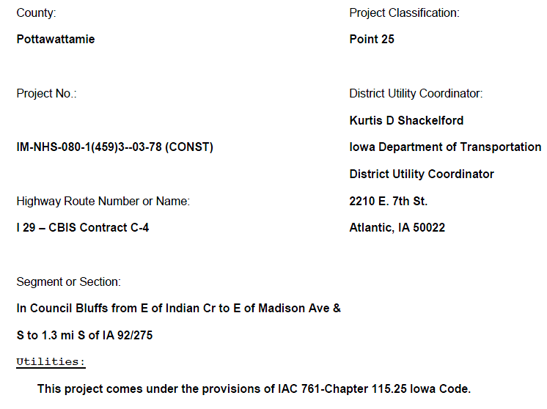
After Point 25 process Utility Bid Attachment (UBA)

Slide 34
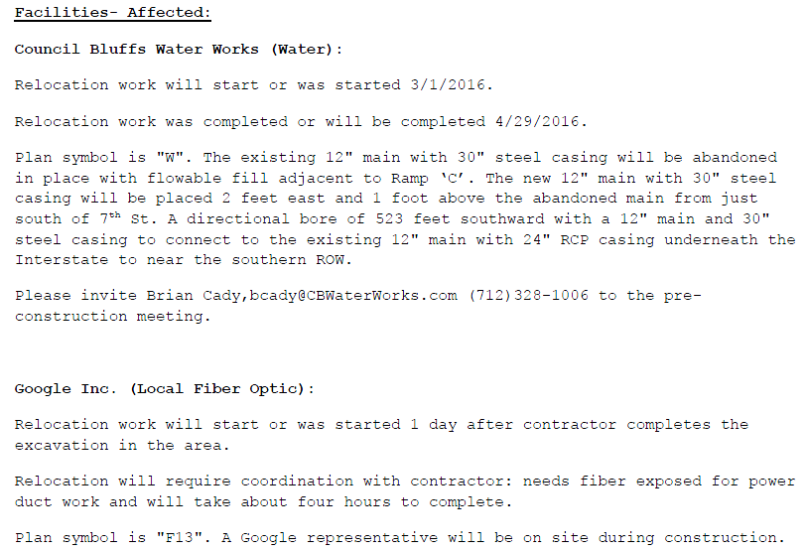
After Point 25 process Utility Bid Attachment (UBA)

Slide 35
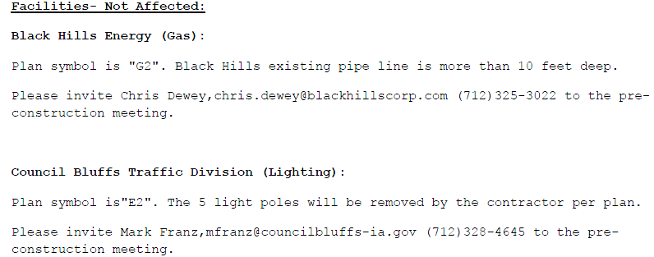
After Point 25 process Utility Bid Attachment (UBA)

Slide 36
Point25
Question or comments?

