Slide 1
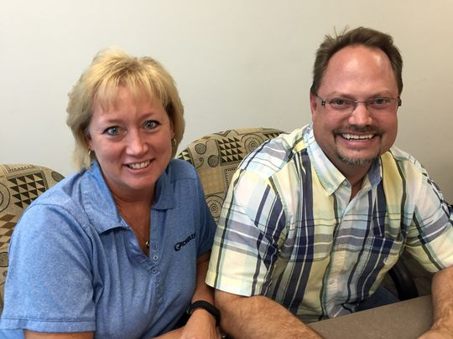
Humor in Messaging
We’re little, but we’re loud
in the Hawkeye (and Cyclone) State
Tracey Bramble
Iowa DOT Office of Strategic Communications
Willy Sorenson, P.E.
Iowa DOT Office of Traffic and Safety

Slide 2
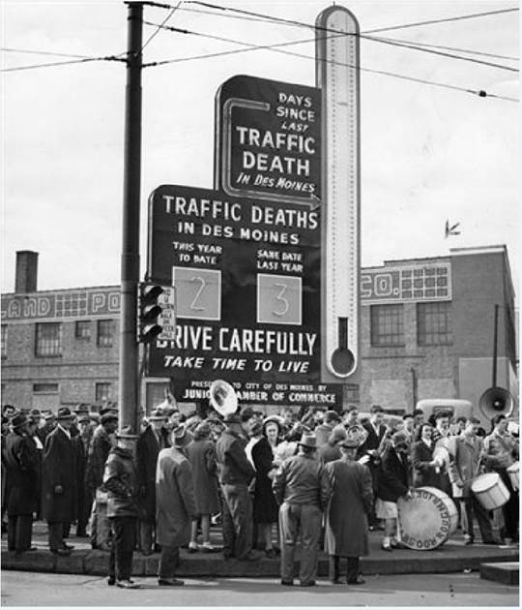
We weren’t the first – or were we?
Circa 1946

Slide 3
Getting started
Third time’s the charm.
Director Trombino asked the traffic engineers to look at displaying fatality counts. We said “No.”
Director Trombino asked the traffic engineers to look at what other states were doing related to displaying fatality counts. We did. But we still said, “No” to Iowa doing the same.
Director Trombino told the traffic engineers to come up with a plan to display traffic fatalities on DMS boards.

Slide 4
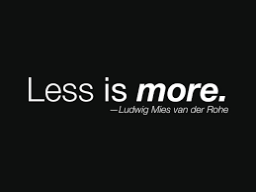
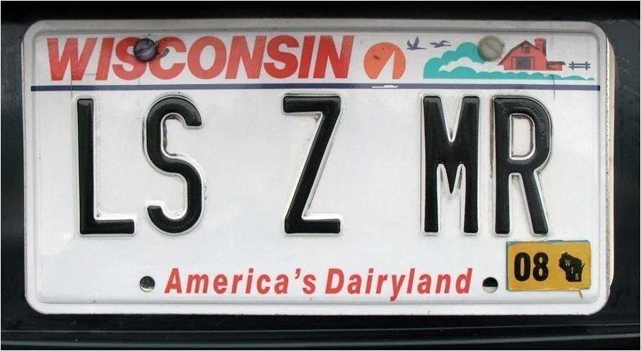
It’s good to be “special” – that’s our Willy
Been doing standard, boring DMS posts for 20 years
As a good traffic engineer, understands sound traffic engineering, but has an innate dislike of traditional safety messages on DMS. “Click it or Ticket”
Dying to get more creative since “Buckle up or eat glass” 10 years ago
Less is more philosophy

Slide 5
Branding
Historically, traditional messages ran for multiple weeks during non-rush hour
Previous safety campaigns were not generating desired results or conversations
Recreate the model based on Less is More philosophy
Important the brand be related to limited use

Slide 6
Round one – the first six months
Marrying engineering and communications
Review team of six
4 engineers and 2 communications people
Final approval from Director Trombino
We didn’t push the envelope right off the bat

Slide 7
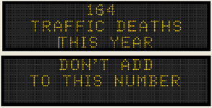
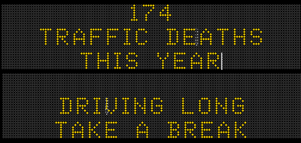
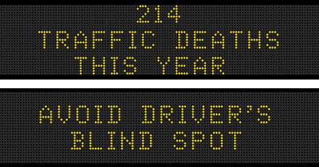
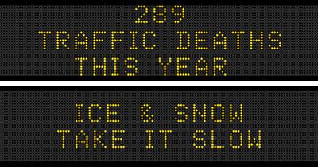
Round one – the first six months

Slide 8
When we knew we had something
We crossed the line between comfortable and creative twice in the first six months
Middle management wasn’t keen the two “creative” options

Slide 9
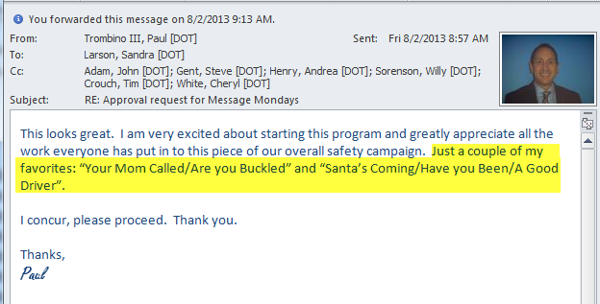
When we knew we had something
They thought they gave us enough rope to hang ourselves and allowed us to present the options to the director – who said those two were his favorites

Slide 10
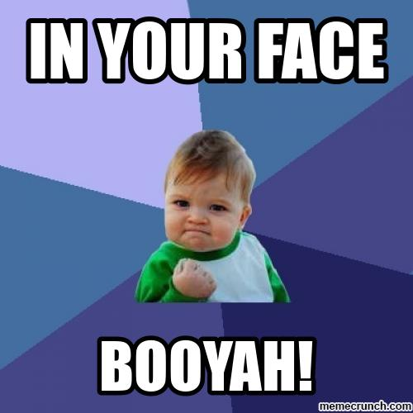
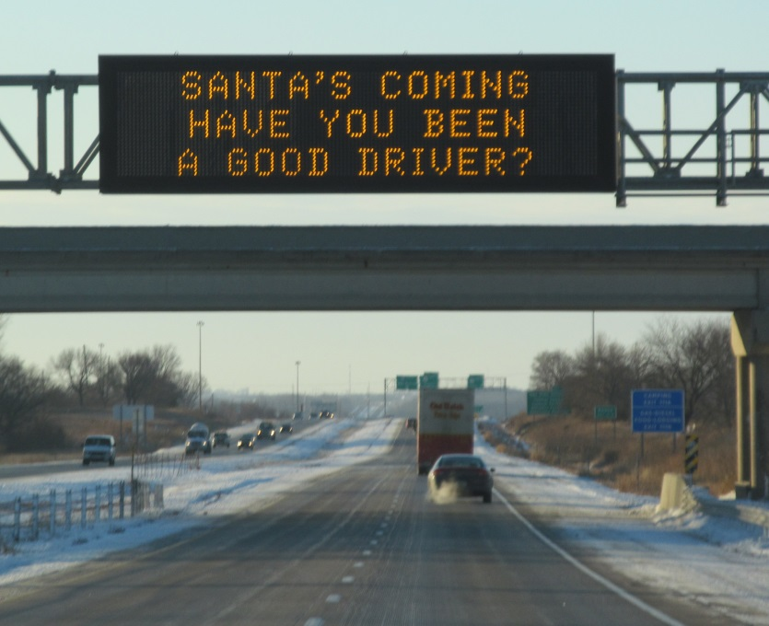
It got real when we injected Mom and Santa into the mix.

Slide 11
Iowa’s guiding principals
Don’t repeat a message
Kick boring ideas to the curb
Don’t wear out your welcome – limit exposure to one day per week
Oh yea… and it needs to be transportation safety related

Slide 12
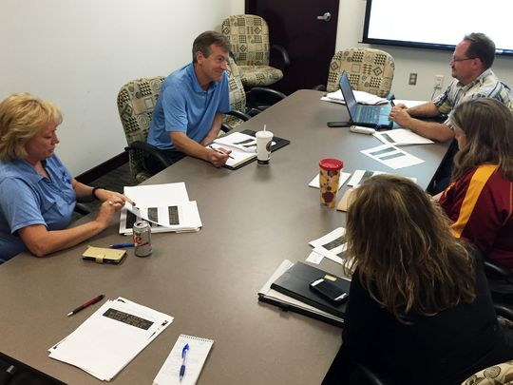
Iowa’s process
Start with a multi-disciplinary team
Spirited discussion is encouraged
For efficiency, develop a chunk of messages at a time – we do six months

Slide 13
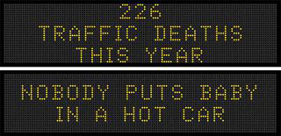
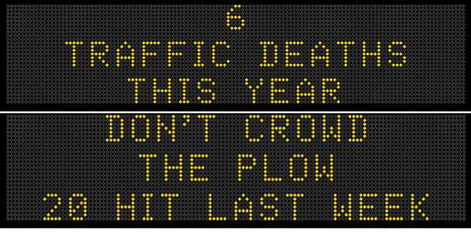
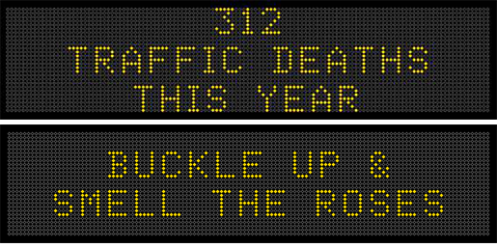
Iowa’s process
Allow flexibility to change things up if it makes sense.

Slide 14
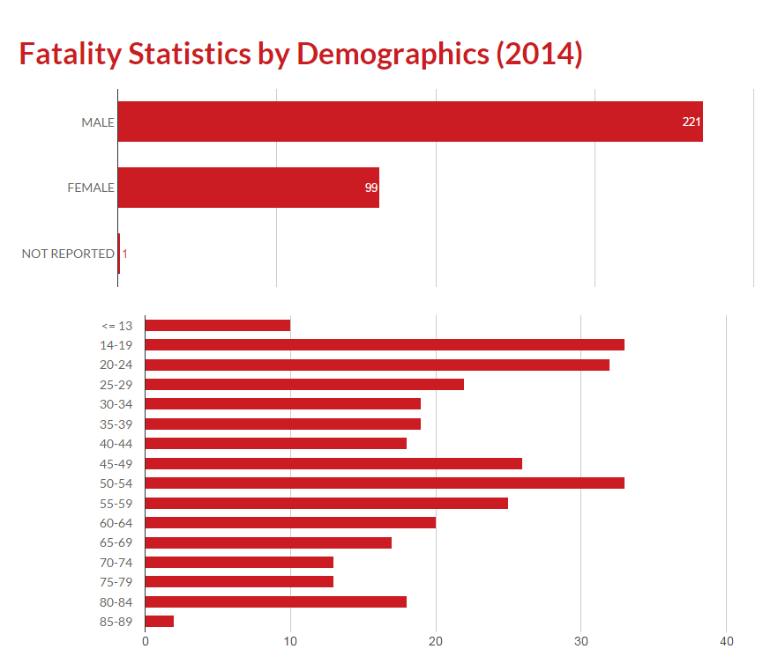
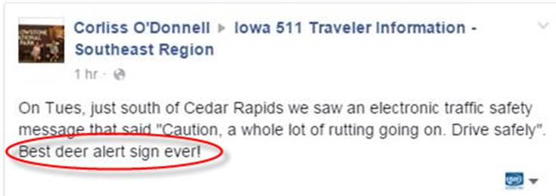
Gear messages to your target audience

Slide 15
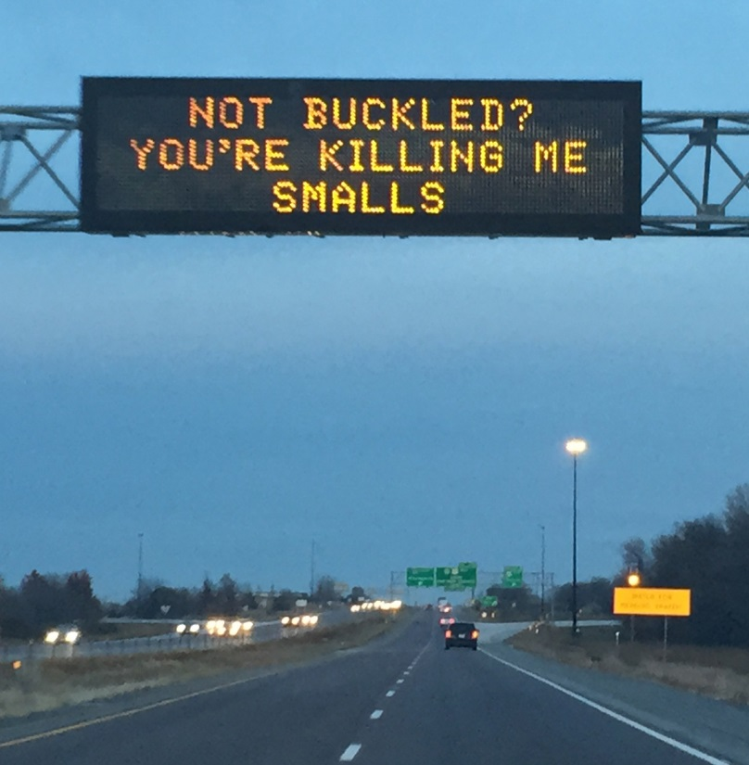
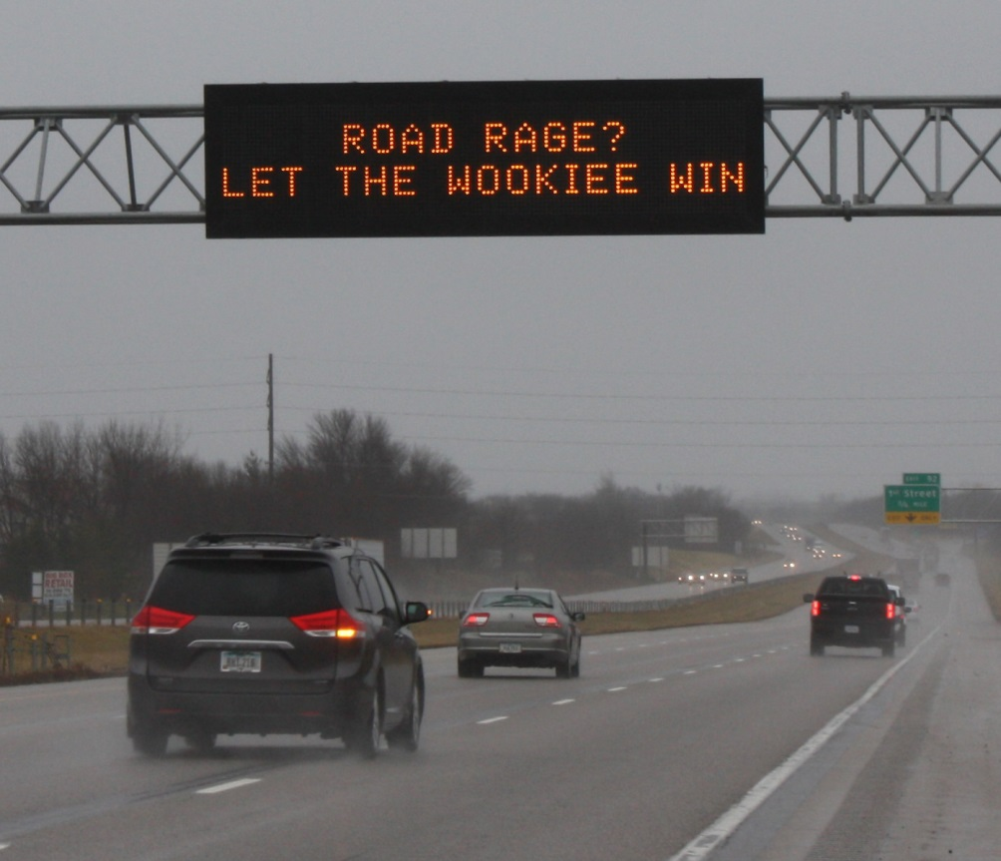
Tap into pop culture
More people than you think will “get it.”

Slide 16
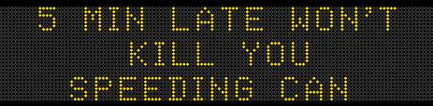
Tie to Zero Fatalities focus areas

Slide 17
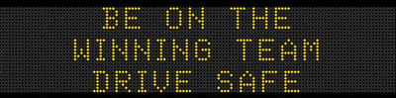
Relate posts to events

Slide 18
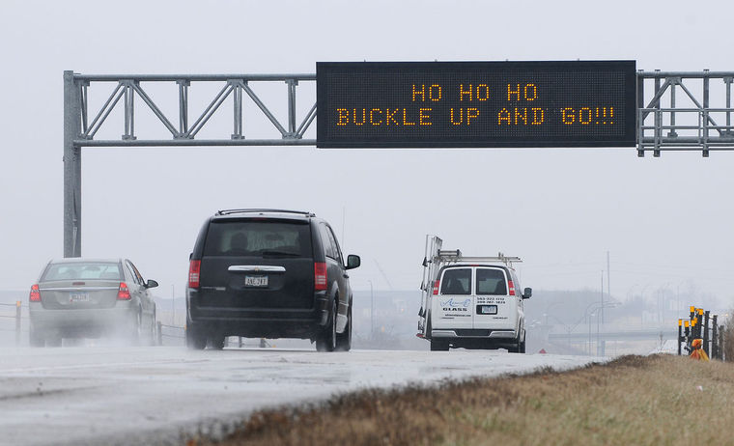
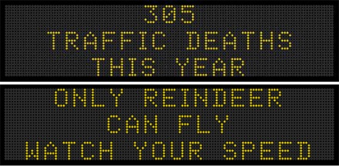
Tie in to holidays

Slide 19
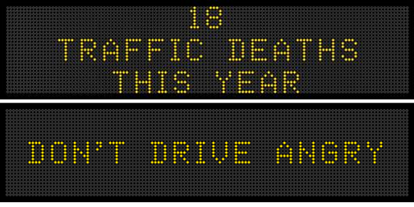
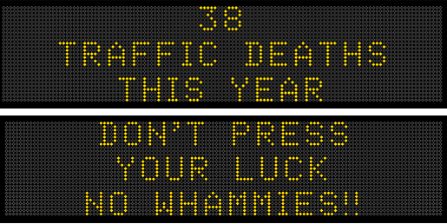
Combinations that have worked for us - holidays and pop culture

Slide 20
Appeal to family ties

Slide 21
Pay homage to NHTSA
But don’t repeat messages

Slide 22
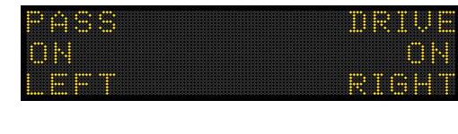
There’s power in pet peeves

Slide 23
Thinking outside the “Box” Highway Safety vs. Transportation Safety

Slide 24
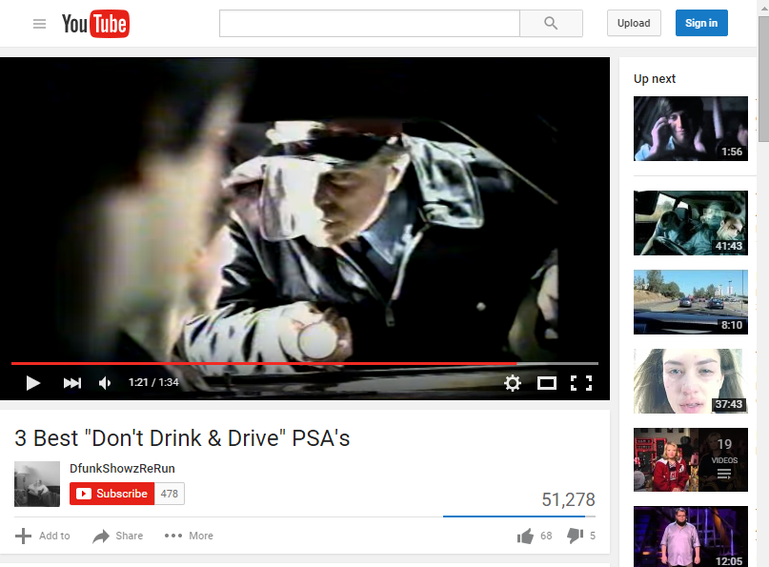
E-mail to DOT Employees, DPS, FHWA (Iowa) and other Public & Private groups

Slide 25
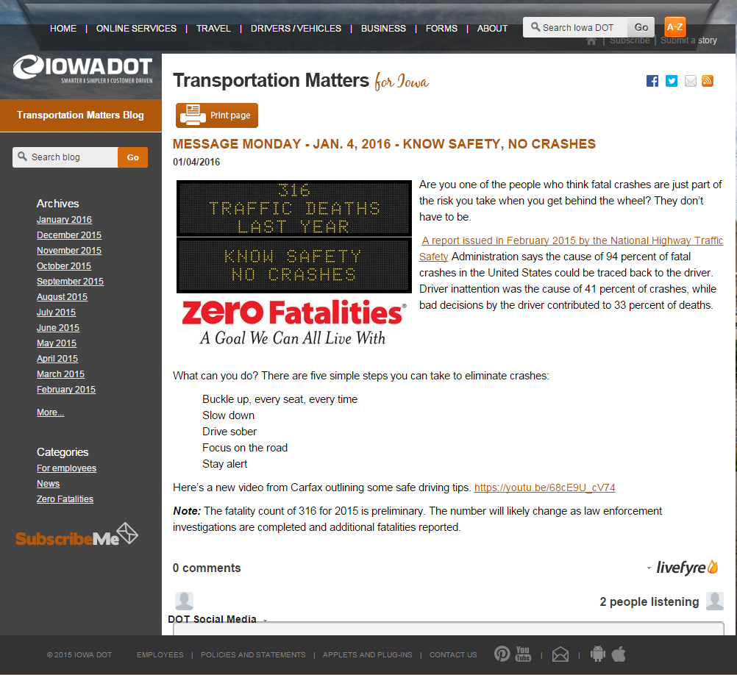
Tell the “rest of the story”

Slide 26
If you’re lucky, George will take notice

Slide 27
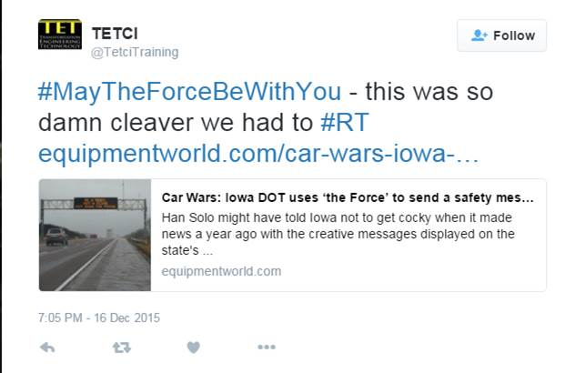
Extend social media to industry
When has anyone ever called an article in Equipment World “so damn clever?”

Slide 28
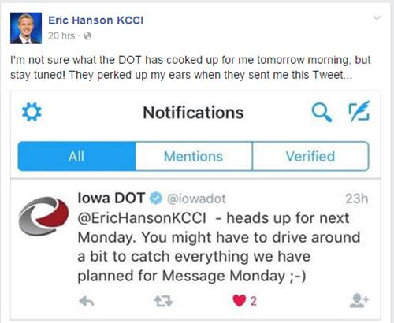
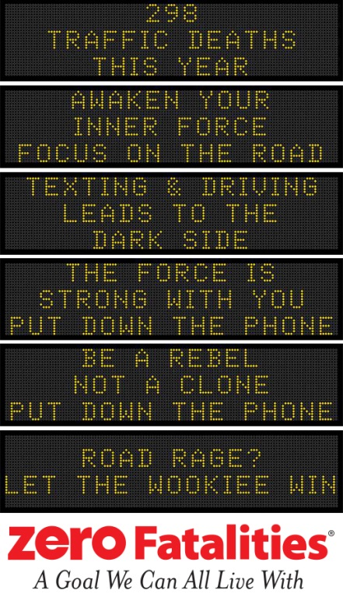
Engage your local media

Slide 29
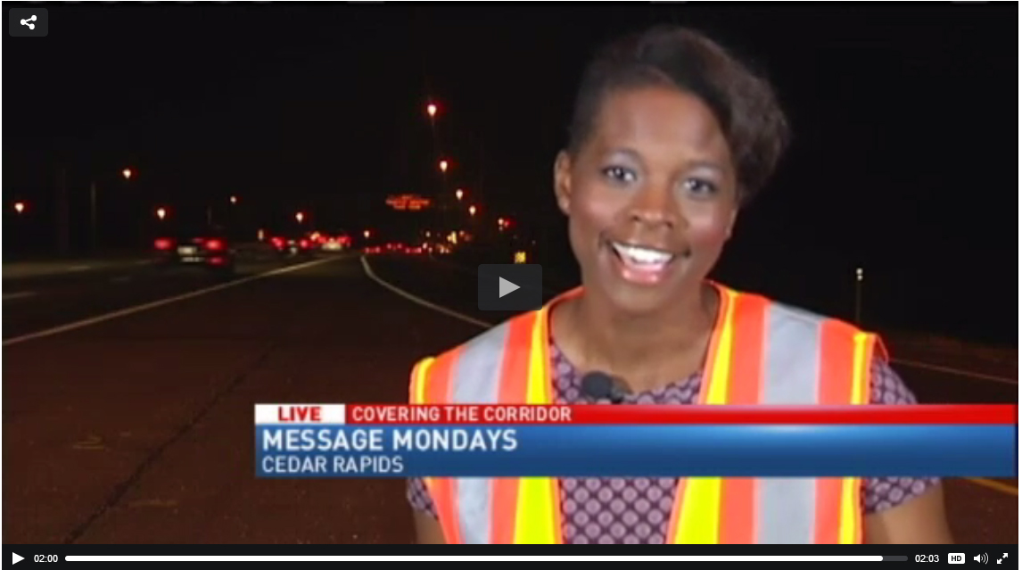
Local media

Slide 30
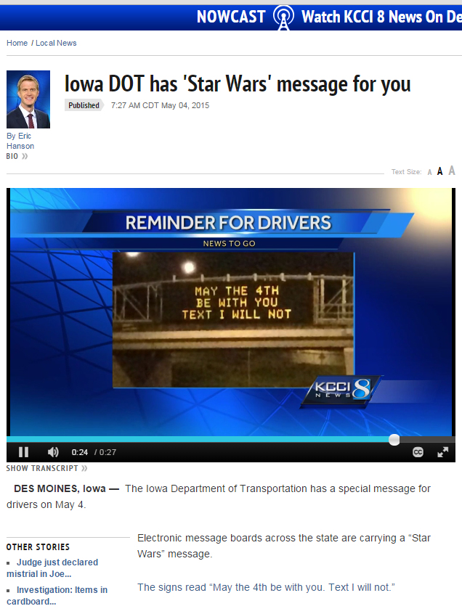
Local media

Slide 31
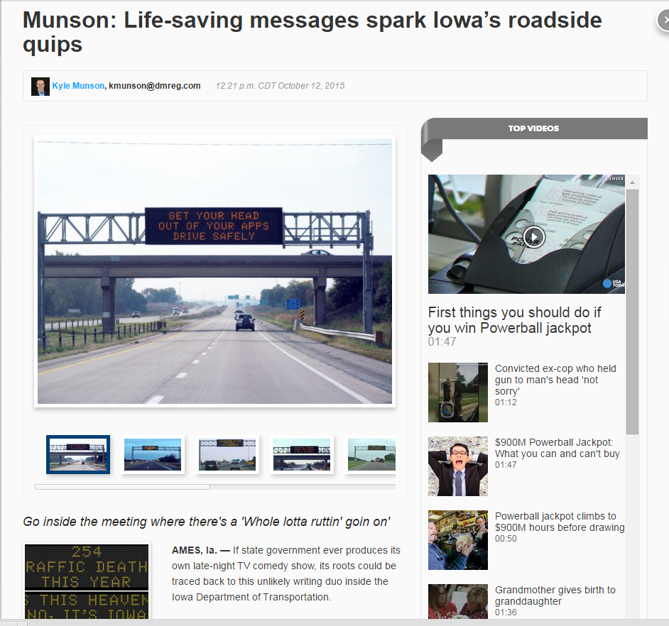
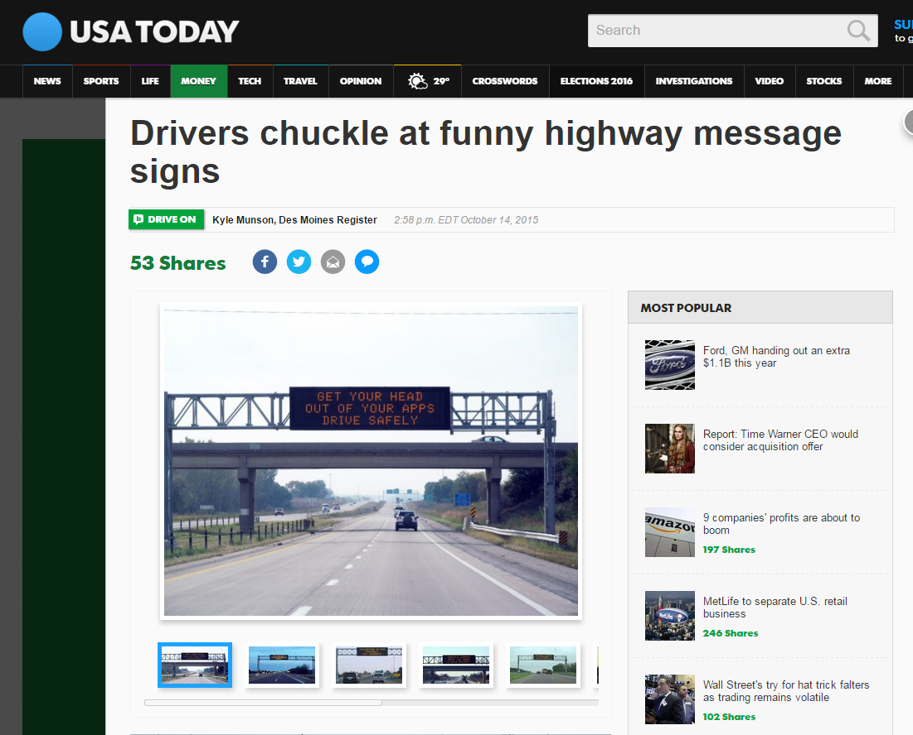
Local media spreads nationally

Slide 32
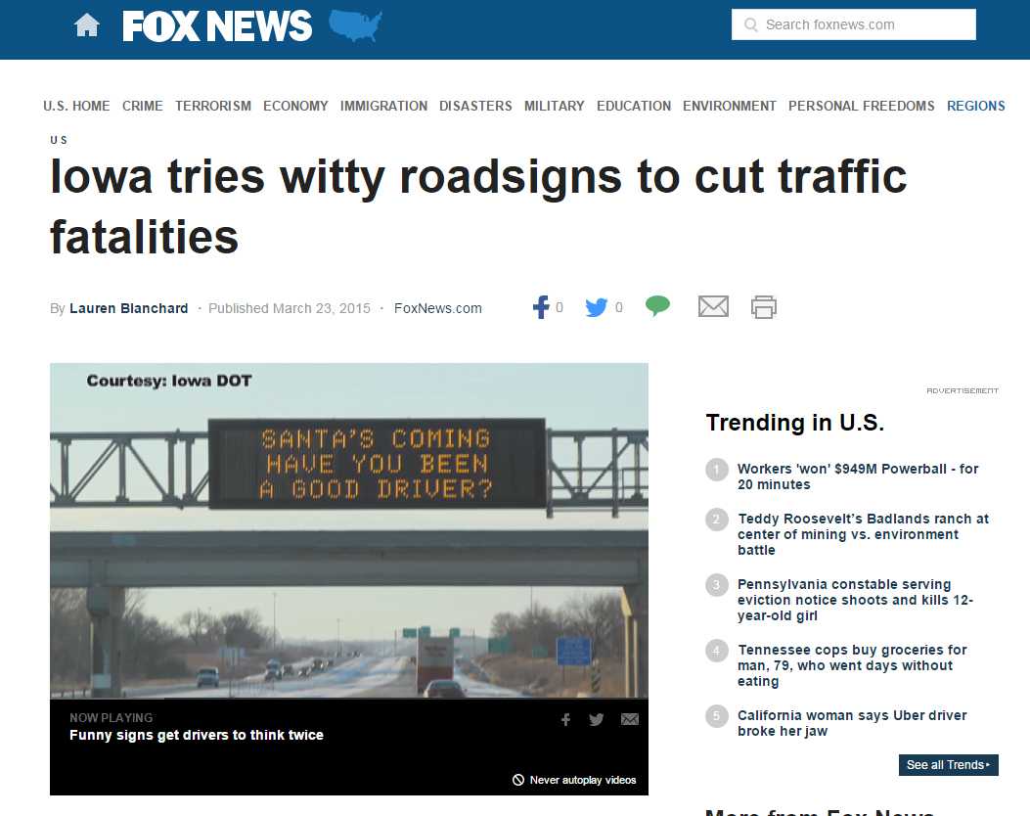
National media

Slide 33
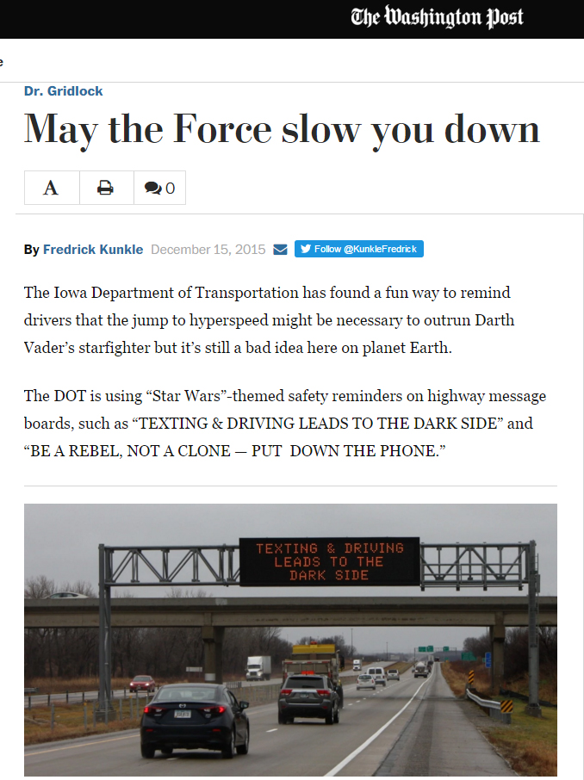
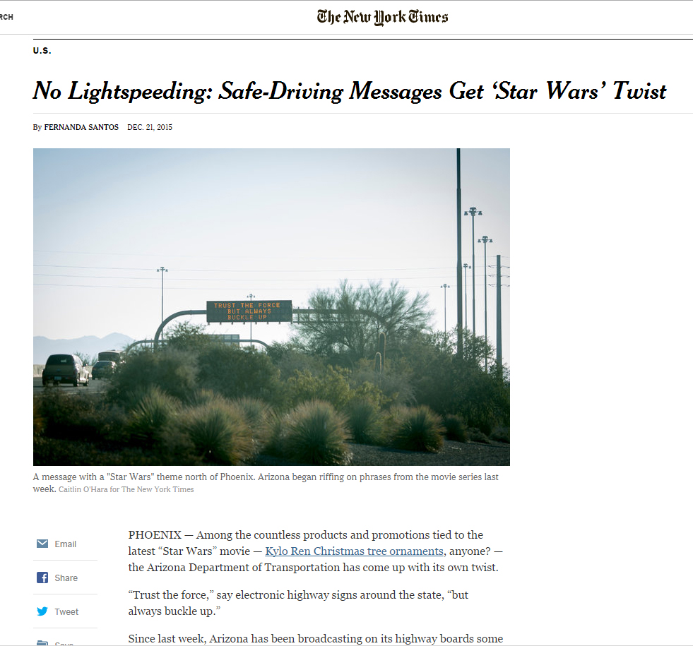
National media

Slide 34
Lots of positive public response

Slide 35
Lots of positive public response

Slide 36
Inspirations
Not afraid to steal or share - thanks Tennessee for “Oh Cell No”
Openly beg for ideas from employees and the public

Slide 37
Inspirations
Contests with the state’s public universities

Slide 38
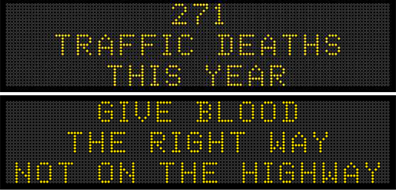
Dealing with backlash

Slide 39
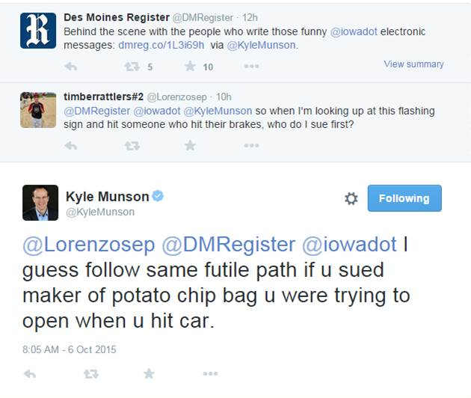
Dealing with backlash
Make sure the commenter knows he/she is being heard
Ask for other M/M ideas so commenter becomes part of the team.
Pass comments along to the advisory group

Slide 40
Even we have limits

