Slide 2
174

Slide 3
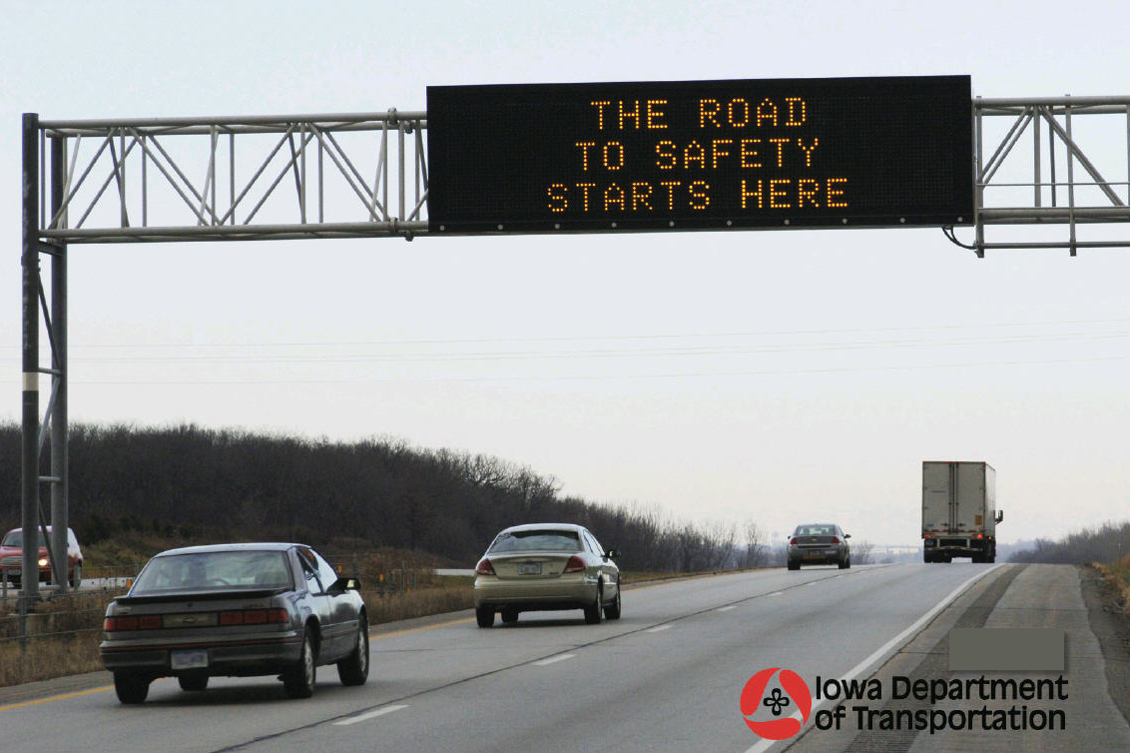
Safety Projects / Efforts

Slide 4
Some projects to Highlight
Wrong Way Driving
Intersection Conflict Warning Systems
Dynamic Message Signs (DMS)
Message Monday

Slide 5
Background
Grew up in Gowrie, Iowa
High School
Prairie Community Schools
(Now SE Valley Jaguars)
Dad taught
Chemistry
Earth Science
Physical Science
Physics
Jr. High Football/Track/Golf
Sister was there too

Slide 6
Civil Engineering, P.E.

Slide 7
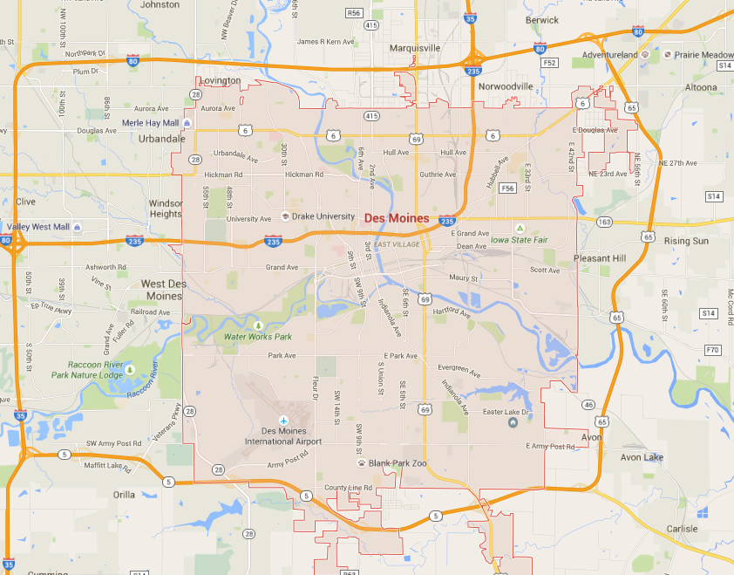
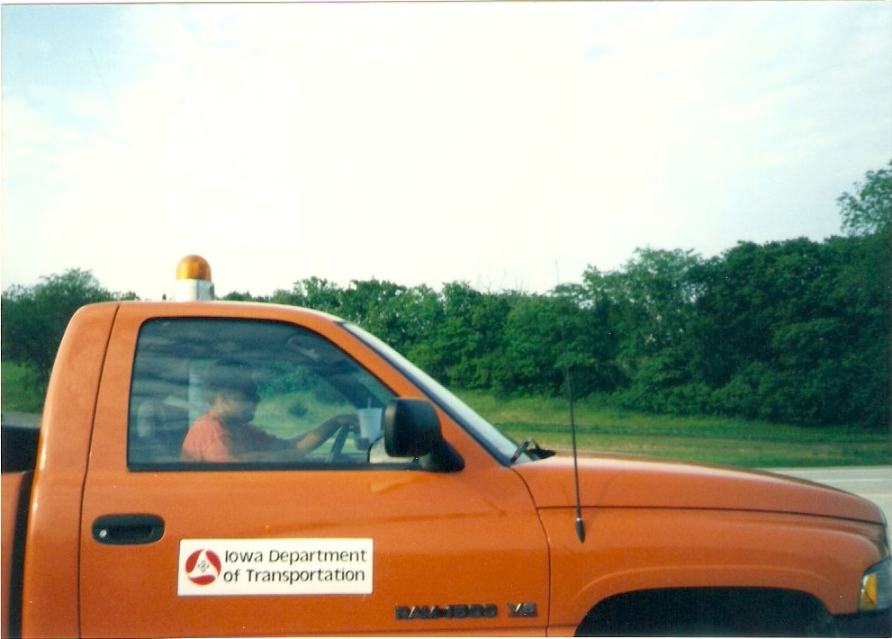
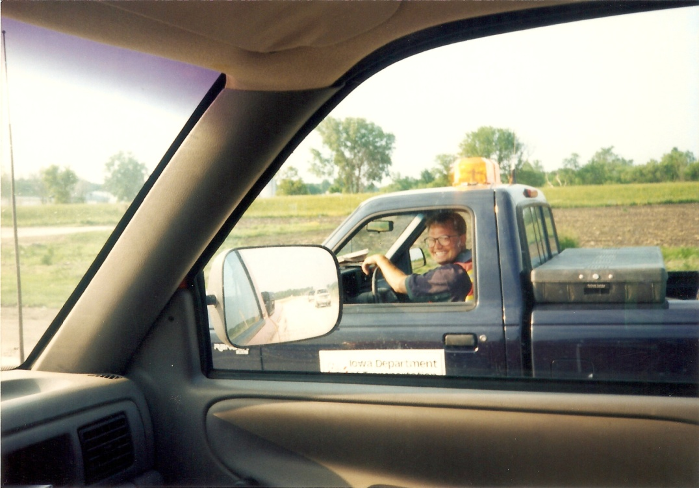
Out of College
Des Moines RCE
US 65 / Ia 5 Bypass
I-35/80
Carlisle

Slide 8
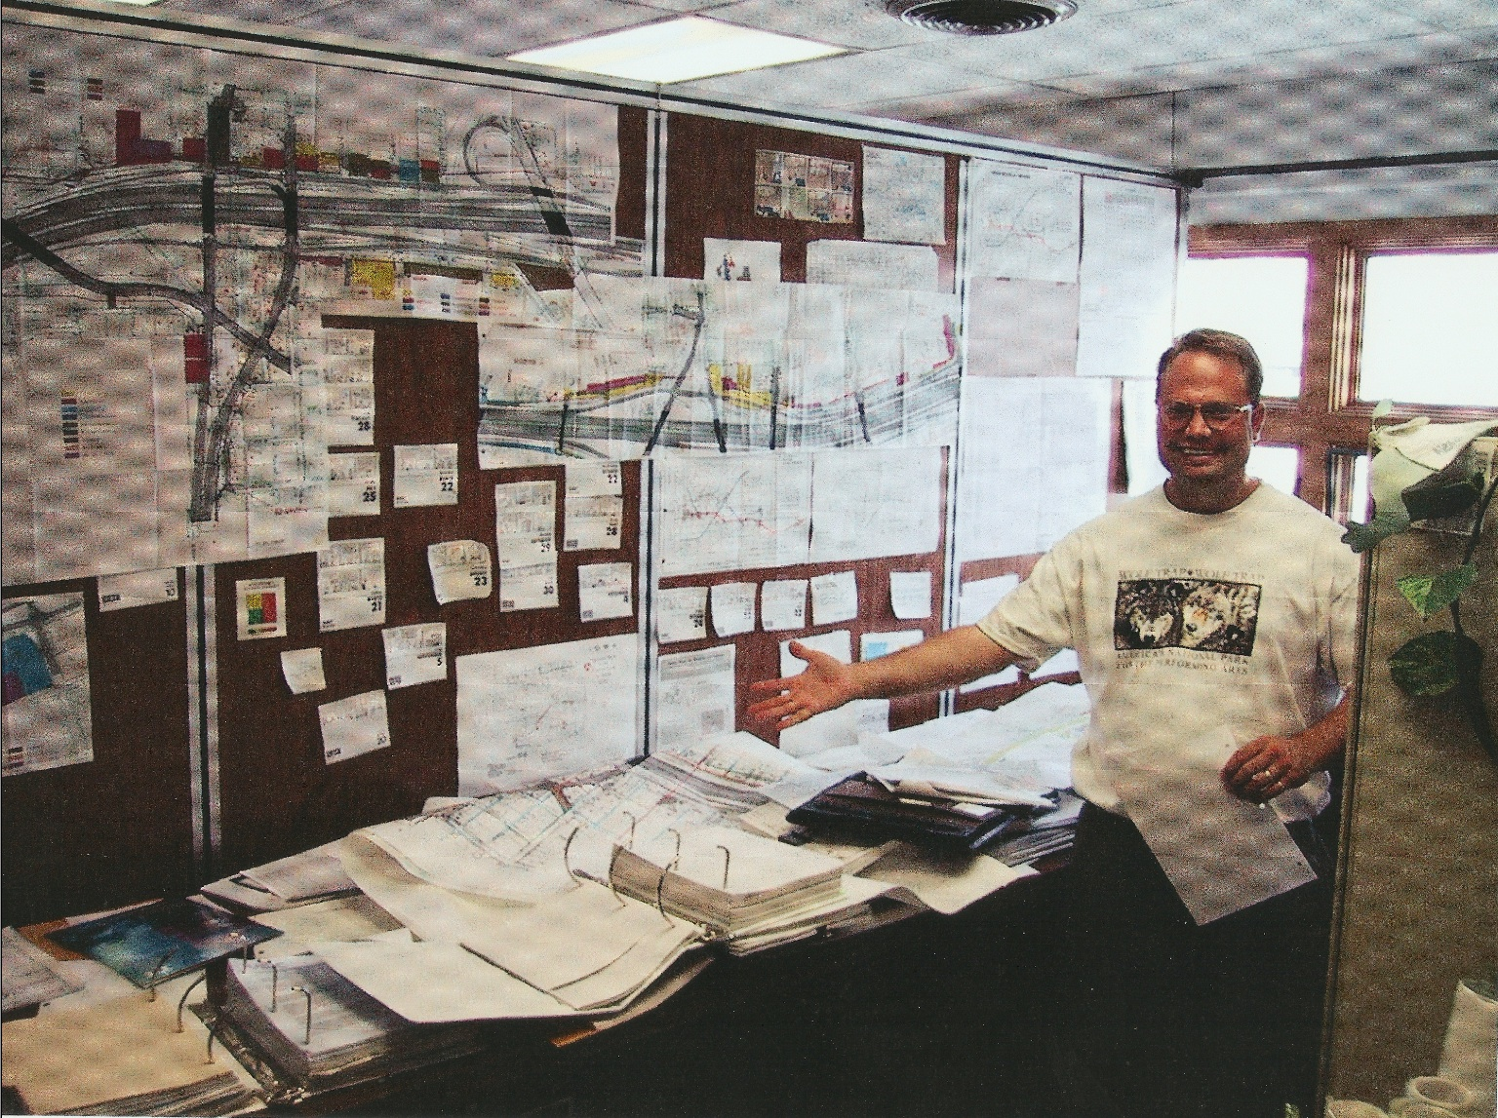
Background (continued)
I-235
Coordinated $ 50 Million in Utility Relocations

Slide 9
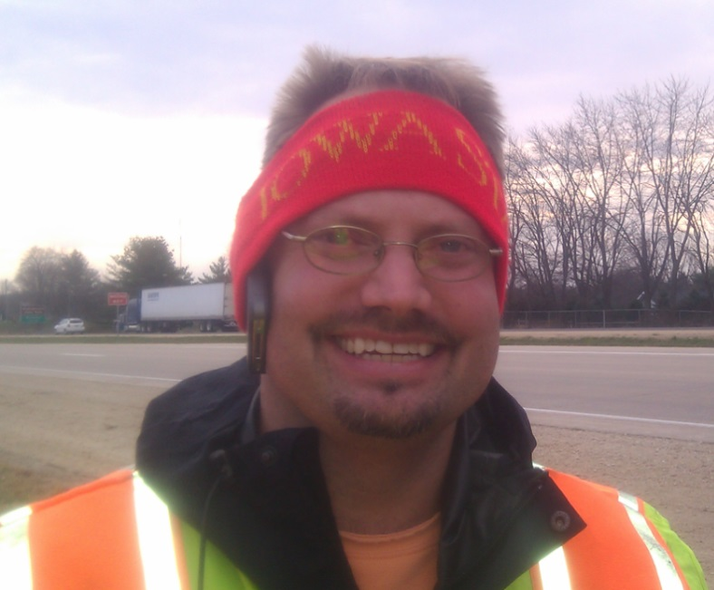
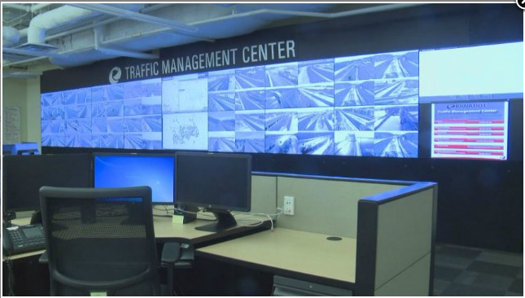
Background (cont.)
Intelligent Transportation Systems (ITS) Engineer (9 years)
Created the I-235 camera, sensors & signs system
Statewide DMS
Laid foundation for our Traffic Mgmt. Center

Slide 10
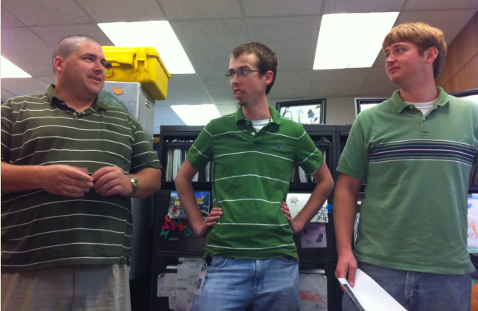
Mechanical Eng. vs Civil Eng.
MEs build bombs
CEs build targets

Slide 11
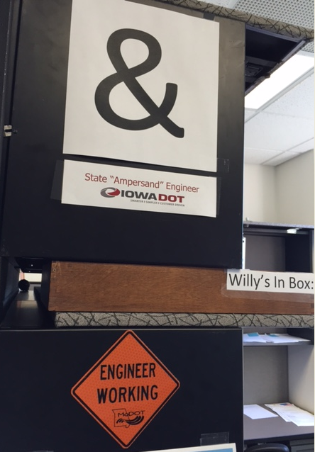
Now….
Office of Traffic & Safety
Started in 2011
Assistant Office Director
Traffic & Safety Engineer
Special Projects Engineer
State “Ampersand Engineer”
Best Job at the DOT!!

Slide 12
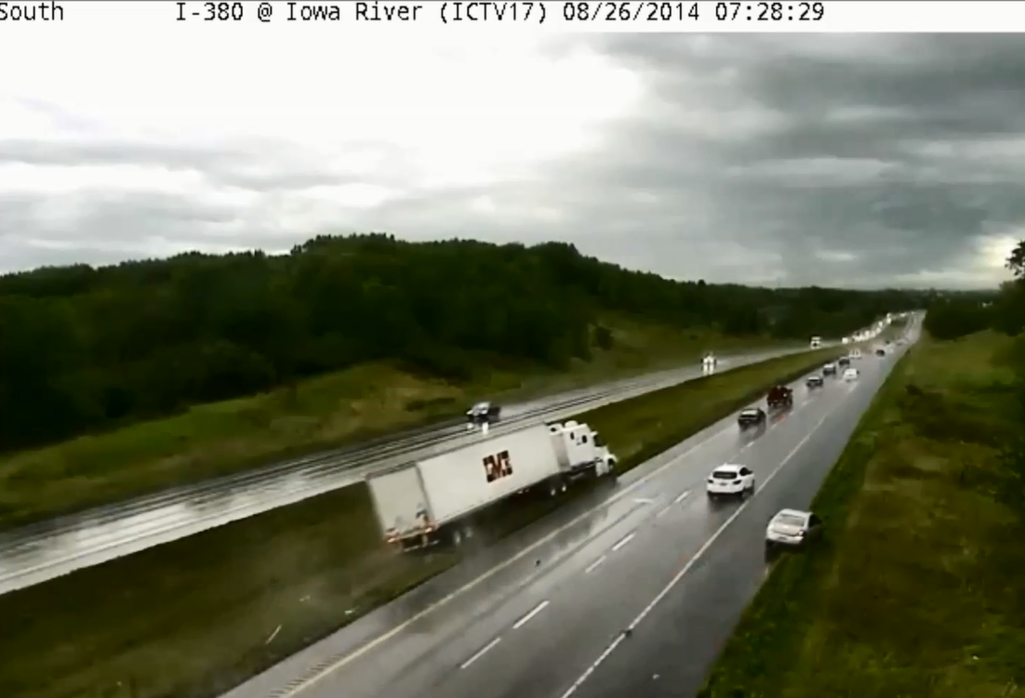
If a picture is worth 1,000 words…. What about a video?
Using video helps understand things that are not written by professional authors
C:\Users\wsorens\Desktop\Physics Teachers Presentation 6-29-16

Slide 13
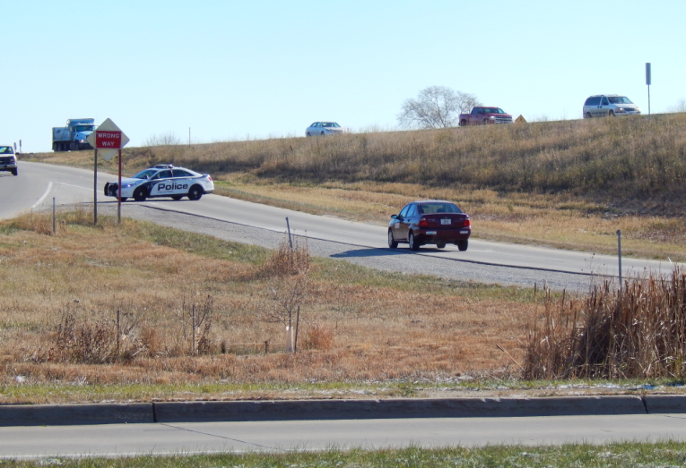
US 30 Wrong-Way Driving

Slide 14
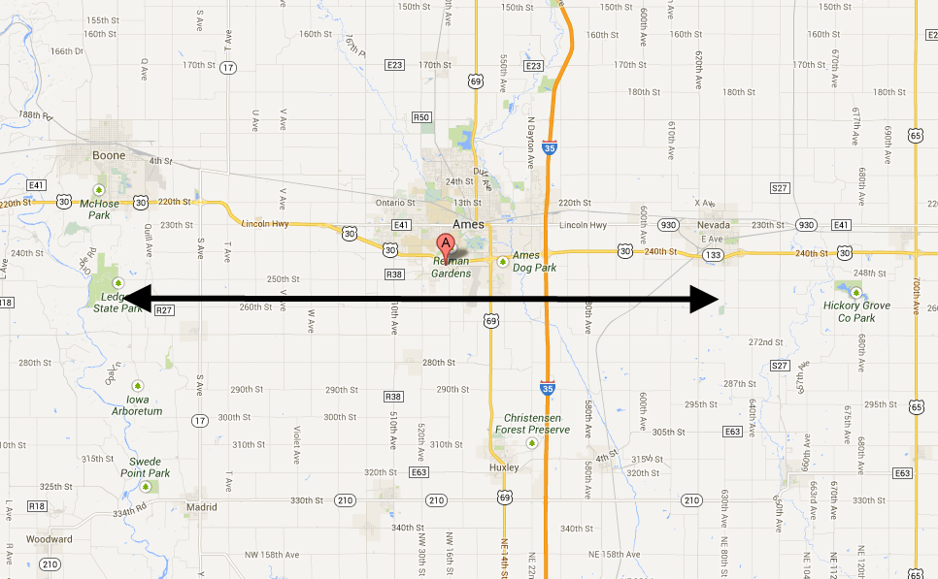
Project Location
Boone
Nevada
Ames
25 miles

Slide 15
Situation/Background
166+/- (911 calls & Eye Witness) Wrong Way Drivers (WWD) in the last 8½ years.
7 WWD Crashes in last 10 years (none in last 5)
3 Fatalities
2 were from a “U” turn on mainline
1 was coded as “unknown”

Slide 16
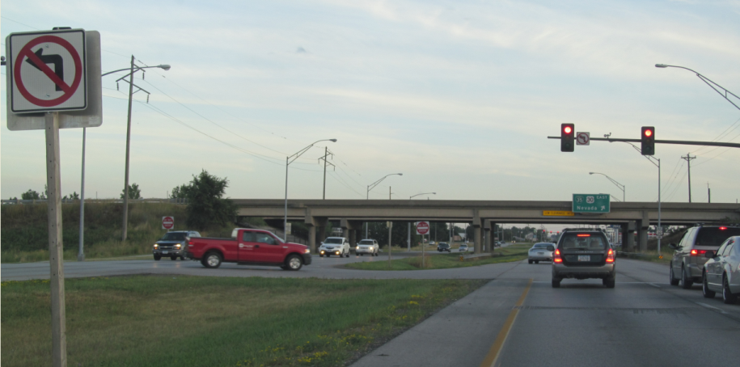
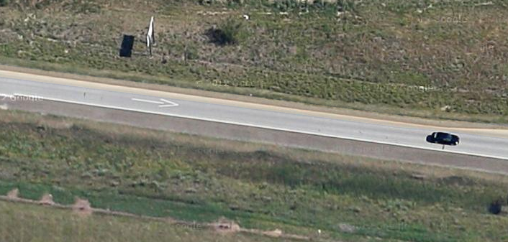
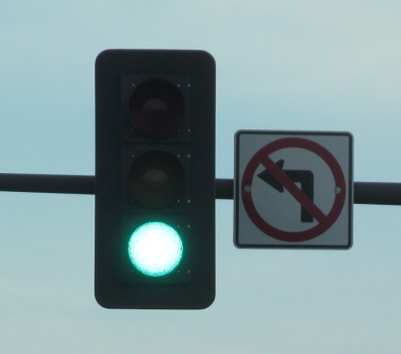
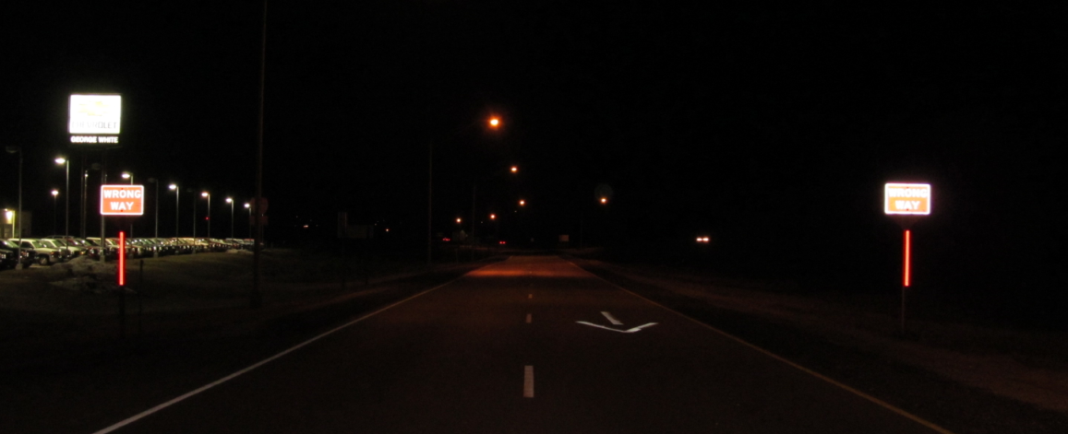
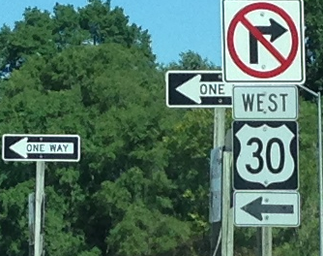
Low-Cost / Updates in 2012
Review with a “Checklist”

Slide 17
Average # of 911 calls
Before low-cost treatments
1 - 911 call every 3 weeks
After
1 – 911 call every 6 weeks
Does that mean we only have 1 wrong way driver every 6 weeks?
Probably not.
A Florida study showed 90% of people call 911.

Slide 18
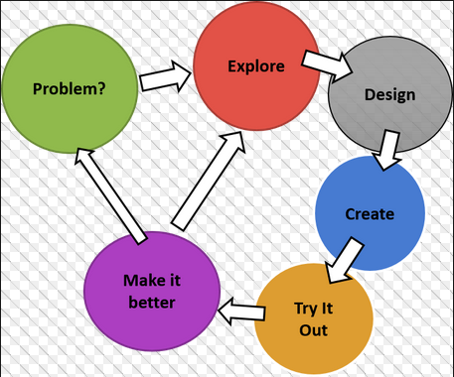
Engineering Problem Solving
Step 1: What is the problem?

Slide 19
Just how many are there?
Wrong Way Drivers on ramps/entrance points – self correct
Wrong Way Drivers on Mainline
911 calls
Crashes
Injury Crashes
Fatal
Crashes

Slide 20
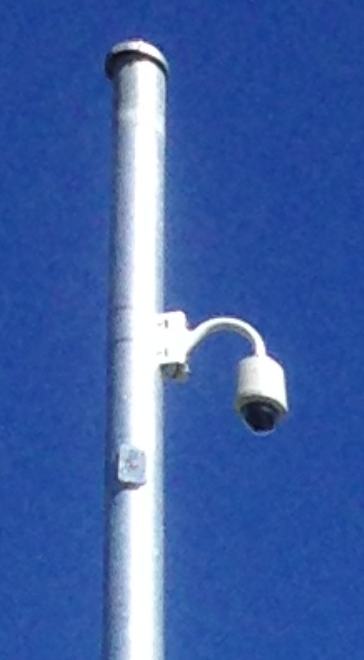
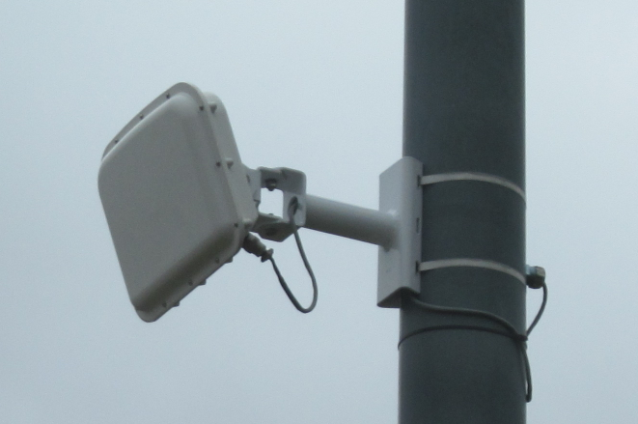
2 types of technology
Cameras (with video analytics)
Radar sensors (speed and direction)

Slide 21
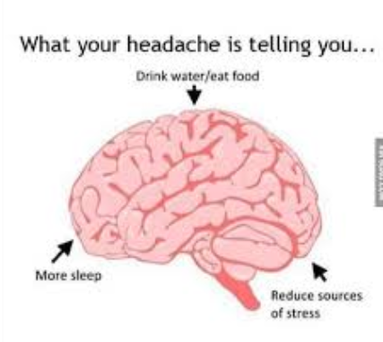
My goal…. Determine Points of Entry (fix the problem/eliminate the headache
Option B
Option A
Solve with signing, painting & lighting

Slide 22
Steps….
No recent crashes, no support, no money.
Use video to help create awareness.
Ask for free stuff…

Slide 23
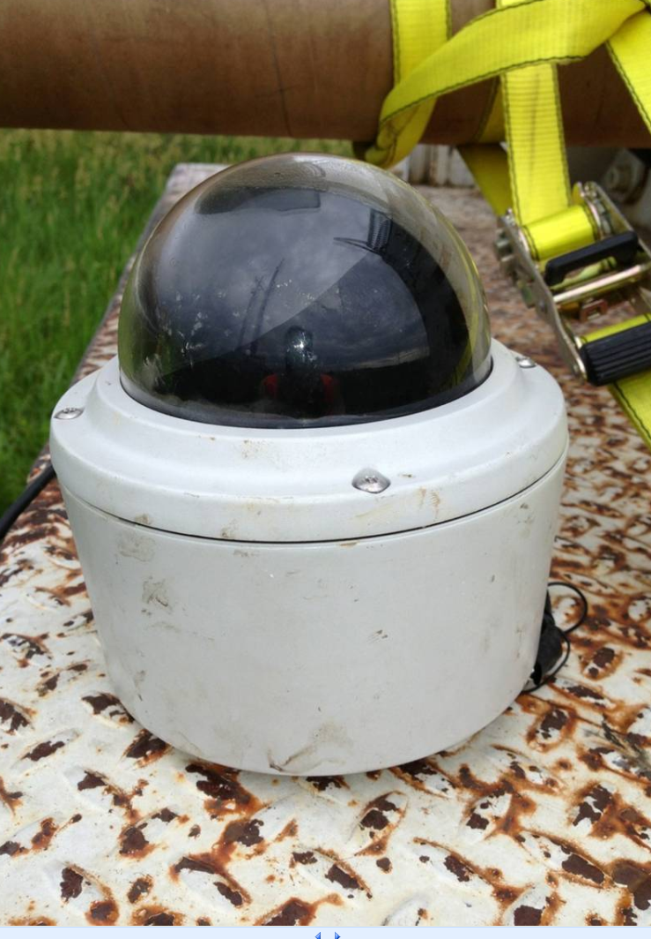
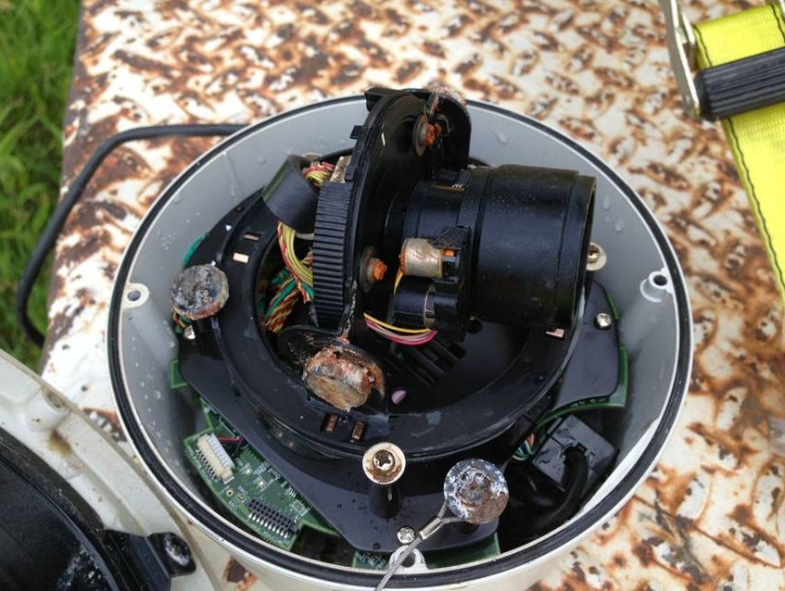
Created a “Test Bed”
Video IQ gave us a camera… and another

Slide 24
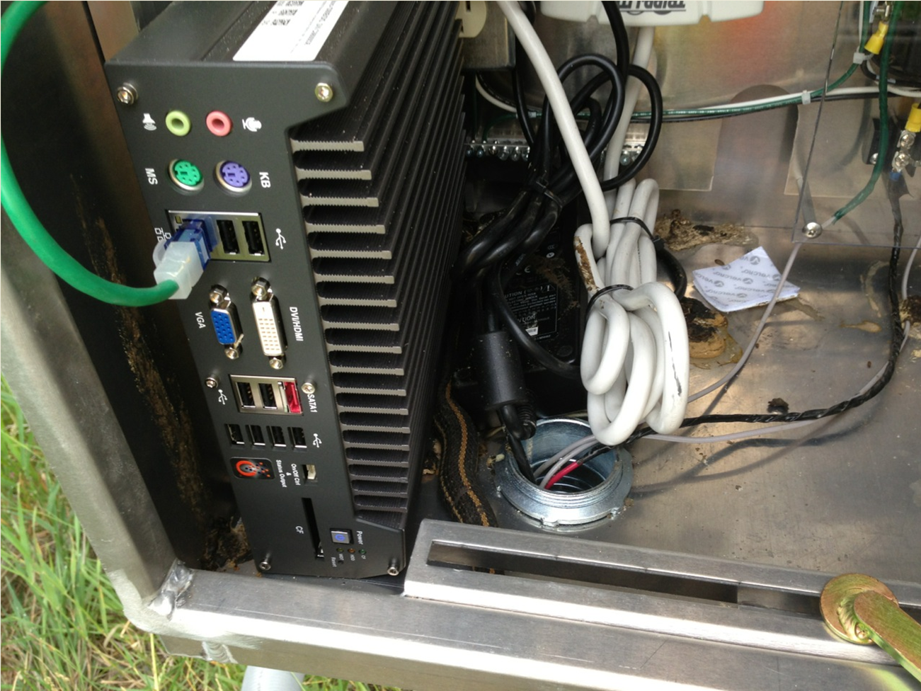
Traffic Vision loaned us a mini server

Slide 25
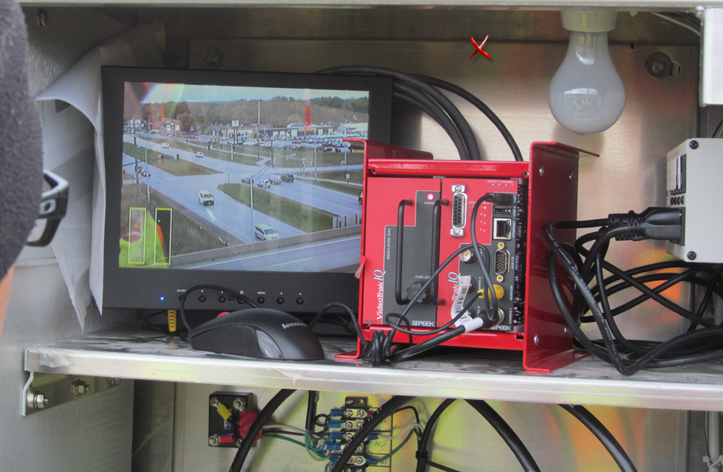
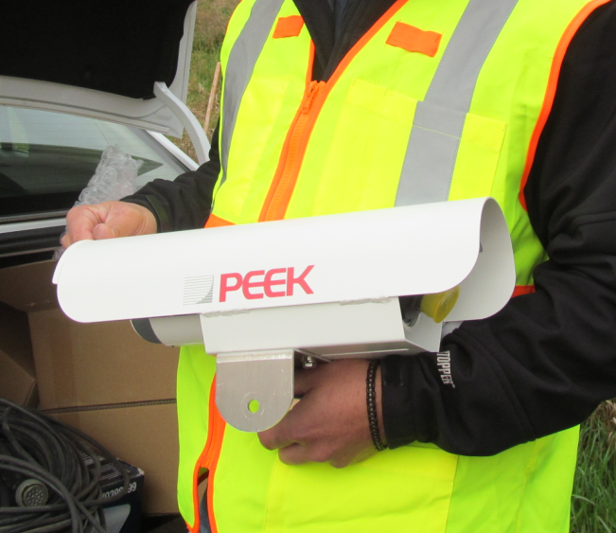
Create a “Test Bed”
Peek supplied a camera for 2 weeks

Slide 26
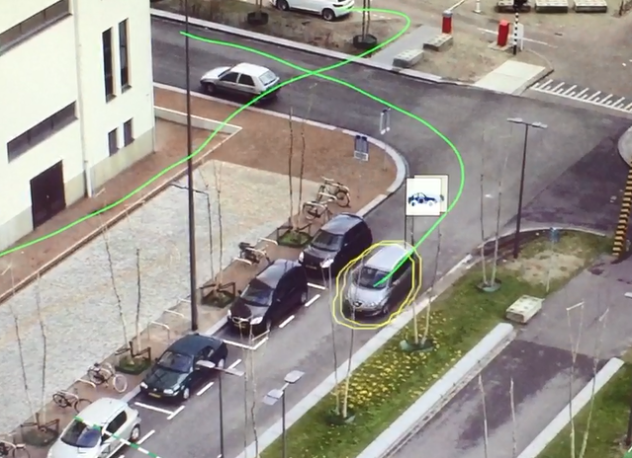
Bosch Example
Video

Slide 27
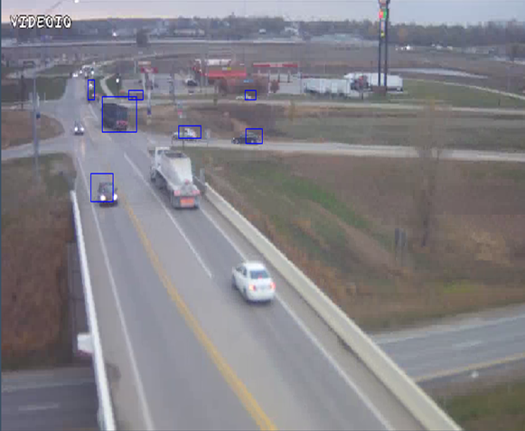

Slide 28
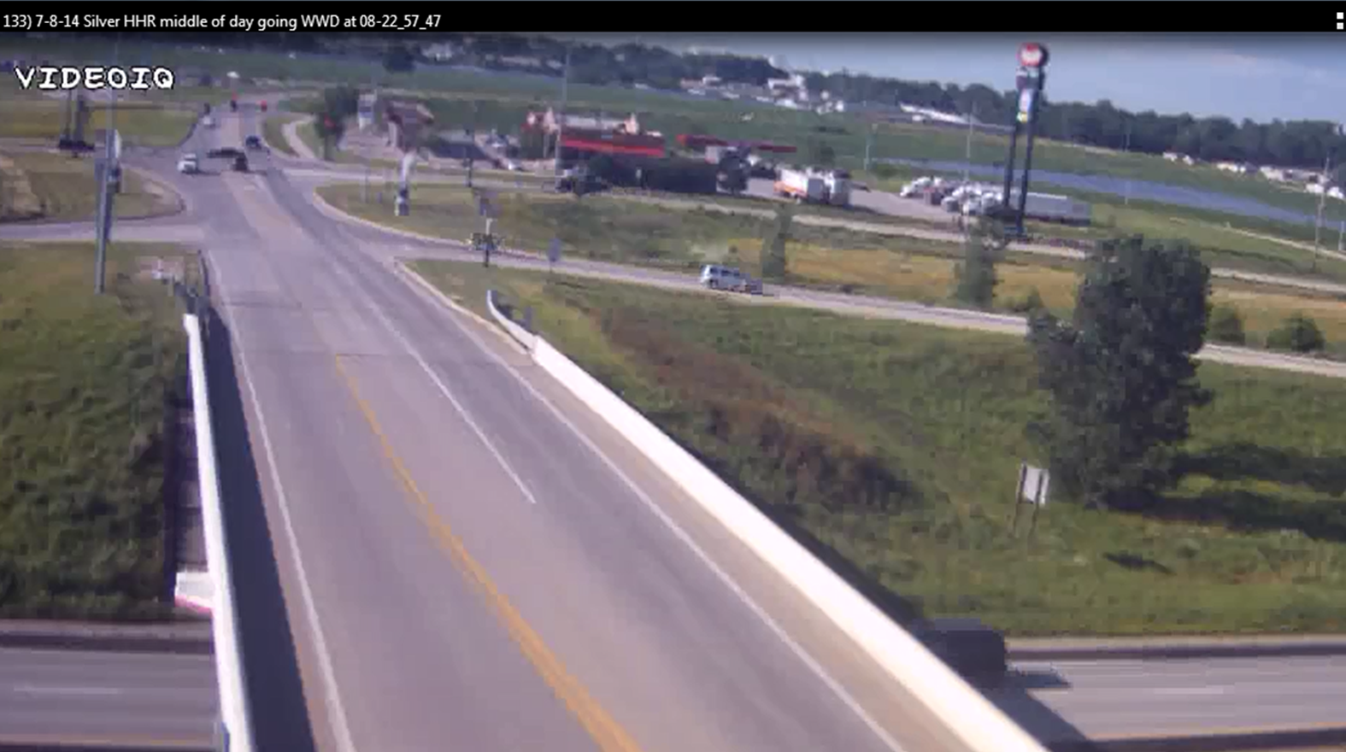
Video Link

Slide 29
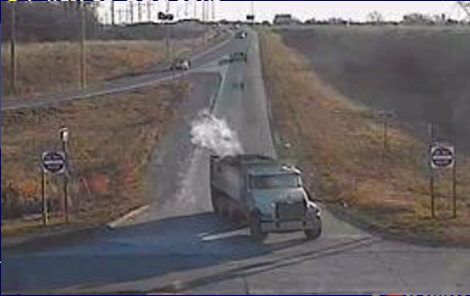

Slide 30
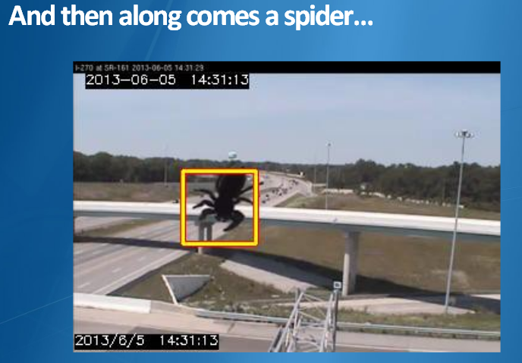
Other Issues….

Slide 31
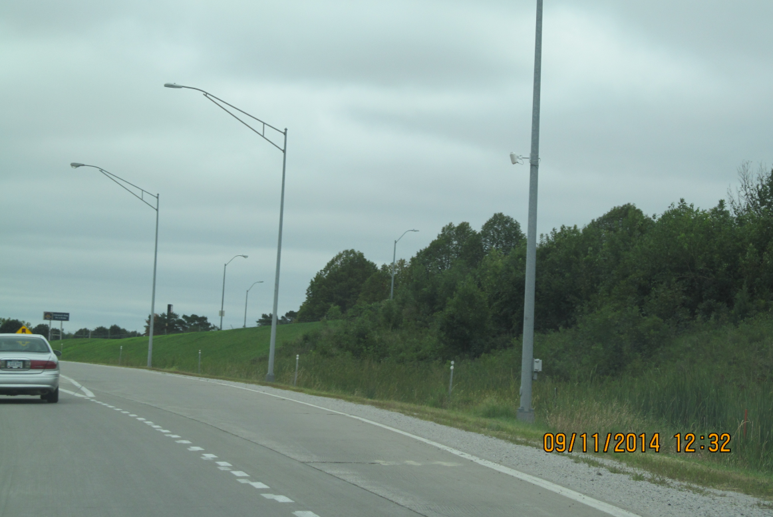
Radar Sensors

Slide 32
Dual Radar Beams

Slide 33
Wrong Way Examples

Slide 34
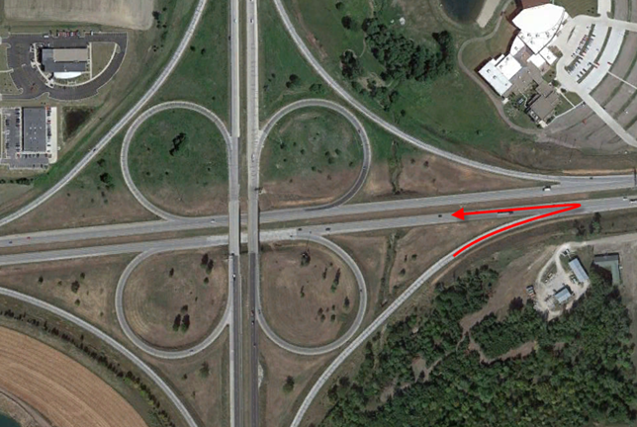
Have to See it to Believe it!

Slide 35
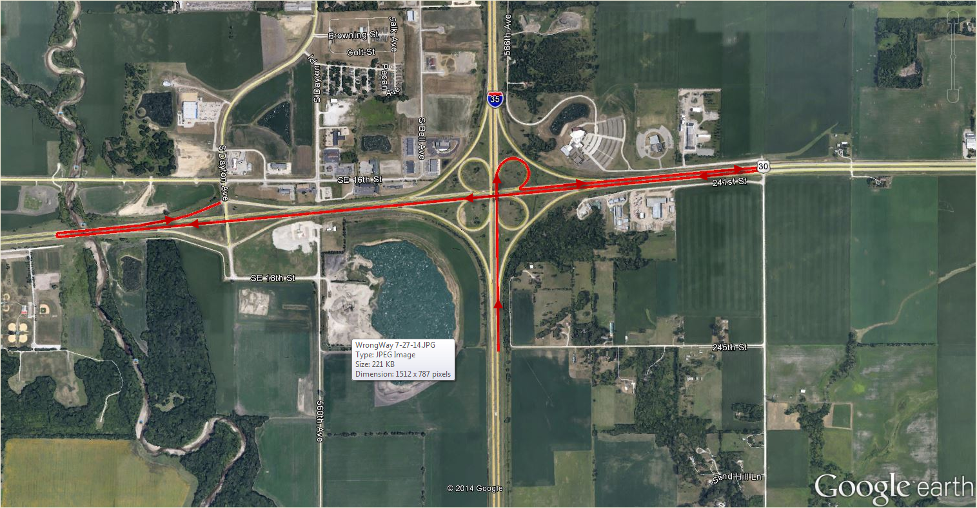
About 2 weeks Later

Slide 36
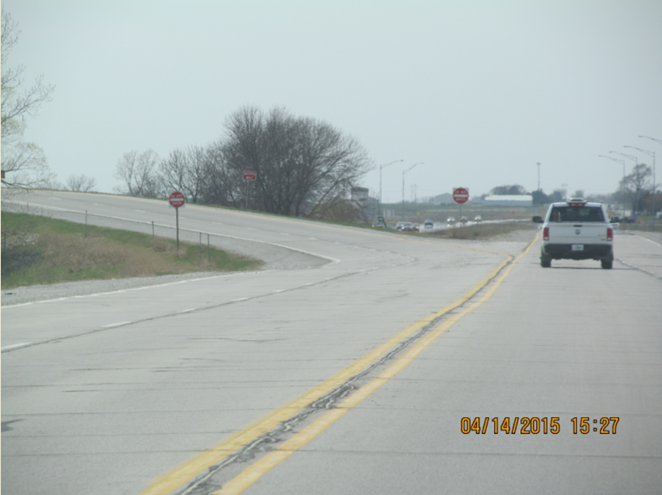
Examples of “Wins” for WWD Efforts

Slide 37
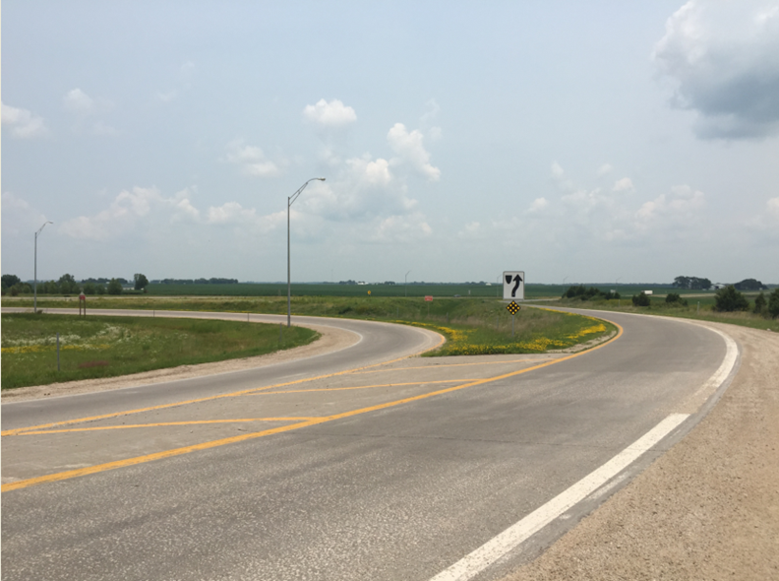
Examples of “Wins” for WWD Efforts

Slide 38
However….
A broken sensor (not reporting anything) and a nobody going the wrong way look EXACTLY the same

Slide 39
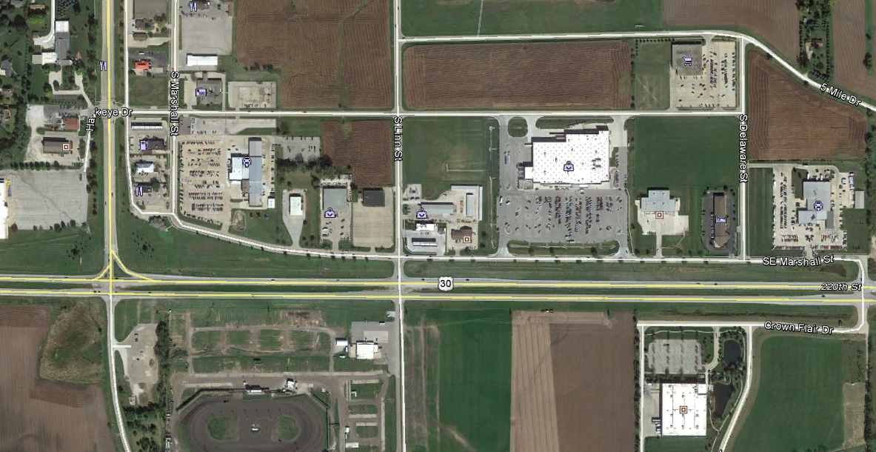

Slide 40
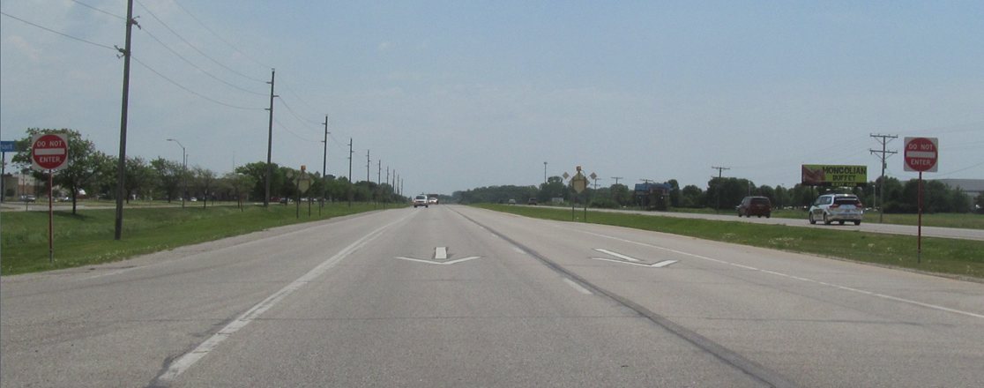
Linn St. at US 30 in Boone

Slide 41
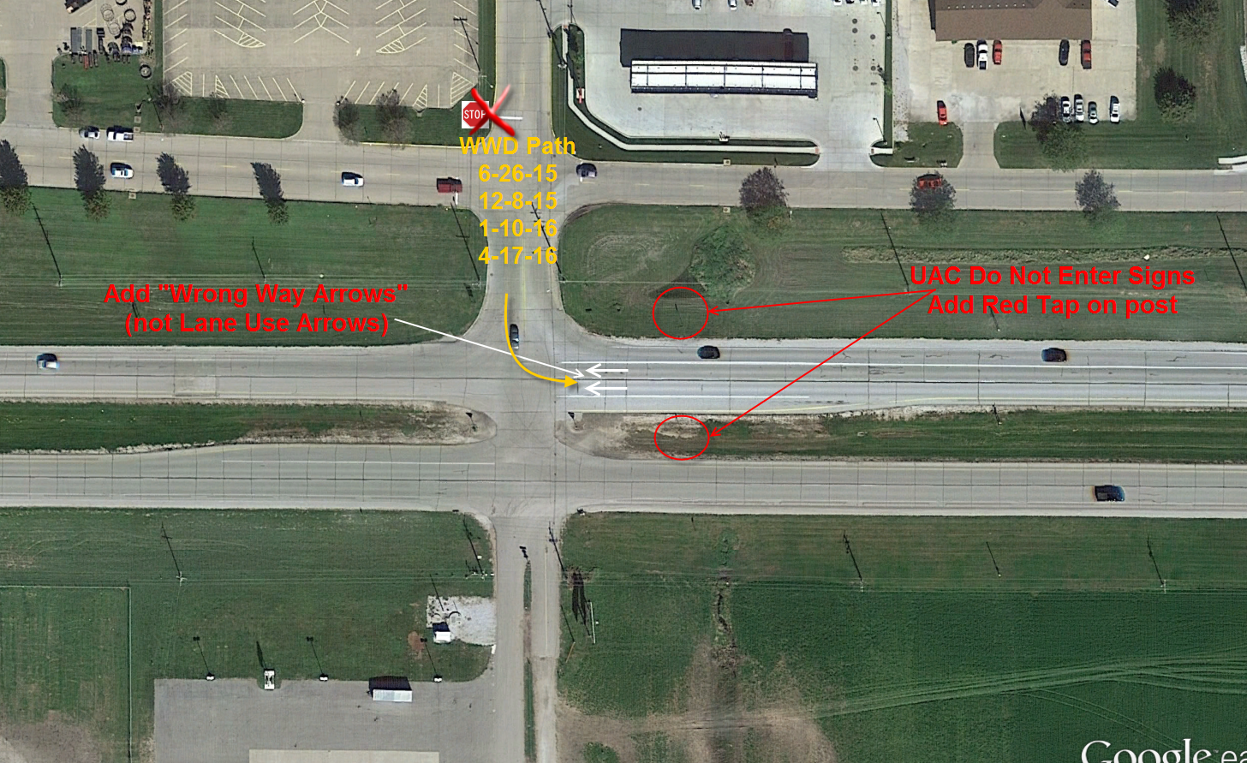

Slide 42
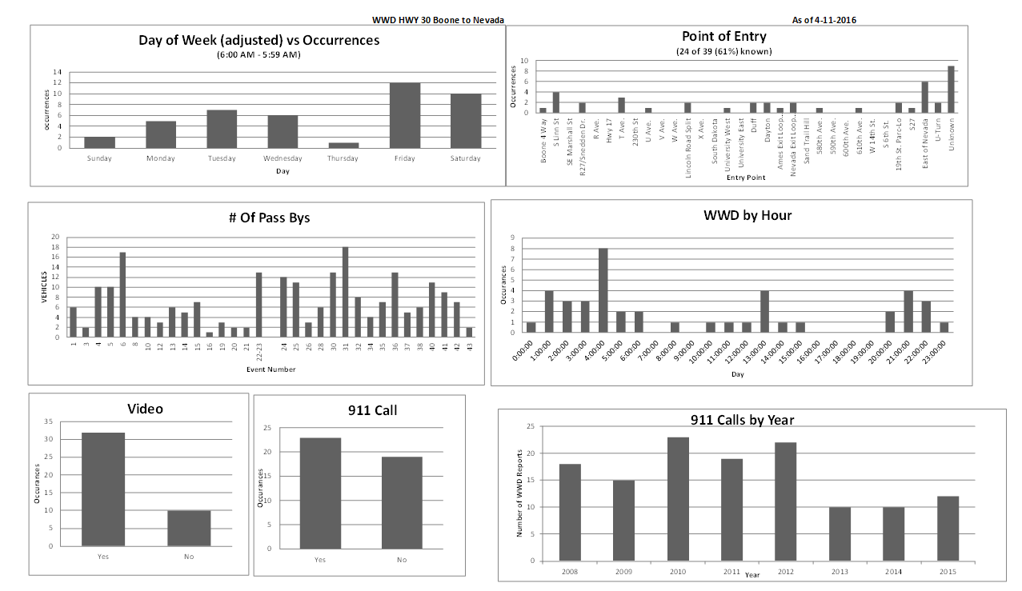

Slide 43
WWD Example 9/9/15
Video Link

Slide 44
What have we learned?
WWD can start anywhere
Detection at Point of Entry is the best
Enhanced Signing/Painting & Lighting can help
What are you going to do on your way home on US 30 (or any 4-lane road)?

Slide 45
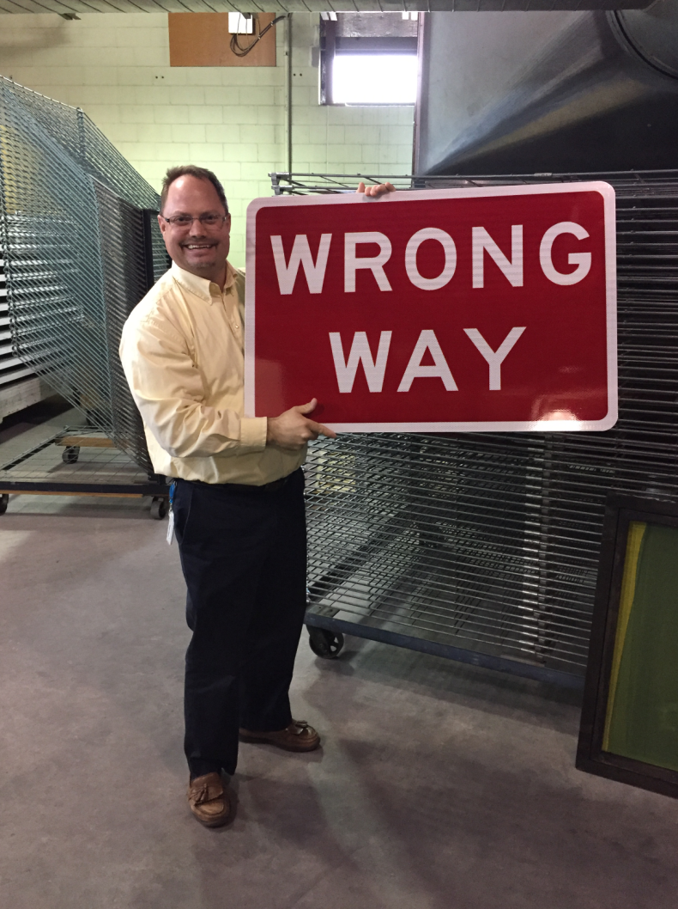
Any questions before next topic?

Slide 46
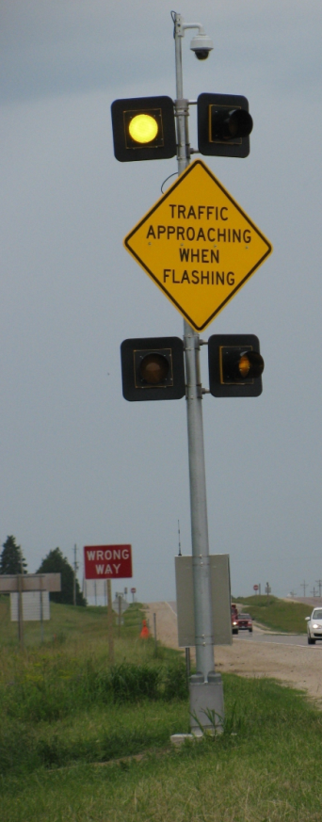
iCWS
Intersection
Collision
Warning
System

Slide 47
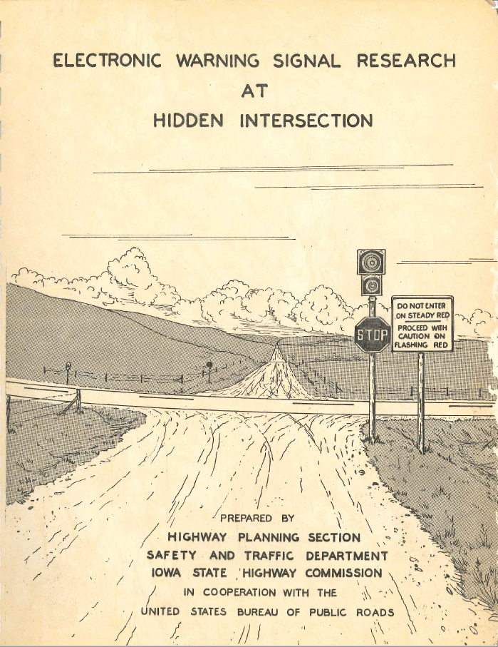
Not a new concept (1959)

Slide 48
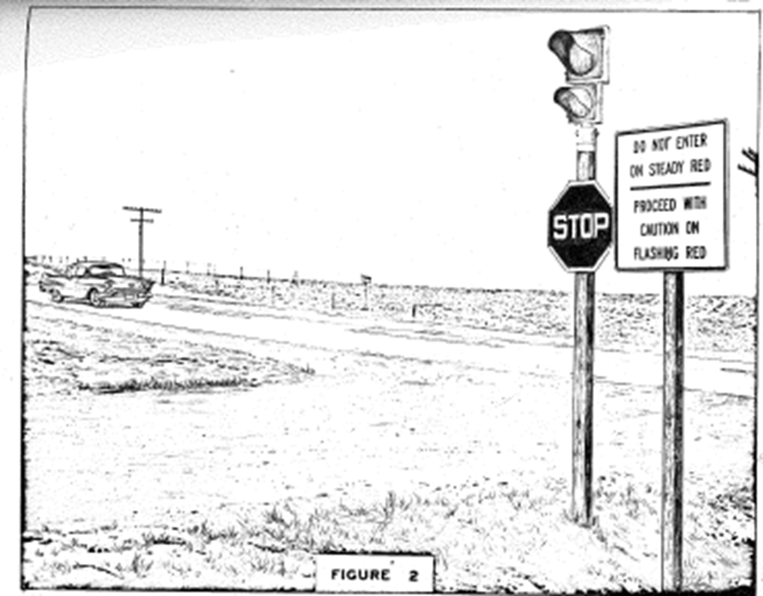

Slide 49
Iowa has 2 types of iCWS
Minor Road warning only (5)
Major & Minor Road warning (1)

Slide 50
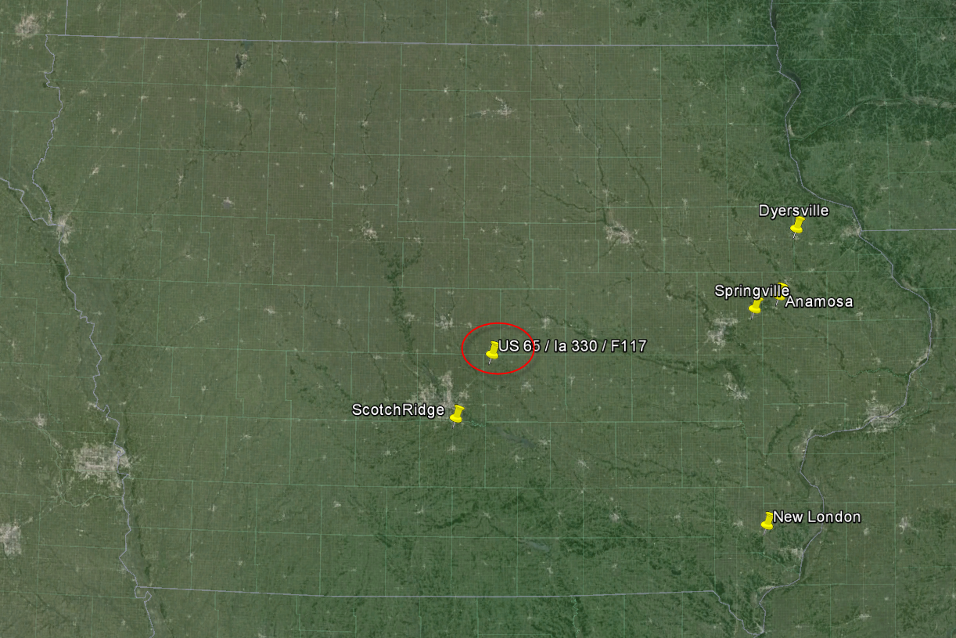

Slide 51
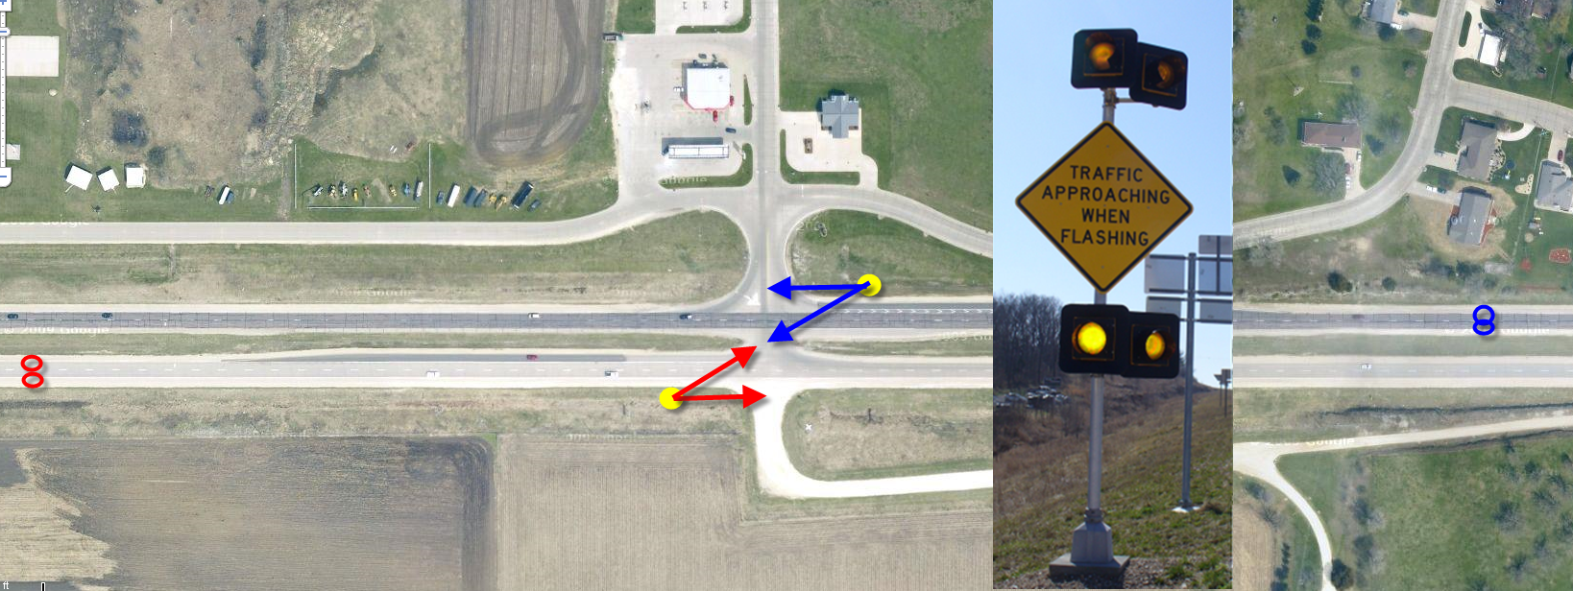
Minor Road Warning

Slide 52
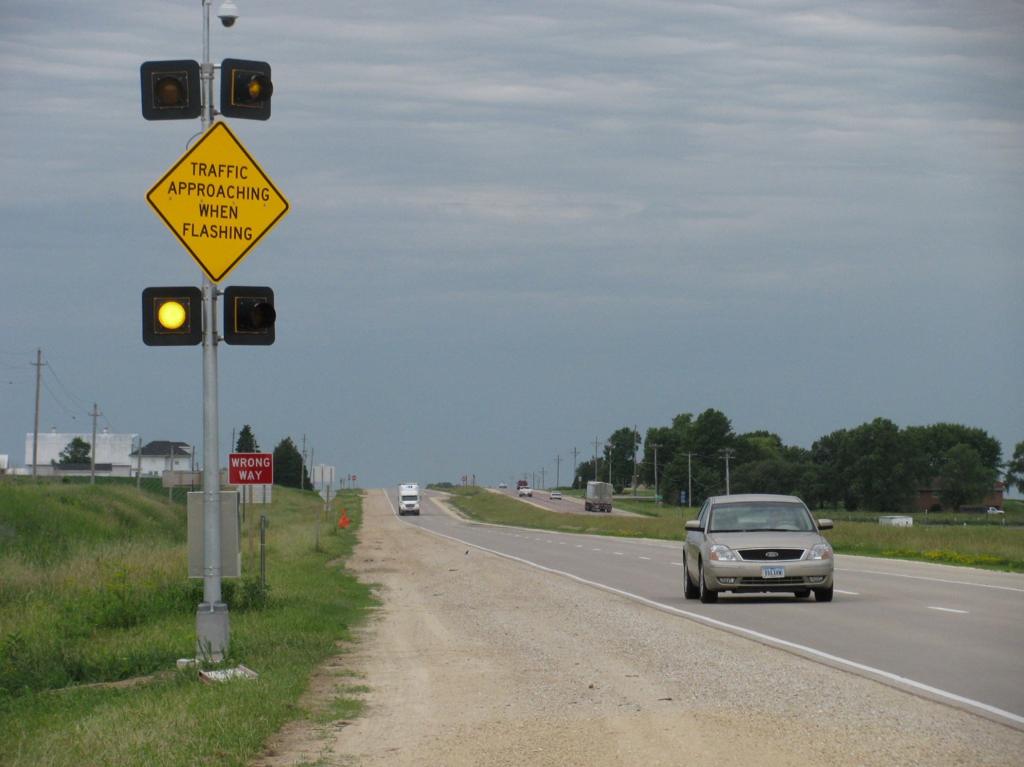
Dyersville and Anamosa
Sign placement on the “left”

Slide 53
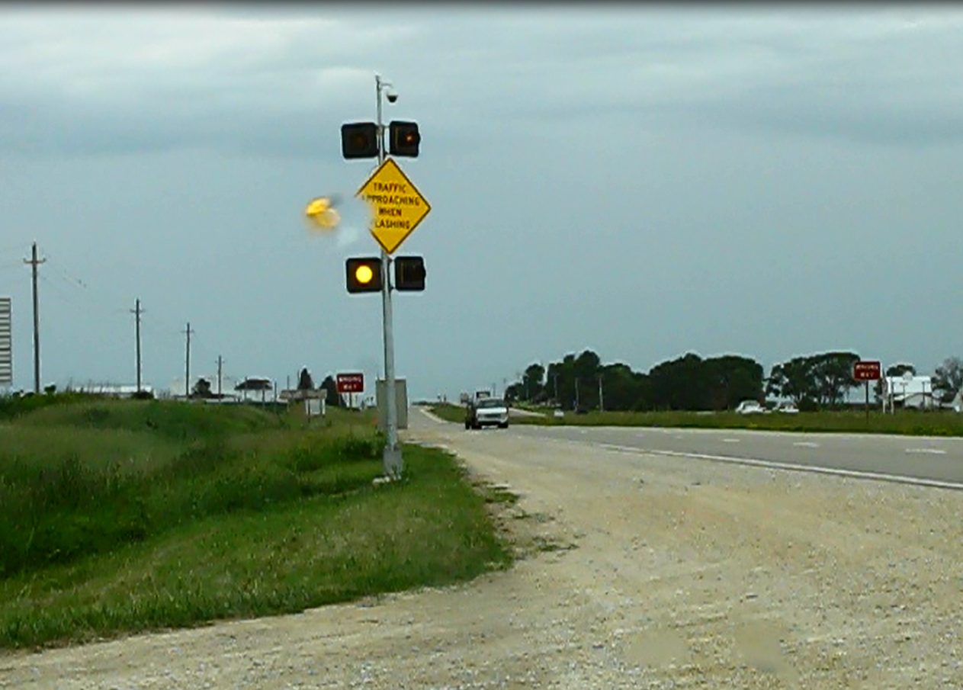
Dyersville
Video Link

Slide 54
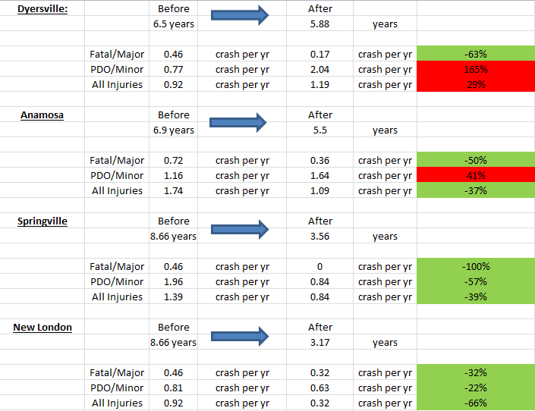
ICWS with at least 3 years
6 fatal or major injury crashes have been prevented

Slide 55
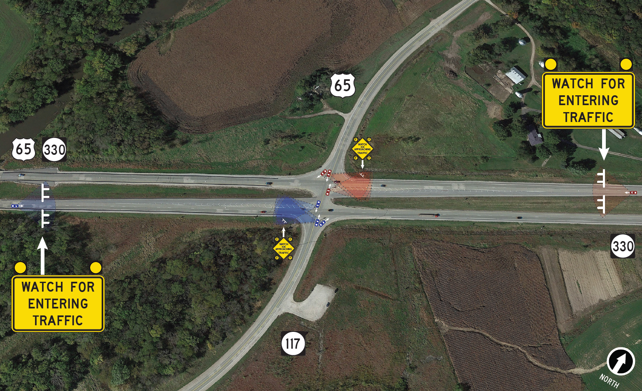

Slide 60
Expected Crash Reduction
Iowa’s previous 5 installations have shown a 48% reduction in Fatal/Majors
(previously, we only installed the signs for the side road)
US 65/Ia330 has warning signs for both side road and mainline traffic
Nationally, a recent study has shown an 80% reduction of targeted crashes warning both.

Slide 61
Why texting & driving might be a bad idea
Link to video

Slide 62
Some people should not have a license…
Video Link

Slide 63
iCWS
Anything on iCWS before next topic?

Slide 64
Statewide Overhead DMS

Slide 65
Started in 1993, 1998, and 2005

Slide 71
Uses
Incidents
Detours
Special Events
Construction Information (Closed lane)
Travel Times
AMBER Alerts
Weather – Winter Storm Warnings
Message Monday

Slide 72
Cell Modems & Service for DMS
IP Addressable
Ethernet and Serial ports
Verizon Network
Low bandwidth (10k to 30k per second)
Just fine for DMS, RWIS, other devices that run on 9600 baud

Slide 73
Message Monday
Start the conversation with co-travelers, friends, family and co-workers
Awareness
Focused on 5 Driving Behaviors
95% of crashes due to driver error
Seat Belts, Drinking, Distraction, Drowsy & Aggressive driving
Only on Mondays
Memorable (funny, serious, heartfelt)
One and done
15 other states are coping us

Slide 74
This week’s Message Monday

Slide 75
E-mail/Blog/FB/Twitter

Slide 76
Do you know why we did this one?

Slide 77
Next Week…….

Slide 78
Any Message Monday Ideas?
Willy Sorenson, P.E.
Traffic & Safety Engineer
Office of Traffic & Safety, Iowa DOT
800 Lincoln Way, North Annex
Ames, Iowa 50010
(515)-239-1212 Office
willy.sorenson@dot.iowa.gov

Slide 79
Anyone…. anyone…..

Slide 80
Questions?

