Slide 1
Impaired Driving
Inhibits driving ability
  Drive to fast
  Slows reaction time
Inhibits decision making abilities

Slide 2
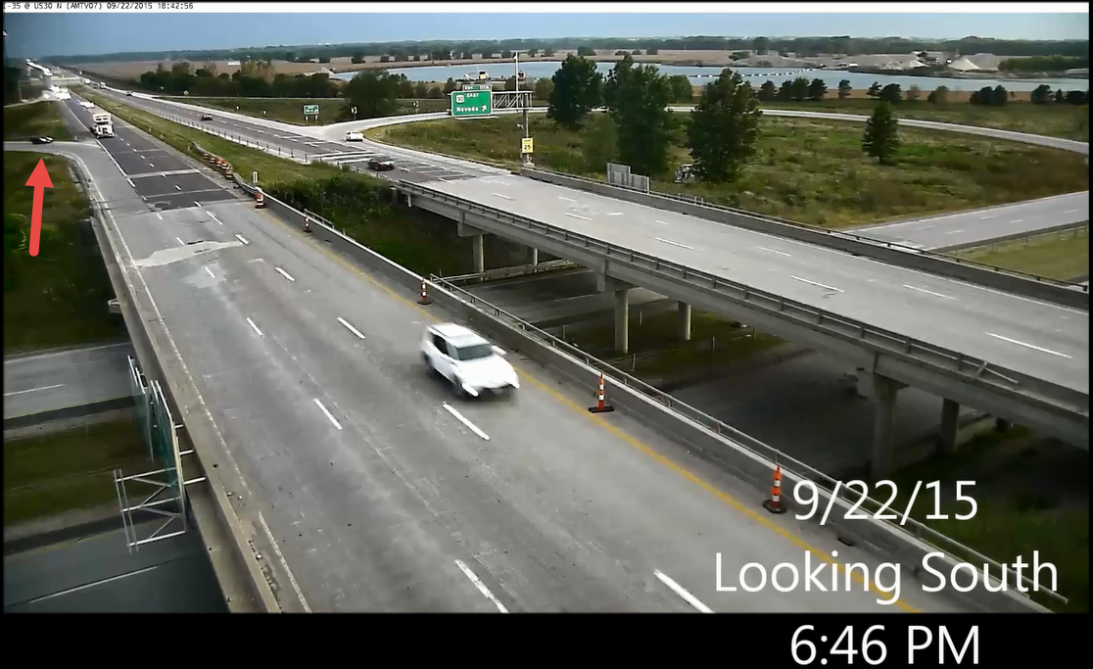
This driver as it turns out was under the influence during this event. Here we have the driver riding the outside edge of the curve. This seems to suggest that the driver is taking the curve a little too fast

Slide 3
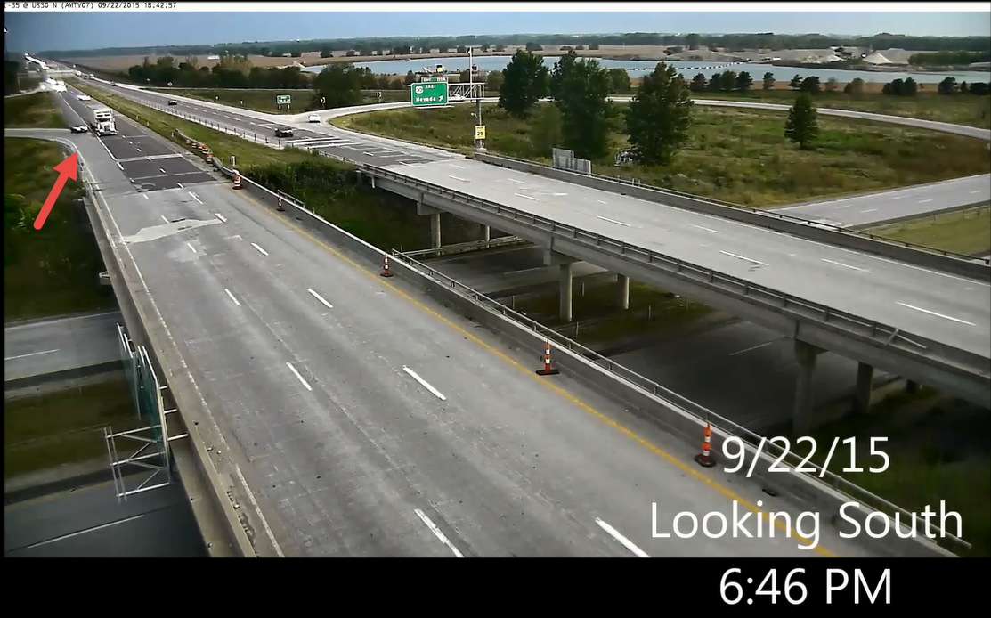
Right before the impact the driver does not seem to be trying to avoid this easily avoidable crash. This also may indicate the driver didn’t attempt to look before merging. The slow reaction time and carelessness can all be affects of driving under the influence.

Slide 4
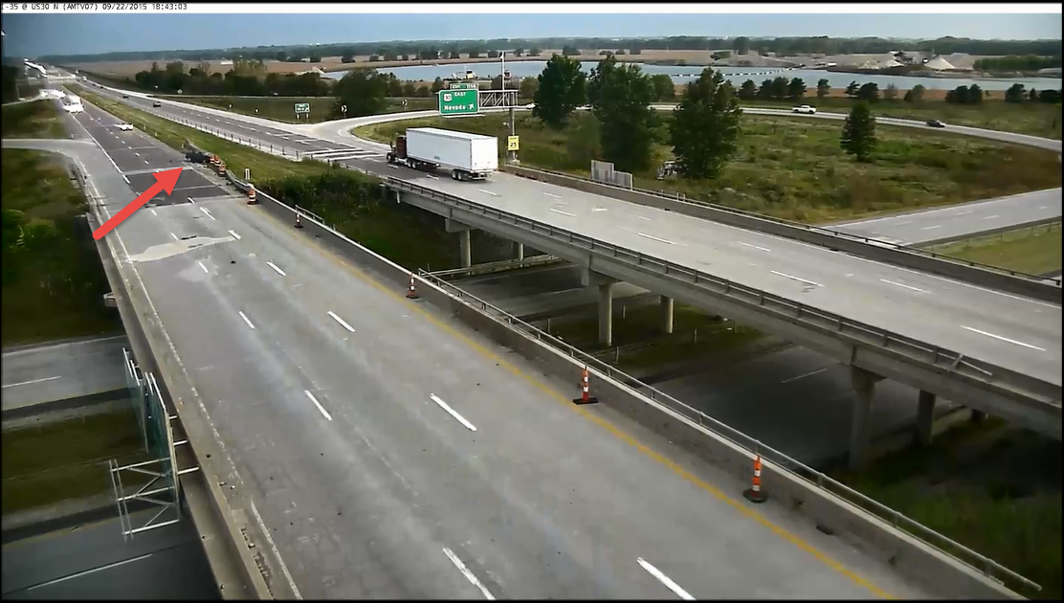
After the crash the car comes to rest in one of the barriers and is seemingly immobilized.

Slide 5
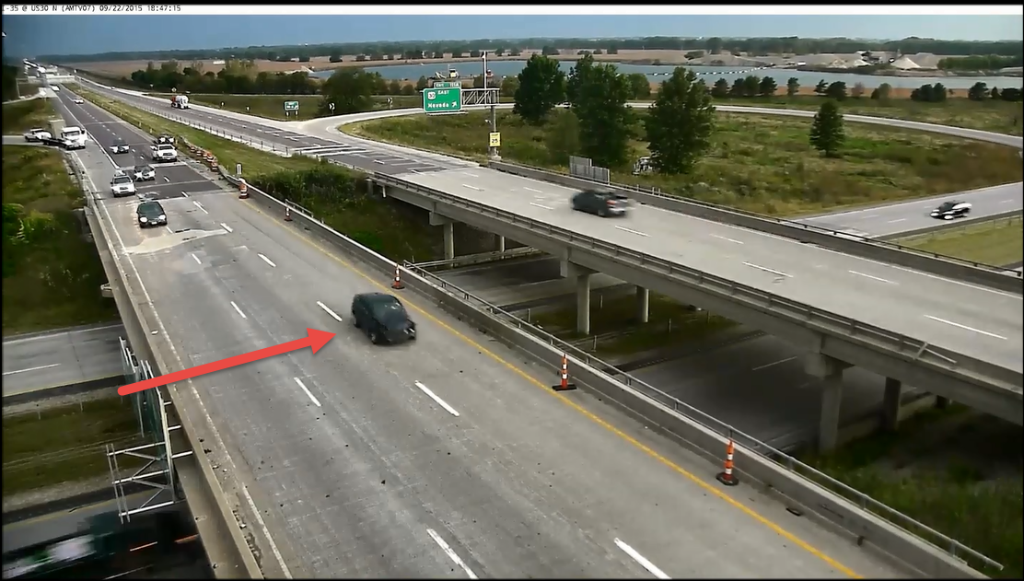
However the car is not immobilized and once a bystander tries to help the driver makes the decision to flee. The driver is later caught and charged with the extra crime of leaving the scene along with driving under the influence.

Slide 6
