Slide 1
Slick Road Conditions
Water
  Hydroplaning
  Cruise Control
Ice/Snow
  Bridges
  Cruise Control

Slide 2
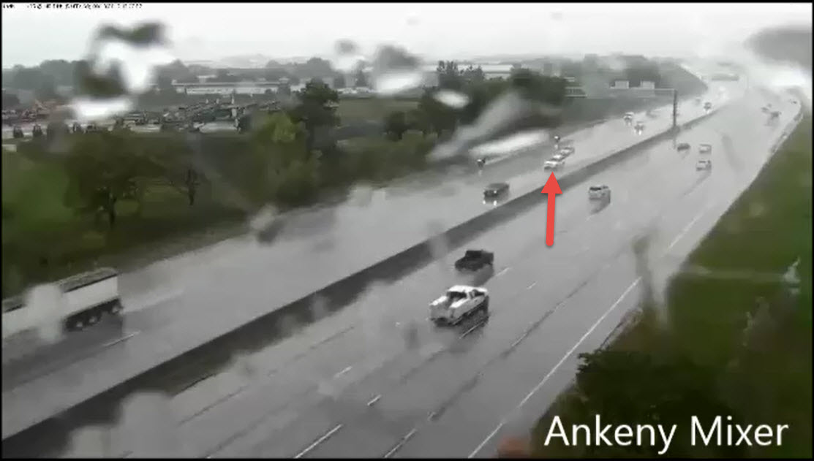
When conditions are very wet roads are very slick and extra caution needs to be taken to ensure your safety and the safety of those around you.

Slide 3
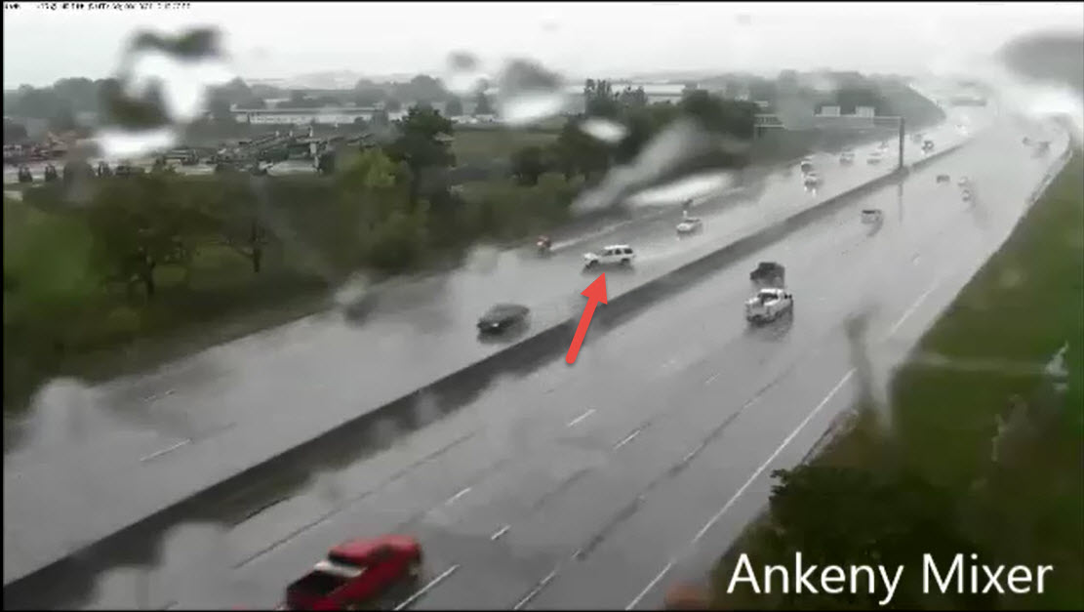
Hydroplaning can happen when your tires can’t make contact with the road. If your cruise control is on your car may lose control very easily.

Slide 4
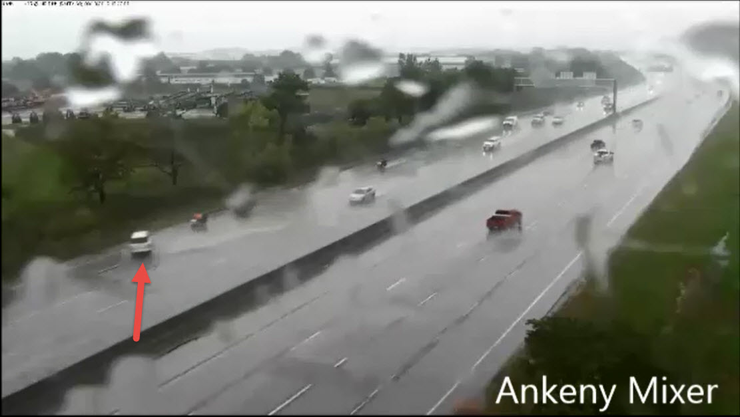
Luckily this crash was narrowly avoided.

Slide 5
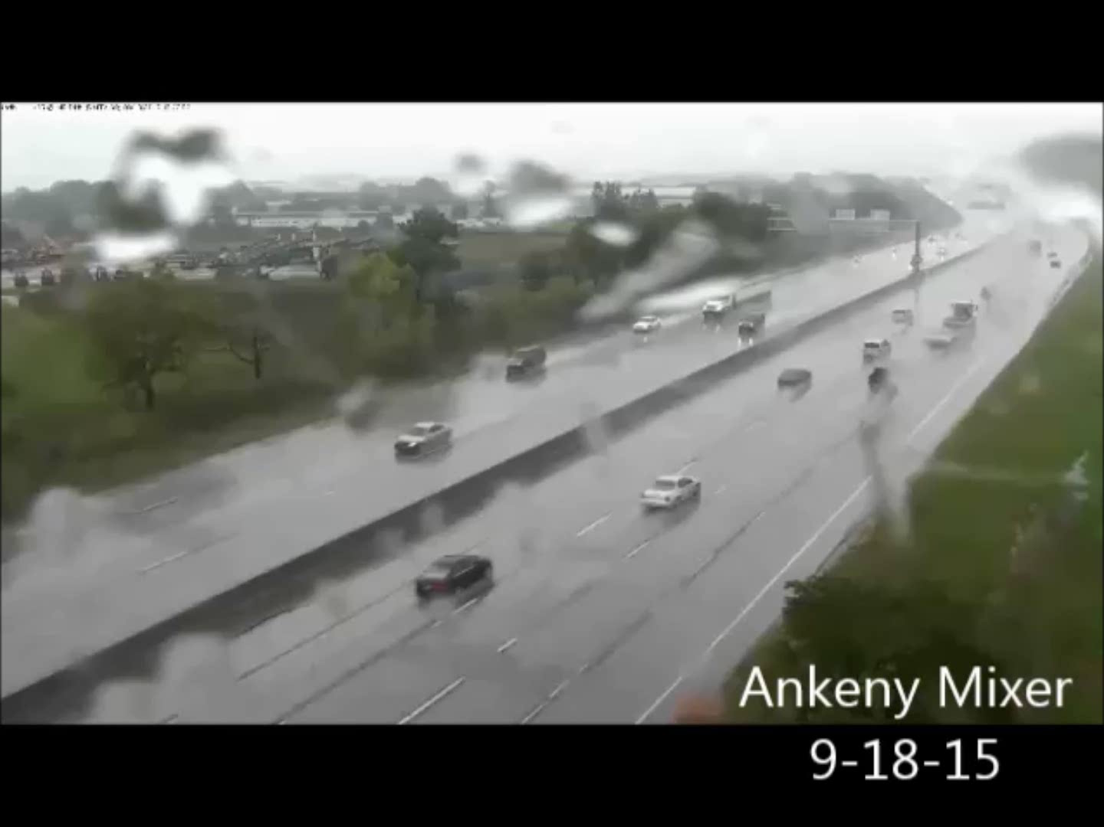

Slide 6
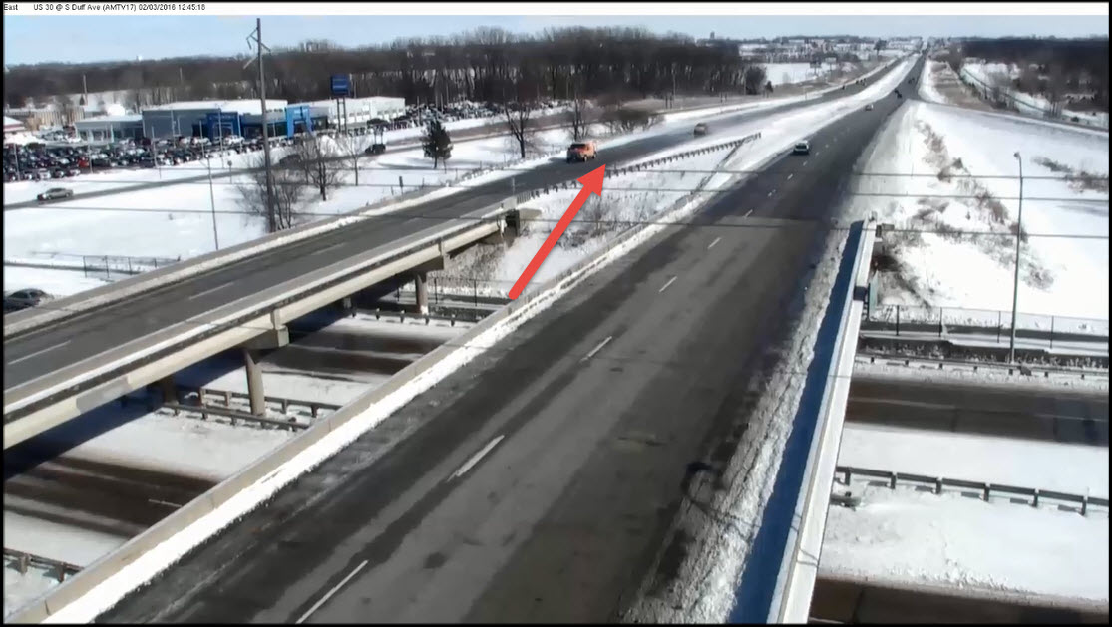
In winter ice can accumulate on the roadway and cause it to be very slick. Ice is more likely to accumulate on and around bridges.

Slide 7

Drivers that use cruise control over these icy spots are particularly susceptible to loosing control.

Slide 8

Losing control on a bridge at high speeds can cause very violent collisions with a high chance of injury. Luckily there were no other vehicles nearby for this incident.

Slide 9
