Slide 1
Texting and Driving
Distracting
Takes eyes off the road
Can cause collisions
Illegal

Slide 2
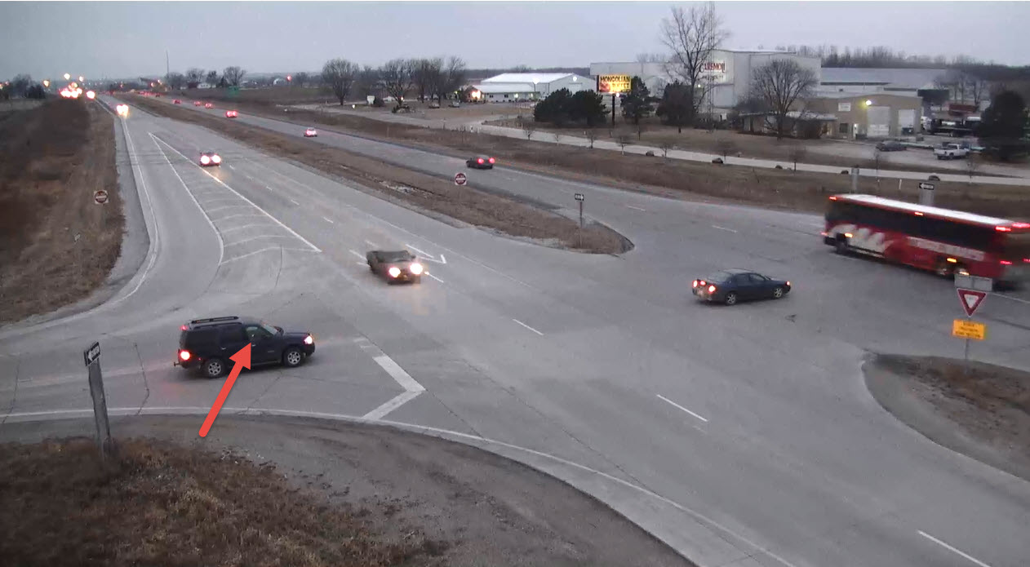
Example
This Driver is texting at a stop sign.

Slide 3
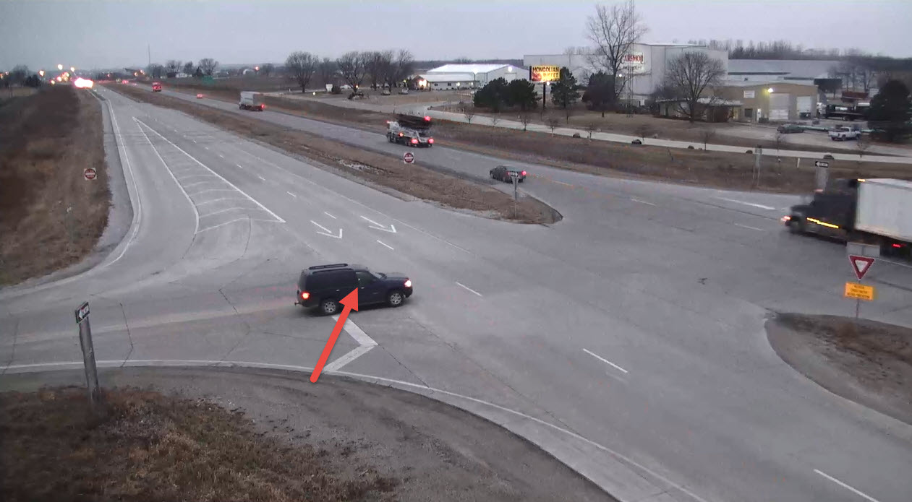
The driver continues texting after the stop and is driving distracted.

Slide 4
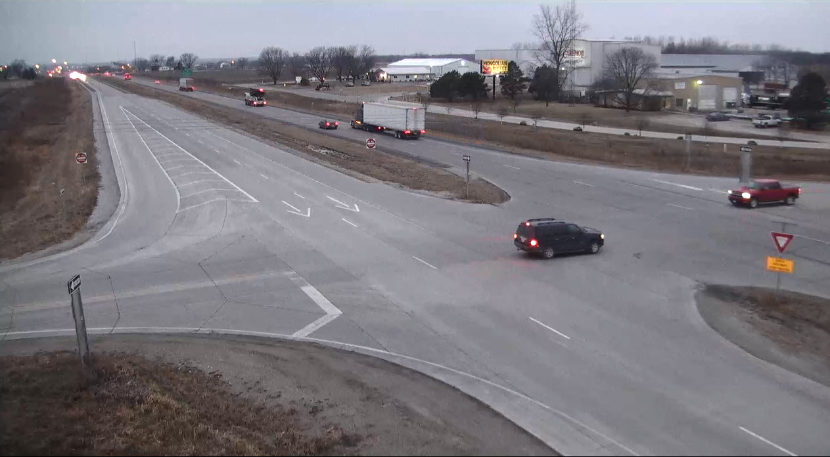
The truck pulls out early into the drivers path. The driver fails to see them because their eyes are off the road.

Slide 5
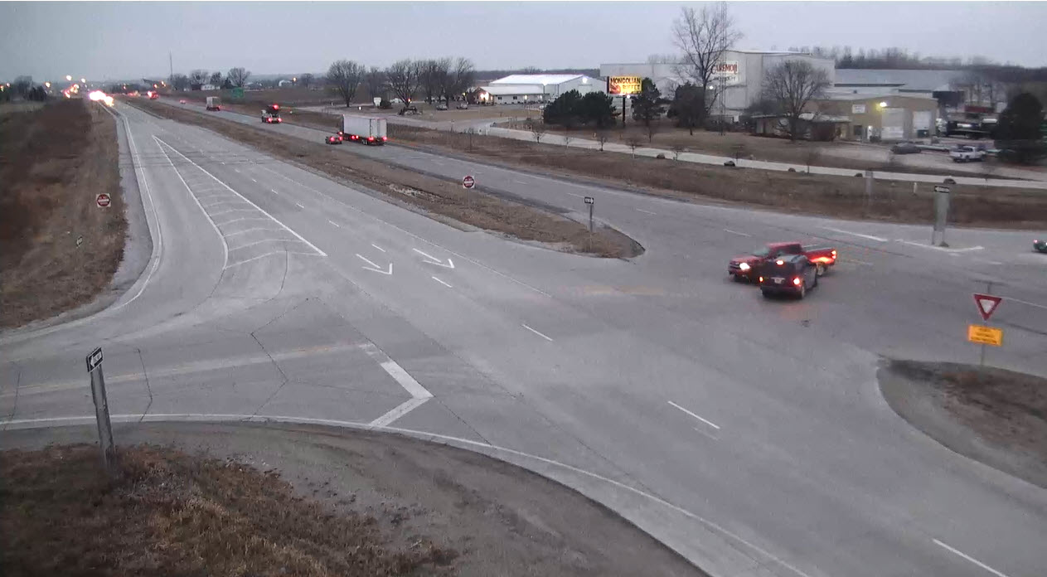
Since the driver did not see the truck there was a collision and because the driver was illegally texting the crash was deemed their fault.

Slide 6
