Slide 1
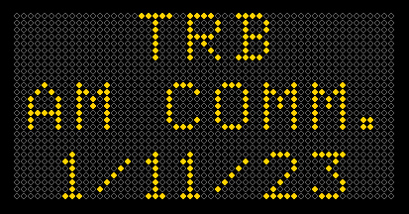

Slide 2
But first…. Incase you did not drive thru Iowa in December …

Slide 3
Agenda
Tell the story of Iowa DOT’s Access Management Policy overhaul
Highlight “Advances” in Access Management
Functional Area
AADT Based Categories based on 20th Year
Proof of Necessity
AM Plans/Corridors
Clear Responsibilities of Owner
Permit is a License – Not a Grant or Property Right

Slide 4
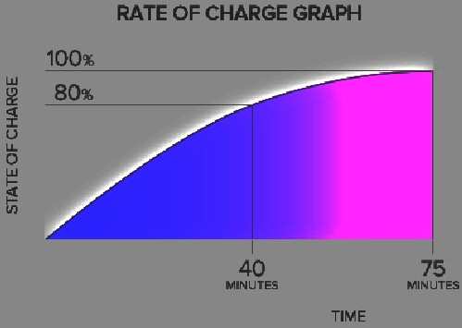
Comparing Charging a Tesla to Updating our Policy. Using the 80/20 Rule
2014
2018
2022

Slide 5
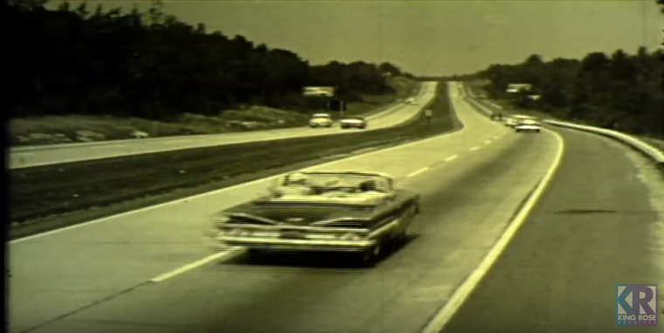
Not much has changed with Iowa’s Access Mgmt Policy since 1960s

Slide 6
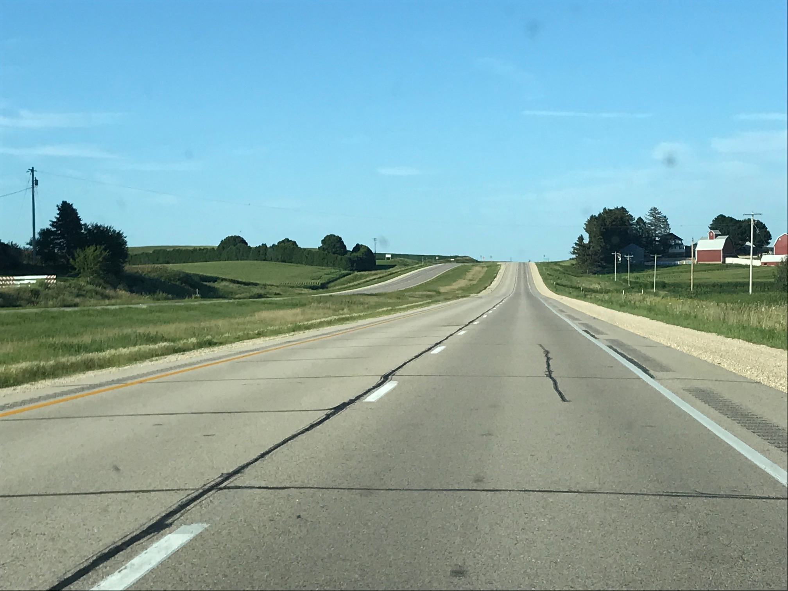
Reason….
Many of our roads still look like this:

Slide 7
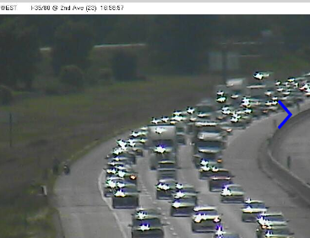
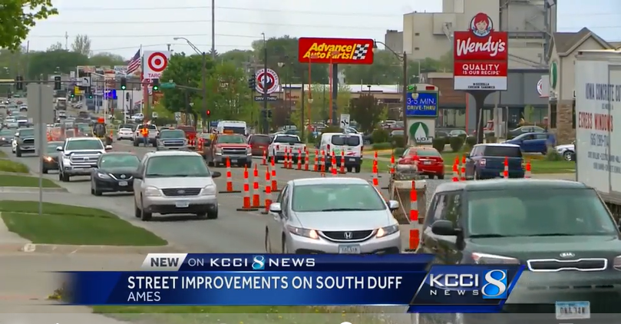
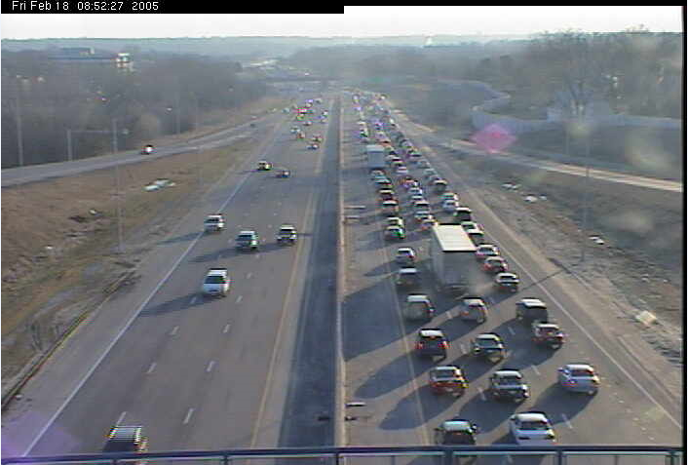
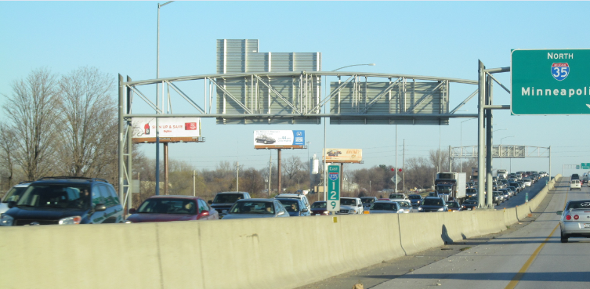
But not all of them!!!!

Slide 8
National Consultant Team
Phil Demosthenes
Kristine Williams
Vergil Stover

Slide 9
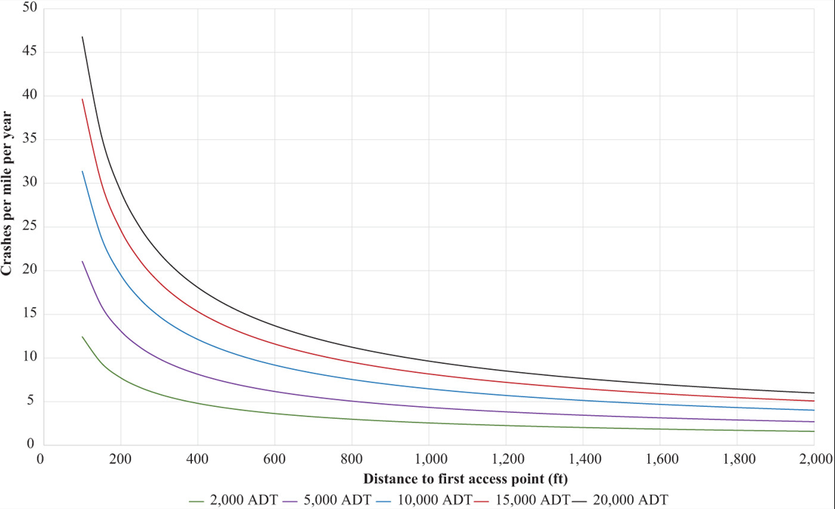
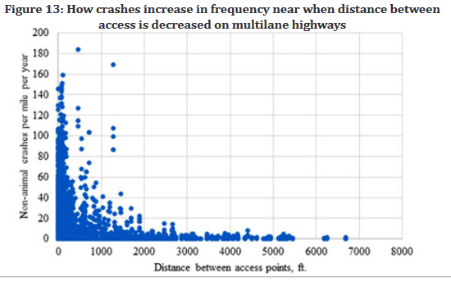
Data Analysis provided by Iowa State University 4 Papers
1st full movement access (on cross street) after a Ramp
1st full movement access (on mainline) after a Ramp

Slide 10
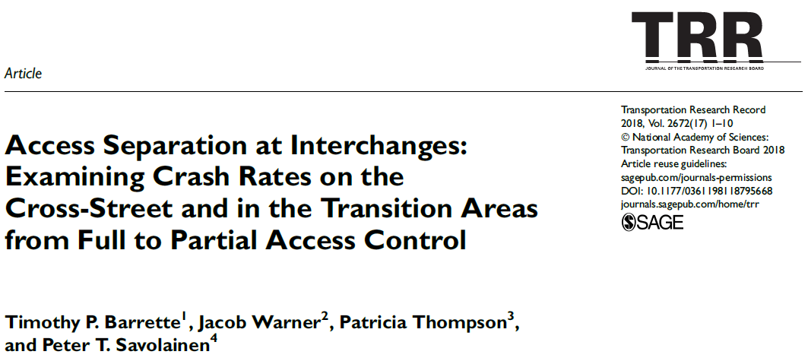
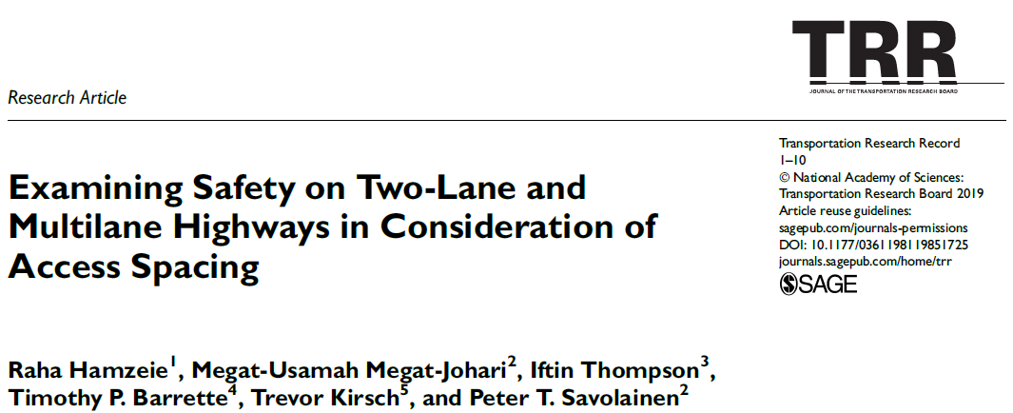
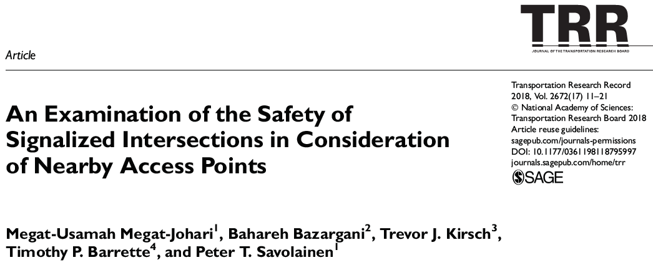

Slide 11
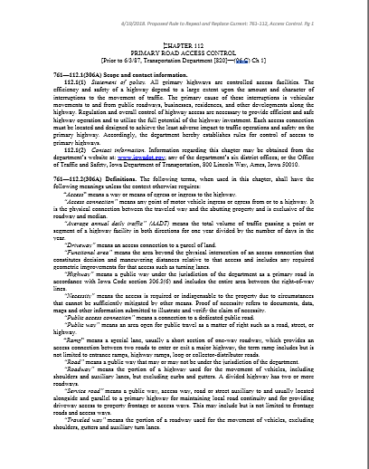
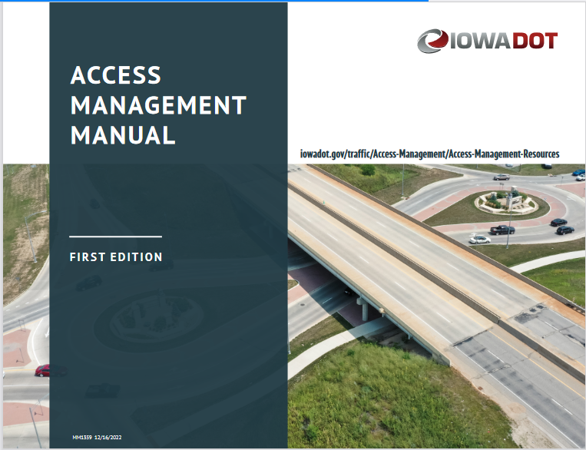
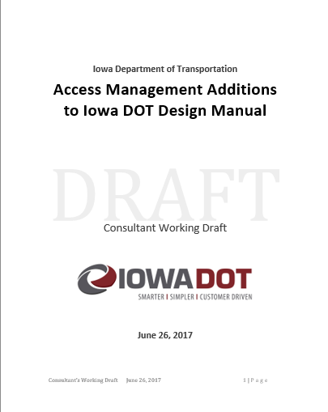
Update Rule & New Manual
Rescind and Replace Chapter 112
Access Management Manual (New!) (provides greater details, examples and explanations)
9 pages
165 pages
17 pages
&
97 pages

Slide 12
Changing the Culture
Accepted
Functional Area
Allowance of an Access vs Design of Access
Engineered vs Cookie Cutter
Same design requirements as public road (think Turn Lane Warrants)
---------------------------------------------------
A specific Access is not a Property Right
Proof of Necessity
Working on it

Slide 13
It Started with GIS Mapping of all existing Access points

Slide 14
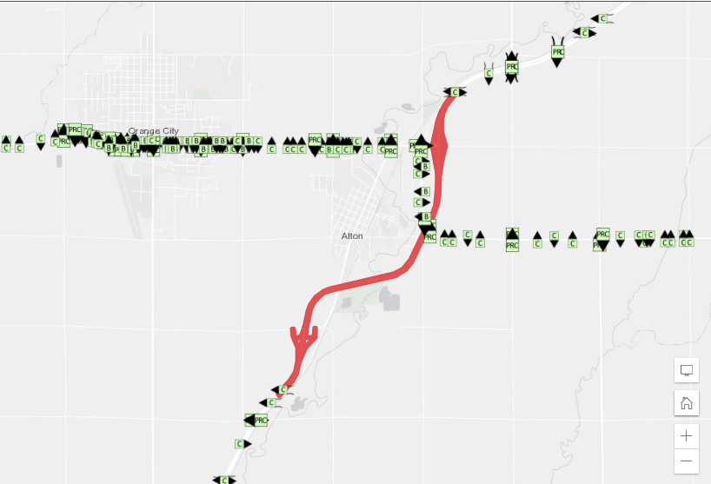
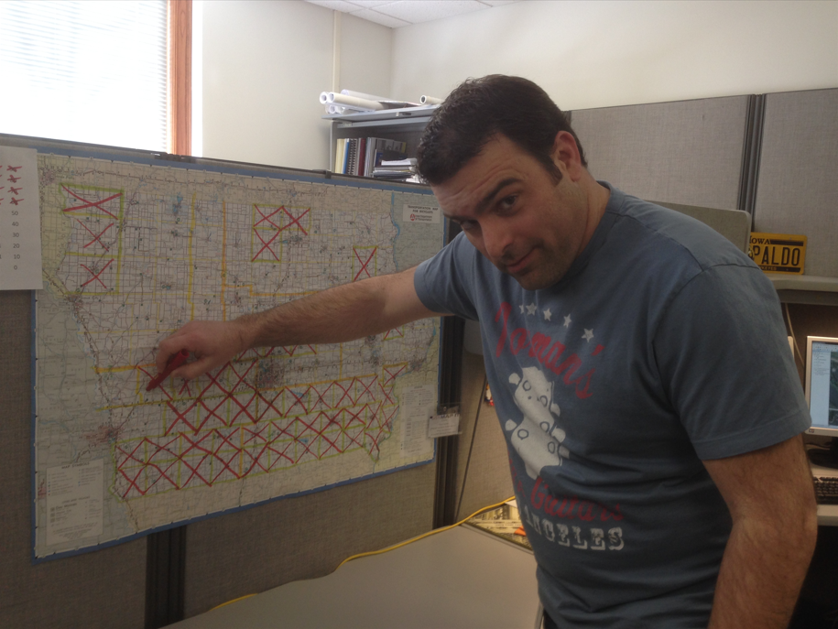
Statewide Mapping of ALL Access Points

Slide 15
20-Year Traffic Volume Map
Developed and led by Jeff Von Brown in Systems Planning
Uses 2018 Traffic data to establish basic trend
Will need to be updated every 5 years
This is only intended to be used for Access Management purposes
Notes:
Not all of the changes in the new administrative rules correlate to a single sub-rule. Some of them correlate to several new sub-rules or changes to existing rules. One of these changes is that everything in the new admin rules uses the 20th year projected design traffic volumes. Whether that be for deciding the category of a roadway segment, determining how far out to acquire access rights, or selecting the entrance type for an access. This map was developed by Jeff Von Brown and team in the Systems Planning Bureau and uses 2018 traffic data to establish a basic trend line. This map will need to be updated every 5 years and is only intended to be used for access management purposes.

Slide 16
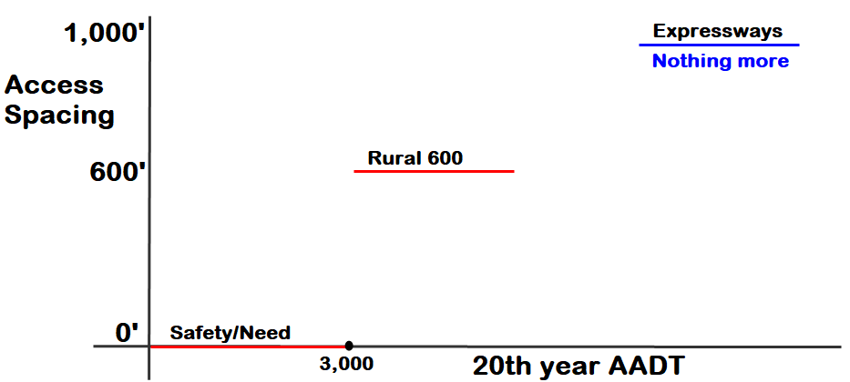
Categories
Notes:
One of the biggest changes to come with the new administrative rule chapter is the reclassification of the priority system to a category system. In addition to the language change the shift separates municipal and rural categories which is something required by Iowa Code. The table demonstrates the possible shifts roadways with the current priority classification could make. A new sub-rule about Access Management Plans previously known as Corridor Agreements was also added. The Access Management plans are for unique situations, and for any corridor that has an Access Management Plan it will be mapped in ArcGIS as if it were a 10th Category (effectively those corridors get their own layer). This new rule was our way of adding more flexibility to the administrative rules. I will talk more about Access Management Plans here in a minute. Lastly a sub-rule was added requiring a report anytime a category is to be revised. This would be similar to a staff action, and it is recommended to review the categories every 5 years.

Slide 17
ArcGIS Category Map
Notes:
I’m not sure if you want to briefly show this or not.

Slide 18
Functional Area
"Includes any area upstream or downstream of an intersection where intersection operation and conflicts significantly influence driver behavior and vehicle operations. The functional area of an intersection is a calculated value based on the intersection's geometrics, posted speed limit, traffic volume, type of traffic control used, and perception-reaction-time values determined by the American Association of State Highway and Transportation Officials."
Used for determining the first access point from newly constructed intersections, interchanges, and free-flowing movements
Notes:
One of the major concepts that the new administrative rules introduce is Functional Area. The functional area is defined as that area of an intersection where operation and conflict points, significantly influence driver behavior and vehicle operation. It consists of both the upstream and downstream functional area distances and is calculated from numerous variables. To clarify upstream is as you approach the access or intersection and downstream is after you have cleared the access or intersection. Calculating the functional area can aid in determining where the first access point should be located from newly constructed intersections, interchanges, and free-flowing movements. Requiring functional area analyses will help in reducing conflict points, weaving movements, and potentially the amount of shadow effect. Detailed guidance will be in the Access Management Manual.

Slide 19
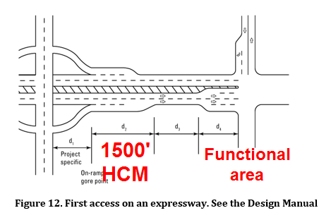
1st At-Grade after a Ramp
1500’

Slide 20
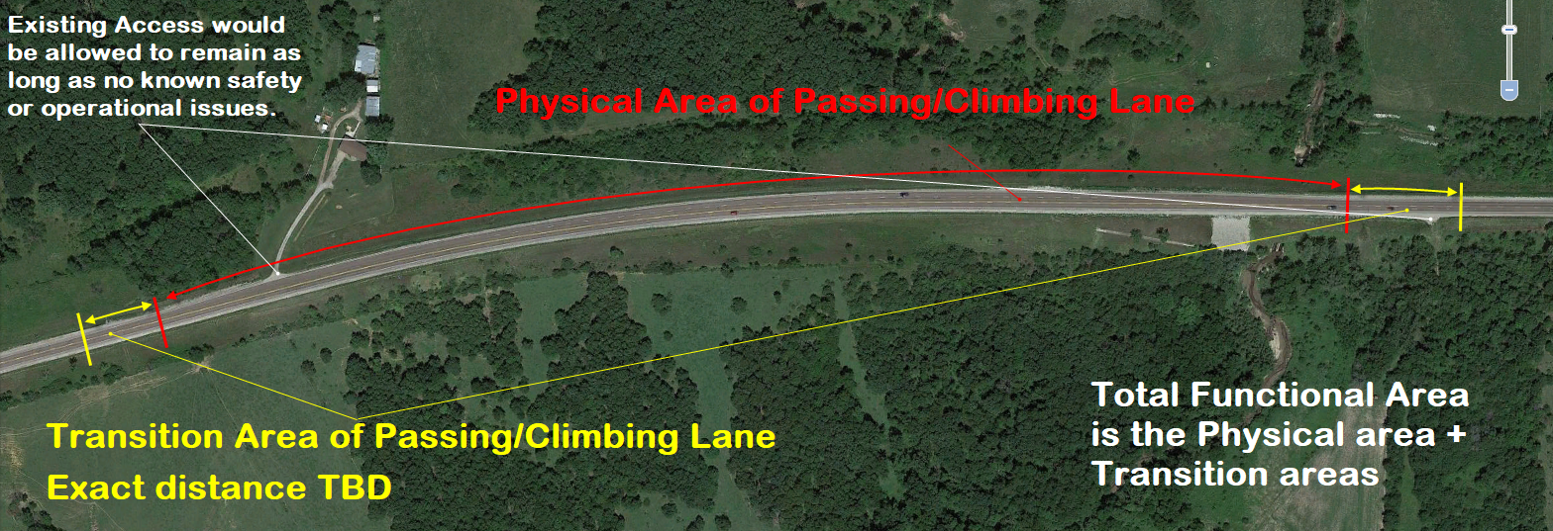
Functional Area of Passing/Climbing Lanes

Slide 21
Proof Of Necessity
“Necessity” means the access is required or indispensable to the property because of circumstances that cannot be sufficiently mitigated by other means.
Proof of necessity refers to documents, data, maps and other information submitted to illustrate and verify the claim of necessity.

Slide 22
How we use it.

Slide 23
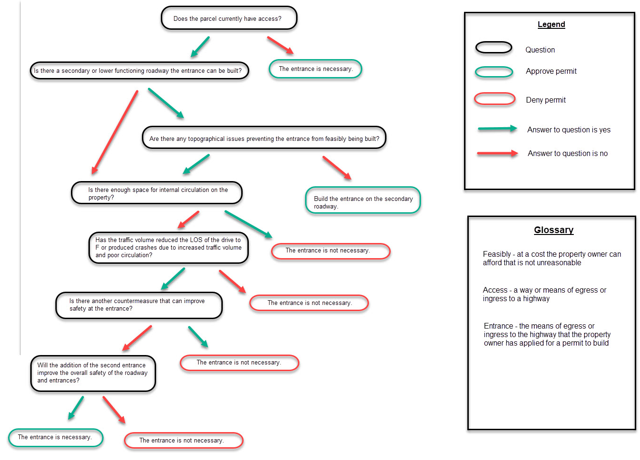
Proof of Necessity Flowchart
Notes:
I recently created a draft Proof of Necessity flowchart for the EOT’s to use when deciding whether or not an entrance is necessary. This is a first draft and changes are currently being made to it. The idea is to be a concrete as possible so that the decisions for approving and denying permits is defensible.

Slide 24
A Permit is not a Property Right
Re-worded Acquisition Language
We also do not file them in the Courthouse anymore.
(have not so for the last 7 or 8 years)

Slide 25
This is Your Access
d. The property owner and the owner’s authorized agent agree by accepting the permit to indemnify, defend and hold harmless the state of Iowa and its employees from all claims arising out of construction or use of the access.
e. The property owner and applicant assume liability for the construction and ongoing use of the access.

Slide 26
Access Connections
Private Connection Types (20th year volumes) A - high volume use (> 100 peak hour trips) B - moderate volume use (11-99 peak hour trips) C - low volume use (<10 peak hour trips) (Residential)
New….. D - limited use (AADT 1 per day use) (Field, Utility Huts, etc)

Slide 27
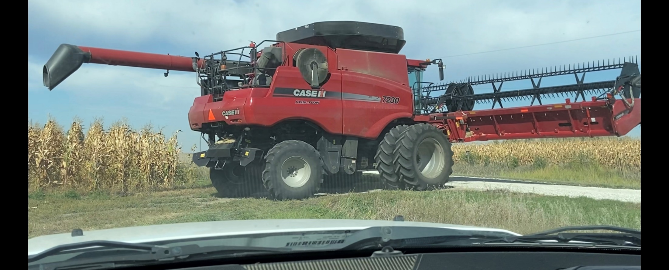
New Type D Access
This is a rural field or utility entrance
Less than 1 AADT
More lenient on spacing requirements
e.g. for a Rural 600 a type D does not need to meet 600 feet
Type C’s and D’s can be closer to an interchange if the roadway is under 3000 AADT
Allows more entrances per parcel compared to other types
Gives the DOT the ability to control future ‘upgrades’
Notes:
We are now introducing a new Entrance Type called a Type D entrance which is a rural field or utility entrance that has less than 1 AADT. The Type D Access was created to be more lenient in segments with higher spacing requirements and allows more low volume entrances per parcel. This was another way to make the administrative rules flexible. We want to be lenient where we can and more restrictive where it matters most.

Slide 28
Managing How Accesses “Grow Up”
112.3(2) A new access permit is required when there is a change in use of the access connection. A change in access use includes a change in predominant vehicle types or an increase in traffic volumes or a situation when the use exceeds the design and engineering limitations of the existing access design. If the property owner desires to change from the historical access use or to a use not authorized by the terms and conditions of the existing access permit, a new permit is required.

Slide 29
Managing Access’s Development
The Designer of this interchange allowed a residential access.
NOT a Traffic Signal
Notes:
Permits, Chapter 112.3(2). This new sub-rule now requires that when there is a change in use of the access then a new permit is required. We are doing this to prevent accesses from exceeding the original purpose without department review. An example of a scenario where this occurred is on IA 141 in Grimes. A type C farm entrance became a fully signalized public road connection close to an interchange without a proper review.

Slide 30
Managing the Median
112.3(11) The department has the authority regarding operational modifications to the highway and all access connections.
We always had authority over movements allowed in/out of an Access. This just made it clear.

Slide 31
On-Line Permitting

Slide 32
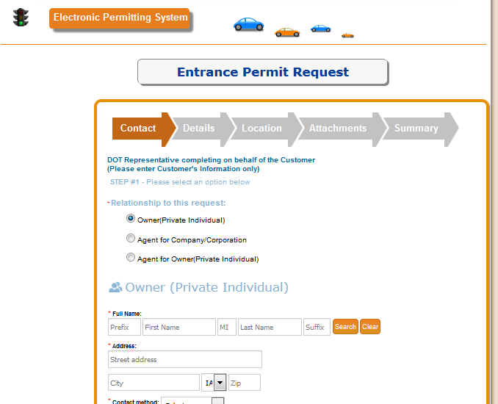
Iowa DOT (former) Director
Any interaction with the public that is on paper should be electronic.
TurboTax

Slide 33
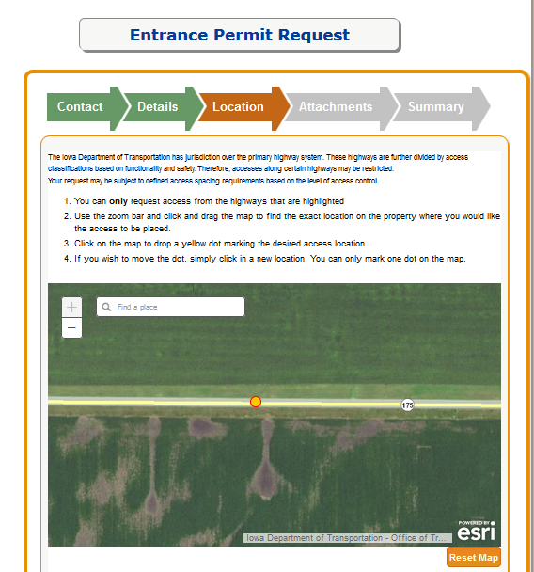

Slide 34
Questions…..

Slide 35
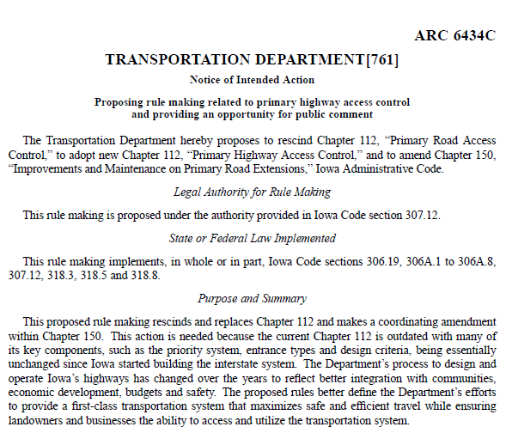
Access Management Administrative Rule
Approved and in use as of Nov 9th 2022
… and it only took 8 years…

Slide 36
So… unless another state has implemented an Access Policy in the last 2 months, with these principals..
In Closing…
Iowa is now the lead in best practice
(my opinion of course).
Philip Demosthenes 1/6/2023

Slide 37
Our Access Management Policy is the Tesla of Access Policies. (Right now anyway)
In my opinion of course
Willy Sorenson 1/11/2023

Slide 38
Questions?

