Slide 1
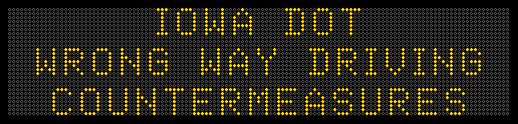
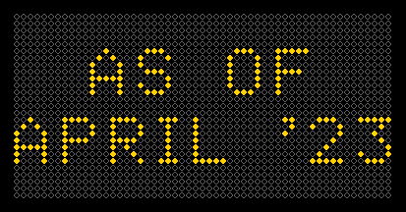

Slide 2
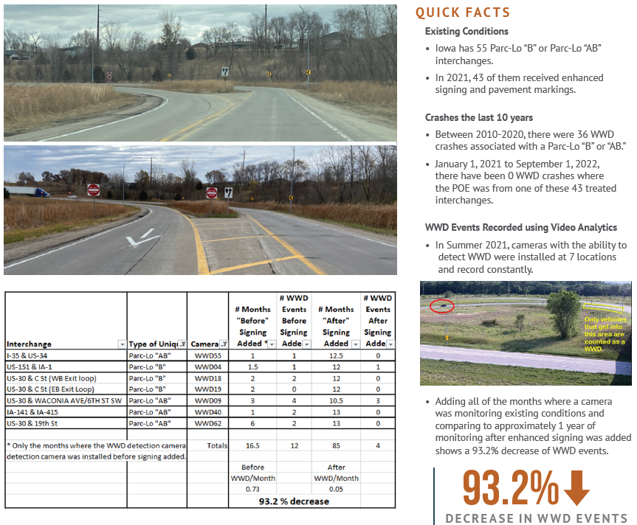
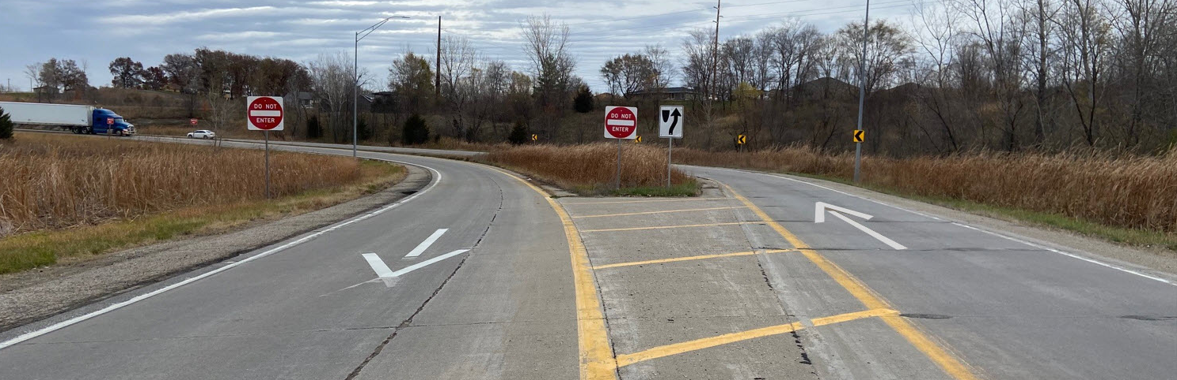

Slide 3
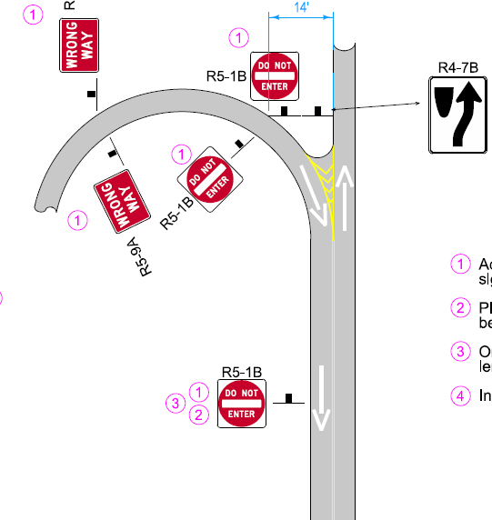
Folded Diamond
Interchange

Slide 4
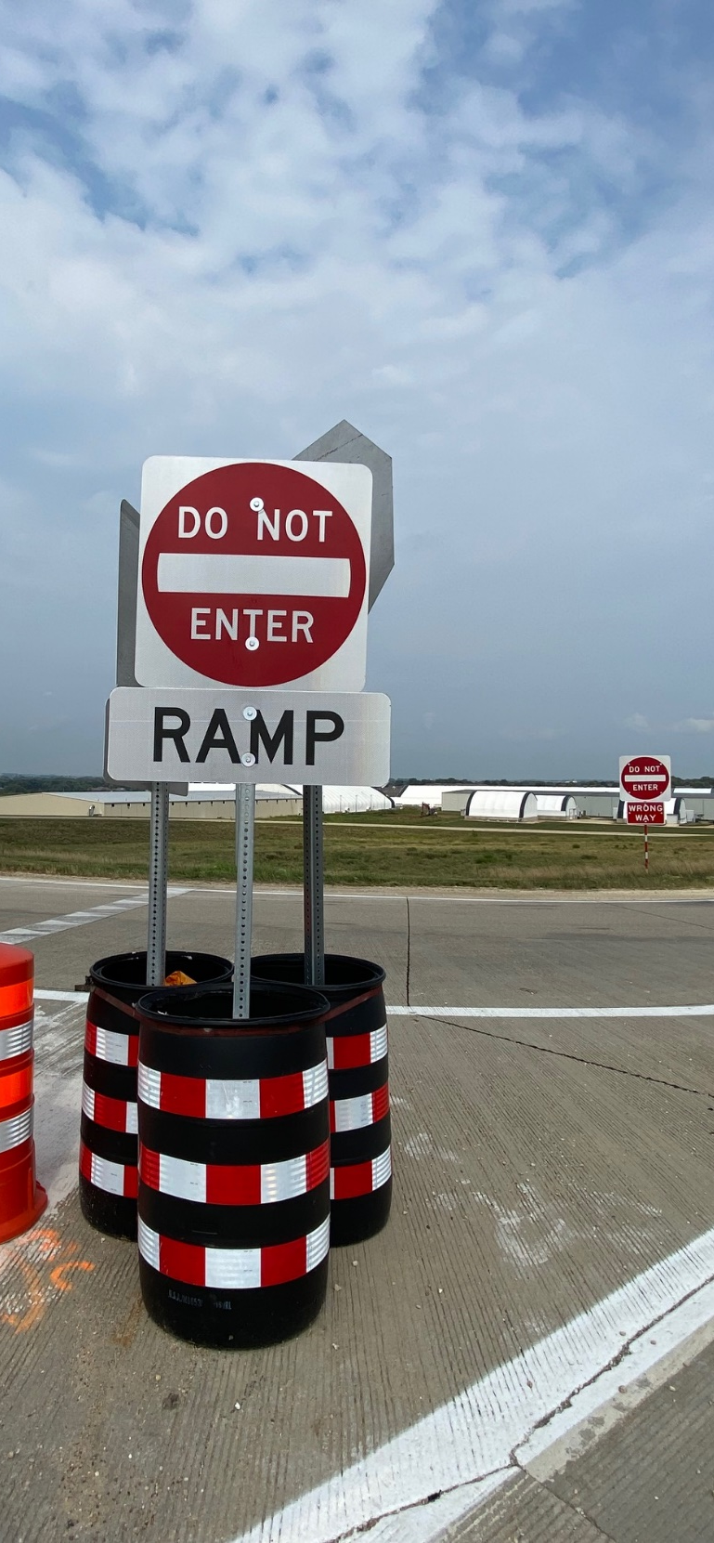
Treatment #9
Over the course of a year, we tried 8 different treatments.
Finally….. #9
Installed 7/19/21
1 WWD every 27.5 days
91% reduction

Slide 5
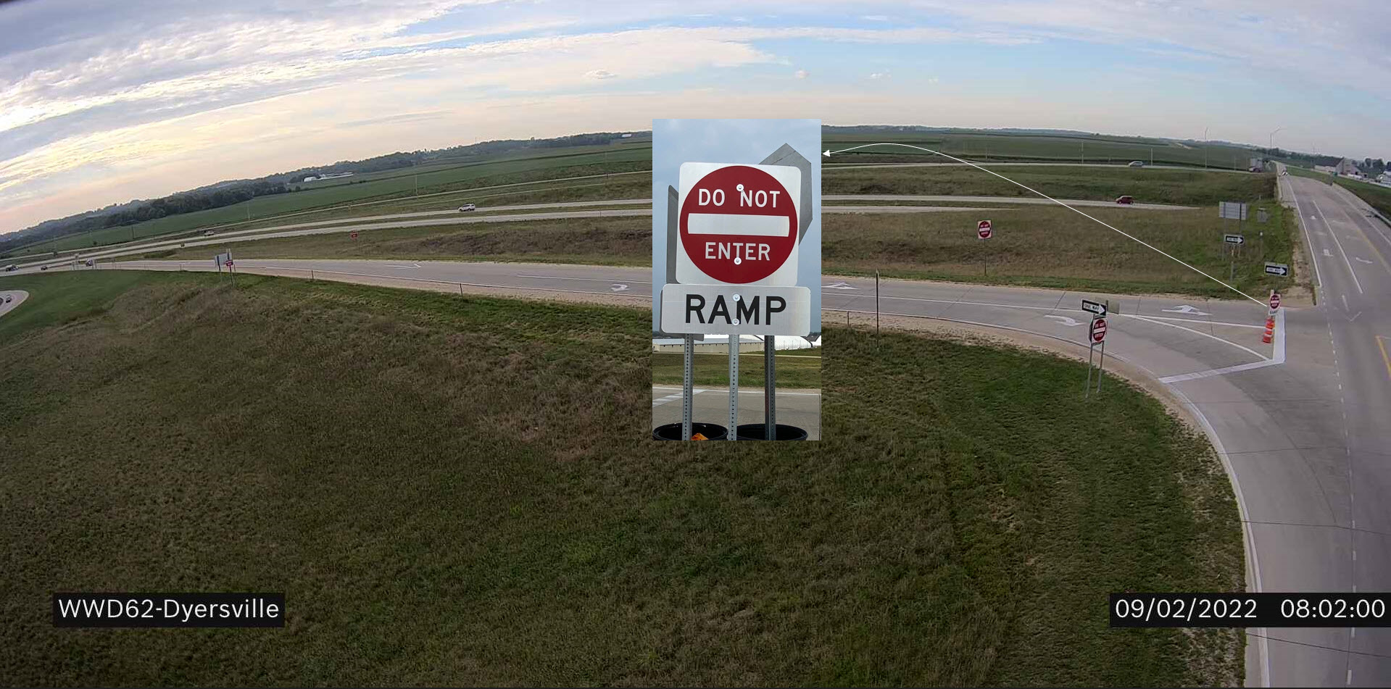
Dyersville Update

Slide 6
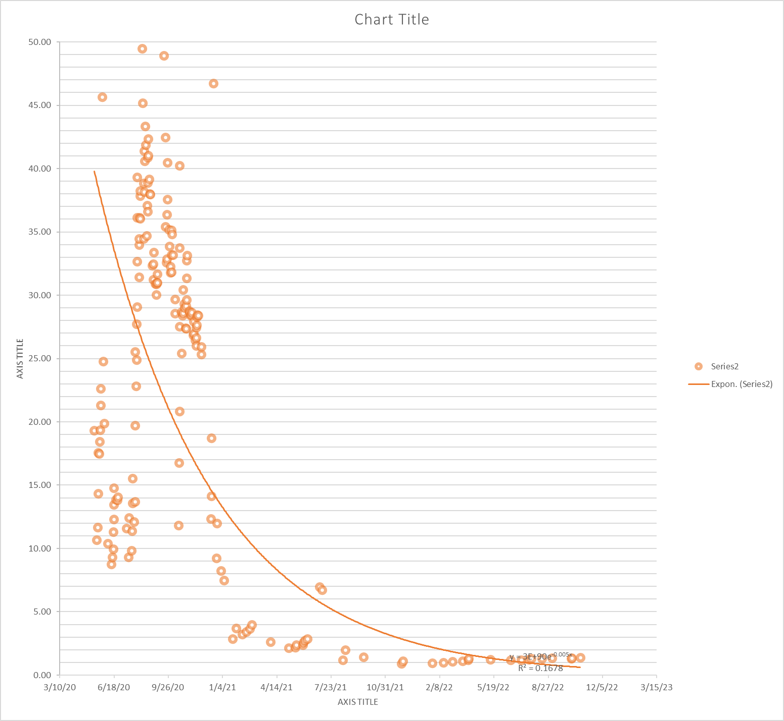

177 WWD Events
21 WWD Events
Average 26.9 WWD/Month for 1st 16 months
Average 1.24 WWD/Month for last 16 months

Slide 7
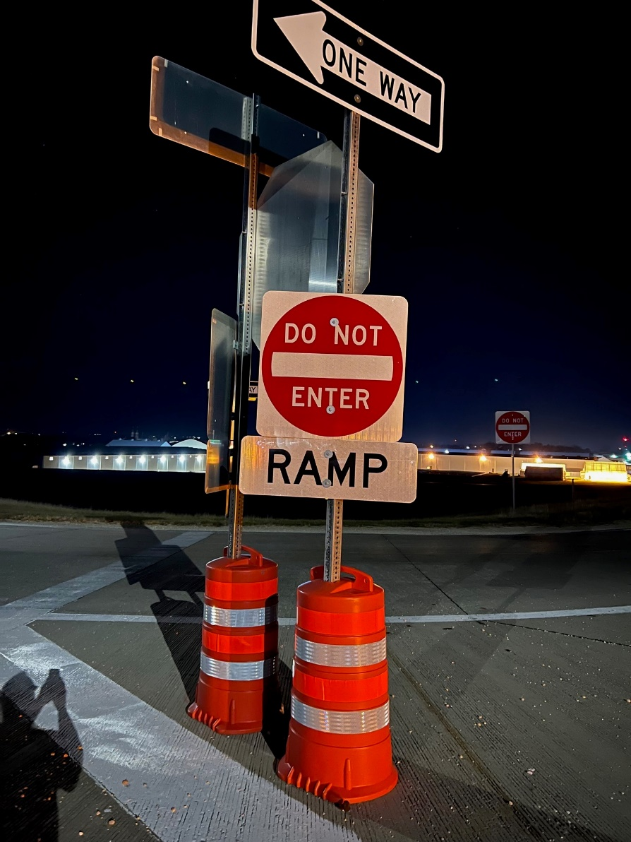

Converted from 3 temp barrels to 2 Post Anchored PSST Legs

Slide 8
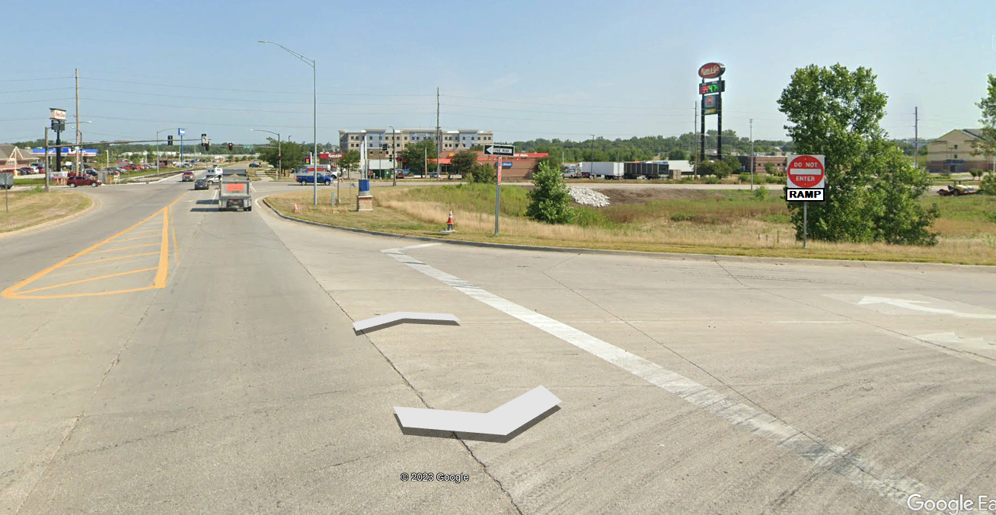
Before adding the Barrels
See if this placement works.
Proposed only. Not implemented anywhere in Iowa (yet). Would like to try at a few locations in 2023.

Slide 9
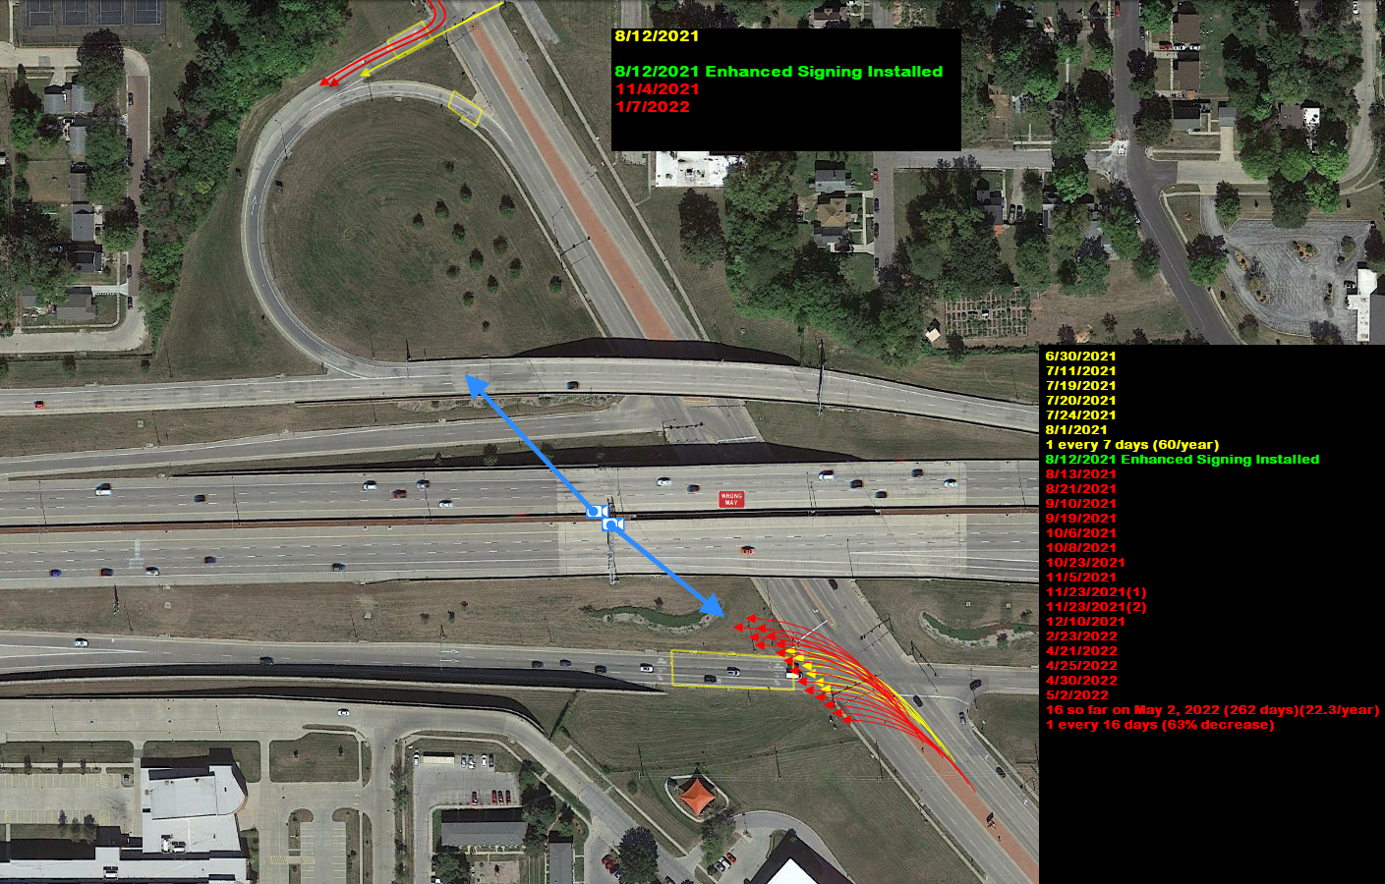
I-235 & Keo Way

Slide 10
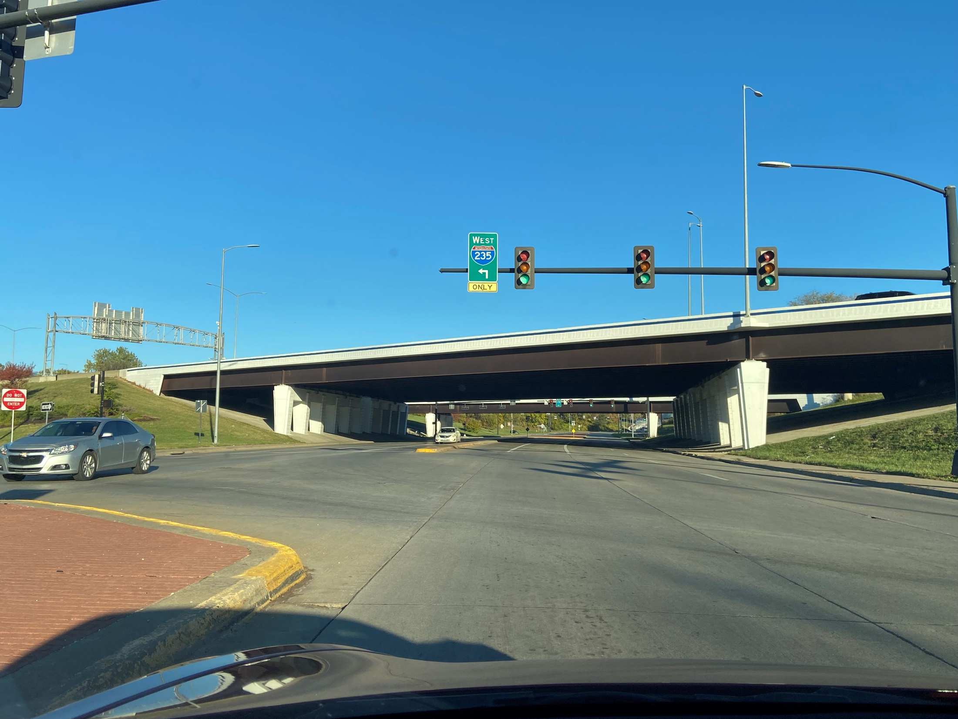
Existing.
Do you see why someone might turn left here?

Slide 11
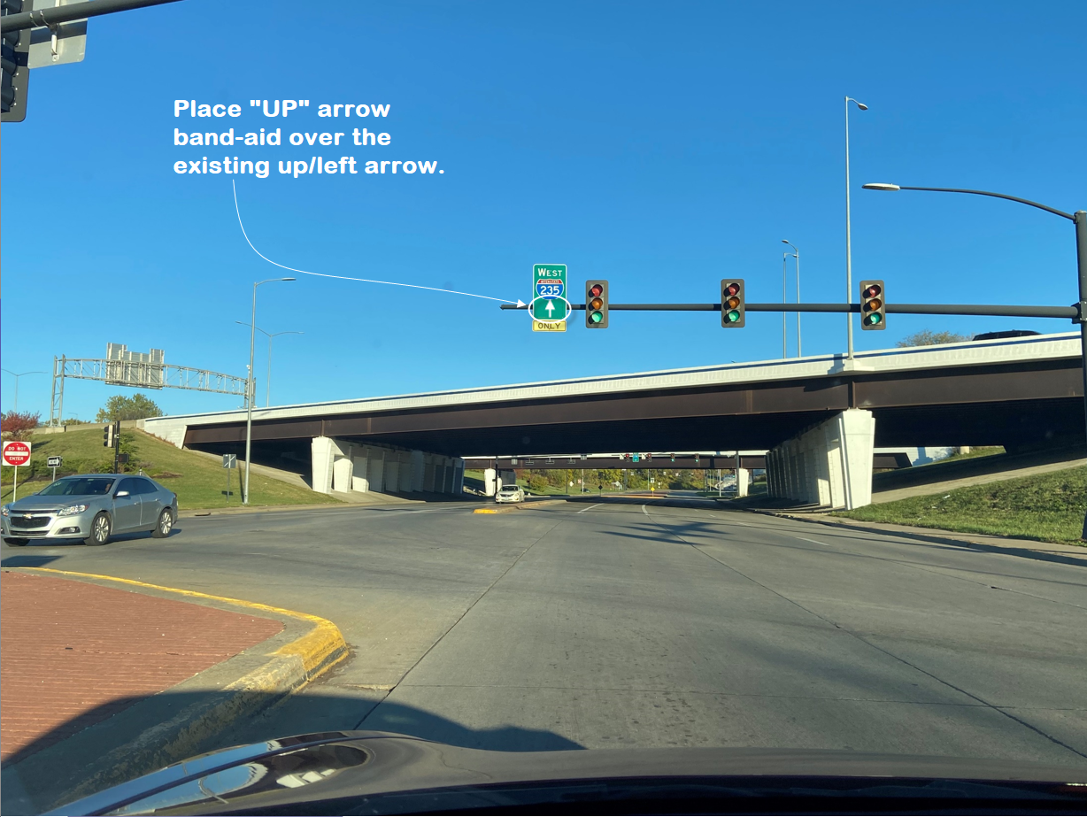

Slide 12
Score:
37 WWD Events Since 6/29/21
  1.7 WWD events/month
  (5 years of 911 or sensor data) (No detection camera)
3 WWD Event since signing changed on 8/29/22
  0.4 WWD events/month
  76% decrease

Slide 13
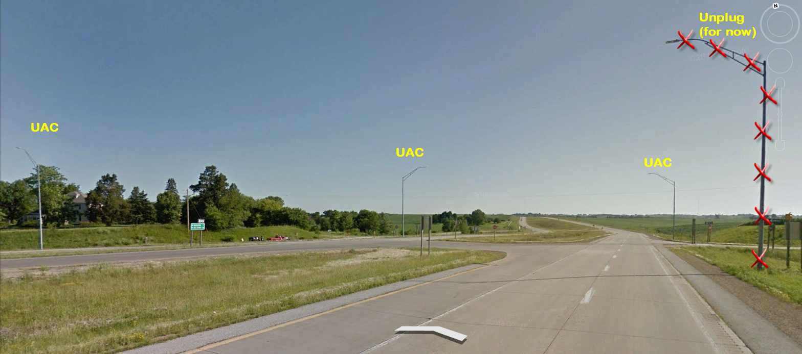
Shut off the Luminaire on 3/4/22
Update on 4/4/23 (after 13 months)
(Night only WWD Events)
Before (Light on) – 71 WWD / 7 ¼ Months (10 WWD/month)
After (Light off) – 58 WWD / 13 Months (4.5 WWD/month)
(55% decrease)

Slide 14
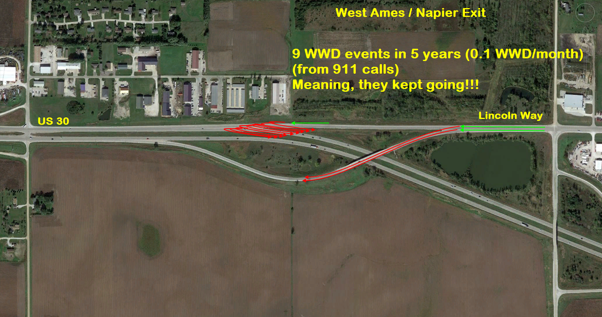
Odd, but not uncommon POE
(Point of Entry)

Slide 15
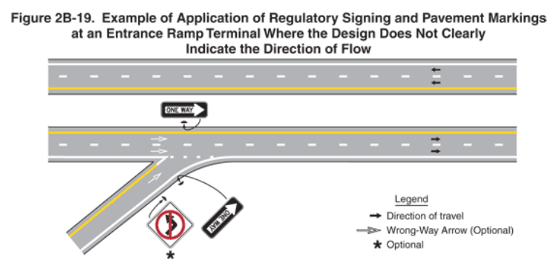
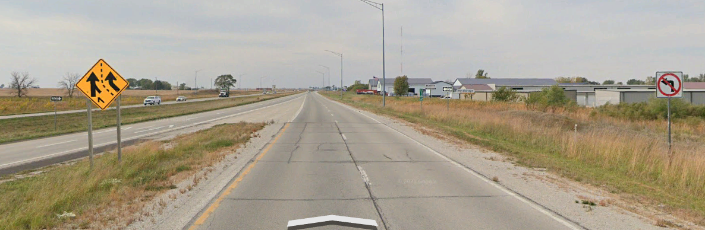

MUTCD Treatment (2B-19)

Slide 16
Score:
9 WWD Events Since 1st we found out
  0.13 WWD events/month
  (5 years of 911 or sensor data) (No detection camera)
1 WWD Event since Enhanced Signing/Pavement Markings
  0.05 WWD events/month
  (20.5 months of data) (7/21/21 to 4/7/23)
  62% decrease

Slide 17
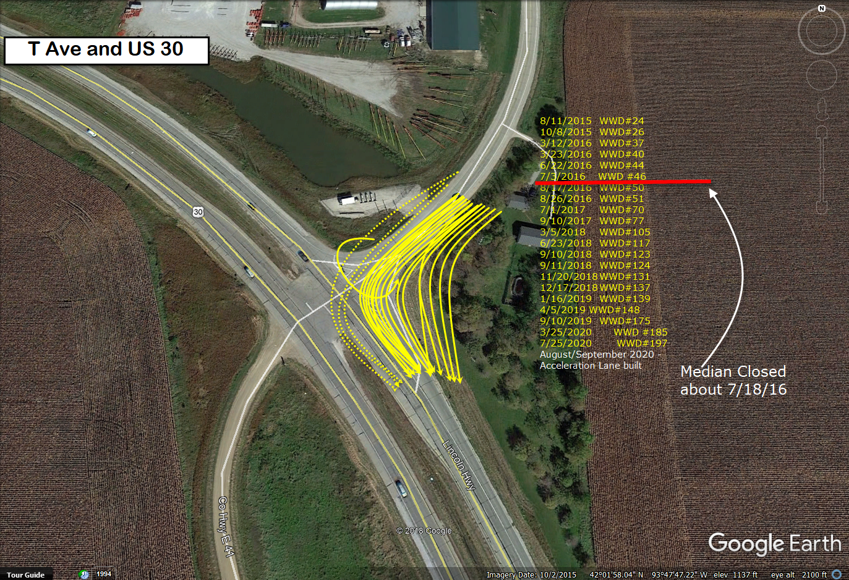
Added an Acceleration Lane

Slide 18
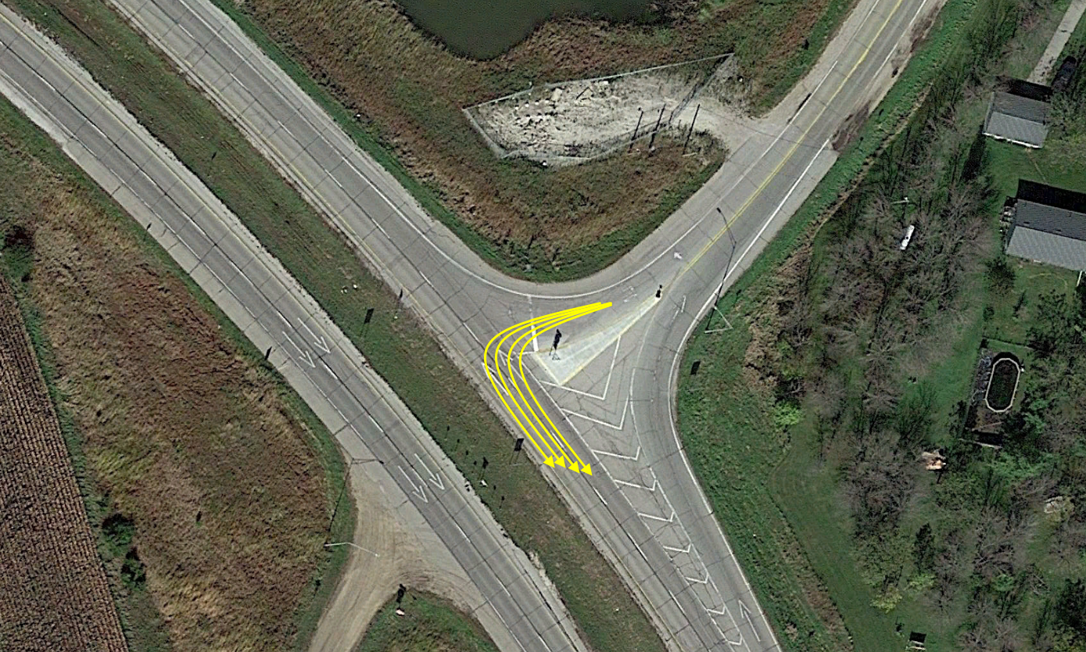
Closed Median – Added Signs and WWA

Slide 19
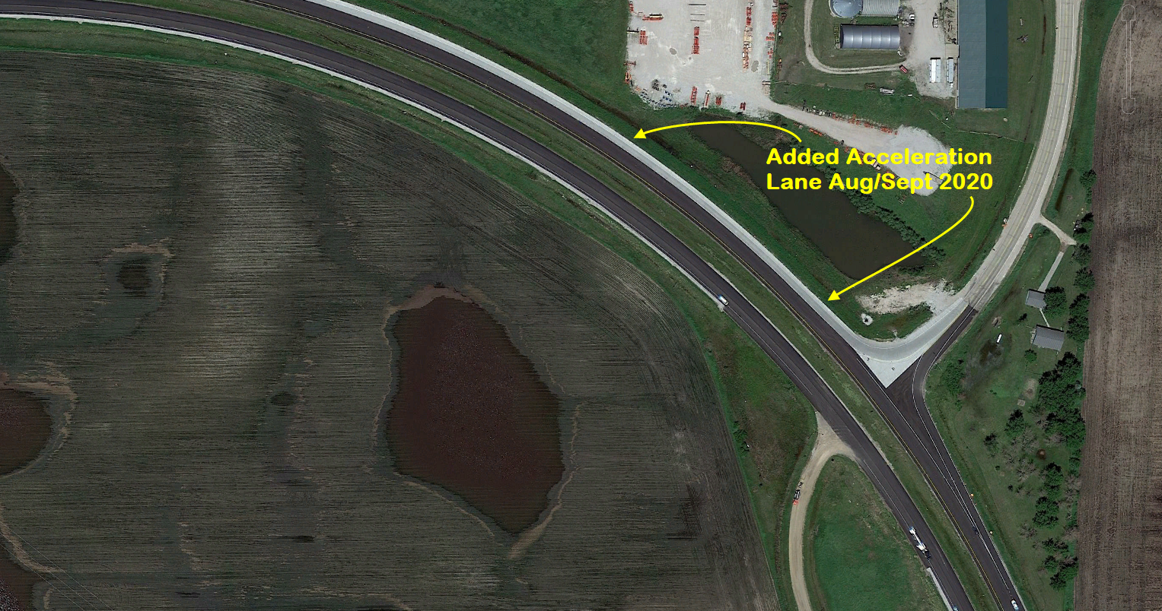

Slide 20
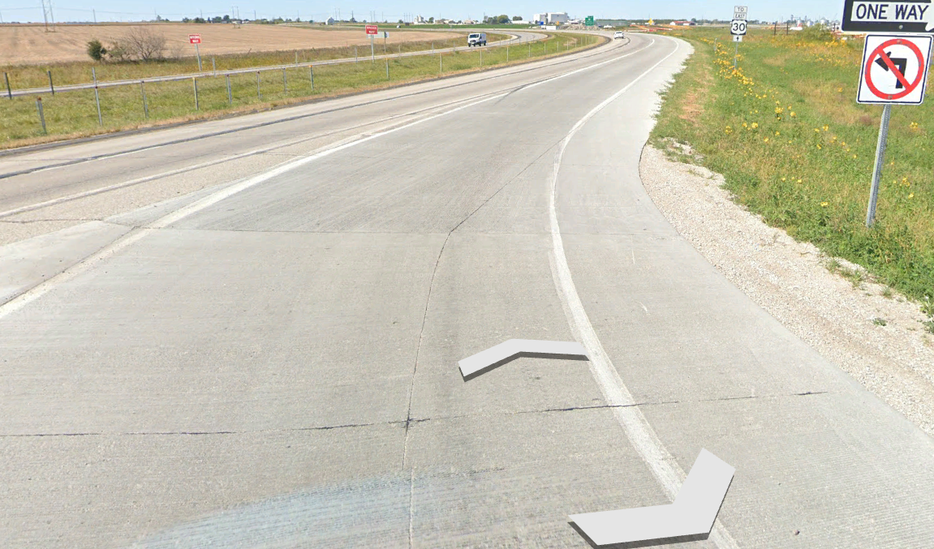
Added Acceleration Lane

Slide 21
Score:
13.5 WWD Events Since we Closed Median on 8/1/16
  4 years (48 months) as of 8/1/20
  0.28 WWD events/month
  (911 or sensor data) (No detection camera)
Acceleration Lane Built Aug/Sep 2020
2.5 WWD Event since Acceleration Lane
  8/1/20 to 4/1/23 (32 months)
  0.08 WWD events/month
  71% decrease

Slide 22
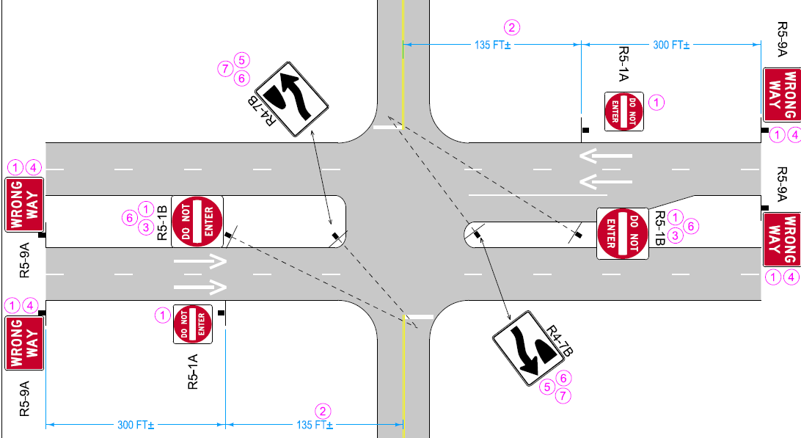
At-Grade Intersection
New Signs/Pavement Markings
Larger Signs
Strategically placed & aimed
New
New
UAC
Larger
New
New
New
New
Larger
New
UAC
New

Slide 23
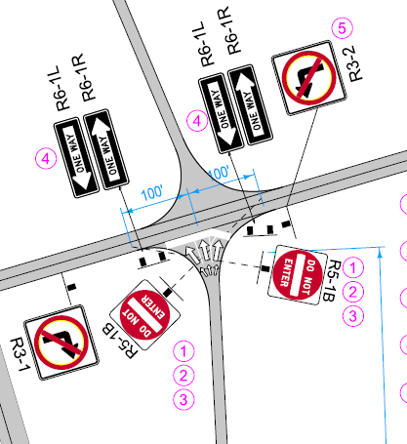
Standard Diamond
Interchange

Slide 24
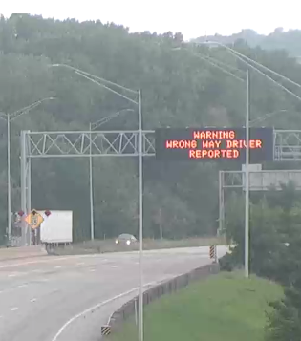
Cedar Rapids & Iowa City
Overhead DMS use
Manually Activated
After a 911 call from Law enforcement
Display for 10 min
All DMS within 10 mile radius
  (Both directions)

Slide 25
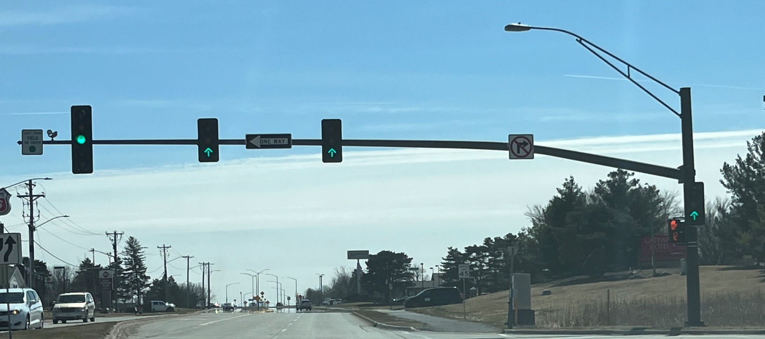
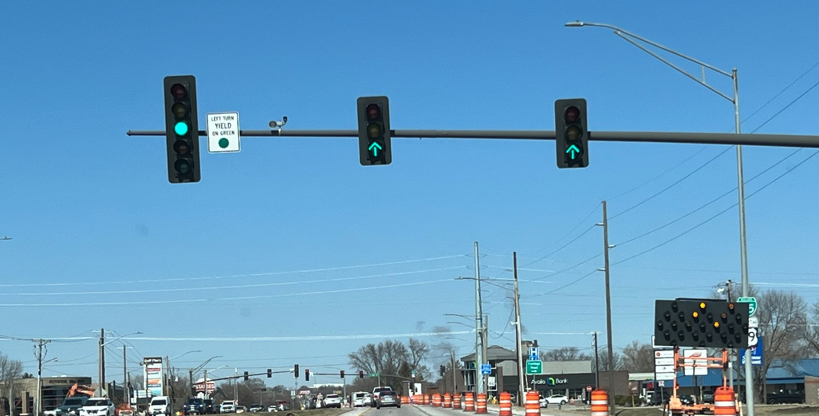
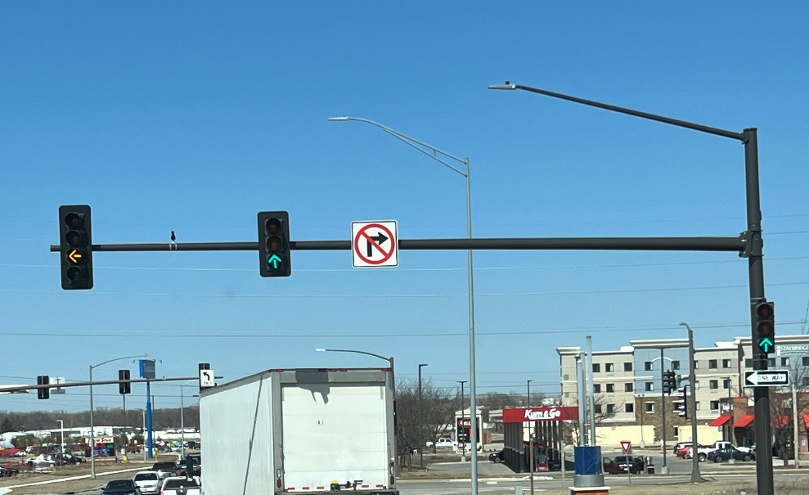
Green Up Arrows 3/16/23
University (SB)
Duff (NB)
Dayton (NB)

Slide 26

Questions?

Slide 27
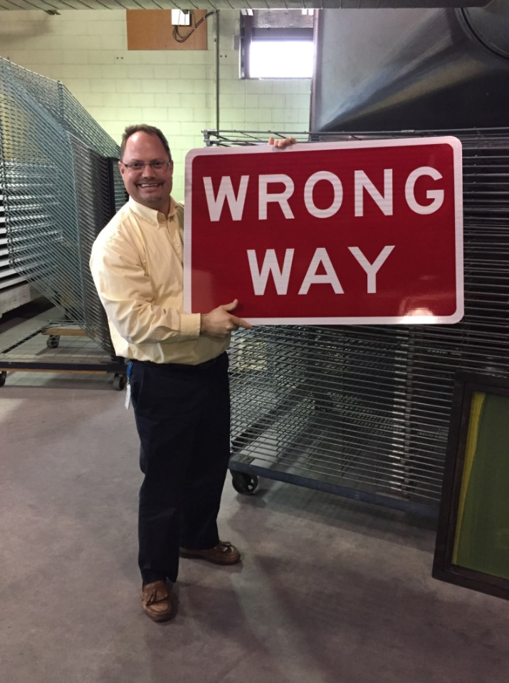
Any WWD Information?
Willy Sorenson, P.E.
Willy.Sorenson@iowadot.us
(515)-669-4628 Cell (99% of getting me)
  Traffic & Safety Engineer
  Traffic & Safety Bureau, Iowa DOT
  800 Lincoln Way, North Annex
  Ames, Iowa 50010
(515)-239-1212 Office (1% chance I’ll answer)

