Slide 1
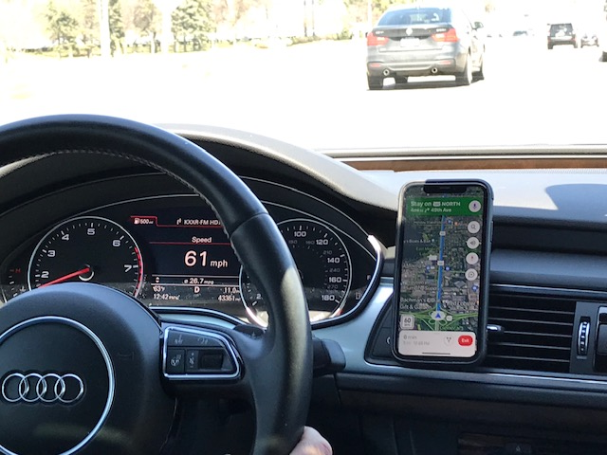
Potential Approaches for
Wrong-Way Driving Applications
E N T E R P R I S E
Project Update
ENTERPRISE Board Meeting - November 2020

Slide 2
Project Purpose
Purpose: To create industry interest in a concept that integrates wrong-way alerts into in-vehicle systems and mobile applications
ENTERPRISE Champions:
Cory Johnson (MnDOT) and Willy Sorenson (Iowa DOT)
Project Budget: $21,500

Slide 3
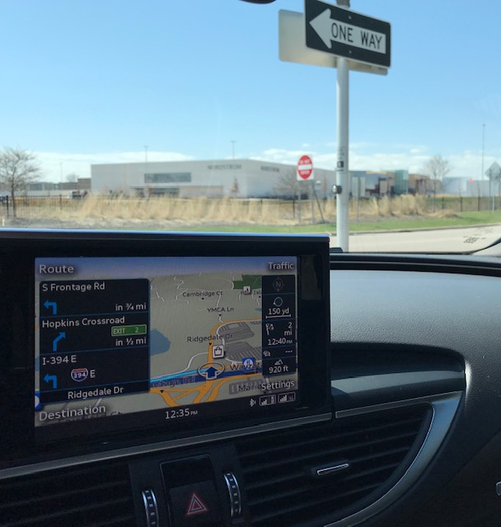
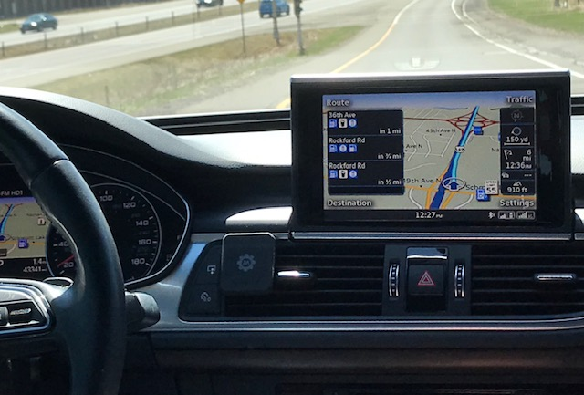
CONCEPT: In-Vehicle Systems

Slide 4
CONCEPT: In-Vehicle Systems
Detect Wrong-Way Movement =>>
Based on vehicle movement and map data
Alert Driver =>>
So driver may self-correct before a crash occurs

Slide 5
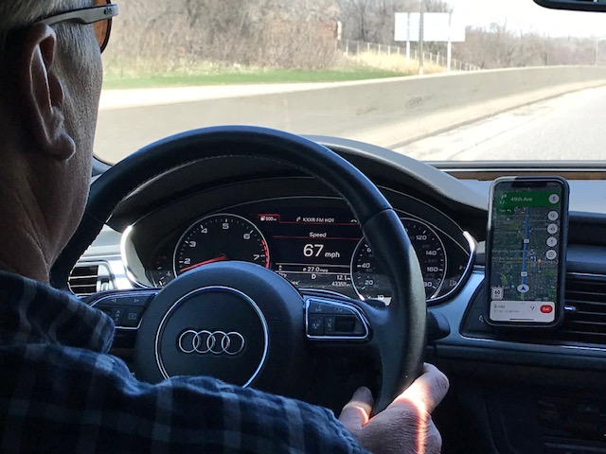
CONCEPT: Mobile Applications (e.g. Google Maps, WAZE, etc.)

Slide 6
Tasks
Task 1: Summarize Wrong-Way Driving Issues and Challenges
Created outreach materials – overview document, presentation
Task 2: Describe Concept for Wrong-Way Driving Applications
Created outreach materials – overview document, presentation
Supporting outreach: virtual meetings with industry contacts, documenting outcomes
Task 3: Technical Memorandum
Summarize project activities: outreach, outcomes, lessons learned
Not a typical research report

Slide 7
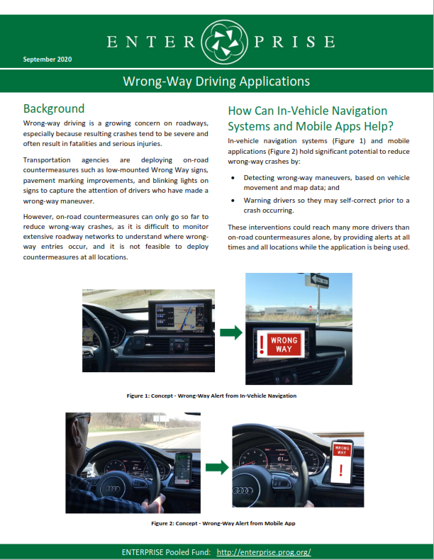
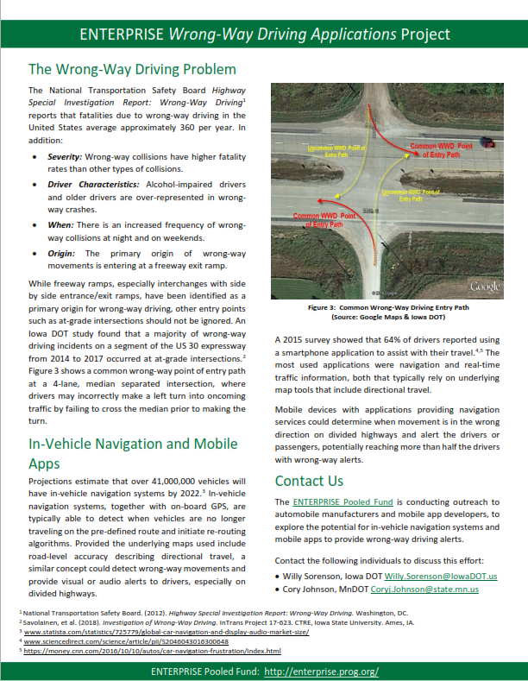
Outreach Document
Posted at ENTERPRISE Website:
Potential for WWD Applications

Slide 8
Presentations and Meetings to Date
Presentations Completed:
Event | Date | Presented by | Follow-Up or Outcomes
2020 SAE International World Congress (WCX Digital Summit) ftp://165.206.203.34/TASUtilityCoordinationPlans/Willys%20Misc%20FTP%20Folder/Wrong%20Way%20Driving%20Presentations/For%20SAE%202020%20Conference/ | June 2020 | Willy Sorenson | Dave McNamara from Brandmotion contacted Willy to request a meeting
CAT Coalition: IOO/OEM Connected Automation Work Monthly Webinar | July 22, 2020 | Willy Sorenson | N/A – Information-sharing presentation, with limited time for discussion.
Industry Meetings Completed:
Company | Meeting Date | Point of Contact
Brandmotion | 6/18/20 | Dave McNamara - Manager, Business Development dmcnamara@brandmotion.com
General Motors | 9/30/20 | Dave Craig - Chief of Maps david.craig@gm.com
CēVē | 10/9/20 | Kris Milster, Transportation Lead kris@ceve.io
Reported on this at July Board Meeting

Slide 9
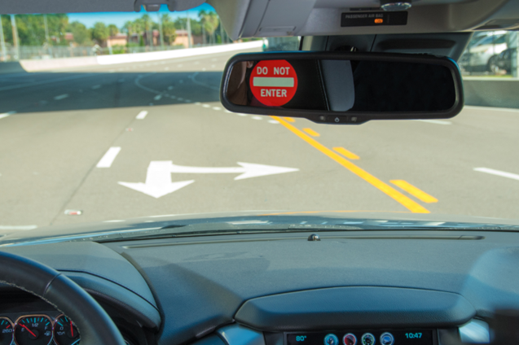
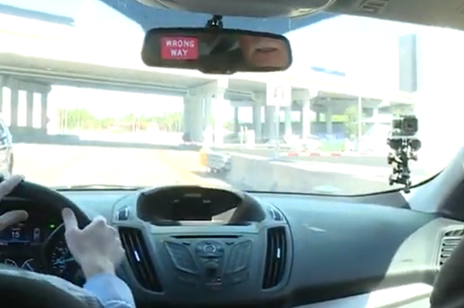
Brandmotion – Tampa CV Pilot
Brandmotion in-vehicle mirror
After-market device
Provides in-vehicle signs and alerts to wrong-way drivers
Alerts to oncoming right-way traffic
Alerts to the TMC
Uses Connected Vehicle technology - requires infrastructure (RSUs)
Photos/videos: https://www.tampacvpilot.com/

Slide 10
Recent Industry Interaction: General Motors
Meeting with Dave Craig, Chief of Maps, General Motors (GM)
In-vehicle navigation/mapping systems
Currently in 30-40% of vehicles
Expected to decline, customers prefer to plug cell phones into infotainment system for route guidance.
Advanced Drivers Assist System (ADAS) Maps needed for wrong-way detection
Layer beneath infotainment map, has heading and curvature. ADAS could be used to determine if vehicle direction of travel matches the road segment direction – for WWD detections.
ADAS maps can be integrated into vehicles even if they are not equipped with navigation; contributes to multiple safety applications.
Potential supplement to mapping-based WW detection
Front-facing camara in the vehicle could detect Wrong Way signs or Do Not Enter signs, providing a confirmation (second source) to supplement map detection and increase confidence in notifications.
This would rely on real-time connectivity and current sign configurations.
Outcome: Dave will share this ENTERPRISE concept/idea with GM Strategy team to generate interest, internal discussion, and potential for production in GM vehicles.

Slide 11
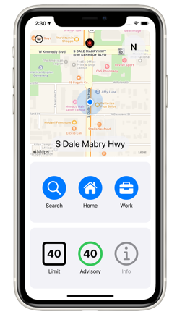
Recent Industry Interaction: CēVē
Meeting with Kris Milster and David Aylesworth, CēVē
CēVē Mobile App:
Provides time to green light estimates, optimal speed advisories, exceeding speed limit, alerts for school zones and high-capacity events.
Does not currently provide route guidance currently
CēVē app can be in the background and used with other apps (e.g. Waze)
Currently available for Apple devices:
Officially supports select cities in Florida and northern Virginia
Android release of CēVē app estimated for Q1 of 2021
Uses open source mapping data
https://www.ceve.io/

Slide 12
Recent Industry Interaction: CēVē
Feasibility
Digital wrong-way detection is possible
GPS accuracy (3m) is good enough for median or barrier-separated roadways
CēVē Concept for WWD Detection
WWD heading compared with SAE J2735 MAP message at intersections
WWD is confirmed, warning is created and sent to wrong-way driver (and others)
No roadside units necessary; CēVē app obtains MAP messages (selected intersections) from other sources
Outcome:
CēVē proposed a small pilot/proof of concept of WWD feature in the CēVē beta app. Will work with Iowa DOT using corridor(s) in Iowa.
Notes:
CēVē noted this information could be valuable to mapping providers, could have some market value from CeVe’s business perspective.

Slide 13
Other Potential Interactions (In-Progress)
Tesla
Contacted Tesla through Customer Service chat box
ENTERPRISE WWD Applications overview white paper sent via email
Toyota Connected – contact in progress
Waze – contact in progress
Auto Manufacturers/ Mobile App Developers
Other
Kardos & Associates LLC / Continental
Contacted ENTERPRISE with initial interest, follow-up in process
FHWA Safety Team
Pitch concept of a nationwide WWD XML feed, similar to Work Zone Data Exchange (WZDx) concept
When WWD information is received by 911 or TMC, Post information (WWD* Lat*, Long*, initial time*, Heading? Route? vehicle description? Remarks?) for 10 minutes
3rd party apps/auto manufactures could receive & post to their apps/vehicles during 10 min period

Slide 14
Tesla’s Full Self Driving as of (11/6/20) – Stop Sign

Slide 15
Tesla’s Full Self Driving as of (11/6/20) – Traffic Signal

Slide 16
Tesla’s FSD as of (11/6/20) Approaching Traffic Signal

Slide 17
Planned Outreach
2021 SAE World Congress
Abstract accepted for podium presentation - Willy Sorenson
April 2021: Will be a Virtual Event (again)

Slide 18
Questions or Comments?

