Slide 1
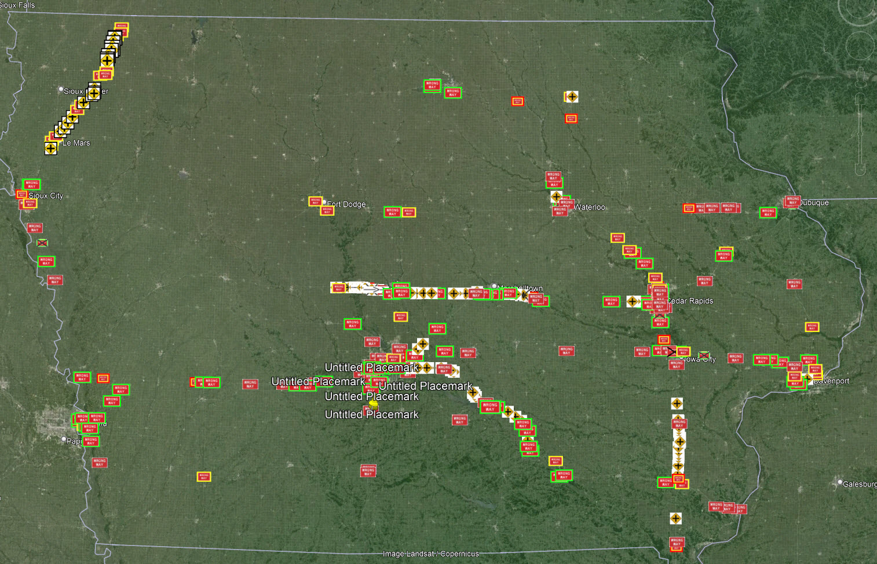
Network Screening for Wrong Way Driving
How we did it & How we did
Willy Sorenson, P.E.
Special Projects Engineer
March 27, 2024
3/2/2023

Slide 2
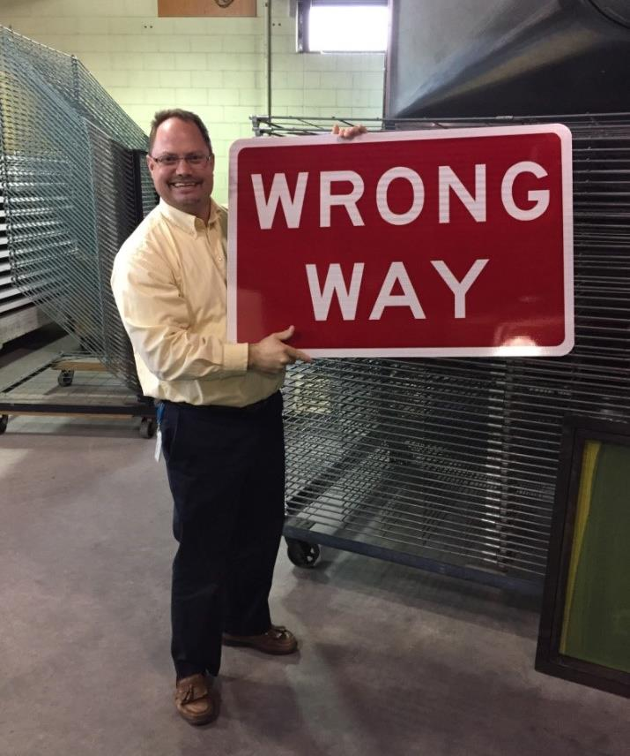
Agenda
Network Screening
How we ranked 472 Interchanges
What we did
Brief overview of our Signing and Pavement Markings layouts
How we measured success/failure
Installed wrong way detection 62 cameras
How we did after 2 ½ years
A before/after overview of WWD events and crash history
Additional Treatments
When initial treatments needed more
What to take notes on and tell your boss
2 low-cost treatments that showed very good success
3 other low-cost treatments that showed promise (just need more time)

Slide 3
After collection WWD Data for 10 years with $0 budget…
We got $1.5 Million of Safety funding (HSIP)
Choice:
340 locations enhanced signing & pavement markings
OR
15 locations Full ITS camera detection and LED Blinking signs
We went with Systemic approach
(Enhanced Signing & Pavement Markings)

Slide 4
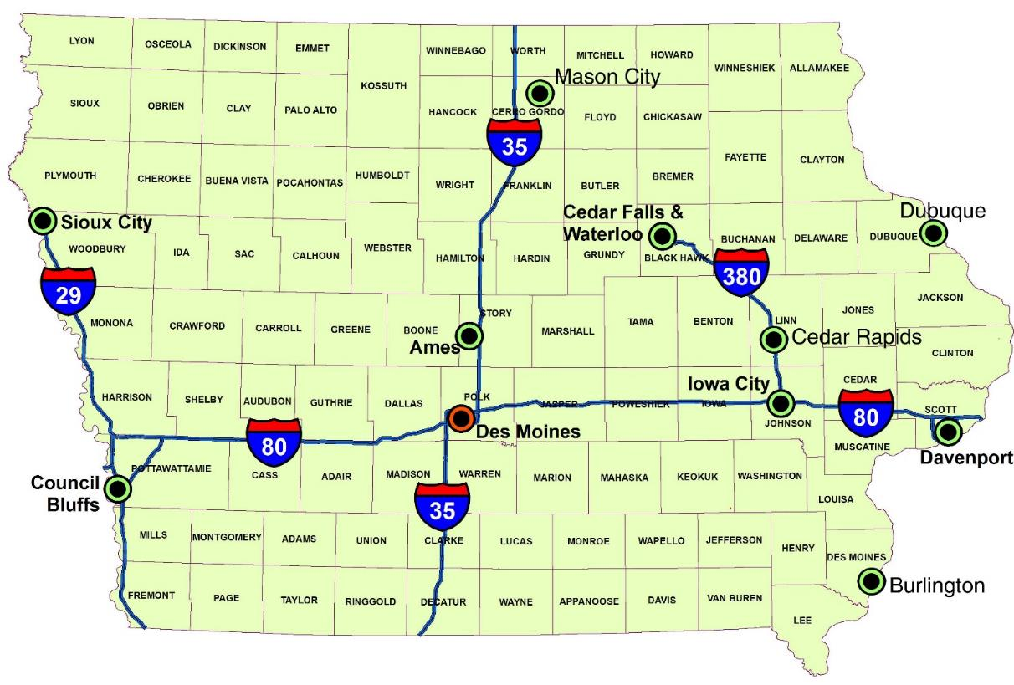
User Note: Click the image icon to add your image
DELETE THIS BOX WHEN FINISHED
Network Screening
?
Where to Spend?

Slide 5
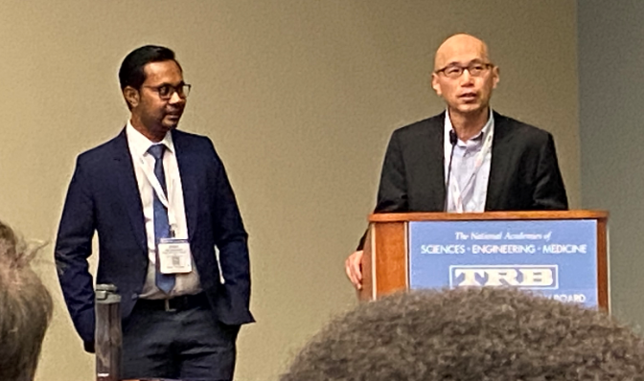
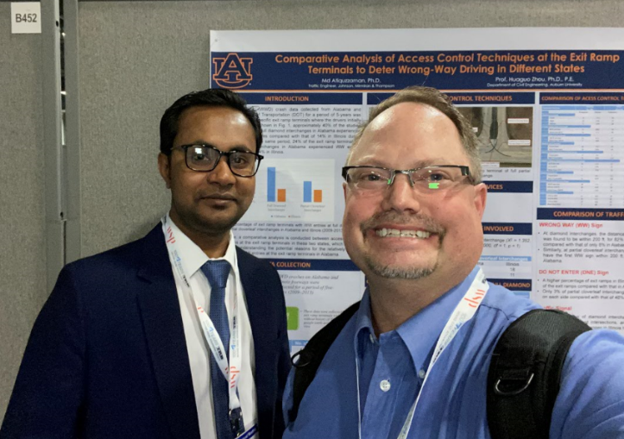
Use our Study!
By Dr. Huaguo Zhou & Md Atiquzzaman
Auburn University
Based on Risk Factors
https://journals.sagepub.com/doi/pdf/10.1177/0361198118783152

Slide 6
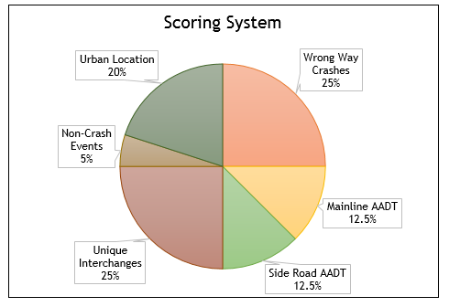
Iowa’s Modifications
WWD Crash History
Traffic Volumes
(Mainline and Sideroad)
Interchange Geometry
Proximity to Liquor License
(Urban/Rural)
Non-crash WWD Reports

Slide 7
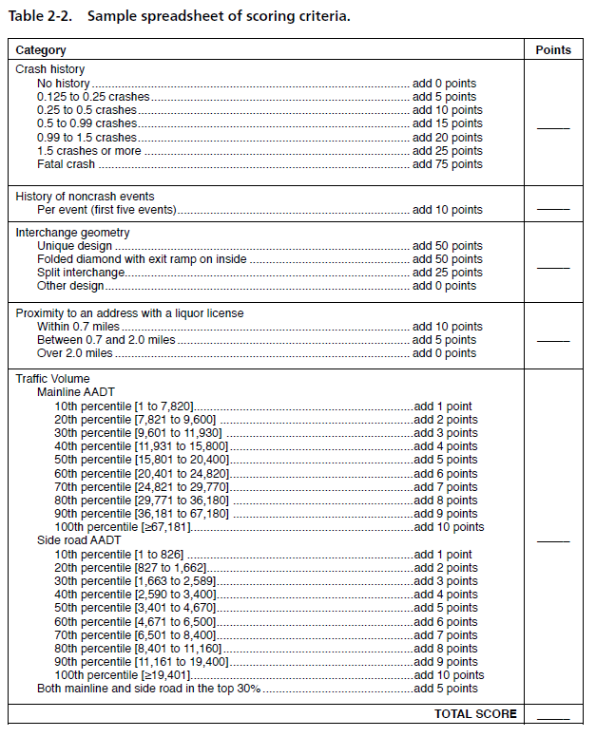
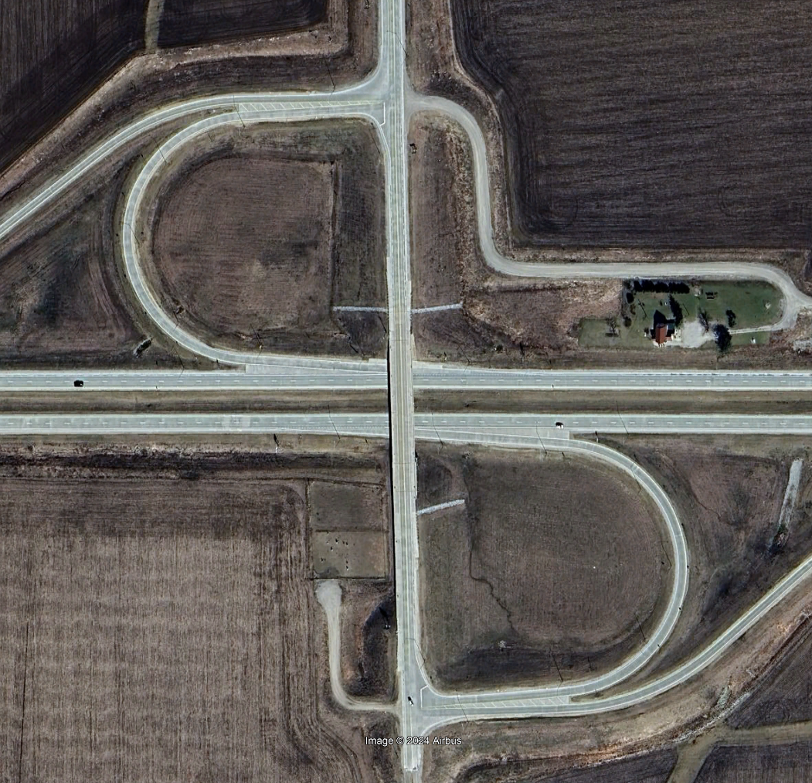
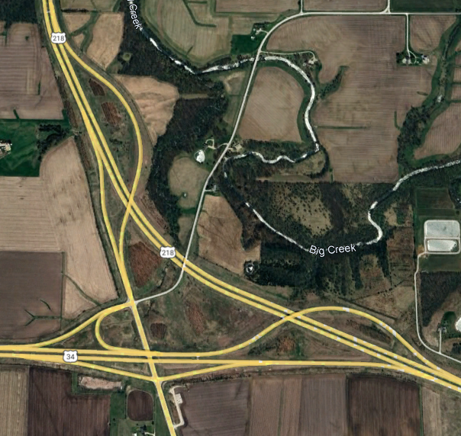
Scoring Process
Pages 17 – 20 of the Handbook
Geometry example
Folded Diamond (Parclo) & ‘Unique’ get 50 points

Slide 8
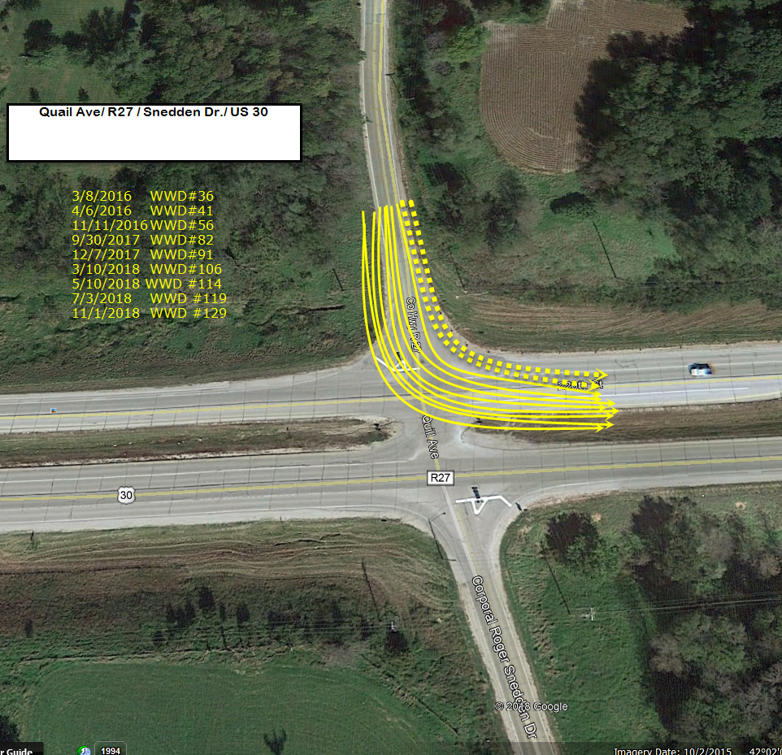
Don’t Forget about At-Grade Intersections
Expressways
This Point of Entry is more common than you think!
About 99.5% of At-Grade WWD start by “Turning Short” (Left)
About 0.5% start by “Turning Long” and Right

Slide 9
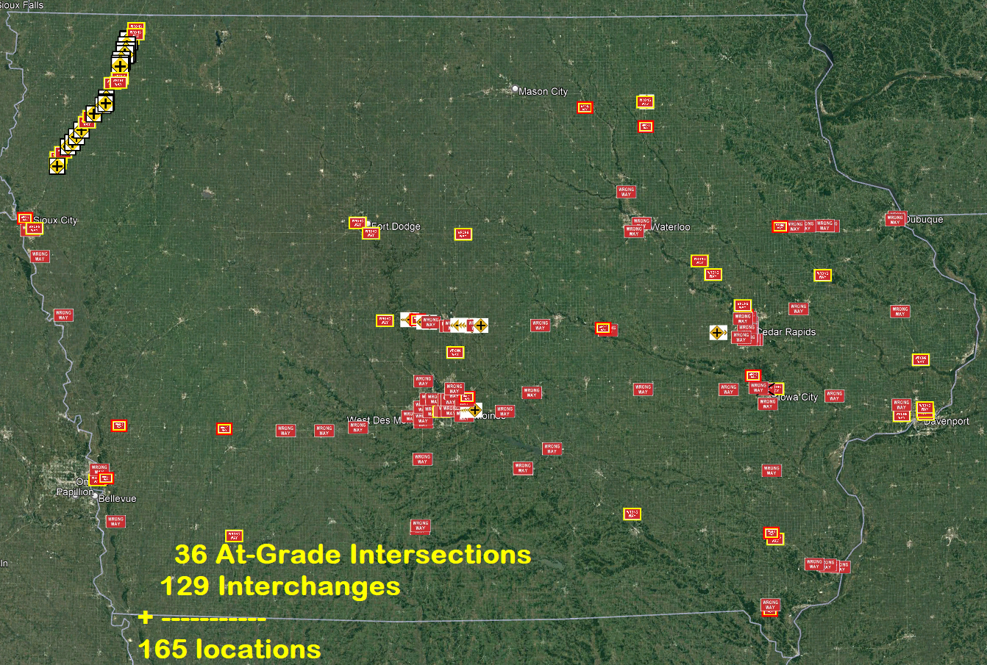
Locations have been set

Slide 10
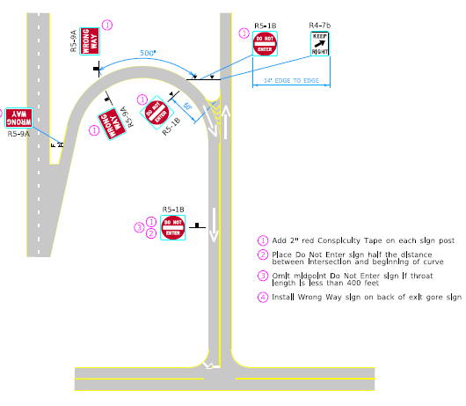
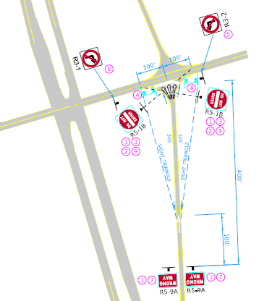
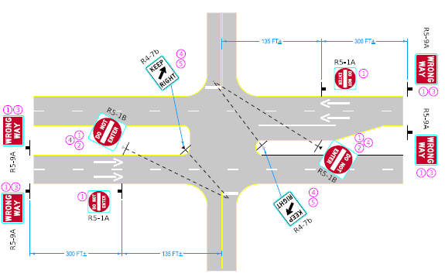
General Signing
Philosophy
Signs:
Placement
Angle
Size
Pavement Markings:
Wrong Way Arrows
Edge Line Extensions

Slide 11
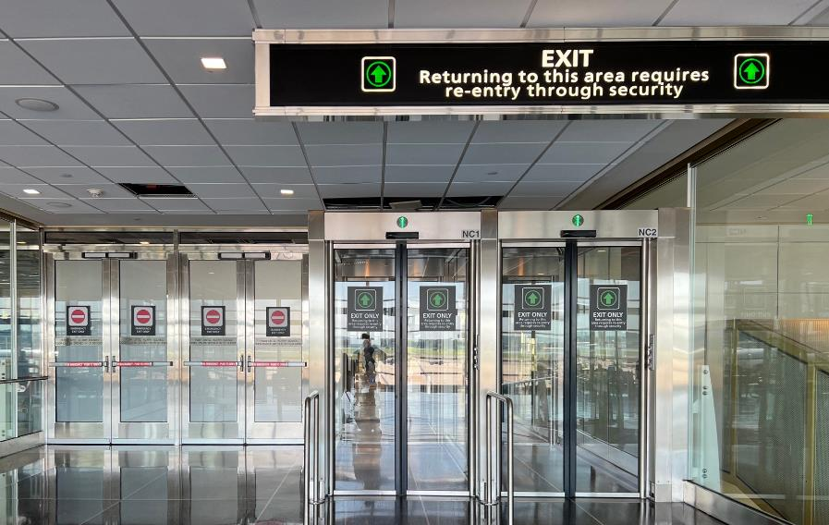
Parclo Interchange
Create a “Gateway”
Provide “Positive Guidance” also
We tend only to give negative guidance
…and assume drivers will figure it out
Double up important signs
Upsize to 48”x48”
(Do Not Enters)

Slide 12
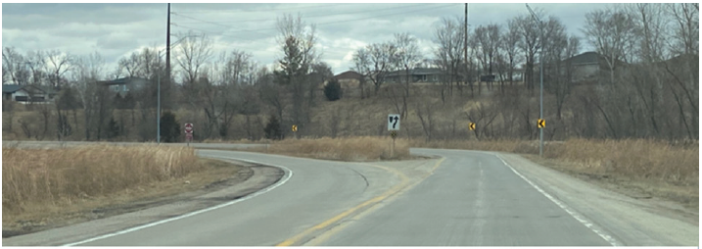
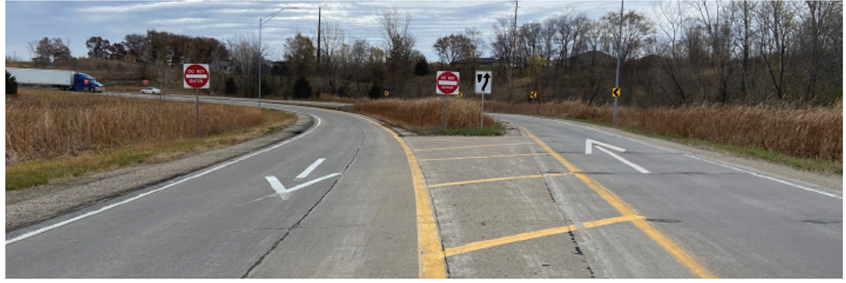
Before
After
After part 2

Slide 13
Diamond Interchange
Who do you want to see the signs?
Set them back from Stop Line
Angle to the approaching Traffic
Upsize to 48”x48” (Do Not Enters)
No Right Turn 36”x36”

Slide 14
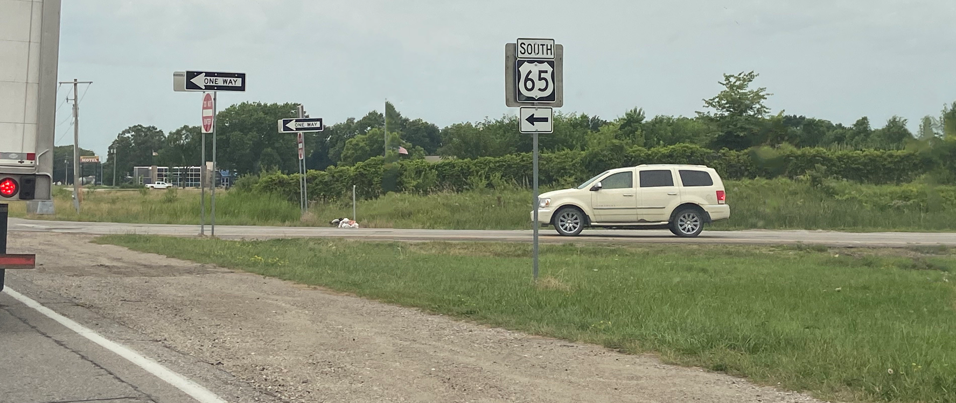
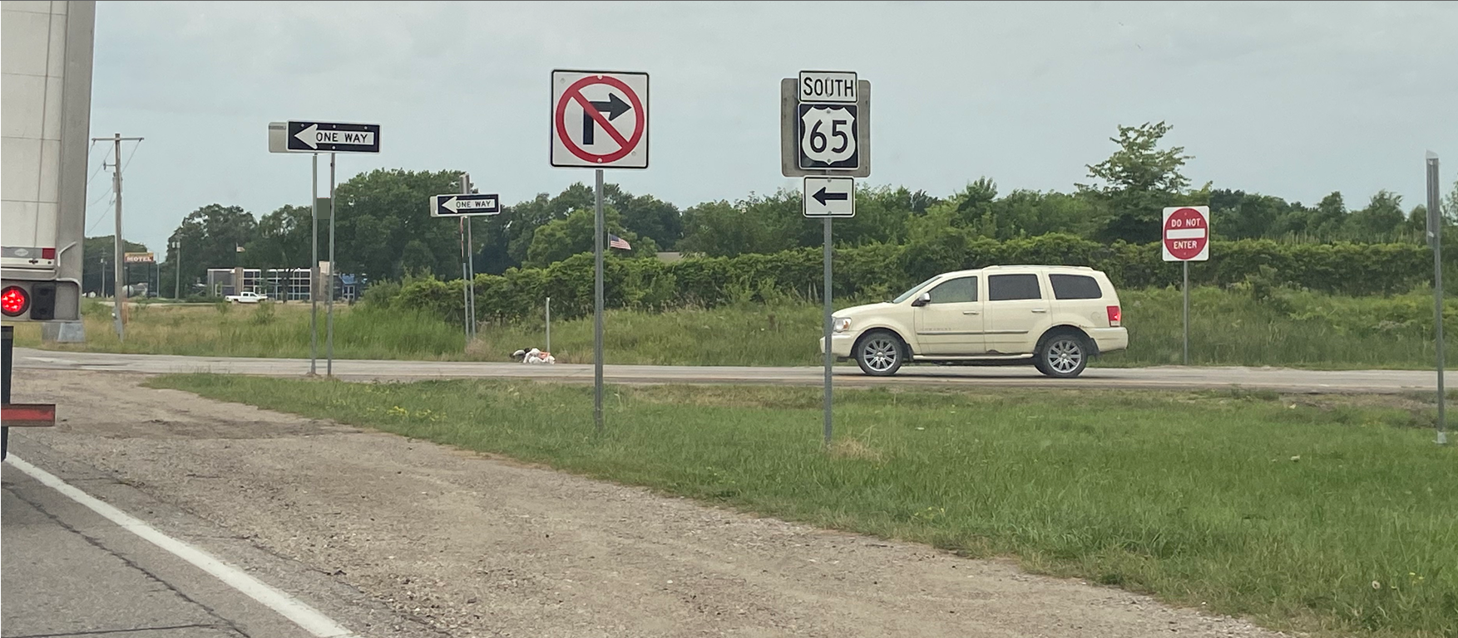
Diamond Interchange
Who do you want to see the signs?
Set them back from Stop Line
Angle to the approaching Traffic
Upsize to 48”x48”
(Do Not Enters)
No Right Turn 36”x36”

Slide 15
At-Grade
Intersections
Positioned & Angled the “Keep Right”
Converting to Text Version of “Keep Right”
Angle Do Not Enter to the approaching Traffic
Upsize to 48”x48” (Do Not Enters)
Added Wrong Way Signs
Added Wrong Way Arrows
Updated from image on page 67 / 153 of Handbook

Slide 16
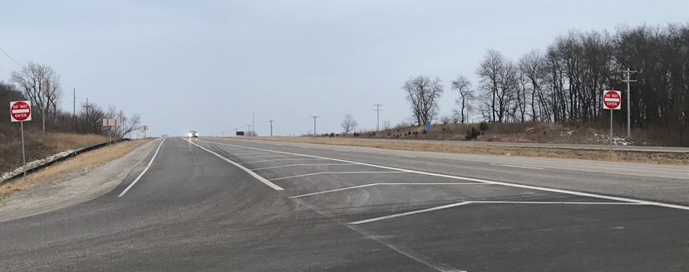
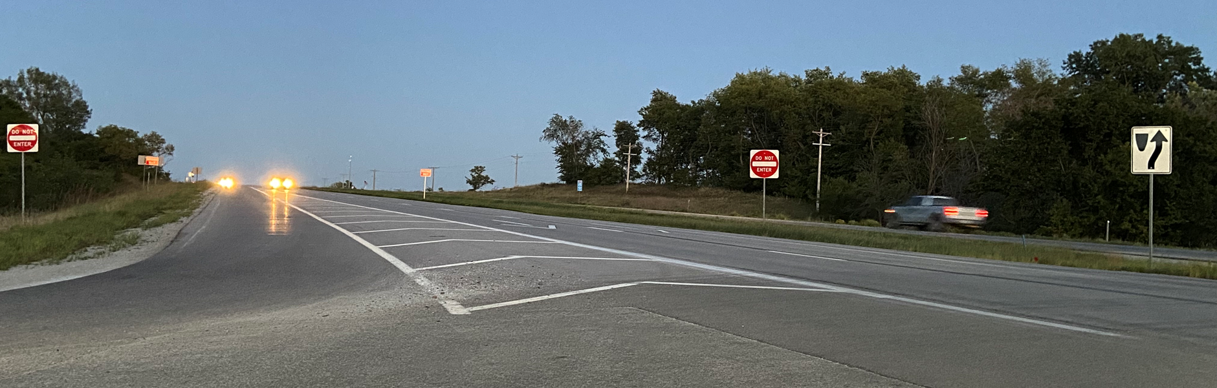
Before
After
After w/ Text Version

Slide 17
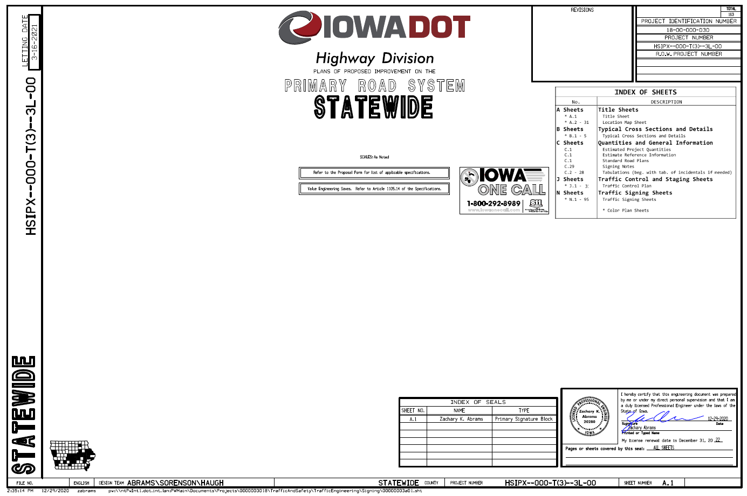
Locations have been set
Plans Created

Slide 18
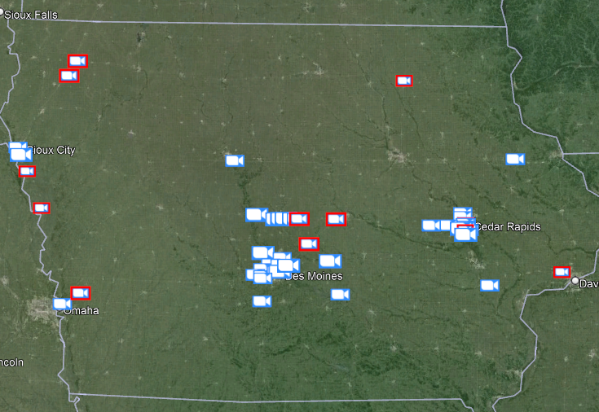
How we Measured
Success or Failures using:
62 WWD Detection Cameras
WWD Crash Reports

Slide 19
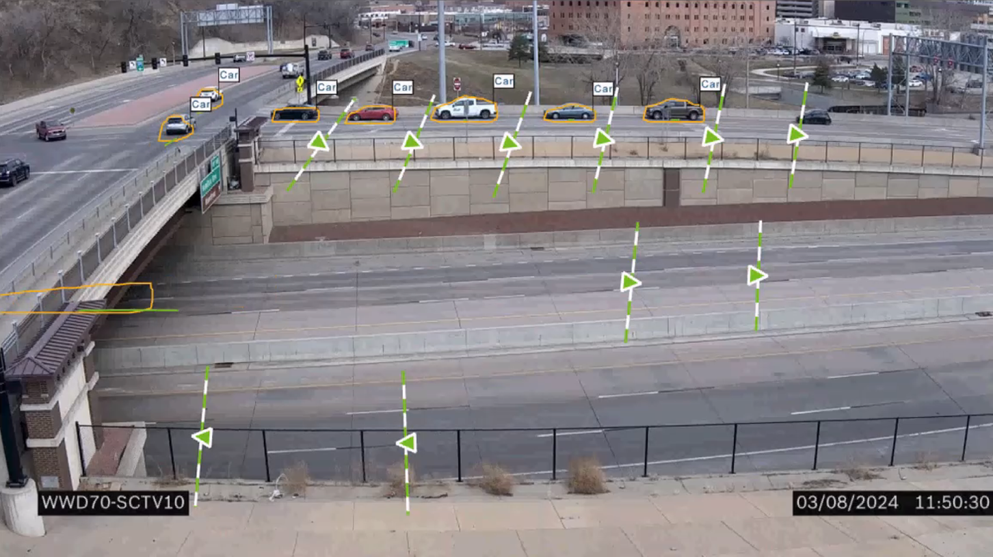
Zone 4
Zone 3
Zone 2
Zone 1
Zone 5
Zone 6

Slide 20
User Note: This slide is for a full screen image, with no words. To insert your own image, right-click on this image, and select Change Picture > This Device…
DELETE THIS BOX WHEN FINISHED

Slide 21
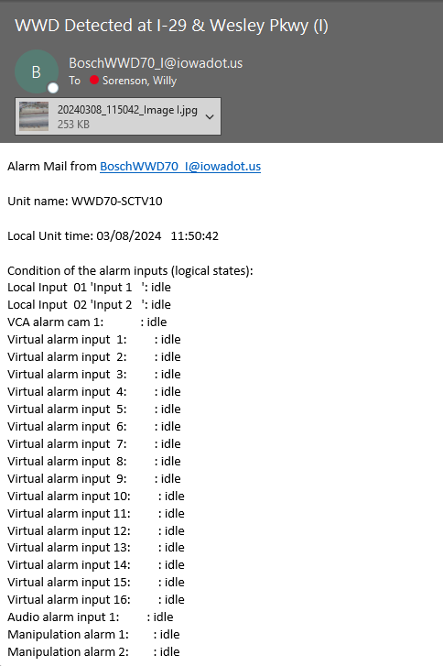
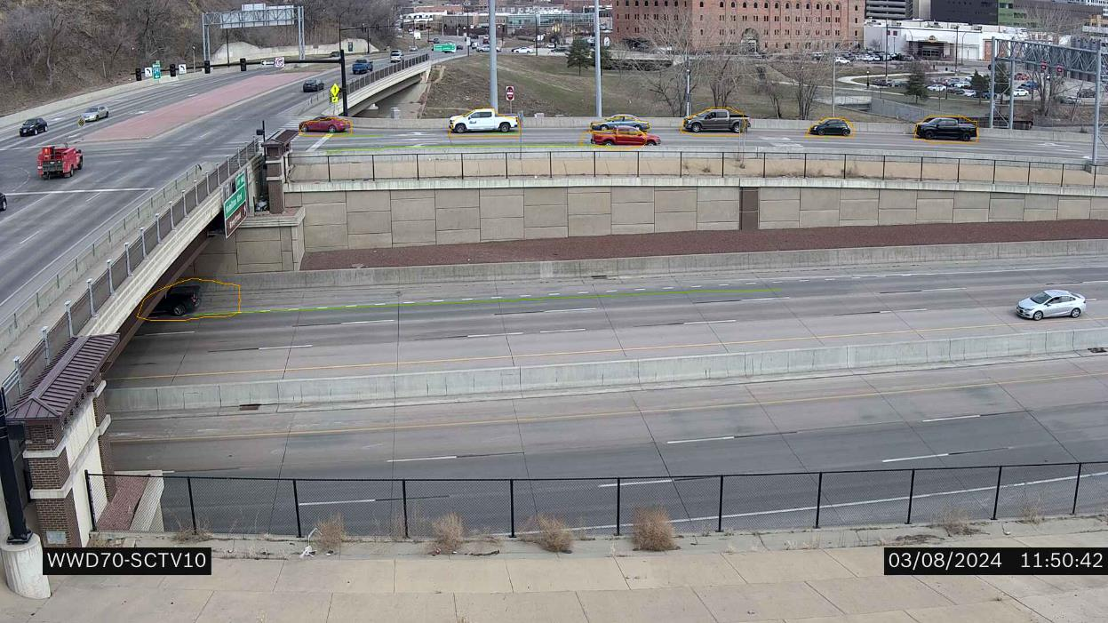
4 e-mails show up within seconds

Slide 22
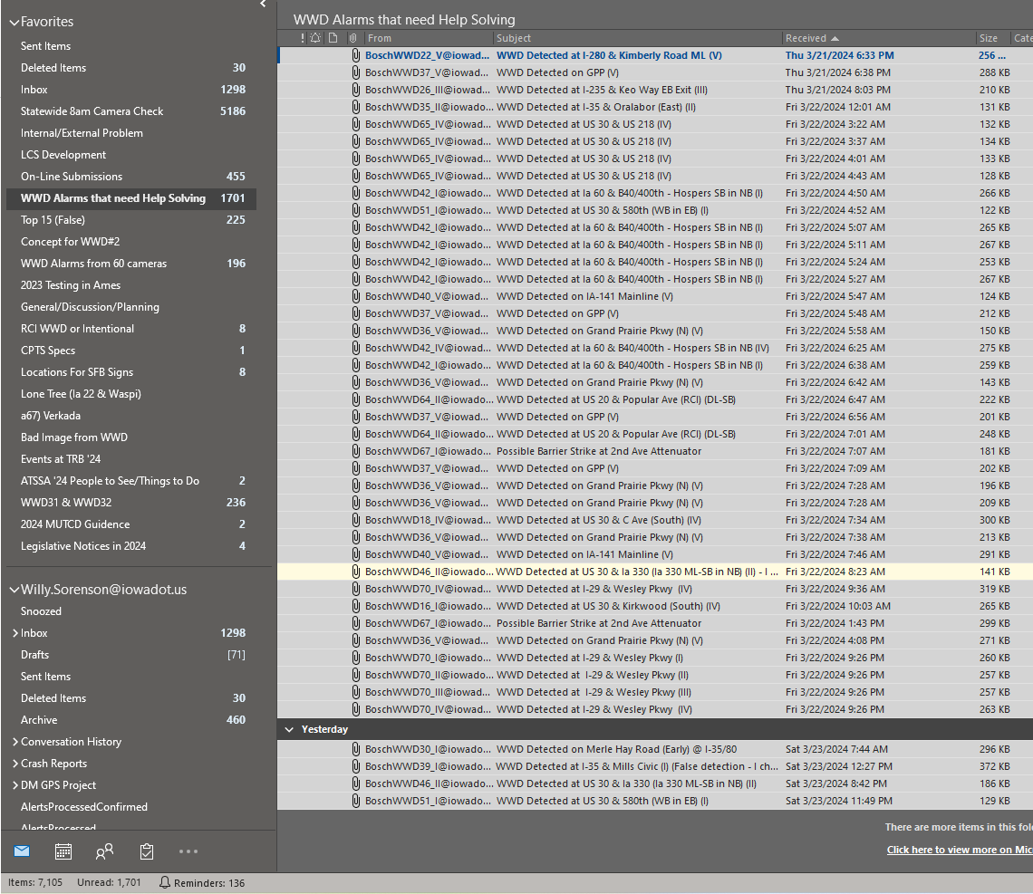
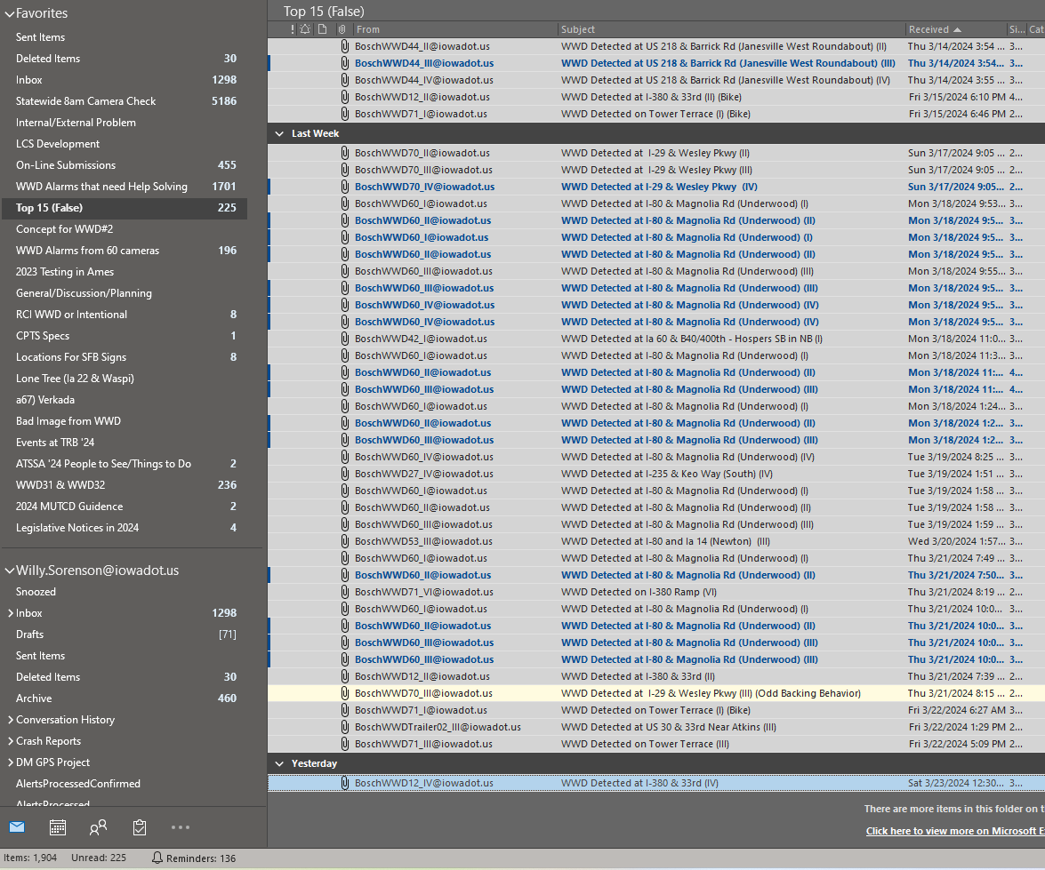
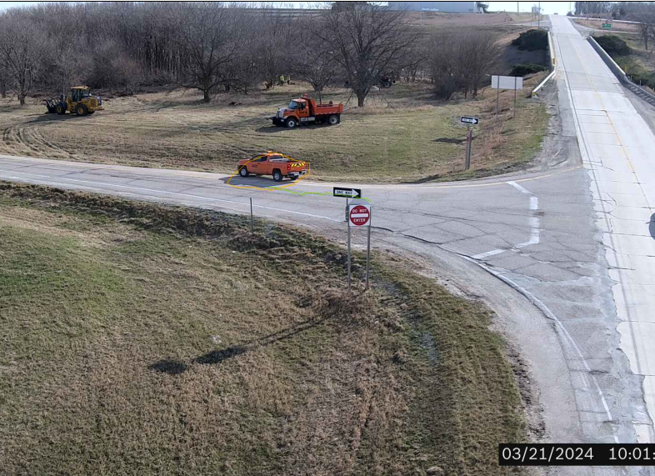
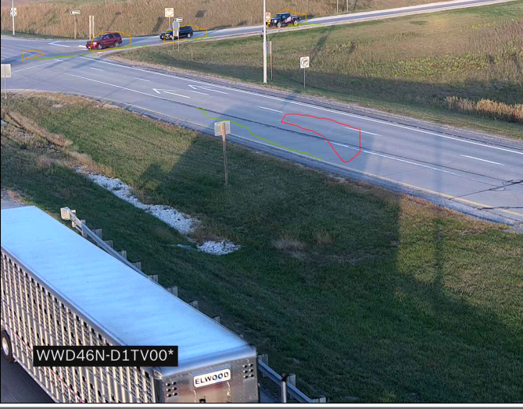
Too Many False Calls to Dispatch 911
(From these 3 year old cameras/firmware & position)
Shadows, Clouds, Reflections, Headlight blooming, etc.
Maintenance vehicles, mowers, tow trucks, law enforcement, helpful neighbors, etc.
7,105 false calls… in the last 6 months
1,905 false calls… in the last 6 months

Slide 23
Results after 2 ½ years
Camera Data
Deployed 80% in 2021
19.9% more in 2022
Final 0.1% in 2023

Slide 24
Parclo “B” / Folded Diamonds

Slide 25
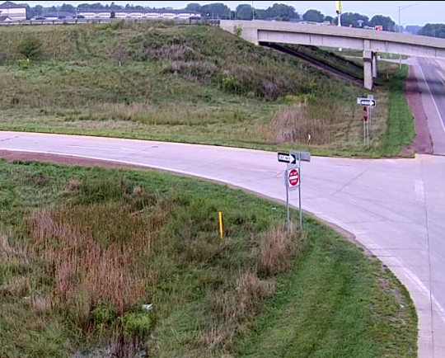
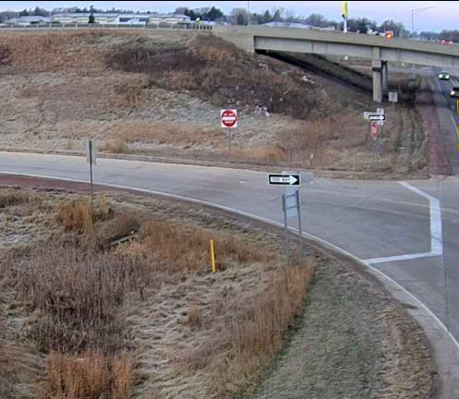
“Before”
“After” Enhanced Signing and Pavement Marking Package
“After” Adding RAMP sign under DNE
Location | WWD/Month | WWD/Month | Reduction | WWD/Month | Reduction Sign | Total
I-29 & Ia 175 | 0.91 | 0.42 | -54% | 0.42 | 0% | -54%
Kept Going | None | 0.17 | Use as baseline | 0.42 | +147% (only 1 WWD and only 2 ½ Months)
I-29 & Singing Hills | 2.31 | 0.91 | -61% | 0.42 | -21% | -82%
Kept Going | None | 0.04 | Use as baseline | None | Decrease/But very small
Ia 60 & US 18 | 3.08 | 2.85 | -7% | 1.71 | -37% | -44%
Kept Going | None | None | None | None | None

Slide 26
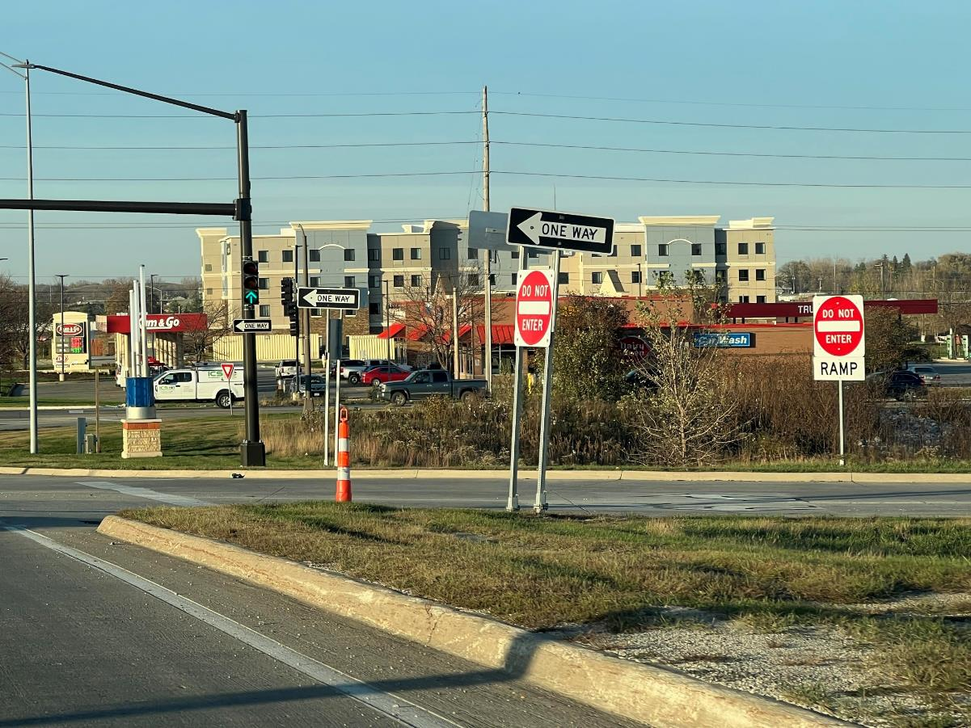
Carefully consider when adding the RAMP Sign.
We only tested in urban areas when an access point to was nearby.
May not want to use in areas where drivers are looking for a ramp entrance.

Slide 27
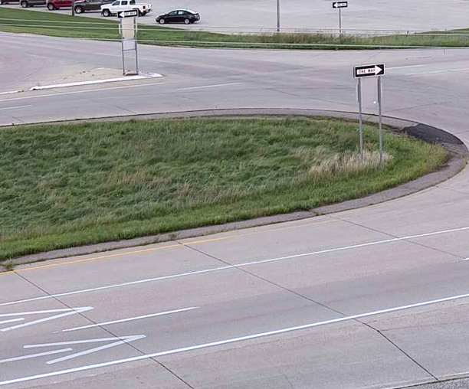
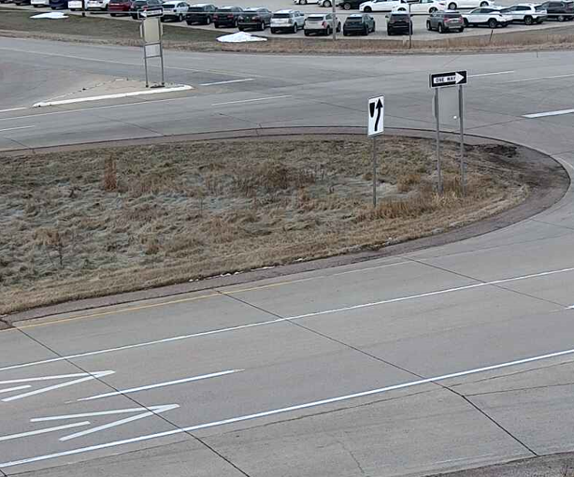
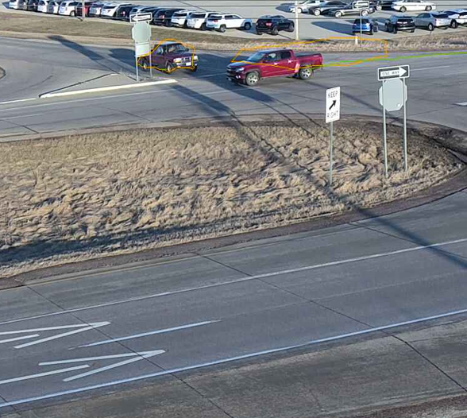
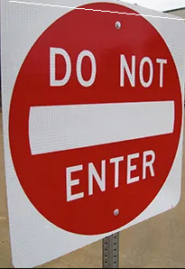
“Before”
“After” Enhanced Signing and Pavement Marking Package
“After” Switching Keep Right Sign from Graphic to Text version
Location | WWD/Month | WWD/Month | Reduction | WWD/Month | Reduction Sign / Total
Ia 60 & 400th | 2.41 | 1.81 | -25% | 0.92 | -37% / -62%
Need more time.
Swapping 10 more locations in 2024

Slide 28
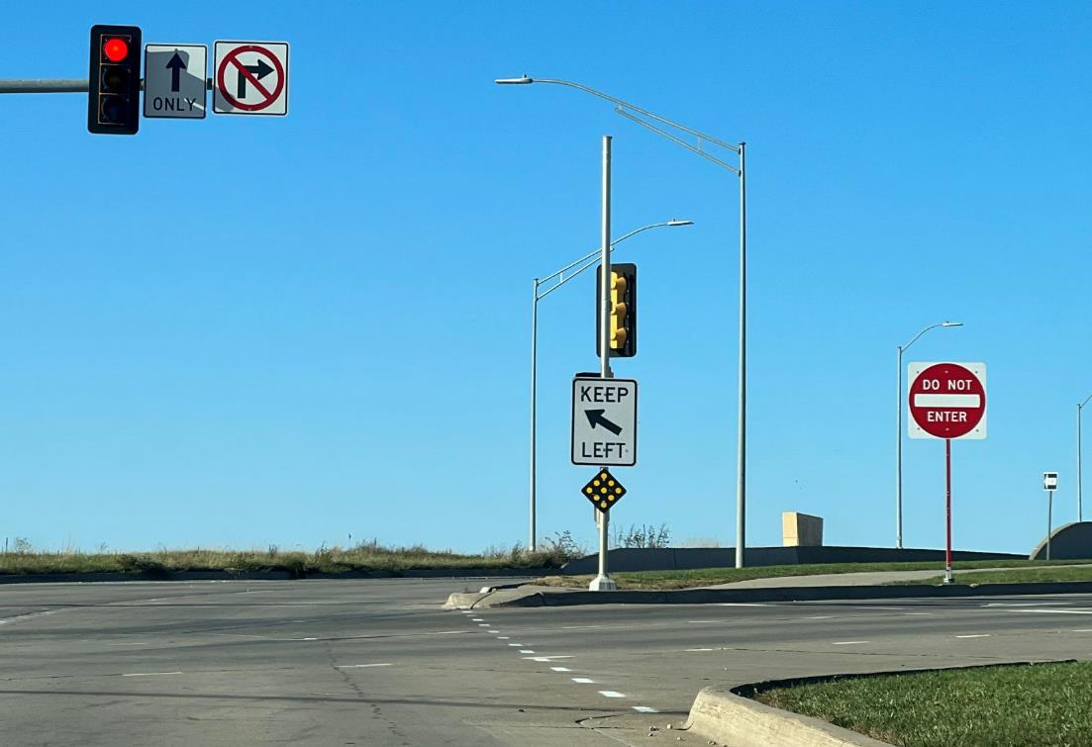
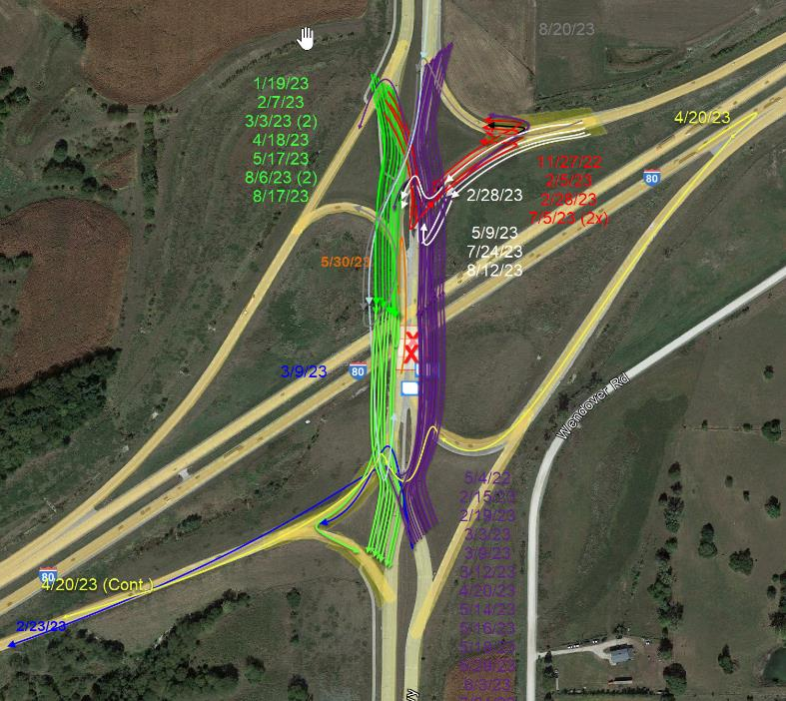
Additional Treatments
Attempted
Diverging Diamond Interchanges
Lane Line Extensions
Add Do Not Enters for Drivers already WWD and last ability to stop them.

Slide 29
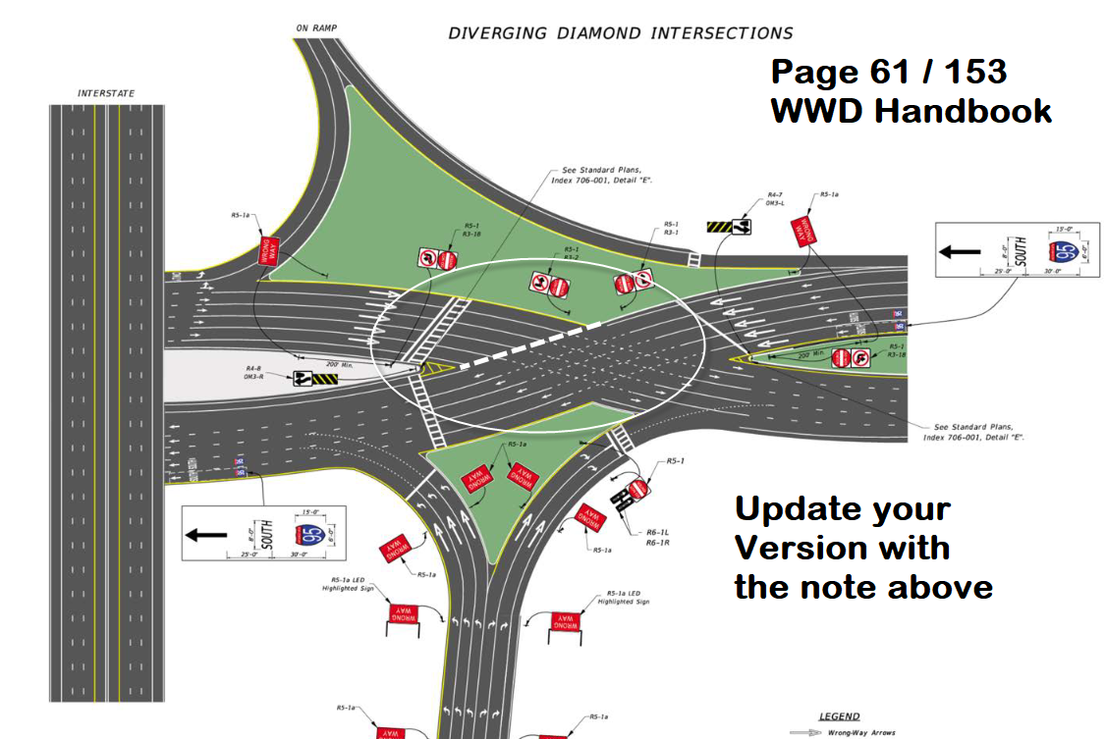

Slide 30
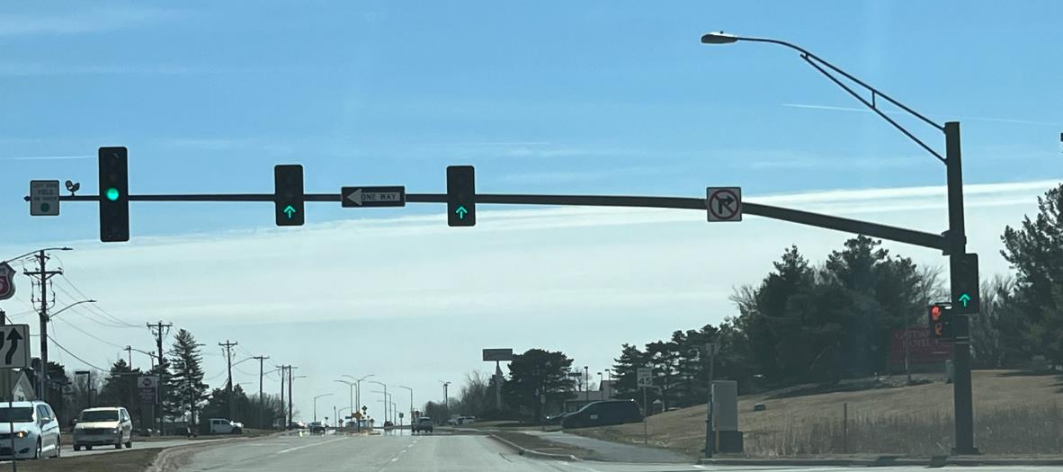
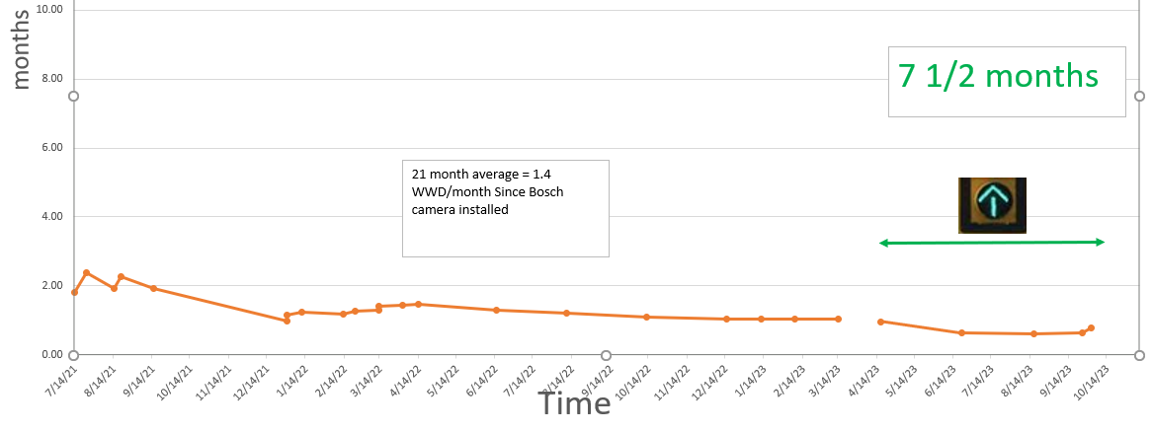
Additional Treatments
Attempted
Green Up Arrows
3 locations
21 months of “Before data”
7 ½ month of “After data”

Slide 31
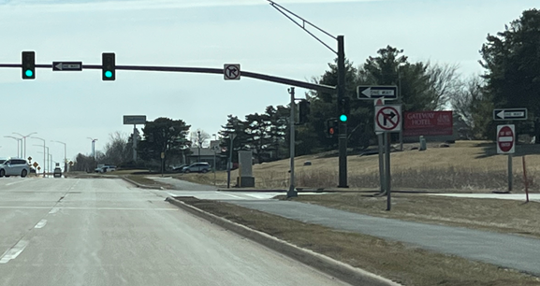
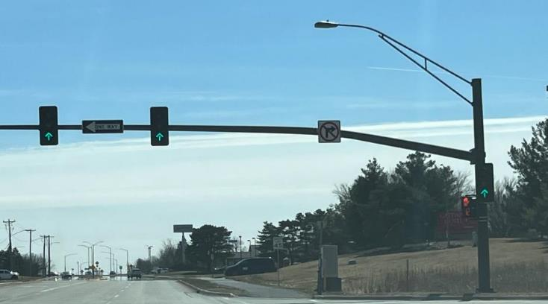
“After” Green Up Arrows
“After” Adding RAMP sign under DNE
“Before”
Location | WWD/Month | WWD/Month | Reduction | WWD/Month | Reduction Sign | Total
US 30 & University | 1.02 | 0.68 | 33% | 0.30 | 37% | 70%
US 30 & Duff Ave | 1.06 | 0.56 | 47% | 0.08 | 39% | 86%
US 30 & Dayton | 1.55 | 1.36 | 12% | 0.40 | 59% | 71%

Slide 32
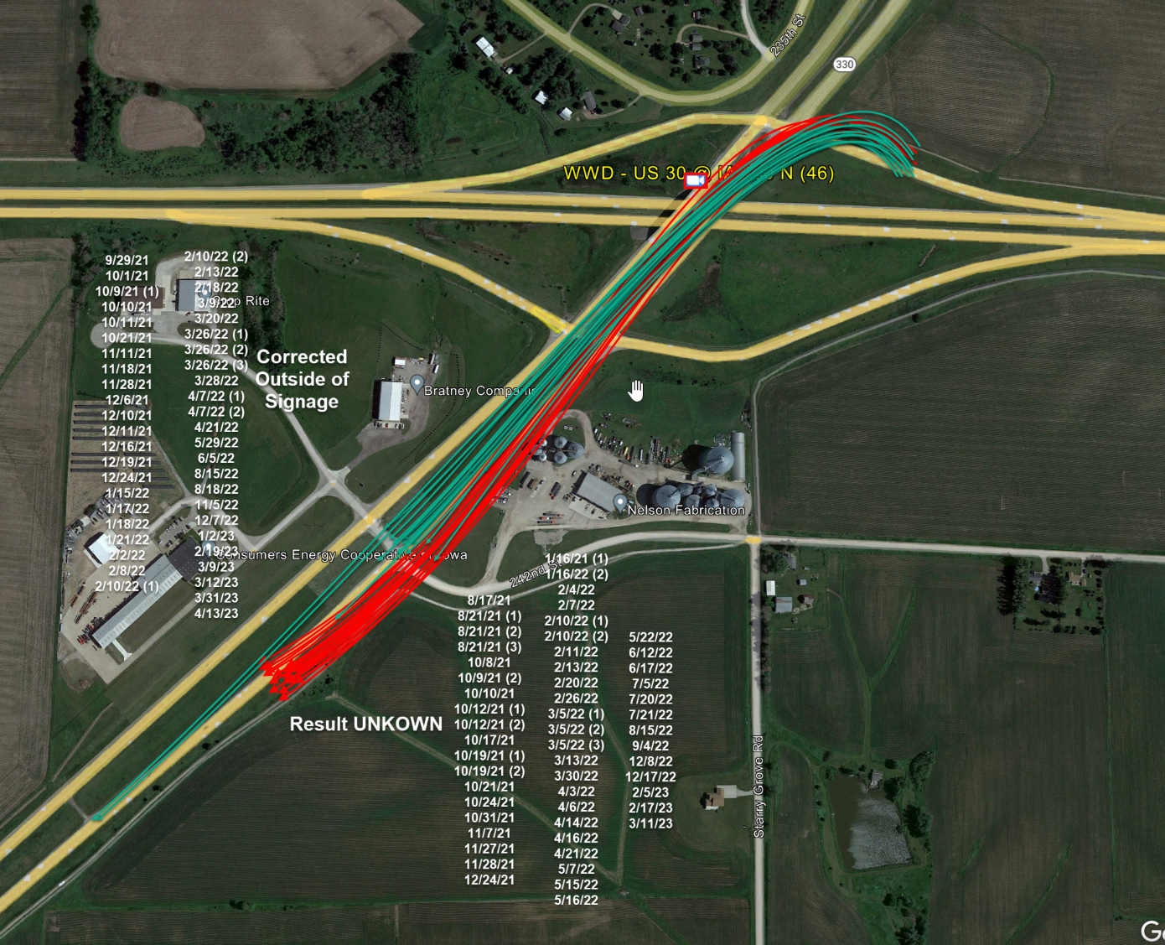
Case Study
US 30 & Ia 330
Hypothesis to test:
Can you use daytime WWD events that self correct within 1,000’ as a surrogate to reducing WWD events that “Keep going”?

Slide 34
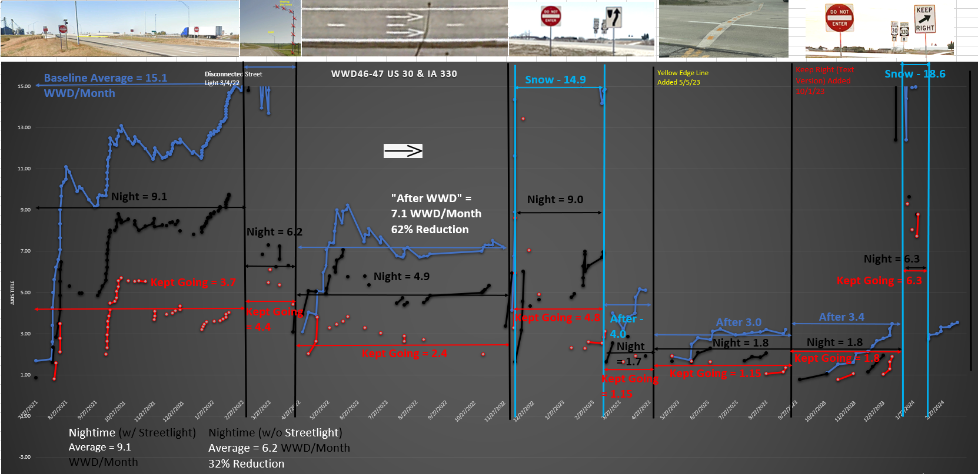

Slide 35
When you have a known Impairment problem location Over 2x limit (around 0.16 and up)
Consider ITS

Slide 36
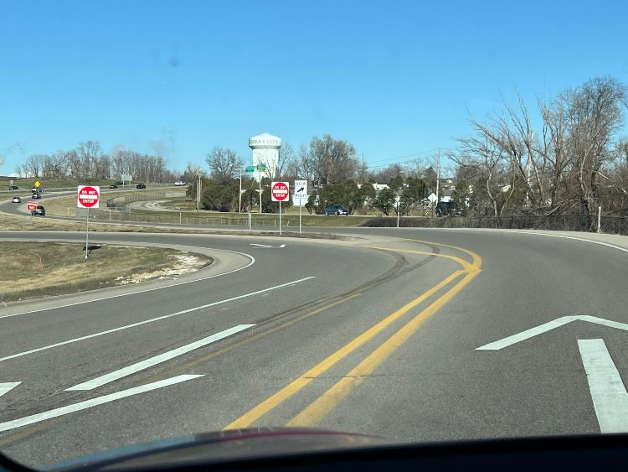
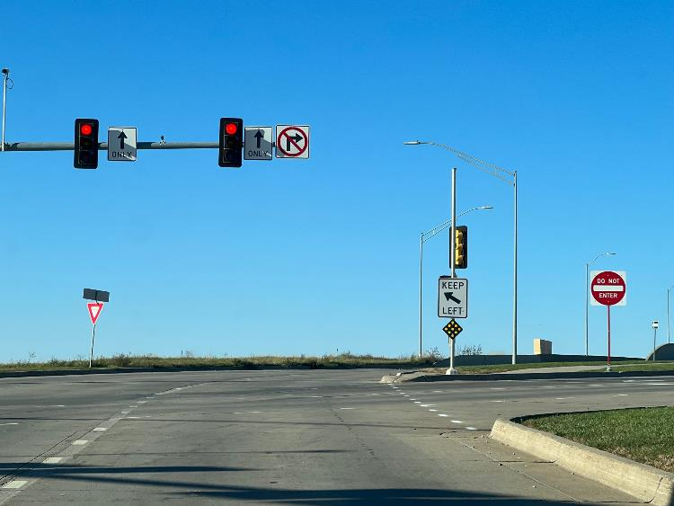
Summary Items to tell your Boss
Add this “Gateway” countermeasure to your Parclo “B” interchanges
Look at your Diverging Diamond Interchanges
Add Lane Line Extensions at DDI Cross overs
Add the 2 Do Not Enters for WWD on the sideroad to stop them from getting on Mainline

Slide 37
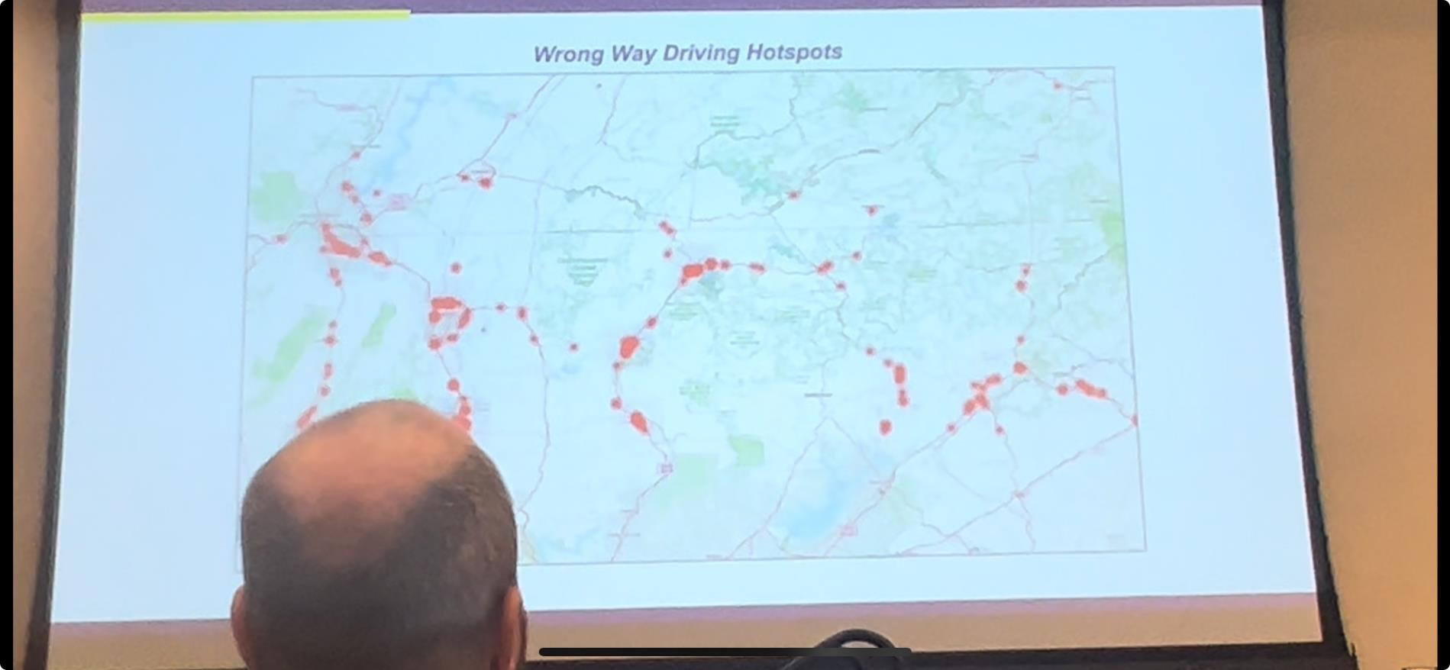
Connected Vehicle Data
The future of network screening!!
Example from Michelin Vehicle Smart Phone Data
Iowa will be looking into this

Slide 38
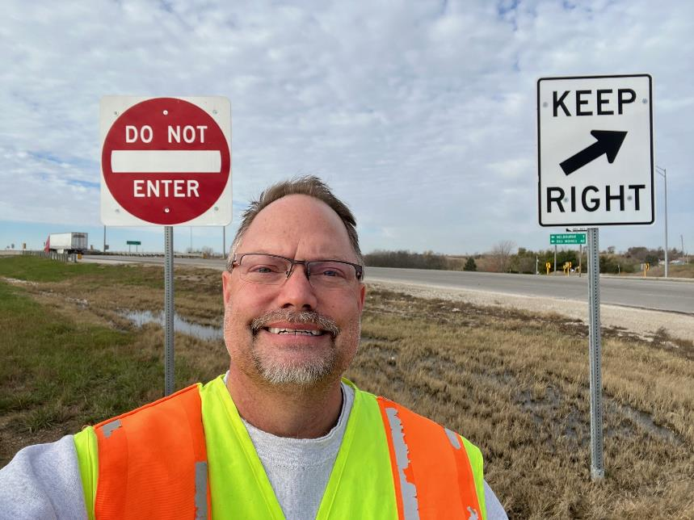
Questions?
Willy Sorenson, P.E.
(515)-669-4628
Willy.Sorenson@Iowadot.gov​
Iowadot.gov

