Slide 1
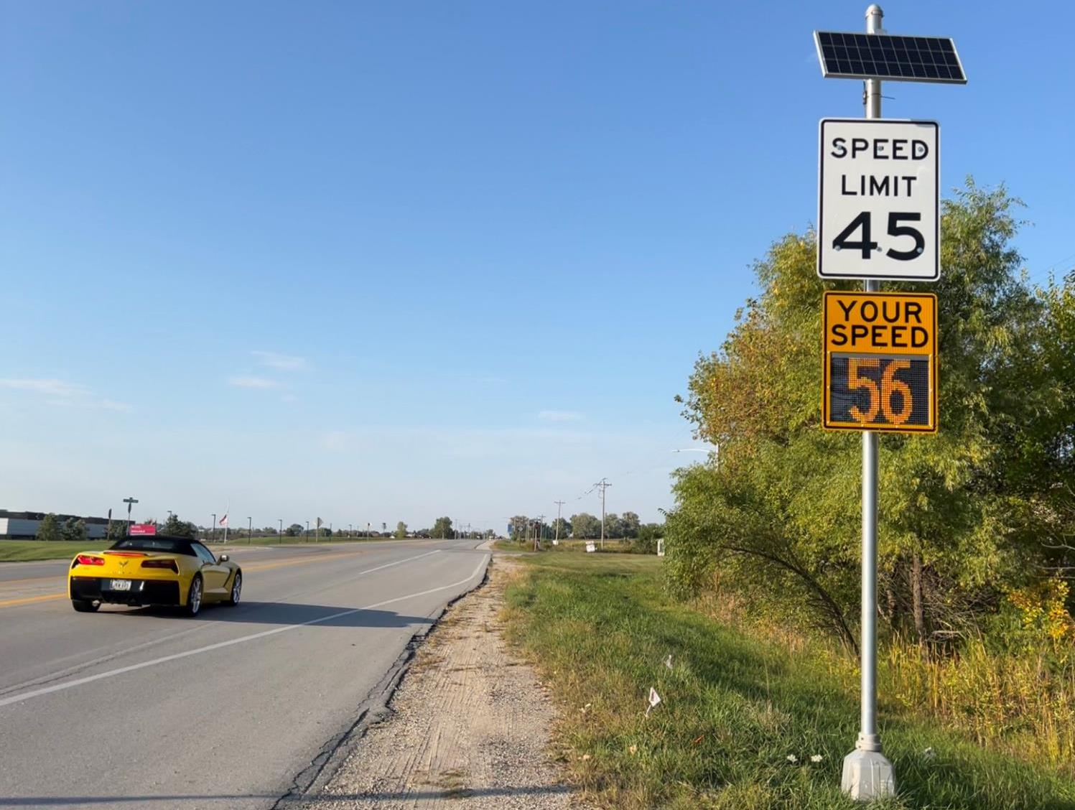


Speed Feedback Sign Program
For towns on Primary Highway System
Willy Sorenson, P.E.
Traffic & Safety Engineer
February 20, 2024
3/2/2023
Ia 17 NB Granger, Ia

Slide 2
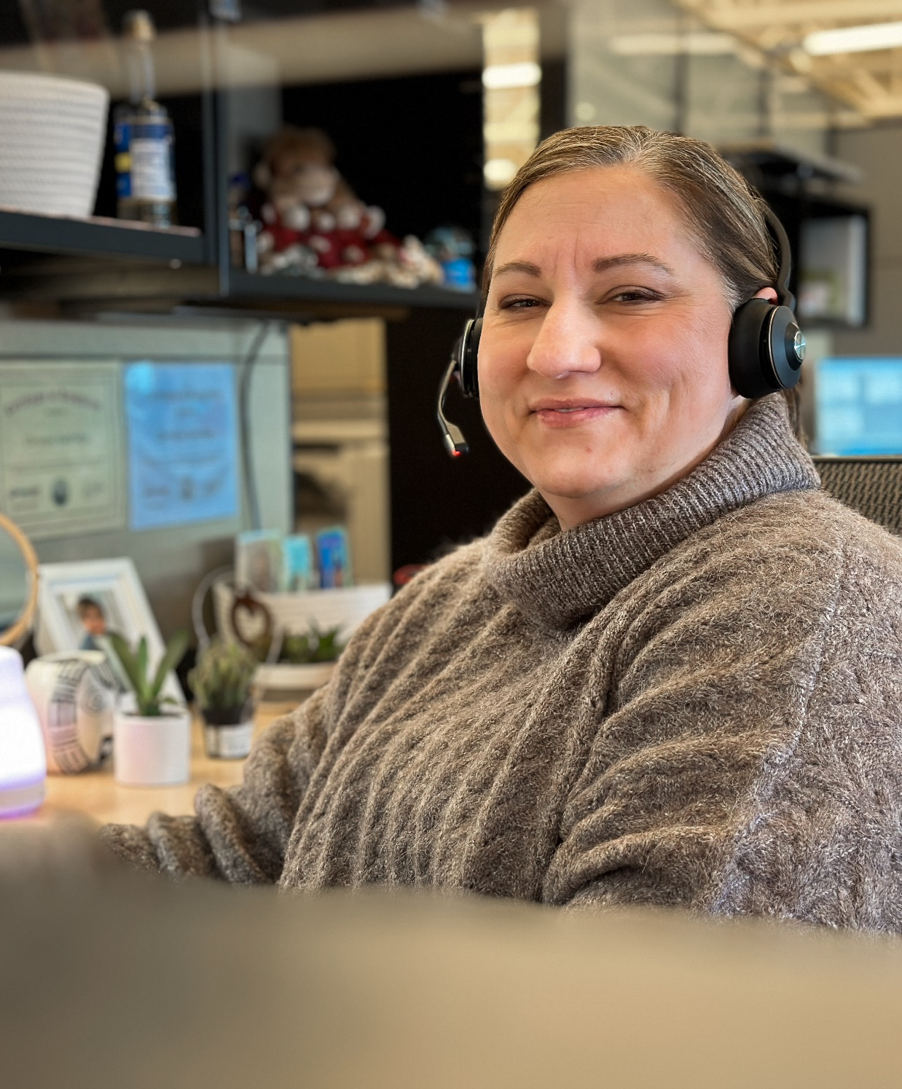
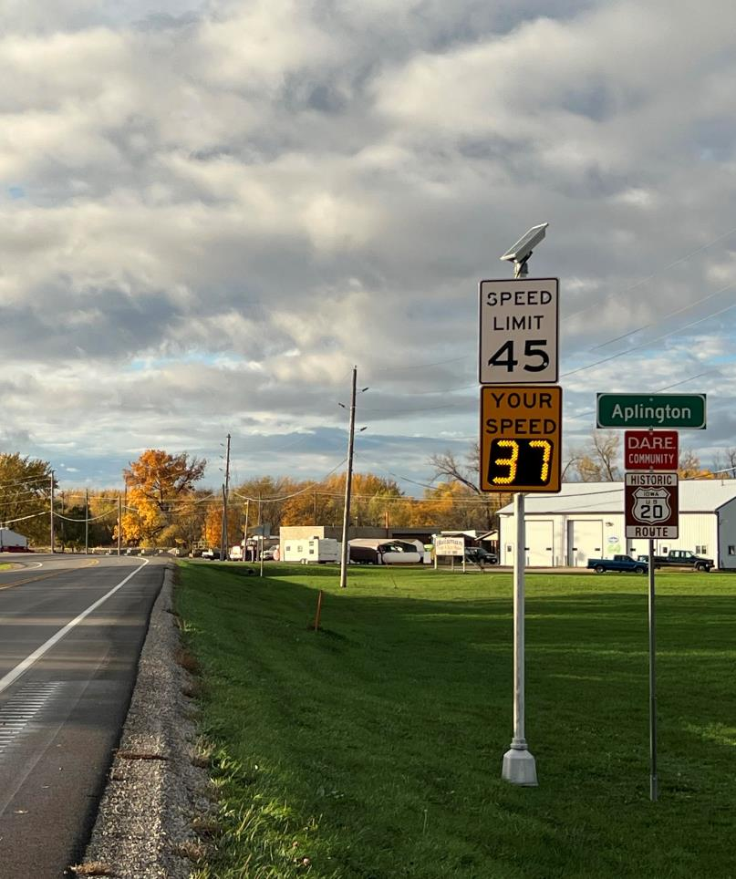

Agenda
Overview of Program
Who is eligible?
What’s the catch?
How to I get one?
Timing
Questions…

Slide 3
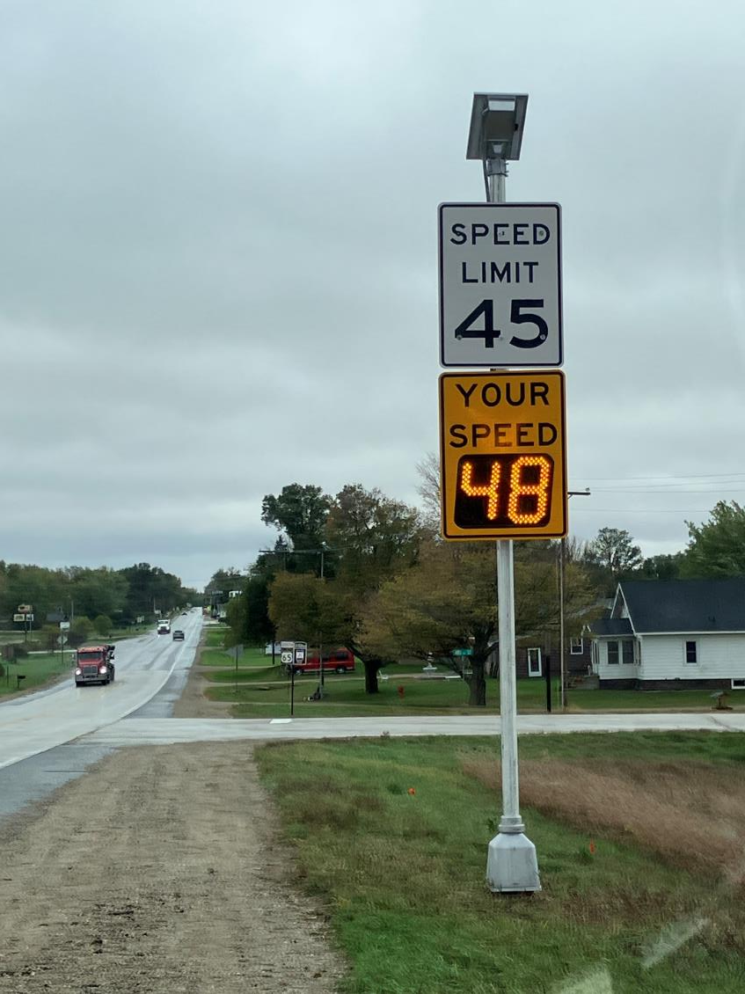
US 65 SB Northwood, Ia
Overview
Towns requesting lower speed limits is a common request to the DOT
  Many times, we would recommend a higher speed limit after an official study was done.
Late 2021: Traffic & Safety along with Assistant District Engineers discussed “Traffic Calming” (Gateway) treatments that could be implemented to help speed limits be effective
The use of Speed Feedback signs surfaced as one of the best treatments (for the money).

Slide 4
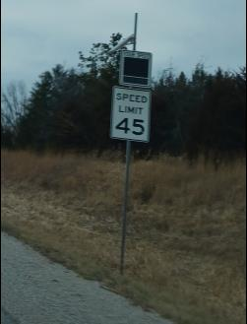
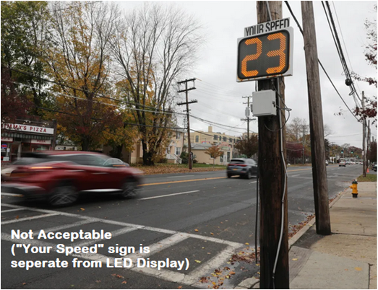
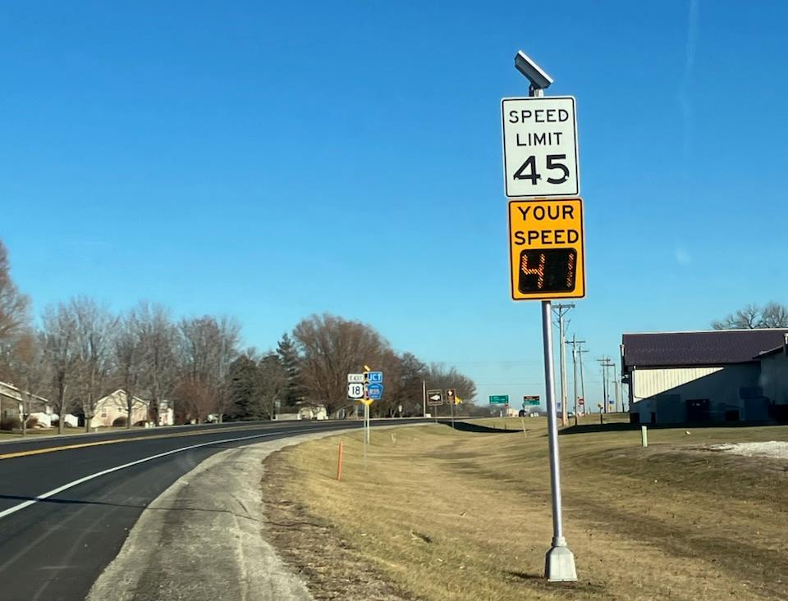
Needs to look Professional
Not an after thought
Not scraped together
The “Look”
US 18 EB Britt, Ia

Slide 5
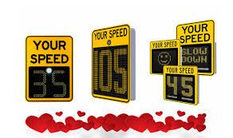
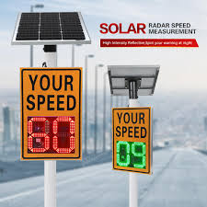
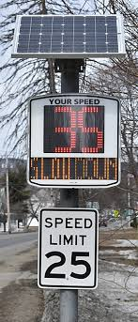
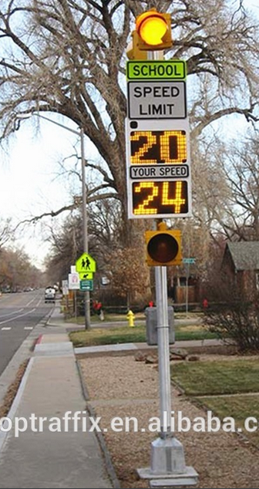
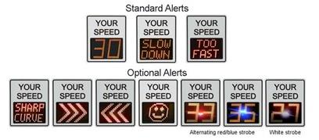
No Extras

Slide 6
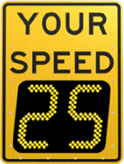
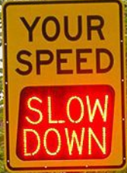
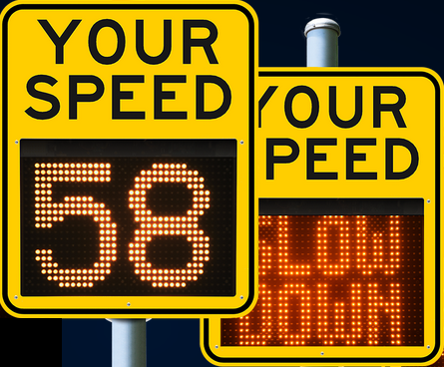
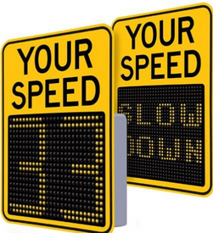
We are allowing: “SLOW DOWN”
Implemented when approaching speed is 20 MPH over the new/approaching limit
At 30 MPH over it goes blank

Slide 7

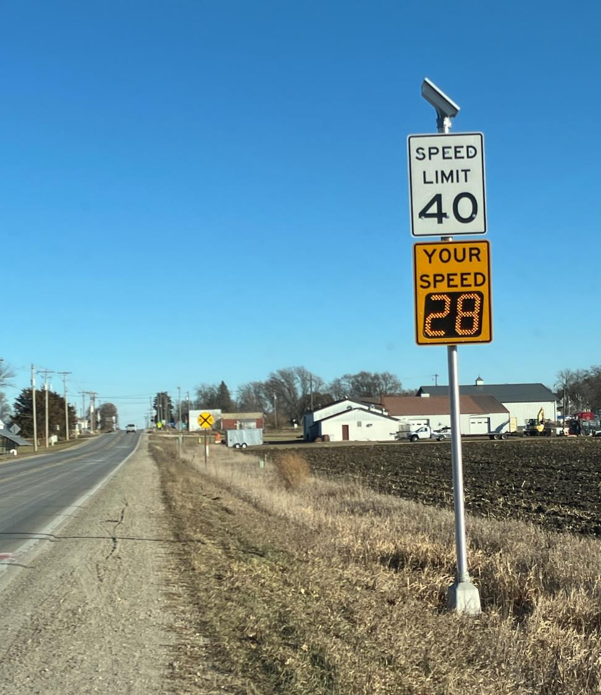
Who is Eligible?
Must be on a Primary (State) Highway
All roadways, except Interstate
Initial targeted Communities
  Population between:
    1,000 and 10,000
Currently expanded to Communities
  Increased Feb 1st, 2024
  Population between:
    750 and 15,000
US 18 EB Britt, Ia

Slide 8
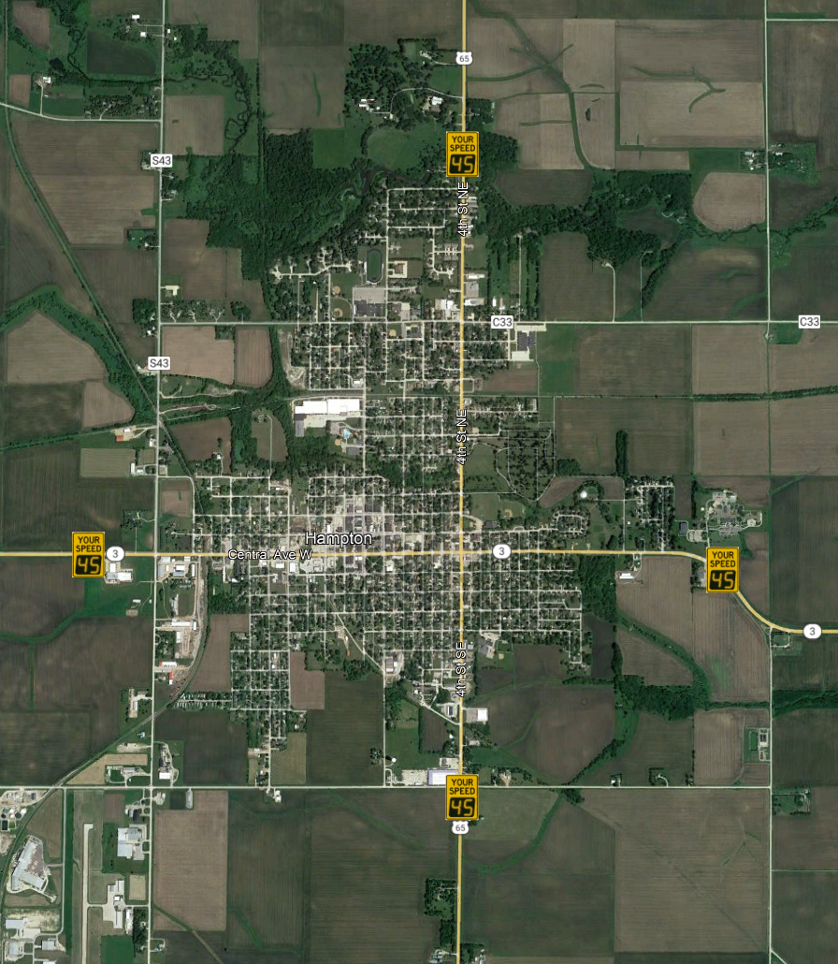


How Many Can I Get?
One per approach.
Hampton, Ia (example)

Slide 9
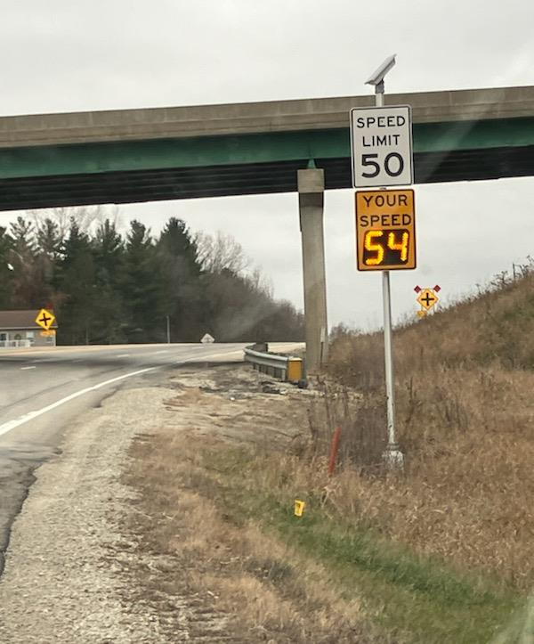
Where can they go?
Our initial thoughts where at the 1st Speed Limit Reduction
But we realized each town will have unique issues so we opened it up to any Speed Limit reduction.
Then we realized some towns have long Speed Limit zones, to we opened it up to allow confirmation speed limits signs within a speed zone.
Ia 9 EB Decorah, Ia

Slide 10
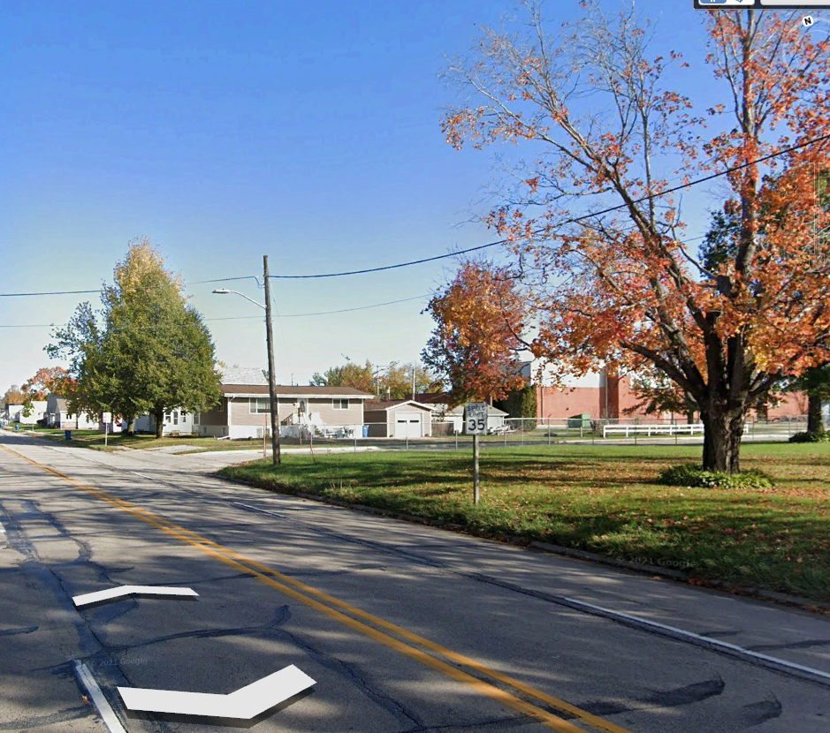
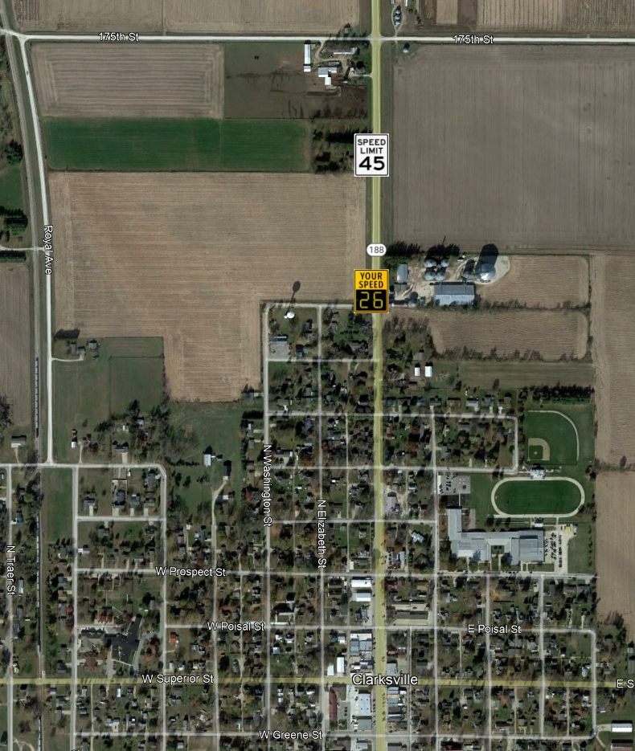
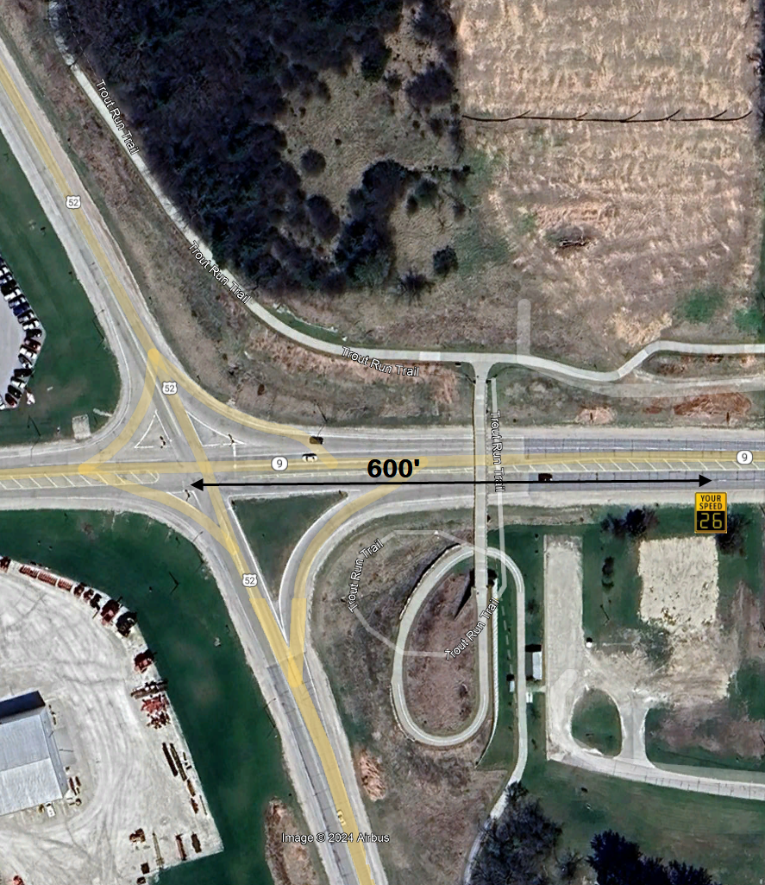
Where can they go?
However…
Beyond a Stop Sign at least 600’
When there is a series of step down speed limits with no other land use changes…
  Put it closer to town
Not under a tree (shade issues)
  Unless no other location and City is willing to pay electrical costs

Slide 11
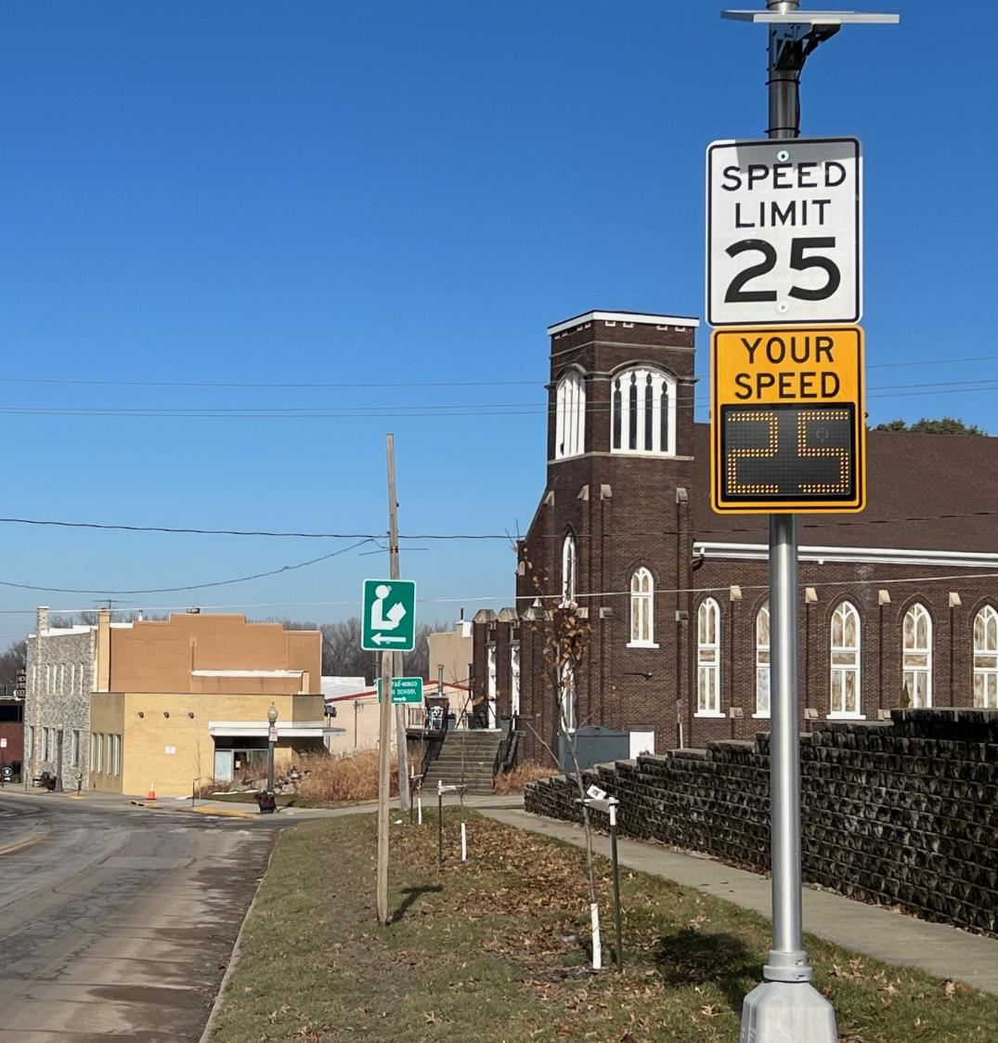
What’s the Catch?
City has to agree to take over ownership and maintenance.
Comes with a 5-year warranty on parts (including batteries)
Ia 117 NB Colfax, Ia

Slide 12
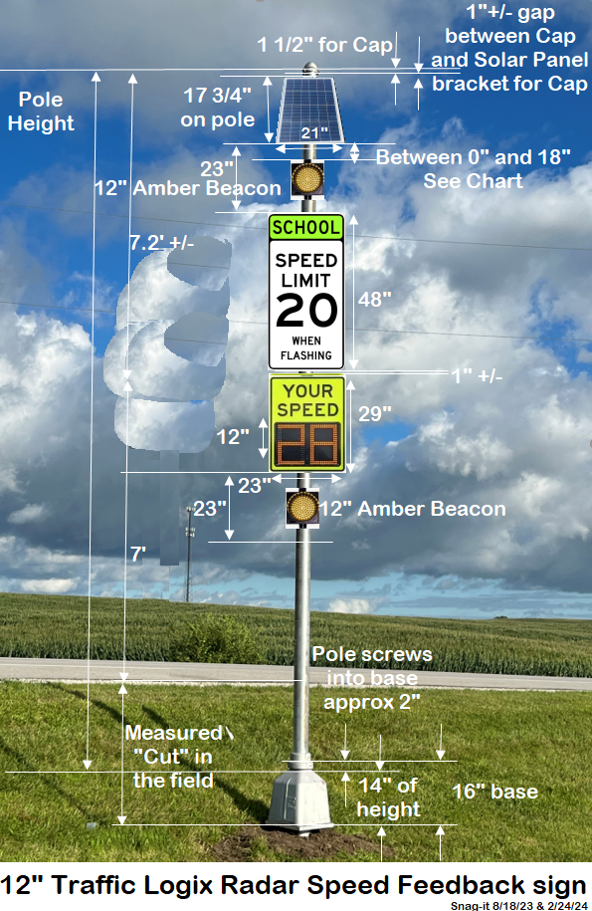
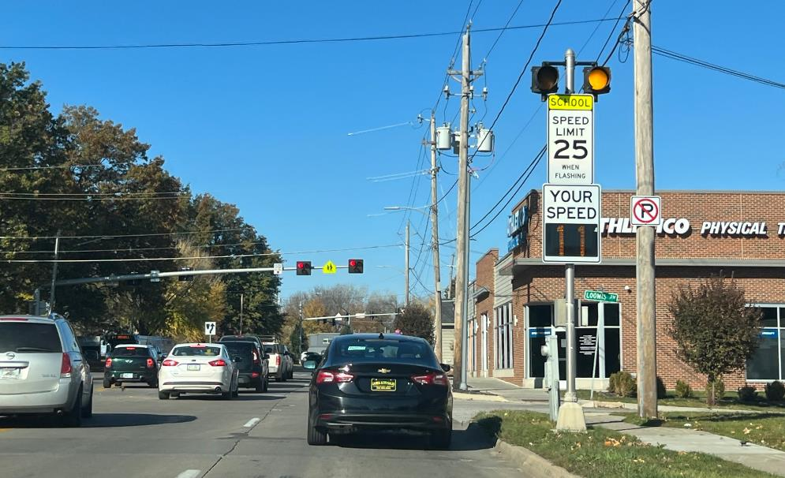
Iowa DOT’s Proposed System
Other Applications
School Zones:
Bedford, Iowa will be first.
Will only display speed during school arrival/dismissal
City of Des Moines’s System
SW 9th NB Des Moines, Ia

Slide 13
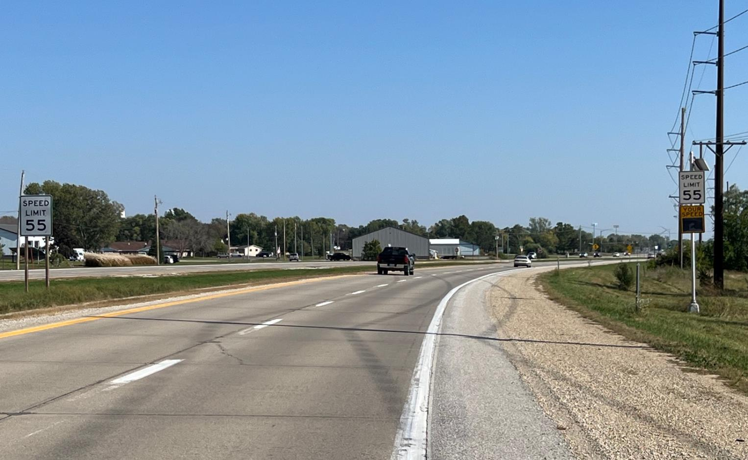
4-Lane Expressways
Ia 141
Granger

Slide 14
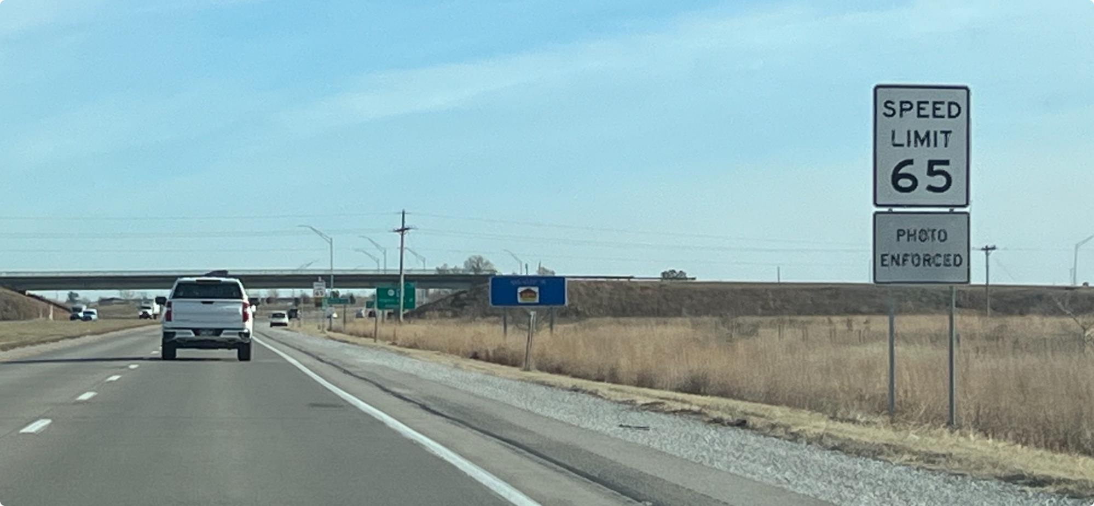
4-Lane Expressways w/ Photo Enforcement
US 163 EB Prairie City

Slide 15
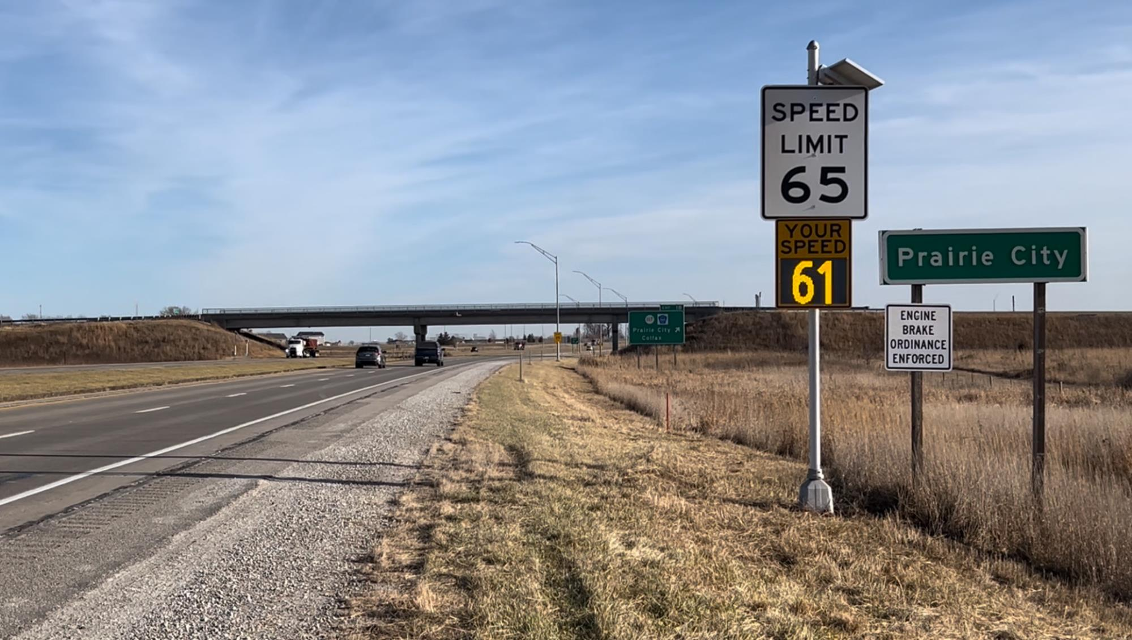

Slide 16
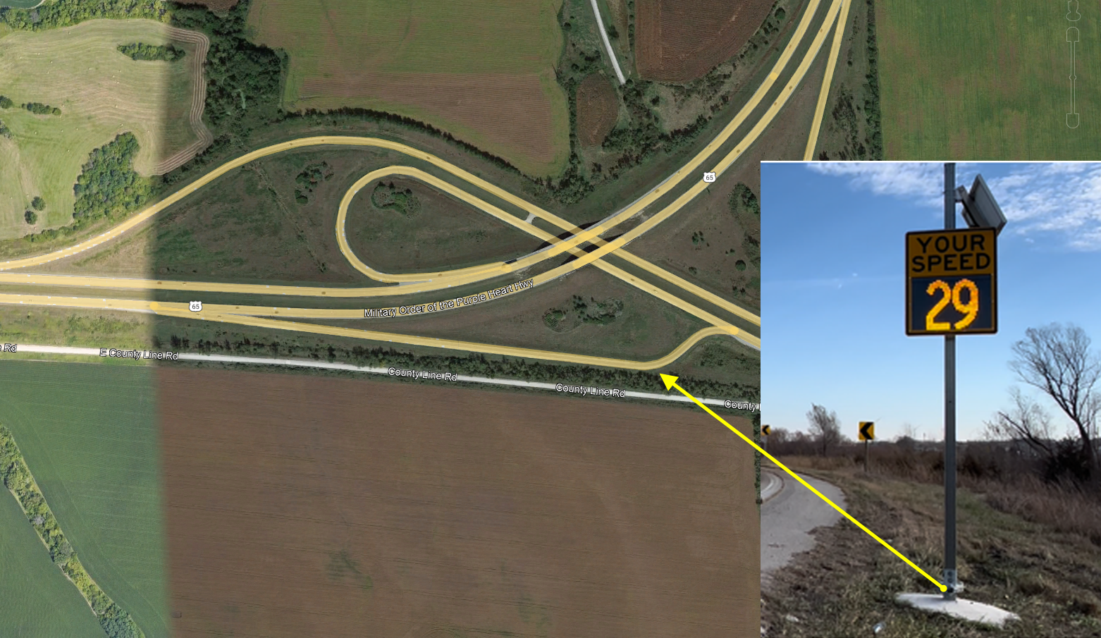
US 65 / Ia 5
West of
Carlisle, Ia
Sharp curves

Slide 17
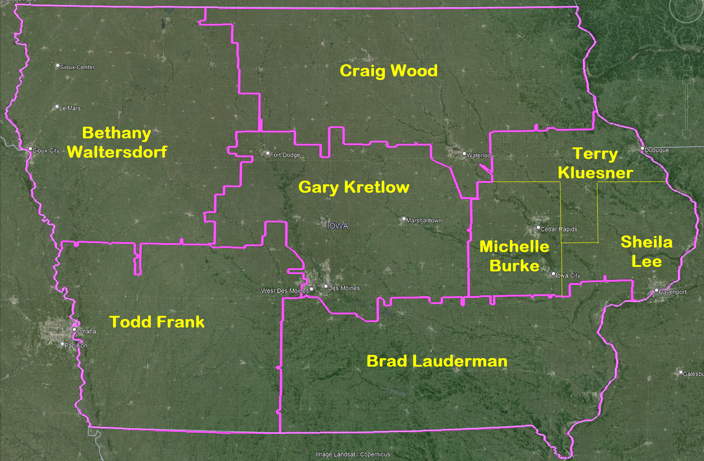
Work with the Iowa DOT’s Traffic Tech. for the District you are in.
How can I get one? …or 2 … 3 or 4?

Slide 18
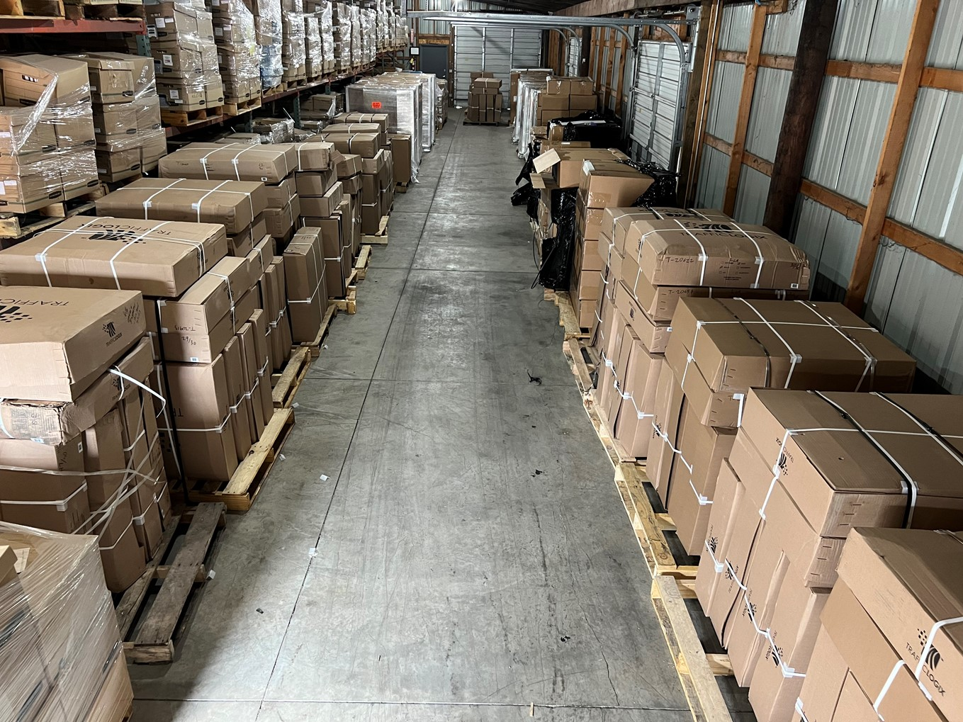
- Attribution
Budget:
We have budgeted $750,000 annually for the next few years
190 signs purchased during year 1
Installed 66+/- during year 2 (so far)

Slide 19
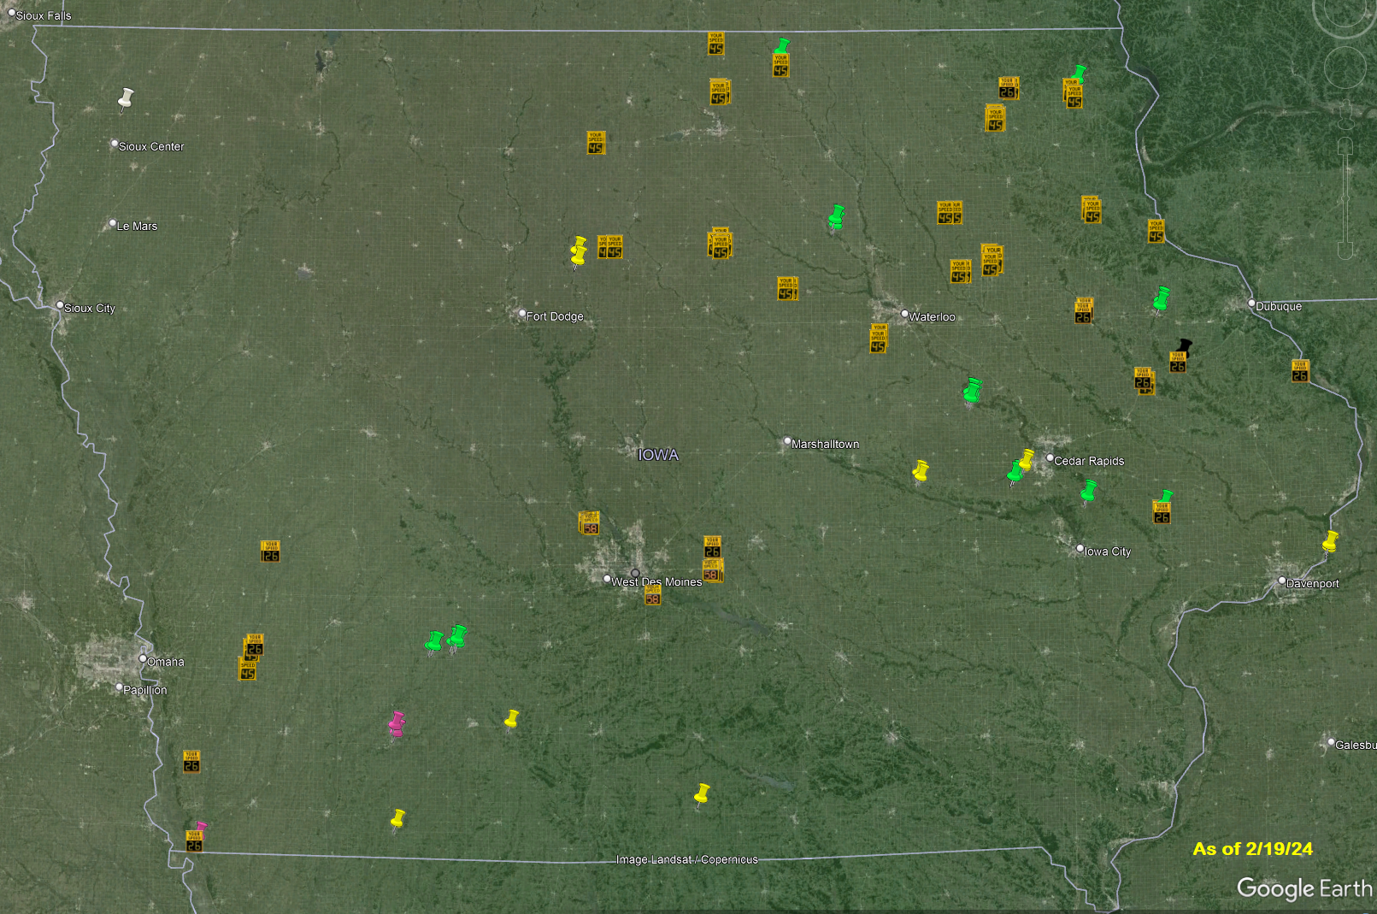
66 working
24 in various
pre-working
stages
100 still in warehouse

Slide 20
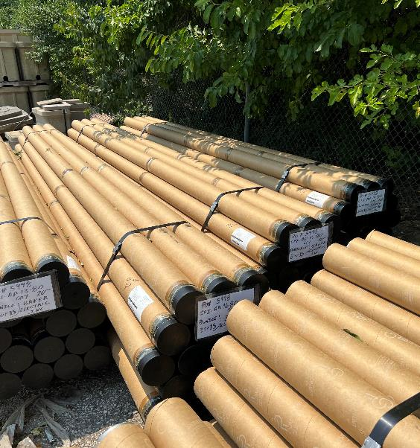
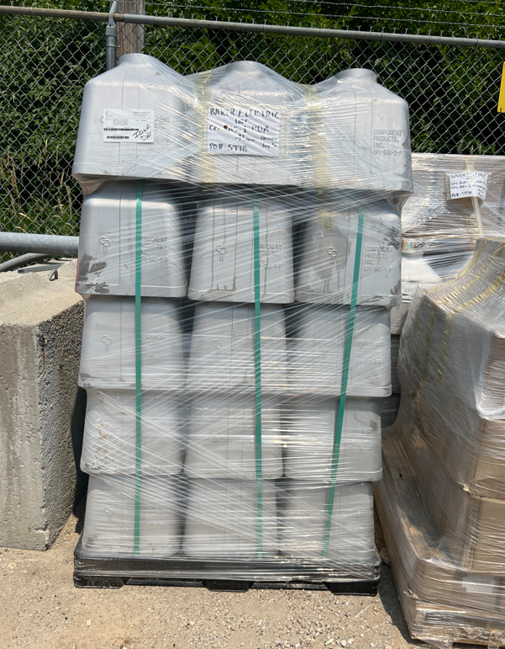
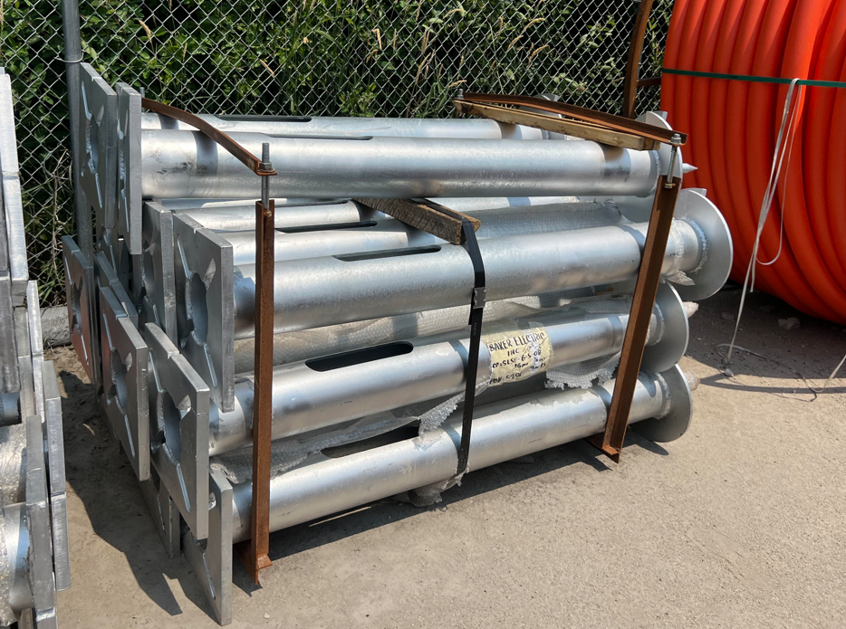

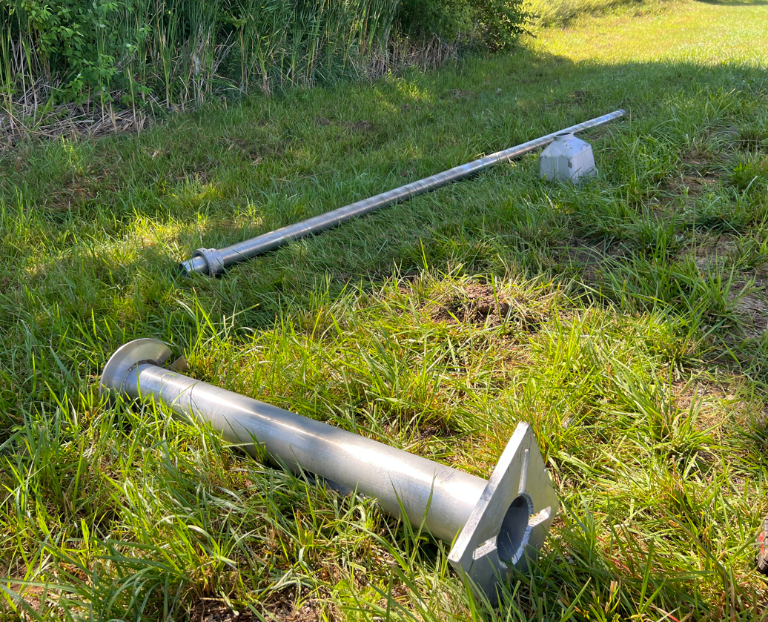

Timeline Expected
2 to 6 months after signing Permit…. Usually
DOT has an electrical contractor ‘on-call’ for footing/base/pole. They can do about 4 per day.
DOT Maintenance crews will mount signs
Traffic Techs (or Willy) will configure them

Slide 21
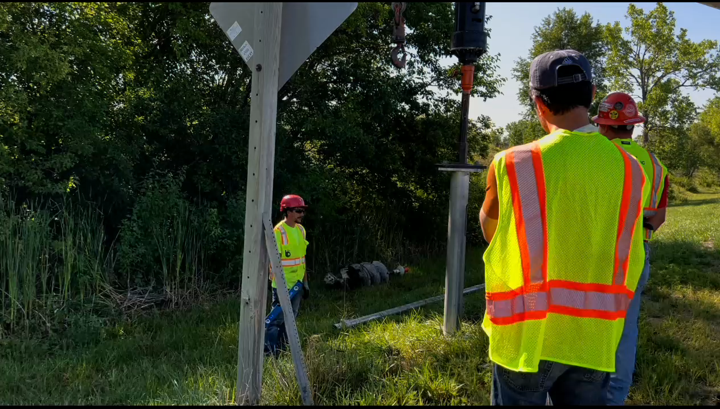

Slide 22
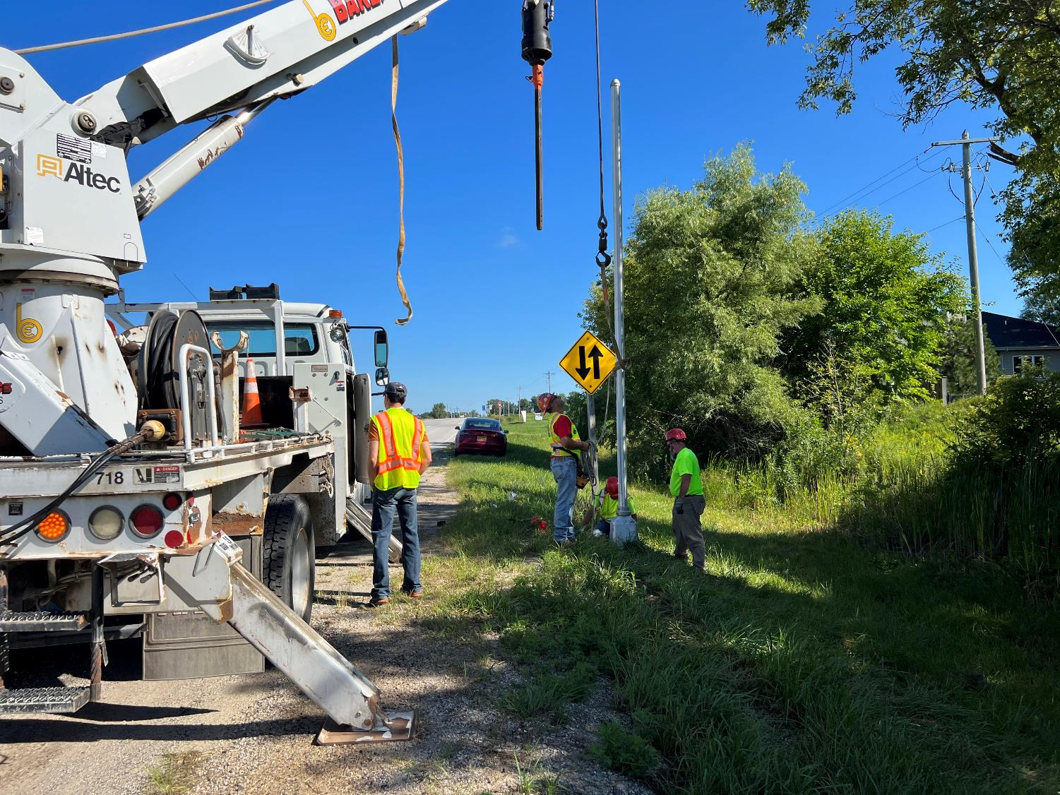

Slide 23
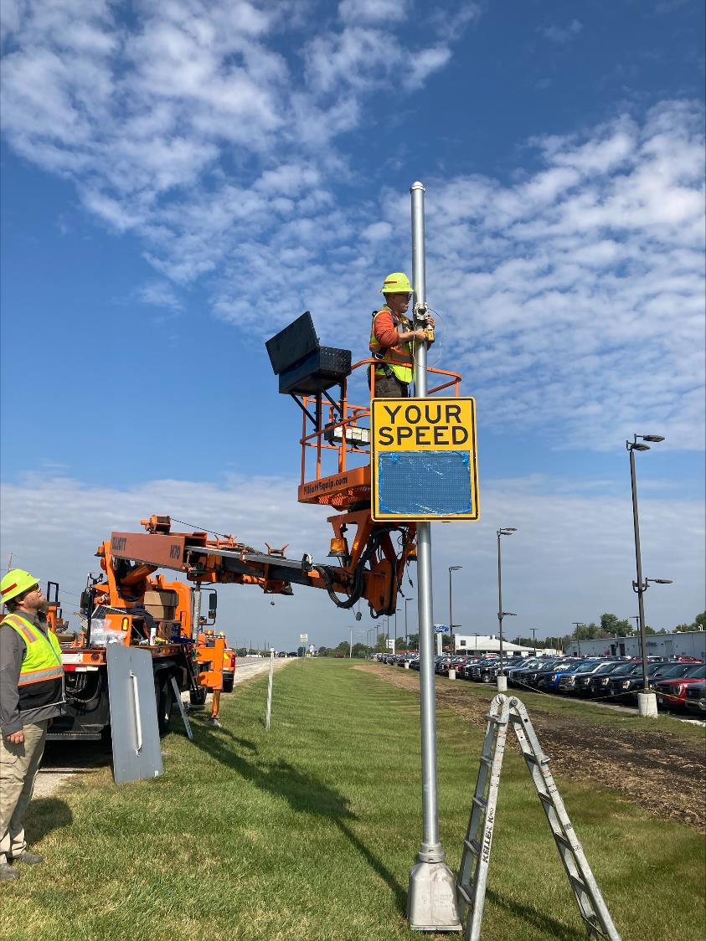
Installation
DOT Maintenance Crews
Hang Speed Feedback
and Speed Limit Sign
Ia 141 NB Granger, Ia

Slide 24
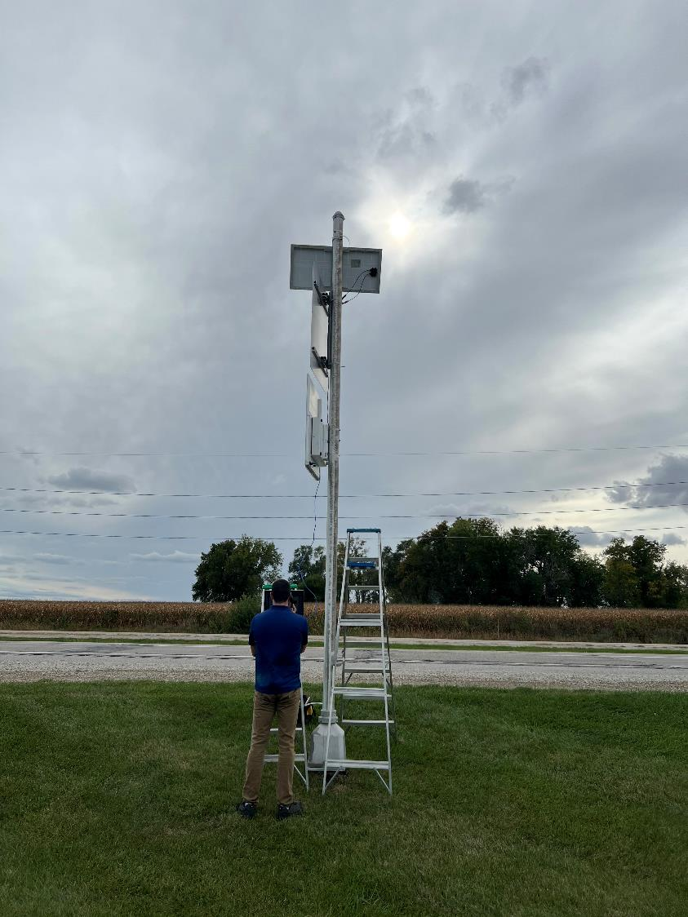
Sign Commissioning
Update settings for the correct Speed limit
Tweak the radar settings on high- speed roadways

Slide 25
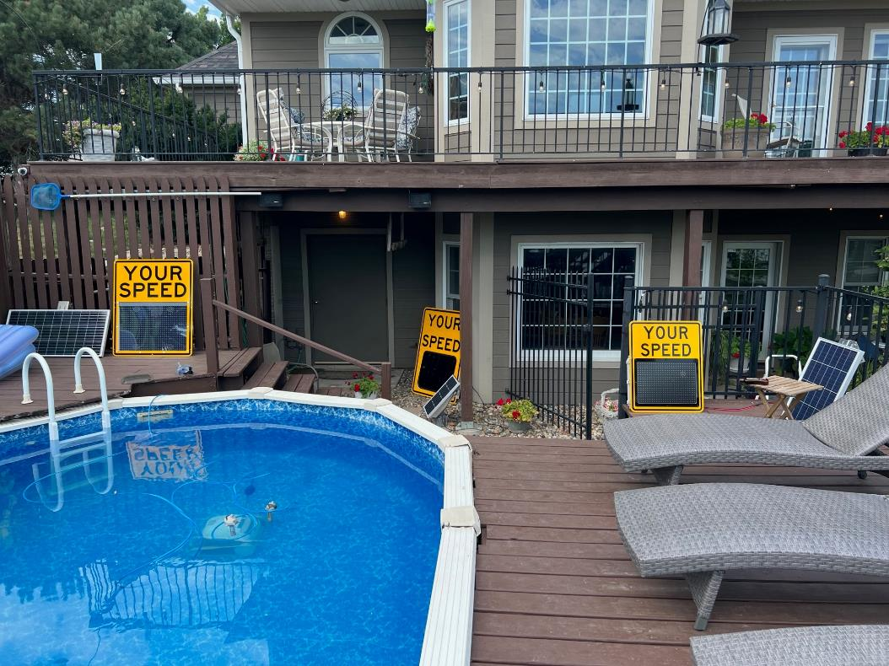
Costs…
Pole, Base, Footings - $1,303.50 for tallest pole(18’)
Contractor to install footings and pole - $1,905.24
Actual Sign Costs
$3,905.56
$2,435.00
$5,350.50
Low end $6,000…………….High End $8,000

Slide 26
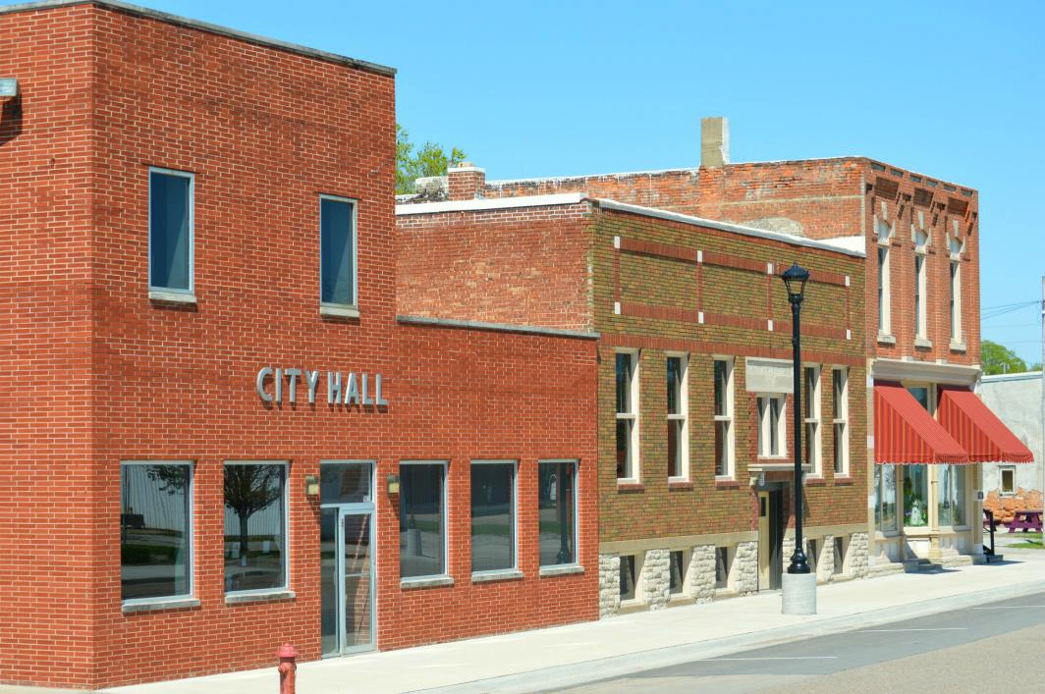
Locals can Purchase from our Contracts
If a town would like a sign
for a city street.
(not a Primary Highway)
Our vendors will honor the pricing.
Including the 5 year warranty

Slide 27

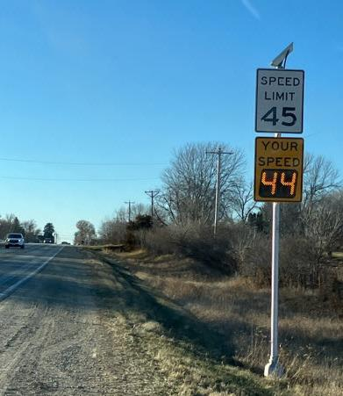
Research
We believe this is the 1st in the nation with such a wide / uniform treatment for speed entering communities.
Iowa State University (InTrans) has been hired to perform a statewide study on the effectiveness of the signs.
Ia 9 WB Manly, Ia

Slide 28
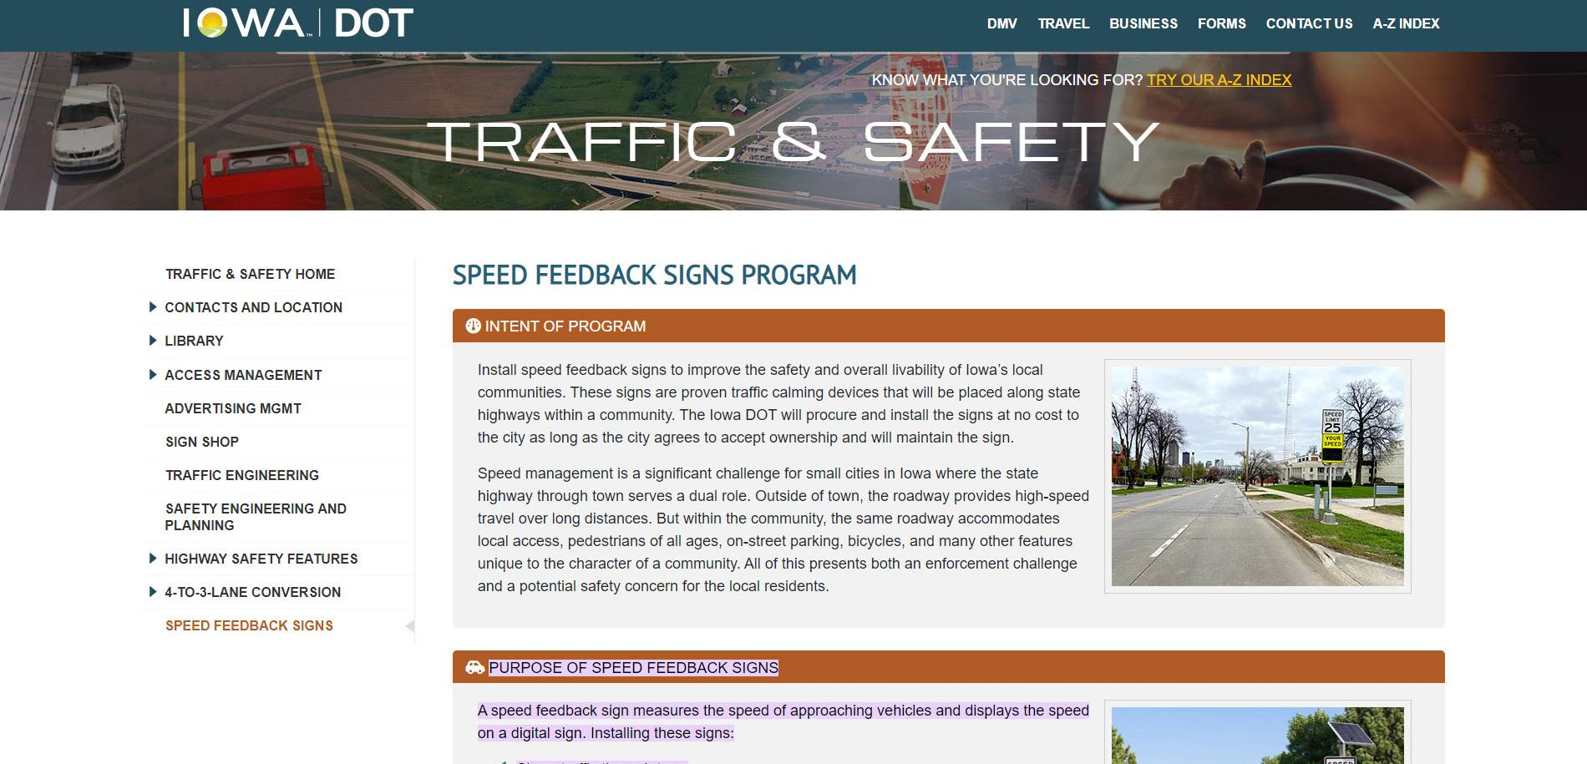
https://iowadot.gov/traffic/Speed-Feedback-Signs
… or just Google “Iowa DOT Speed Feedback Sign”

Slide 29
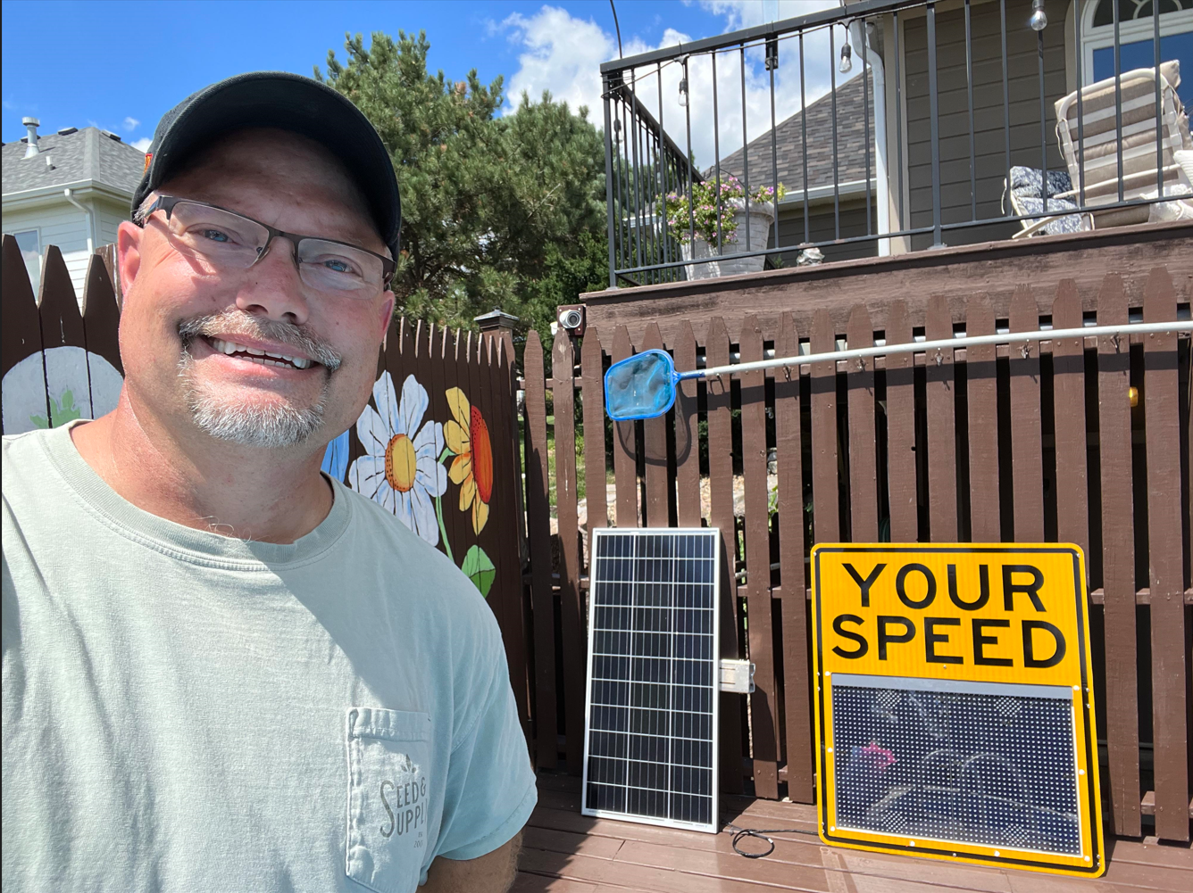
Questions?
Willy Sorenson, P.E.
515-669-4628
Willy.Sorenson@IOWAdot.gov​
iowadot.gov

