Slide 1

Transportation Systems Management & Operations (TSMO)
Organizing for Reliability Peer Exchange
Washington D.C
February 7, 2018

Slide 2
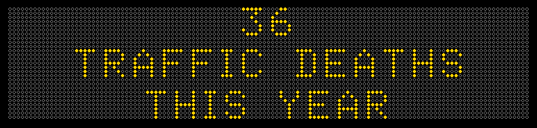
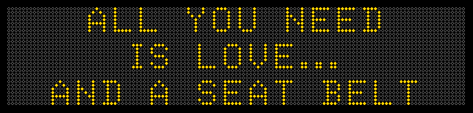
Welcome!

Slide 3
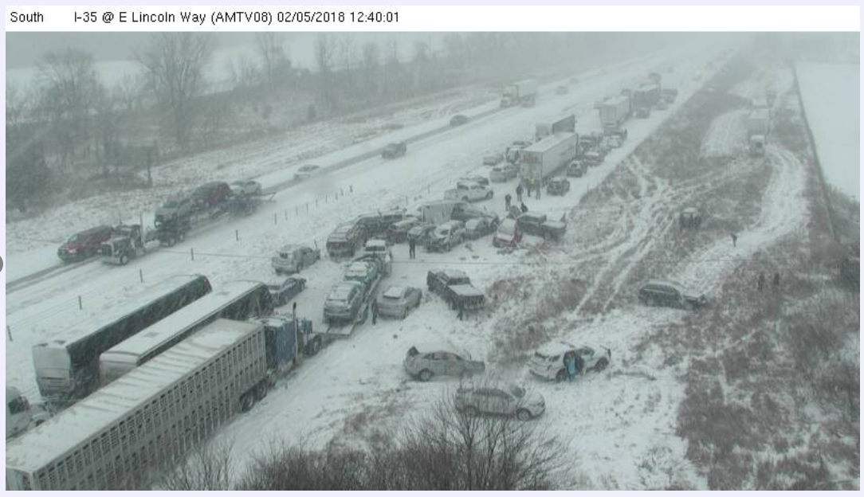
Monday. I-35 near Ames, Iowa 70+/- pileup – 1 fatal (7 statewide)

Slide 4
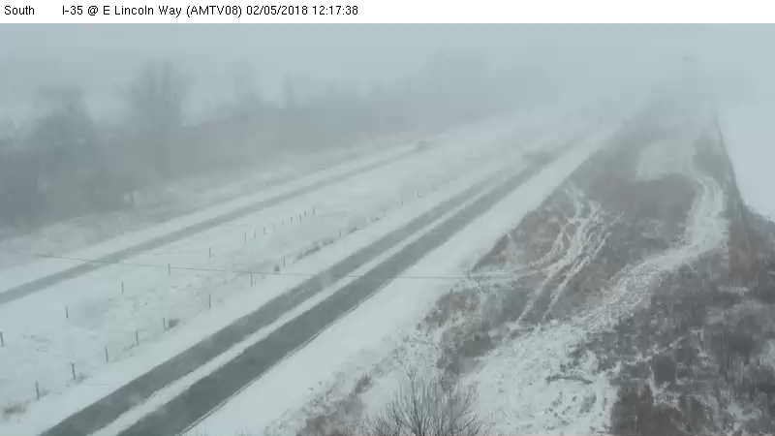

Slide 5
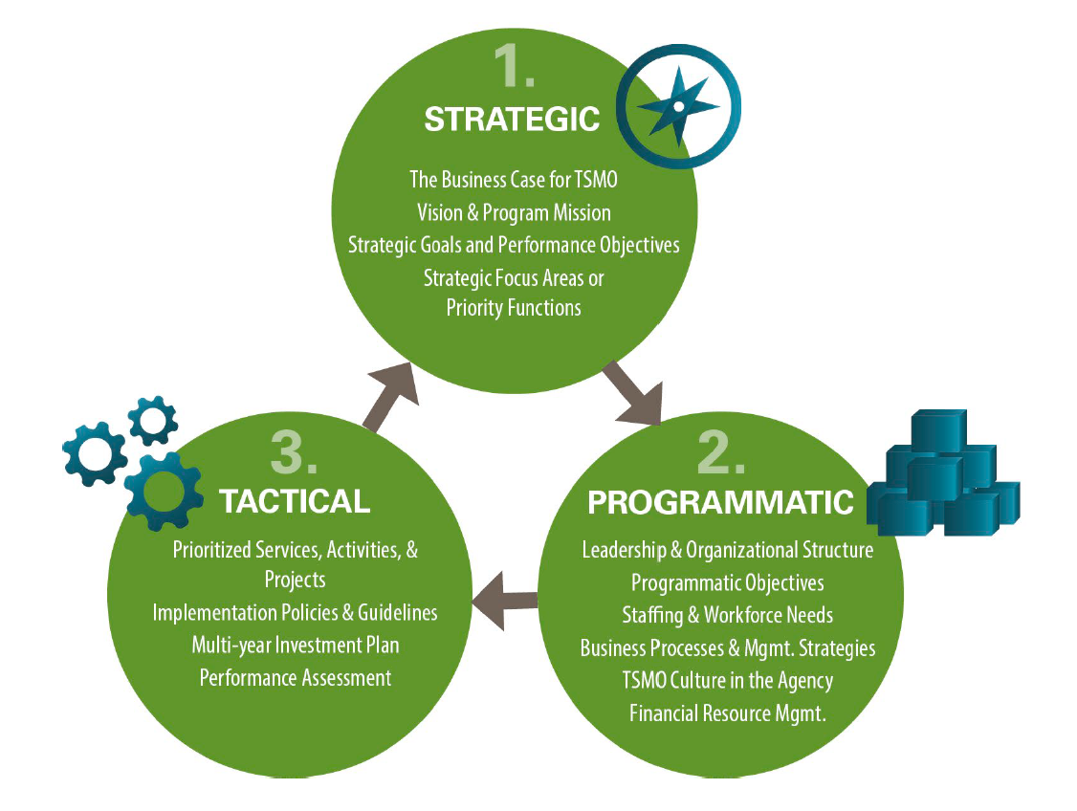
Iowa TSMO – The Secret Sauce
The “Iowa Model” TSMO Plan
50,000 ft
(10 pages)
30,000 ft
(104 pages)
10,000 ft
(1,000 +/- pages)

Slide 6
Iowa TSMO – The Secret Sauce
The “Iowa Model” TSMO Plan
The Business Case
Established TSMO Budget
Business Processes first
Customer Service focus – “service layers”
Data focus
University Partnerships

Slide 7
Why Manage Traffic in Iowa?
(Business Case)
Economics
Safety
Mobility
+
=
Transportation Systems Management and Operations

Slide 9
Traffic Safety in Iowa
404 Iowa
Fatalities
in 2016
37,461 US Fatalities in 2016
Around 3,000 incidents per month
53 minutes average lane blockage

Slide 10
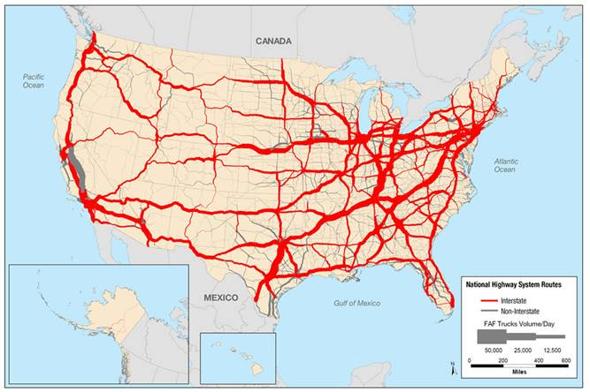

2040 Truck Volumes

Slide 11
Transportation Economic Impacts in Iowa
80% Goods shipped by Truck
$406B
Value of Goods Moving through Iowa
30% Projected Growth in Truck Tonnage
$380M in lost fuel and time

Slide 12
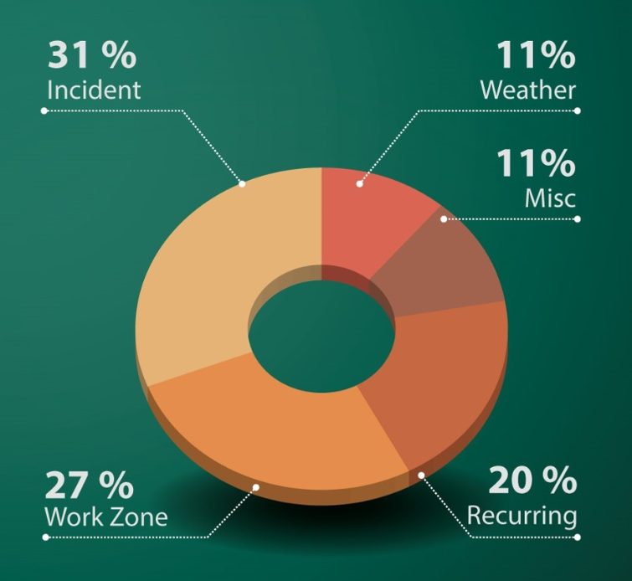
Recent Results from 2016 Interstate Congestion Report

Slide 13
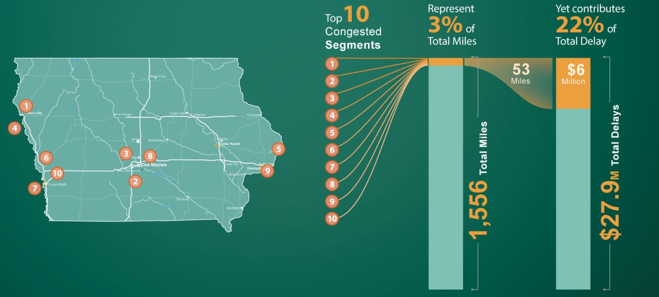
Recent results from 2016 Interstate Congestion Report

Slide 14
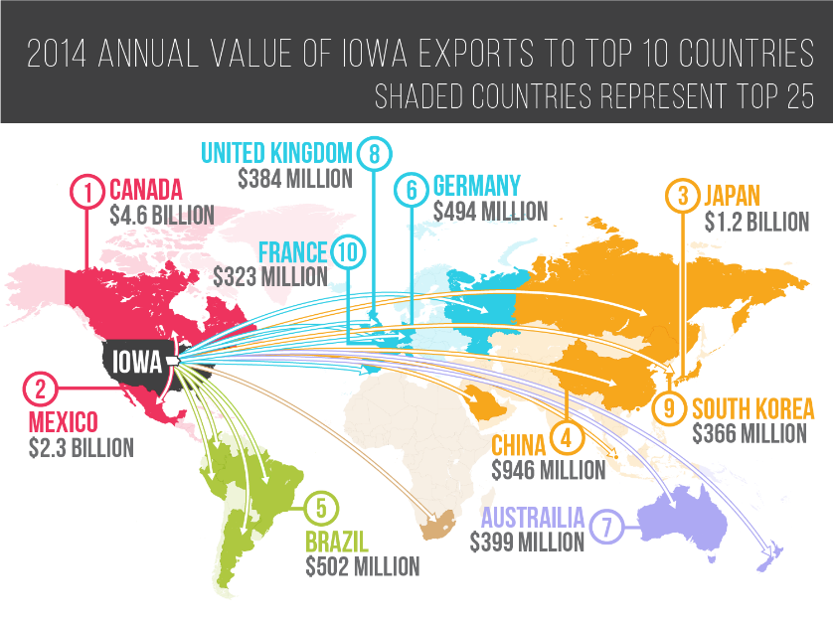

Slide 15
Iowa TSMO – The Secret Sauce
The Business Case
The “Iowa Model” TSMO Plan
Customer Service Focus – “service layers”
Established TSMO Budget
Business Processes First
Data Focus
University Partnerships

Slide 16
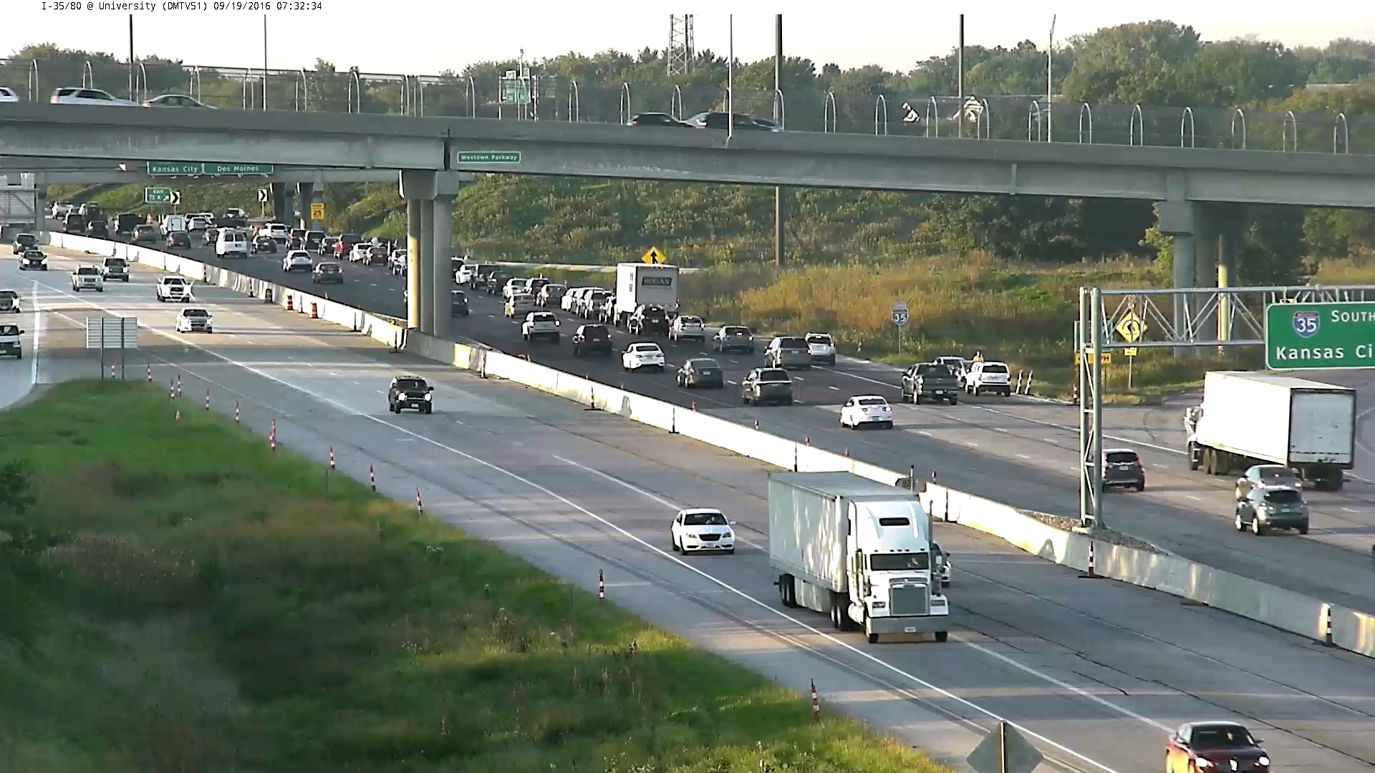
Notes:
Play video several times to call attention to the correct things. Distracted driving – Driver error

Slide 17
Iowa TSMO – The Secret Sauce
The Business Case
The “Iowa Model” TSMO Plan
Customer Service Focus – “service layers”
Established TSMO Budget
Business Processes First
Data Focus
University Partnerships

Slide 18
The Process
FHWA Capability Maturity Workshop
  2013
  DOT Districts and Central Office Staff
  Evaluated 6 critical dimensions

Slide 19
The Process
 |  |  | 5-Year Program Integration and ICE-OPS
 |  |  | New ATMS and Decision Support System
 |  |  | Real-Time System Performance Measures
 |  |  | TSMO-Oriented Policies and Buy-in
 |  |  | District Capacity Building
 |  |  | Internal and External Relationships
Business Processes
Systems and Technology
Performance Management
Initial:1.5
Culture
Organization/
Staffing
Collaboration
LEVEL 1
Performed
LEVEL 2
Managed
LEVEL 3
Integrated
LEVEL 4
Optimized

Slide 20
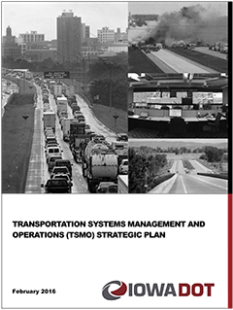
Background
- Completed in February 2016
- FHWA Launch Workshop April 2016
- 5 Year Plan
- 3 Plan Levels
- Annualized Accomplishment Year Plan
- http://www.iowadot.gov/tsmo/

Slide 21
The Process
Mission
Iowa’s transportation system is safe, efficient and reliable, supporting the state’s environmental and economic health as a result of TSMO
Vision
To get you there safely and reliably by proactively managing the transportation system

Slide 22
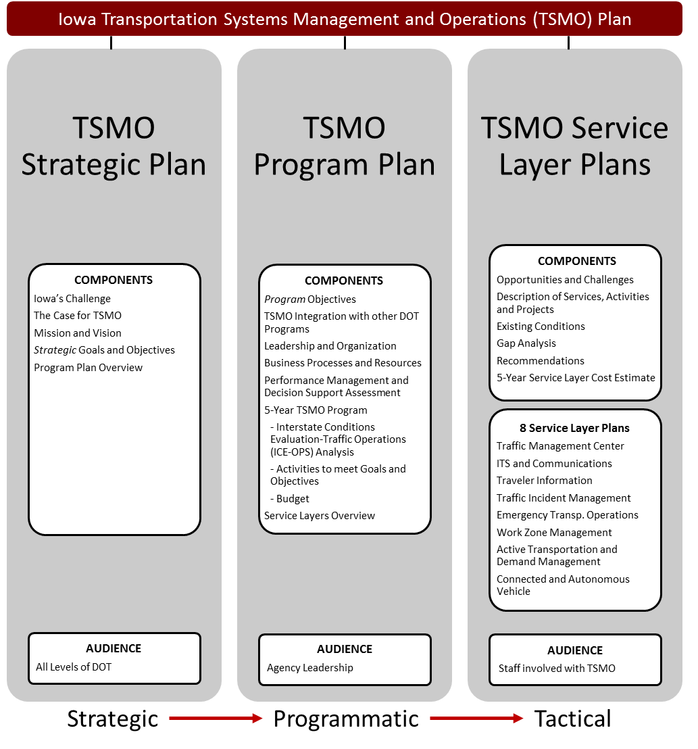
Three Levels of the TSMO Plan

Slide 23
The Process

Slide 24
The Process
Tested Goals and Objectives with Focus Groups
Internal
Traffic Operations
External Partners
Iowa Emergency Management Association
External Users
ABATE of Iowa
Agribusiness Association of Iowa
Iowa Association of Business and Industry
International Traders of Iowa
Des Moines West Side Chamber of Commerce
Highway 61 Coalition
Associated General Contractors (AGC) Iowa
•Corridor MPO – Cedar Rapids area
Associated General Contractors (AGC) of Iowa
Iowa Chapter of the American Traffic Safety Services Association (ATSSA)
Iowa EMS Association
Iowa Northland Regional Council of Governments
Des Moines Area Metropolitan Planning Organization
Systems Planning
Traffic and Safety
Organizational Improvement
Strategic Communications
Districts
Motor Vehicle Enforcement
Construction and Materials
Maintenance
Iowa Tourism Office, Iowa Economic Development Authority
Petroleum Marketers & Convenience Stores of Iowa
City of Ames and Ames Area MPO

Slide 25
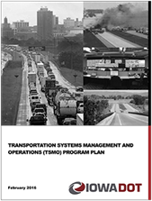
Bringing it all together
TSMO Plan
  5-year Program
  ICE-OPS Analytical Tool
DOT TSMO Steering Committee w/ subcommittees
  Project Delivery Implementation
  Training and Communication
  Work Zone Management
Recent Activities & Accomplishments
  3rd Annual TIM Conference
  Automated Vehicle Pilot
  New TMC Software RFP
  Truck Parking Information Management System
  Statewide TIM Committee
  New TSMO Policies

Slide 26
 |  |  | 5-Year Program Integration and ICE-OPS
 |  |  | New ATMS and Decision Support System
 |  |  | Real-Time System Performance Measures
 |  |  | TSMO-Oriented Policies and Buy-in
 |  |  | District Capacity Building
 |  |  | Internal and External Relationships
Business Processes
Systems and Technology
Performance Management
GOAL:3.0
5-Year Goal
Culture
Organization/
Staffing
Collaboration
LEVEL 1
Performed
LEVEL 2
Managed
LEVEL 3
Integrated
LEVEL 4
Optimized

Slide 27
Iowa TSMO – The Secret Sauce
The Business Case
The “Iowa Model” TSMO Plan
Customer Service Focus – “service layers”
Established TSMO Budget
Business Processes First
Data Focus
University Partnerships

Slide 28








Traffic Management Center-2018/19
ITS and Communications-complete
Traveler Information-complete
Traffic Incident Management-complete
Emergency Management-2017/18
Work Zone Management-2017/18
Active Transp. and Demand Mgmnt.-2018/19
Connected and Autonomous Vehicle-2017/18

Slide 29
Bringing it all together
Iowa
DOT
TIM
TMC
TI
ITS/Comm
EM
WZ
CAV
ATDM
TSMO “Culture”

Slide 30
Iowa TSMO – The Secret Sauce
The Business Case
The “Iowa Model” TSMO Plan
Customer Service Focus – “service layers”
Established TSMO Budget
Business Processes First
Data Focus
University Partnerships

Slide 31
Iowa TSMO – The Secret Sauce
The Business Case
The “Iowa Model” TSMO Plan
Customer Service Focus – “service layers”
Established TSMO Budget
Business Processes First
Data Focus
University Partnerships

Slide 32
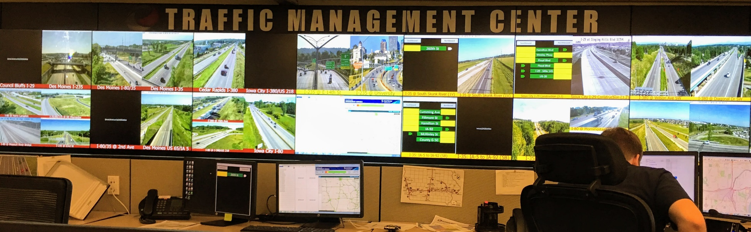
What data does the DOT have?
Speed and Volume –
  Over 300 traffic sensors
  167 automatic traffic recorders
Incidents – Traffic Management Center 24/7/365
Track A Plow – location, plow status, material, images
Work Zones
Winter road conditions
RWIS stations
Pavement condition
Curve location
Camera imagery
Crash data
Notes:
Iowa is fortunate that we collect an enormous amount of data. Listed are just a few examples of the types of data we collect.

Slide 33
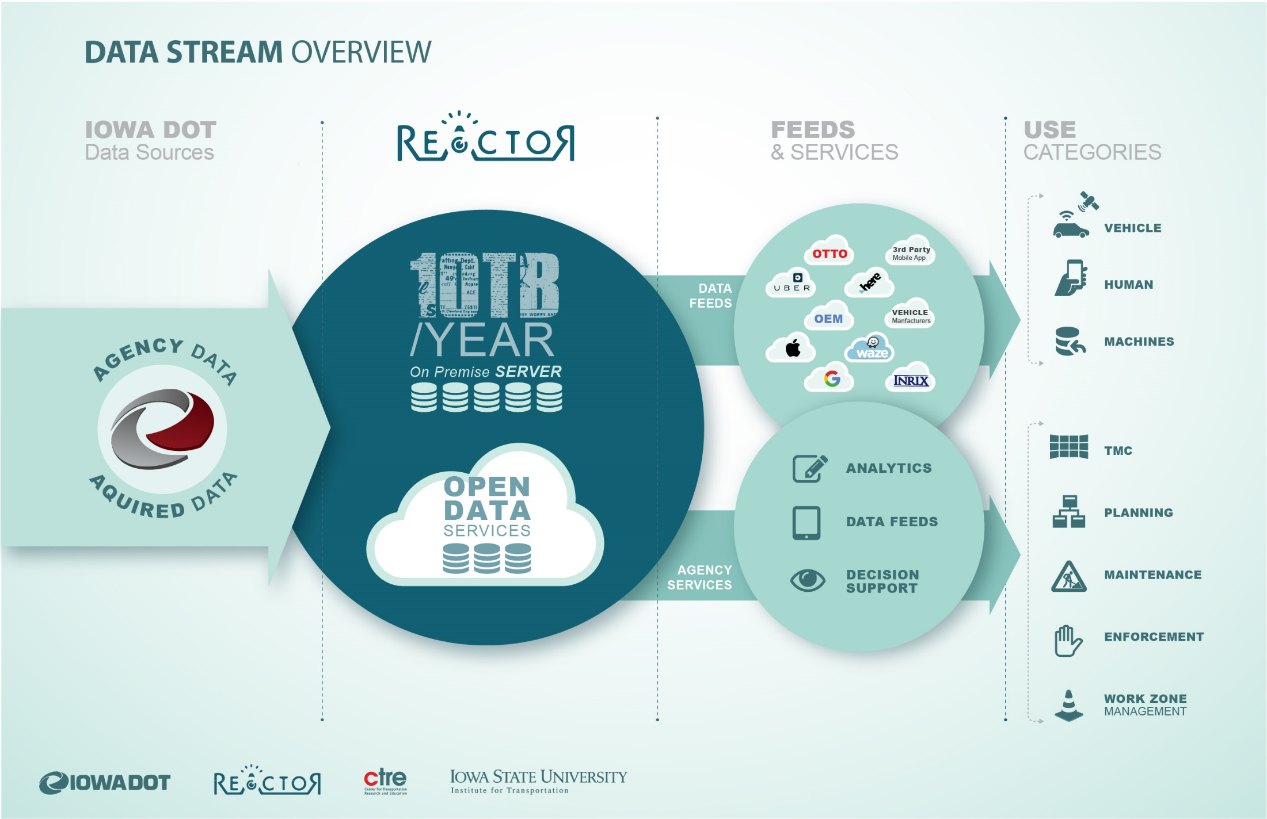
Data Streams

Slide 34
Wrap Up!

Slide 35
Challenges and Lessons Learned
Top down – bottom up approach
Leveraging existing planning processes adds organizational credibility
5-year Plan look ahead has provided clarity for budgeting and programming
Champions are short-lived – must leave a legacy
Use your own data wherever possible
We need better national data to support business case
Implementation takes time – be patient

Slide 36
What Do We Expect?
Safer highways because we keep traffic moving
Fewer delays because we reduce the time it takes to open lanes for a traffic incident
Extending the life of highways through aggressive traffic operations management
Better Customer Service

Slide 37
What Do We Expect?
Quicker response to major emergencies impacting highways
More economic development opportunities because of reliable supply chain
Better quality of life

Slide 38
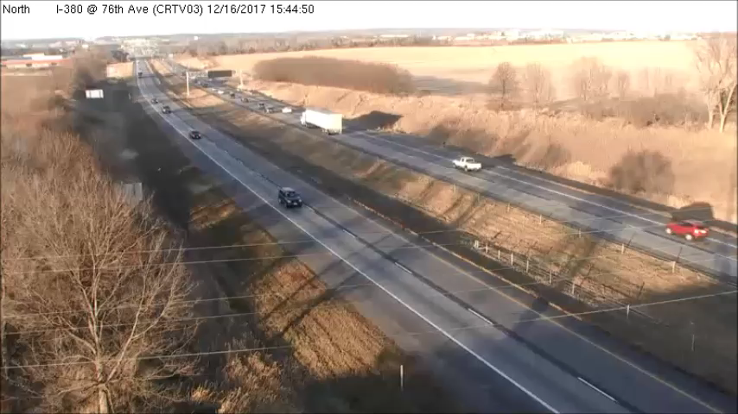

Slide 39

February 15, 2016

Slide 40
Thank You!
Willy Sorenson
Iowa DOT
Special Projects Engineer/Office of Traffic & Safety
515-239-1212
Willy.Sorenson@iowadot.us

