Slide 1
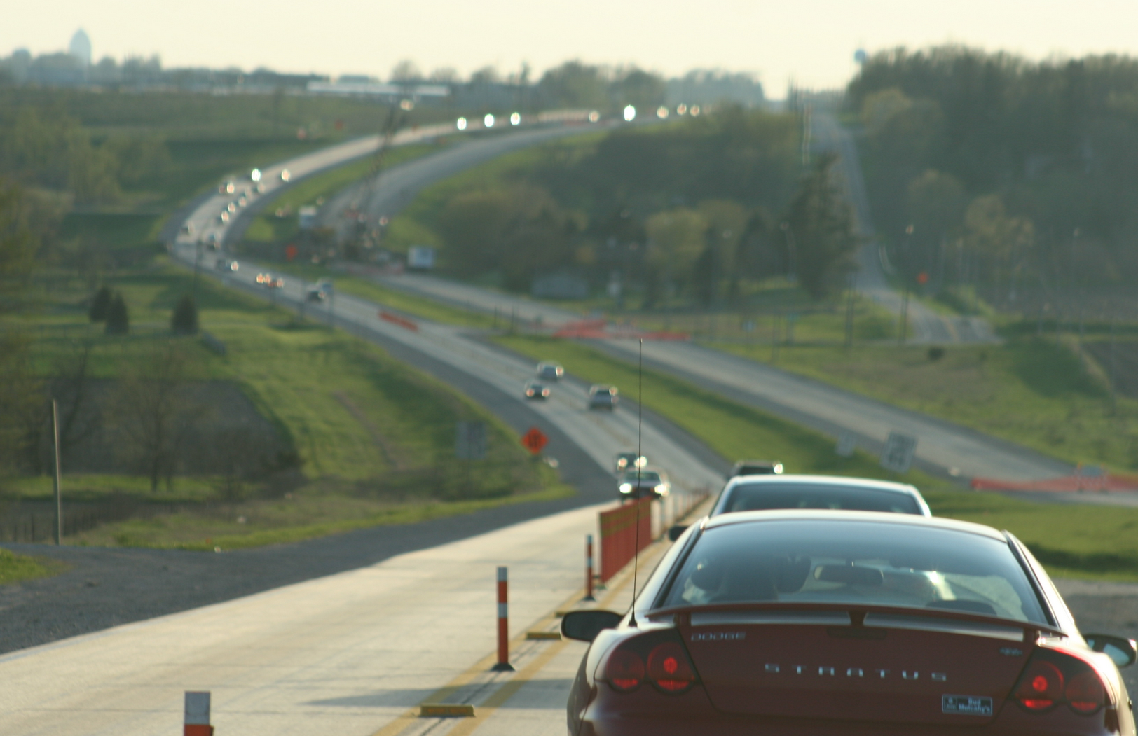


Work Zone Data in Iowa
Skylar Knickerbocker

Slide 2
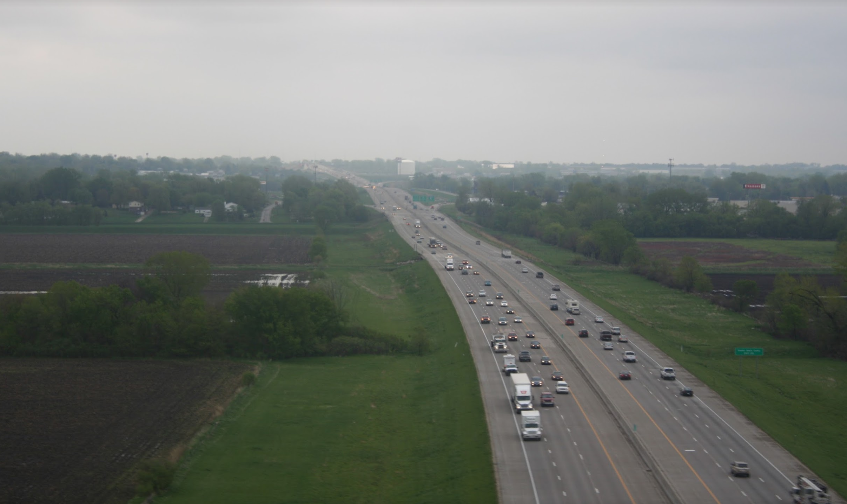
Can you provide a feed with every lane closed within your state/city/county every minute?

Slide 3
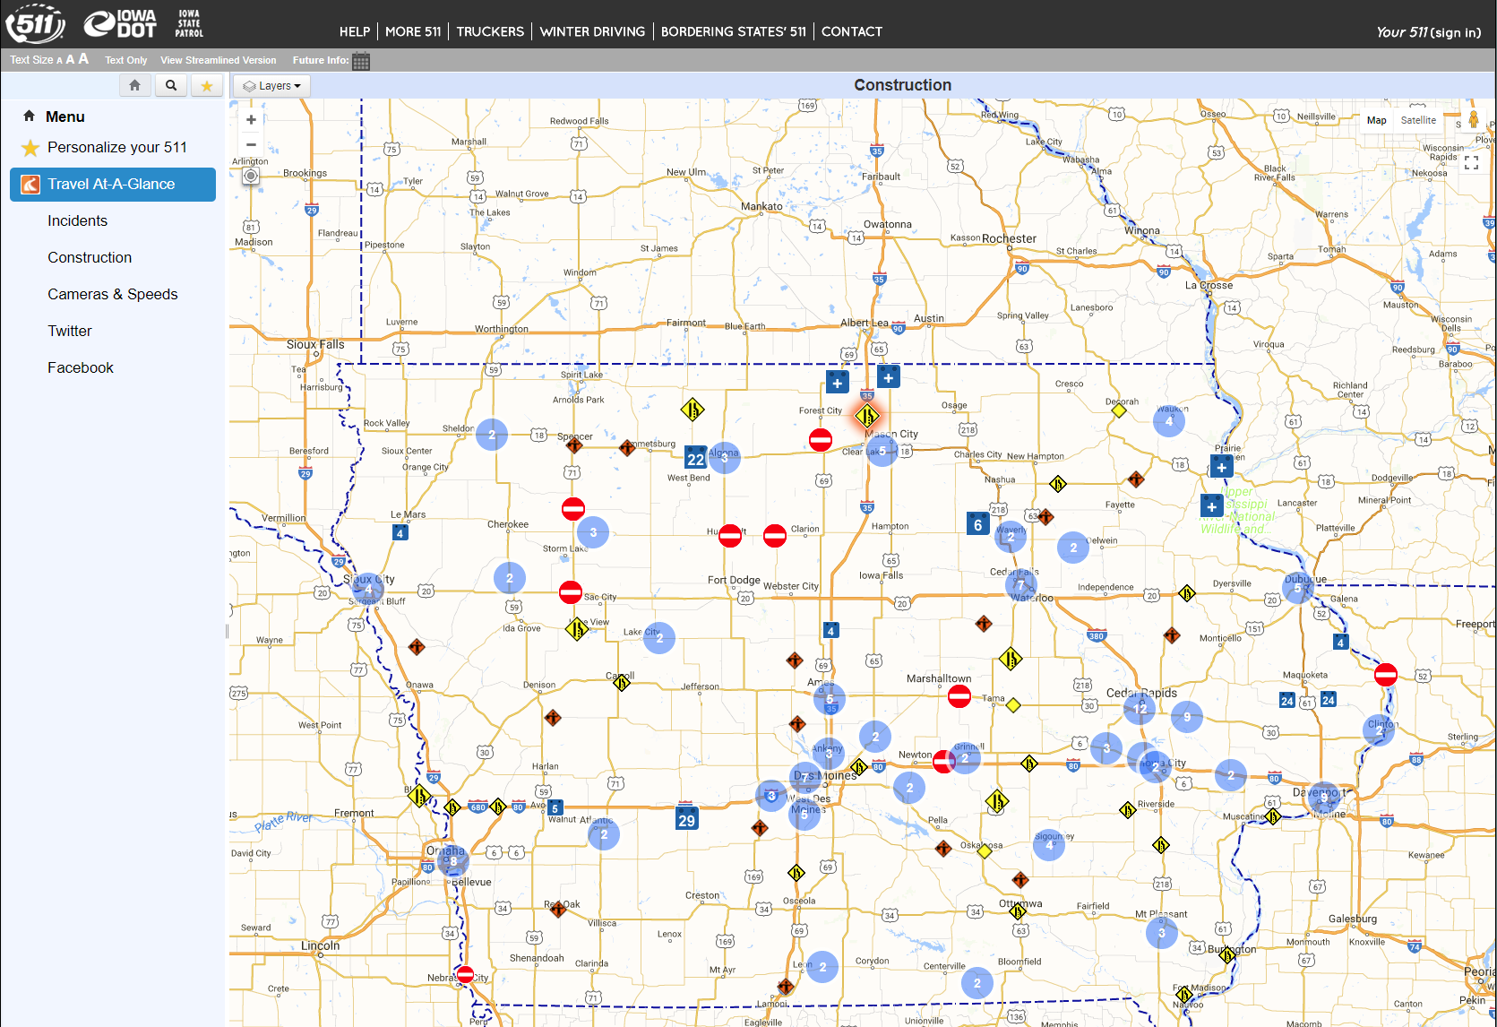
511 data for work zone

Slide 4
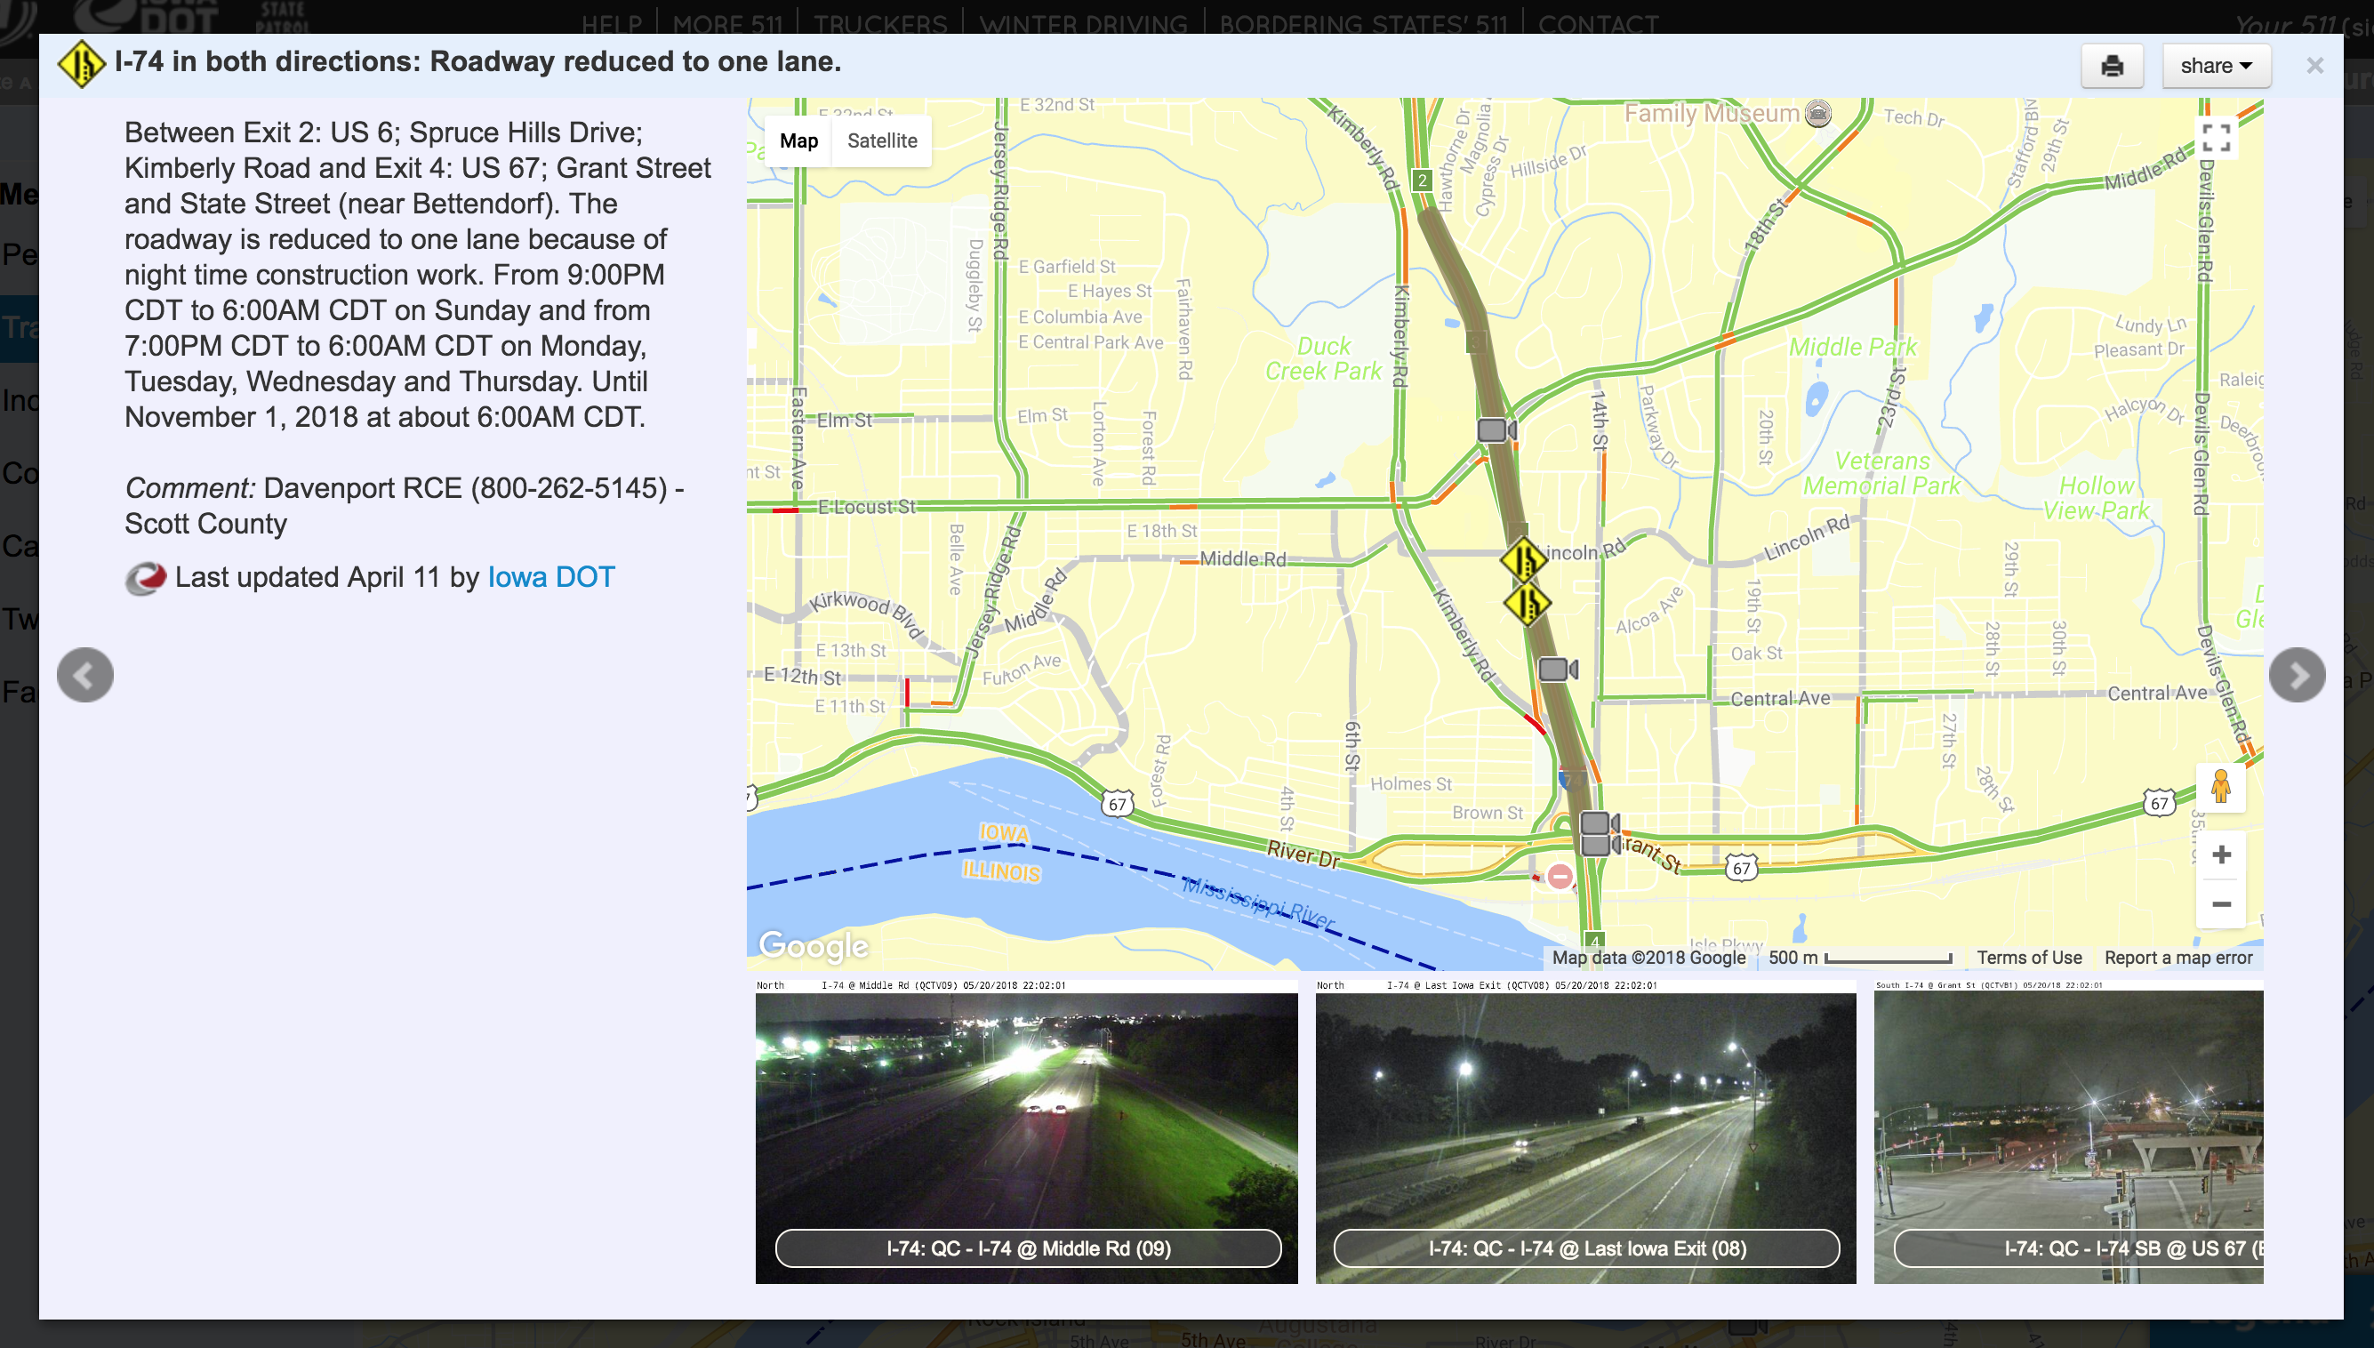
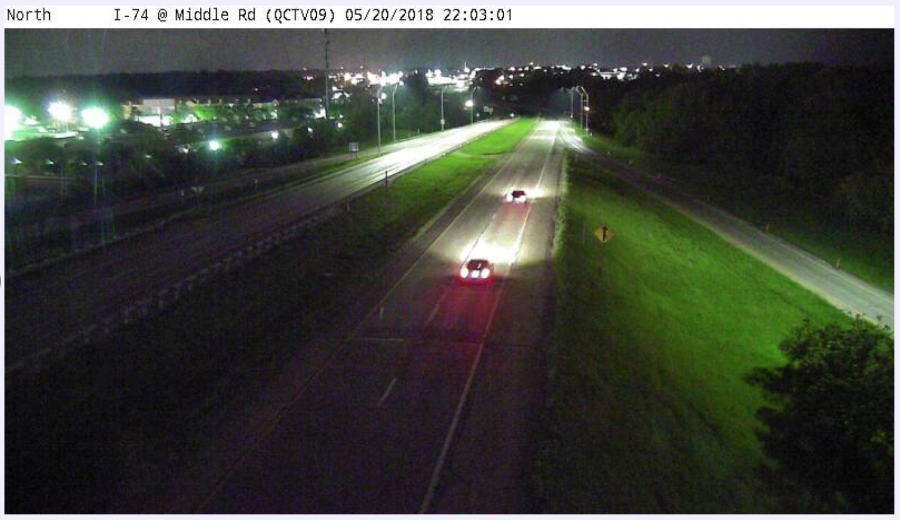
Inaccuracies

Slide 5
Need for improved work zone information

Slide 6
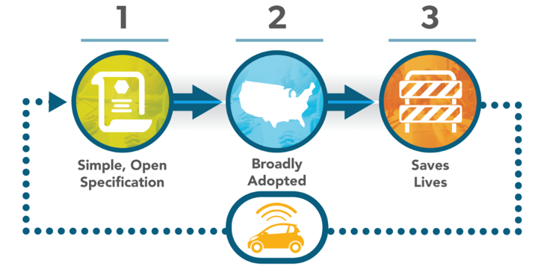
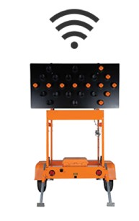
Method to Communicate
Improve Accuracy of
Work Zone

Slide 7
Method to Communicate

Slide 8

Work Zone Data Exchange (WZDx)
Part of U.S. DOTs Data for AV Integration (DAVI) Initiative:
“Access to data is a critical enabler for the safe, efficient, and accessible integration of automated vehicles (AVs) into the transportation system”
Enables infrastructure owners and operators (IOOs) to make harmonized work zone data available for third party use
https://www.its.dot.gov/resources/pdf/WZDx_Webinar_Presentation_26FEB2019.pdf

Slide 9
WZDx v1.1 Common Core
Sample of fields that are included in the specification including:
  Identifier
  Start and End Time
  Begin and End Location
  Work Zone Status
  Number of Lanes (Open lanes, closed lanes, shoulders)
  Workers Present
  Reduced Speed Posted
  Road Restrictions
Some fields are optional
https://www.transportation.gov/av/data
https://github.com/usdot-jpo-ode/jpo-wzdx

Slide 10
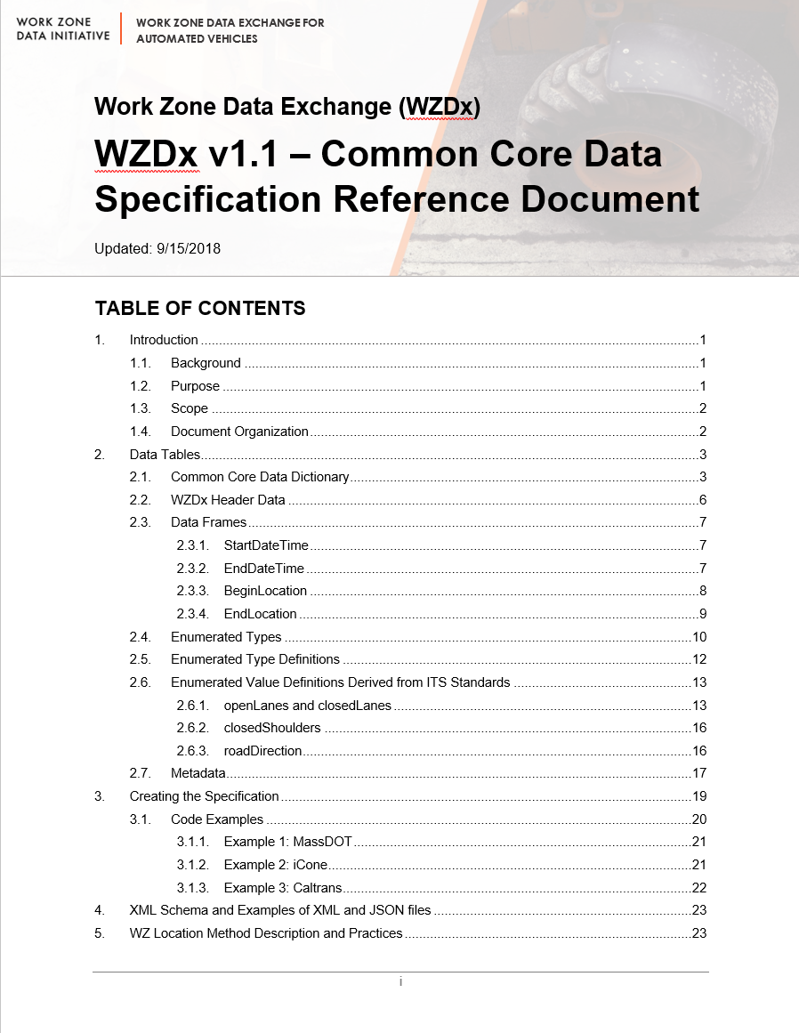
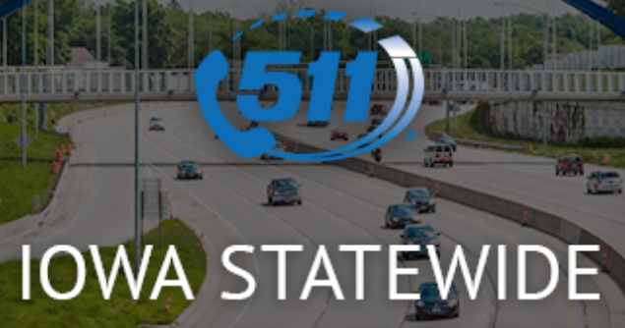
Map 511 data to WZDx v1.1 spec
Using existing data collected within agency
Some challenges and limitations exist within agency and WZDx
Notes:
Low hanging fruit to map existing work zone data to WZDx that is in a format for others to easily consume

Slide 11
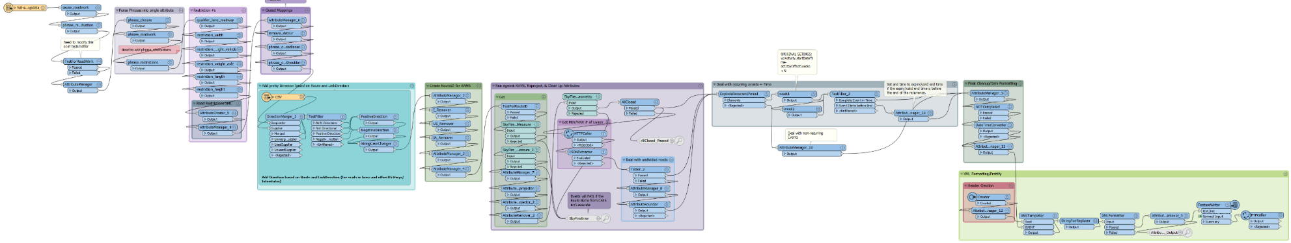
Iowa WZDx Data Pipeline
Formatting existing data in 511 into WZDx Specification
Adding asset management information from RAMS
Handling recurring events
Data cleanup and producing XML
Two Data Sources: 511 and RAMS (roadway assets management system)
Process currently run every 15 minutes

Slide 12
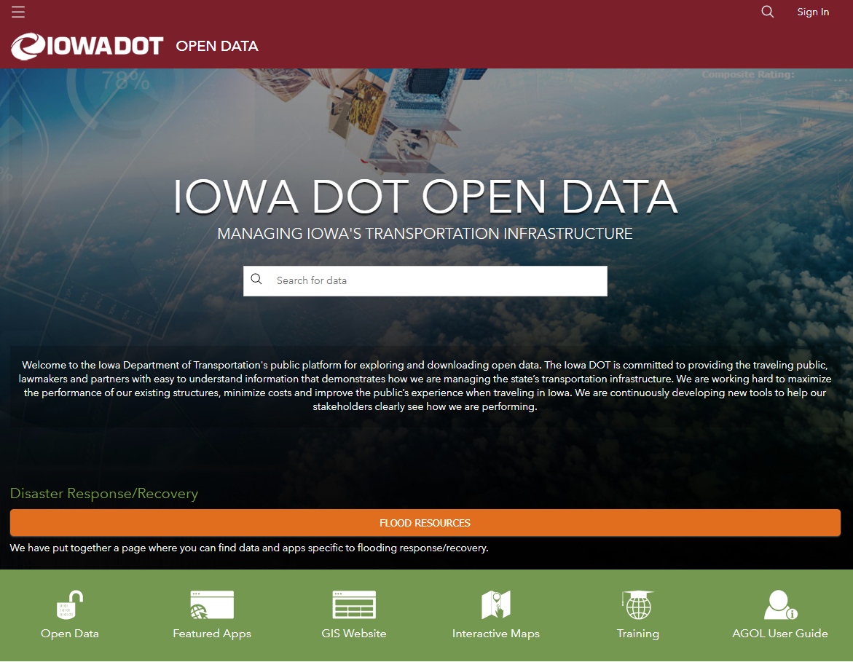
Open Data Portal: https://public-iowadot.opendata.arcgis.com/datasets/iowa-work-zone-data-exchange-wzdx
Direct Link: https://cloud.iowadot.gov/Highway/OTO/wzdx.xml

Slide 13
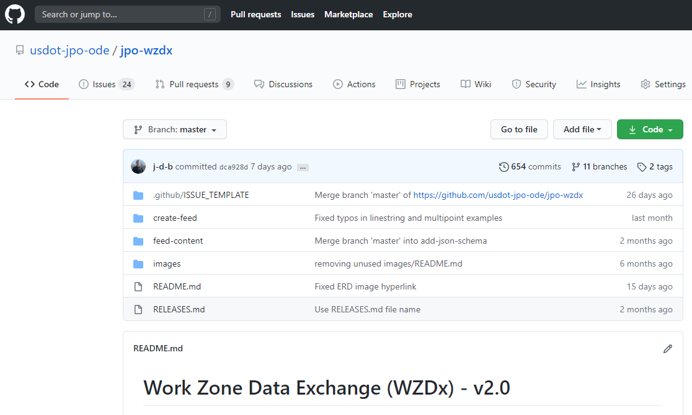
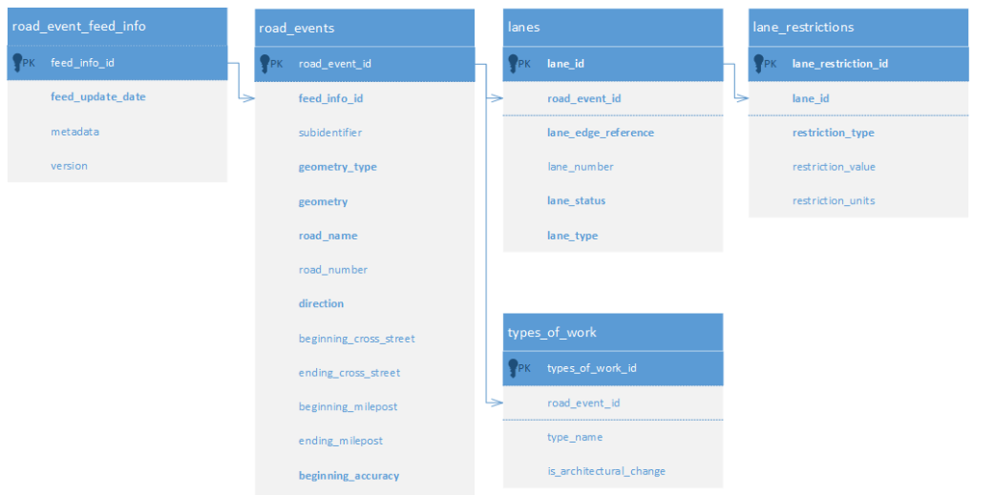
Development of WZDx v2 and v3
Open collaboration through the WZDx Specification Update Subgroup
Become active by watching git hub repository (https://github.com/usdot-jpo-ode/jpo-wzdx)

Slide 14
Improve Accuracy of
Work Zone

Slide 15
Work Zone Vision for Iowa DOT
Draft – Iowa DOT SABP 1.0
In Progress
Standard Communication for Devices (smart arrow boards, connected devices, etc)
Integration of connected devices with planned work zone

Slide 16
Work Zone Vision for Iowa DOT
Draft – Iowa DOT SABP 1.0
In Progress
Standard Communication for Devices (smart arrow boards, connected devices, etc)
Integration of connected devices with planned work zone
Focus on the devices first and how to collect the data (another lower hanging fruit)

Slide 17
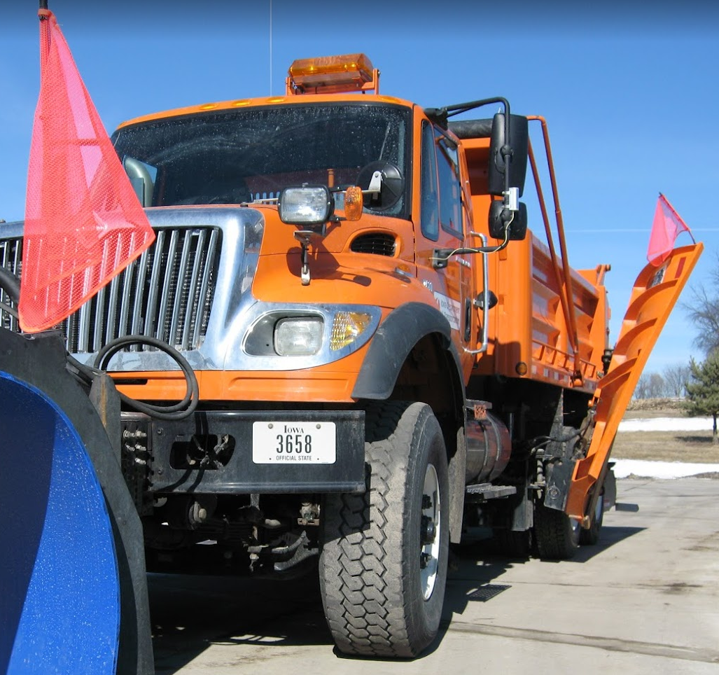
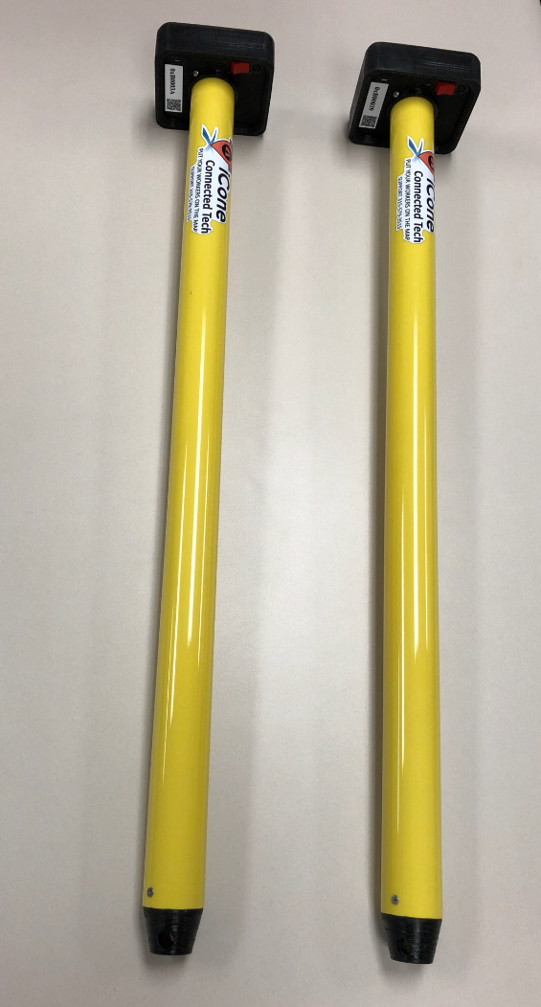
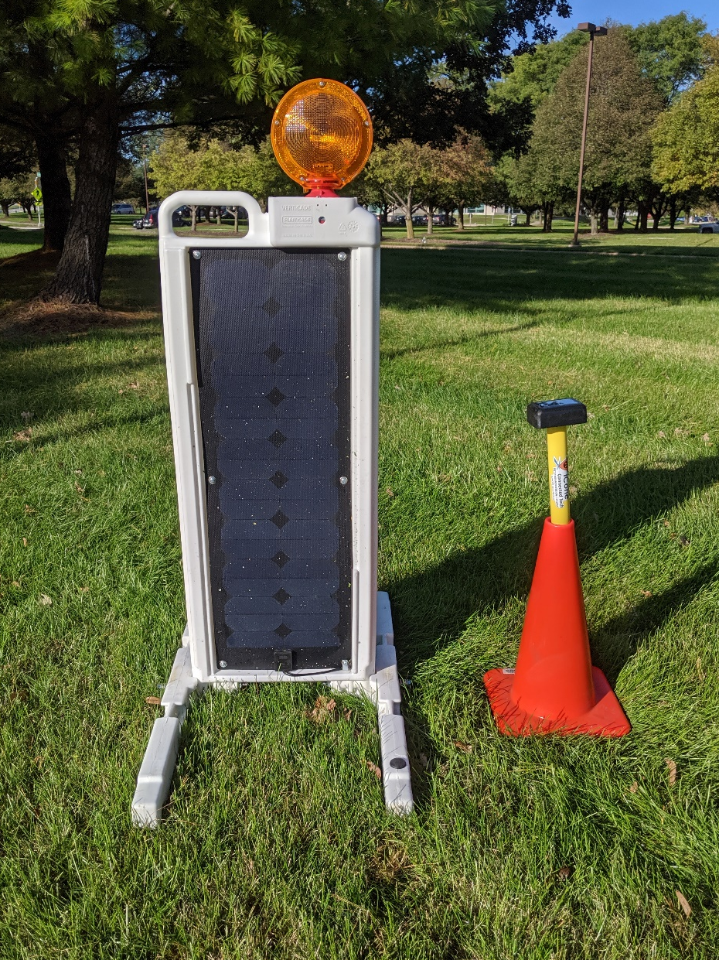
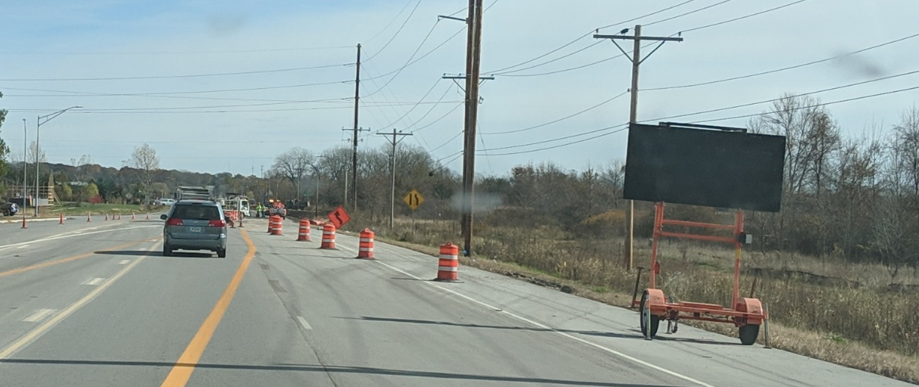
Field Data
I am: ID# 77
I am: Location (lat, lon)
I am: ON

Slide 18
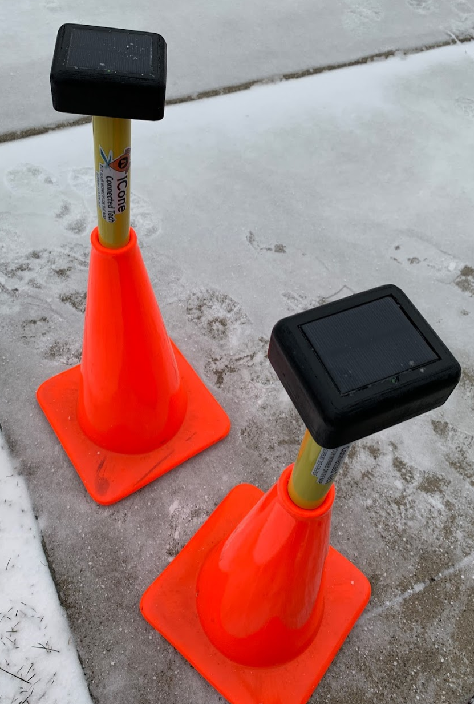
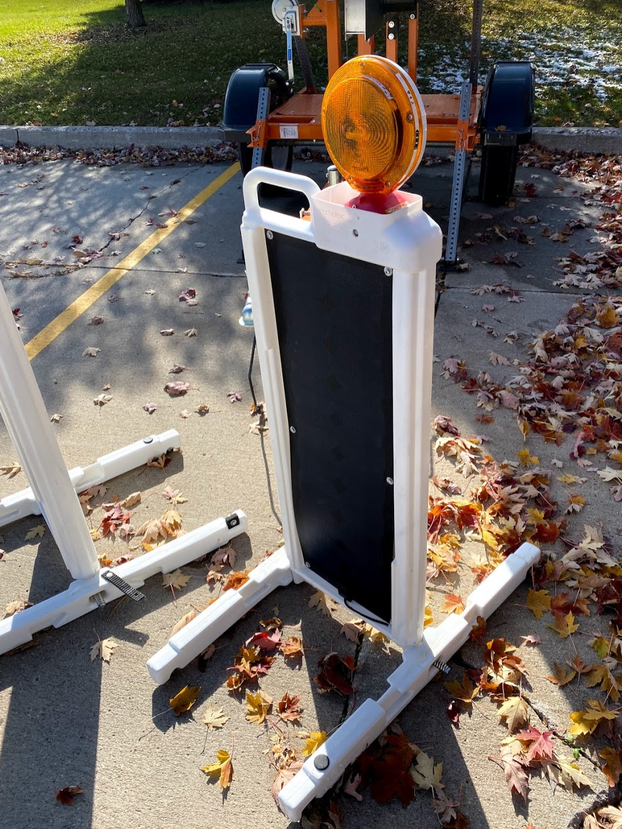
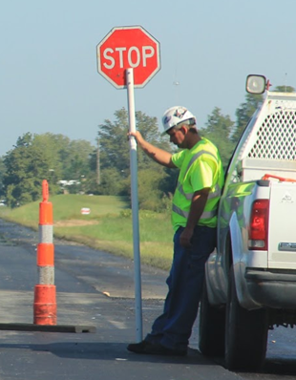
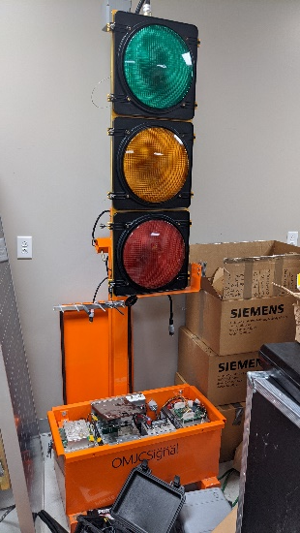
Three Categories
Existing Connected TTCD
New
Connected TTCD
Automated Vehicle Location (AVL)
Notes:
Iowa DOT has focused on smart arrow boards to start because they are existing devices that contractors are deploying. Making them smart has no impact on contractors other than needing to have a smart arrow board (i.e. the field workers do not have to do anything additional beyond what they are currently doing)

Slide 19
Smart Arrow Board Advantages
Provide automated real-time lane closure information with no additional field worker effort
Existing inventory can be modified to meet requirements

Slide 20
What makes an Arrow Board “Smart”?
Communication!

Slide 21

Smart Arrow Board Requirements
Option 2:
Data polled from arrow board directly
Option 1:
Data received from intermediary server
Pushed based on:
Status Change
Location Change
Check-in
Other
Data Push
Manufacturer Servers
Data Pull
From Devices
Available in the Deployment Plan:
https://iowadot.gov/workzonereferencelibrary
Data Pull/Query
From Manufacturer API
Notes:
All manufacturers currently are planning on going with option 1. Through this method they aggregate the data from all of the arrow boards then provide a standard JSON feed. This is actually the preferred method of the Iowa DOT as well.

Slide 22
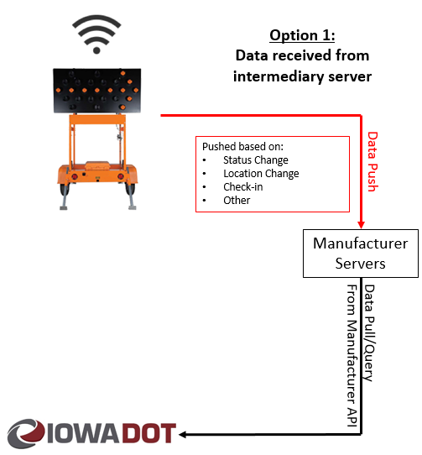
Requirements:
Device updates data feed on pattern changes within 2 minutes
Device updates data feed if moved 500+ feet within 2 minutes
Device provides health check every 30 minutes
SABP includes all arrow boards within Iowa
Available in the Deployment Plan:
https://iowadot.gov/workzonereferencelibrary
Notes:
Performance criteria are established for how quickly the data from the smart arrow board are received by the Iowa DOT.
The fourth bullet point is critical as well. Currently contractors are required to integrate their portable dynamic message signs with the traffic management center. This doesn’t always occur due to the additional effort by both the contractor and the operators in the traffic management center. By the manufacturers including all of the arrow boards in Iowa, it minimizes the effort by the contractors since they do not have to communicate with the TMC when a new arrow board is added. It will just automatically show up in the feed provided by the manufacturer.
This does not have a requirement for the type of roadway which allows the Iowa DOT to determine what arrow boards are on their project. Since these arrow boards will also be used on local agencies projects, the local agencies have the benefit of tapping into this feed in the future as well.

Slide 23
Work Zone Vision for Iowa DOT
Draft – Iowa DOT SABP 1.0
In Progress
Standard Communication for Devices (smart arrow boards, connected devices, etc)
Integration of connected devices with planned work zone
How the devices integrate within the DOT is the next challenge and the most difficult

Slide 24
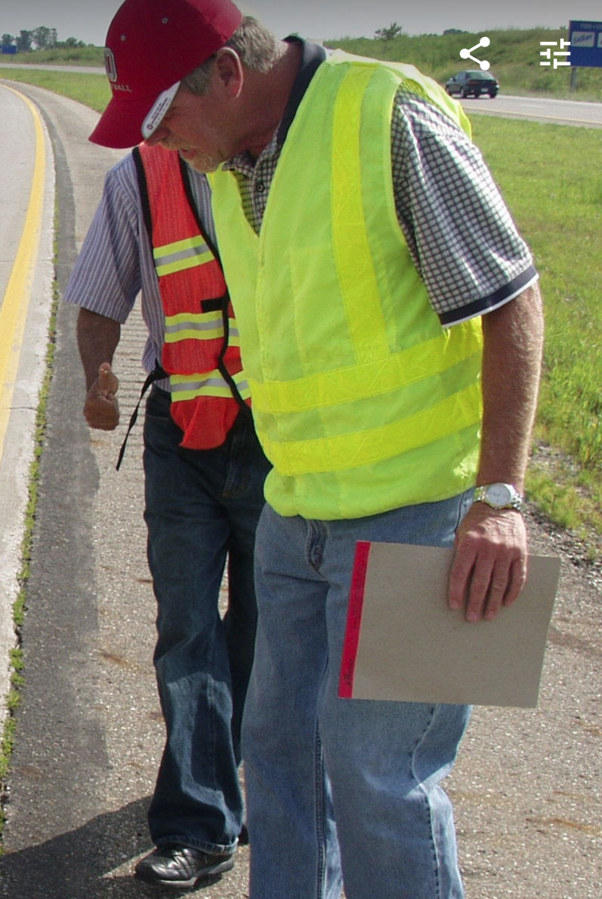
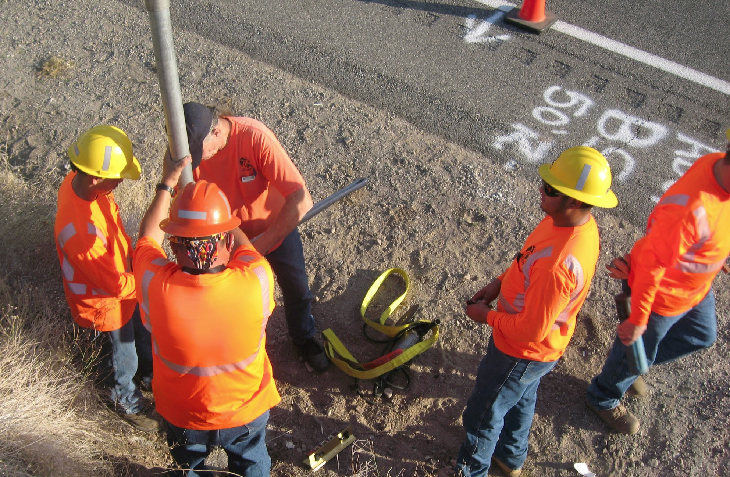
Limited resources
and time
Not another form!
Notes:
Based on the SABP description above, we want to eliminate the additional work for those in the field. So we want a solution for integration that requires minimal effort for those in the field.

Slide 25
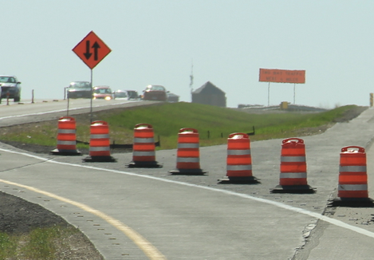
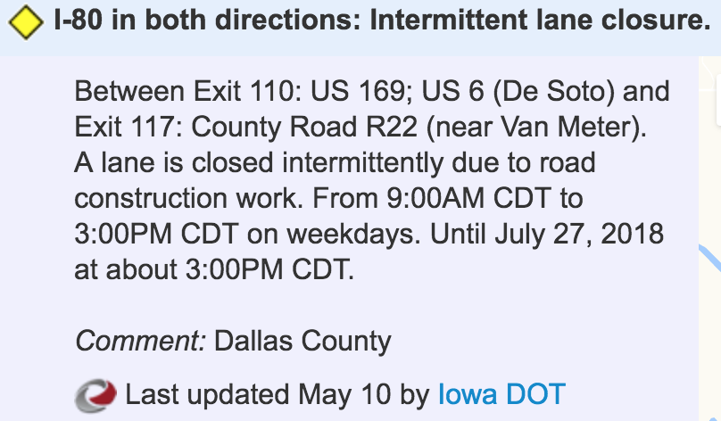
Integration
Planned
Actual
+
=
Work Zone Data Feed
511
Work Zone Data
Field Data
Planned events entered into database
Confirmation from the field through two (or more) “field devices” ID’s associated to the lane closure or other means of input (like an app)
Real time feed generated when “devices” are active during a corresponding planned events (based on spatial and temporal extents)
Notes:
Current plan is to leverage the “planned” data that is inputted into our 511/ATMS system then integrate the field data based on the devices proximity to the “planned” work zone. The requires the same level of effort for users to input their planned work zones but doesn’t require additional work for those in the field.

Slide 26

Work Zone Integration Example
Planned Data |  |  |  |  | Connected Devices |  |  |  | Published Work Zone
Work Zone ID | Route ID | From Measure | To Measure |  | Device ID | Route ID | Measure |  | Work Zone ID | Route ID | From Measure | To Measure
1 | M015546105E | 0.70 | 1.10 |  | Arrow Board | M015546105E | 0.79 |  | 1 | M015546105E | 0.79 | 1.01
 |  |  |  |  | Arrow Board | M015546105E | 1.01
LRS Route
RouteID: M015546105E
From Measure: 0.61
To Measure: 1.28
Planned Work Zoned
RouteID: M015546105E
From Measure: 0.70
To Measure: 1.10
Arrow Board
RouteID: M015546105E
Measure: 0.79
Connected Cone
RouteID: M015546105E
Measure: 1.01
Output:
Actual Work Zone
RouteID: M015546105E
From Measure: 0.79
(Actual)
To Measure: 1.01
(Actual)
Notes:
There are multiple ways the integration could be completed. Right now we are leveraging the Iowa DOT Linear Referencing System to integrate the arrow boards with the work zones. If the devices is located on the same roadway and between the start and end measures then it is associated with the work zone.

Slide 27
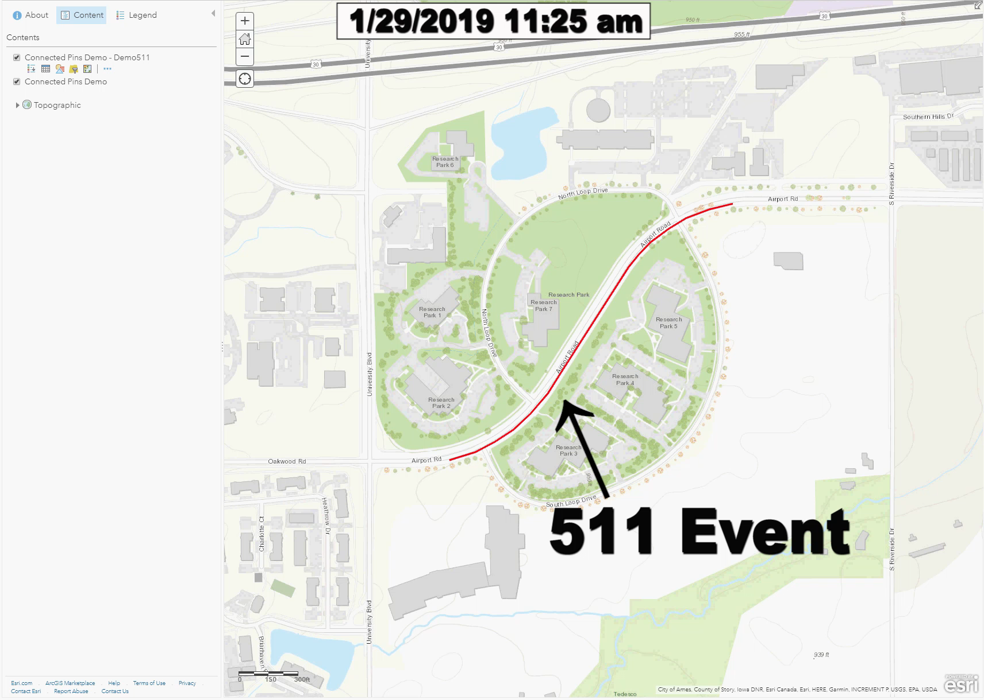
Integration Testing
Notes:
Video shows some initial testing using devices behaving like the smart arrow board. The devices were deployed and the system automatically associated the device to the 511 event without anyone in the field saying it was associated to the work zone.

Slide 28
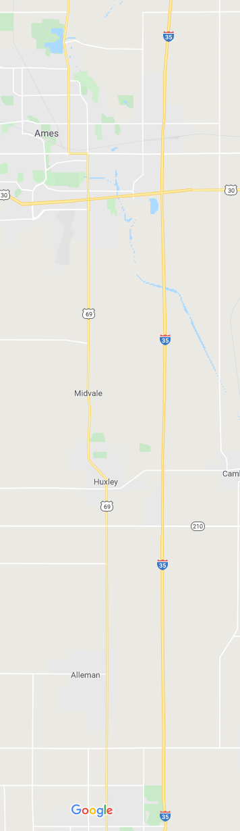
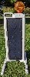

Planned Work Zone #2
Route ID: S001910035N
Measure 110.0 to 113.5
Actual Work Zone #2
Route ID: S001910035N
Measure 110.11 to 113.47
Unknown Work Zone Devices
Route ID: S001910035N
Measures of 107.67 and 108.26
Planned Work Zone #1
Route ID: S001910035N
Measure 95.0 to 102.75
Actual Work Zone #1
Route ID: S001910035N
Measure 98.76 to 99.82
Notes:
With widespread usage, this will also have the added benefit of identifying unauthorized or unknown work zones that occur on the system if no “planned” work zone can be associated to the devices.

Slide 29

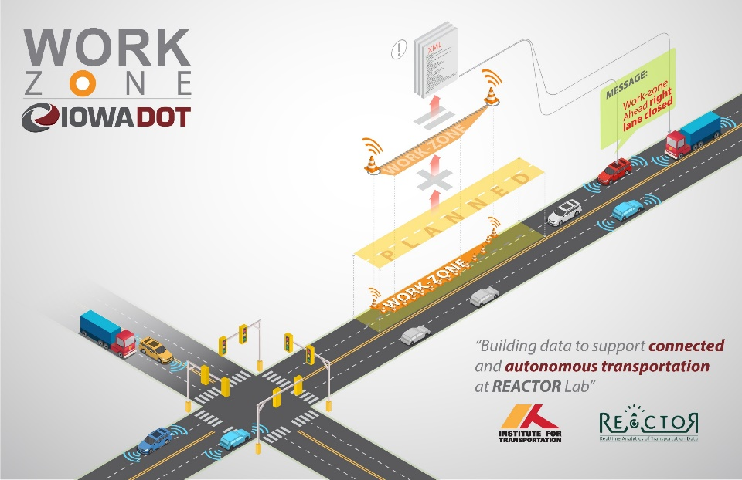
Next steps in Iowa
Implement latest WZDx
Expand to smart flaggers and other connected devices
Implement method of integrating devices within DOT

Slide 30
Work Zone Vision for Iowa DOT
Draft – Iowa DOT SABP 1.0
In Progress
Standard Communication for Devices (smart arrow boards, connected devices, etc)
Integration of connected devices with planned work zone
Future Work
Future Work
Planned Work Zones
Roadway sections must be checked out spatially and temporally (only 1 closure per location)
Work Zone Plans and Design Information and Scheduling
This system will require accurate “planned” work zone data which is a future effort by Iowa DOT to improve/streamline the input of planned work zones

Slide 31
Work Zone Data in Iowa
Skylar Knickerbocker
sknick@iastate.edu
515-294-2238
Willy Sorenson
Willy.Sorenson@iowadot.us
515-239-1212

