Slide 1
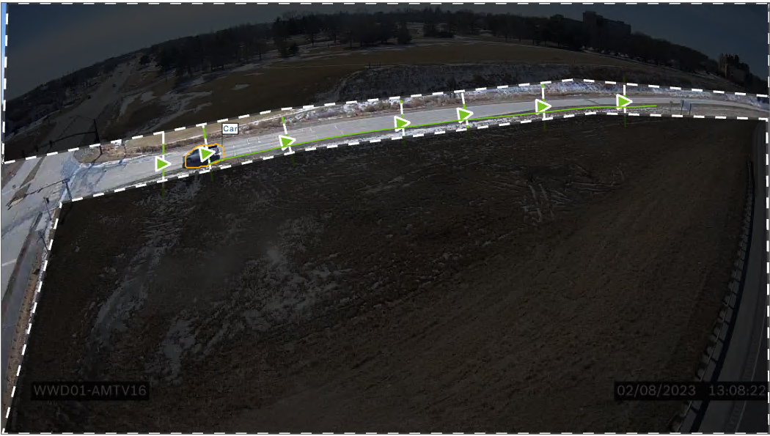
WWD01 – Diamond Interchange

Slide 2
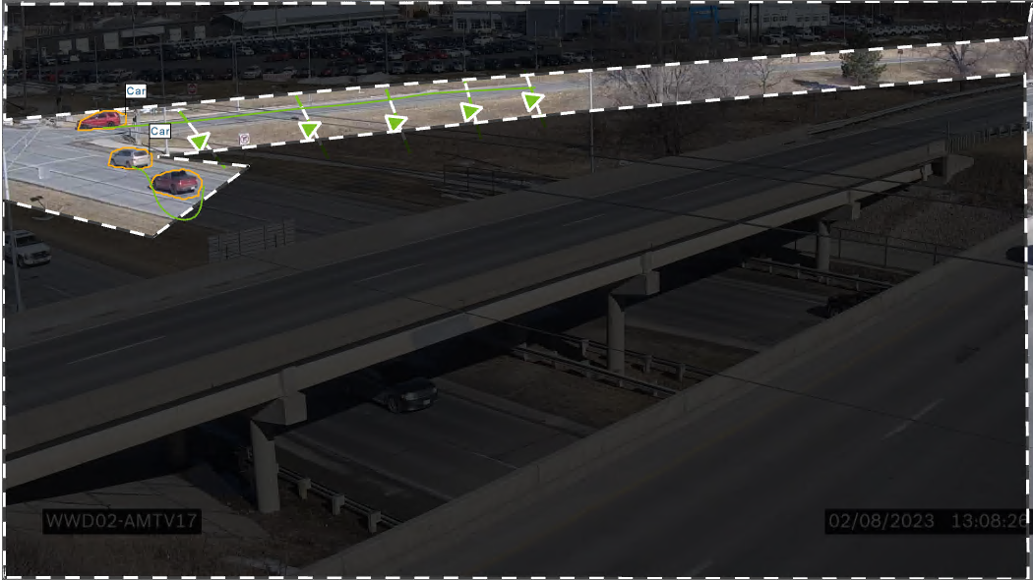
WWD02 – Diamond Interchange

Slide 3
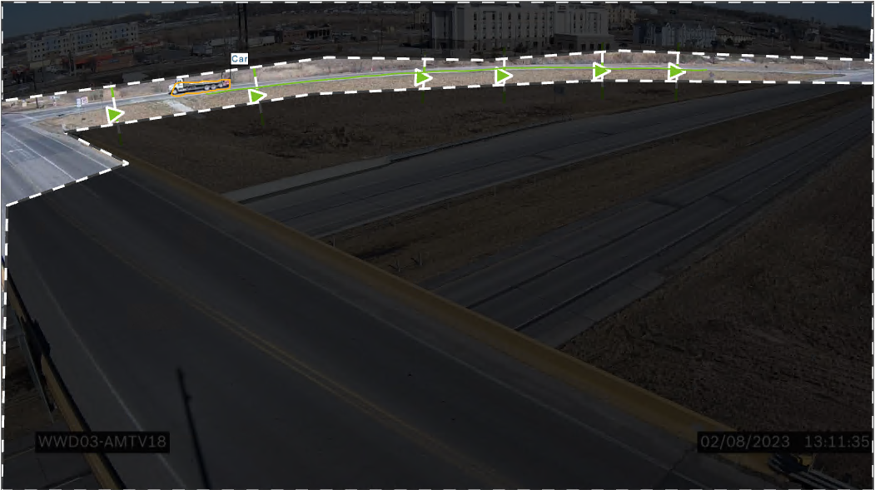
WWD03 – Diamond Interchange

Slide 4
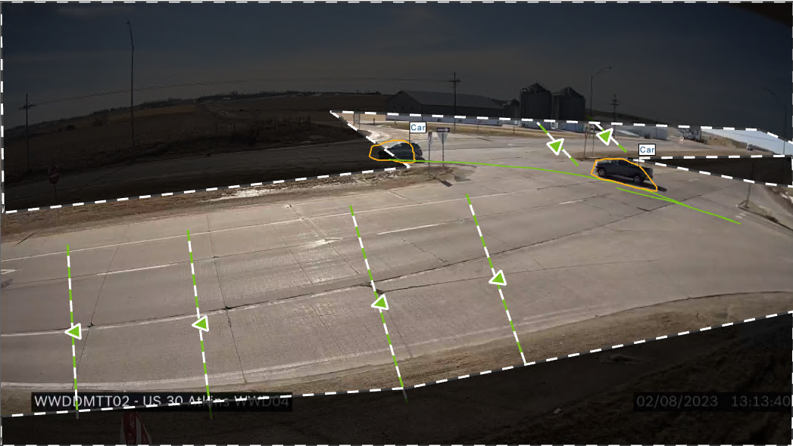
WWDDMTT02 (WWD04) – Trailer – At-Grade Intersection

Slide 5
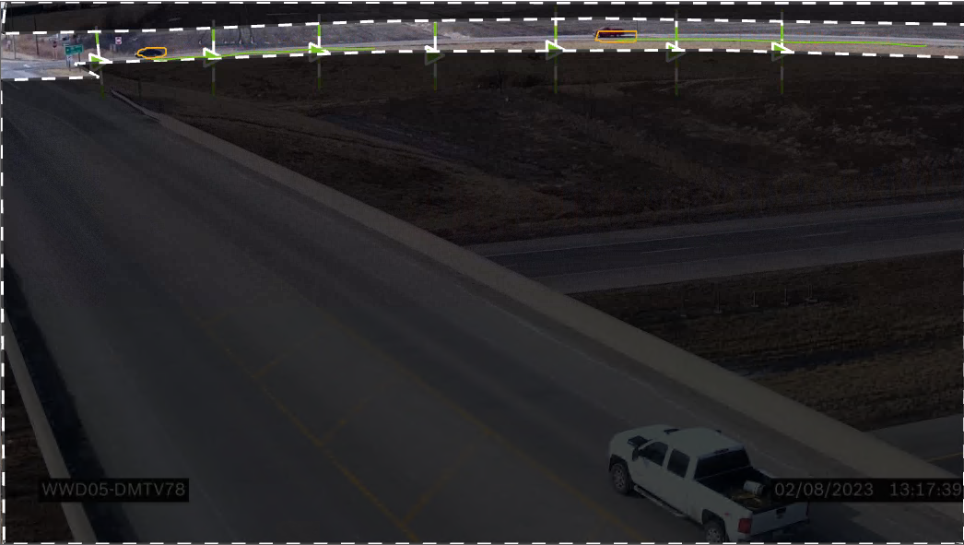
WWD05 – Diamond Interchange

Slide 6
WWD06 – Diamond Interchange
No Image on 2/8/23

Slide 7
WWD07 – Diamond Interchange
Will be installed at US 218 & US 30

Slide 8
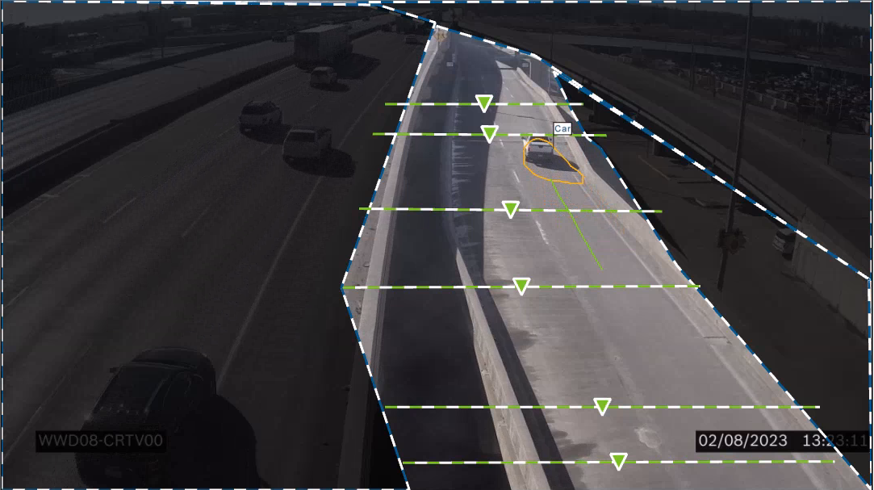
WWD08 – Ramp Only

Slide 9
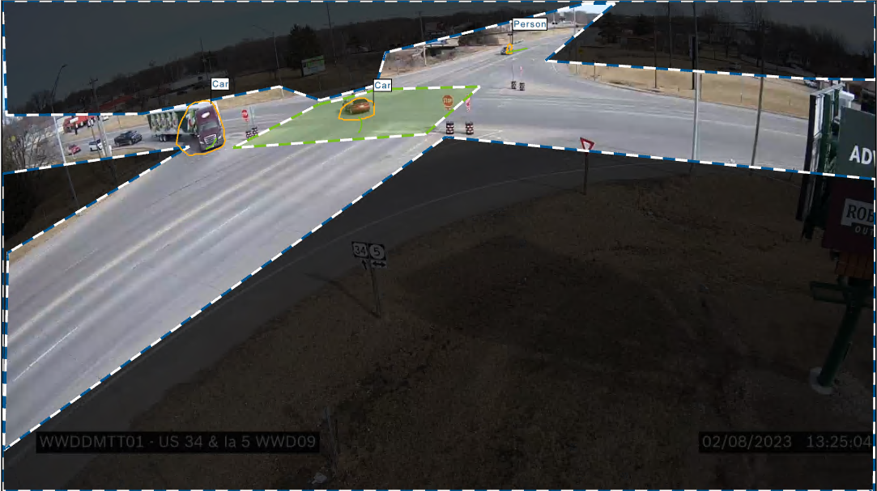
WWD01 – Diamond Interchange
WWDDMTT01 (WWD09) – Trailer – Detecting Stop Sign Running

Slide 10
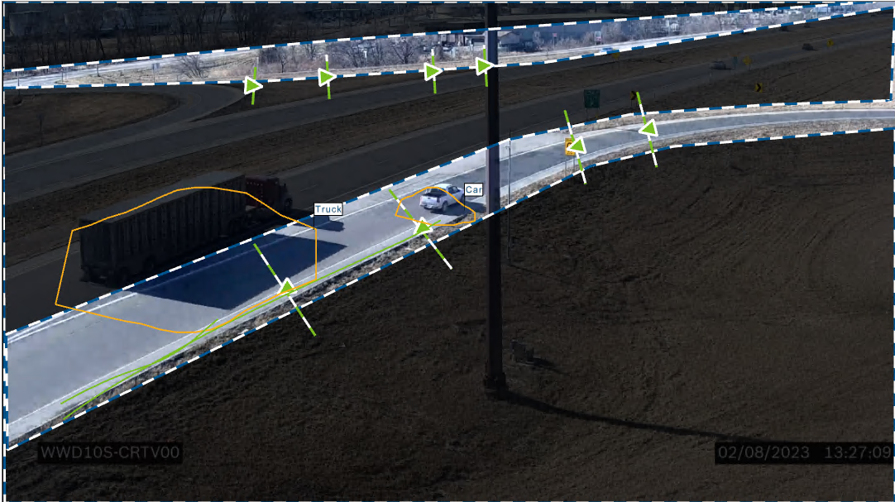
WWD10 – Parclo Interchange

Slide 11
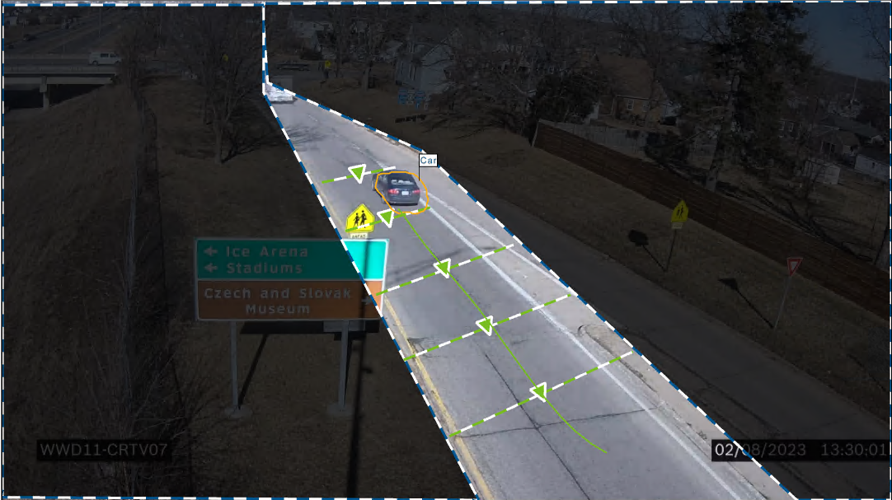
WWD11 – Diamond Interchange

Slide 12
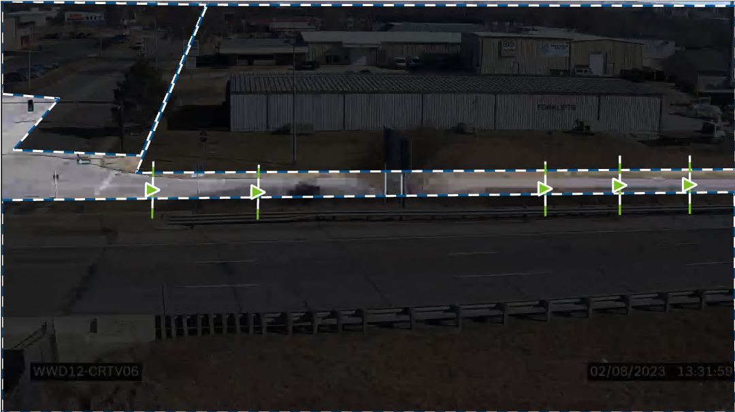
WWD12 – Diamond Interchange

Slide 13
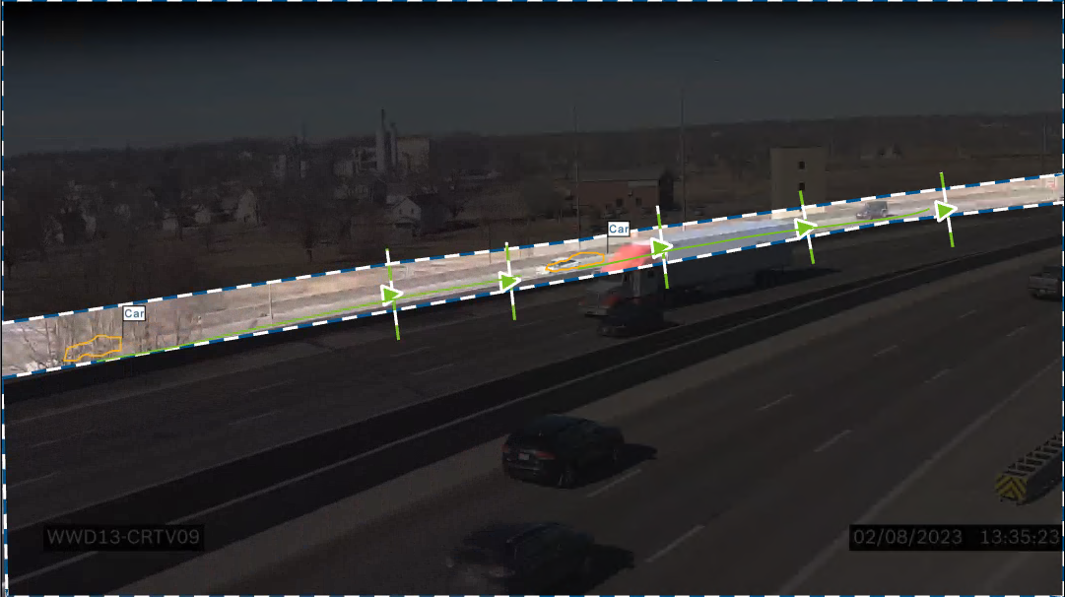
WWD13 – Diamond Interchange

Slide 14
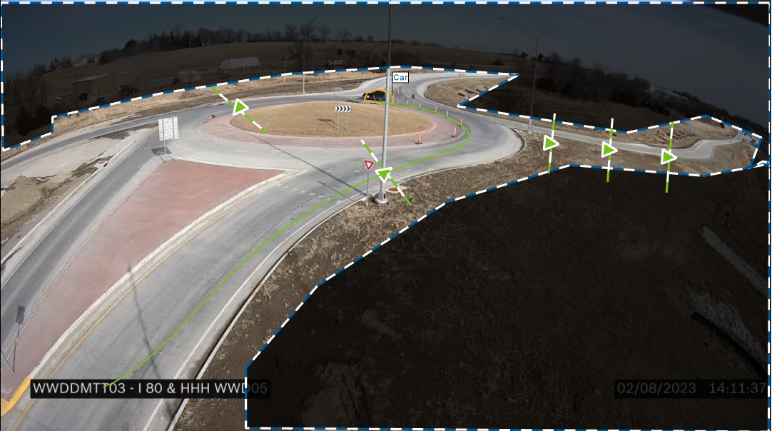
WWDDMTT03 (WWD14) – Trailer – WWD and Semi-Trailer Tracking

Slide 15
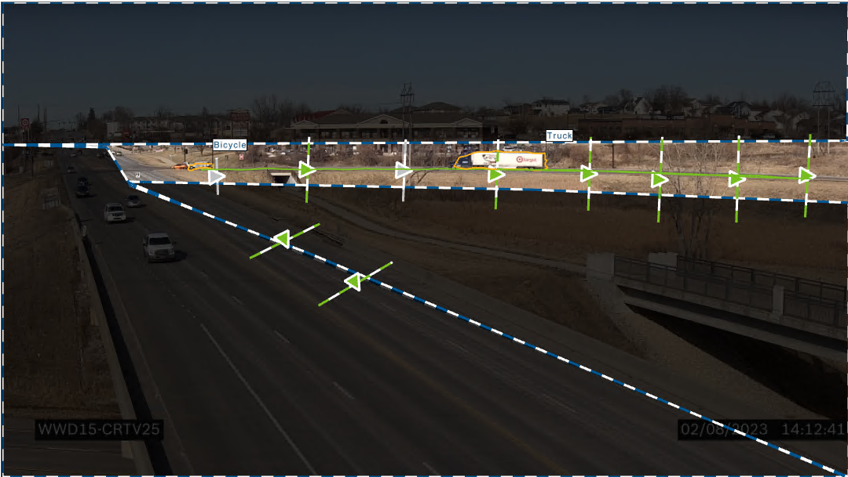
WWD15 – Diamond Interchange

Slide 16
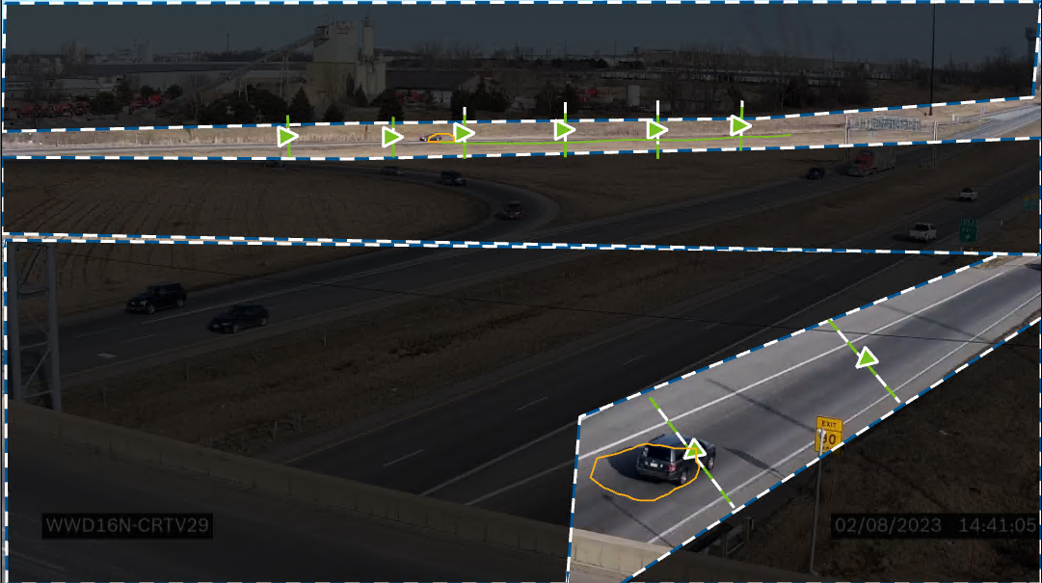
WWD16 – Diamond Interchange / Ramps
Vehicles not identified

Slide 17
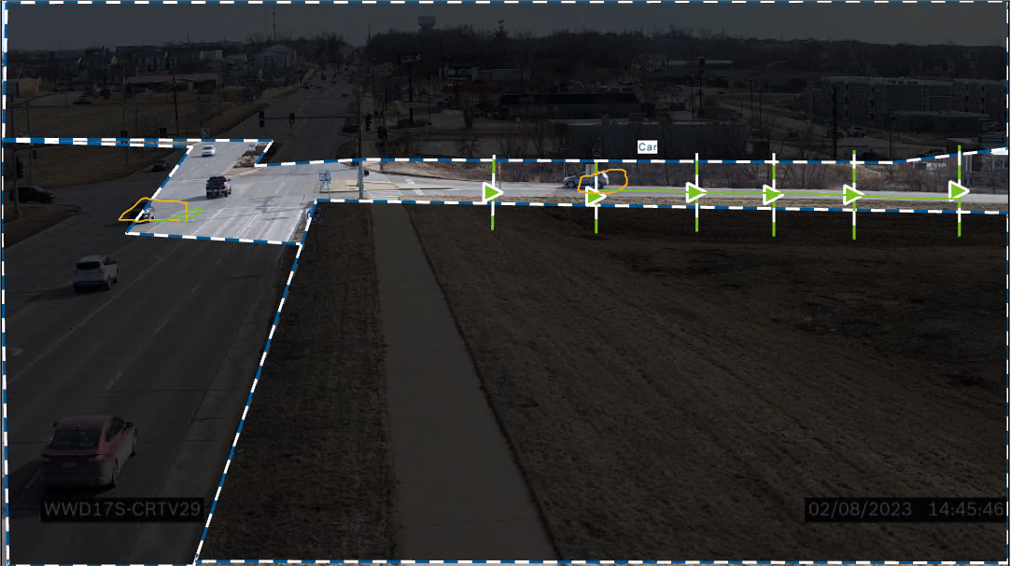
WWD17 – Diamond Interchange

Slide 18
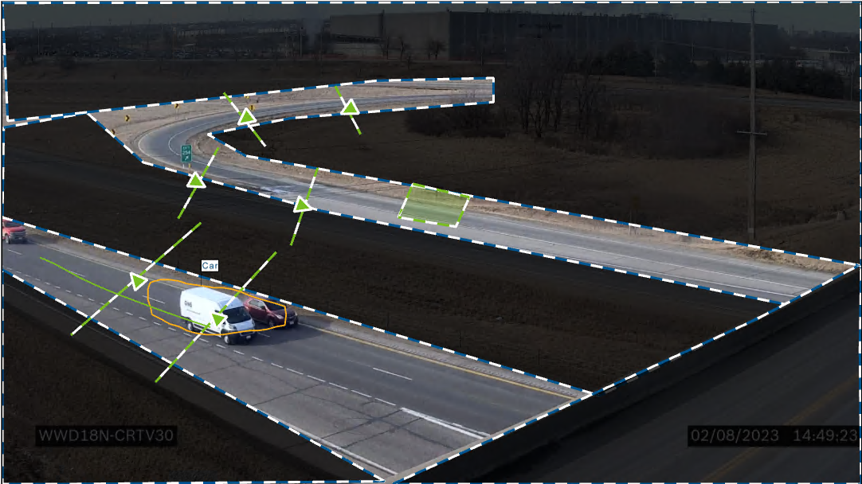
WWD18 – Parclo Interchange

Slide 19
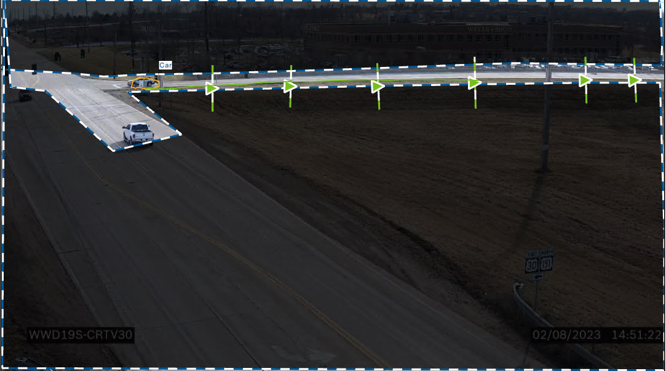
WWD19 – Diamond Interchange

Slide 20
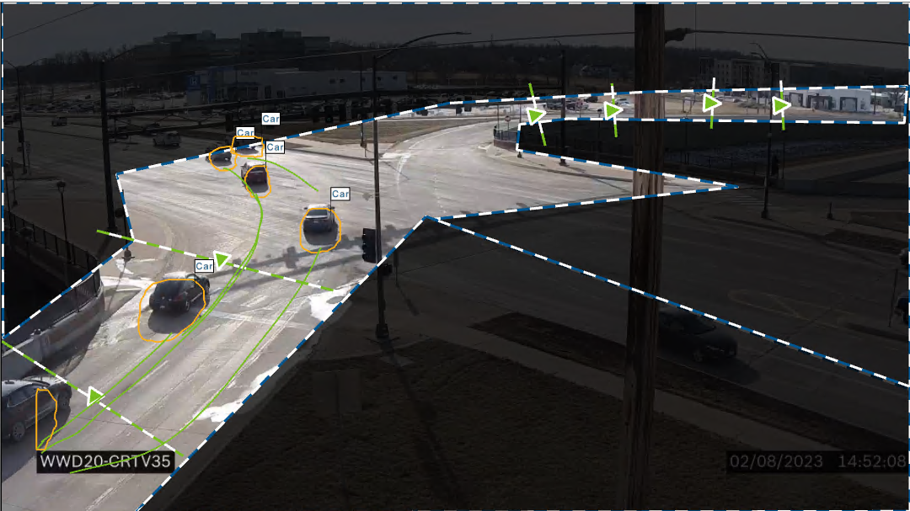
WWD20 – SPUI Interchange

Slide 21
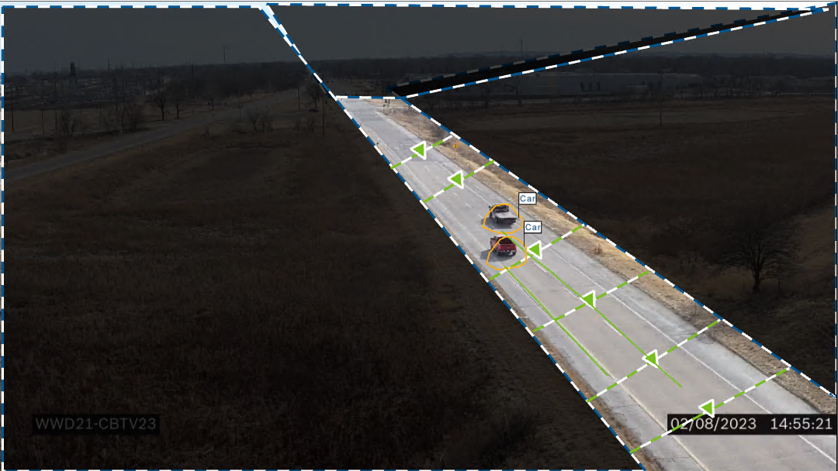
WWD21 – Ramp

Slide 22
WWD01 – Diamond Interchange
Not Installed Yet

Slide 23
WWD01 – Diamond Interchange
Not installed yet

Slide 24
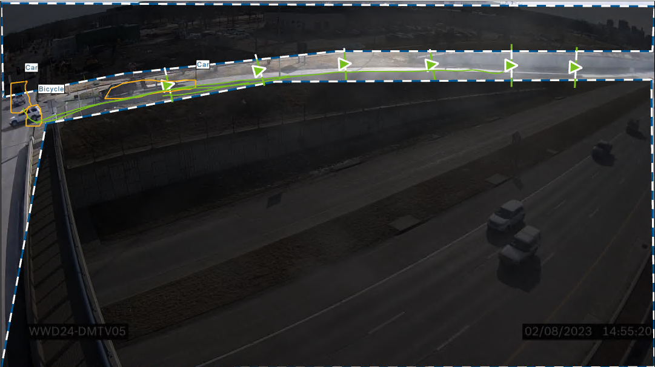
WWD24 – Diamond Interchange

Slide 25
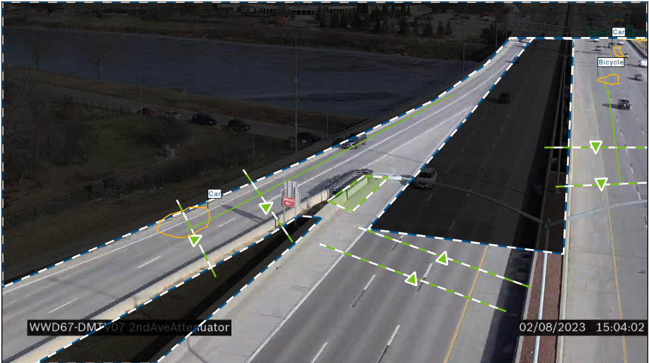
WWD67 – Attenuator Hits and Ramp WWD (Formally WWD25)

Slide 26
WWD06 – Diamond Interchange

Slide 27
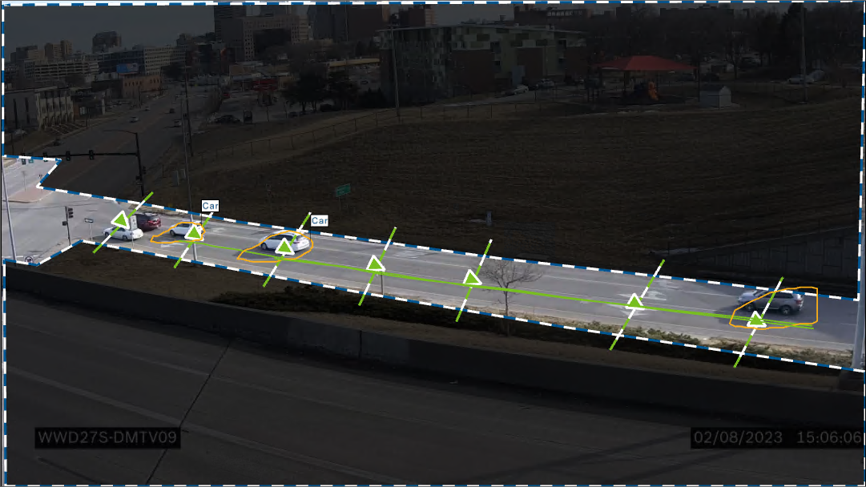
WWD27 – Diamond Interchange

Slide 28
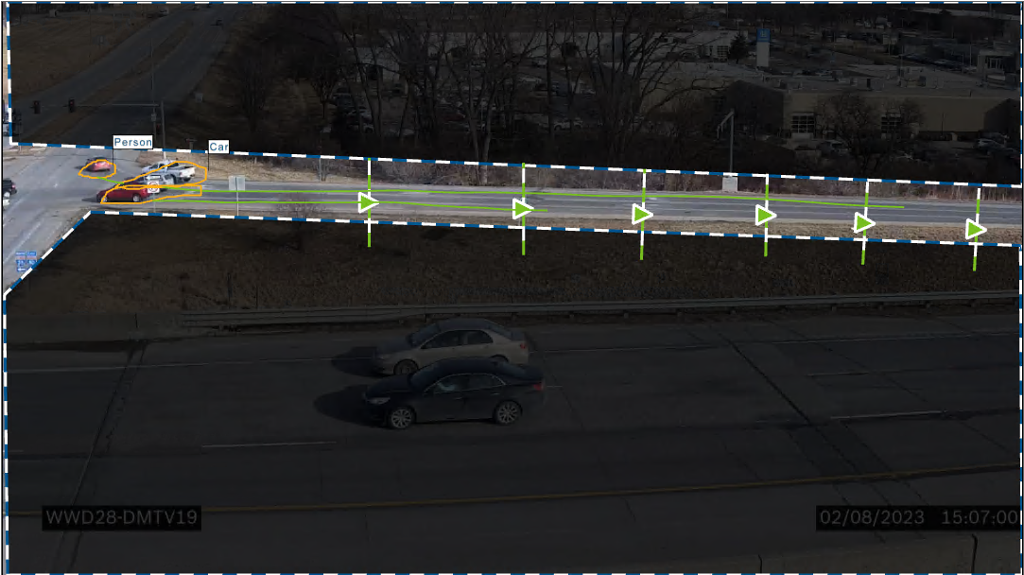
WWD28 – Diamond Interchange

Slide 29
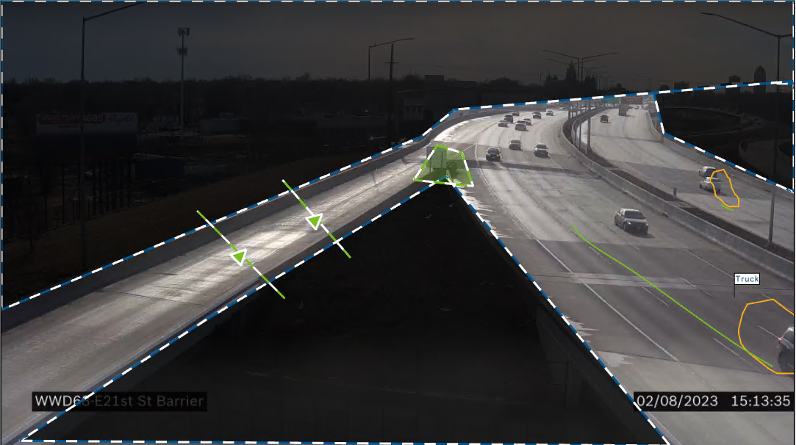
WWD68 – Attenuator & Ramp (Formally WWD29)

Slide 30
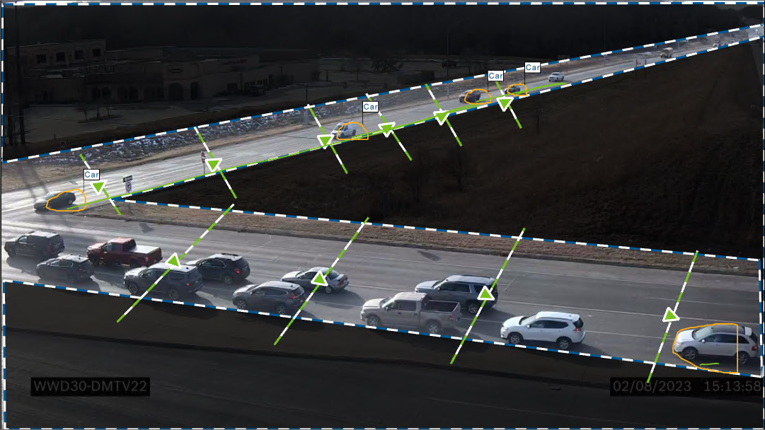
WWD30 – Diamond Interchange

Slide 31
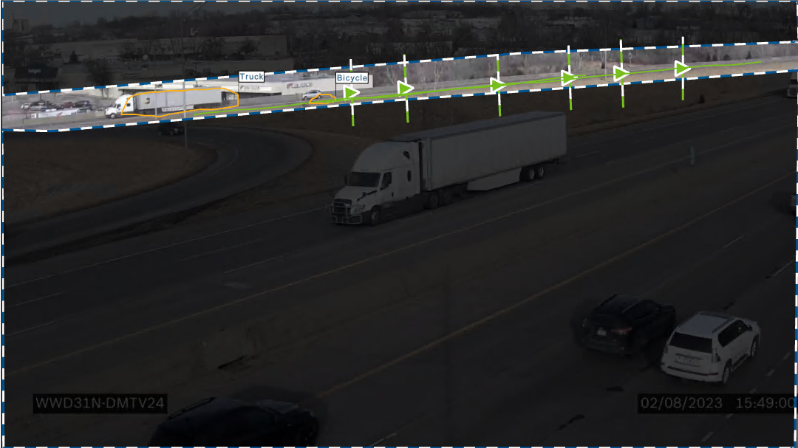
WWD31 – Ramp

Slide 32
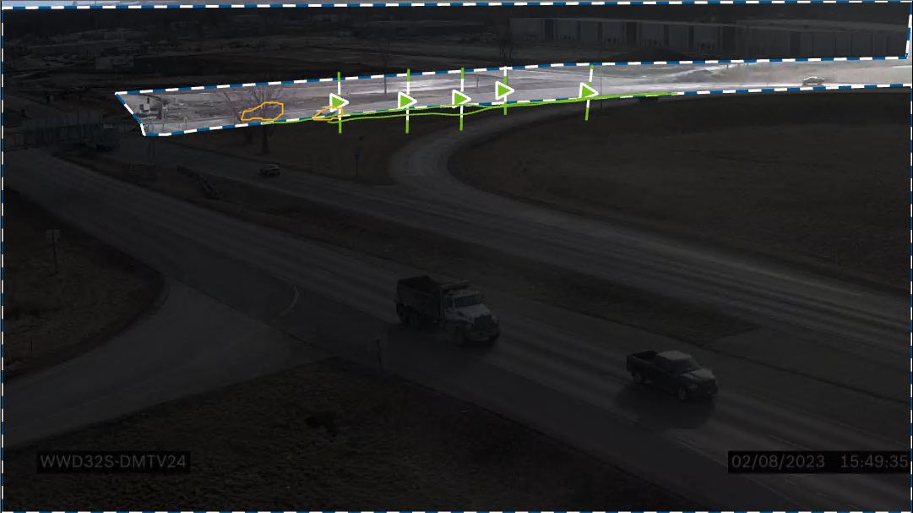
WWD32 – Diamond Interchange

Slide 33
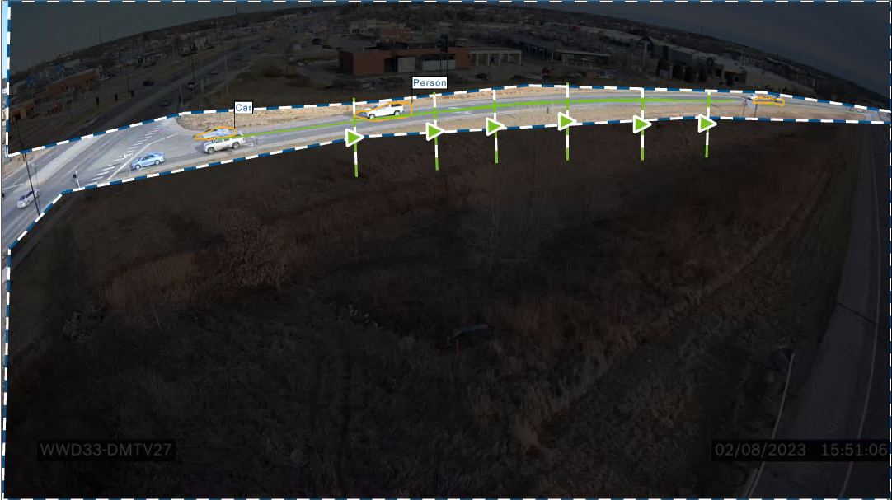
WWD33 – Diamond Interchange

Slide 34
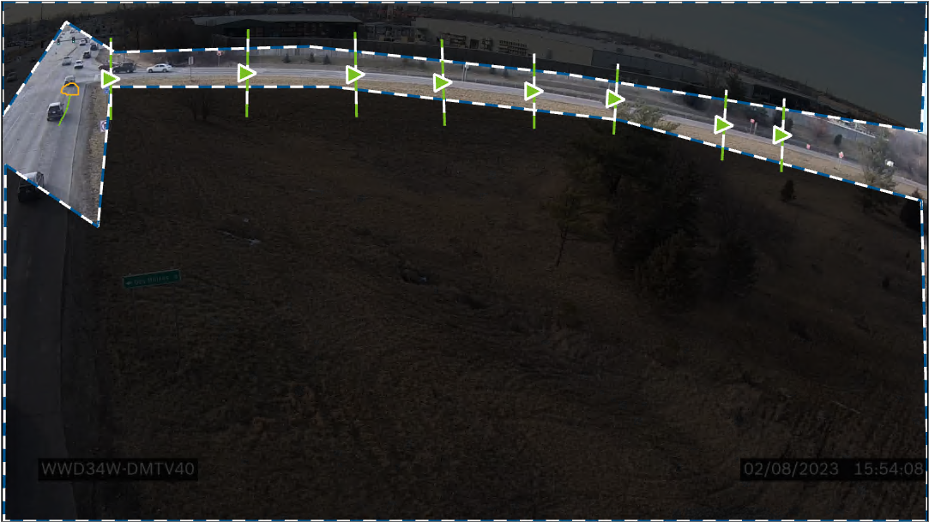
WWD34 – Diamond Interchange

Slide 35
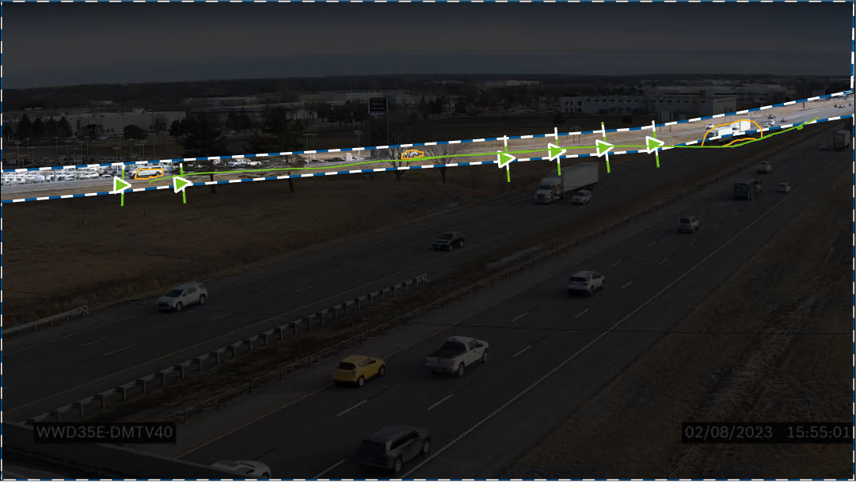
WWD35 – Diamond Interchange

Slide 36
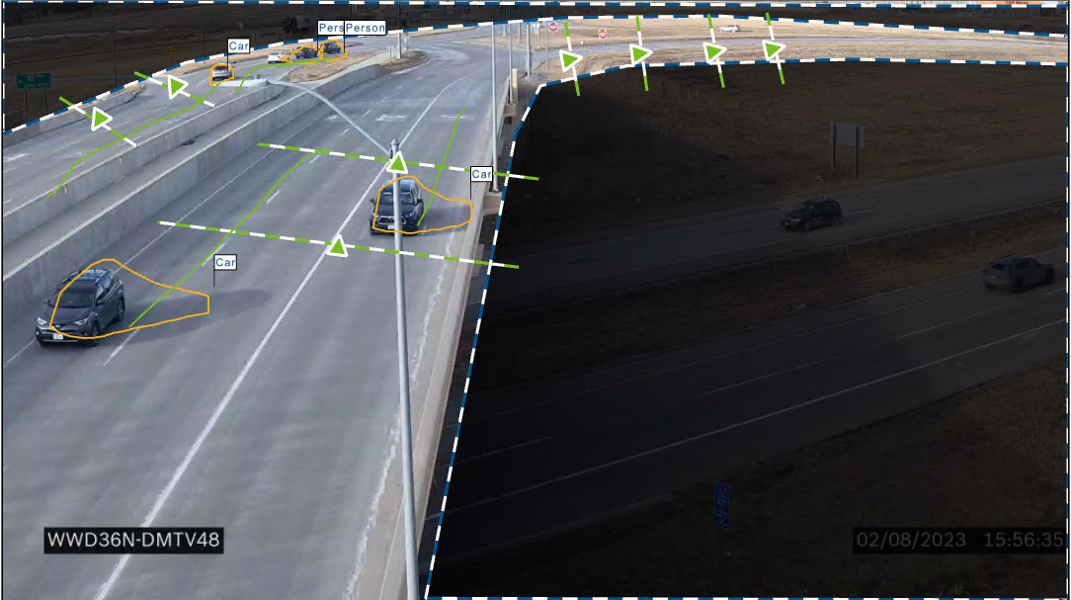
WWD36 – DDI Interchange

Slide 37
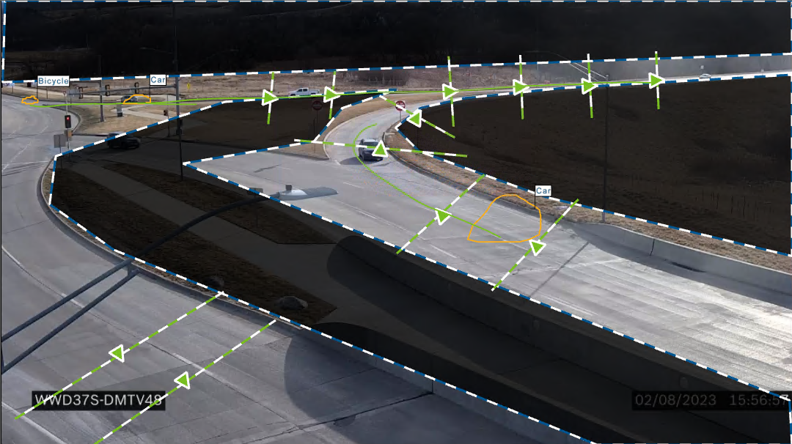
WWD37 – DDI Interchange

Slide 38
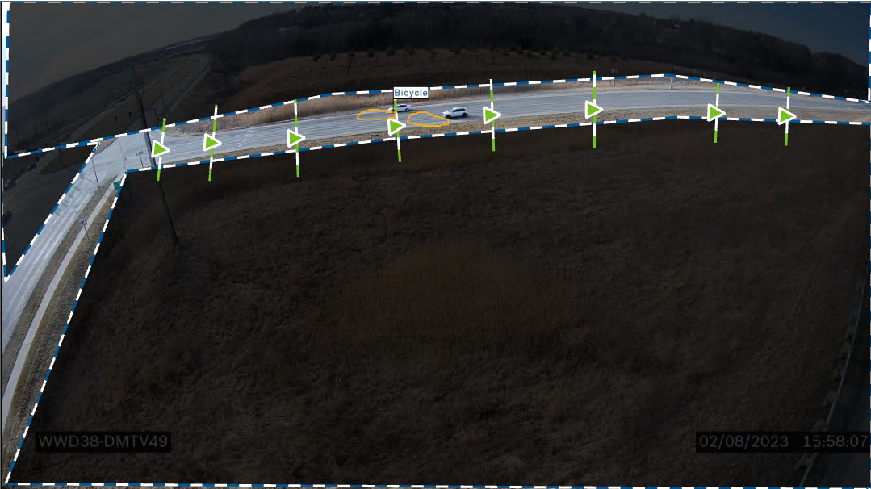
WWD18 – Parclo Interchange

Slide 39
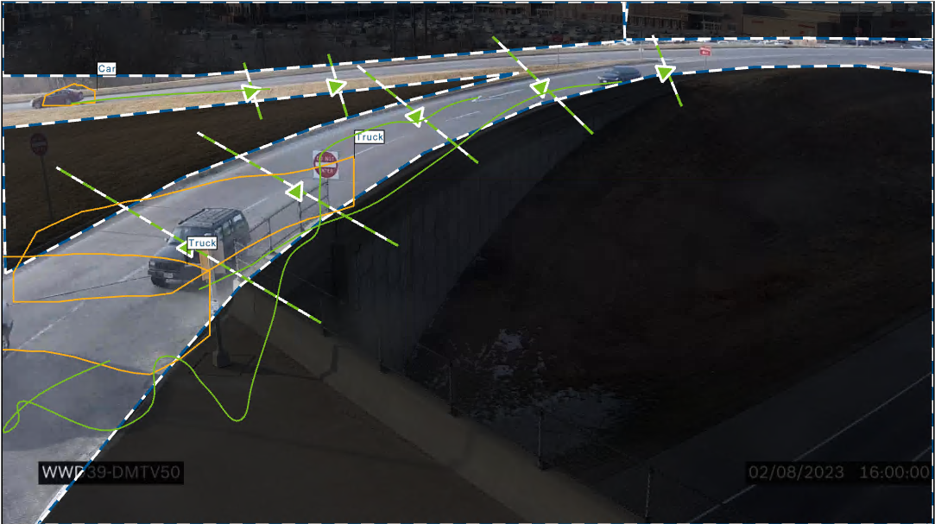
WWD39 – SPUI Interchange

Slide 40
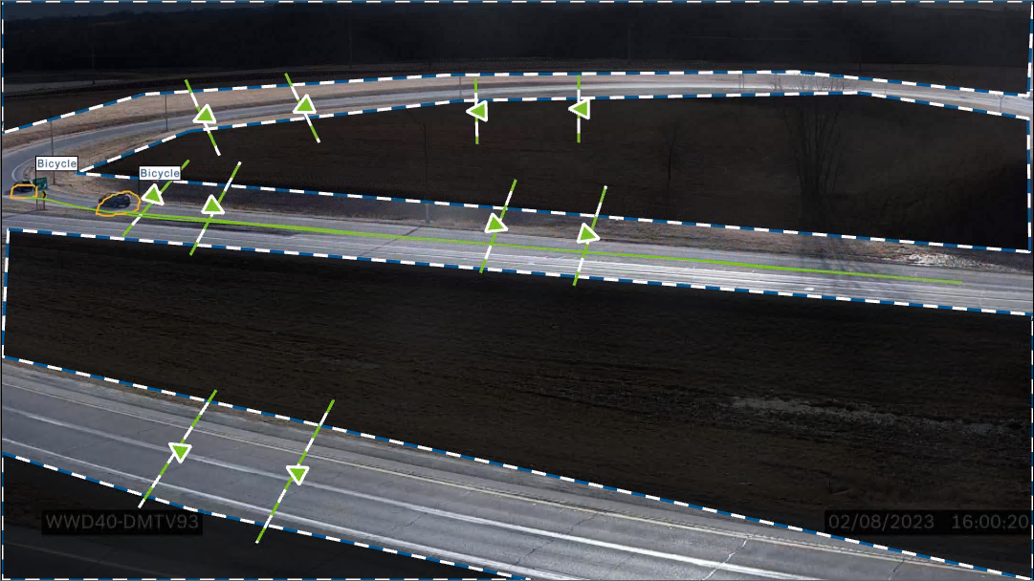
WWD40 – Parclo Interchange

Slide 41
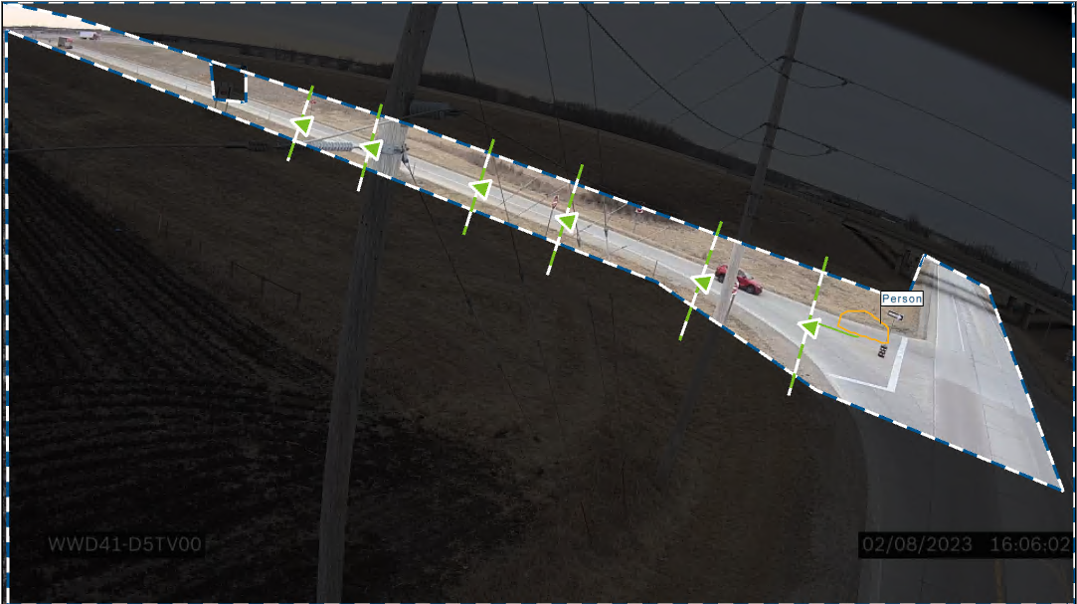
WWD41 – Diamond

Slide 42
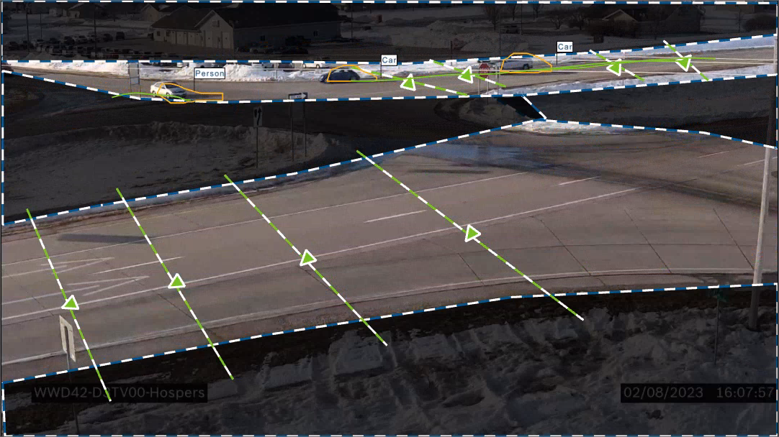
WWD42 – At-Grade Intersection

Slide 43
WWD43 – Diamond Interchange

Slide 44
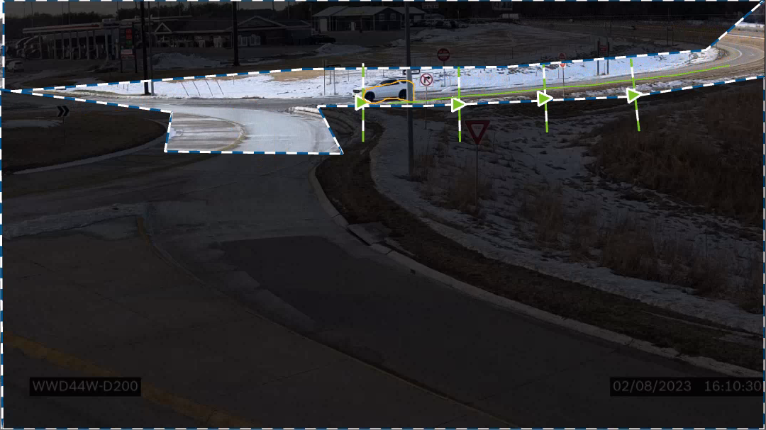
WWD44 – Roundabout / Ramp

Slide 45
WWD64 – RCI at-Grade looking for WW usage of median (formally WWD45)

Slide 46
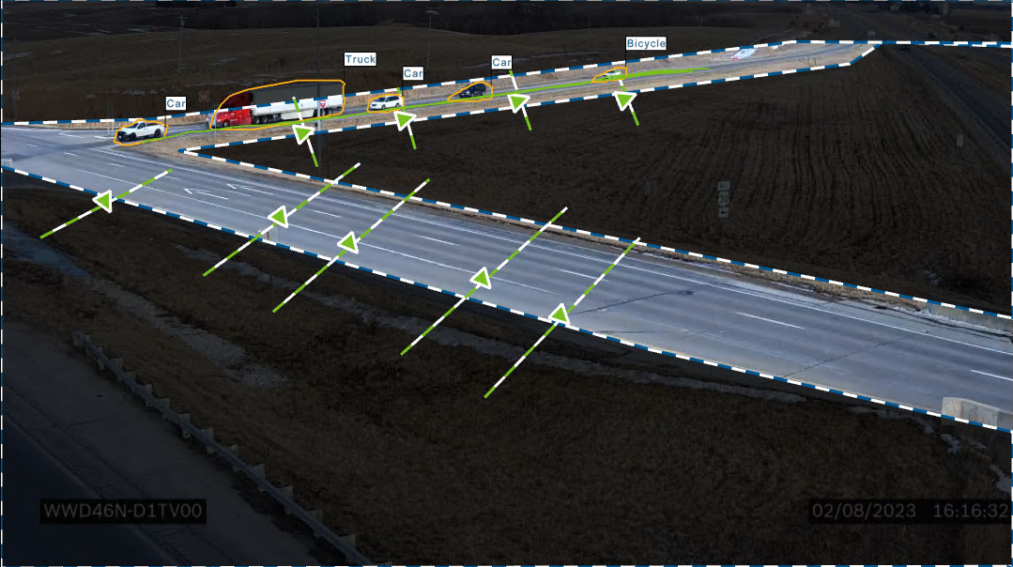
WWD46 – Diamond Interchange – Sideroad Detection

Slide 47
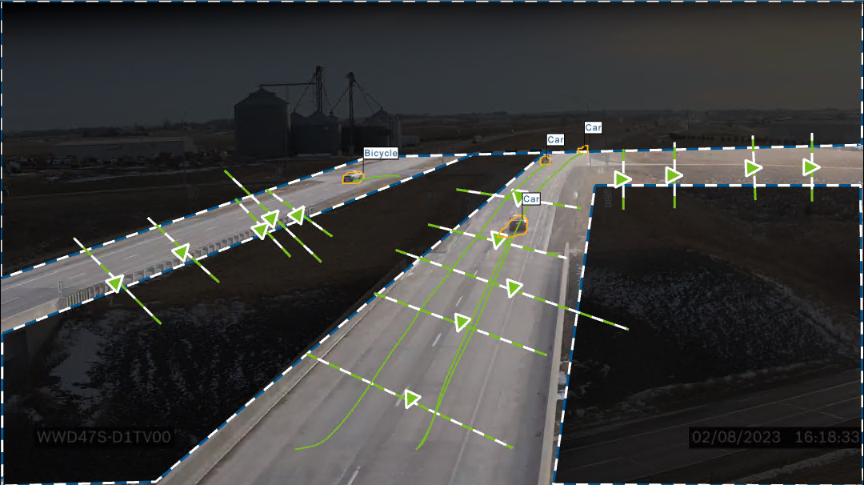
WWD47 – Diamond Interchange / Sideroad Detection

Slide 48
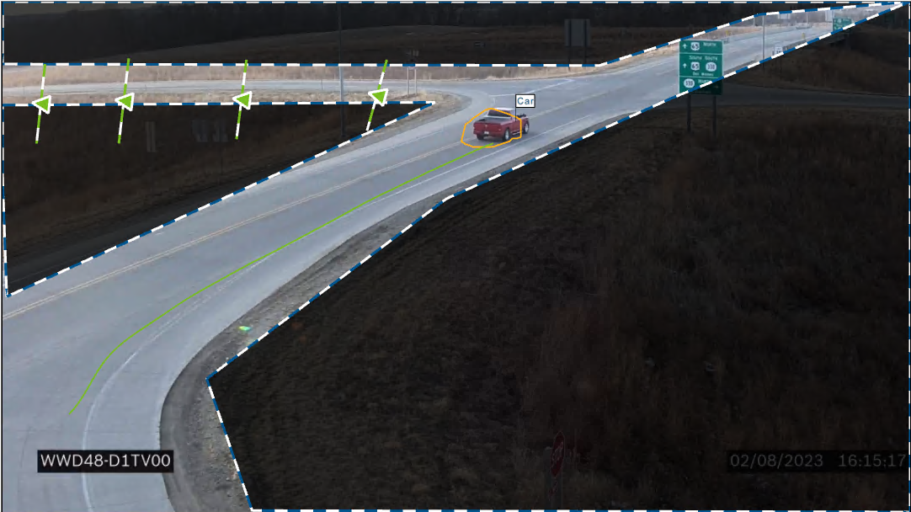
WWD48 – Diamond Interchange

Slide 49
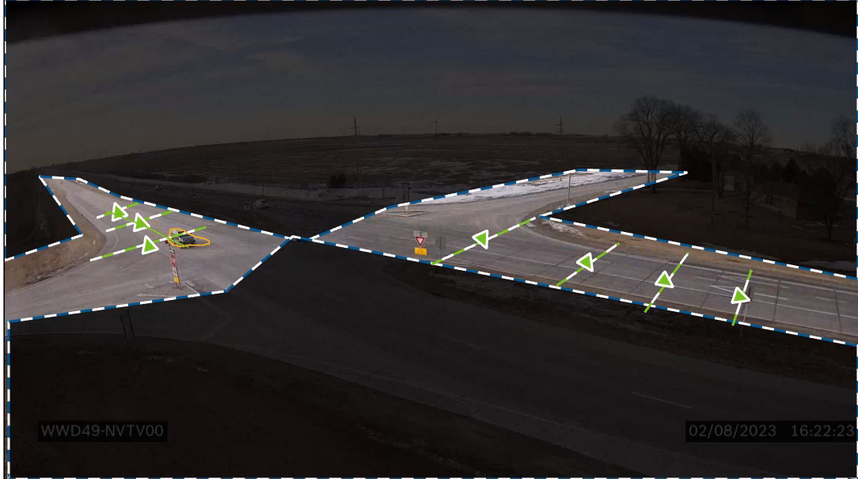
WWD49 – At-Grade Intersection

Slide 50
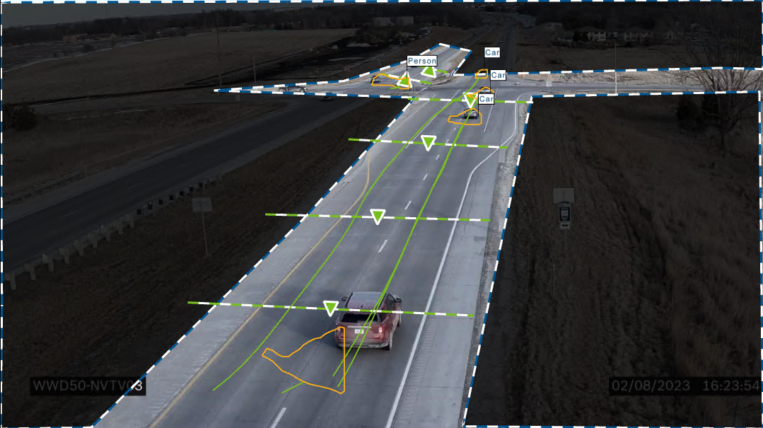
WWD50 – At-Grade Intersection

Slide 51
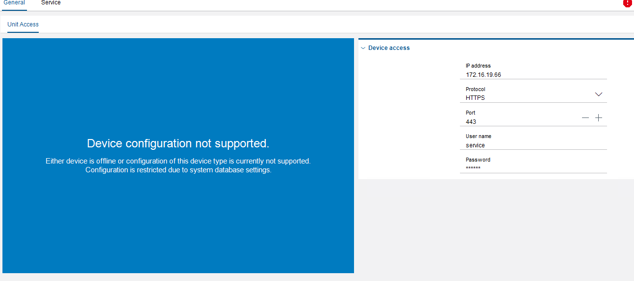
WWD31 – Ramp

Slide 52
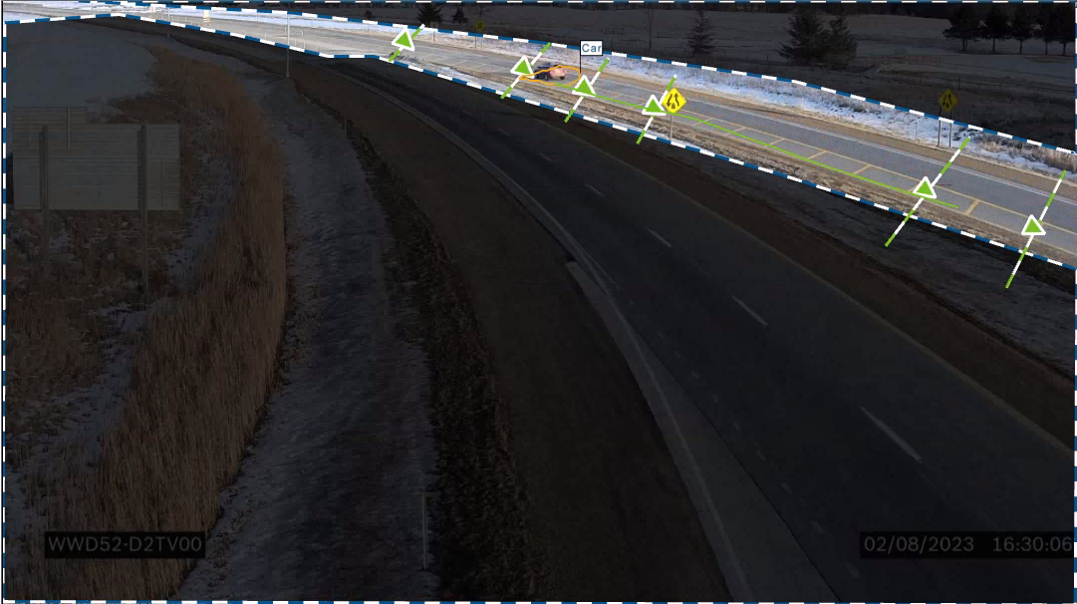
WWD52 – 2 to 4 Lane Split

Slide 53
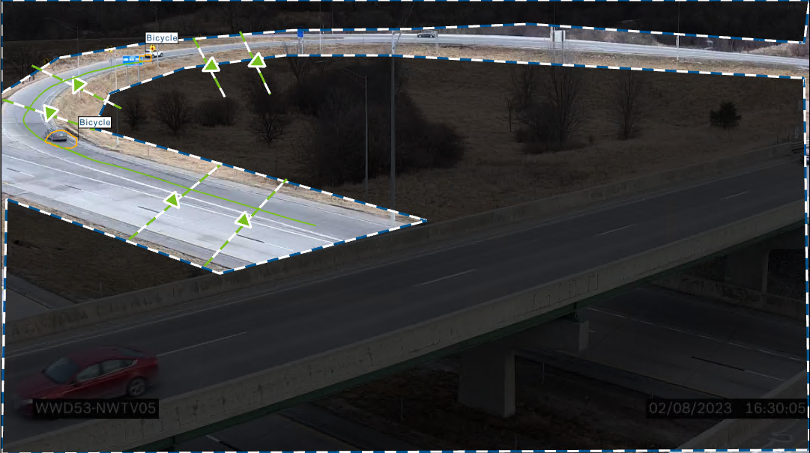
WWD53 – Parclo Interchange

Slide 54
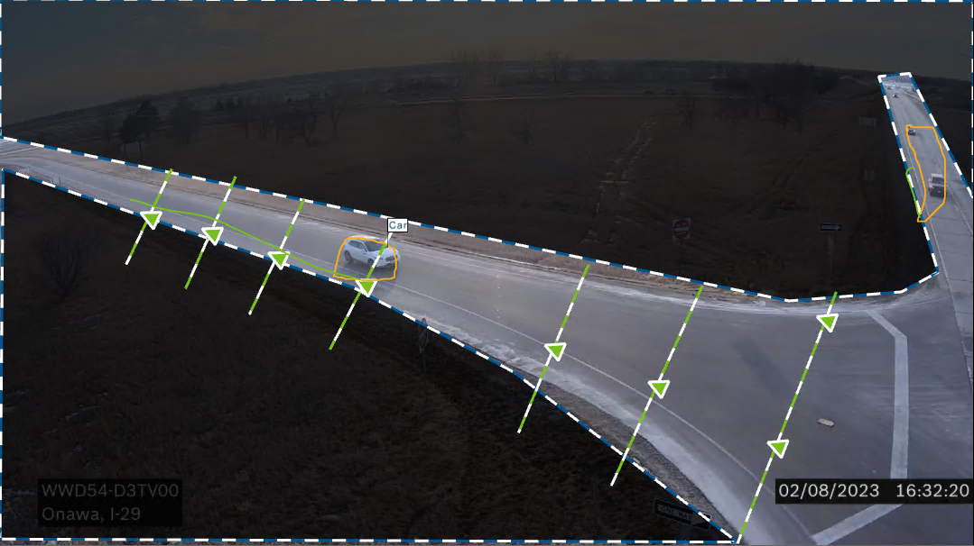
WWD54 – Diamond Interchange

Slide 55
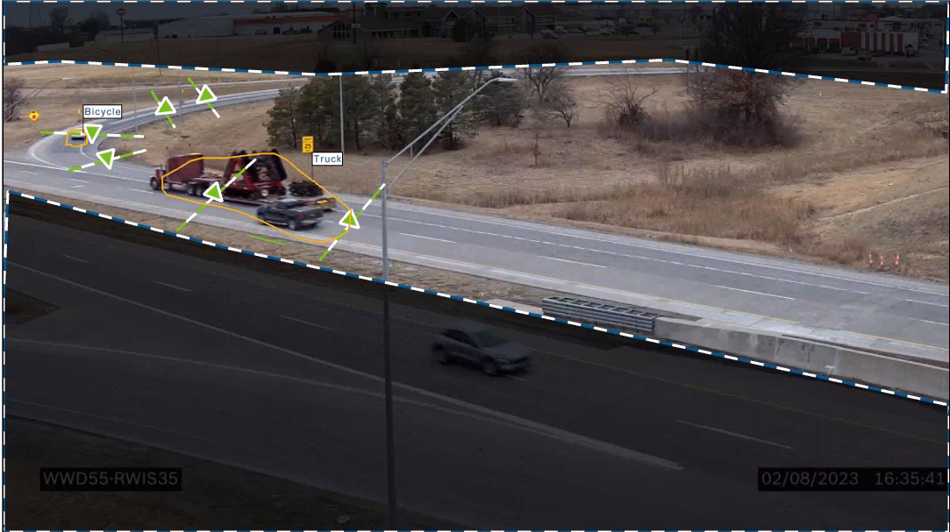
WWD55 – Parclo Interchange

Slide 56
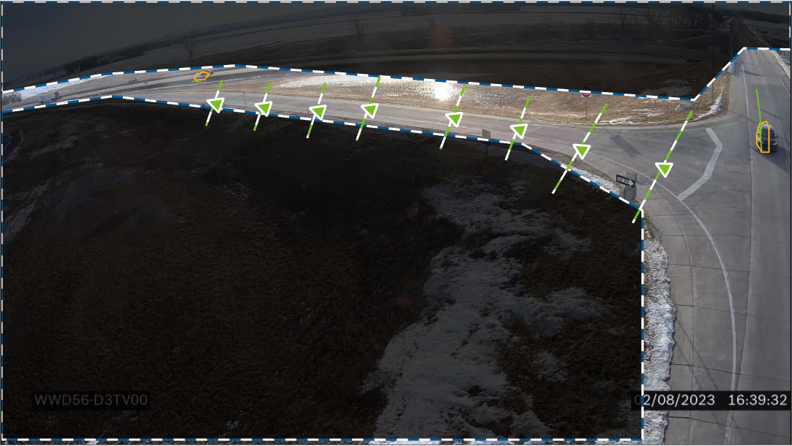
WWD56 – Diamond Interchange

Slide 57
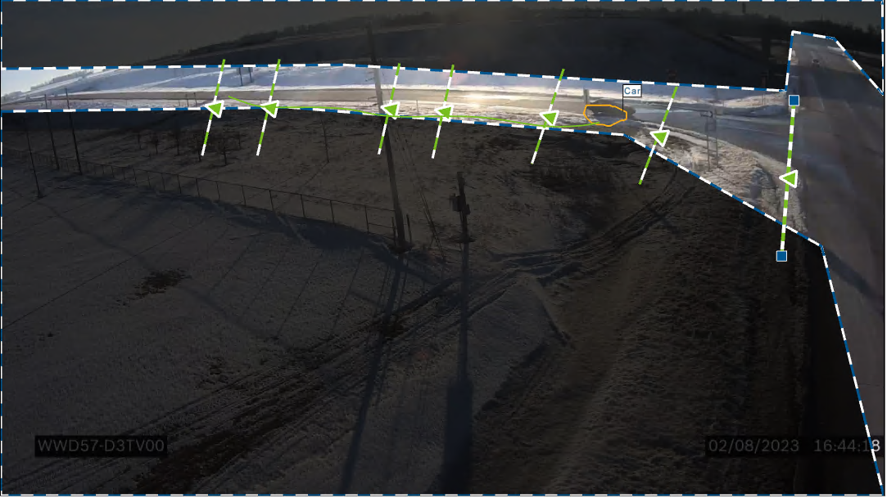
WWD57 – Diamond Interchange

Slide 58
WWD18 – Parclo Interchange

Slide 59
WWD59 – Diamond Interchange

Slide 60
WWD60 – Diamond Interchange

Slide 61
WWD61 – Parclo Interchange

Slide 62
WWD62 – Diamond Interchange

Slide 63
Types of Camera Deployments
Diamond Interchange (where you can see ramp terminal/POE) – 27
Parclo Interchange – 8
Single Point Urban Interchange – 2
Diverging Diamond Interchange – 2
Ramp view only - 5
Roundabout – 1
At-Grade Intersection – 4
Portable Trailer – 3
Crash Attenuator – 3
RCI – 1
4 to 2 Lane Split - 1

Slide 64
Iowa DOT has 62 Bosch FLEXDOME IP 8000i Starlight
Purchased April 2021
- $1,152 (for camera and mounts)
- Does not include POE injector or SD cards
Discontinued
(But that is not a bad thing.)
New version addresses
- Headlight blooming
- Wet pavement reflections
- Shadows
- Elevation (for sizing of detections)
(But I have not tested, just heard the new version is better)

Slide 65
Why Bosch?
Wanted to mount on existing camera poles
(where power and comms exist)
Needed to be flexible on viewing angle and distance away
Wanted to mount to see as much of ‘the WWD story’ as possible
Where they came from
What direction did they turn to go WWD
Did they Self-Correct, if yes… where or how far did they go
Best situation is to see to the end of the ramp gore
Detection Functions
Detection by type, direction, speed, area
Color (but do not use)
Competitive price
Includes analytics and no annual licensing fee

