Slide 2
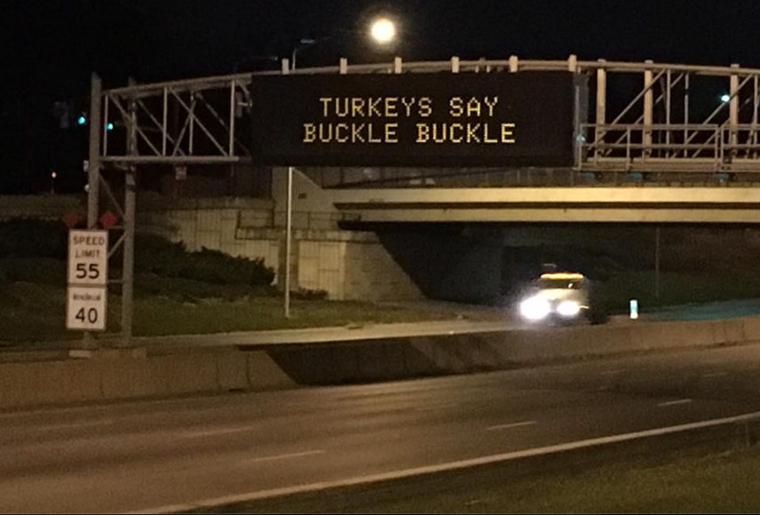
Greetings from Iowa!! Home of “Message Monday”

Slide 3
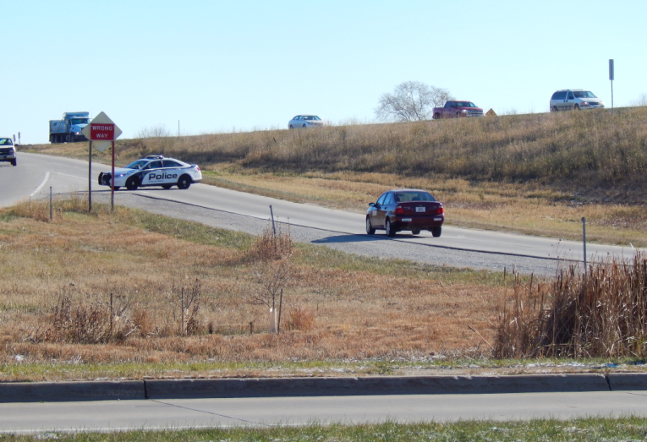
US 30 Wrong-Way Driving

Slide 4
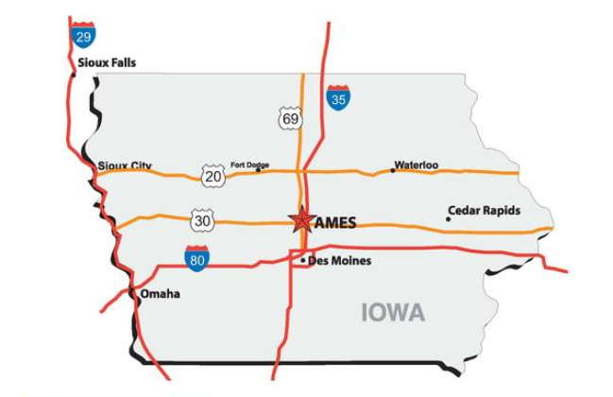
General Location

Slide 5
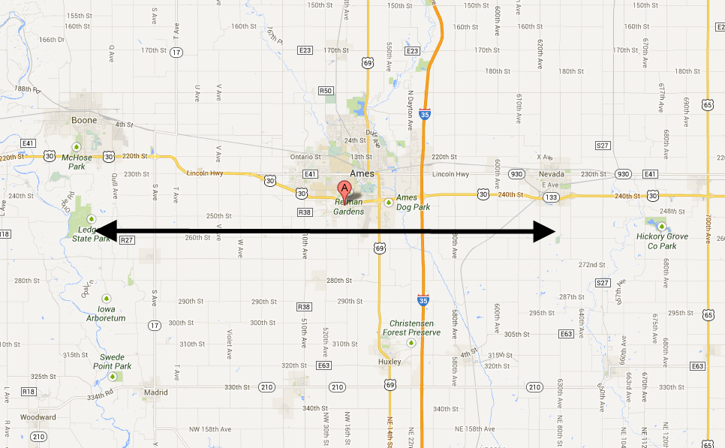
Project Location
Boone
Nevada
Ames
25 miles

Slide 6
Situation/Background
180+/- (911 calls & Eye Witness) Wrong Way Drivers (WWD) in the last 8½ years.
Does that mean we have had 180 WWD?
Probably not.
A Florida study showed 90% of people DO NOT call 911.
7 WWD Crashes in last 10 years (none in last 5)
2 were fatal

Slide 7
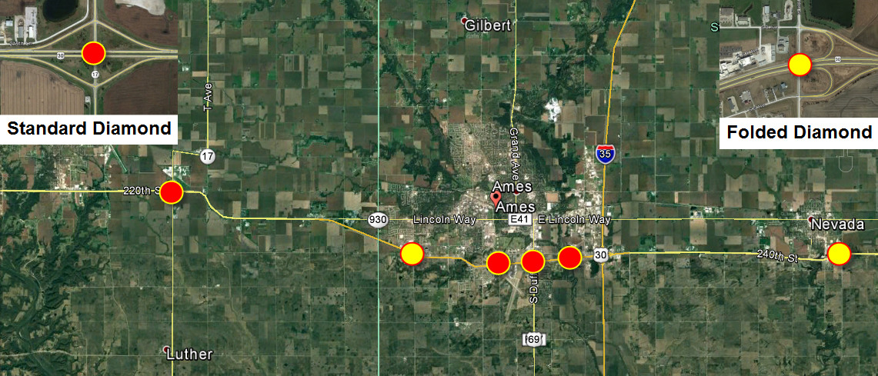
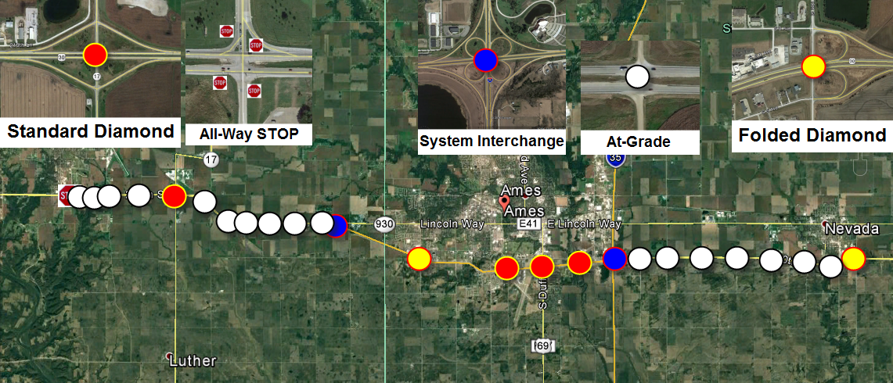
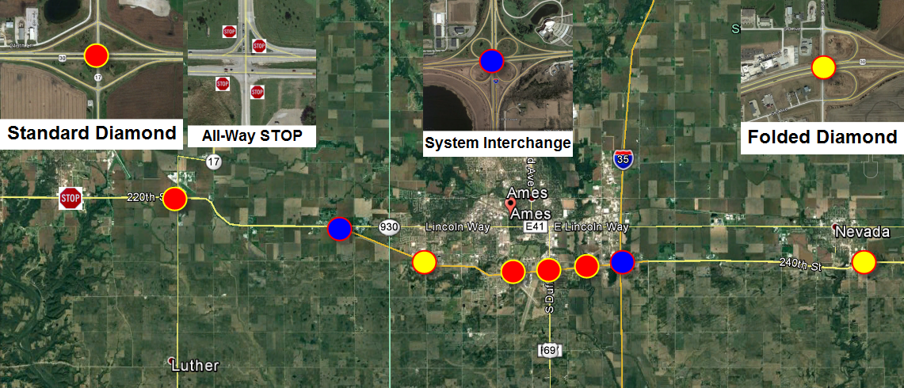
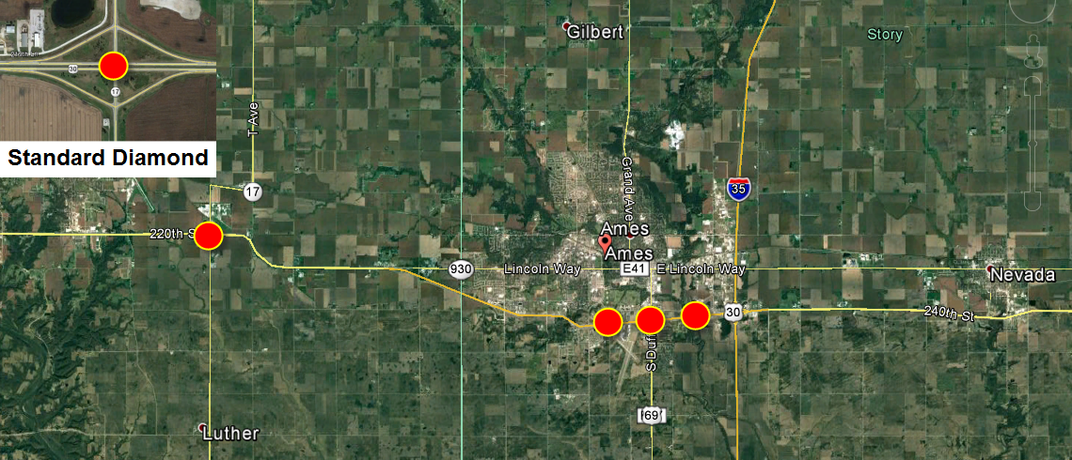
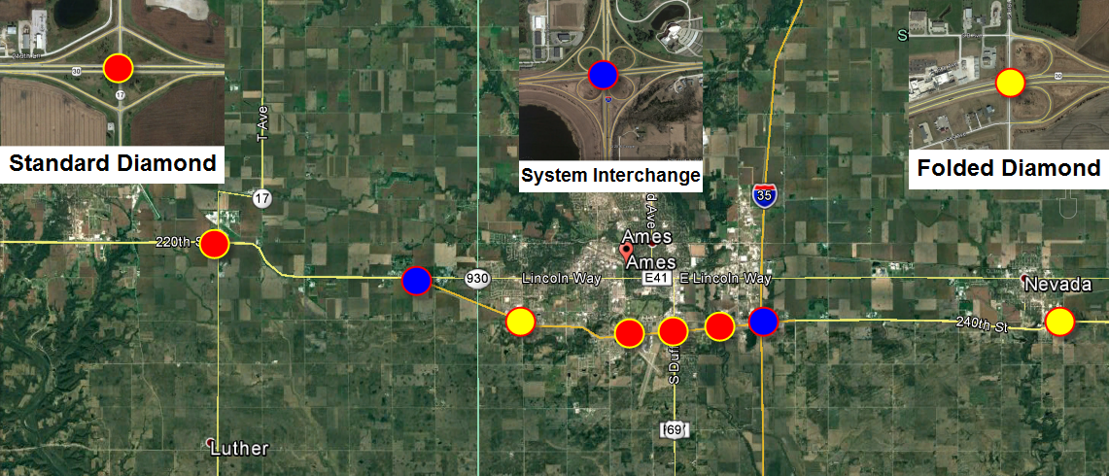
Roadway Types
Perfect mix of:
Interchanges and At-grade intersection

Slide 8
Stages of this “Effort”
Ames PD starts to think the number of 911 calls are excessive.
Asks DOT Help
DOT & City do various signing and painting
enhancements
DOT ‘upgrades’ sensors to detect WWD
911 Data
Begins
Vendor
“Test Bed” begins
1/1/2008
2010 +/-
2012 +/-
8/2/2013
7/1/2014
33 – 911 calls
42 – 911 calls
WWD 911 call every 2.7 weeks

Slide 9
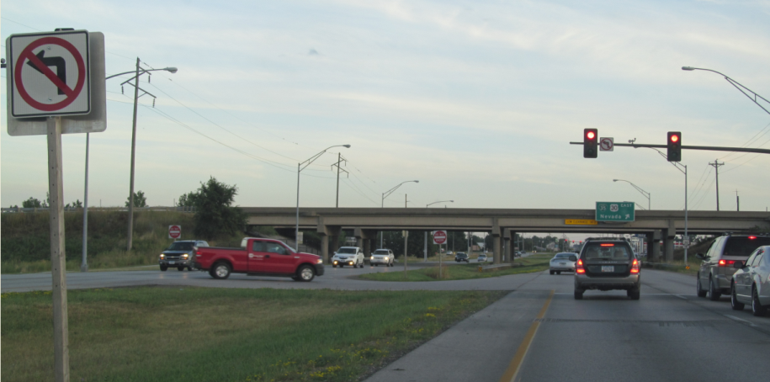
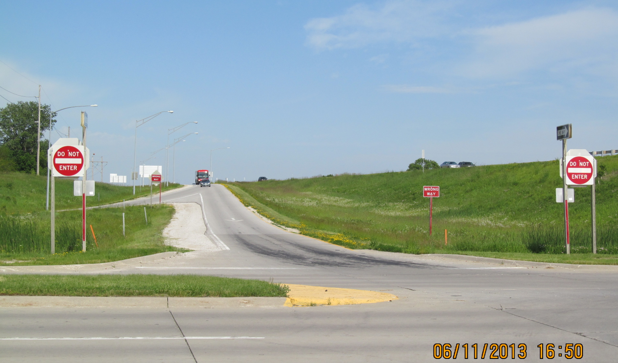
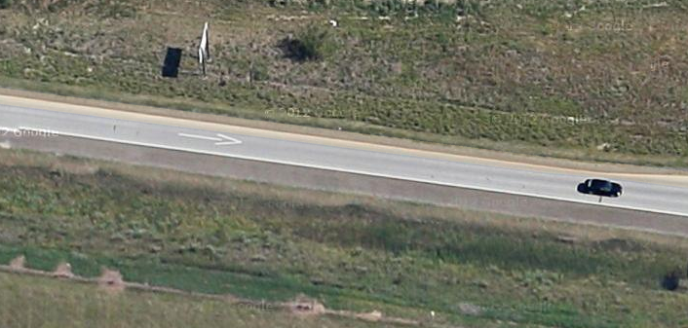
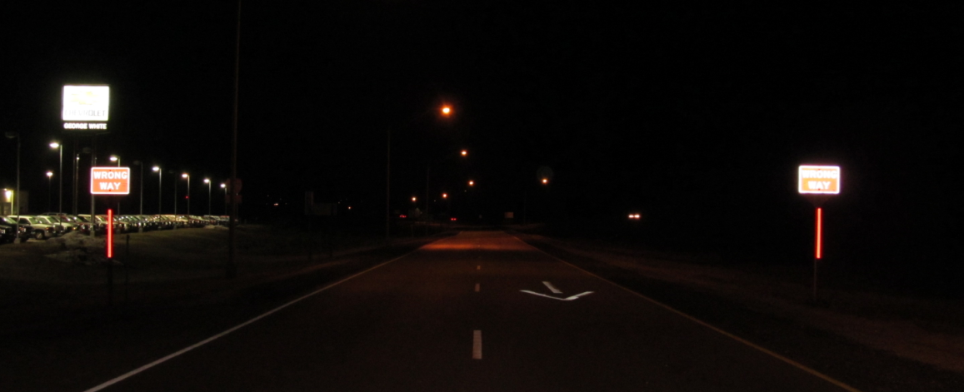
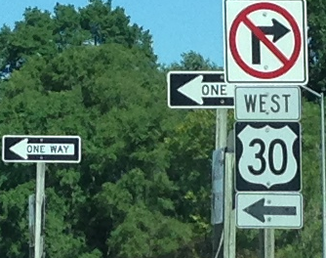
Low-Cost / Updates in 2012
Review with a “Checklist”

Slide 10
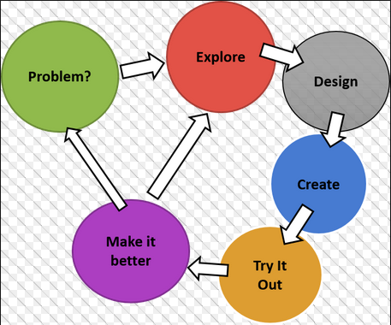
Engineering Problem Solving
Step 1: What is the problem?
ITS
Cameras & Sensors

Slide 11
My goal…. Determine Points of Entry (fix the problem/eliminate the headache)
Specific / Targeted Signing for that location
Option B
Option A
Enhanced Signing Everywhere
Solve with signing, painting & lighting

Slide 12
Just how many are there?
How to you measure this?
Hard
Wrong Way Drivers on ramps/entrance points – self correct
Wrong Way Drivers on Mainline
Ease of Measuring
911 calls
Crashes
Injury Crashes
Fatal
Crashes
Easy
++ Quantity
Quantity ++

Slide 13
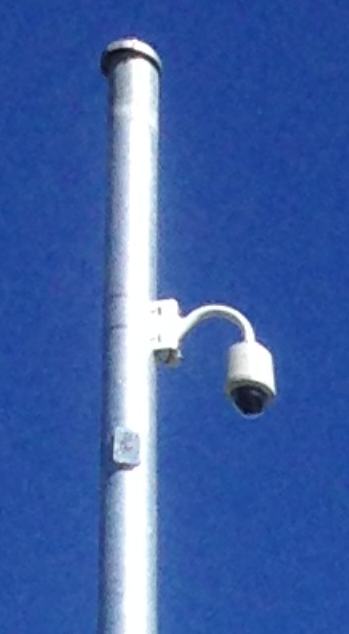
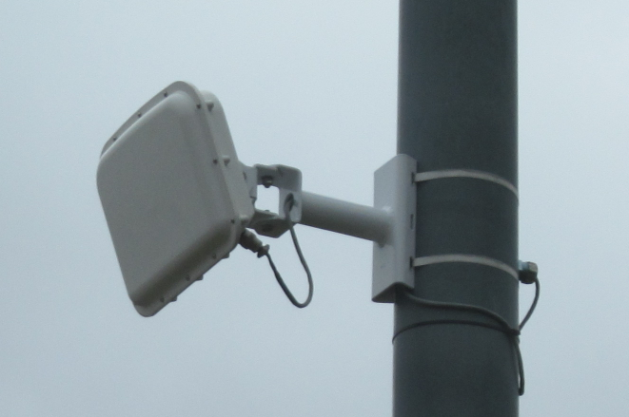
2 Choices in Technology
Cameras (with video analytics)
Radar sensors (speed and direction)
You get:
1) Proof
2) Confirmation
3) Events prior
to WWD

Slide 14
Steps….
Need to find out if video analytics works
Initial Round:
Other Players

Slide 15
Results…. Video Analytics does work!
Read the ENTERPRISE Report
Or just ask me ;0)
Example Videos

Slide 16
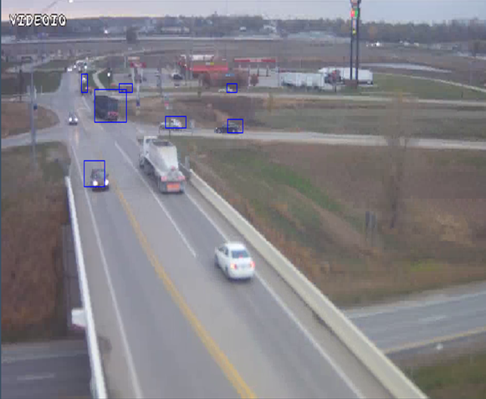

Slide 17
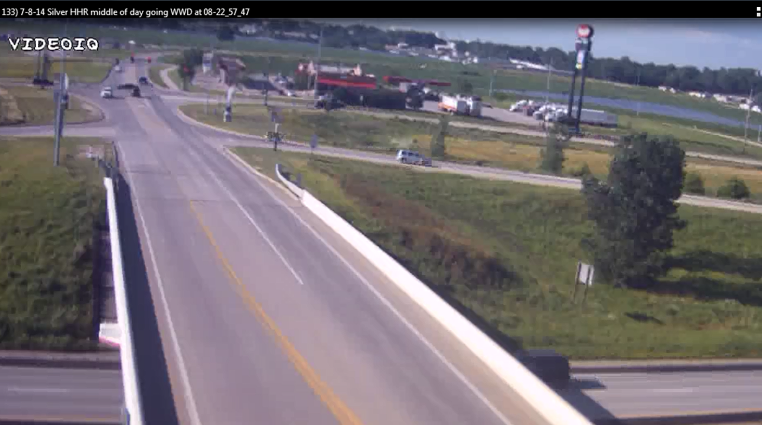
Video Link

Slide 18
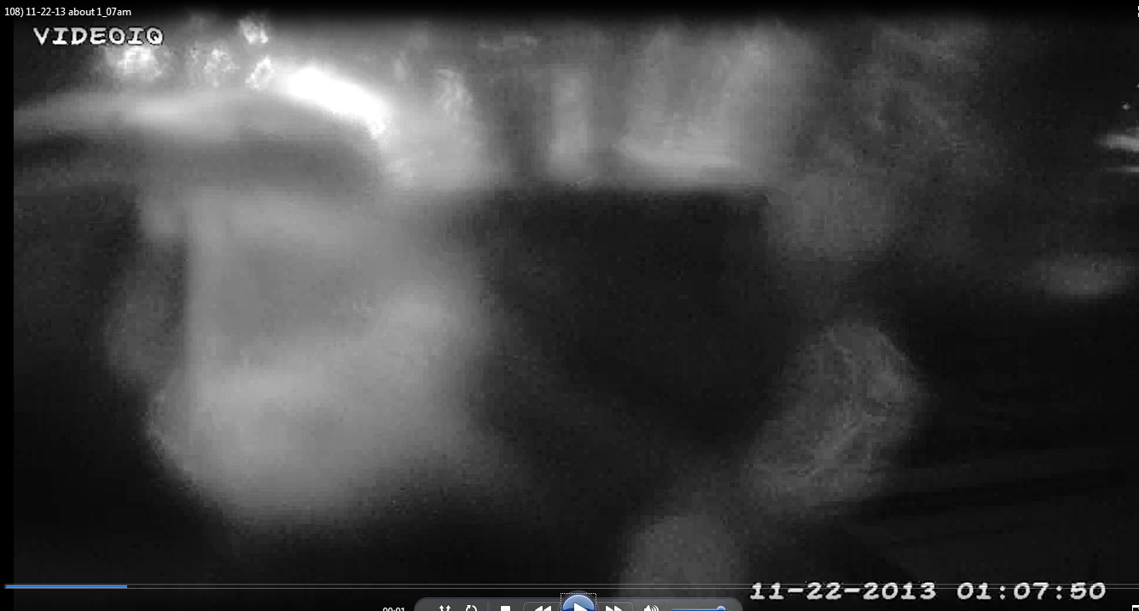
Extreme Weather Example
Link to Icy WWD Example

Slide 19
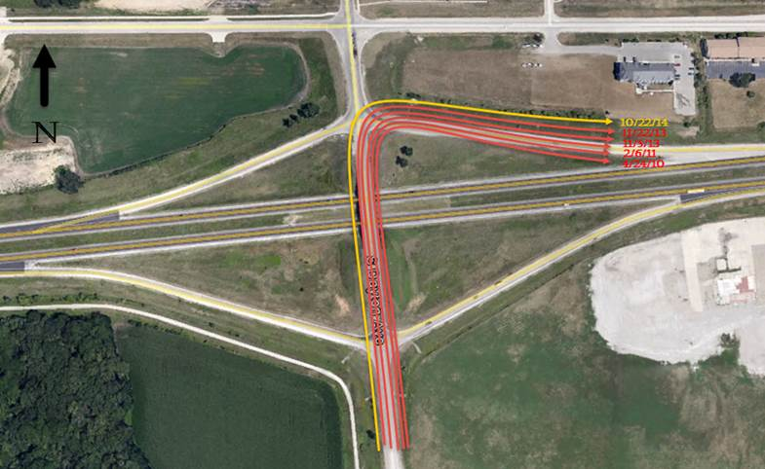
6 Detections – All self correct.

Slide 20
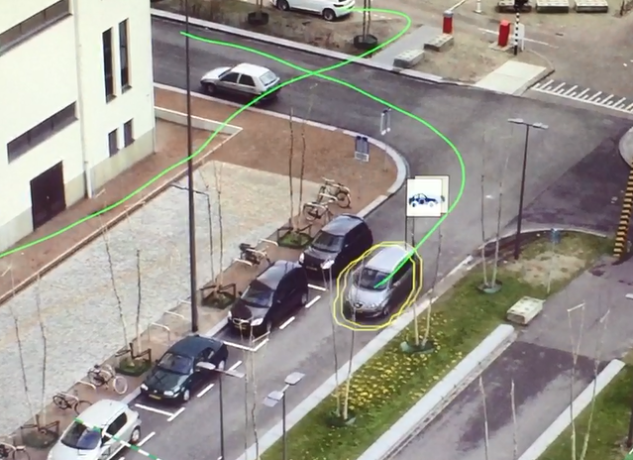
Bosch Example
Video

Slide 21
Next steps…
The Test Bed created some support.
I asked for $$ for Video Analytics.
Denied. (no crashes… no problem)
Instead, our ITS Office offered to ‘upgrade’ our side-fire radar sensors to detect WWD.
We also installed video recording cameras (without analytics)

Slide 22
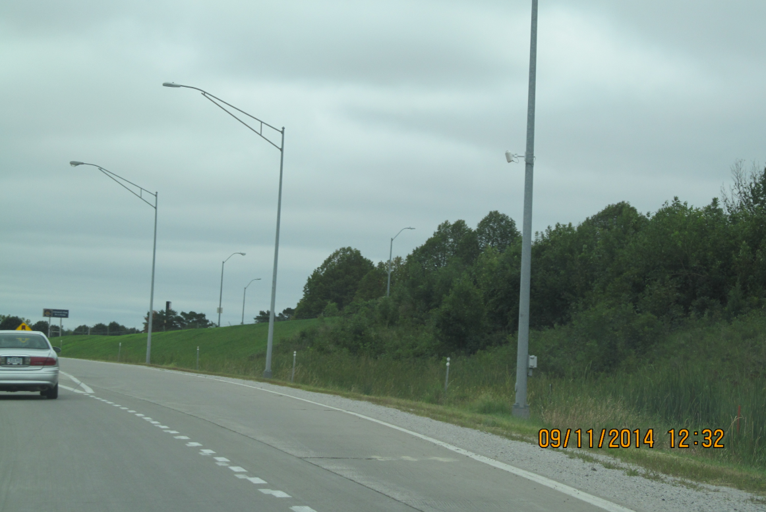
Radar Sensors

Slide 23
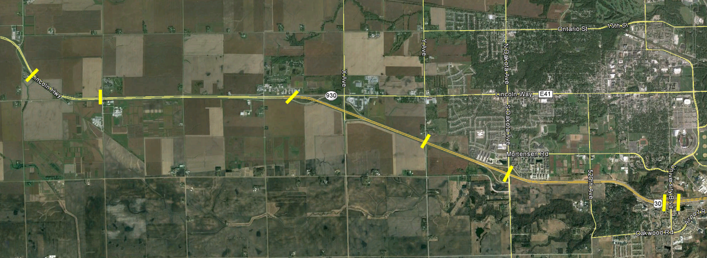
This is what you get…. Not what I wanted

Slide 24
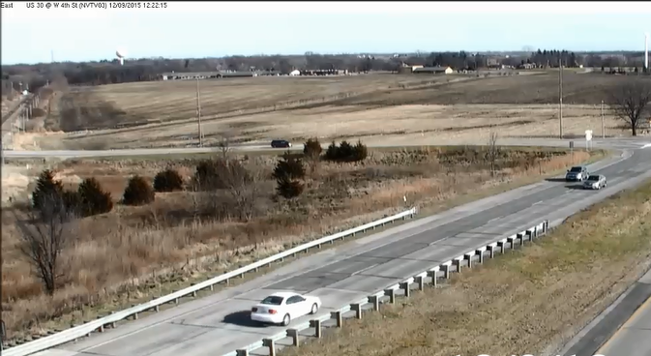
…and so our next phase started July 2014
Link to Video

Slide 25
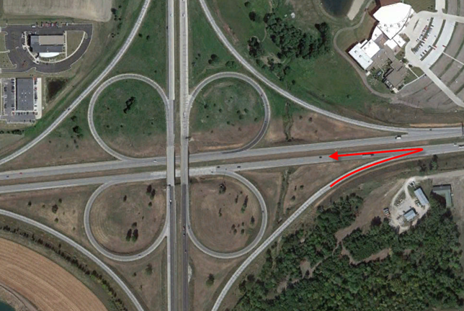
Have to See it to Believe it!

Slide 26
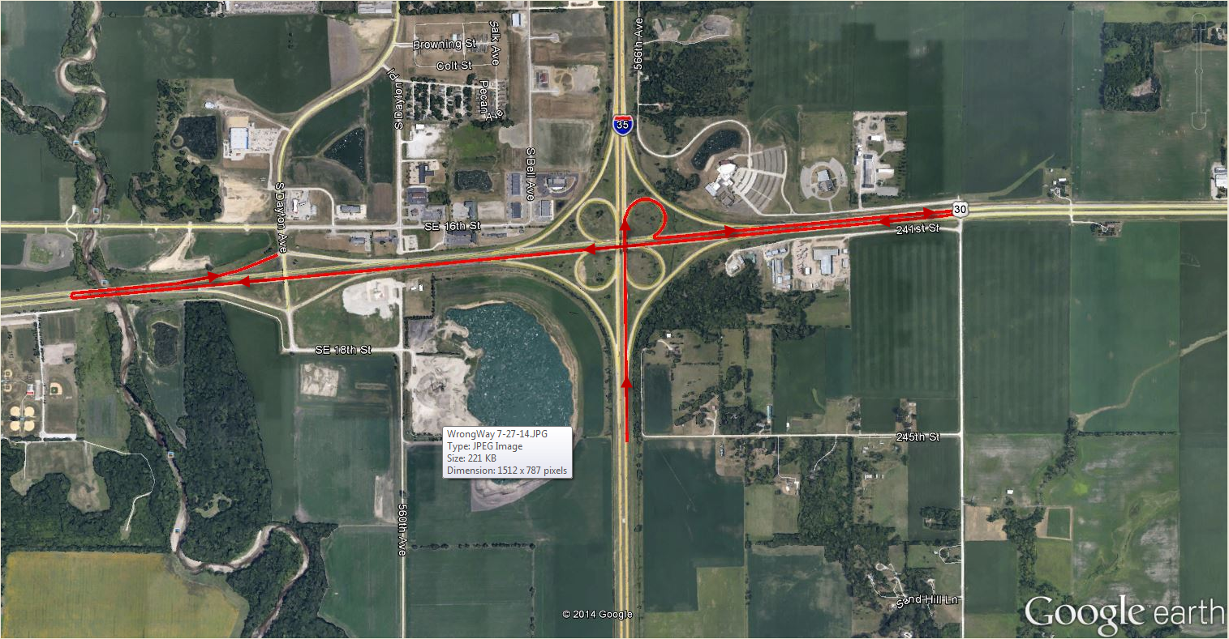
About 2 weeks Later
Link to video

Slide 27
Focusing on Specifics
Once we have 2 similar WWD within 6 months, we will focus our efforts on that specific location with:
Signing
Painting
Lighting (if necessary)
If that is not enough…
More expensive options
Have not had to “go there” yet

Slide 28
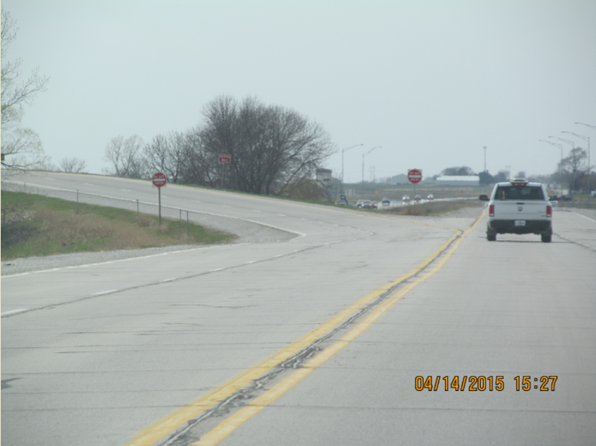
Examples of “Wins” for WWD Efforts

Slide 29
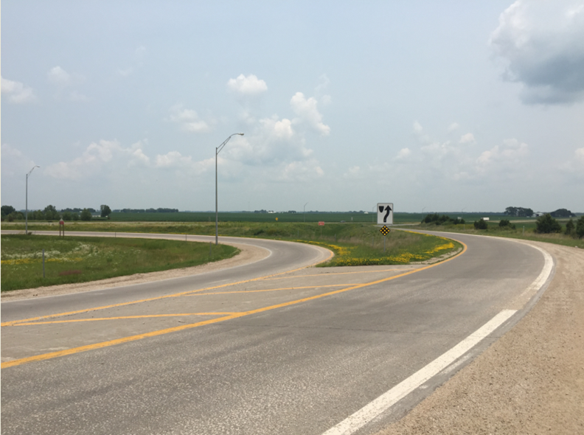
Examples of “Wins” for WWD Efforts

Slide 30
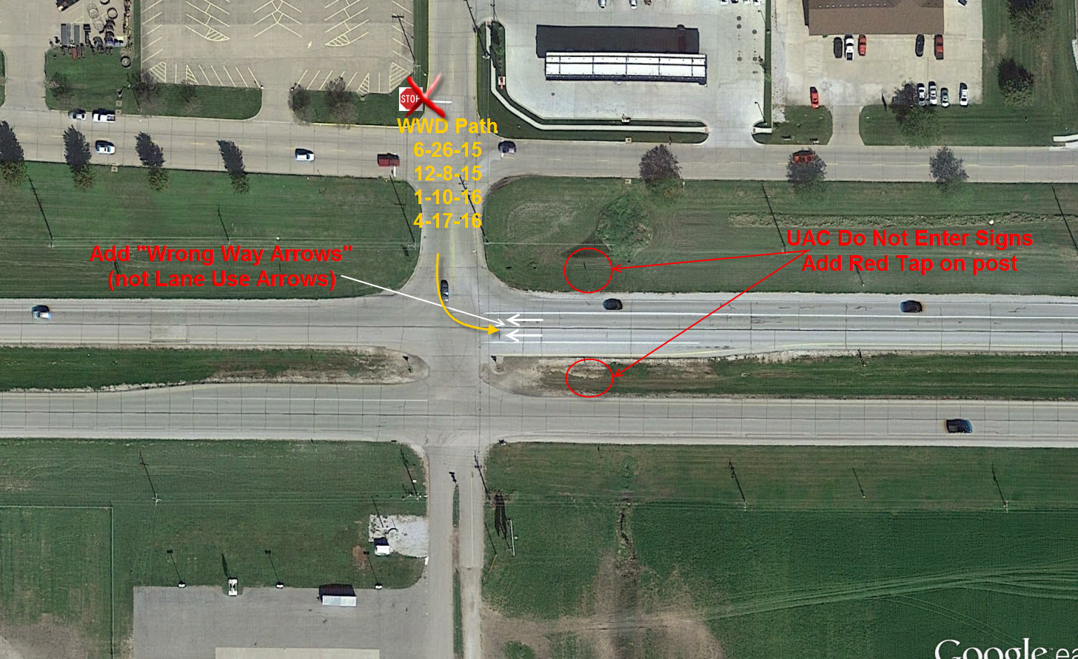
Linn St. in Boone

Slide 31
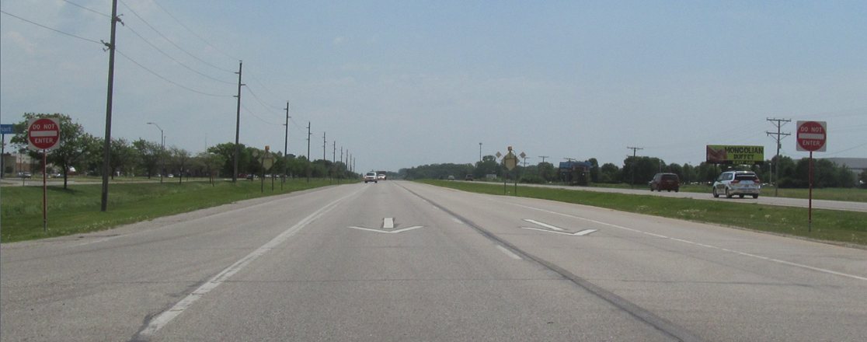
US 30 @ Linn St. (looking east)

Slide 32
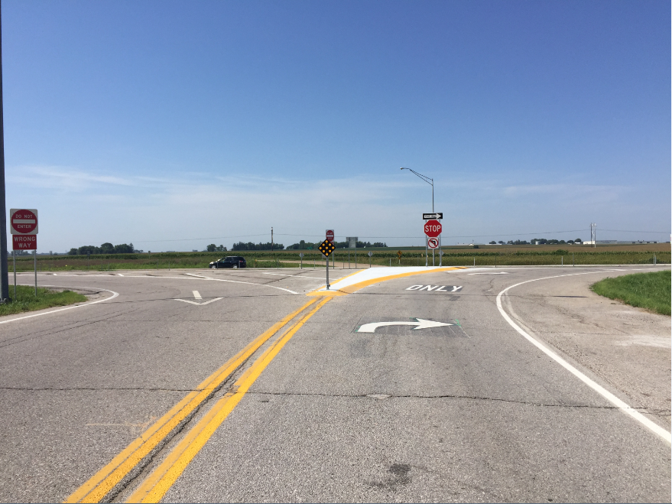
T-Ave

Slide 33
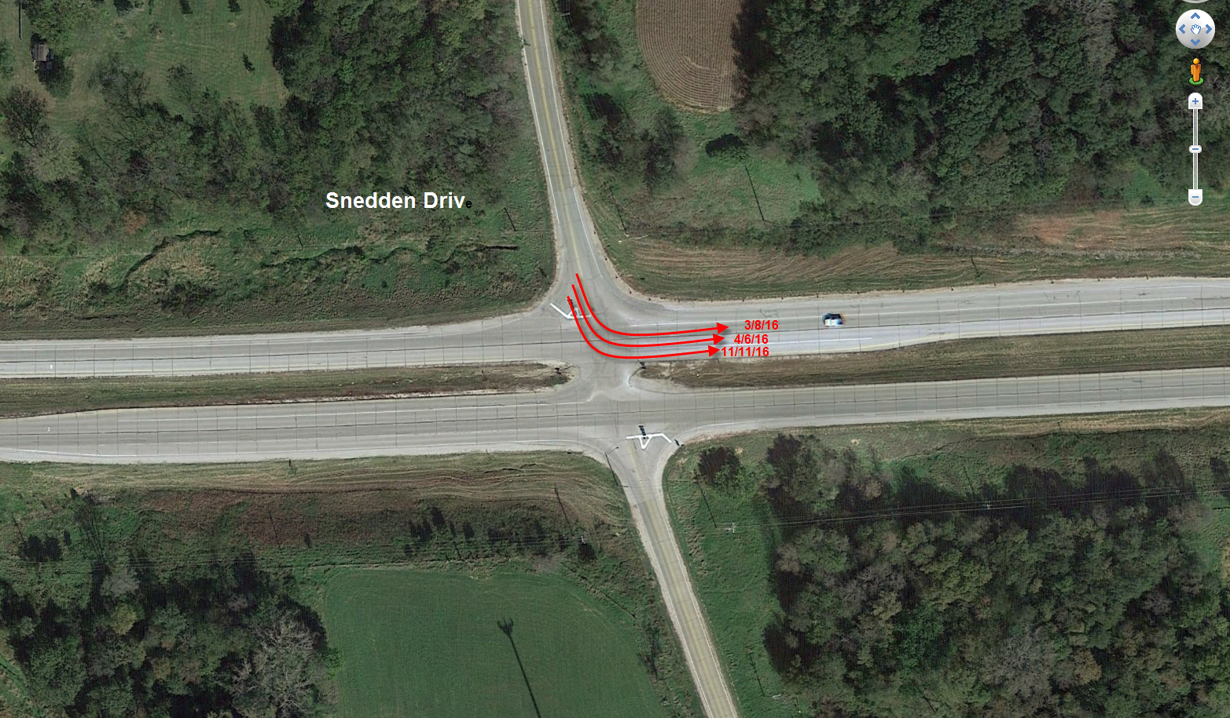
5th Candide for Enhanced Signing

Slide 34
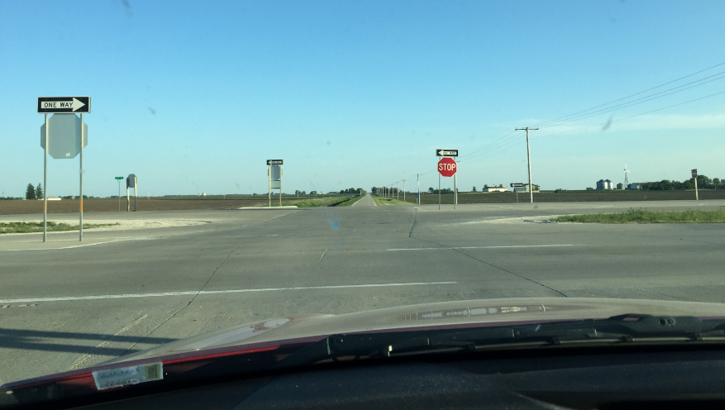
Possible Solution

Slide 35
Other examples of “Winning”
Law Enforcement have targeted this area on weekends and slow nights
Still no crashes

Slide 36
Call in the Cavalry!
Link: 3 police agencies converge

Slide 37
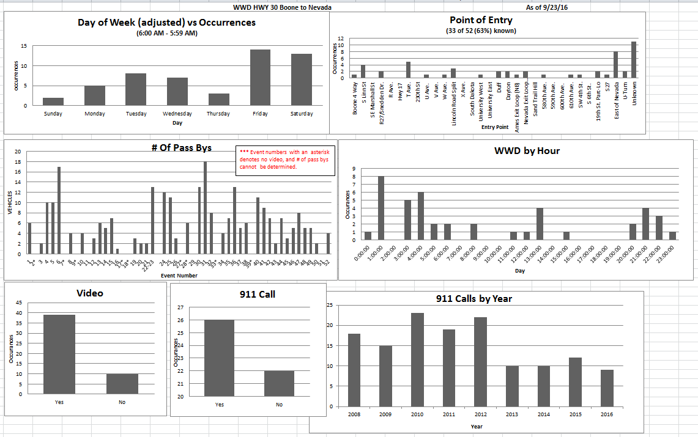
Data

Slide 38
Stages of this “Effort”
Ames PD starts to think the number of 911 calls are excessive.
Asks DOT Help
DOT & City do various signing and painting
enhancements
DOT ‘upgrades’ sensors to detect WWD
911 Data
Begins
Vendor
“Test Bed” begins
1/1/2008
2010 +/-
2012 +/-
8/2/2013
7/1/2014
11/21/16
(today)
33 – 911 calls
42 – 911 calls
23 – 911 calls
(58 known WWD)
WWD 911 call every 2.7 weeks
WWD 911 call every 4.9 weeks

Slide 39
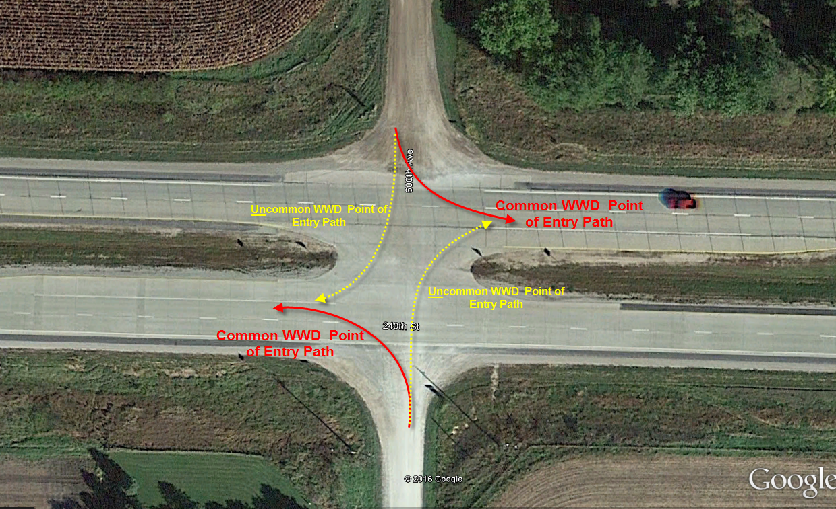
What have we learned?
At grade intersections
69% of WWD “known point of entry” (29/42) start here

Slide 40
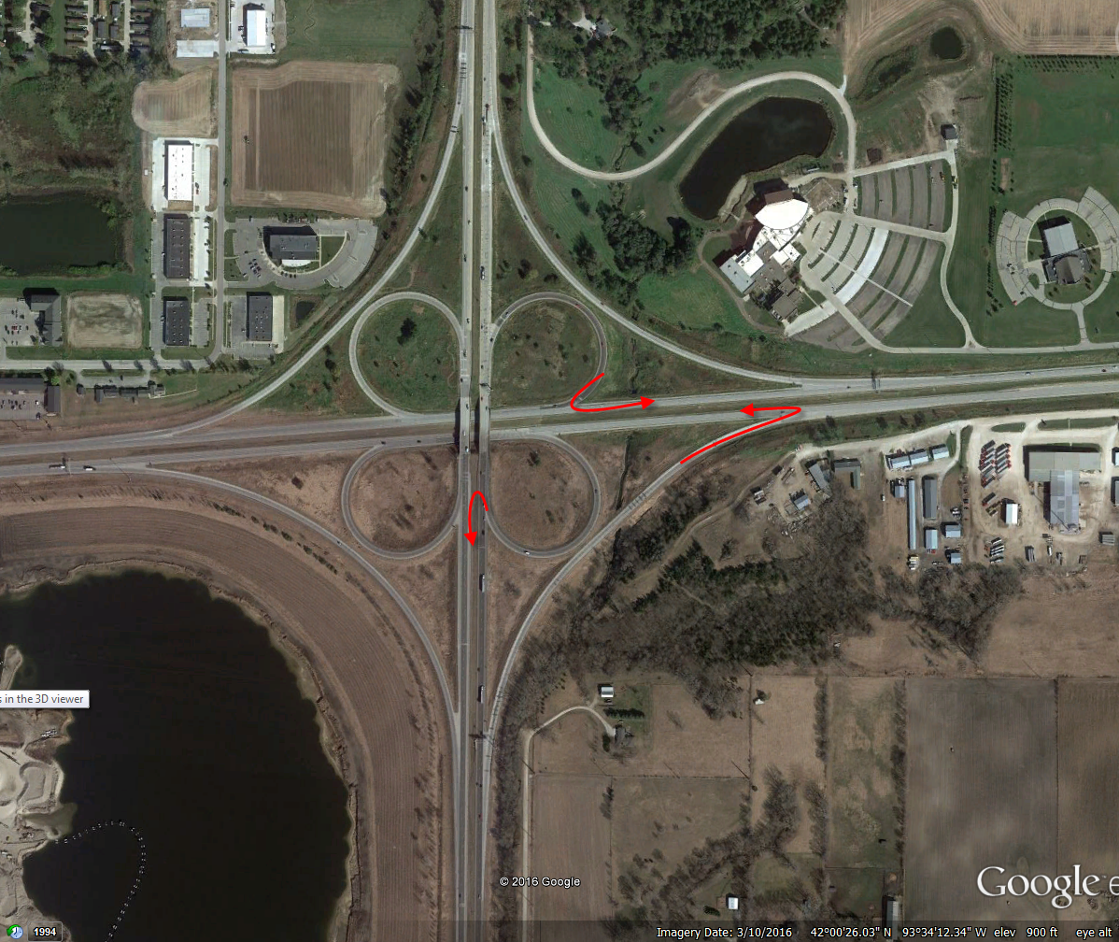
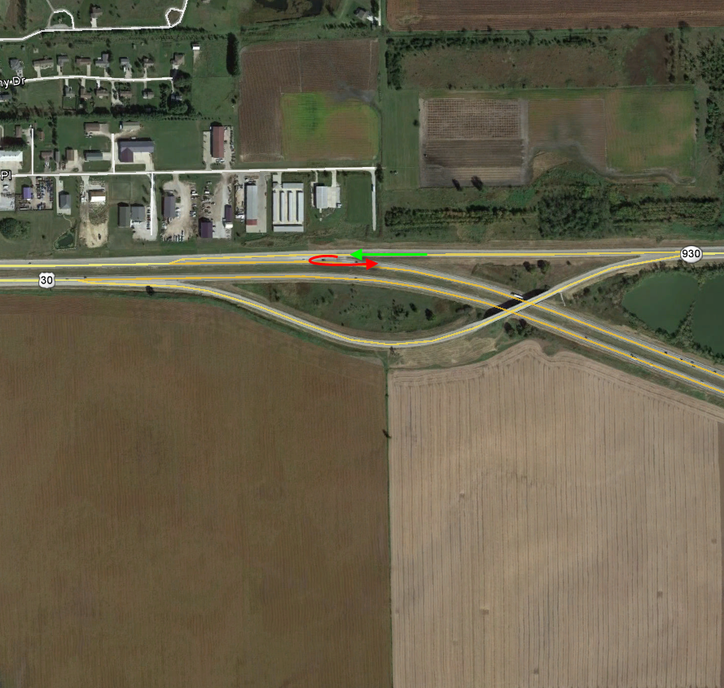
What have we learned?
At Ramps
31% of WWD “known point of entry” (13/42) start here
46% of those (6 of 13) were from free-flowing ramps

Slide 41
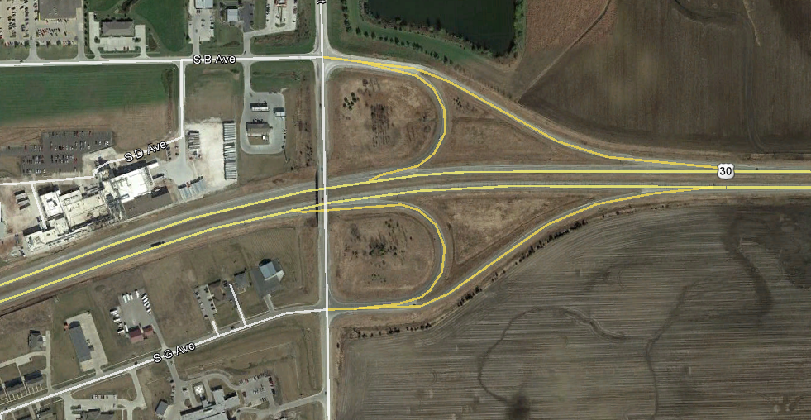
What have we learned
Yes, these can be a problem
But not these…. ;0)
Still don’t know about these

Slide 42
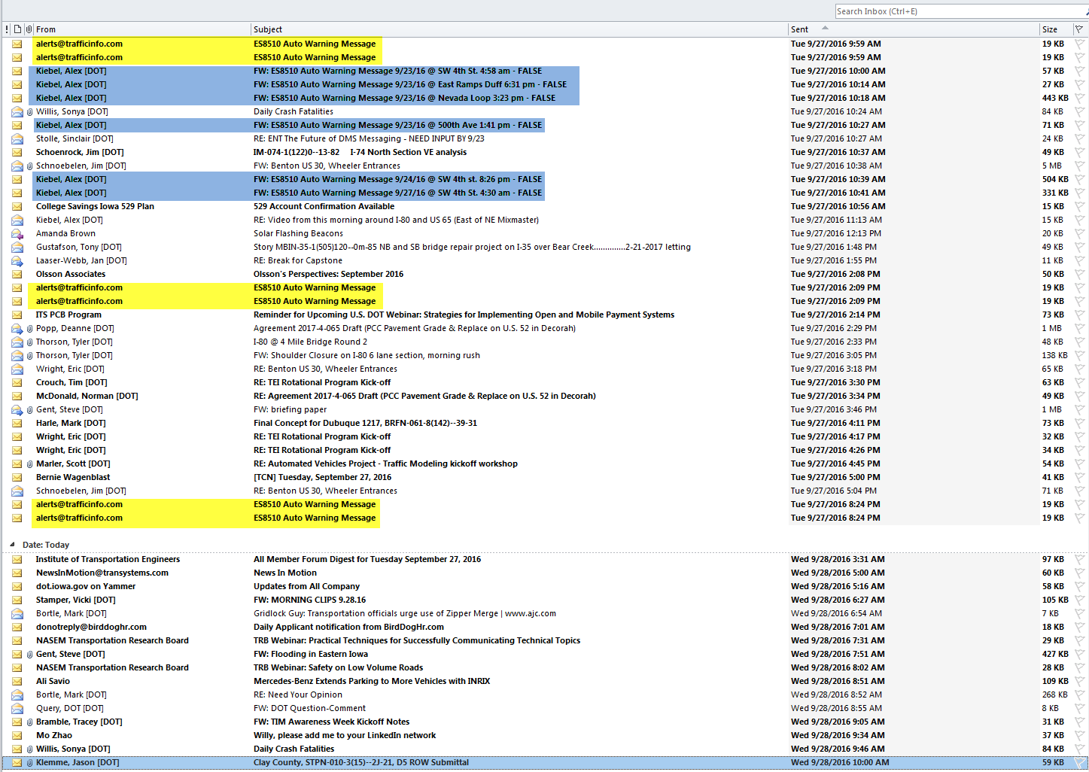
Over 4,000 False Alarms

Slide 43
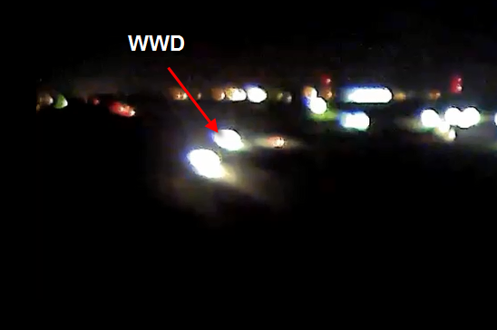
258 documented “Pass-bys”
Link to Video

Slide 44
What have we learned?
WWD can start anywhere
Free-flow ramps
At grade intersections
Ramps
Detection at Point of Entry is the best
Video Analytics is the way to go
Confirmation
Where did they come from (Dayton example)
You can have a WWD Problem
without a Crash Problem

Slide 45
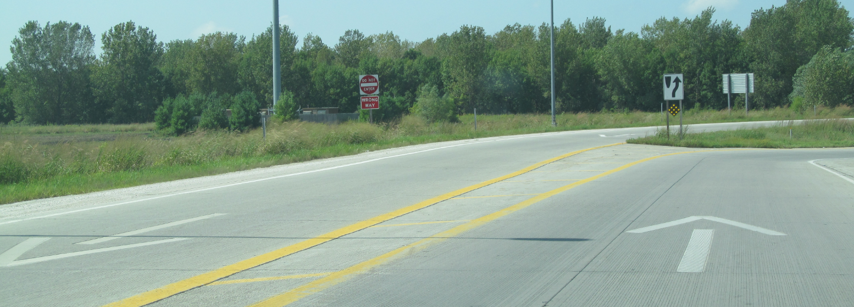
What have we learned?
Enhanced Signing & Painting DOES help!

Slide 46
What have we learned?
What are you going to do on your way home on US 30 (or any 4-lane road)?

Slide 47
Any questions?

