Slide 1
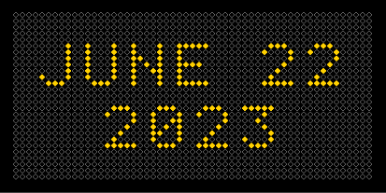
v3

Slide 2
Agenda
Network Screening
Systemic Treatments
$1.5 Million for 2021 Deployment of Enhanced Signing, Pavement Markings & Cameras
Initial results after 1 year

Slide 3
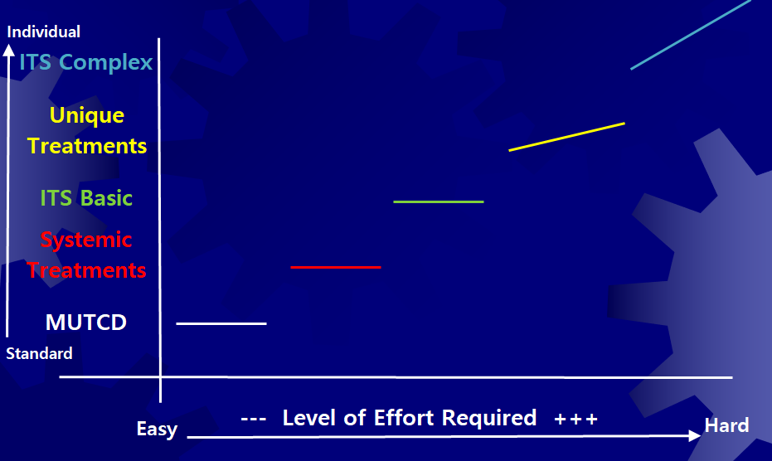
Level of Effort for WWD

Slide 4
After collection WWD Data for 10 years with $0 budget…
I got $1.5 Million of HSIP funding for enhanced signing and pavement markings.
This Photo by Unknown Author is licensed under CC BY-NC

Slide 5
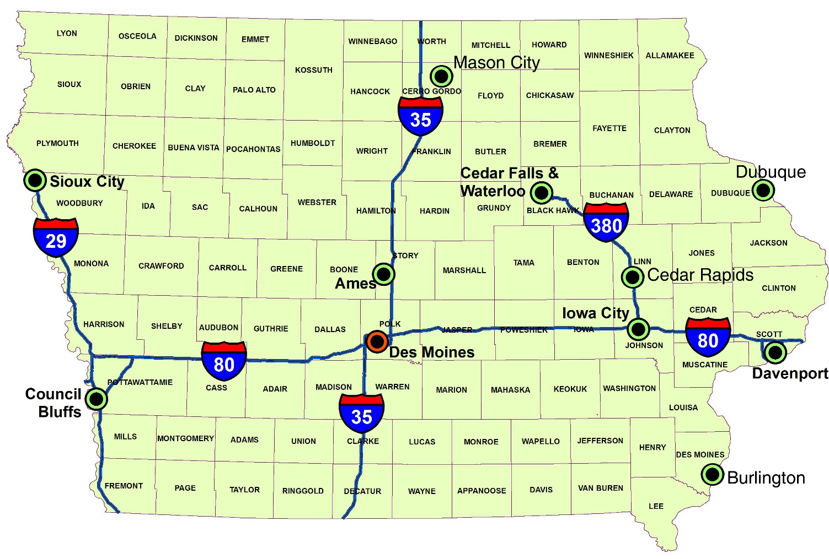
Where to Spend?
467 Interchanges in Iowa
?

Slide 6
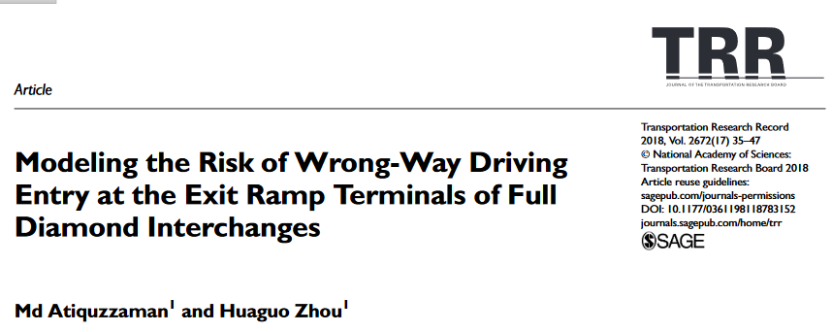
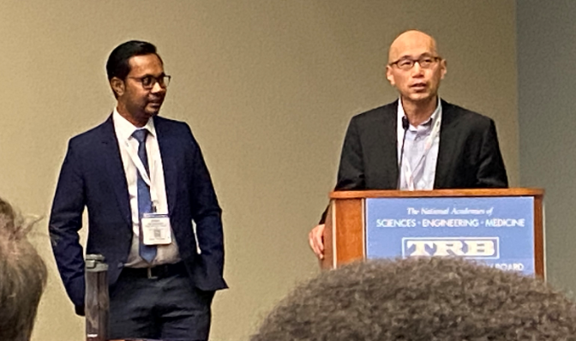
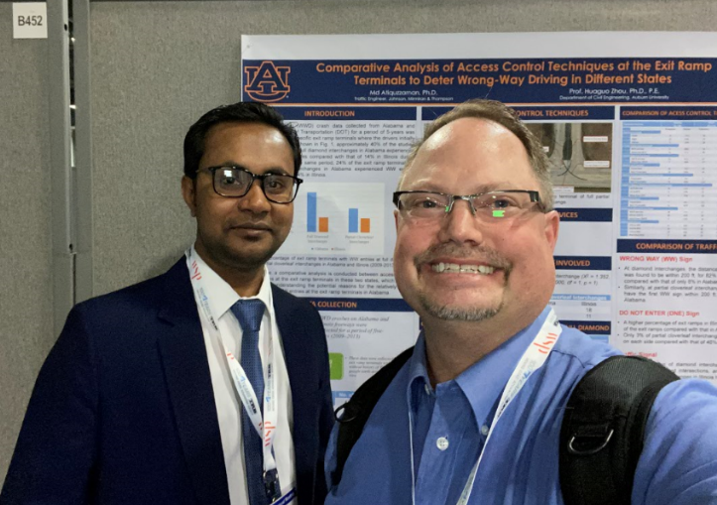
Network Screening
By Dr. Huaguo Zhou & Md Atiquzzaman of Auburn University
https://journals.sagepub.com/doi/pdf/10.1177/0361198118783152

Slide 7
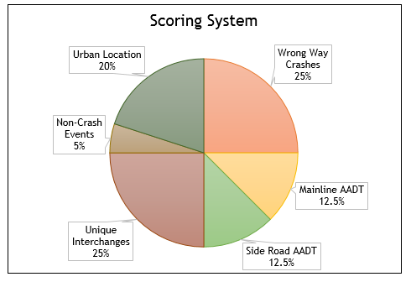
Iowa’s Modification Scoring System

Slide 8
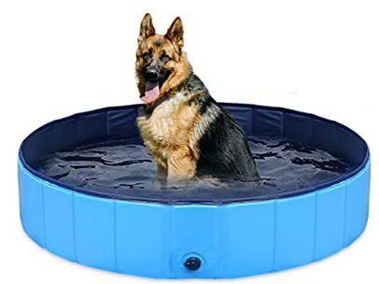
Started with 472 interchanges and then Multiplied by 100 “points”
47,200 Available Points in the Pool

Slide 9
Distribution of Points
Crashes (25%) - 11,800 points
Volume (25%) – 11,800 points
Mainline (12.5%)
Sideroad (12.5%)
Geometry (25%) – 11,800 Points
Urban/Rural (20%) – 9,440 Points
Non-Crash WWD Events (5%) – 2,360 Points

Slide 10
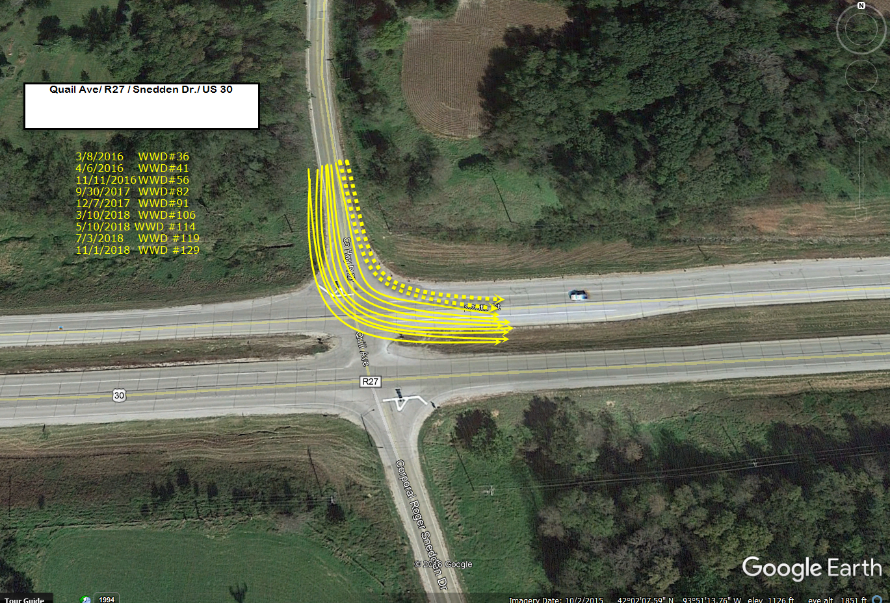
Don’t forget about At-Grades
These were not part of the network screening

Slide 11
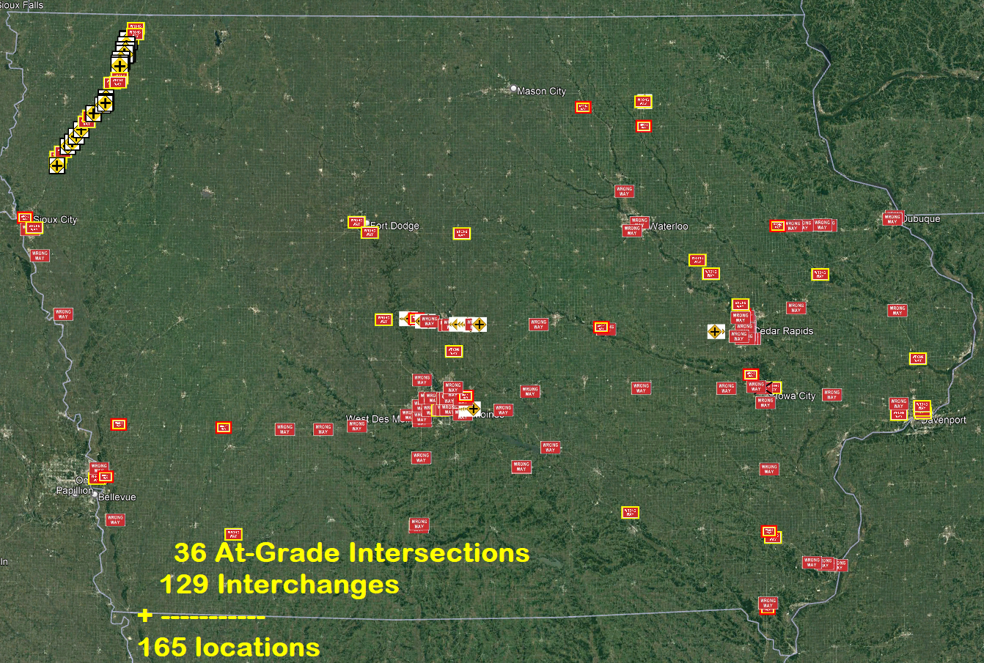

Slide 12
Common Philosophy for Signs
Larger signs
36” x 36” → 48” x 48” (78% increase)
Strategically Placed
Install sign where a potential WWD is looking
Stop placing signs where it is convenient
(like on the back of Stop sign)
Aim (angle) the sign for intended audience
Think about who (why) you are doing this.
Left and Right sides
2 is better than 1

Slide 13
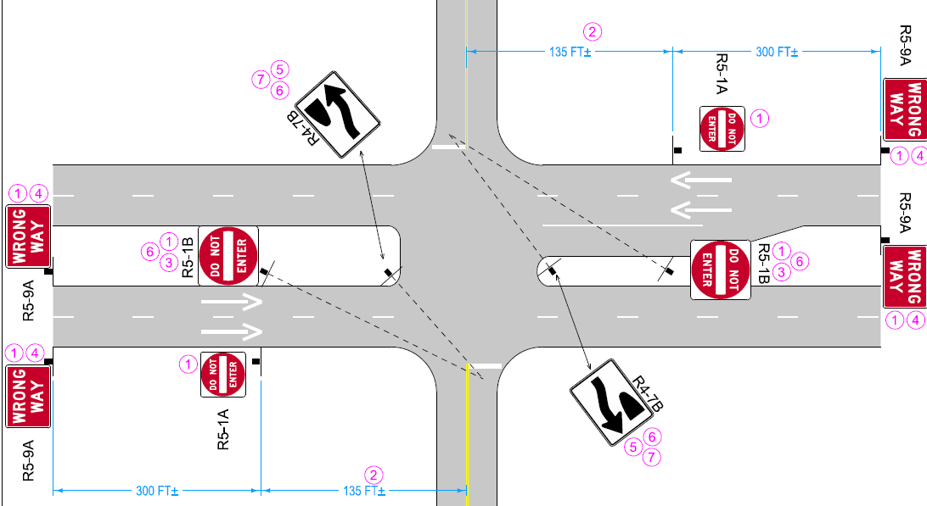
At-Grade Intersection
New Signs/Pavement Markings
Larger Signs
Strategically placed & aimed
New
New
UAC
Larger
New
New
New
New
Larger
New
UAC
New

Slide 14
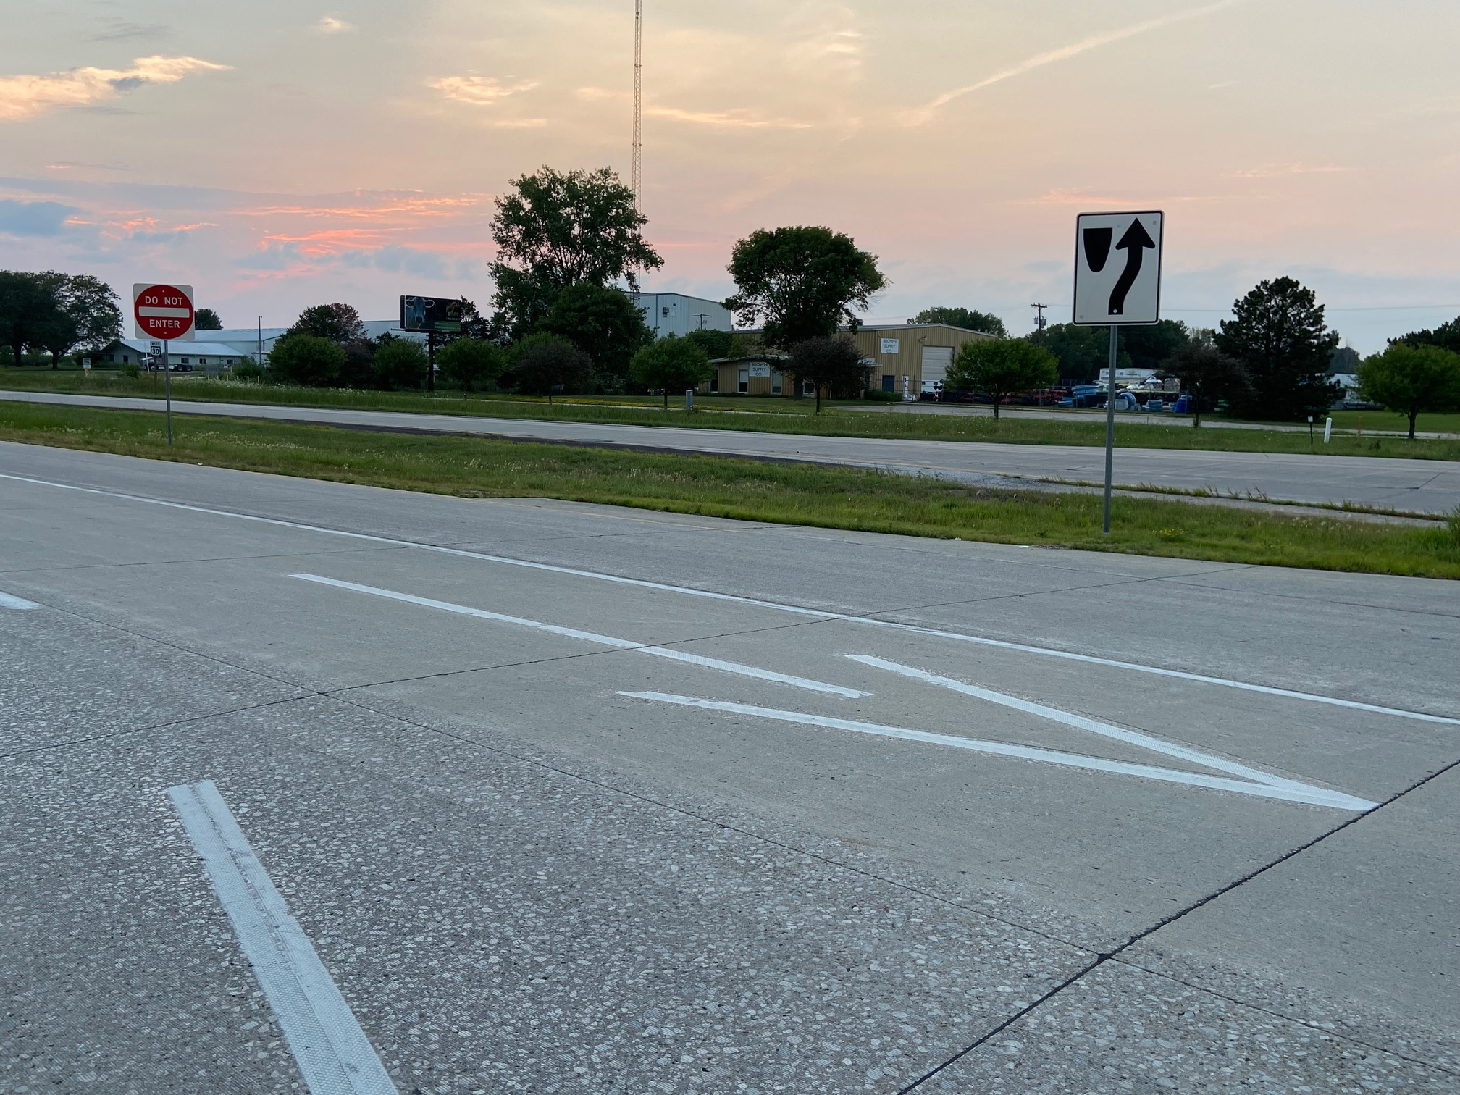

Slide 15
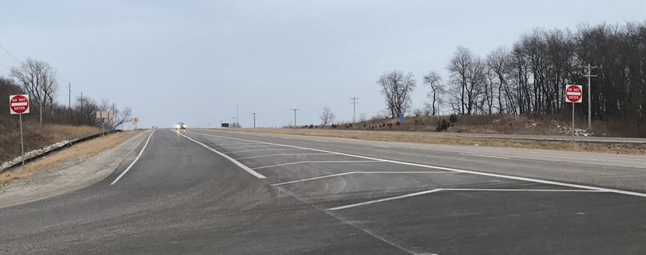
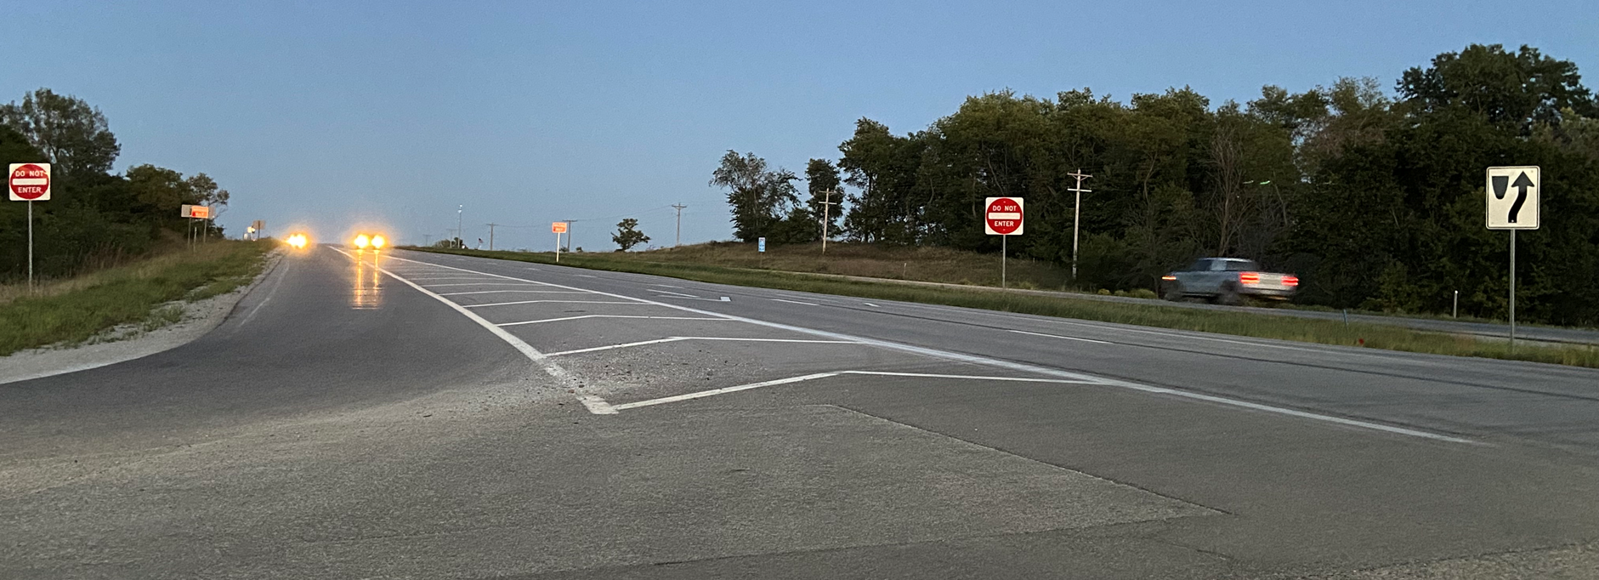
Before (MUTCD)
Good (w/ Systemic Treatments)

Slide 16
Had a few WWD, but this one…

Slide 17
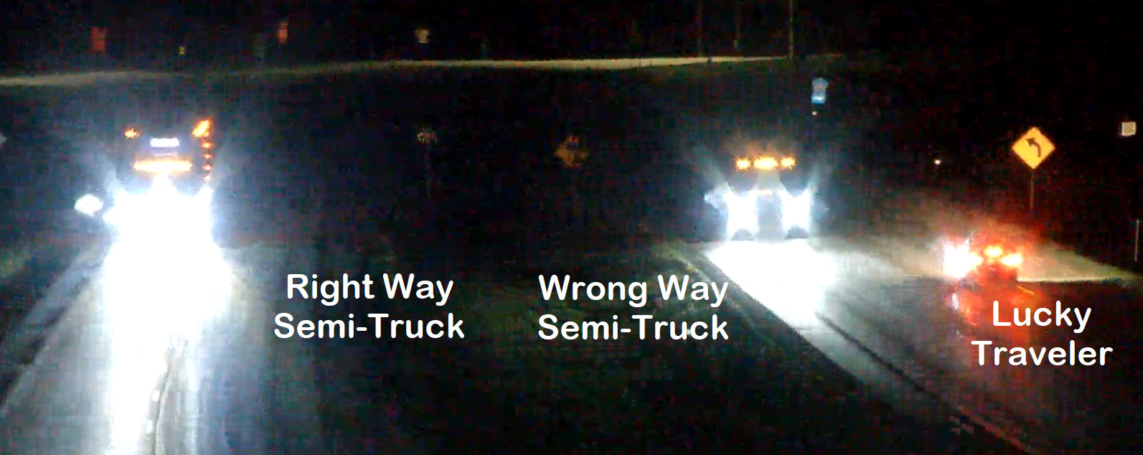
1 mile further down the road…
Was stopped by Police
Blood Alcohol Concentration (BAC) = 0.206

Slide 18
Good (w/ Systemic Treatments)
Added 6/1/23
Red Conspicuity sheeting on Do Not Enter Legs also
Better (I think)… w/ Text Version of Keep Right

Slide 19
Level of Effort for WWD
0.300
BAC
???
0.000

Slide 20
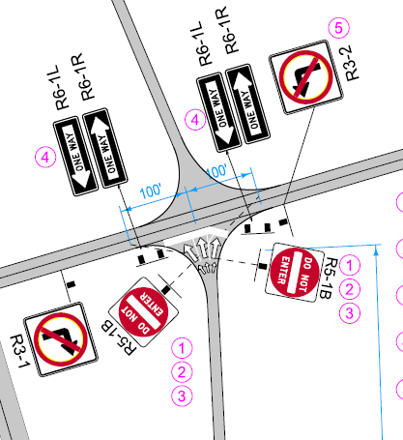
Standard Diamond Interchange

Slide 21
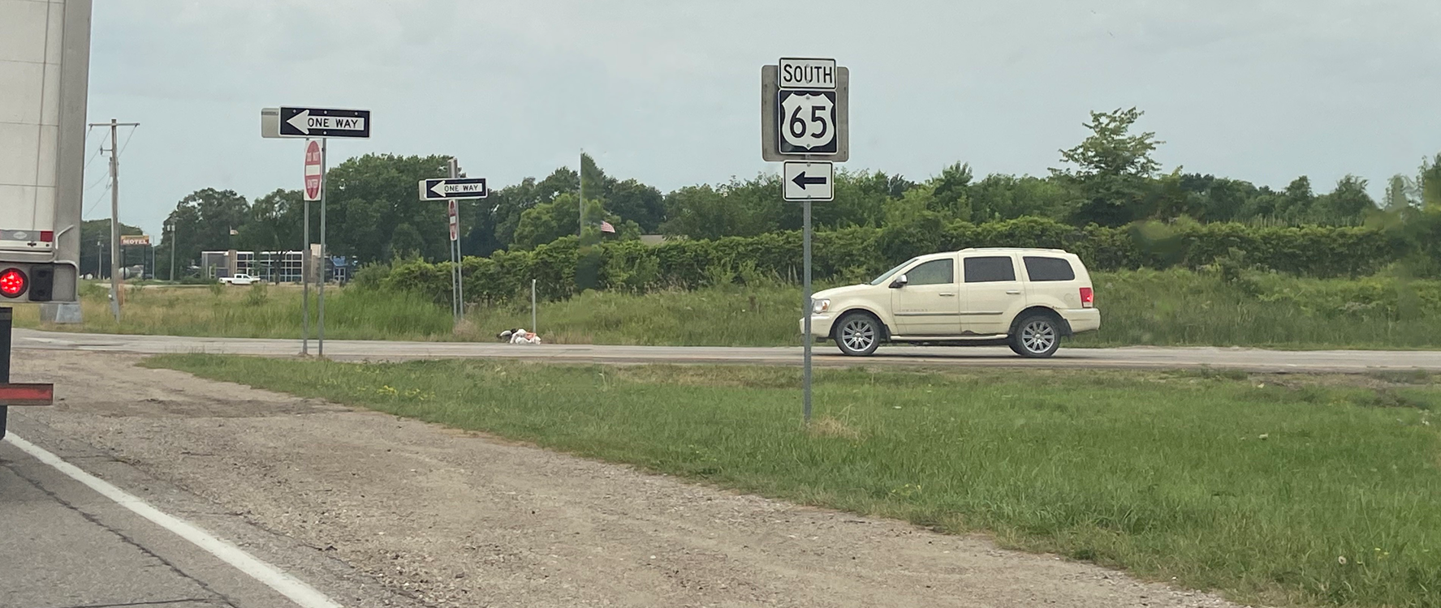
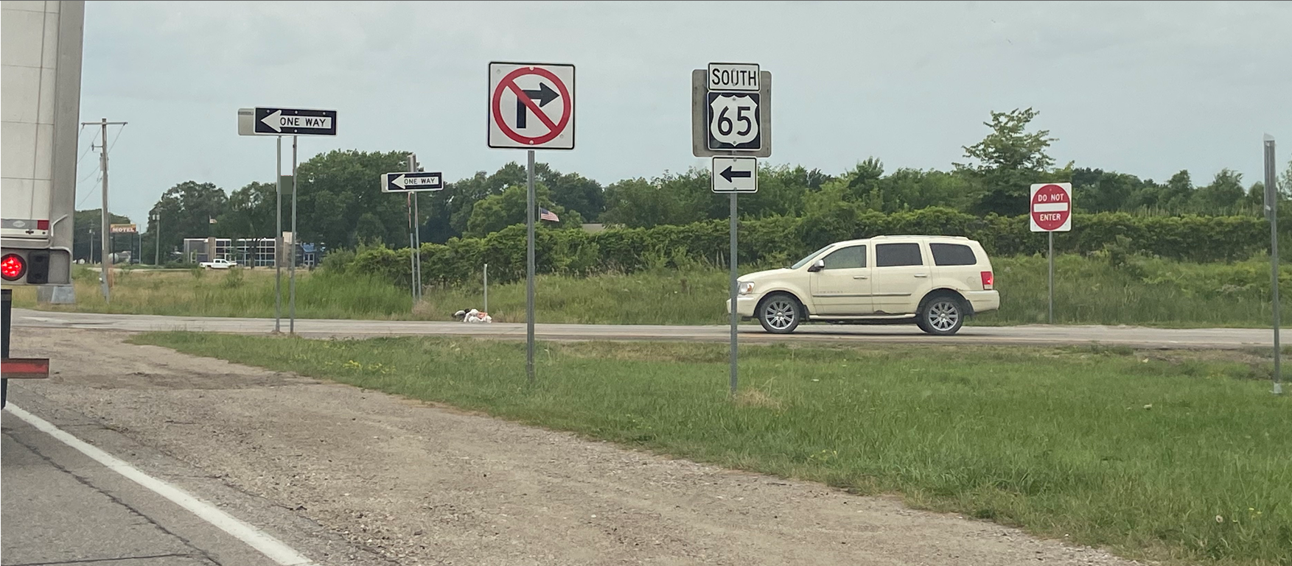

Slide 22
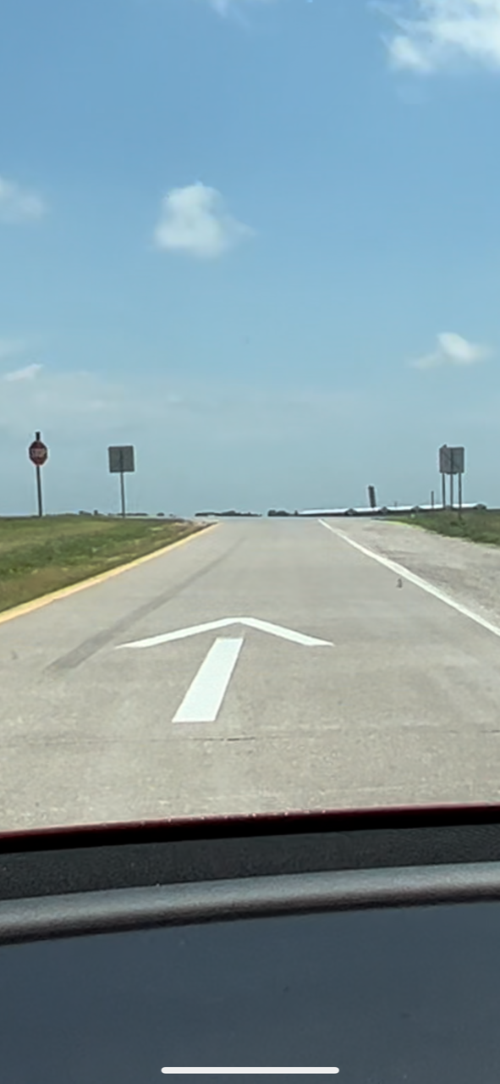
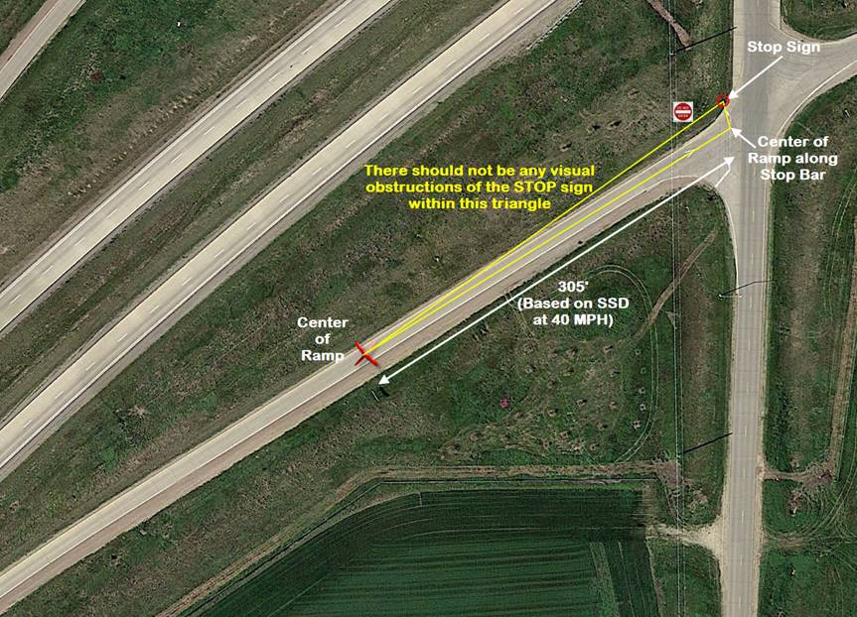
Be Careful with Do Not Enter & Stop Signs
Do Not Enter
Was Blocking the STOP Sign.
We fixed by moving DNE out further.

Slide 23
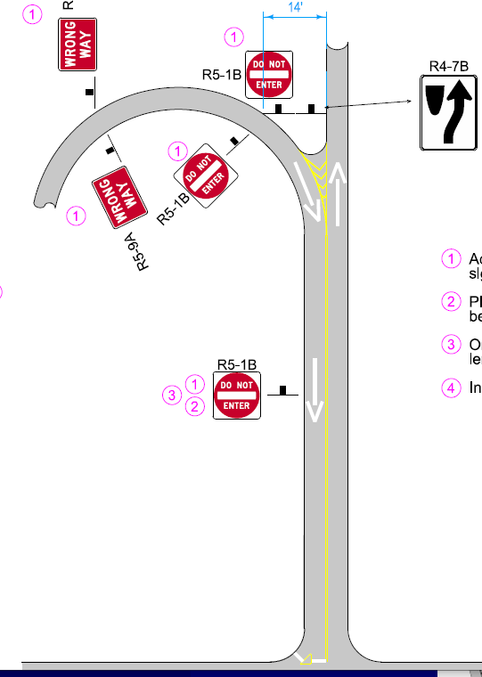
Folded Diamond Interchange

Slide 24
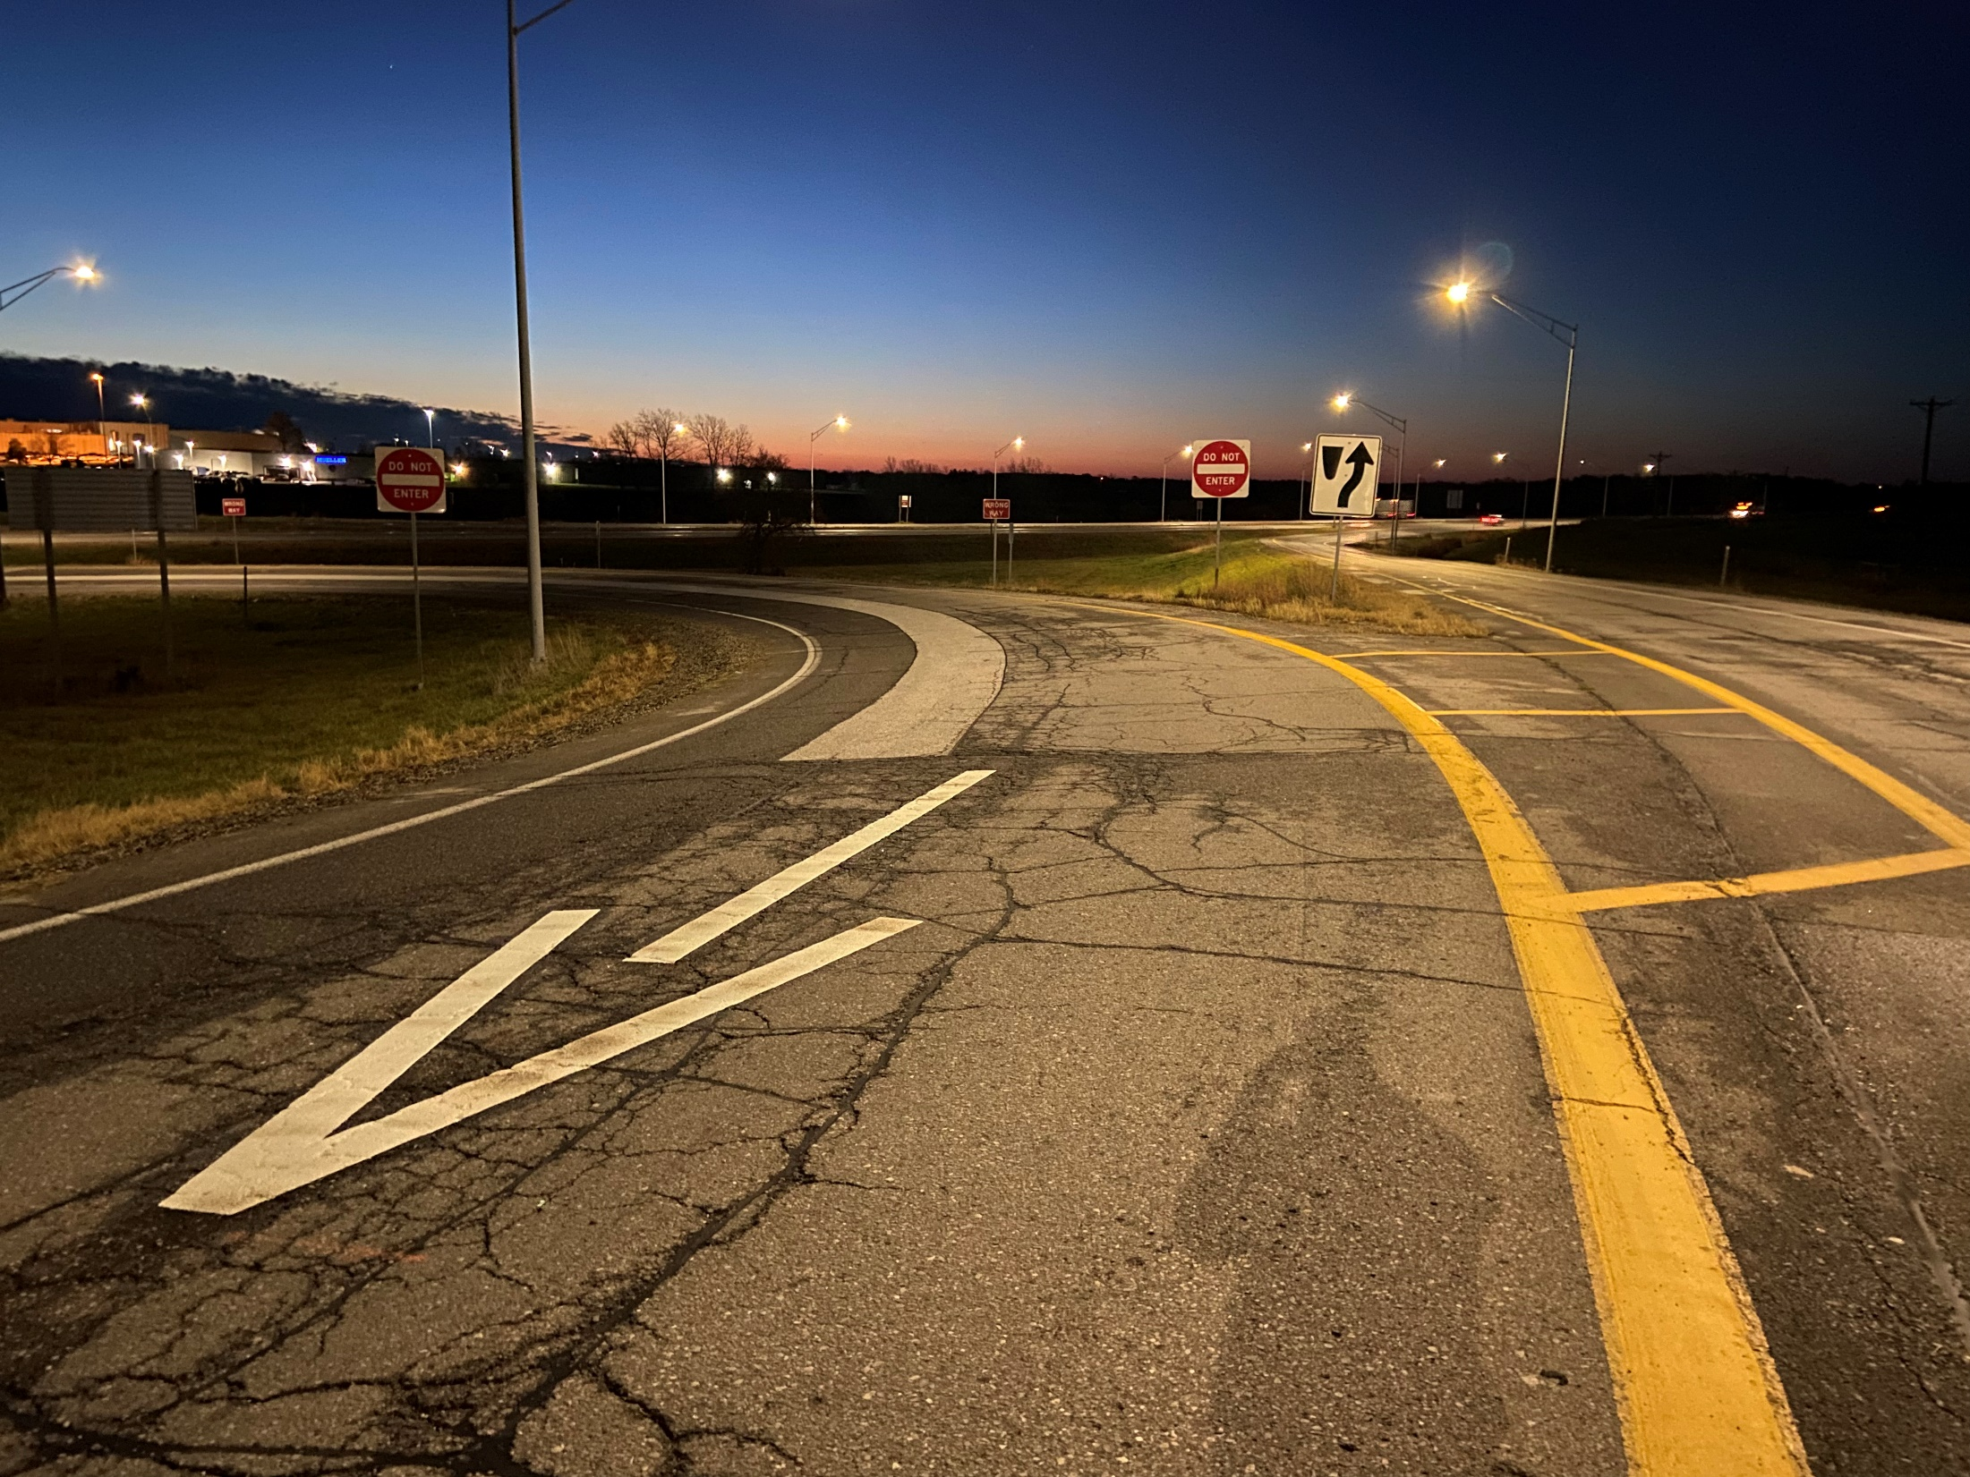
Interesting Countermeasure #1
“Gateway” for Folded Diamonds

Slide 25
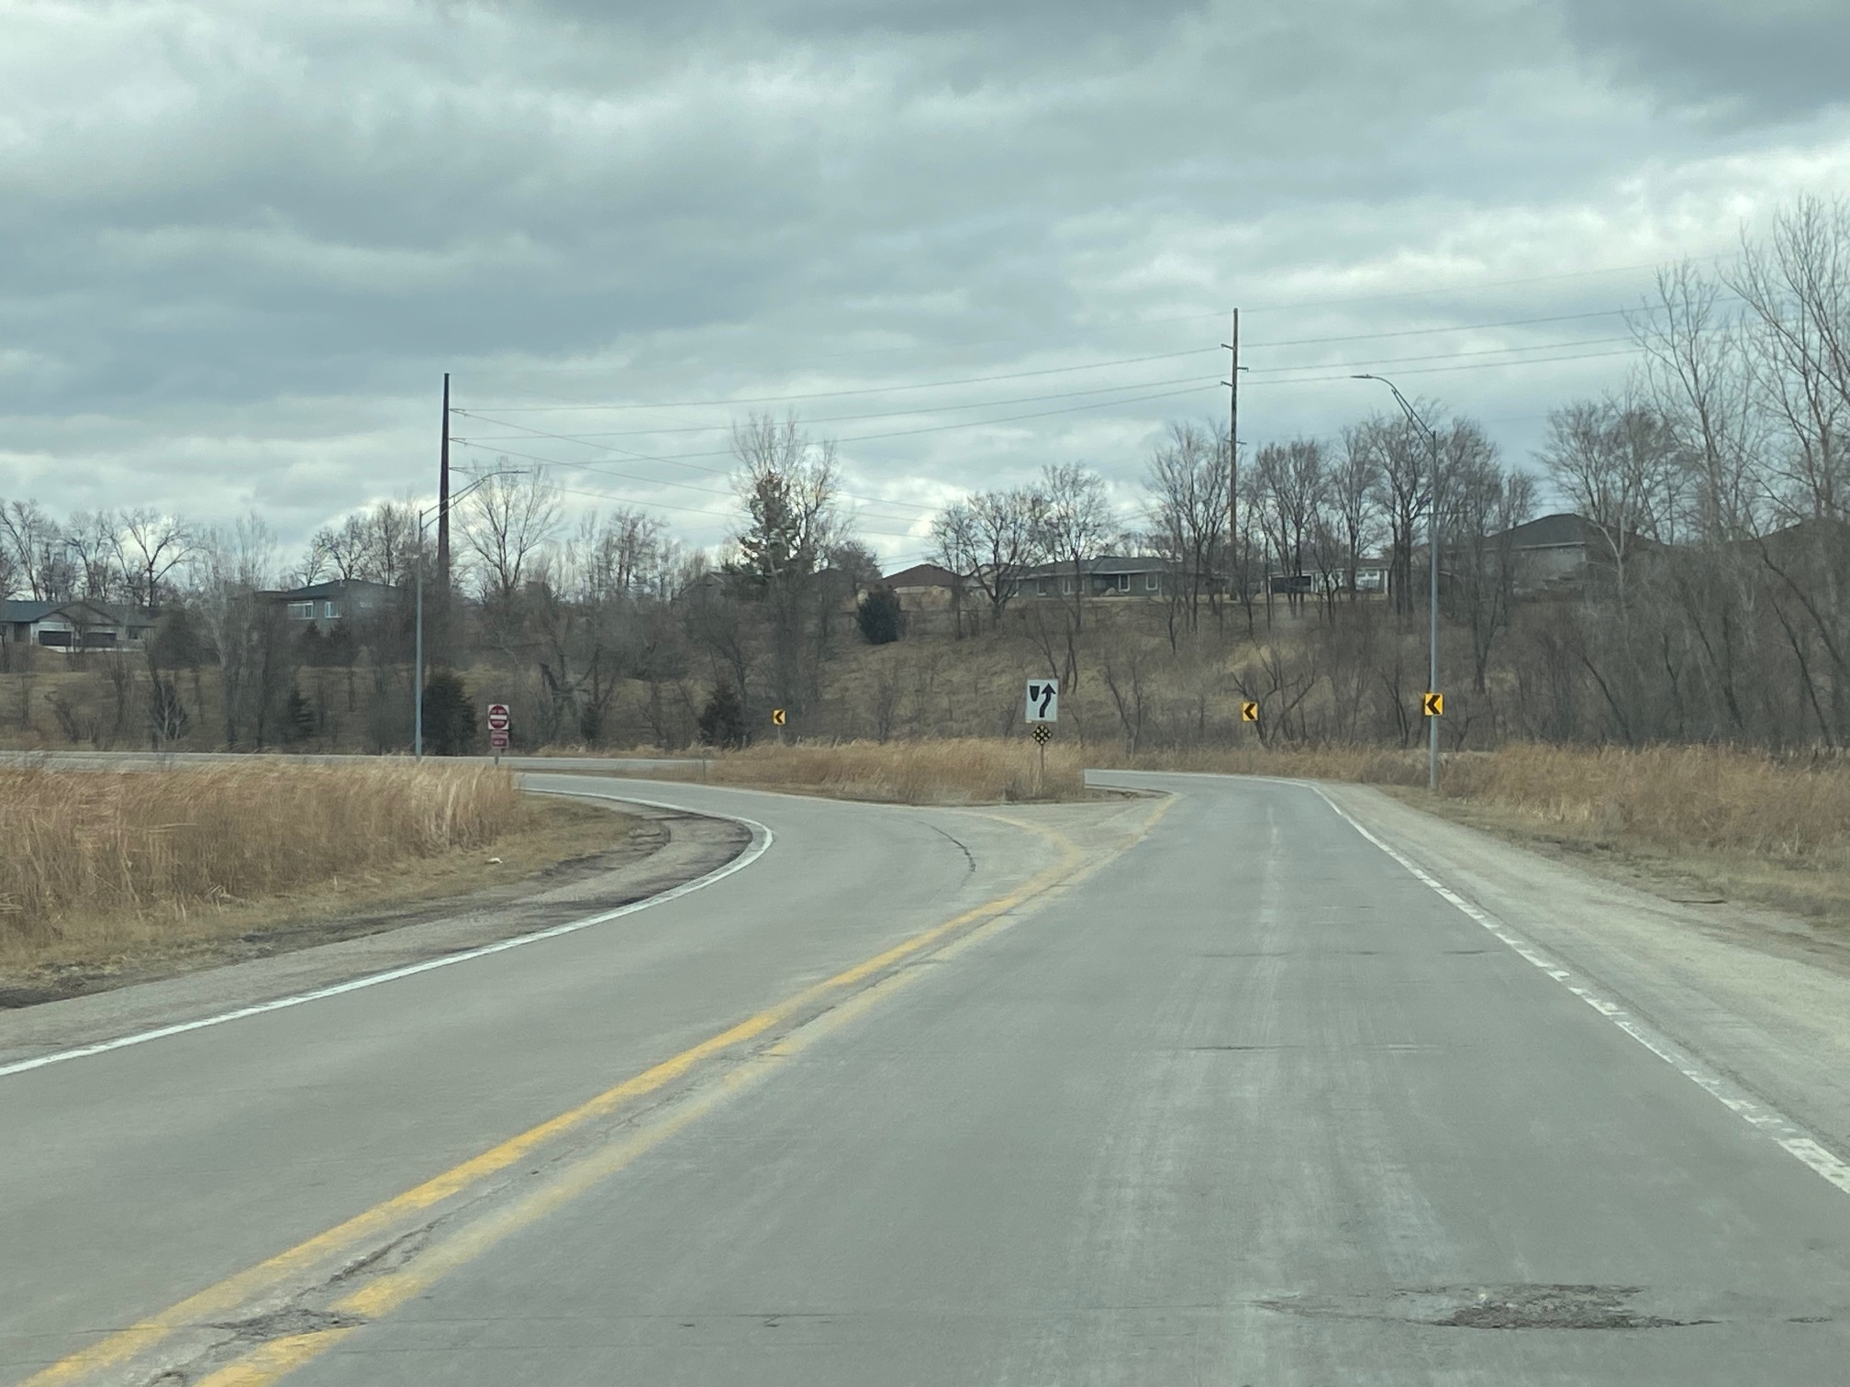

Slide 28
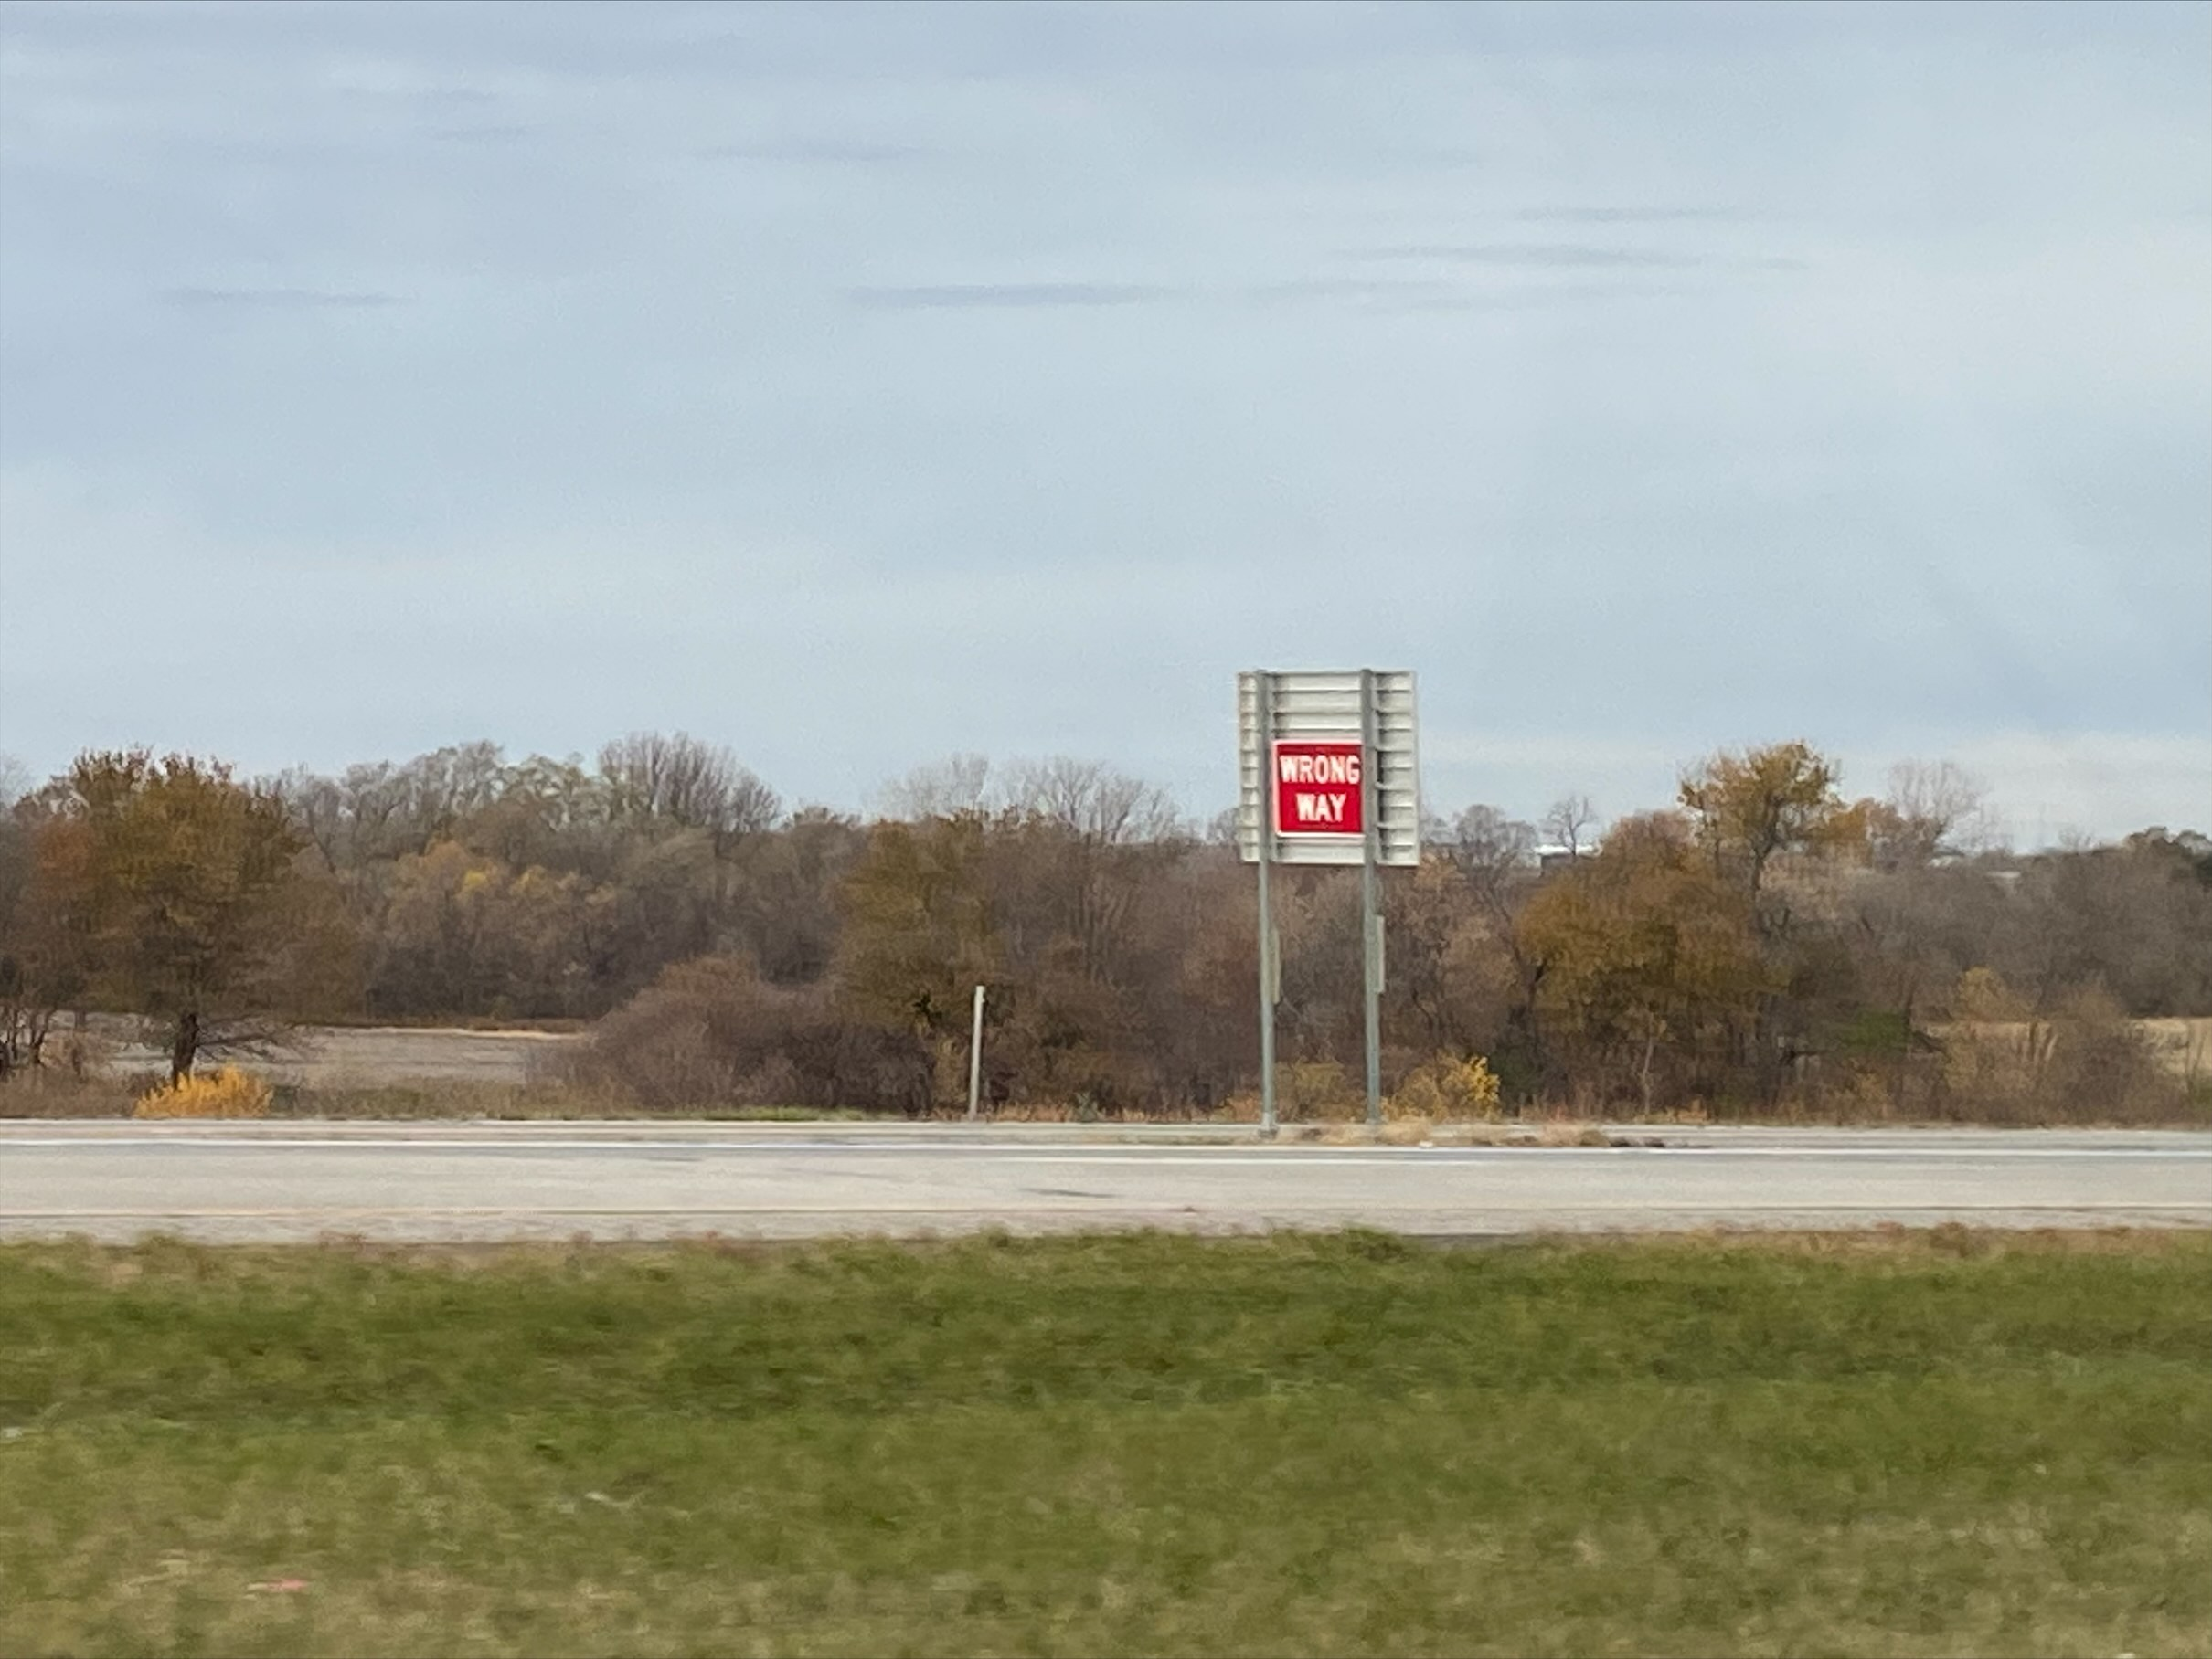
Zac’s Sign

Slide 29
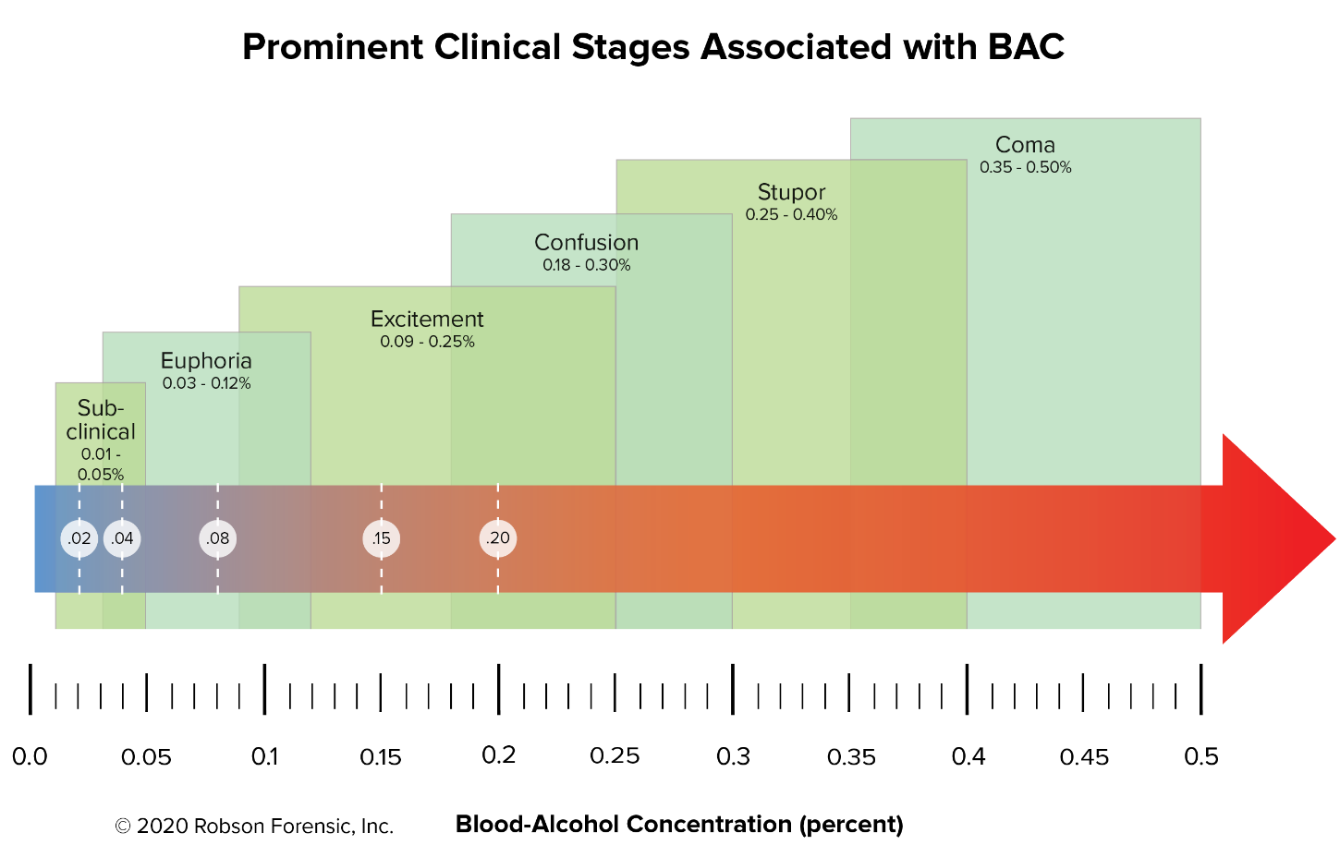
Hypothesis….
If you can solve the WWD problem for Daytime, non-drunks…. (85% that self correct)…. Will it reduce the nighttime intoxicated WWD problem, (the other 15%)?
?
?
?
?
Probably Not

Slide 30
Preliminary Results (Interstates, Freeways & Expressways) With a speed limit of 60, 65 or 70 MPH Currently too hard to review 55 MPH highways
2023 (as of 6/20) 10 crashes
Only 1 might have been at a location that had systemic countermeasures
BAC unknown
4 with BAC (Average was 0.194)
2022 19 crashes
Only 4 may have been from a location with systemic countermeasures
Only 1 (of the 4) recorded a BAC. It was 0.144
6 with a BAC (Average was 0.176)
2021 8 Crashes
None from a location with Systemic Countermeasures
4 w/ a BAC (Average was 0.147)

Slide 31
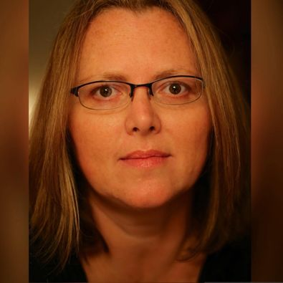
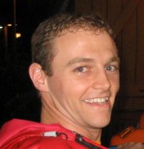
To wrap things up, there is 1 more thing that I’d like you to know and share with your family, friends and co-workers.

Slide 32
Questions?

