Slide 1
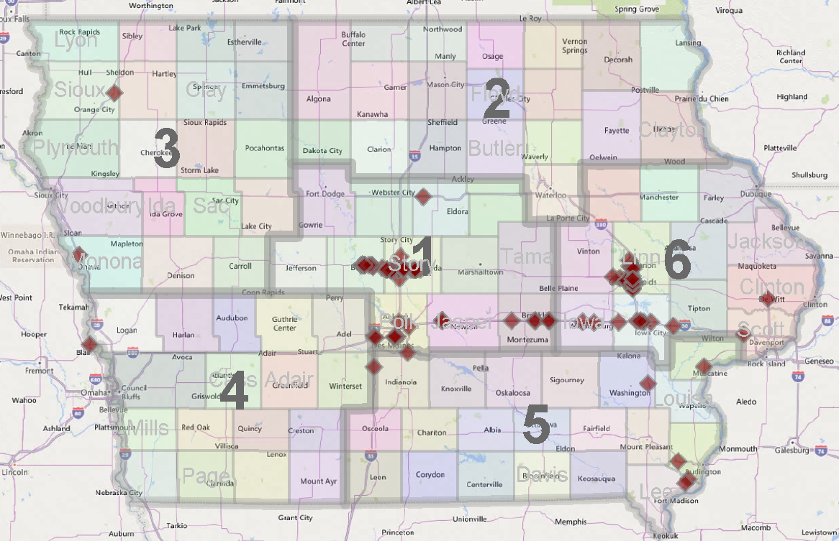
Wrong Way Driving
Building Relationships with 911 Centers
2019 WWD Events that the Iowa DOT is aware of

Slide 2
Agenda
Wrong Way Driving Update 3-4-2021
How big of a problem is this? Crashes? Events? Fatals?
Last 10 year of WWD data gathering and actions
What we are presently working on
Future efforts to work on

Slide 3
WWD Crashes 2008 to 2018
3.4 deaths / year (2008-2018)
6 deaths in 2019
11 deaths in 2020

Slide 5
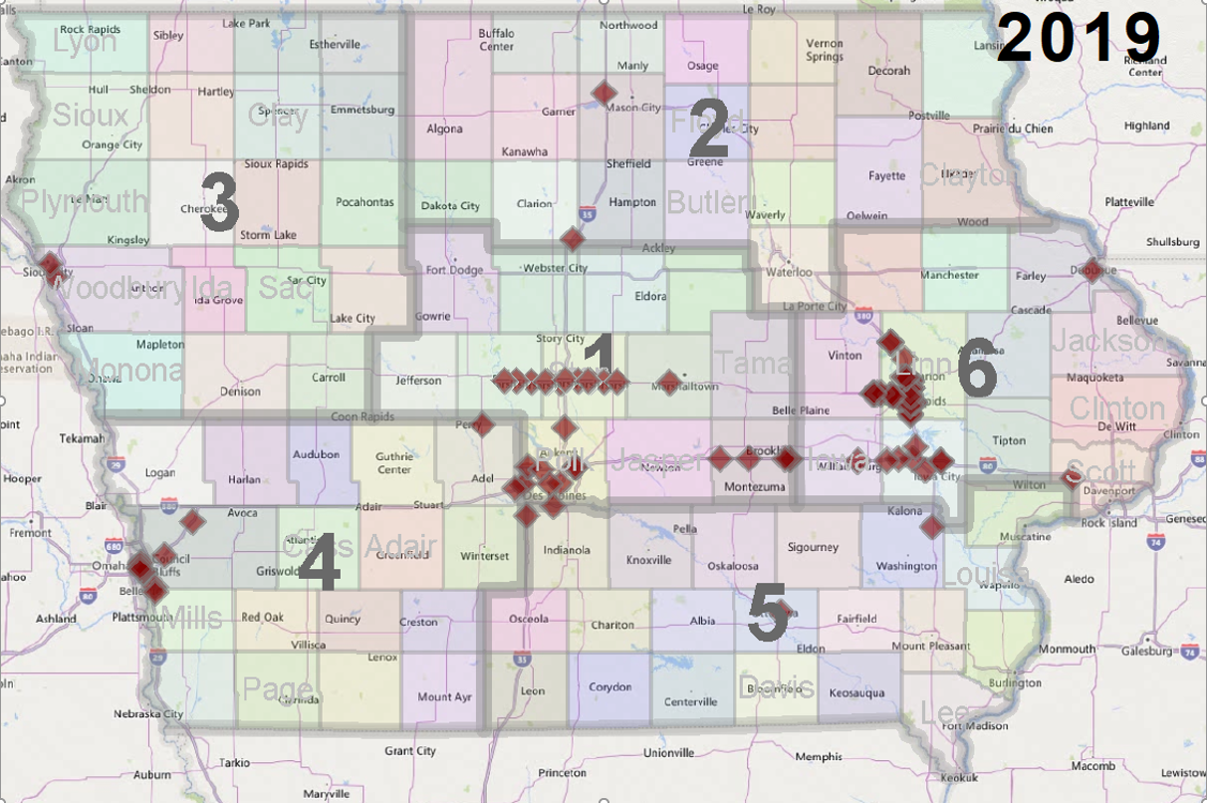

Slide 6
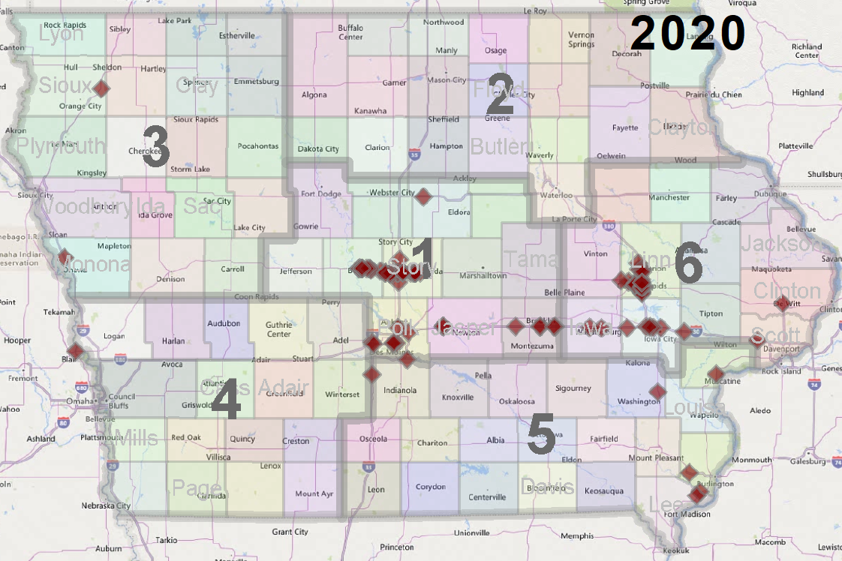

Slide 7
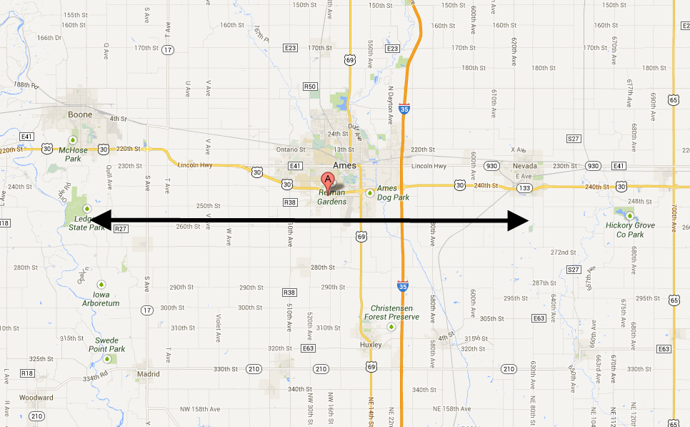
Project Location
Boone
Nevada
Ames
25 miles
Working on this Corridor since 2012

Slide 8
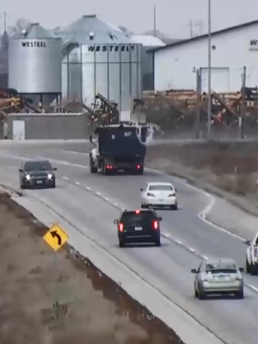
What we “Caught”
216 events since July ’14
Sensors/ 911 calls /Videos
Only 2 “single vehicle” crashes
Over 1,000 “pass-bys”
Unique countermeasures at 7 locations (99% success preventing future)
2 “Good” Detection Zones

Slide 9
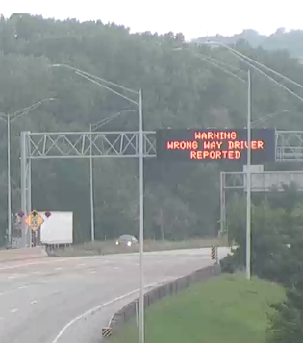
Cedar Rapids & Iowa City
Overhead DMS use
About 20 activations in the 1st 6 months of implementing

Slide 10
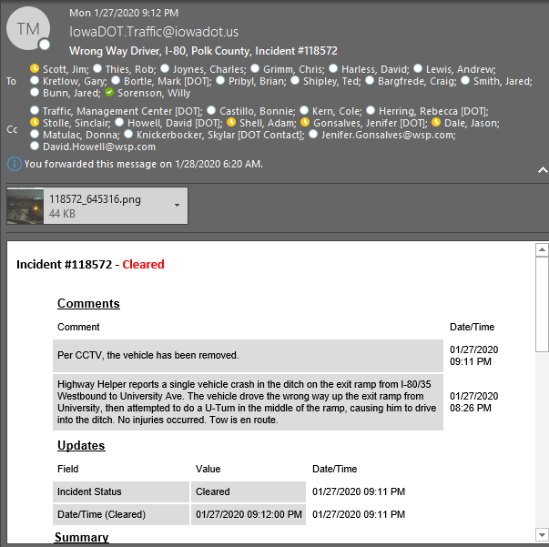
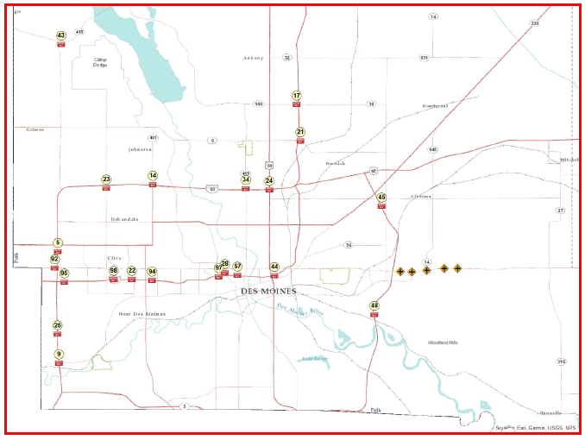
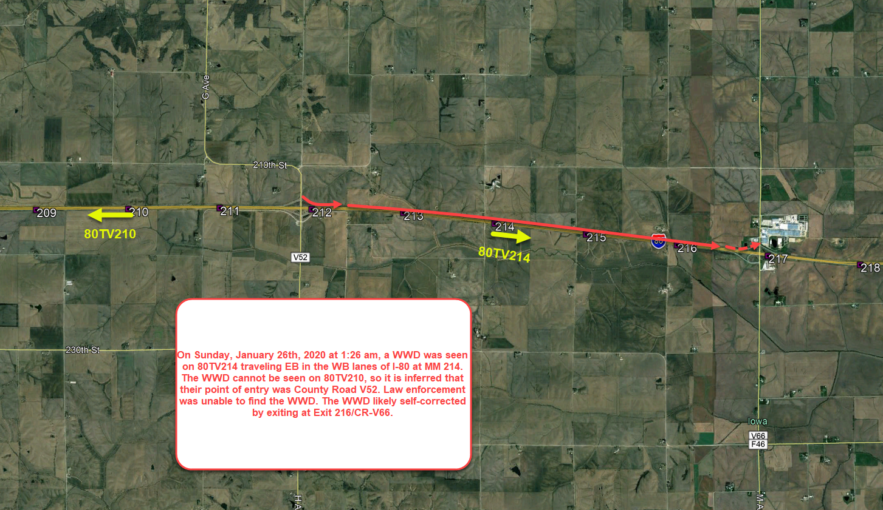
WWD E-mail Notifications
Situational awareness of WWD with TMC e-mails
These e-mails were created specifically for TAS so we can be notified and then track WWD events

Slide 11
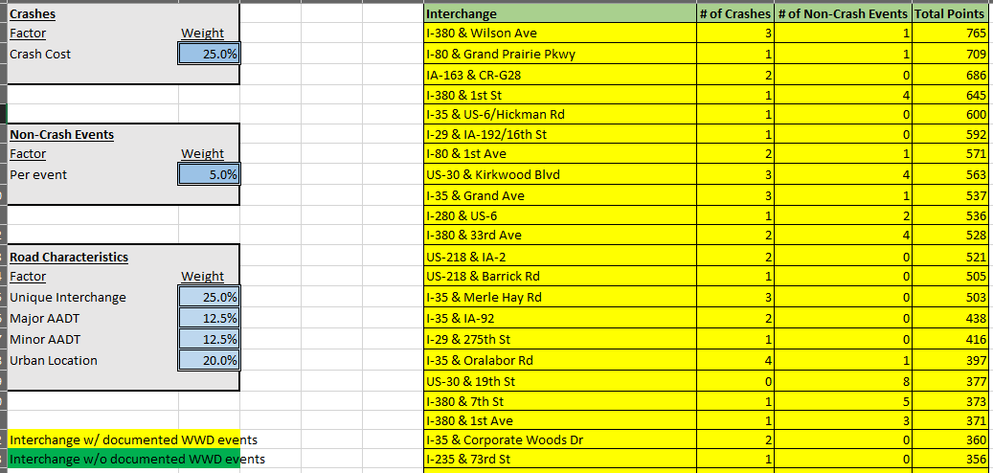
Statewide WWD Database

Slide 12
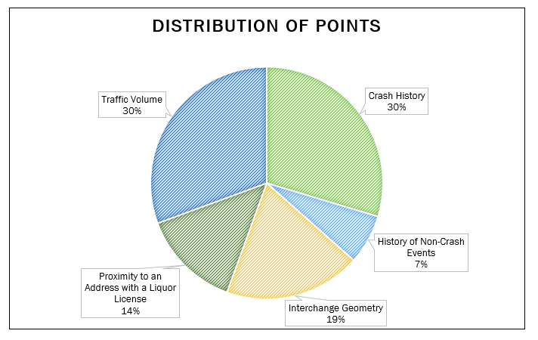
Scoring

Slide 13
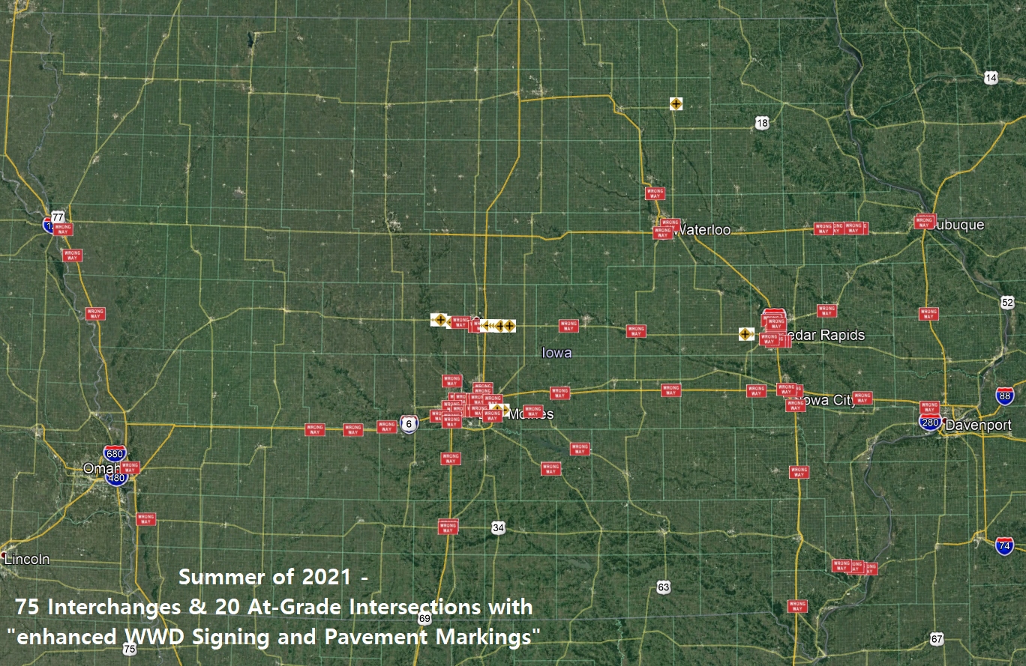

Slide 14
60+/- WWD Cameras (Coming Summer ‘21)

Slide 15
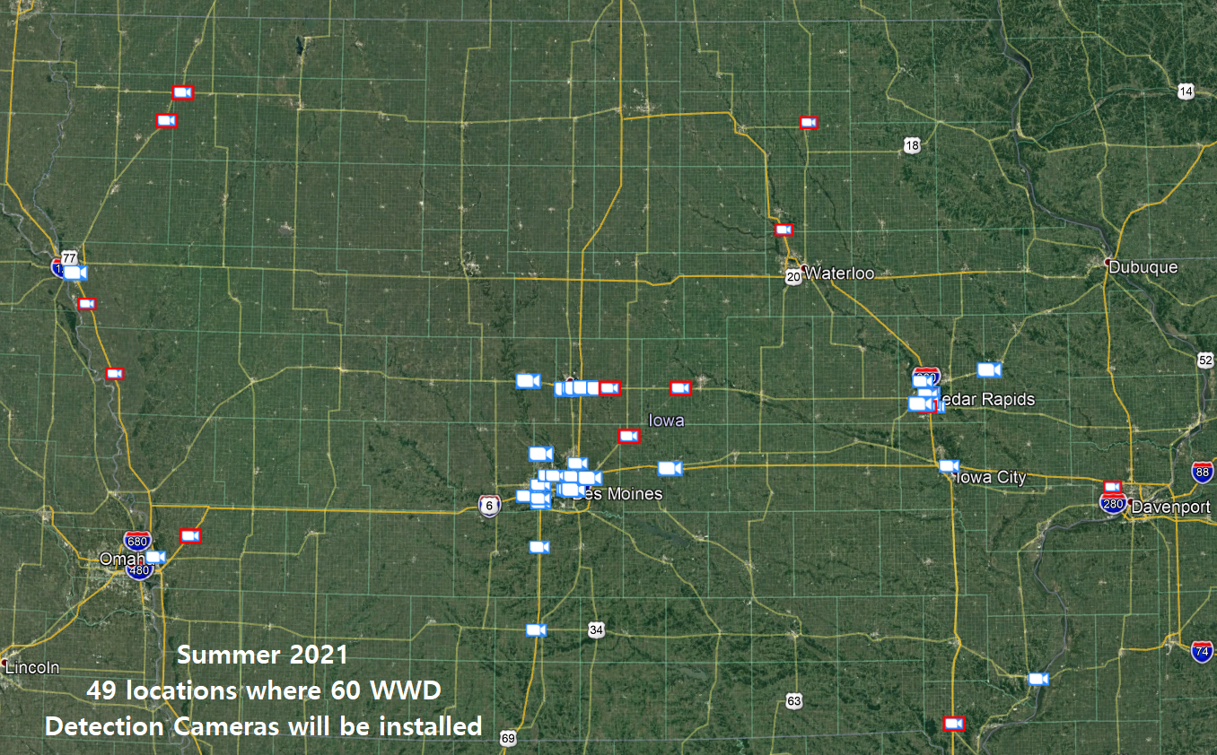

Slide 16
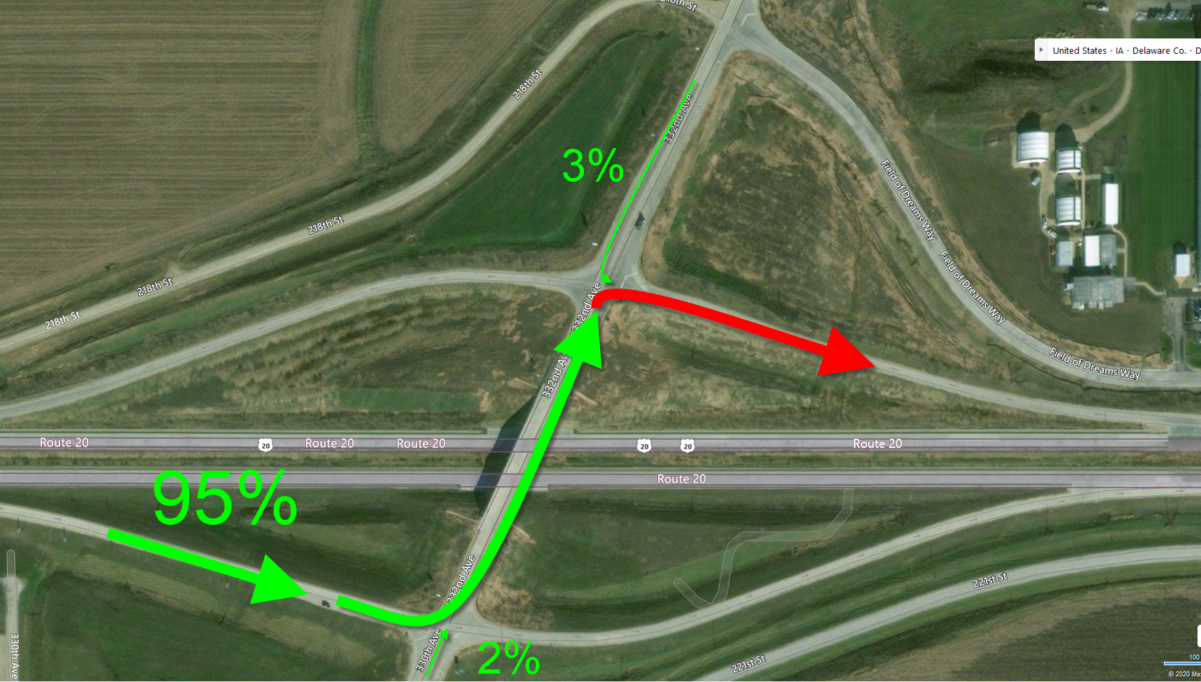
Dyersville (156 events since May)

Slide 18
Notification to 911 Centers
The public is not very good about calling
A Florida study showed 90% of people do NOT call 911
Long term goal is to “notify” 911 centers when these cameras identify a WWD
Need to make sure no false calls
Seconds do count.
If we can’t prevent, we can respond

Slide 19
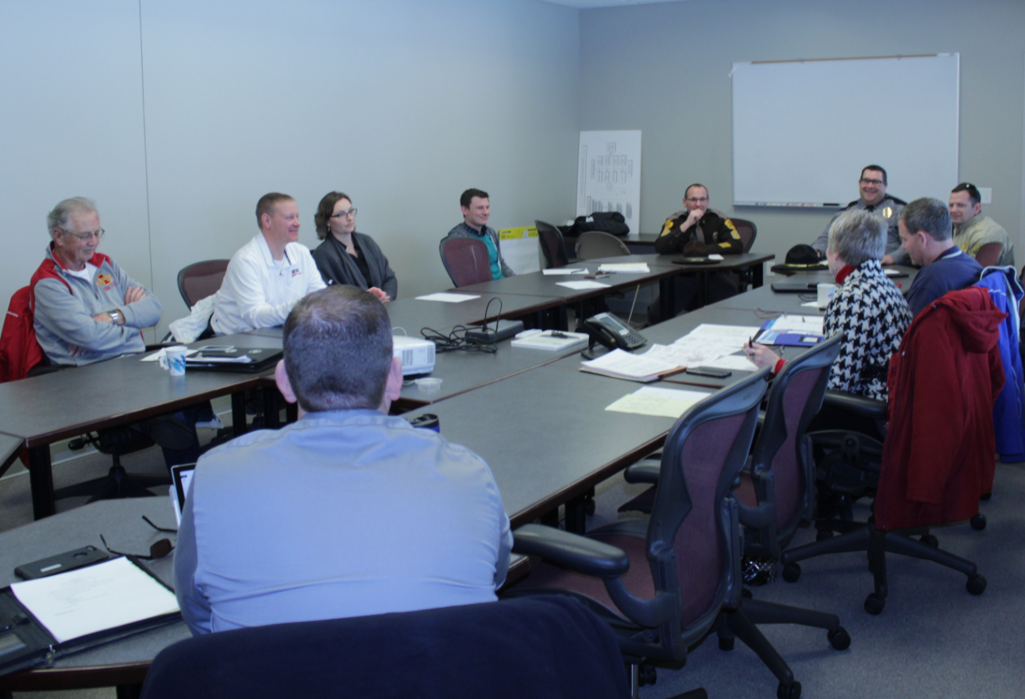
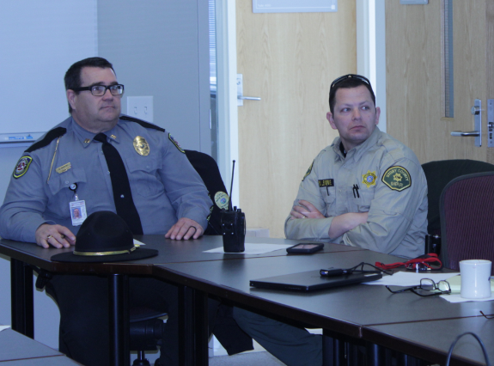
Overall Plan to Combat WWD
Build relationships with local LEA/911 centers
Ames MDST and Cedar Rapids PD are the start
TIM groups would be an excellent next step

Slide 20
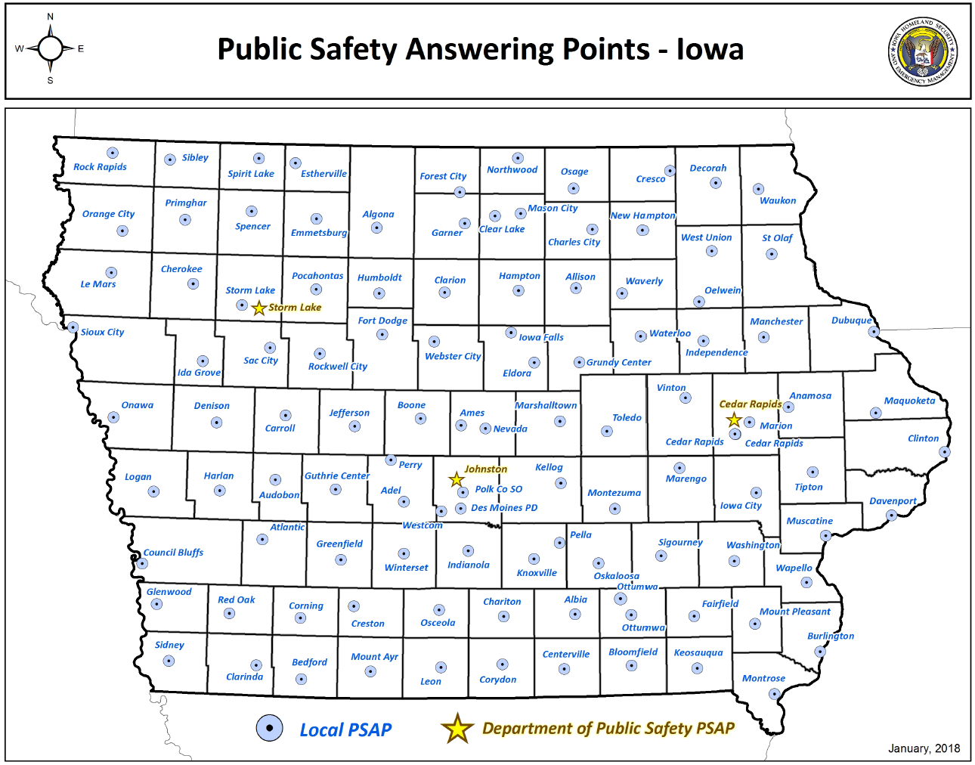
113
Done
Previous data

Slide 21
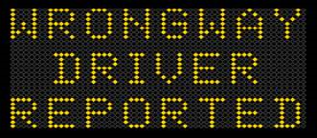
What you & Staff can do
If you have DMS in your area:
If you notify the TMC (immediately), we can activate DMS messages
We will have a record of the event
If you can’t/don’t want to notify the TMC (immediately), we still care “after the fact”
If you don’t have DMS in area
If you tell us within 7 days, we can look at our camera video
We will still document the event
If patterns surface, help can be on the way

Slide 22
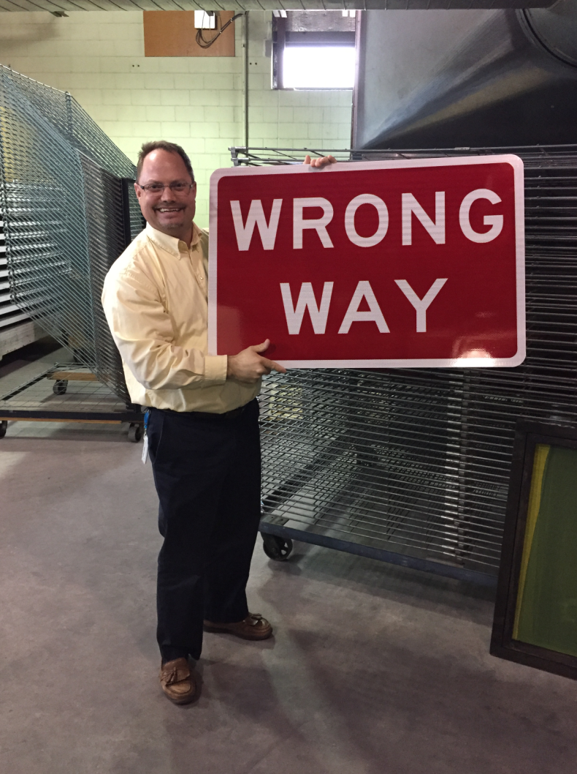

Slide 23
Any WWD Information?
Willy Sorenson, P.E.
Willy.Sorenson@iowadot.us
(515)-669-4628 Cell (99% of getting me)
Traffic & Safety Engineer
Traffic & Safety Bureau, Iowa DOT
800 Lincoln Way, North Annex
Ames, Iowa 50010
(515)-239-1212 Office (1% chance I’ll answer)

