Slide 1
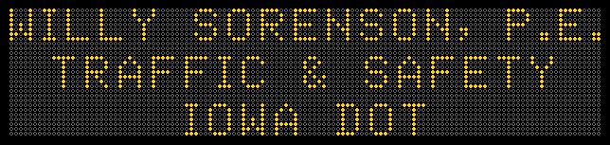
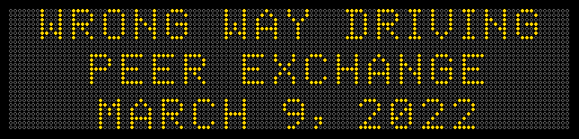

Slide 2
Agenda
$1.5 Million for 2021 Deployment of Enhanced Signing, Pavement Markings & Cameras
Home grown notification system
Unique treatments worth sharing
In-Car notification efforts

Slide 3
Preamble
This presentation was created and is being presented by Willy Sorenson of the Iowa DOT. The views and opinions expressed in this presentation are his and do not necessarily reflect those of the FHWA or USDOT. The contents do not necessarily reflect the official policy of the Department of Transportation.

Slide 4

After collection WWD Data for 10 years with $0 budget…
I got $1.2 Million of HSIP funding for enhanced signing and pavement markings.
This Photo by Unknown Author is licensed under CC BY-NC

Slide 5
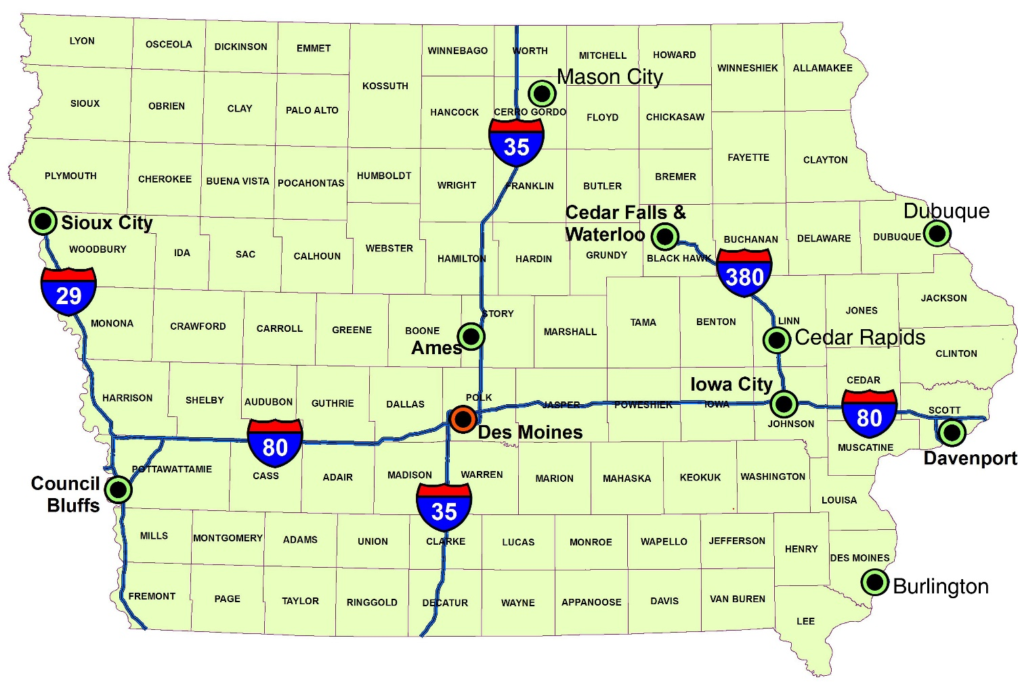

Where to Spend?
467 Interchanges in Iowa
?

Slide 6
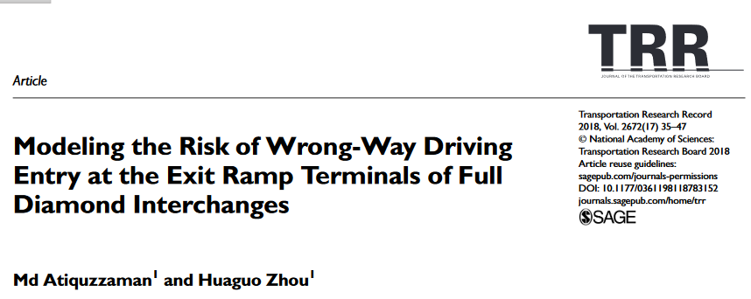
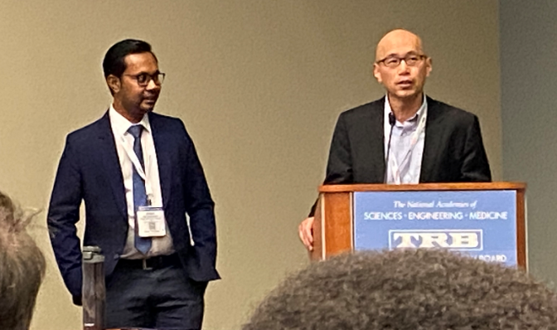
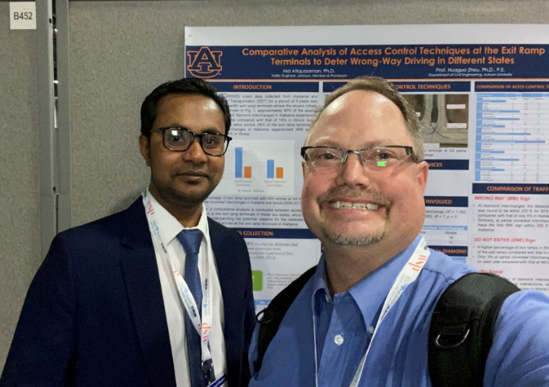
Network Screening
By Dr. Huaguo Zhou & Md Atiquzzaman of Auburn University
https://journals.sagepub.com/doi/pdf/10.1177/0361198118783152

Slide 7
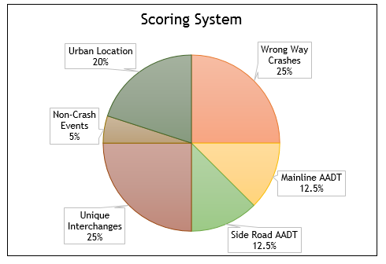
Iowa’s Modification Scoring System

Slide 8
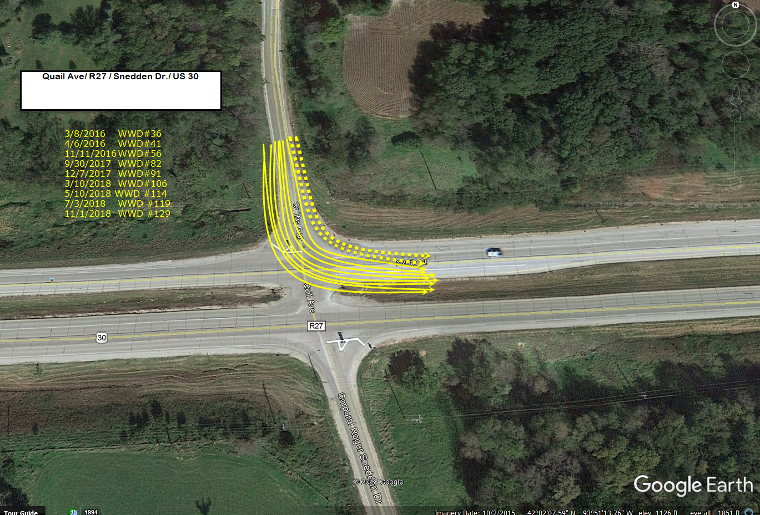
Don’t forget about At-Grades

Slide 9
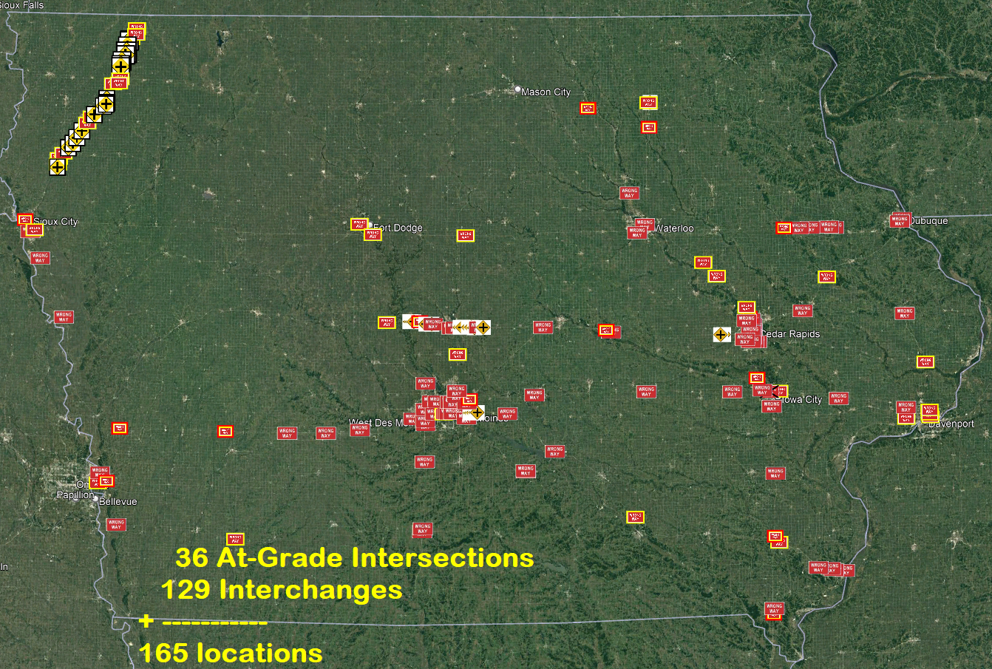

Slide 10
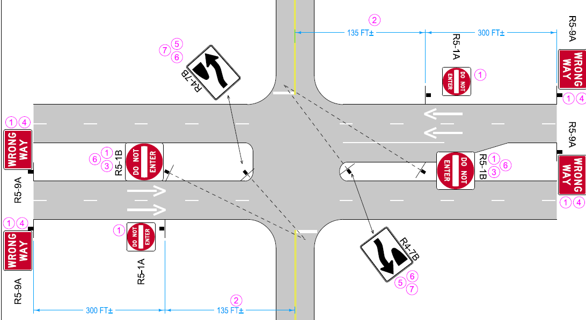
At-Grade Intersection

Slide 11
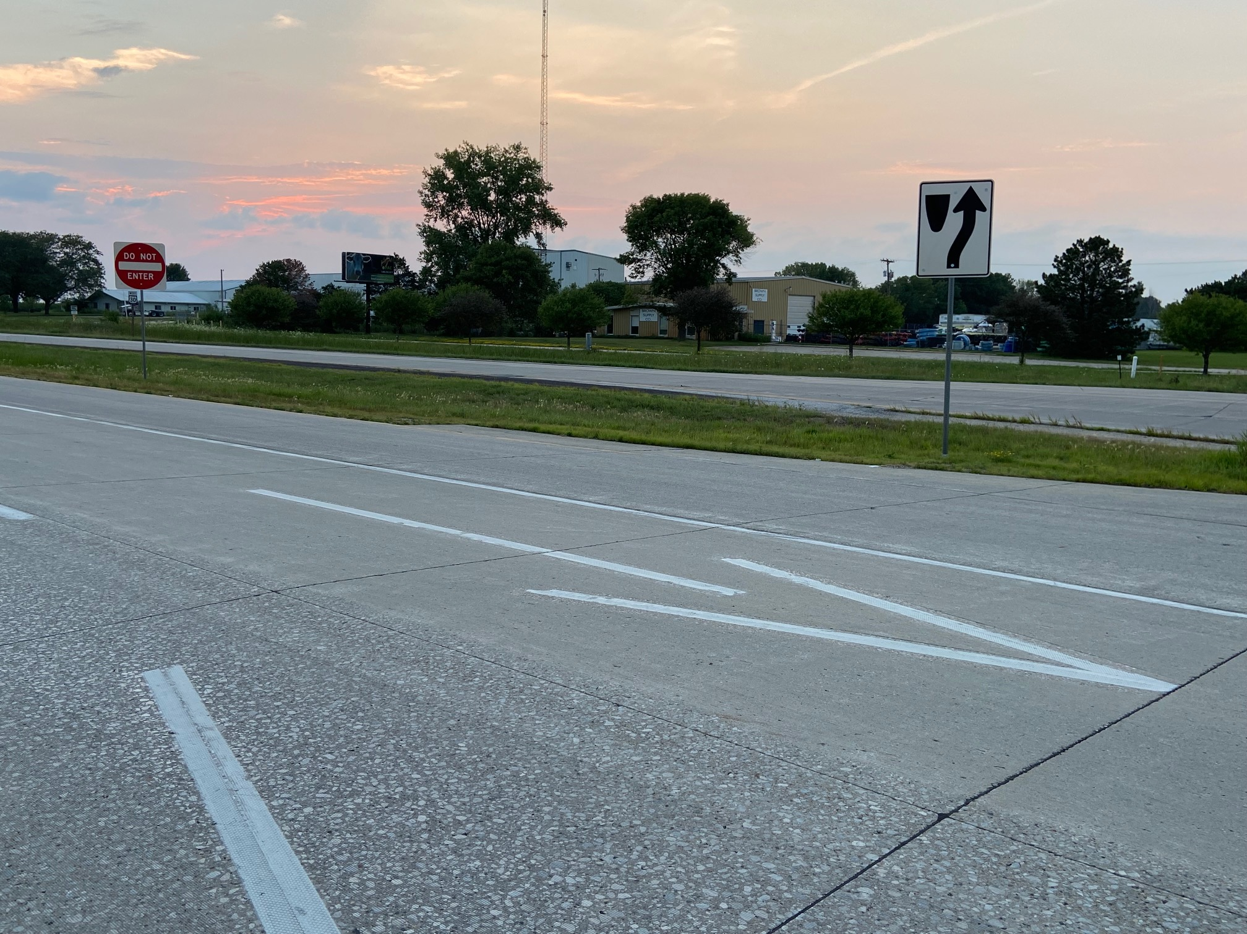

Slide 12
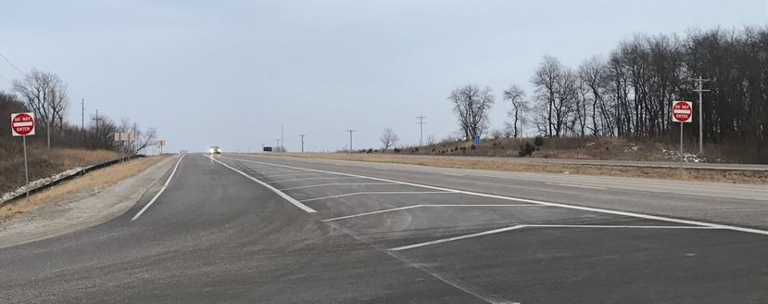
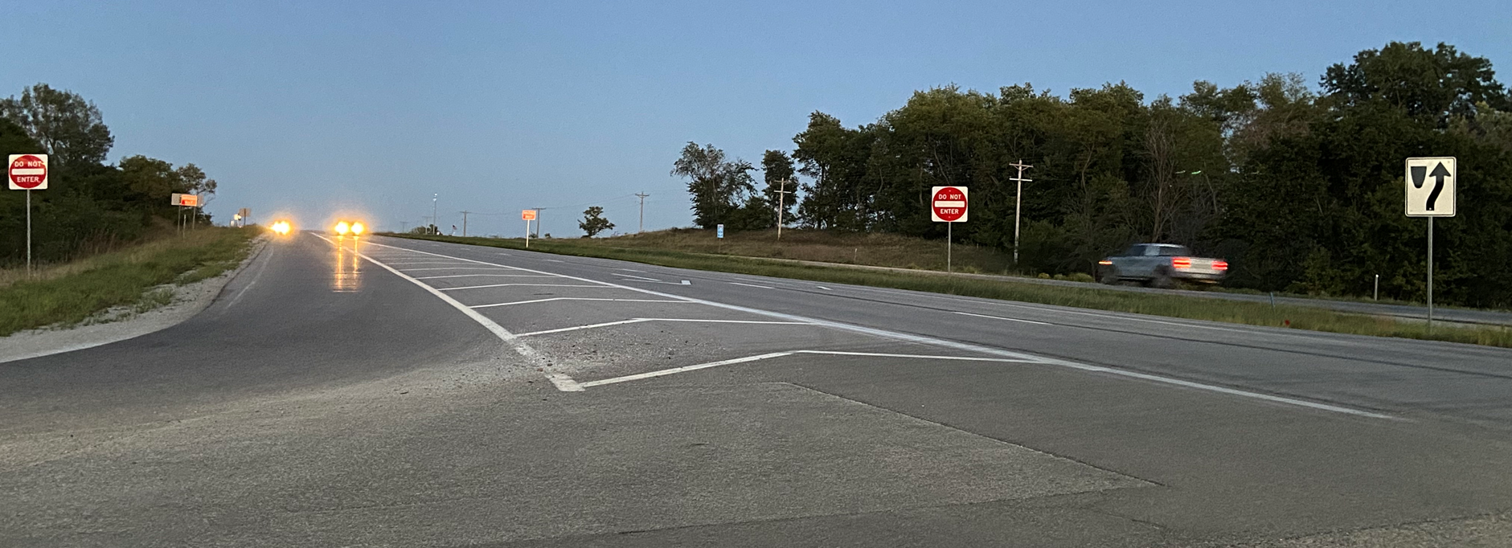
Before
After

Slide 13
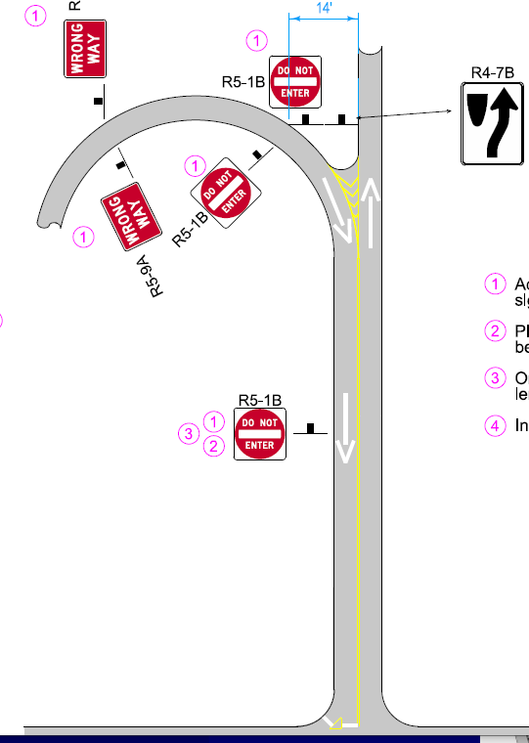
Folded Diamond
Interchange

Slide 14
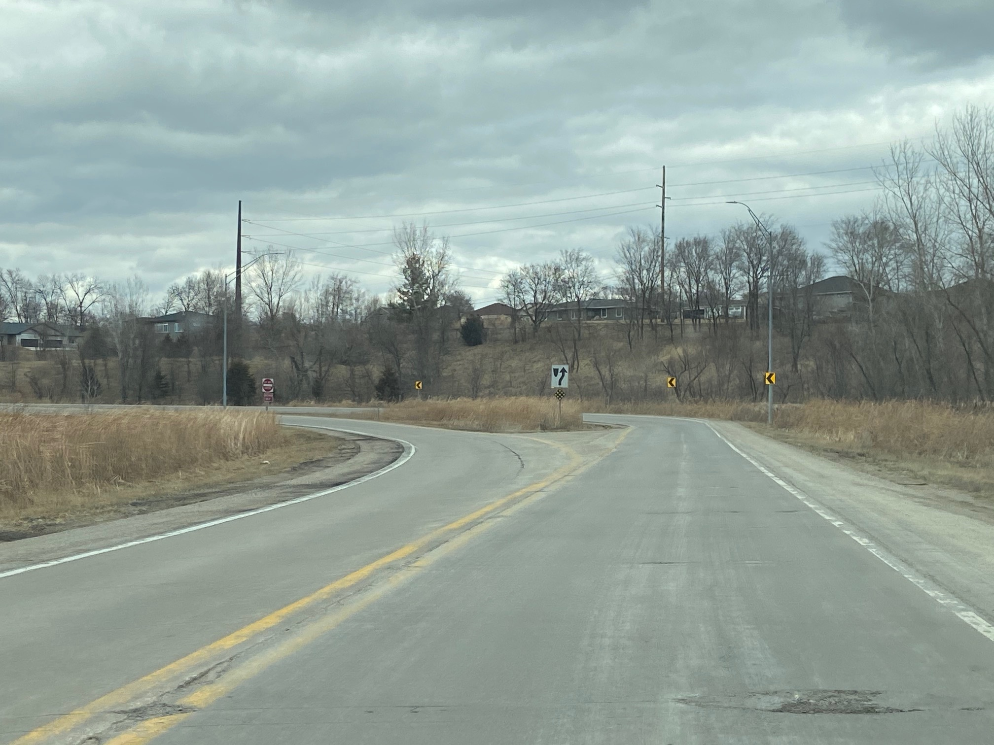

Slide 15
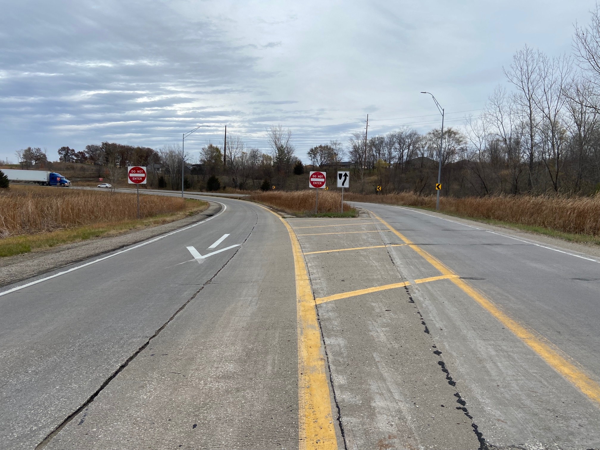

Slide 16
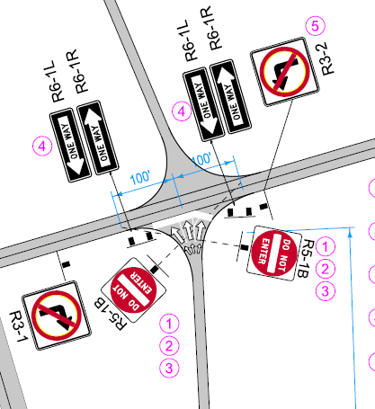
Standard Diamond
Interchange

Slide 17
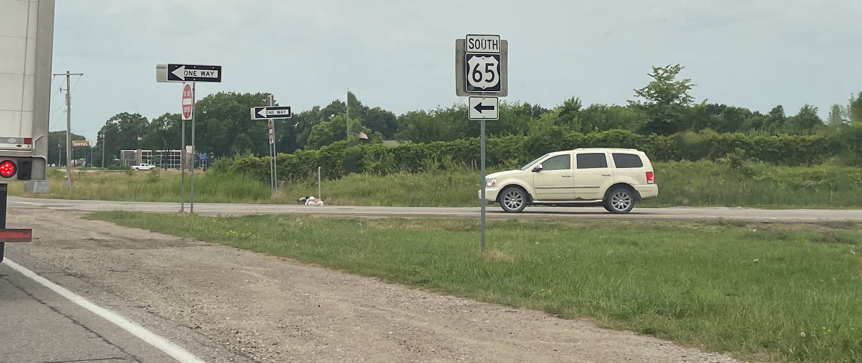
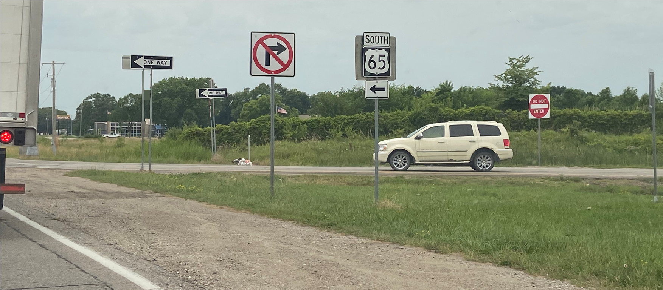

Slide 18
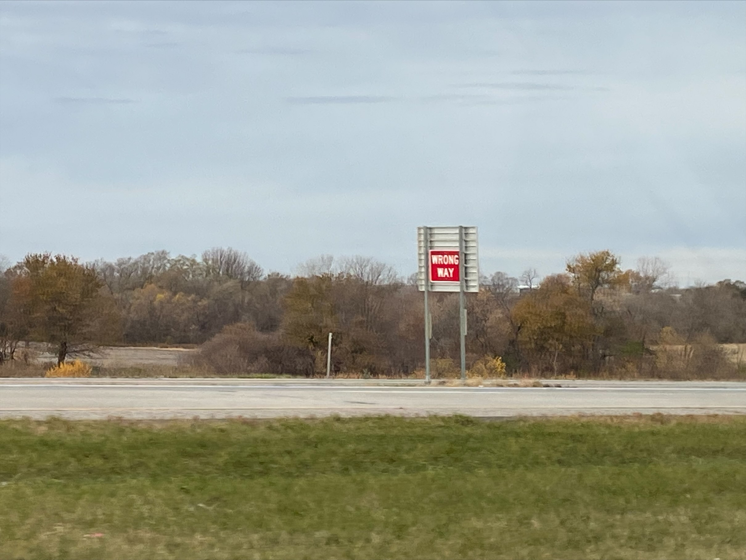
Zac’s Sign

Slide 19
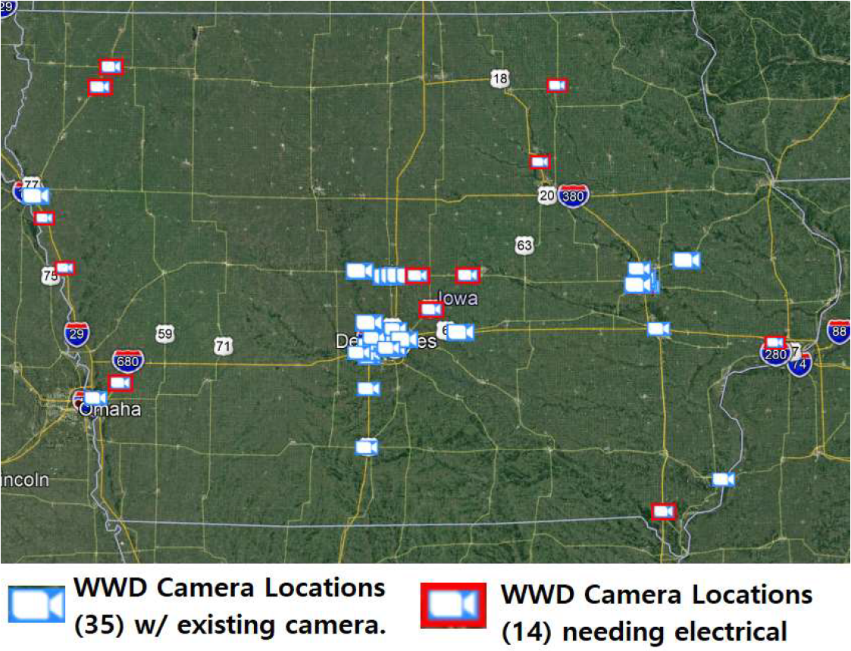
Special “Wrong Way Driving Detection” Cameras w/ Video Analytics & alerting.

Slide 20
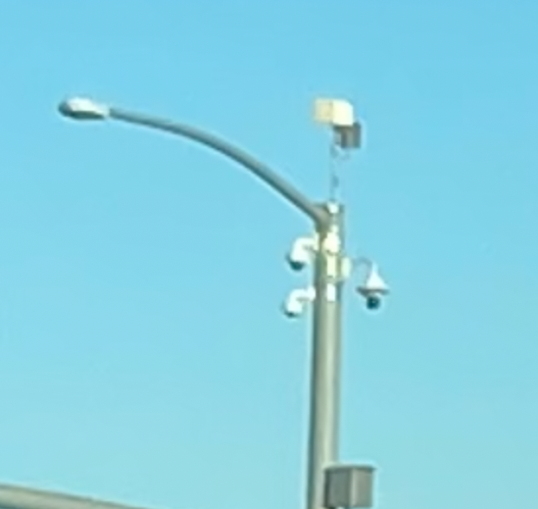
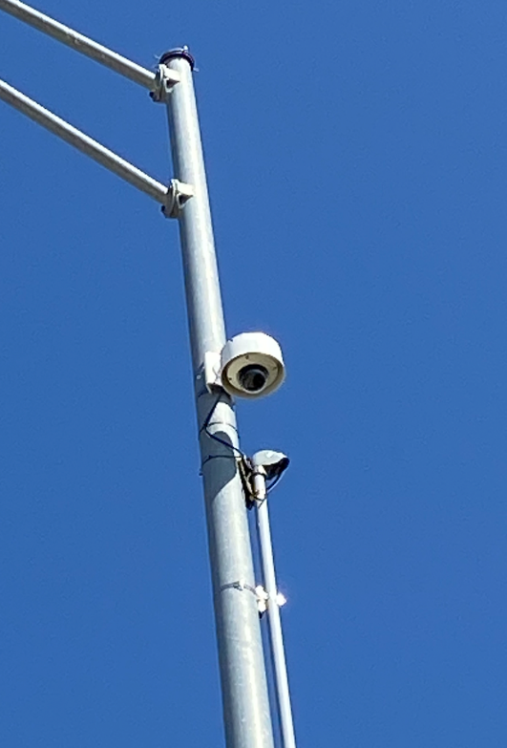
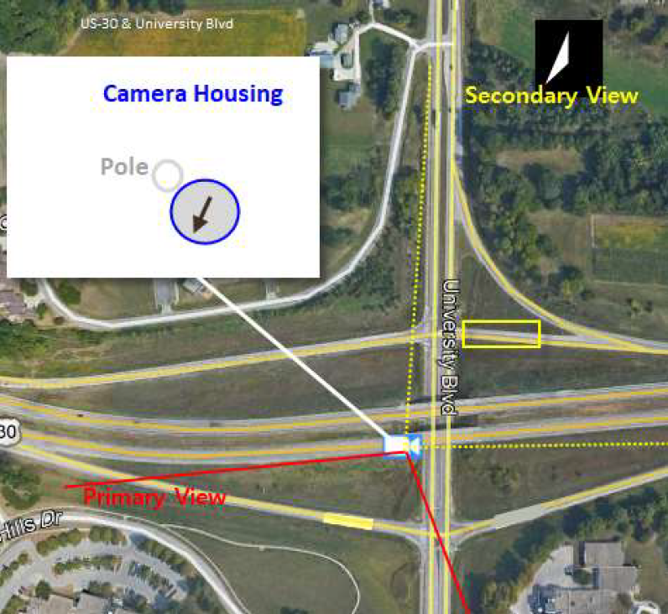
60 Cameras + Installation for $300,000
42 cameras at 35 sites with existing camera
18 cameras at 14 completely new sites

Slide 21
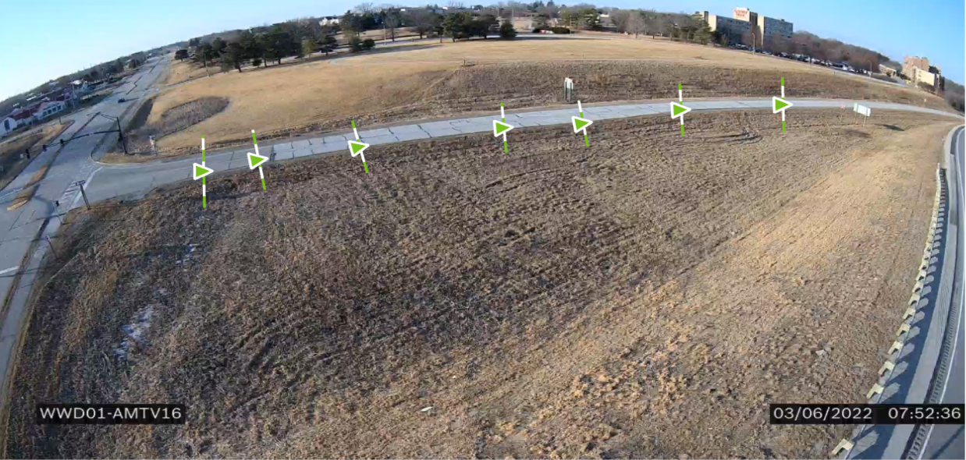
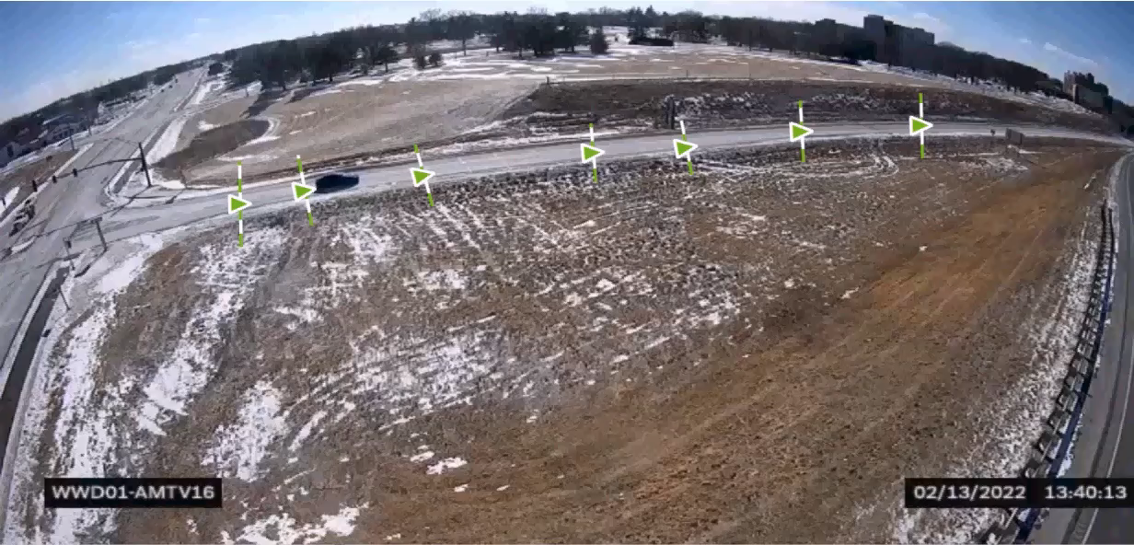
WWD Camera Detection Project:
  60 have been installed
  457 WWD have been detected already
    (after 8 months)
  Roughly 90% self correct, but 10% did not.
  Thousands of other events…

Slide 22
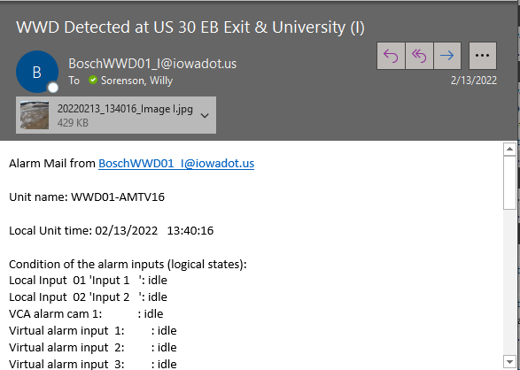
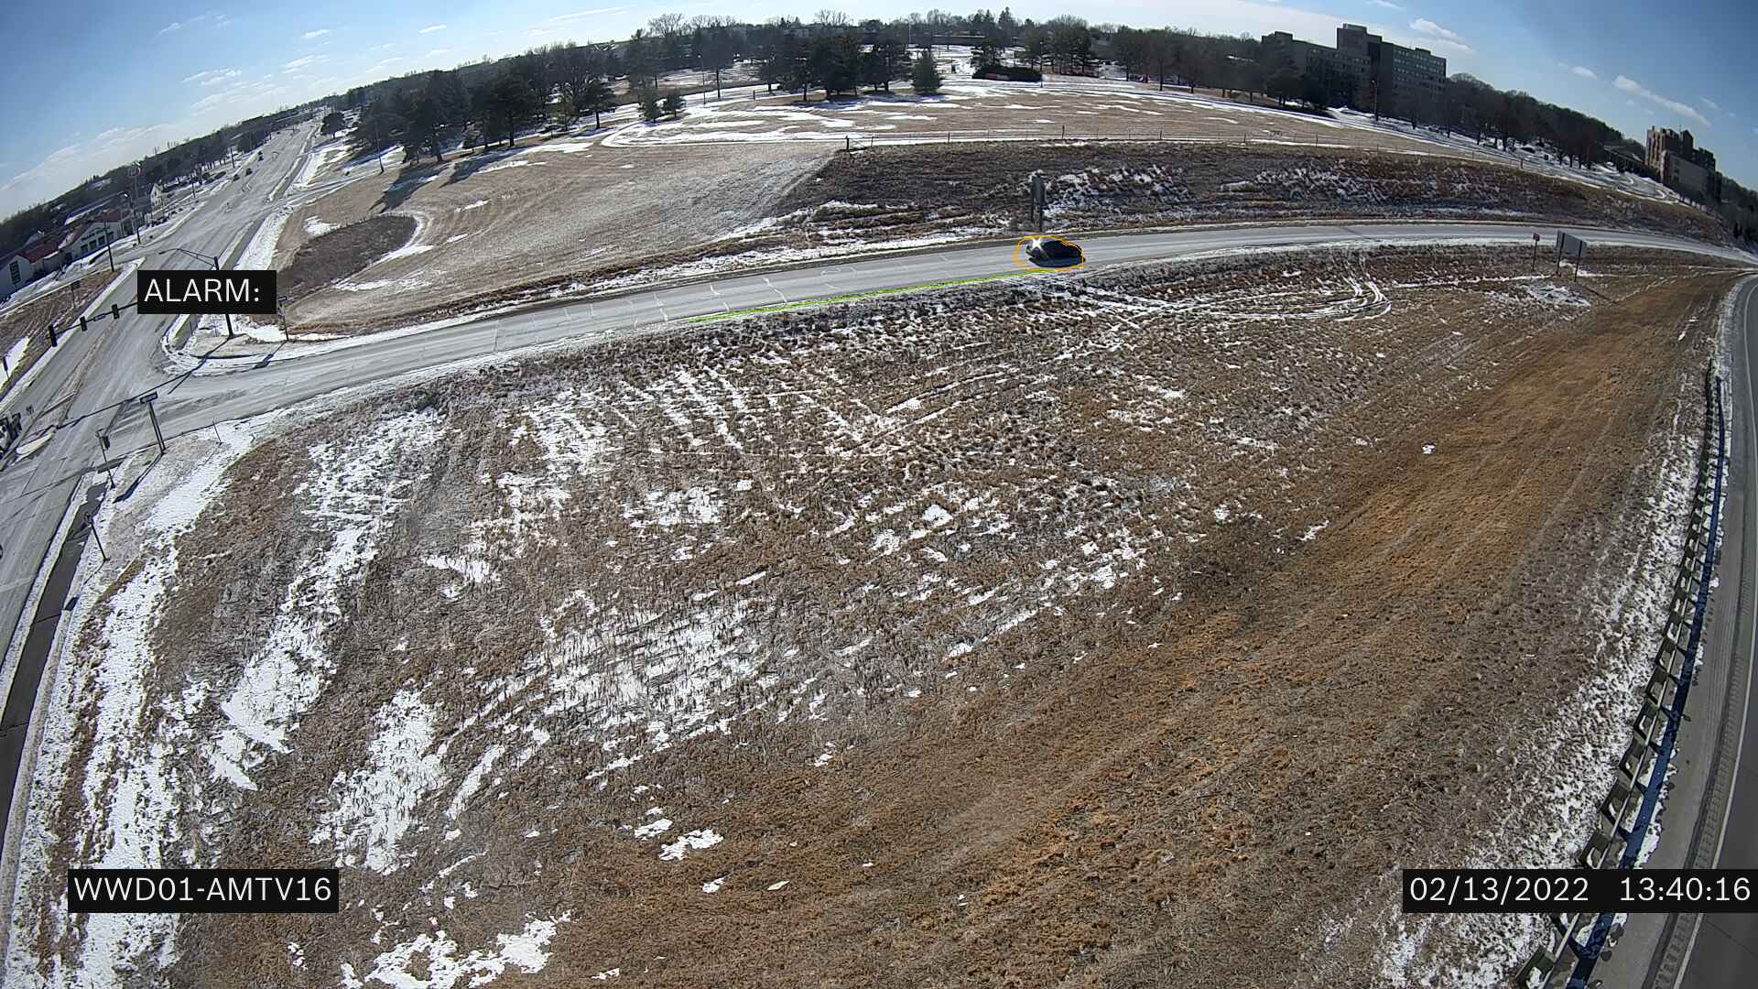
Each WWD “trips” an e-mail alarm

Slide 23
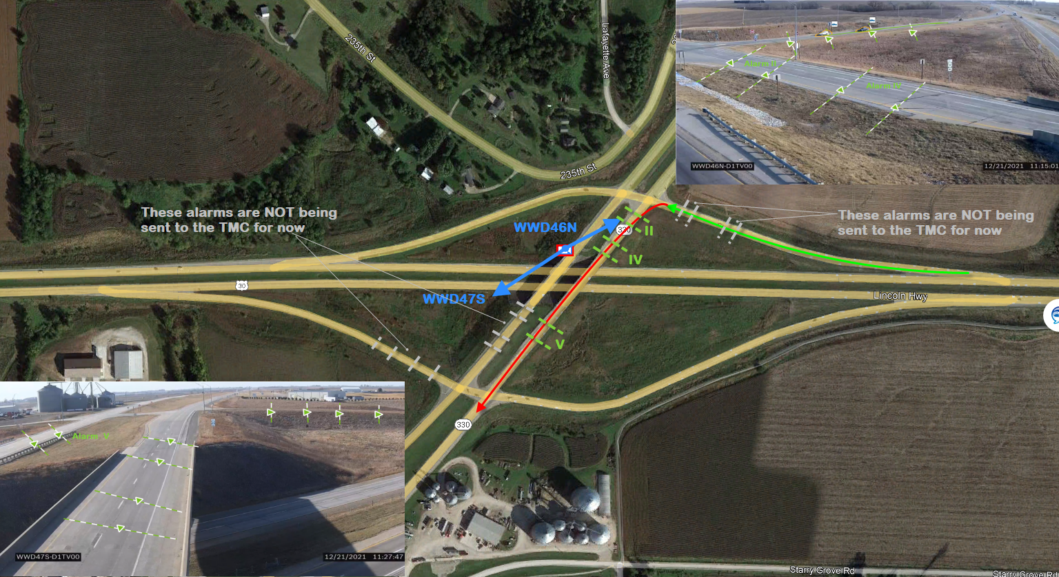
Using the Alarms to Notify

Slide 24
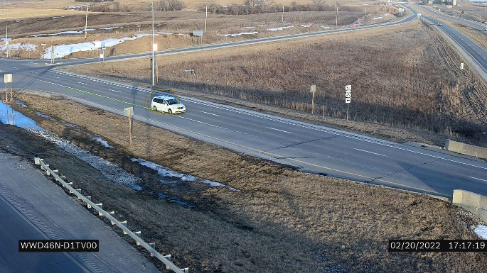
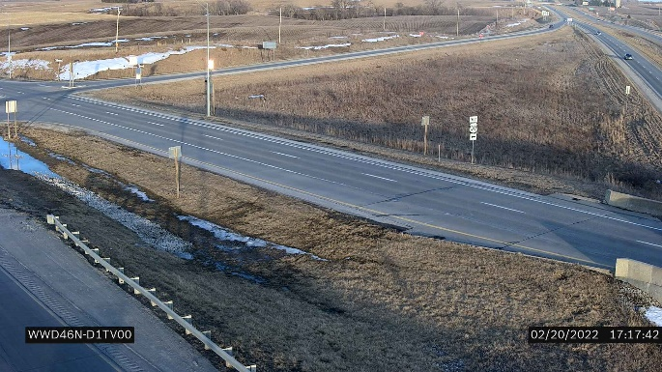
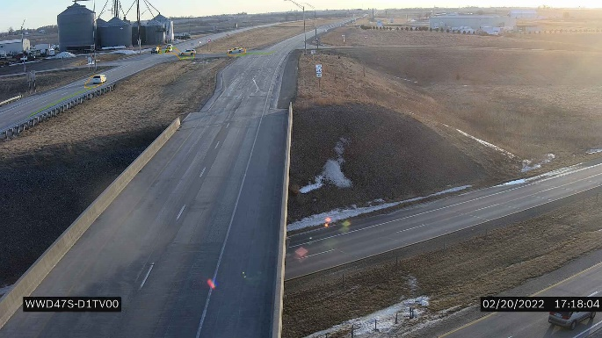


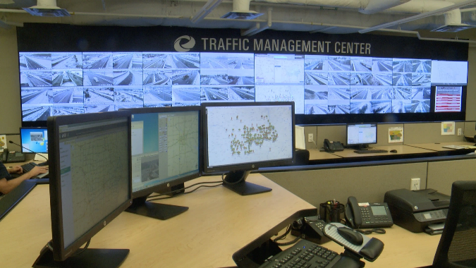
e-mail
e-mail
e-mail
Python Code
48 seconds
e-mail #1
e-mail #2
Phone Call
Read

Slide 25
Lessons Learned
Thermo cameras would eliminate a lot of false alarms (clouds, exhaust plums, shadows, wet pavement reflections) and would catch some that were missed at night due to headlight blooming and low light.
Get best (highest) zoom possible
  Ours were 3 to 10mm (not that great)
  Next time I would get the 12 to 40mm
You will get hundreds of false calls until you have “fine tuned it”.
  Then you are probably missing some!

Slide 26
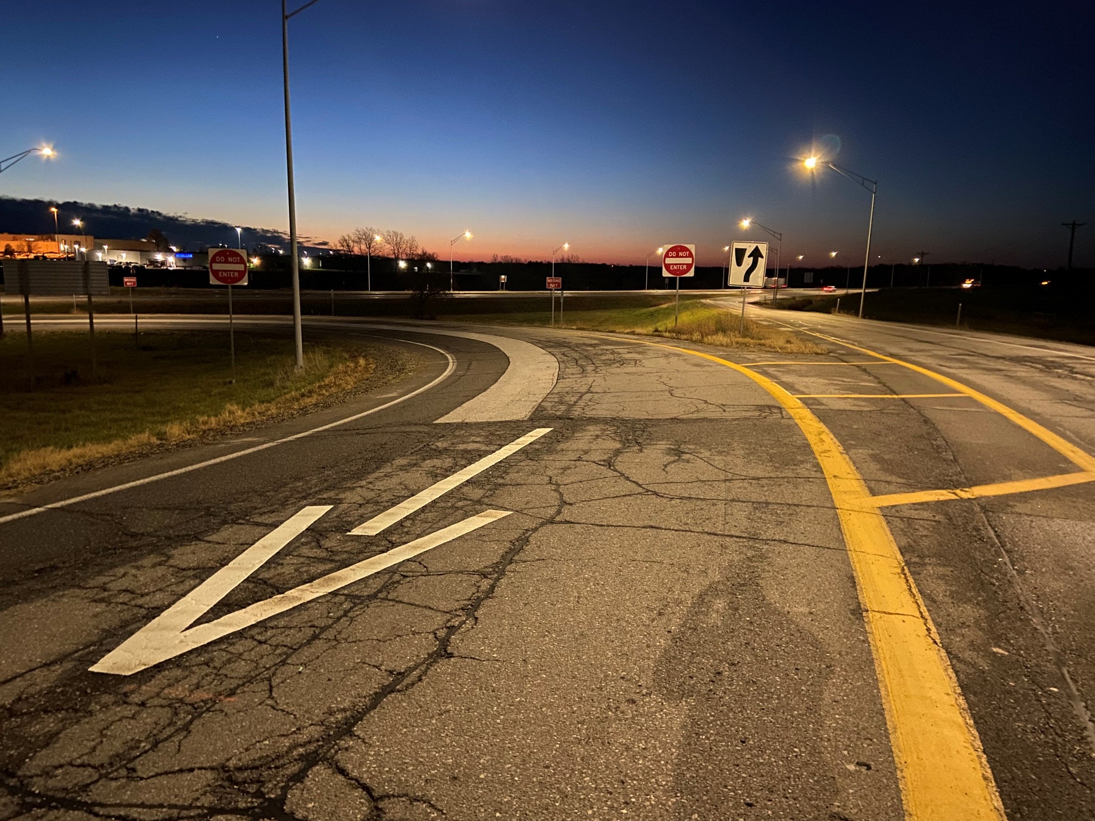
Interesting Countermeasure #1
“Gateway” for Folded Diamonds

Slide 27
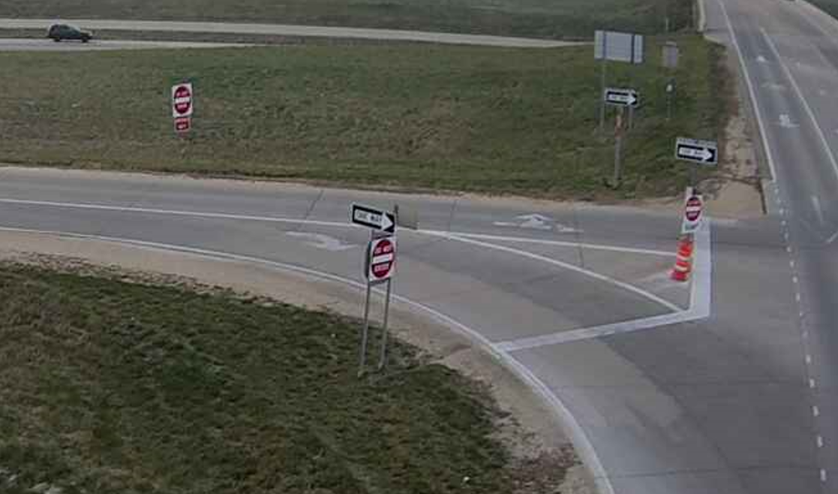
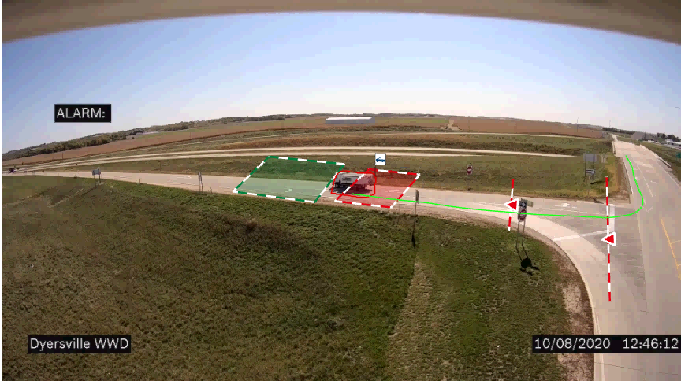
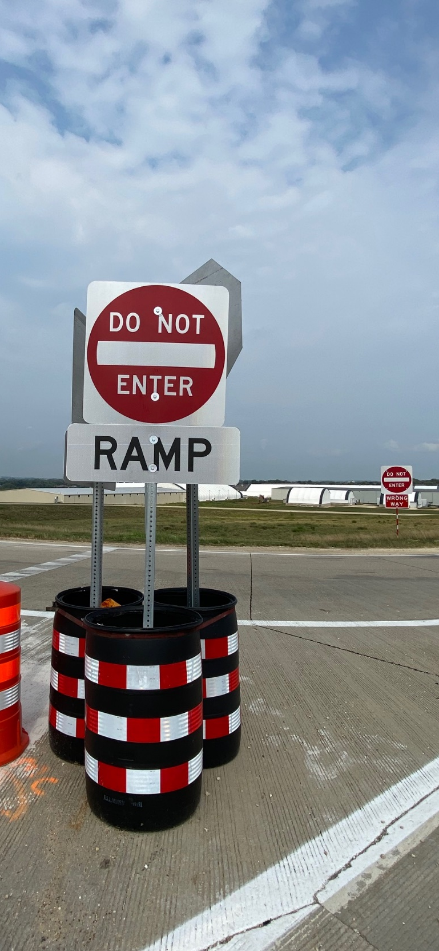
Island Treatment
Interesting Countermeasure #2

Slide 28
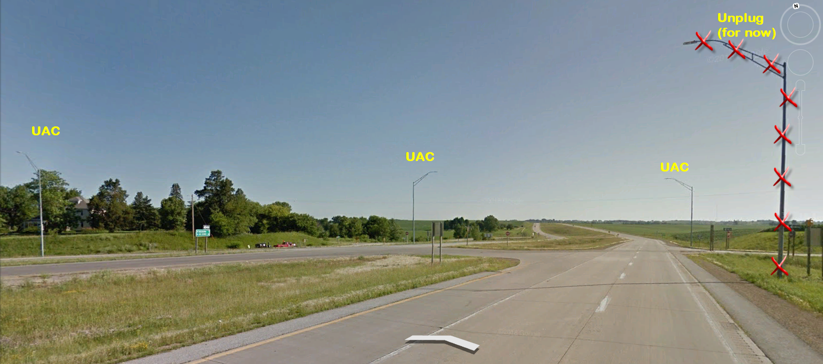
Interesting Countermeasure #3

Slide 29
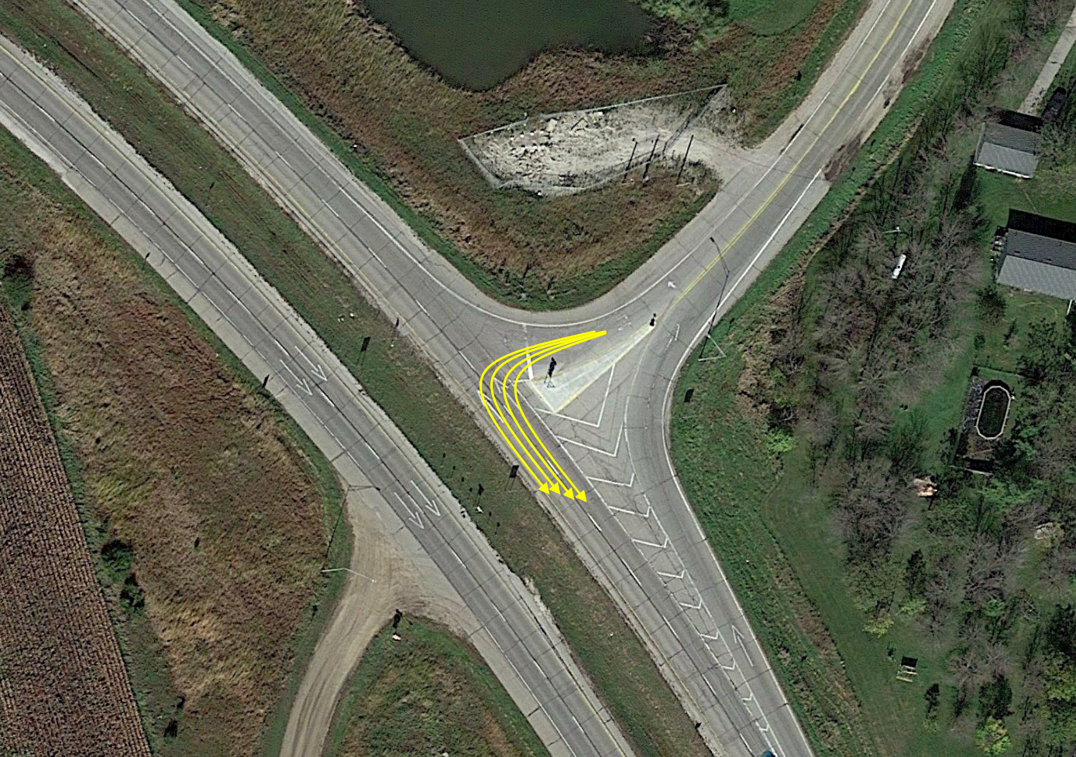
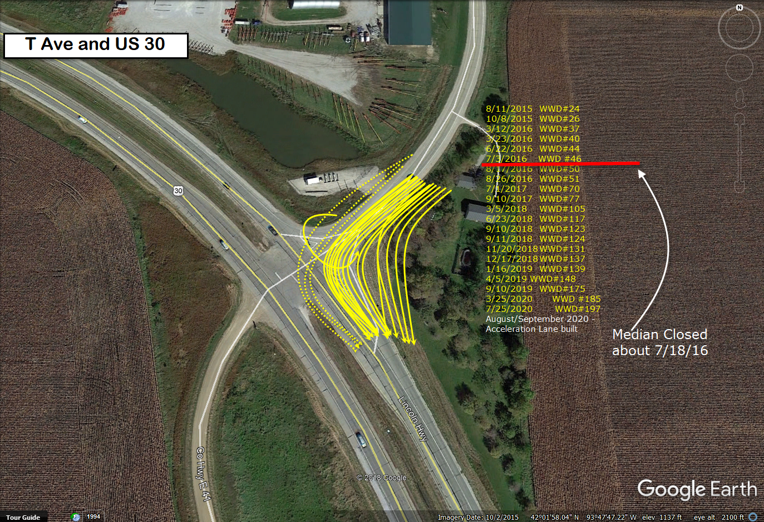
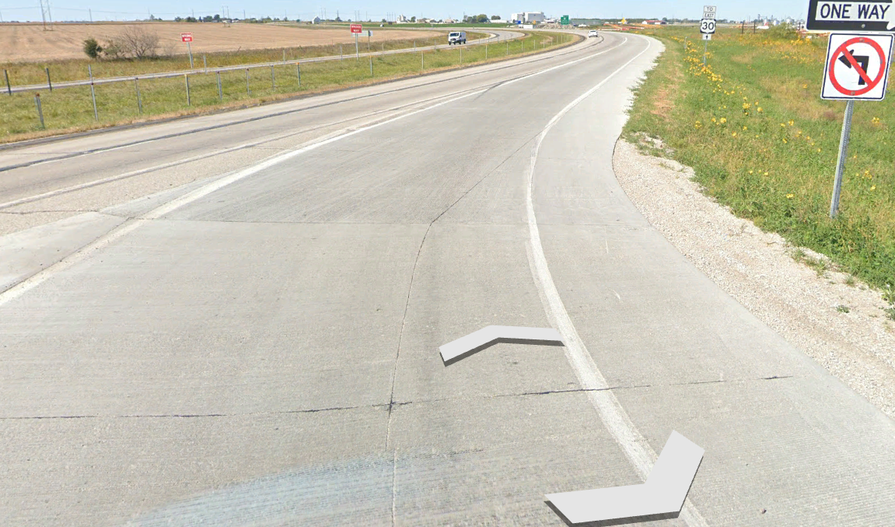
Added an Acceleration Lane
Interesting Countermeasure #4

Slide 30
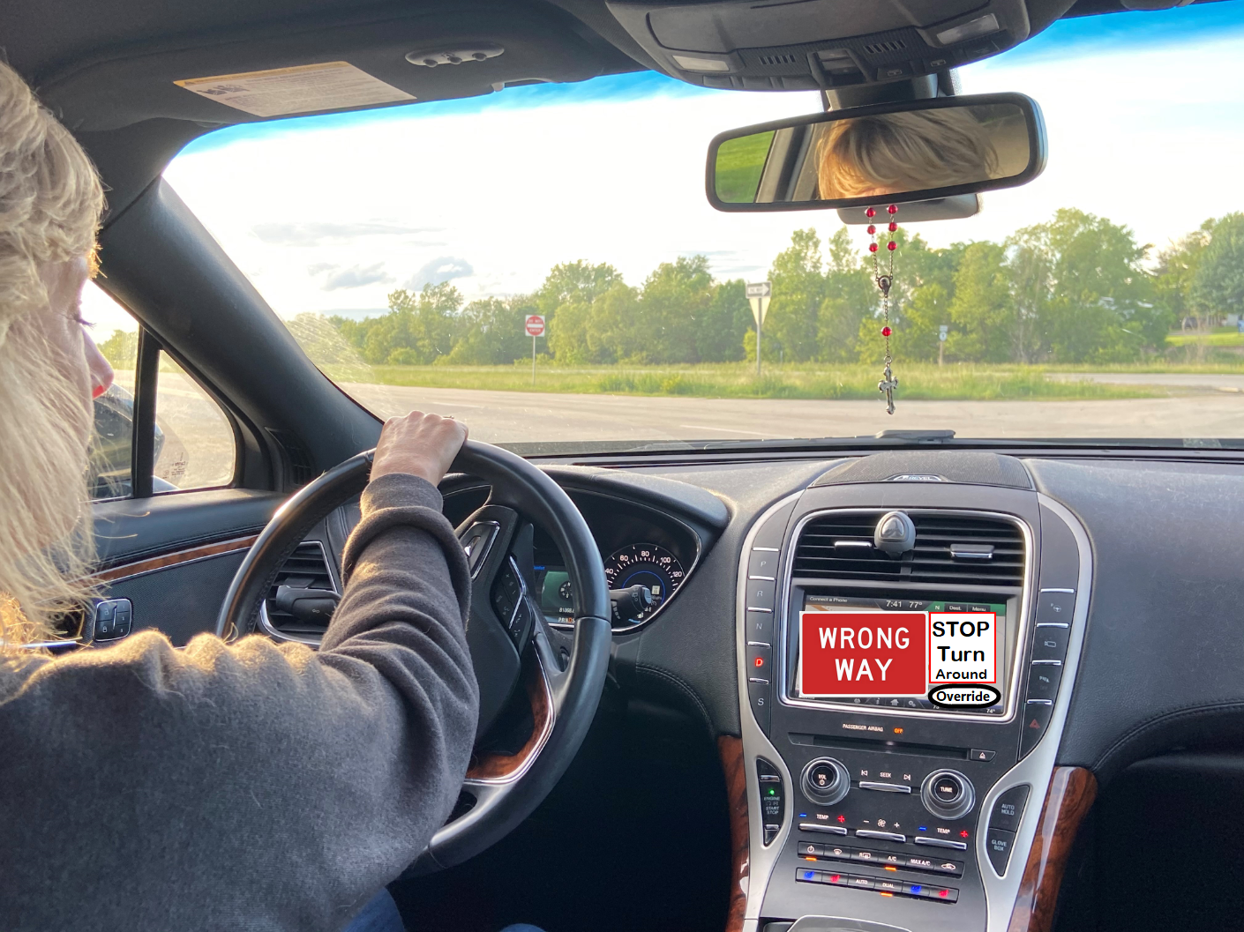
Wrong-Way Driving Applications
  Considerations:
  “False positives”- alerts to drivers who are not driving the wrong direction
    Provide drivers with ability to override the warning?
  What would the system or app communicate with this alert?
  E.g. “Turn around immediately”?
  Construction Zones
  Once “override” Shuts off for 15 min.
  If “connected” it updates the map for everyone

Slide 31
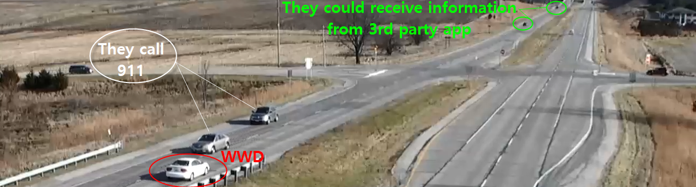
Concept for the ‘near future’, until everyone is driving a “Connected Vehicle”
Similar to the Work Zone Data Exchange Initiative by Federal Highway Administration – Whereas work zone information from State DOT’s can be “broadcast” using XML to tell 3rd party apps, and/or a (connected) car directly information about a work zone they are approaching.
After a 911 center receives a call about a Wrong Way Driver is reported, why can’t we start the process to enable the “broadcast” that information to 3rd party apps and/or a (connected) cars in the vicinity of the Wrong Way Driver?

Slide 32
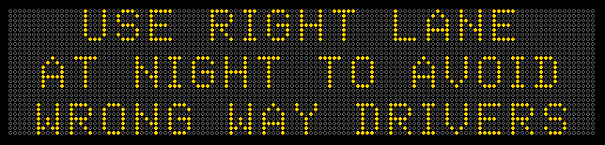
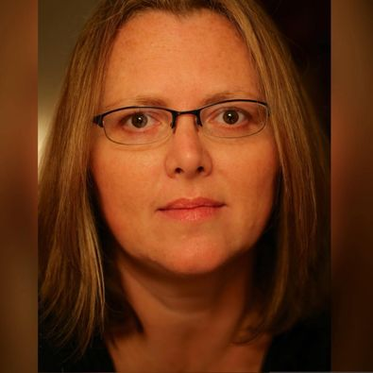
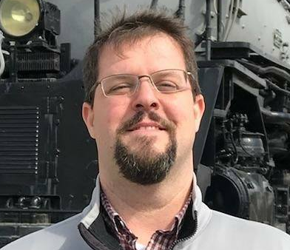
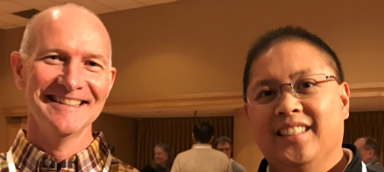

To wrap things up, there is 1 more thing that I’d like you to know and share with your family, friends and co-workers.

Slide 33
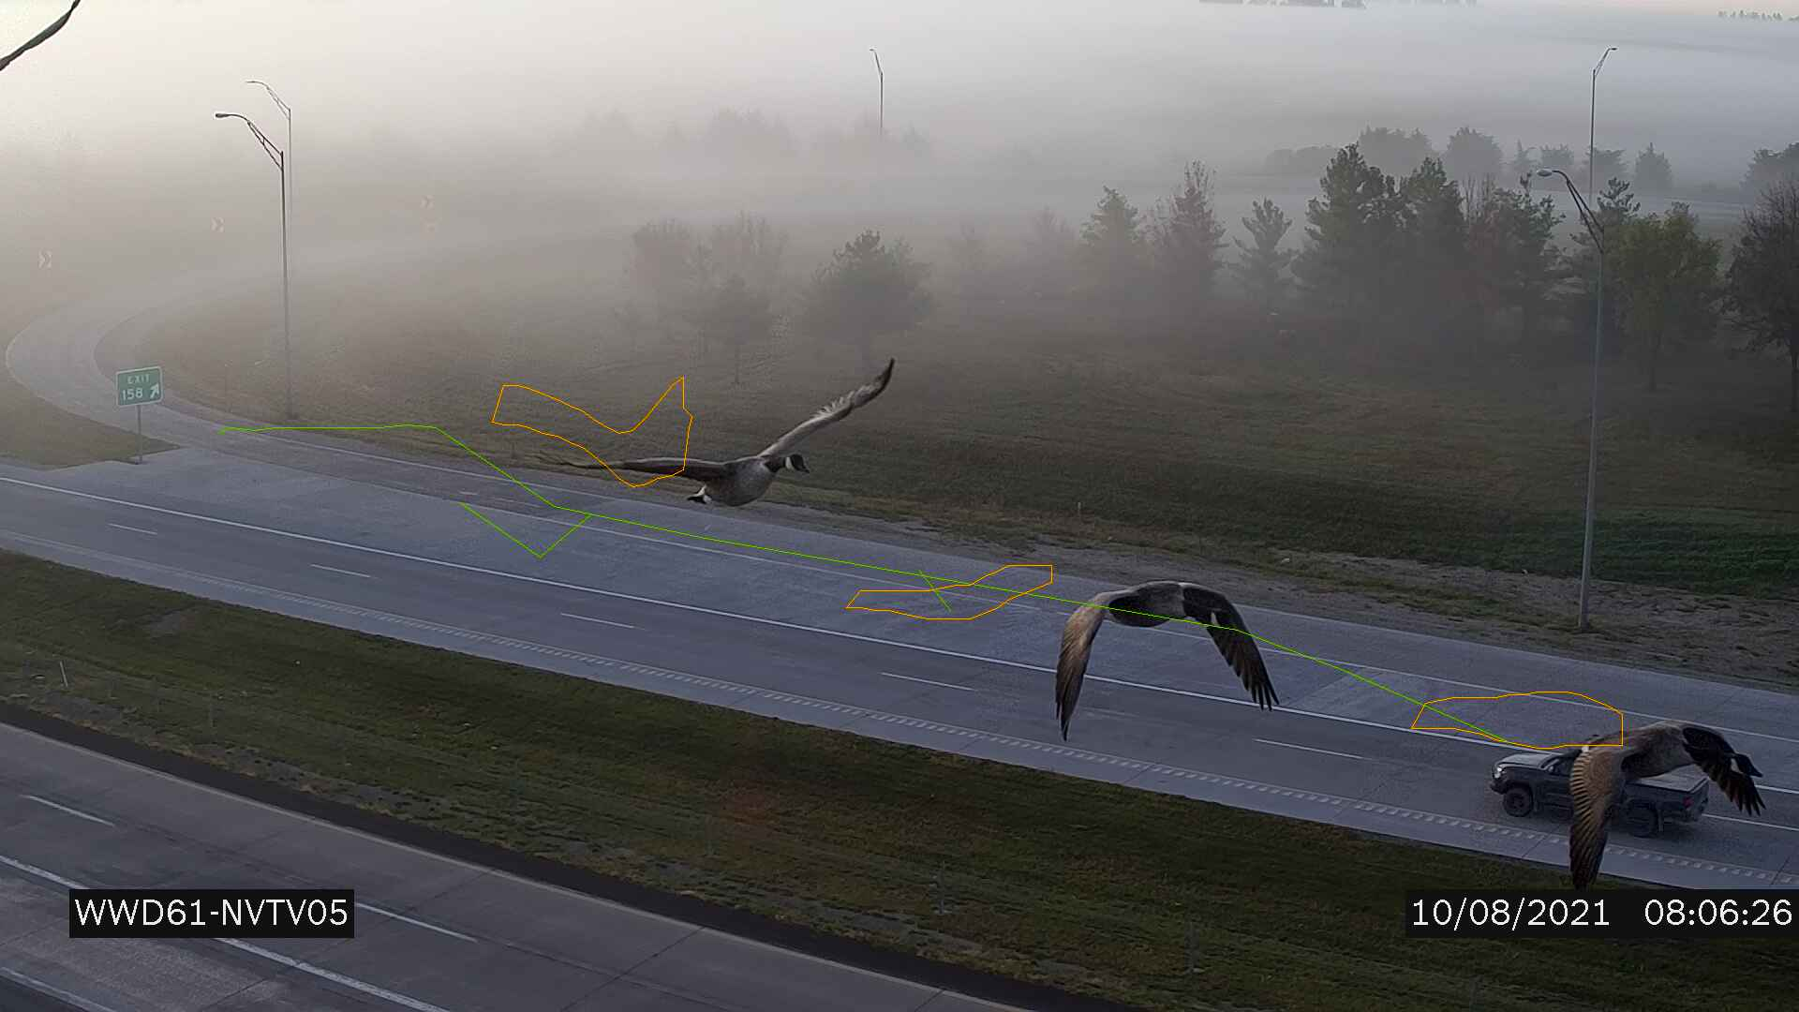
Best False Call Ever!!!!

Slide 34
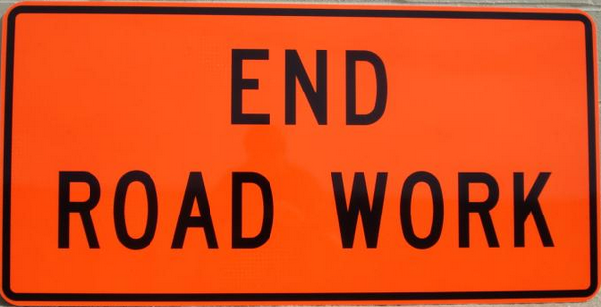
Questions?

