Slide 2
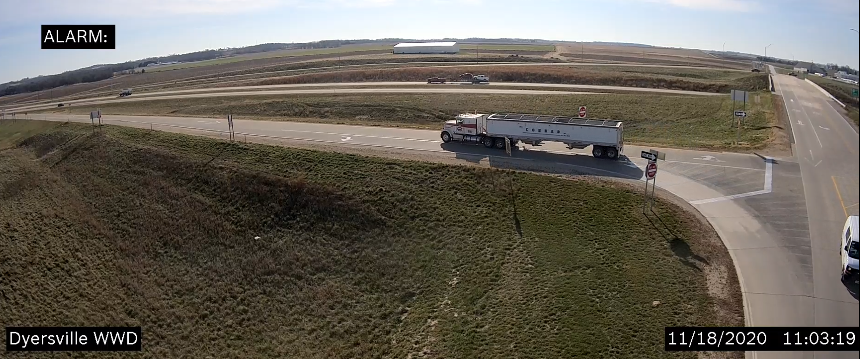
Agenda Iowa DOT’s Efforts on:
Wrong Way Driving Dyersville, Iowa

Slide 3
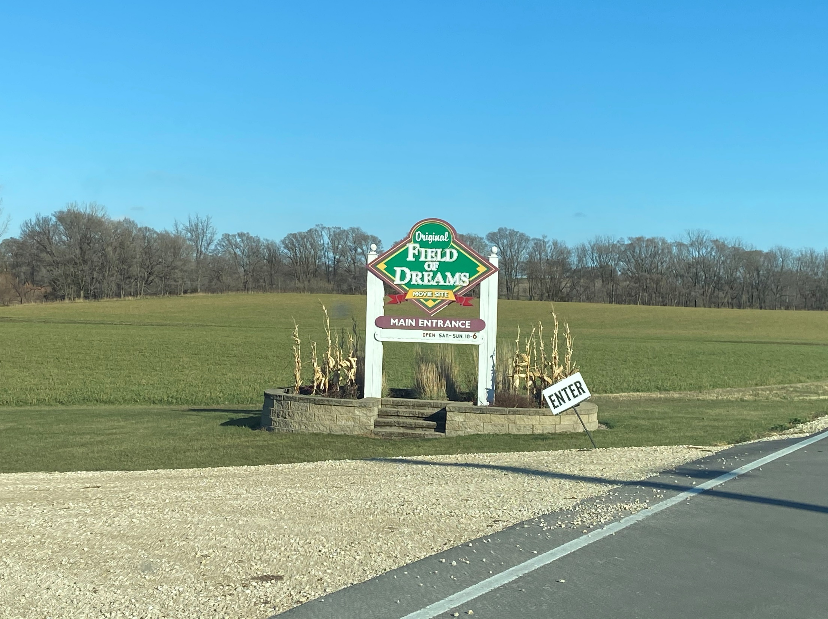

Slide 4
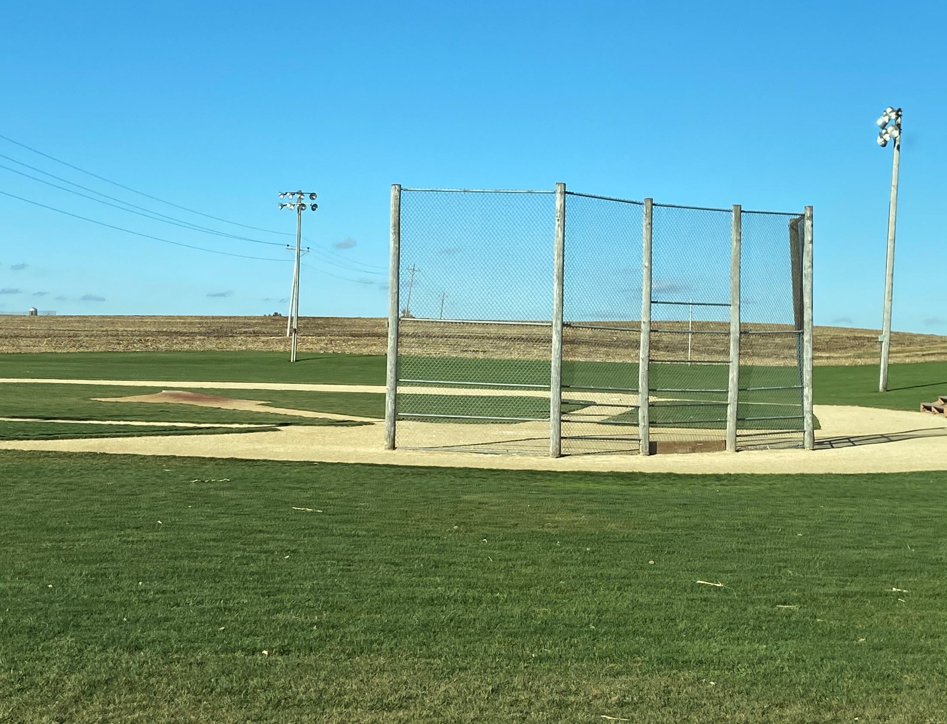

Slide 5
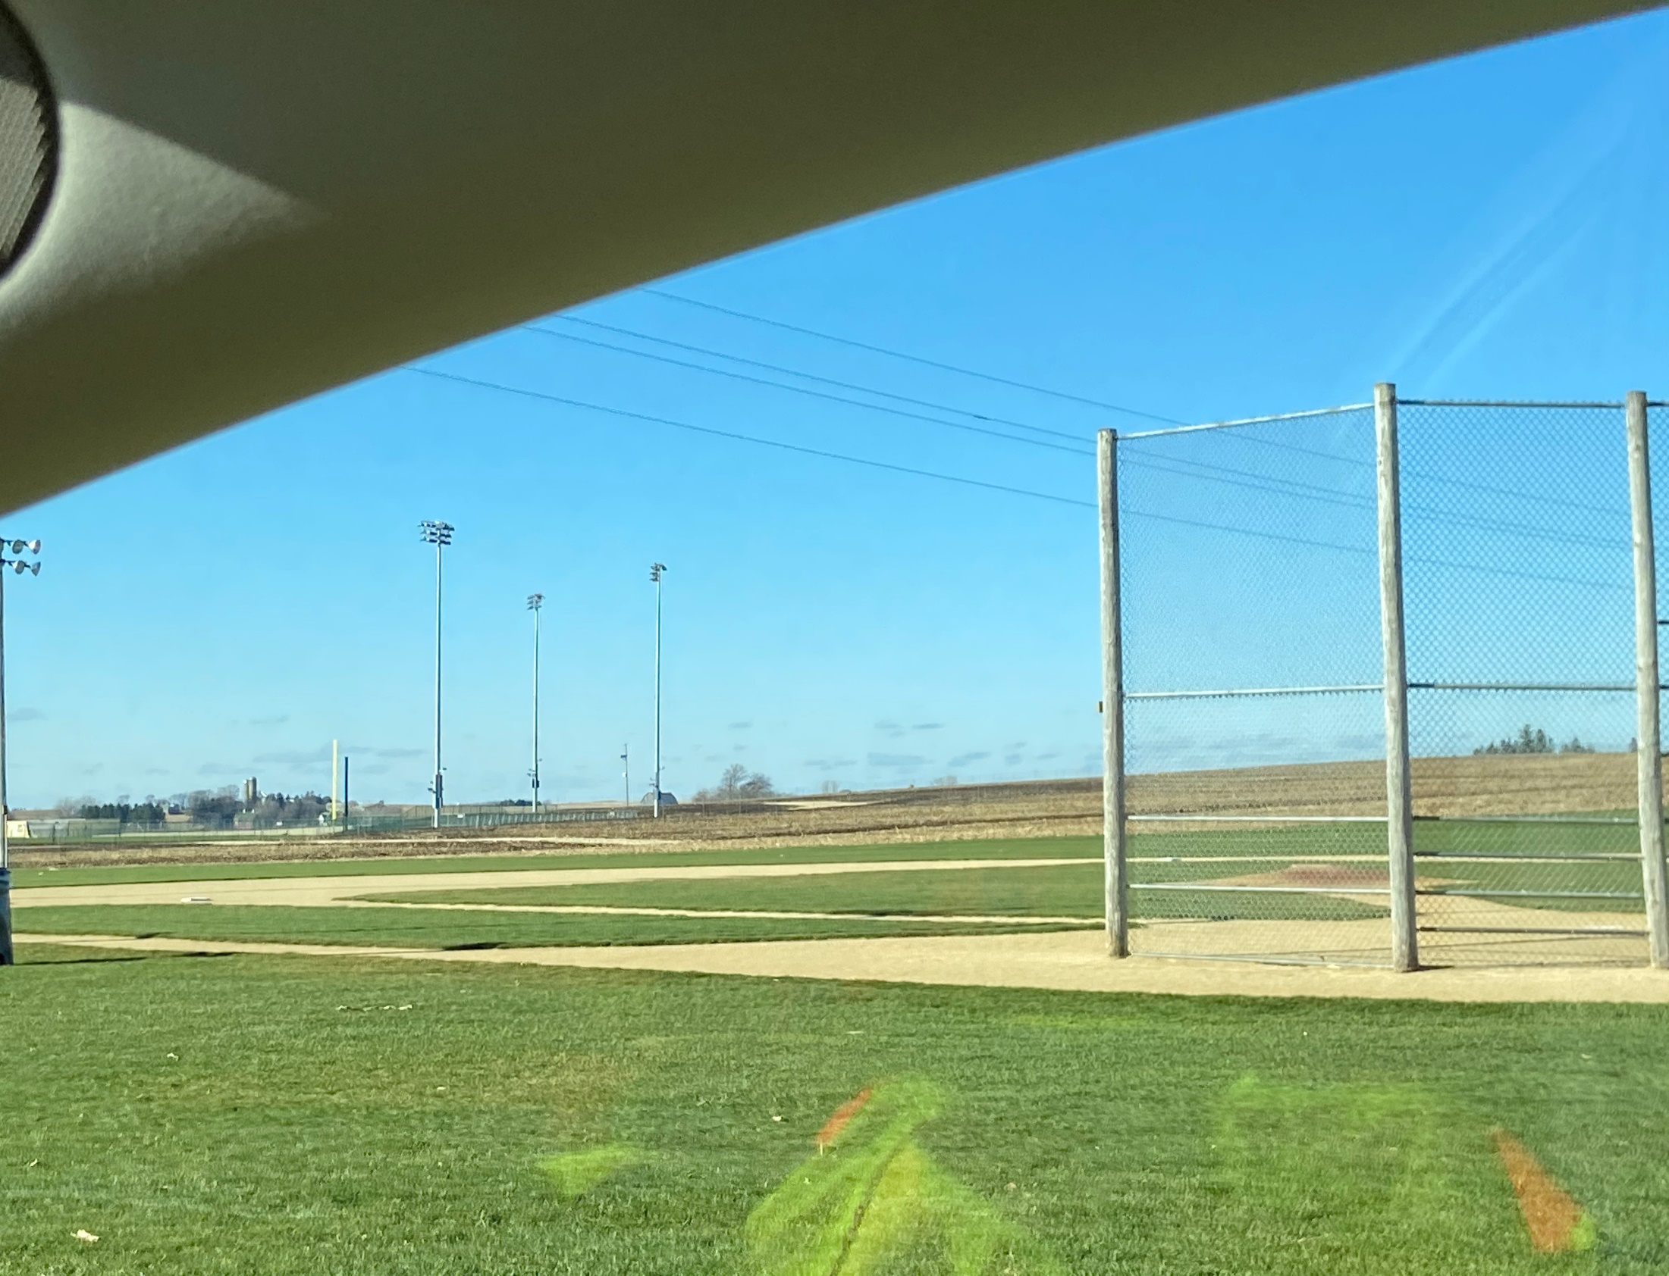

Slide 6
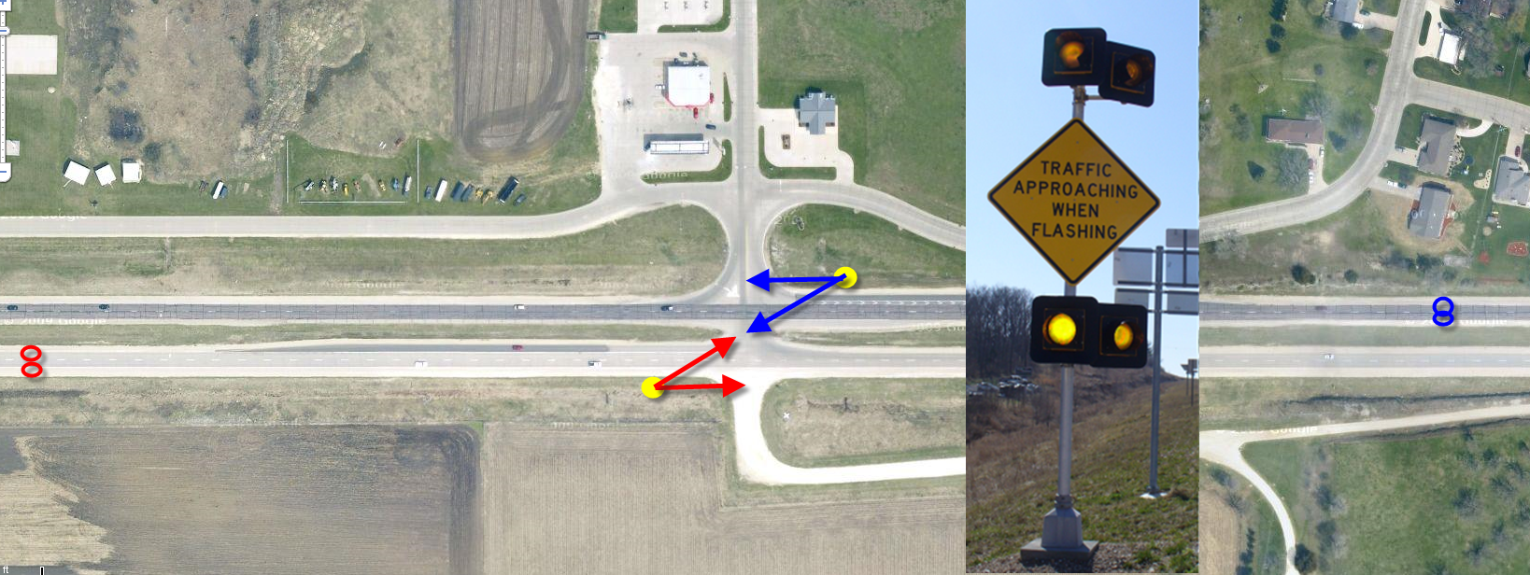
Minor Road Warning

Slide 7
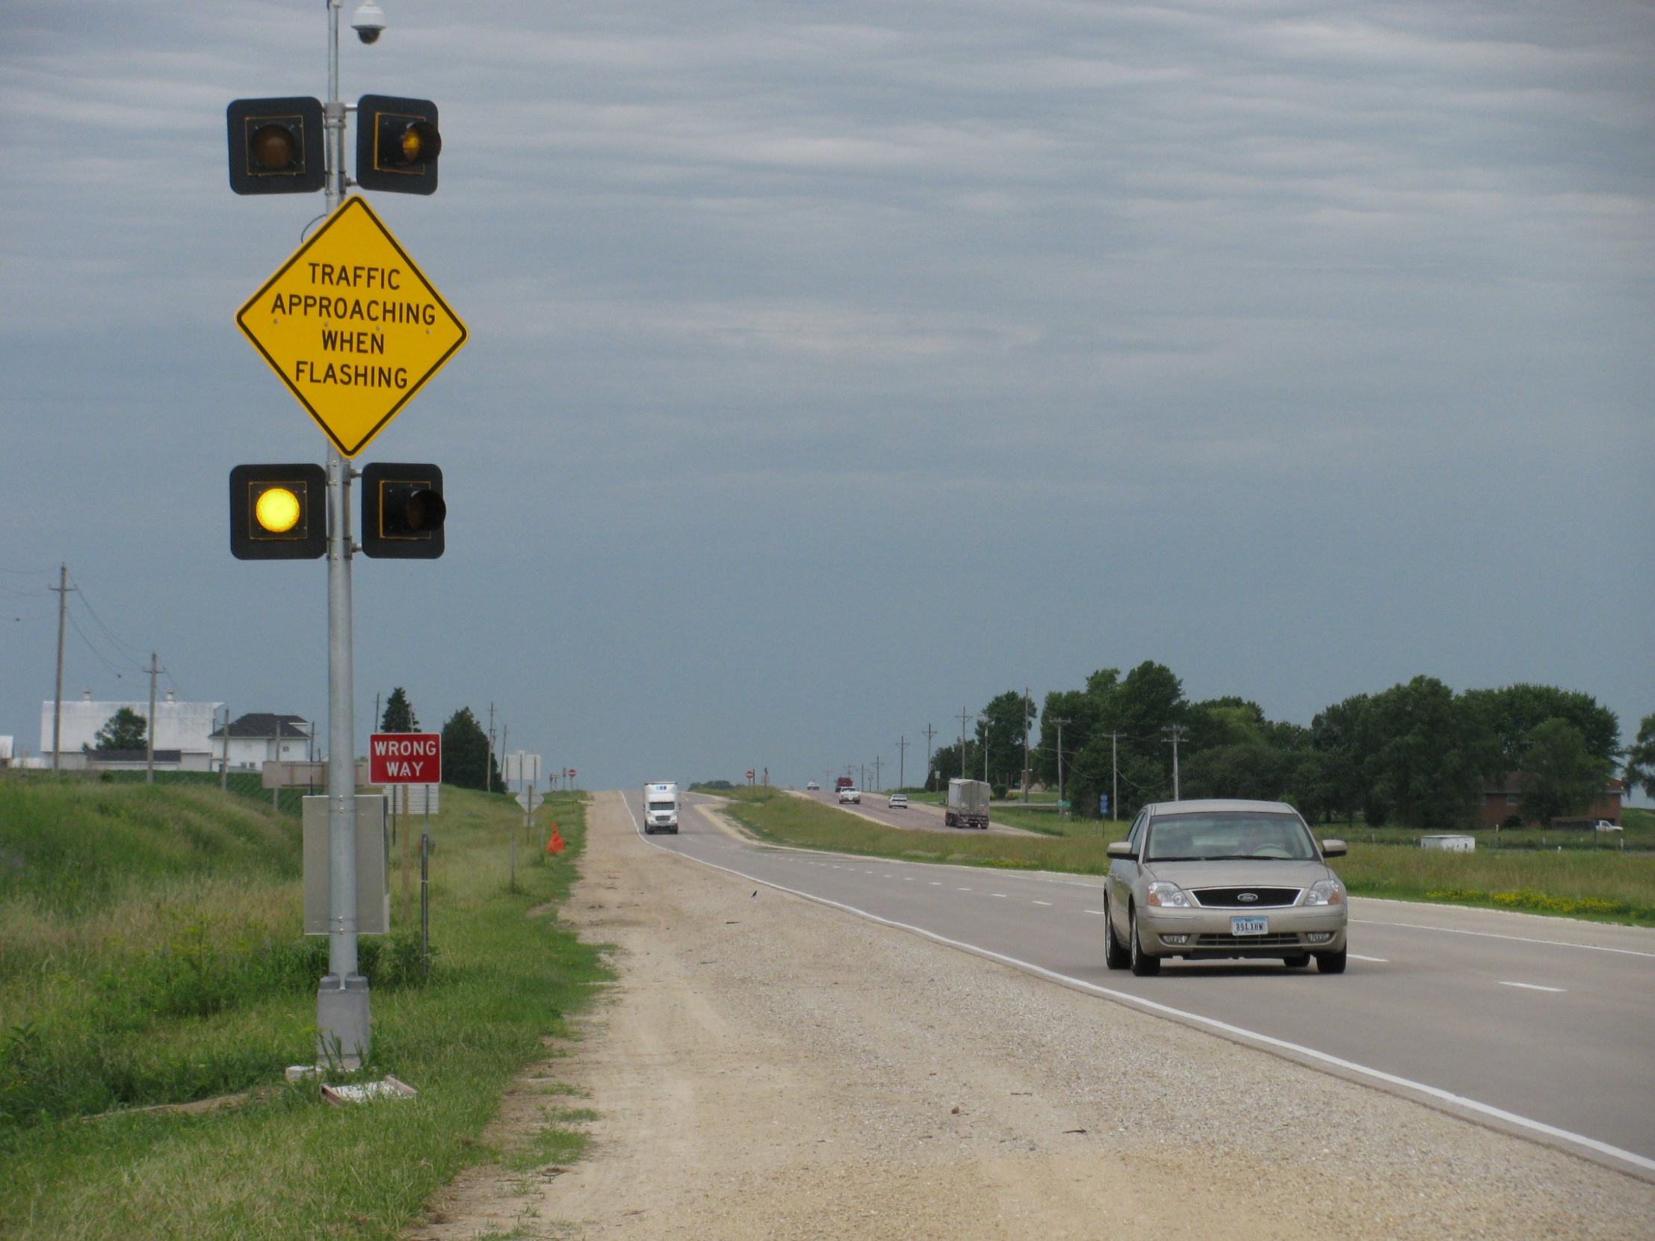
Dyersville and Anamosa
Sign placement on the “left”

Slide 8
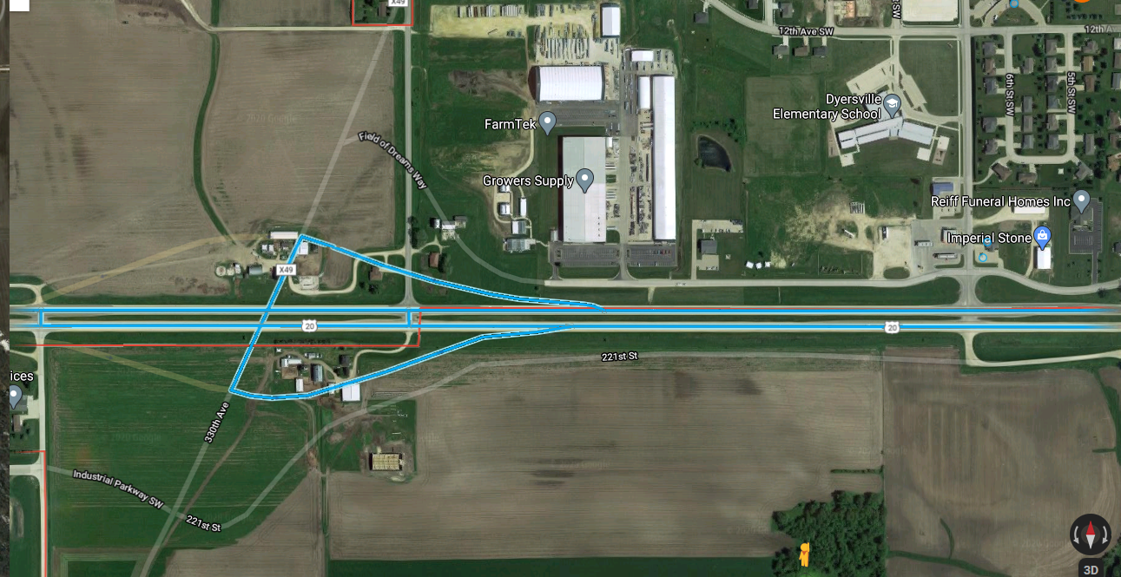
New Interchange Opened December 2016 First Complaint January 2017

Slide 9
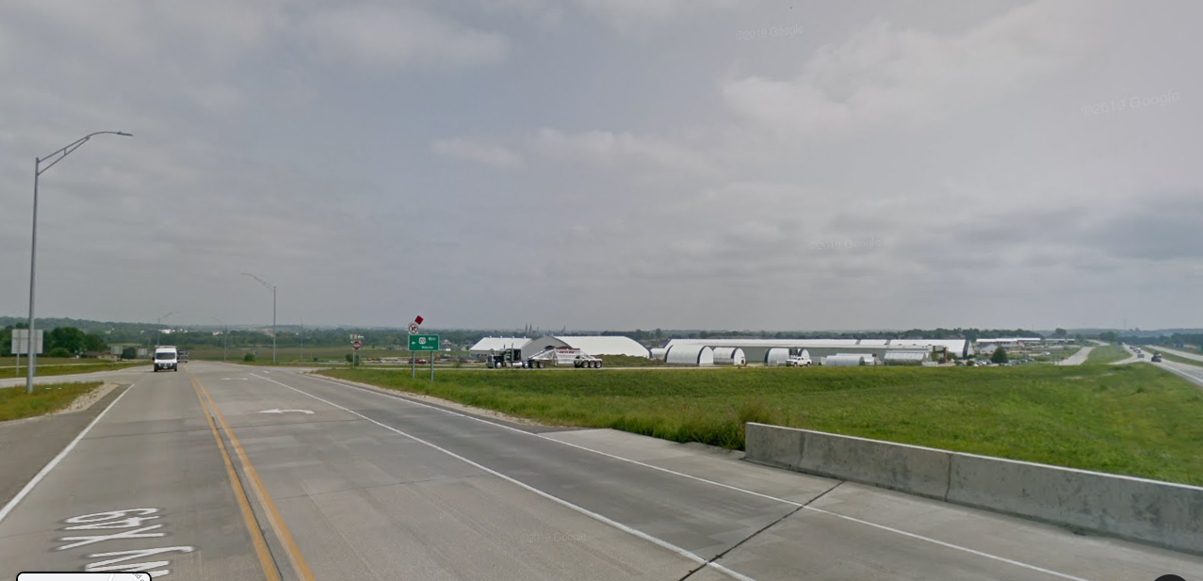
Development

Slide 10
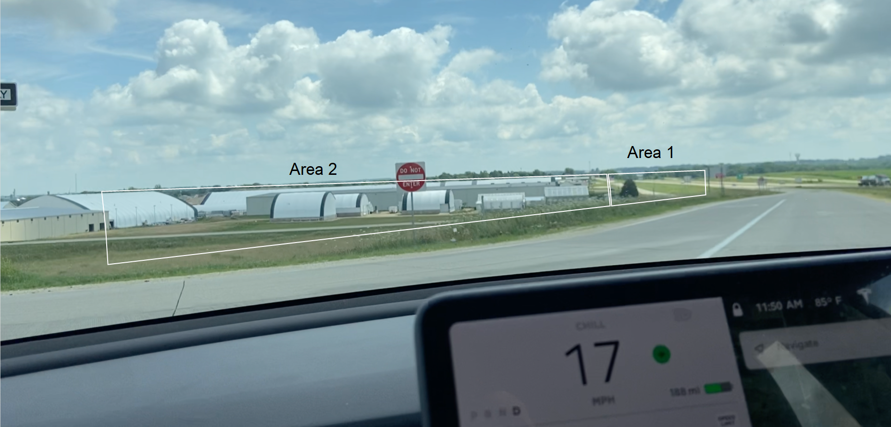

Slide 11
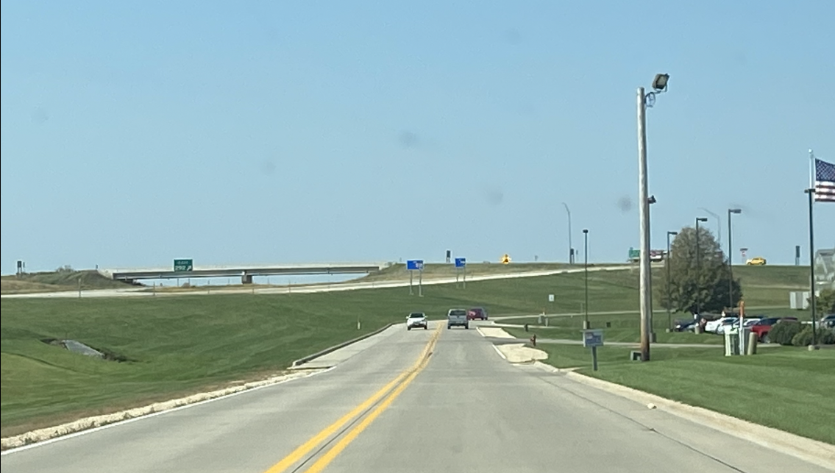

Slide 12
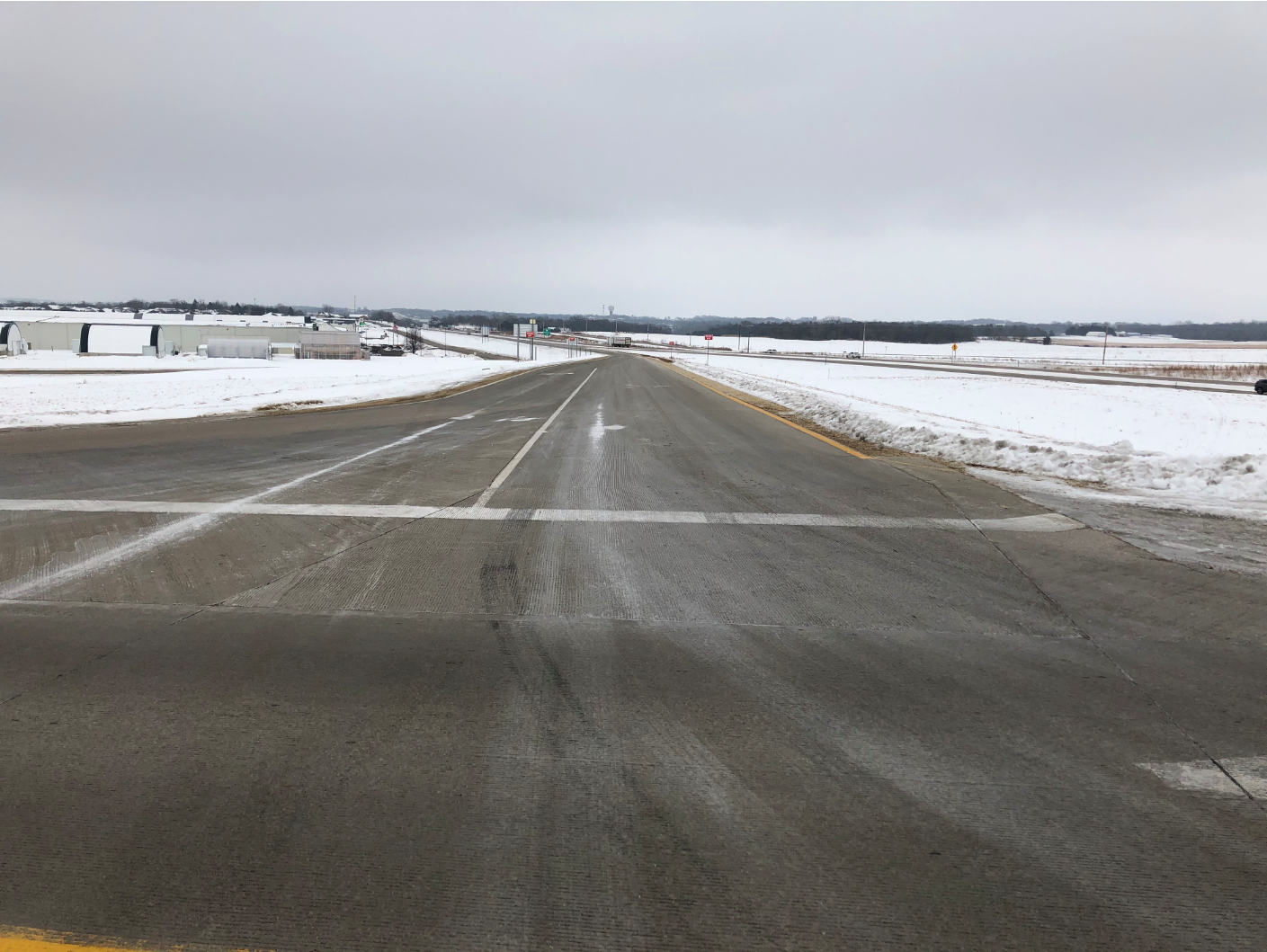

Slide 13
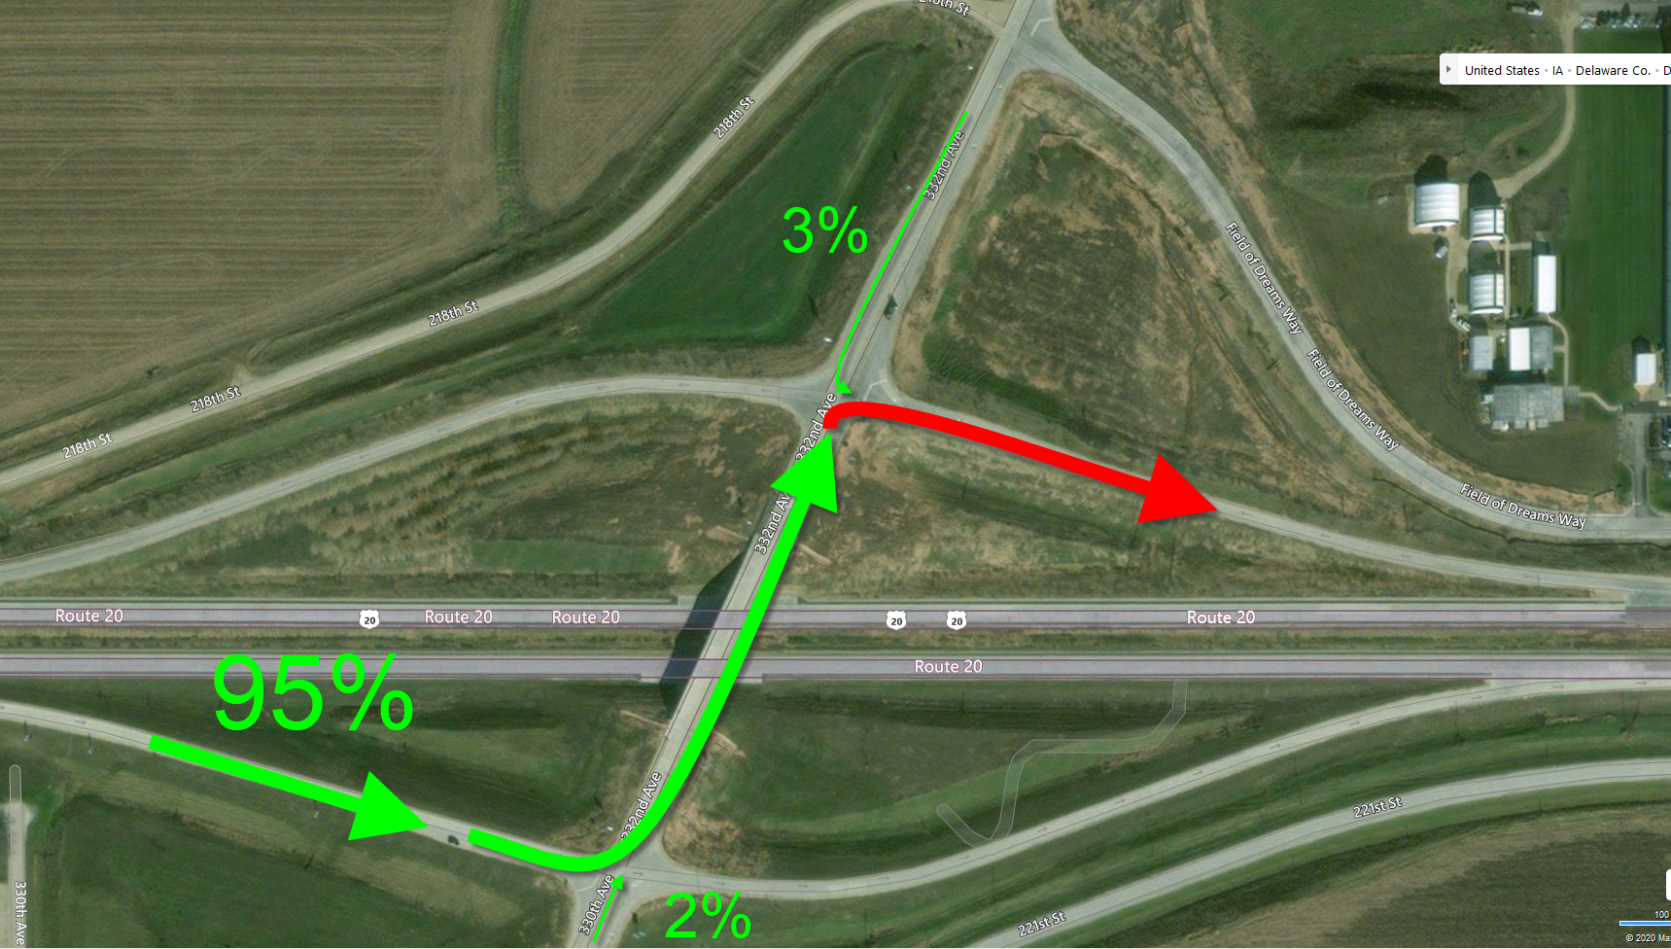
Where are they coming from?

Slide 14
Day vs Night
144 out of 145
99.3%
1 out of 145
0.7%

Slide 15
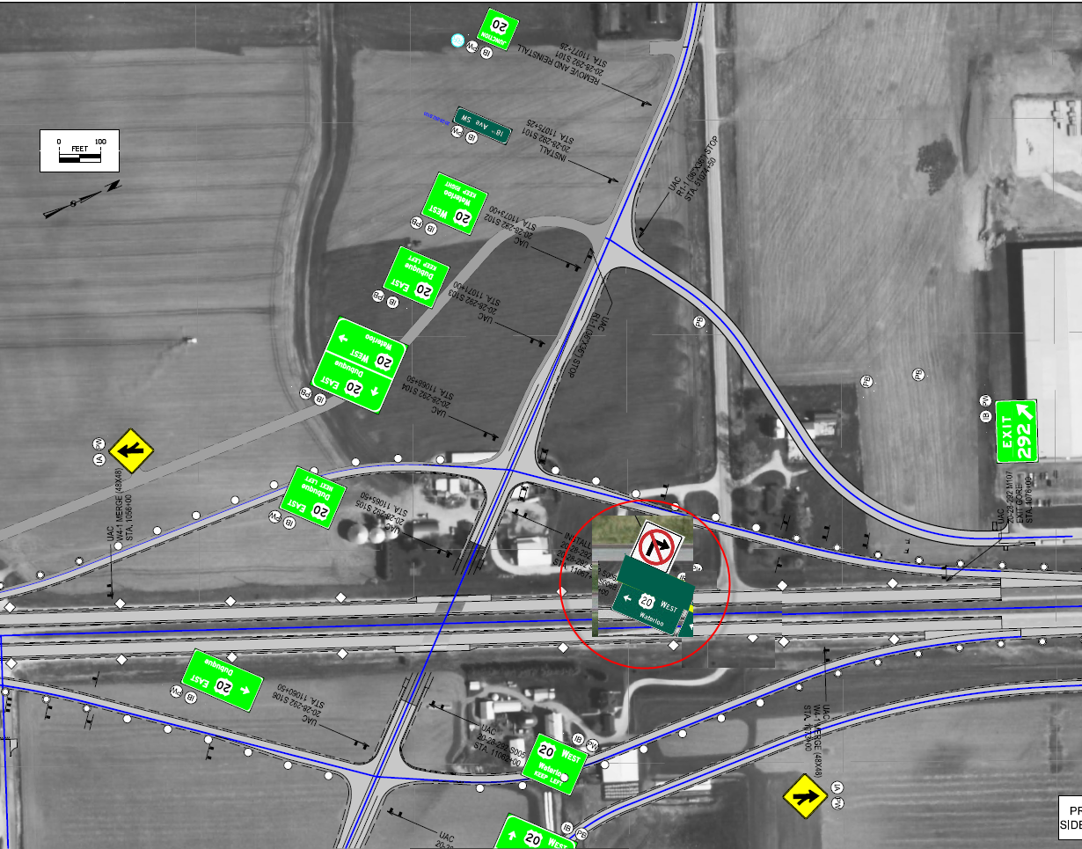
May 2019 Treatment (#1)

Slide 16
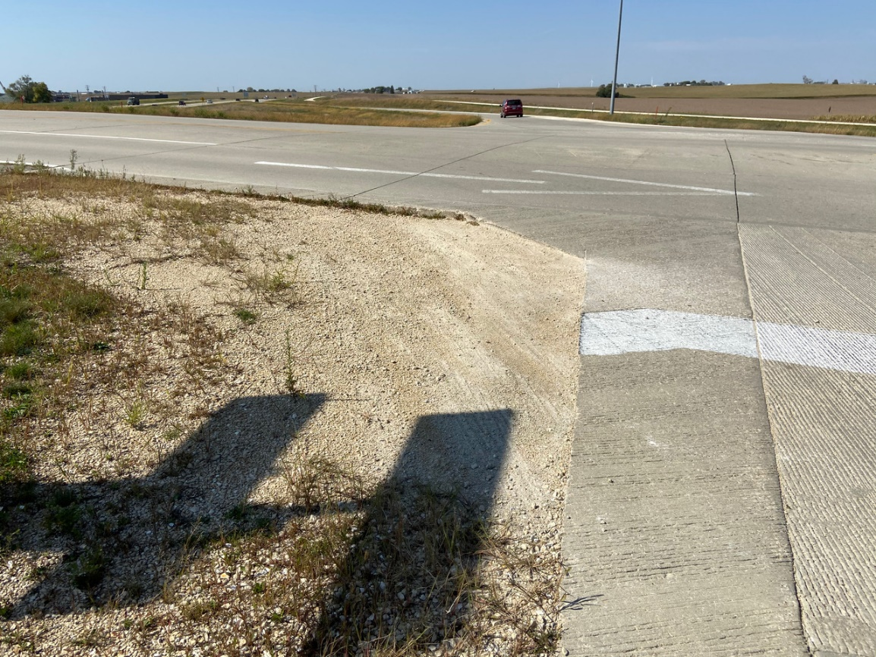
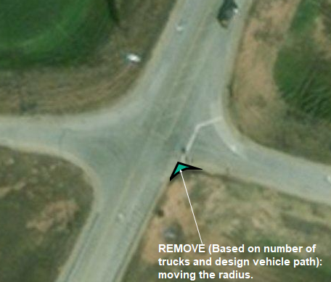
2019??

Slide 17
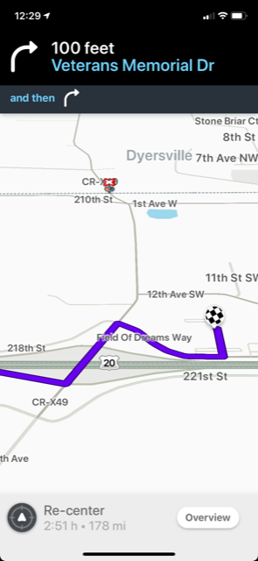
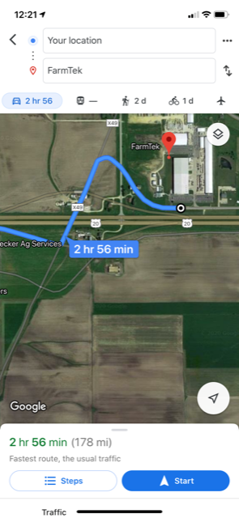
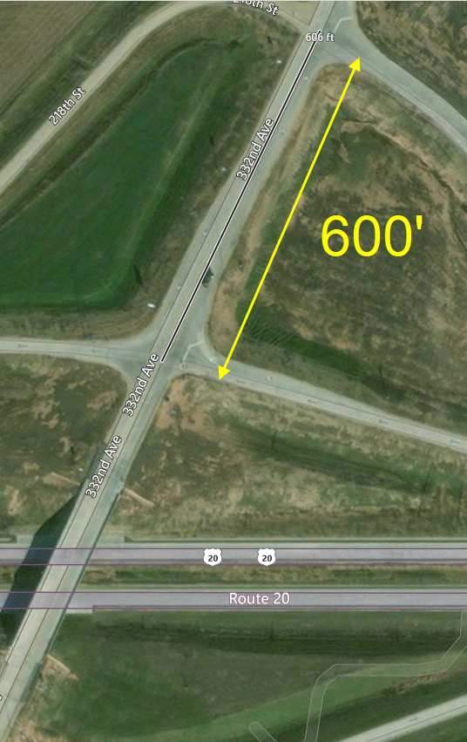
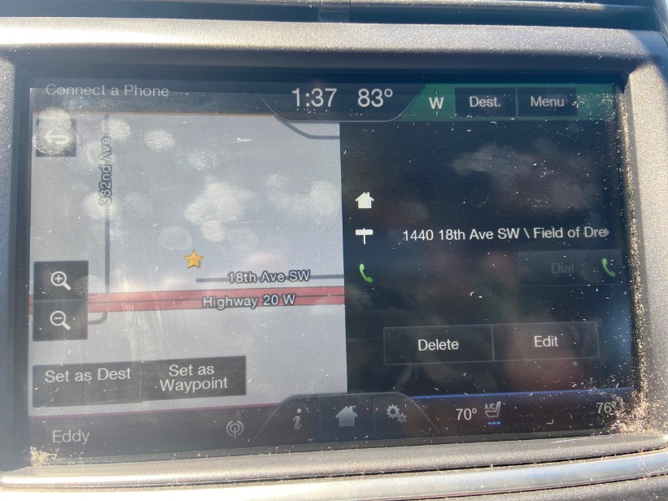
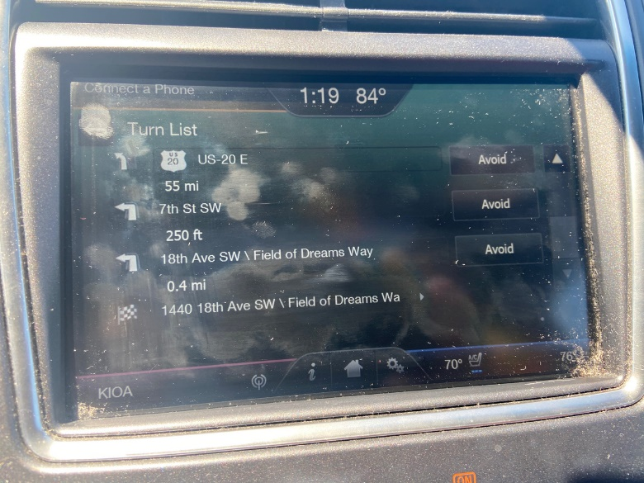
New Interchange / GPS

Slide 18
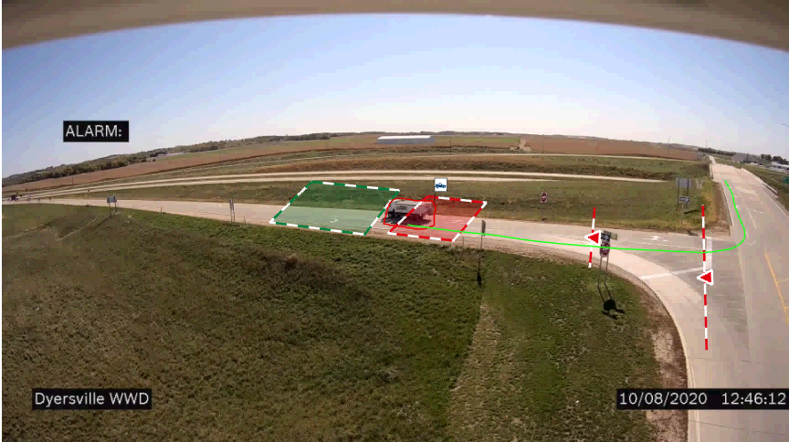
Bosch Camera w/ Video Analytics
Installed May 15th, 2020

Slide 19
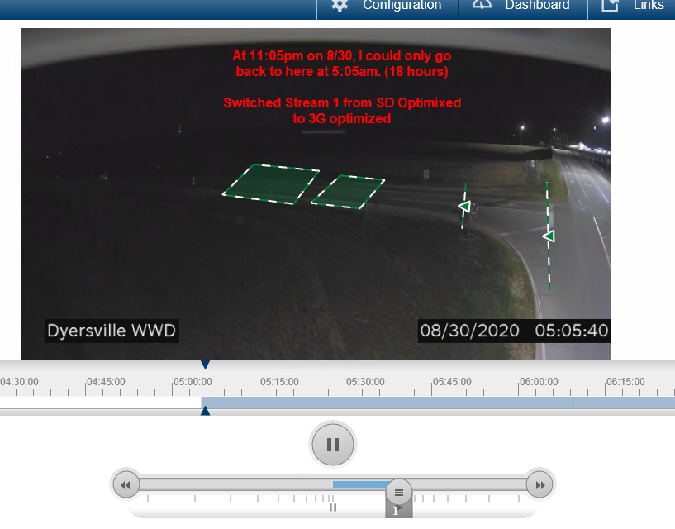

Slide 20
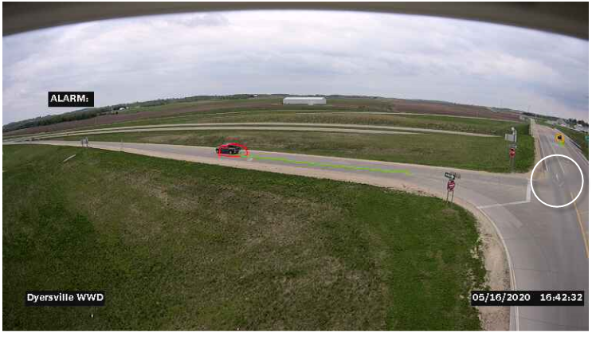

Slide 21
Treatment #2: 36” DNE Installed About 4’ mounting height Angled some, but not 45 to traffic
Completed 5/26/2020

Slide 22
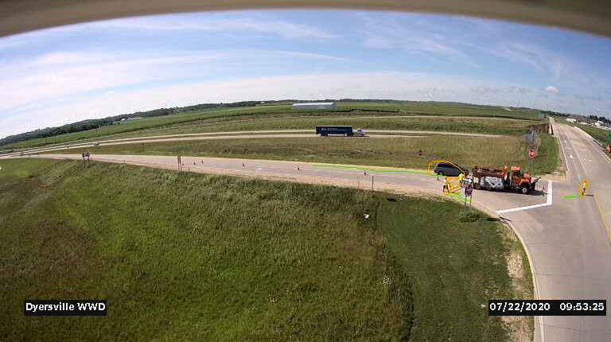
Treatment #3, WWA, LUA, Stop Bar
Completed 7/22/2020

Slide 23
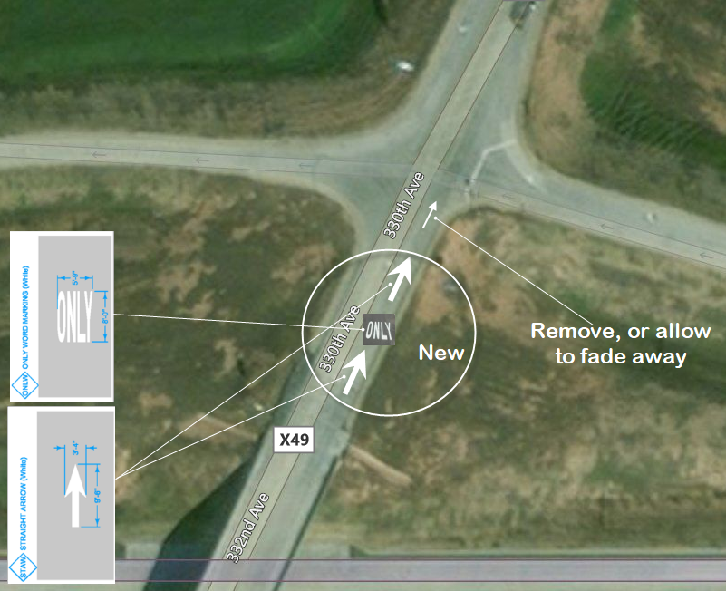
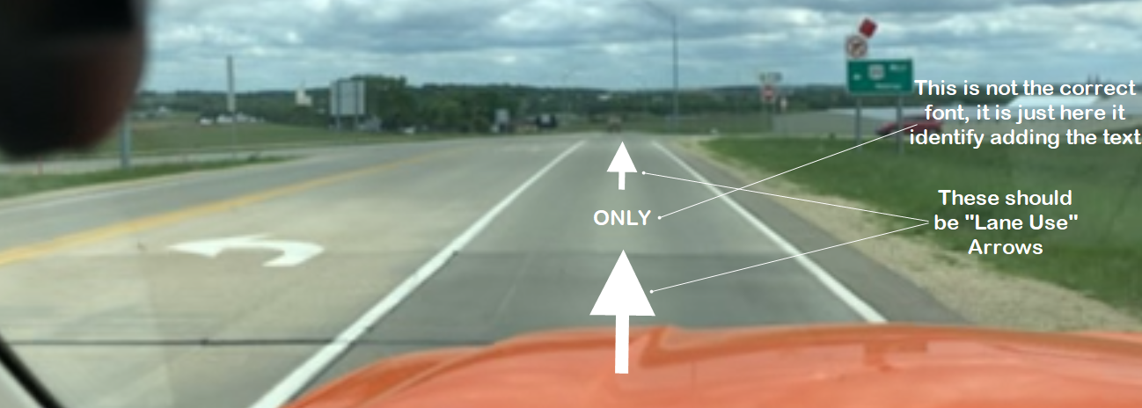

Slide 24
Treatment #4: Upsizing 36” DNE to 48” Straighten One Ways Move “No Right Turn” to separate post
Completed 8/6/2020

Slide 25
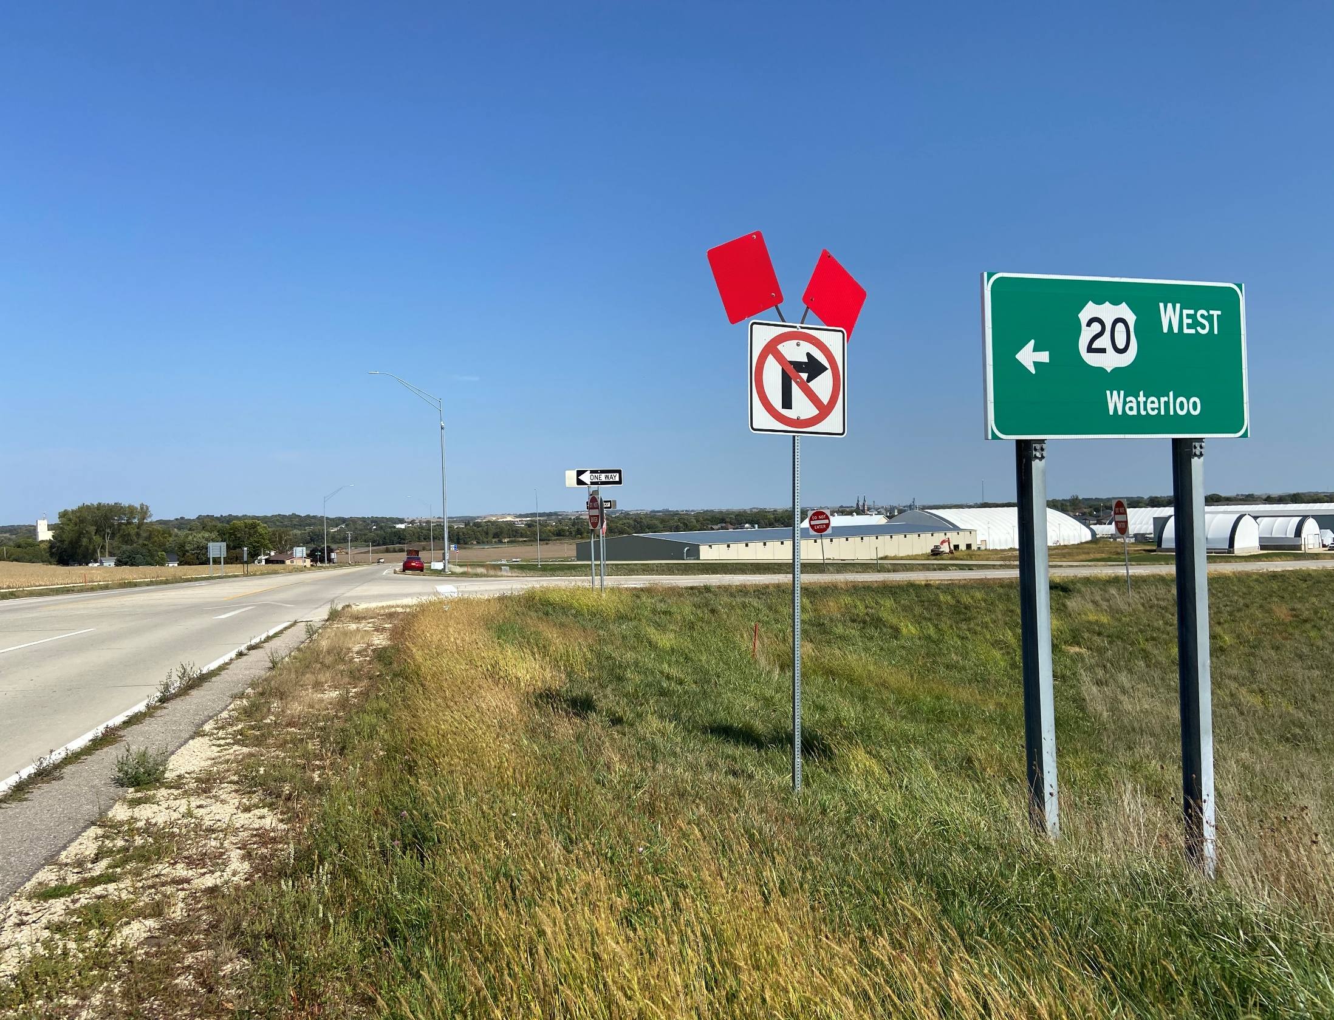
Treatment #4 also

Slide 26
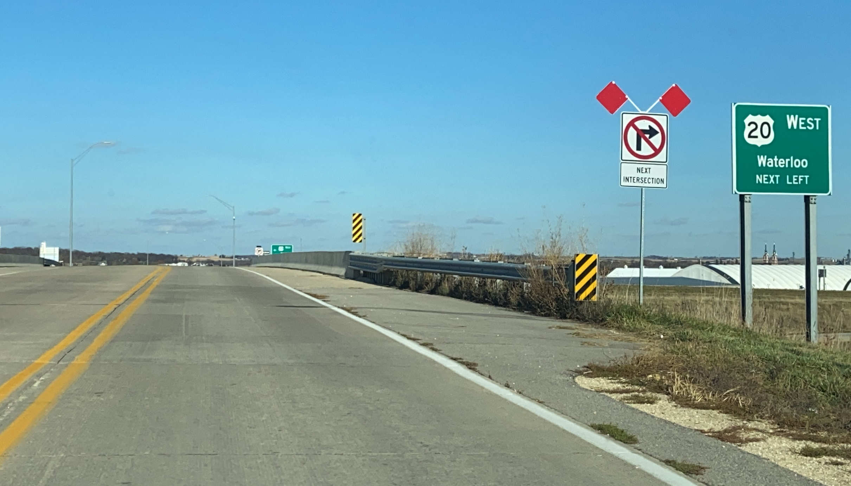
Treatment 5a
Completed 9/17/2020

Slide 27
Treatment 5b (Flashing No Rt Turn)
Completed 10/12/2020
Worthless!

Slide 28
Video

Slide 29
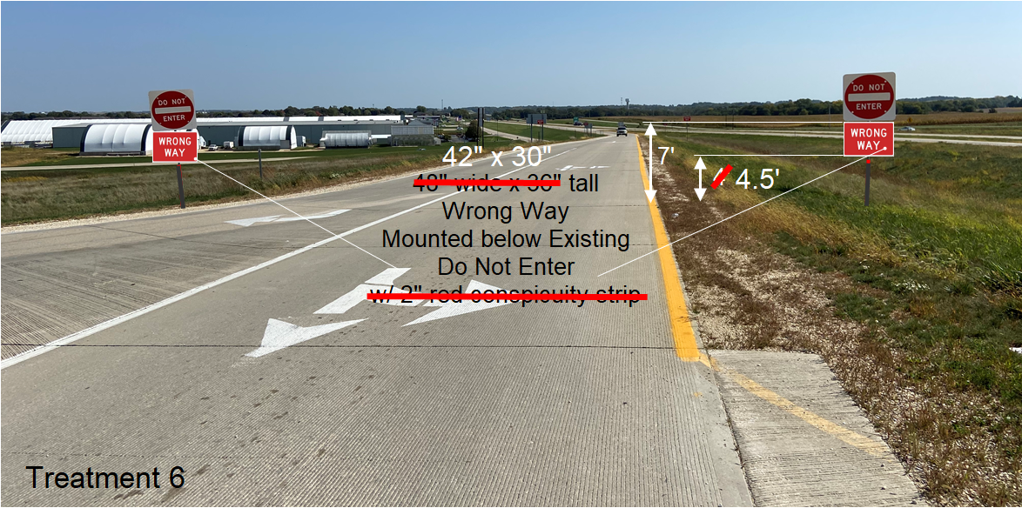
Treatment #6 (Early Dec 2020)

Slide 30
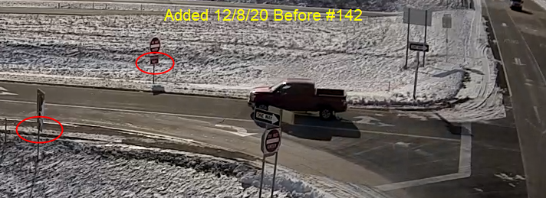
Added Wrong Way Below

Slide 31
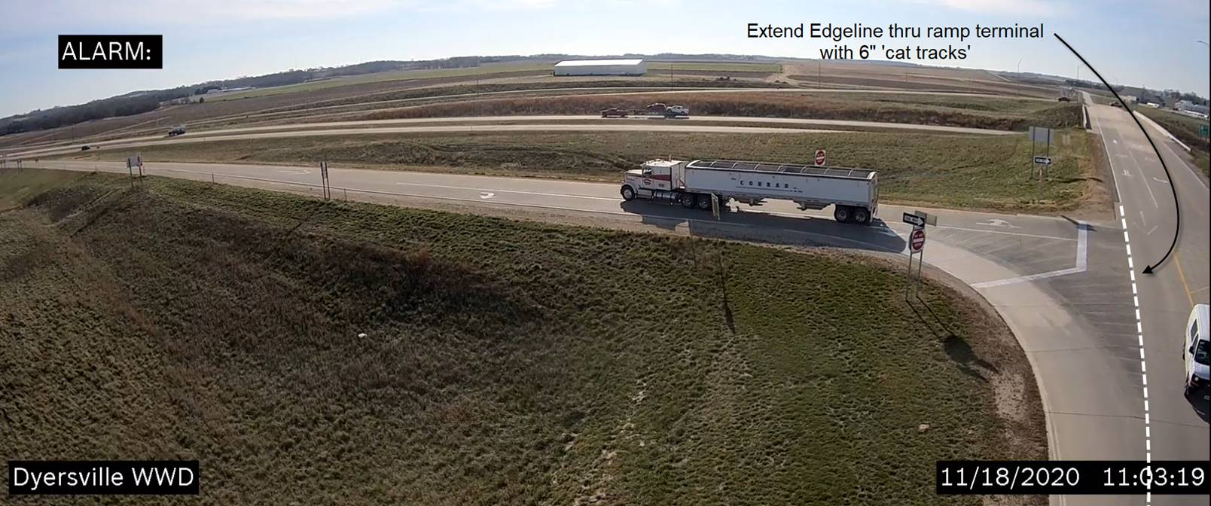
Future Treatment Idea

Slide 32
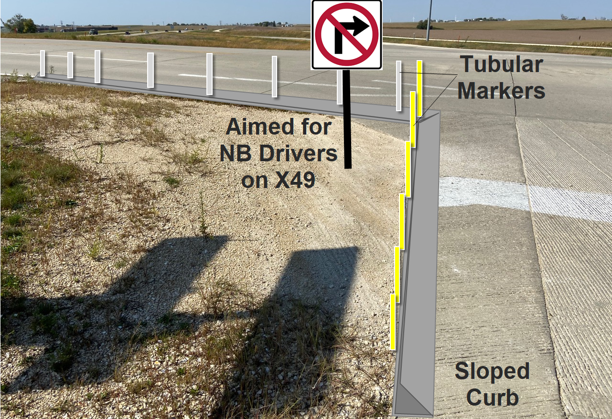
Island and Curb Option

Slide 33
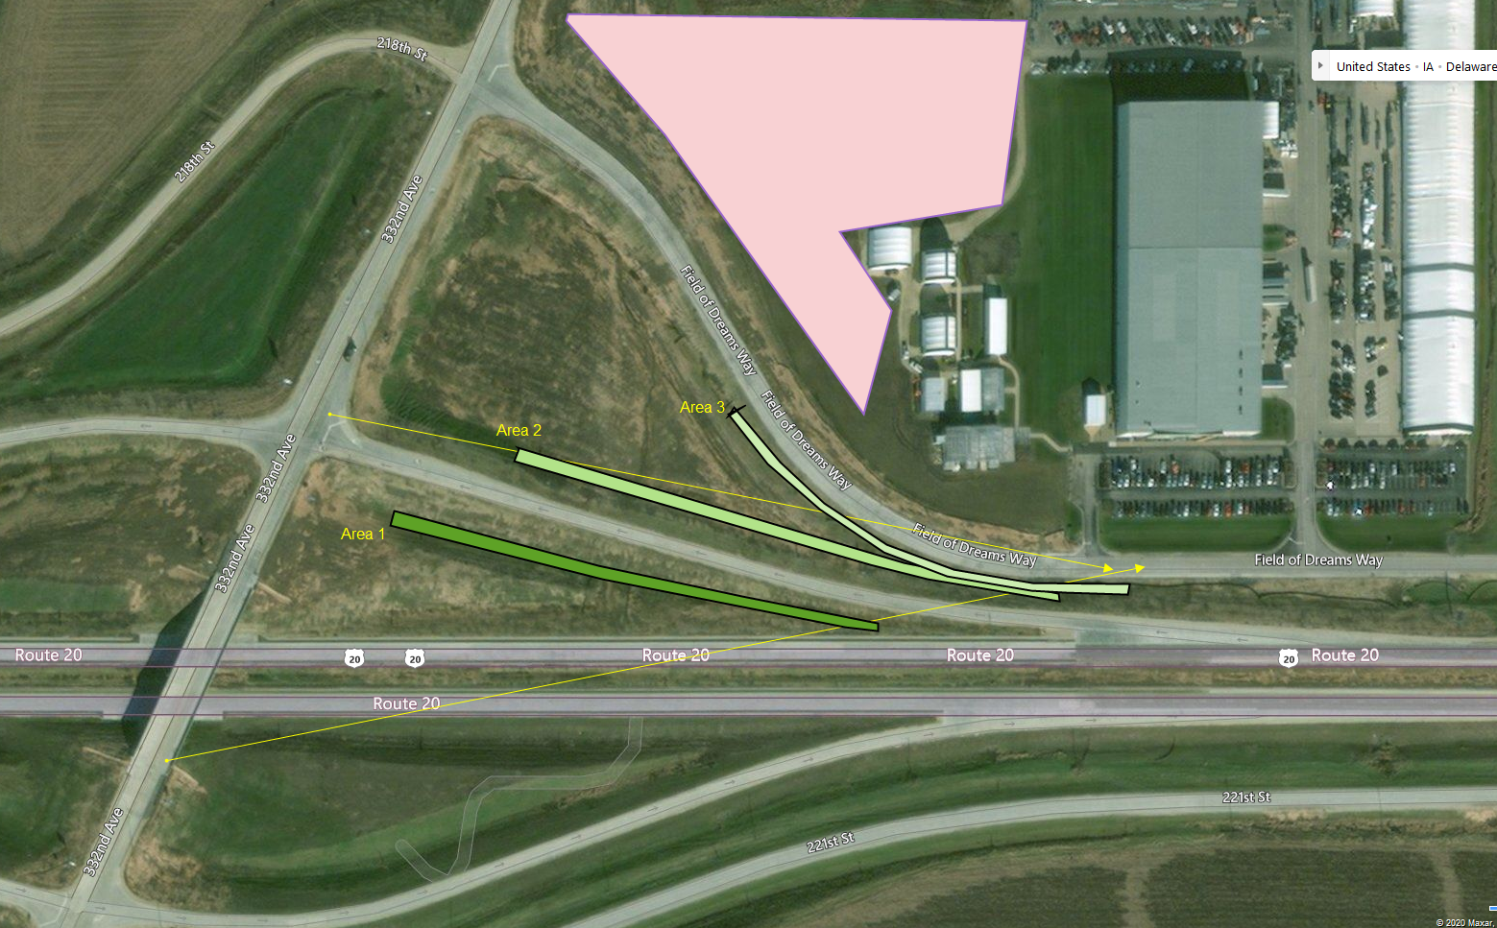
Treeline Option

Slide 34
Any WWD Ideas?
Willy Sorenson, P.E.
Traffic & Safety Engineer
Traffic & Safety Bureau, Iowa DOT
800 Lincoln Way, North Annex
Ames, Iowa 50010
(515)-239-1212 Office (1% chance I’ll answer)
(515)-669-4628 Cell (99% of getting me)
willy.sorenson@iowadot.us

Slide 35
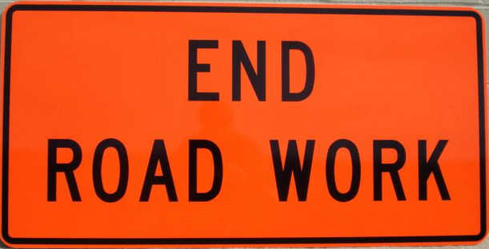
Questions?

