Slide 1
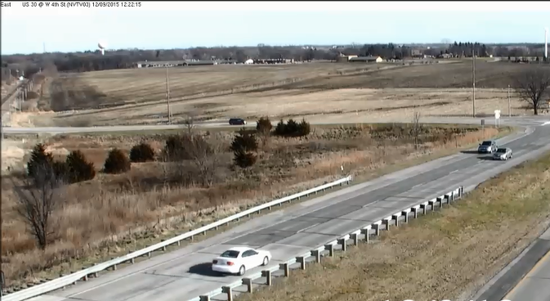
Iowa’s Experience with WWD (Wrong Way Driving)

Slide 3
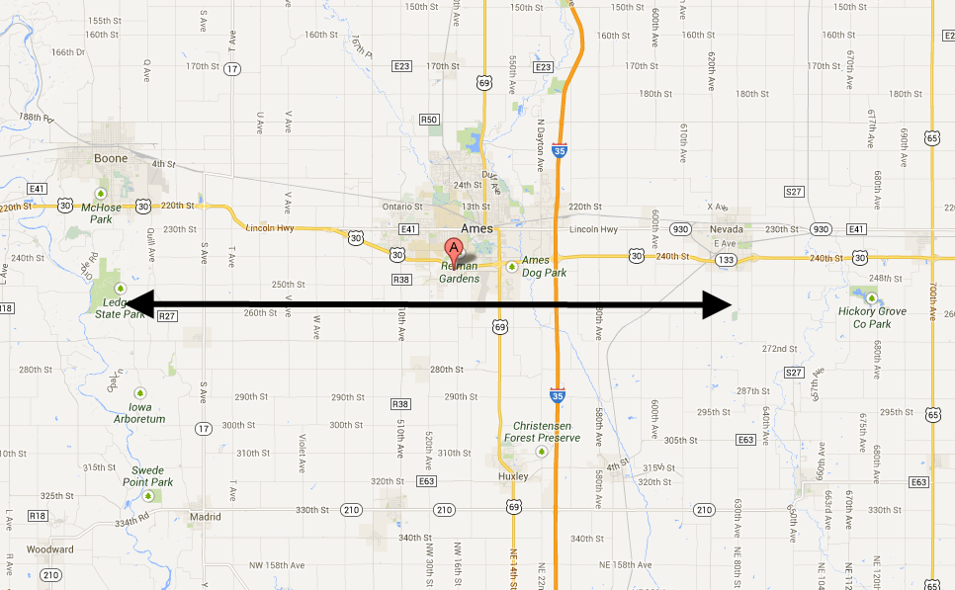
Project Location
Boone
Nevada
Ames
25 miles

Slide 4
Situation/Background
181 (911 calls & Eye Witness) Wrong Way Drivers (WWD) since 2008 (just over 9 yrs).
Does that mean we have had 181 WWD?
Probably not.
A Florida study showed 90% of people DO NOT call 911.
We found (on average)
If a WWD ‘passed by’ 4 cars, no 911 call
If a WWD ‘passed by’ 7 cars, a 911 call was made (86% did not call)

Slide 5
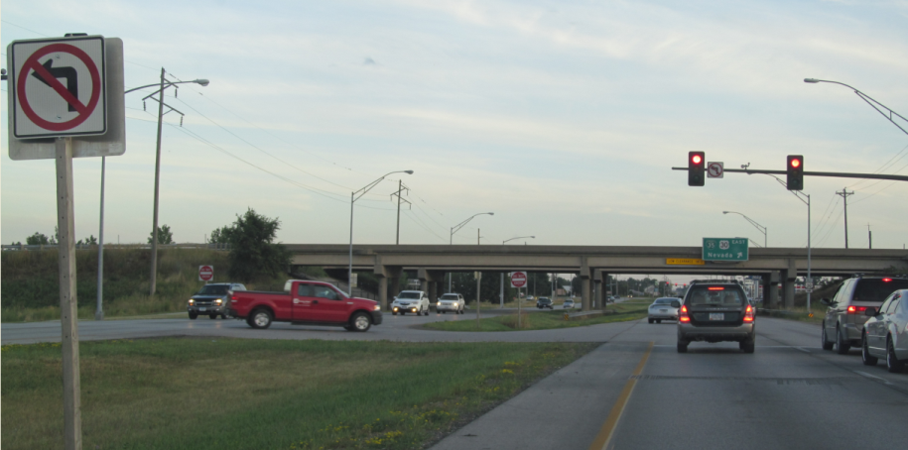
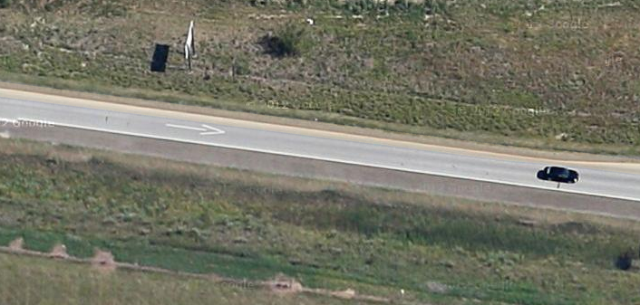
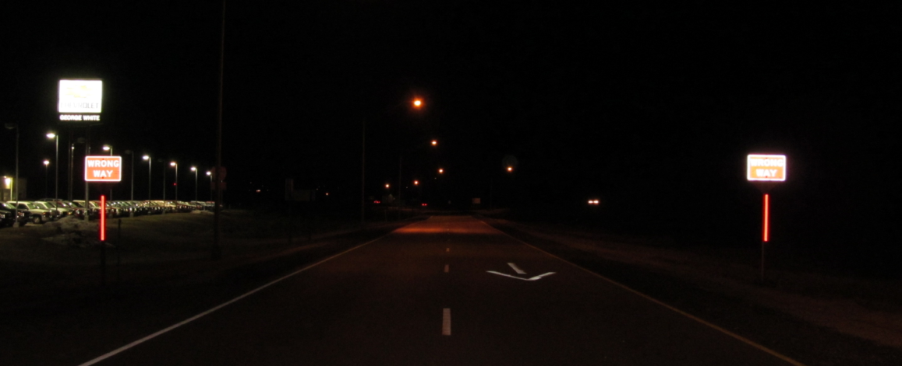
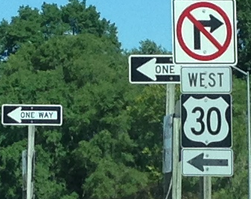
Low-Cost / Updates in 2012
Review with a “Checklist”

Slide 6
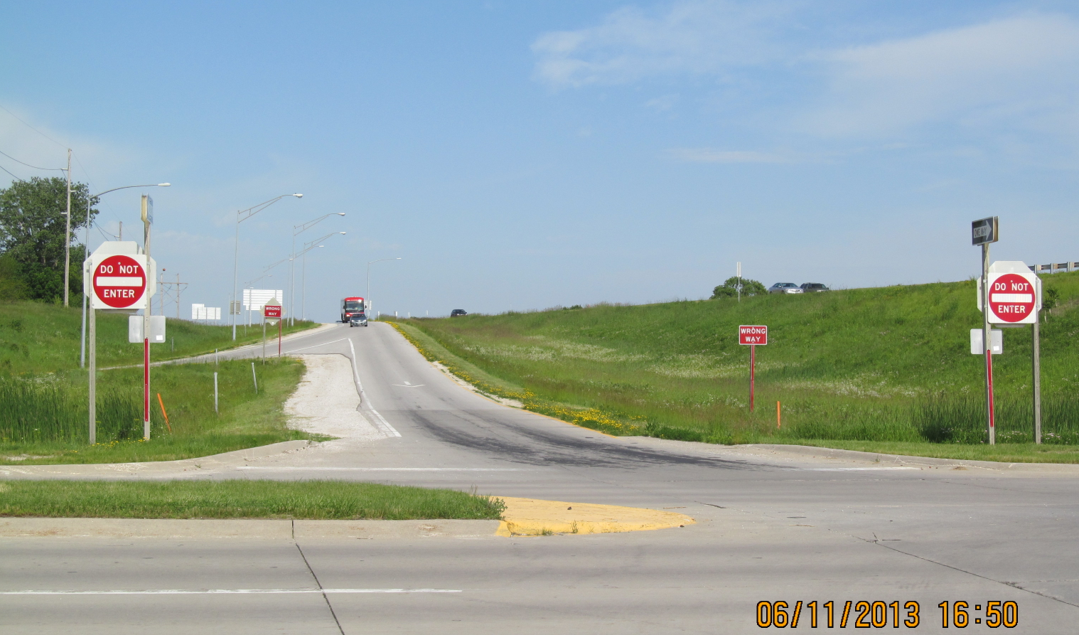
Low-Cost / Updates in 2012

Slide 8
2013 -Present
Need to find out if video analytics works
How? With no money and no support?
Initial Round:
Other Players

Slide 9
Results…. Video Analytics does work!
Read the ENTERPRISE Report
Or just ask me ;0)
Example Videos

Slide 10
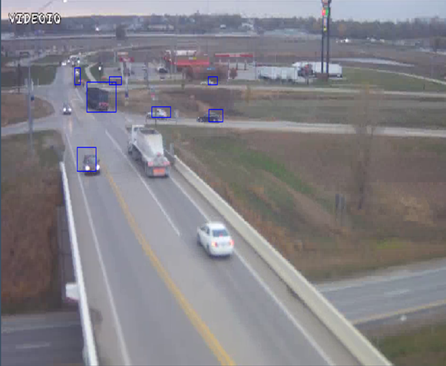

Slide 11
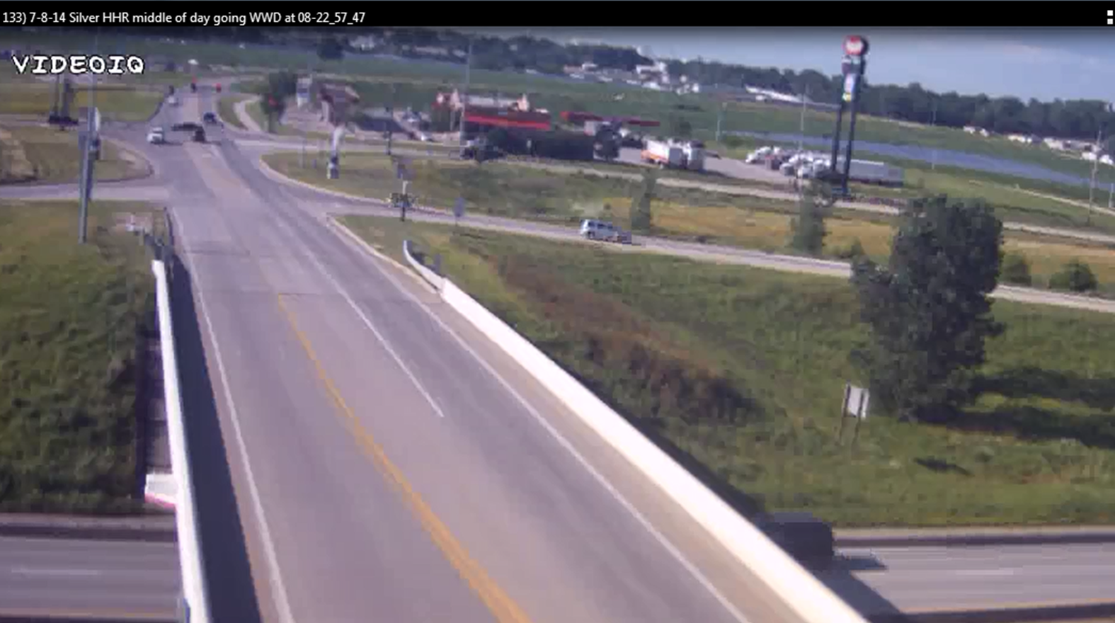

Slide 13
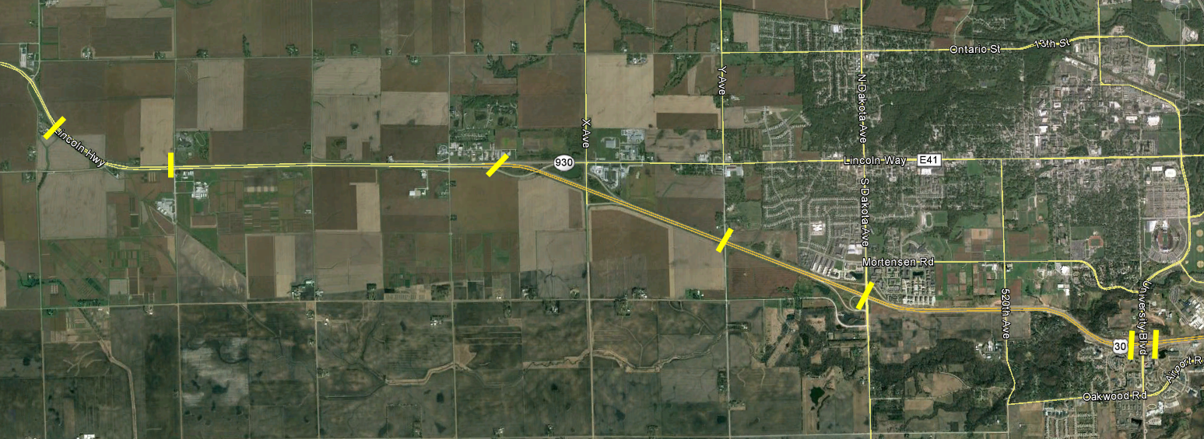
Added ITS Cameras & Sensors
July 2014

Slide 14
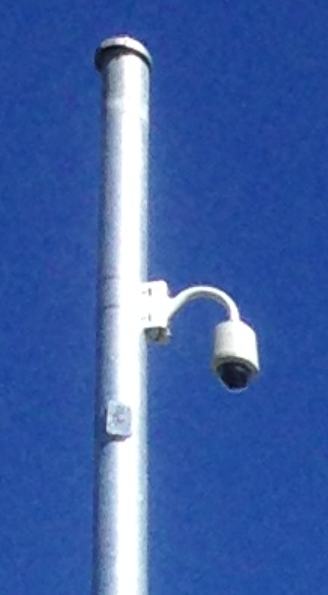
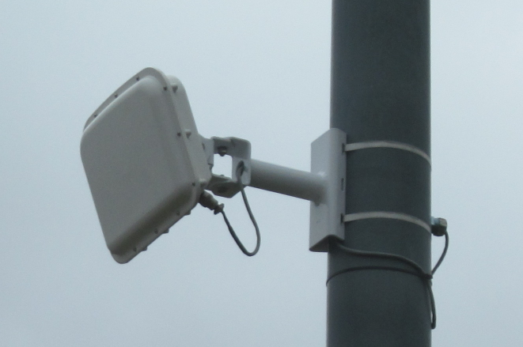
ITS Technology used
Radar sensors (speed and direction)

Slide 15
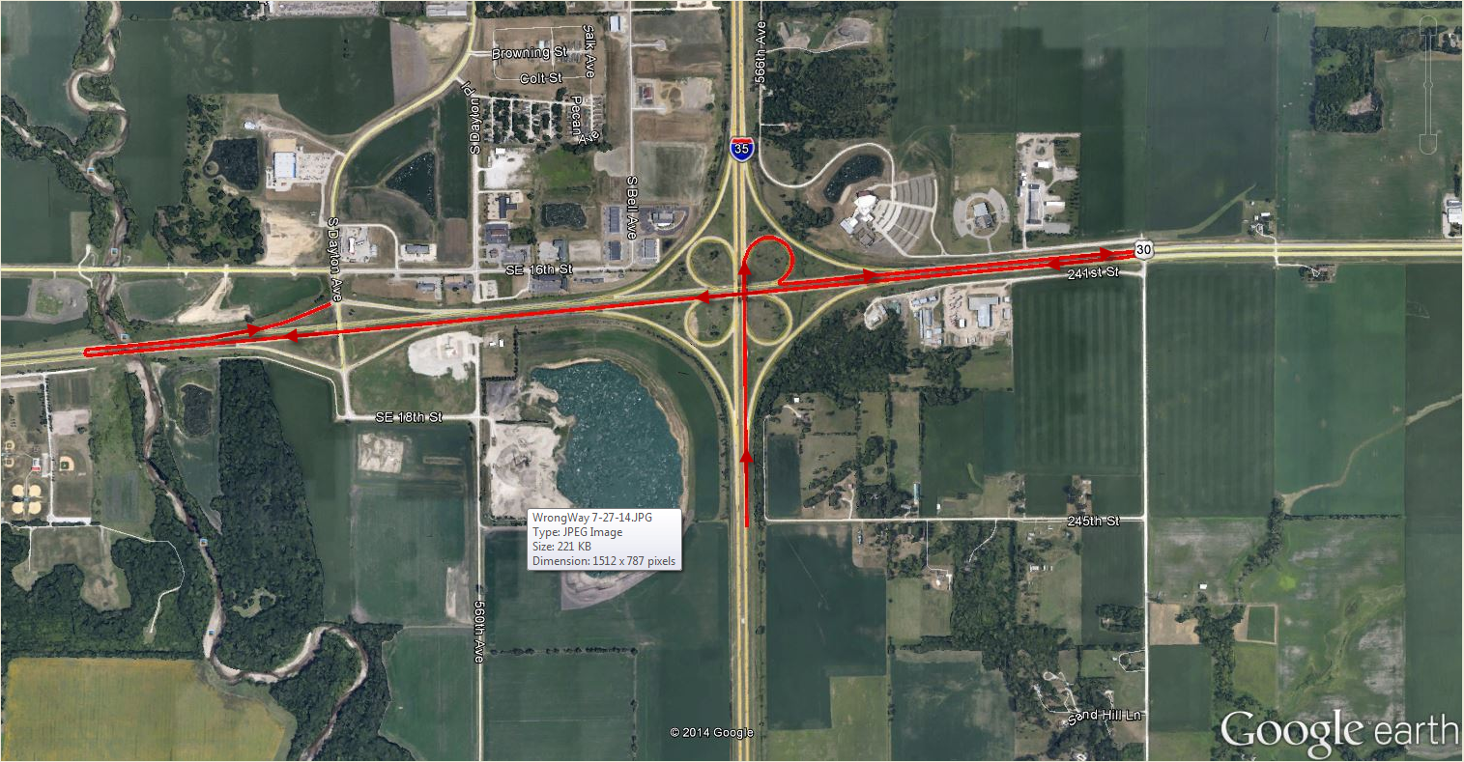
Within 1st 2 weeks
Link to video

Slide 16
Just can’t find the right way…

Slide 17
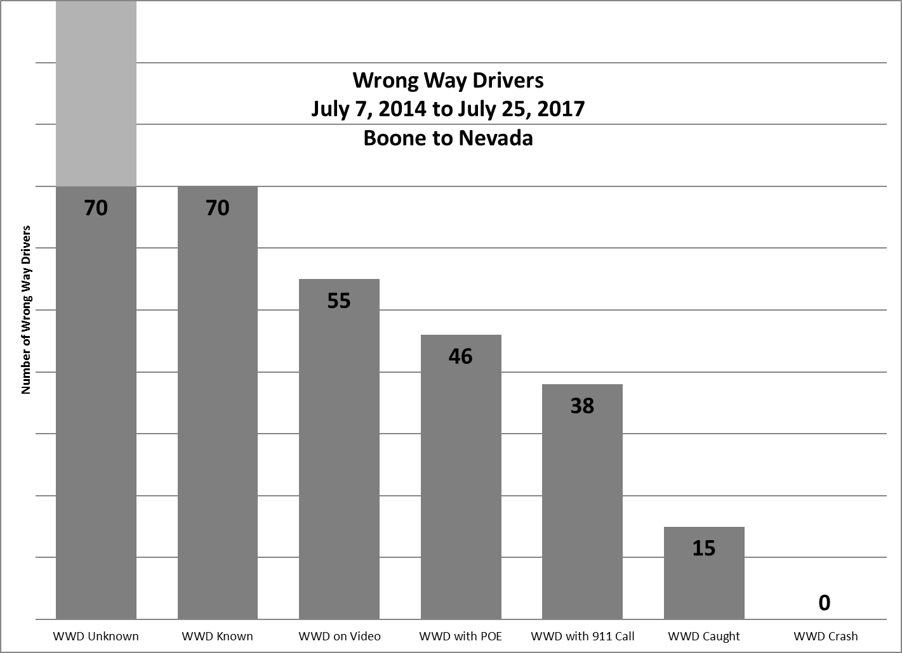

Slide 18
Focusing on Specifics
Once we have 2 similar WWD within 6 months, we will focus our efforts on that specific location with:
Signing
Painting
Lighting (if necessary)
If that is not enough…
More expensive options
Have not had to “go there” yet

Slide 19
My goal…. Determine Points of Entry (fix the problem/eliminate the headache)
Specific / Targeted Signing for that location
Option B
Option A
Enhanced Signing Everywhere
Solve with signing, painting & lighting

Slide 20
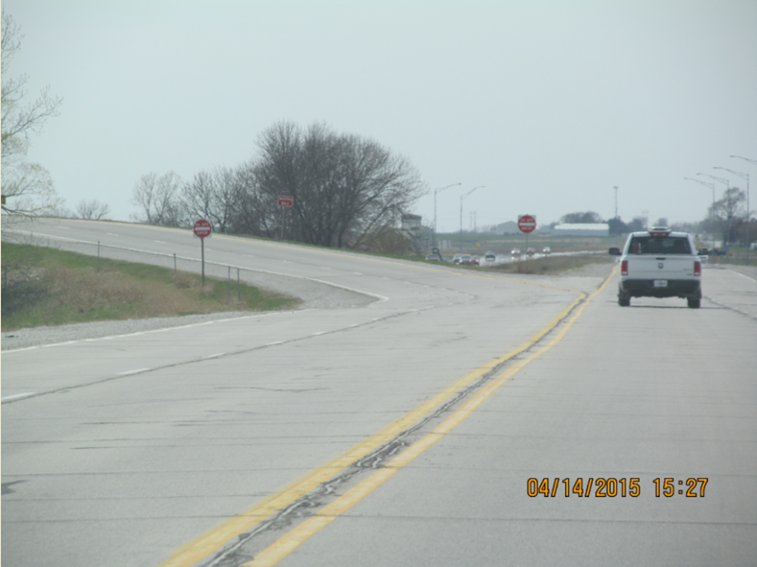
Examples of “Wins” for WWD Efforts

Slide 21
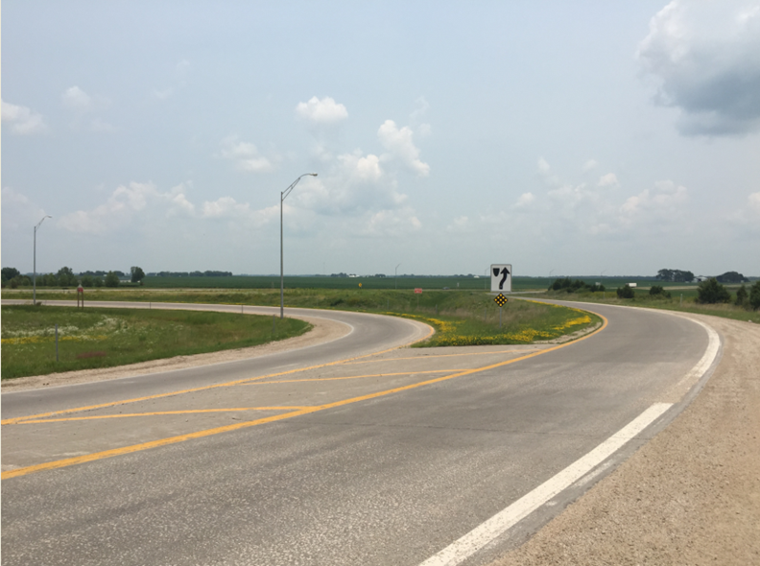
Examples of “Wins” for WWD Efforts

Slide 22
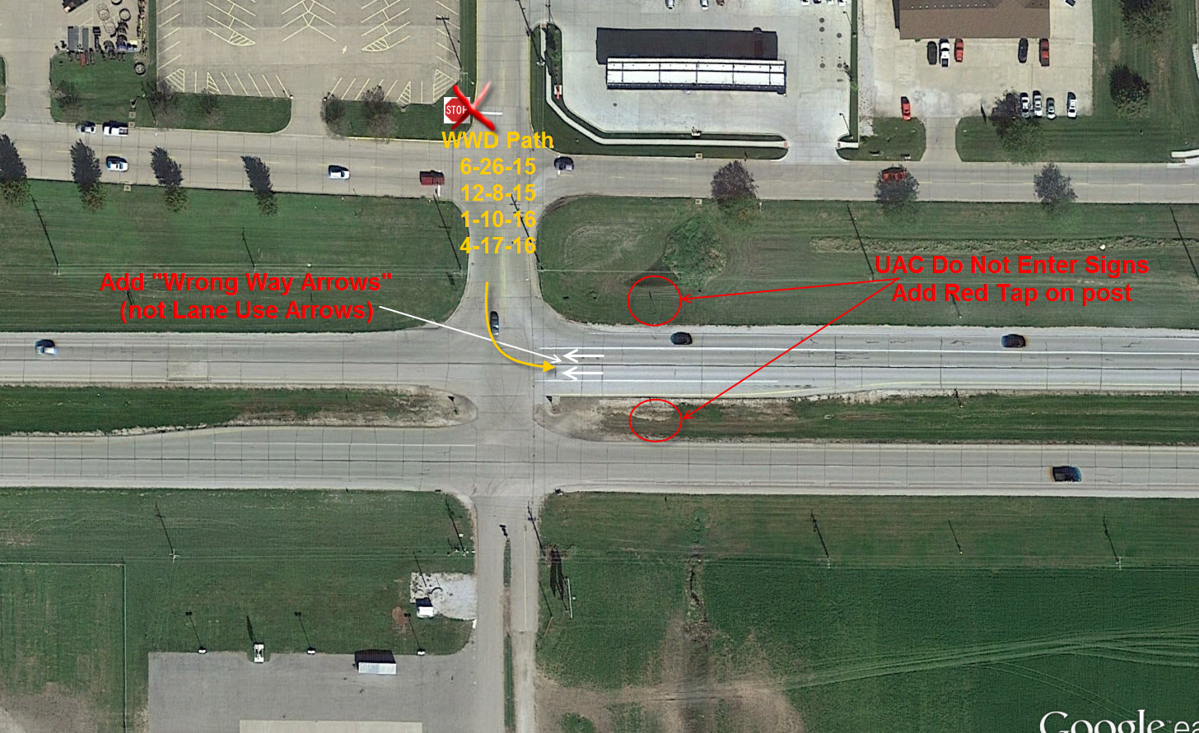
Linn St. in Boone

Slide 24
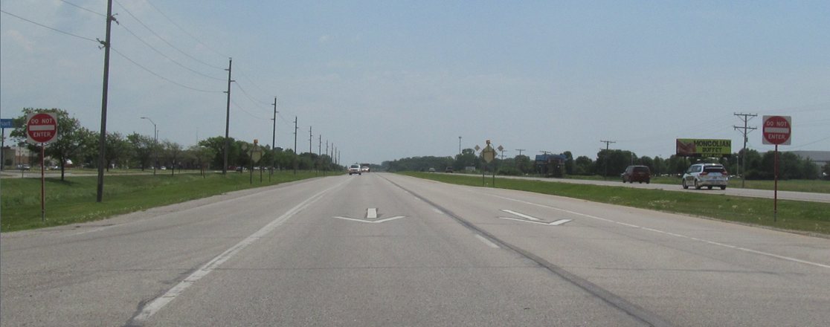
US 30 @ Linn St. (looking east)

Slide 26
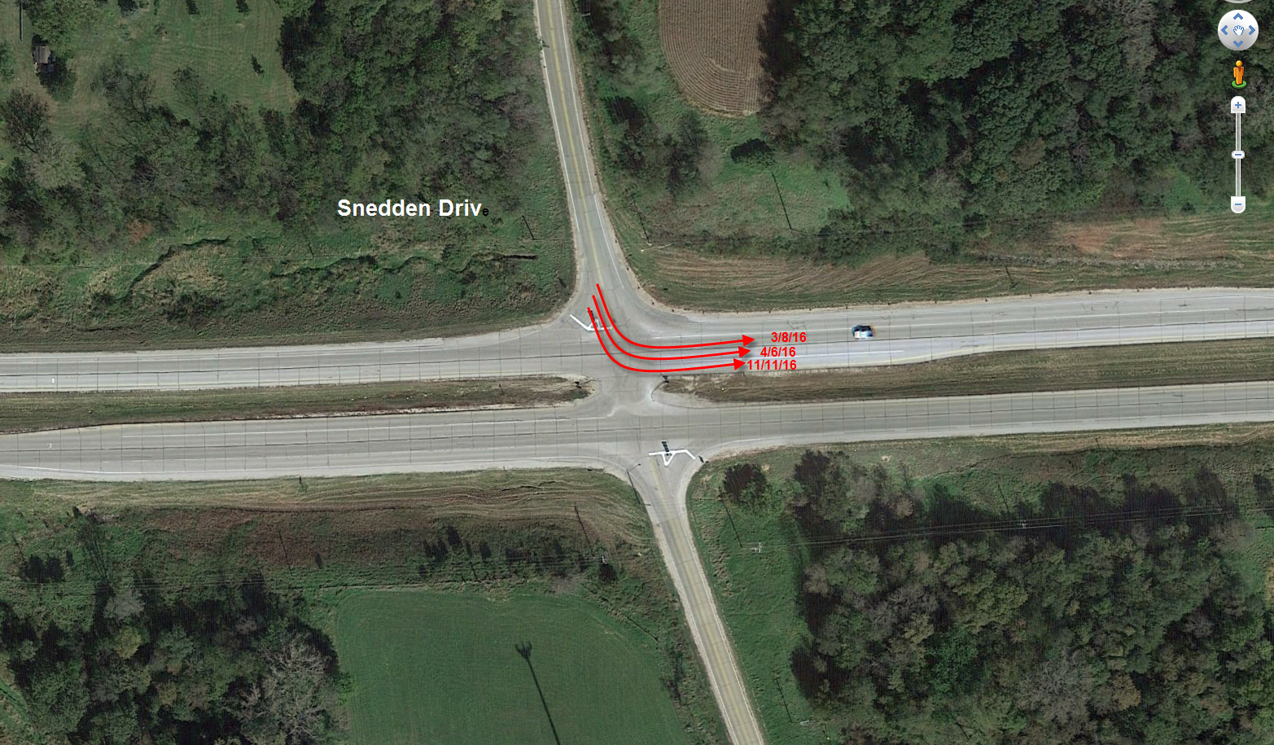
5th Candide for Enhanced Signing

Slide 27
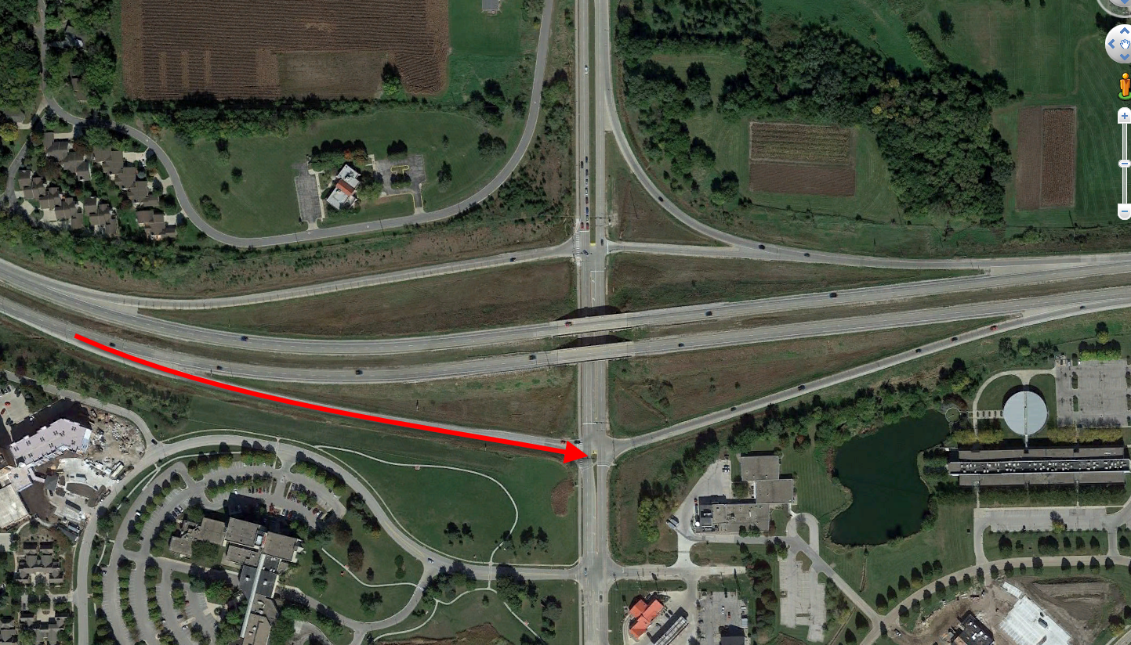

Slide 30
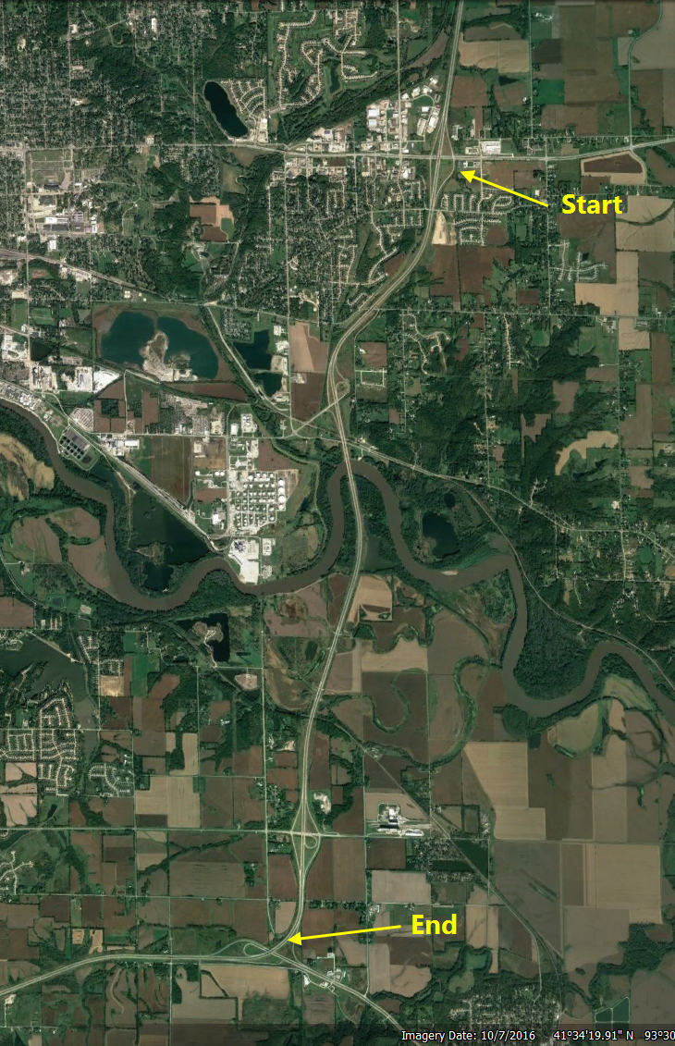
WWD #2 this weekend

Slide 31
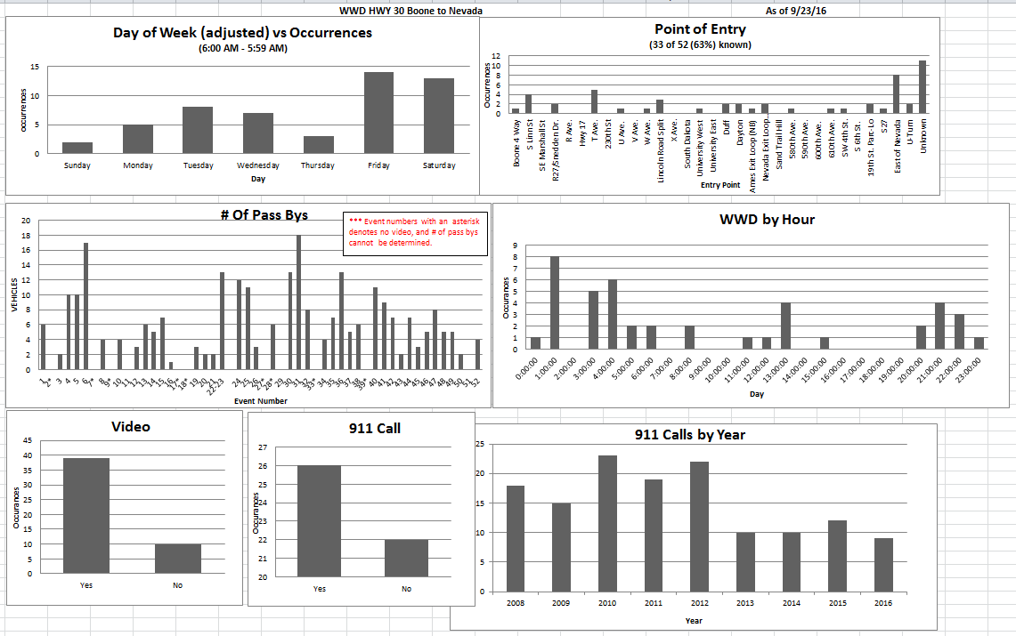
Data

Slide 32
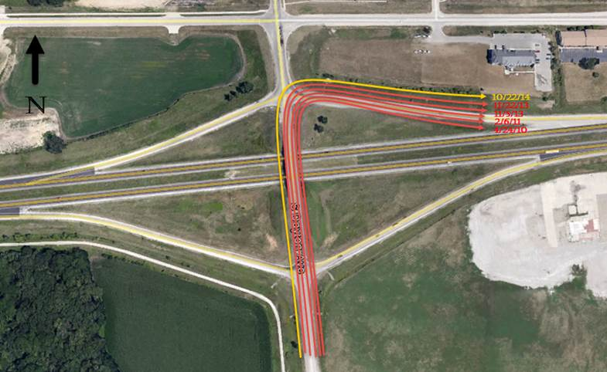
If you look, you will find…..

Slide 33
How we solved this one... Kind of

Slide 34
Where are they coming from?

Slide 35
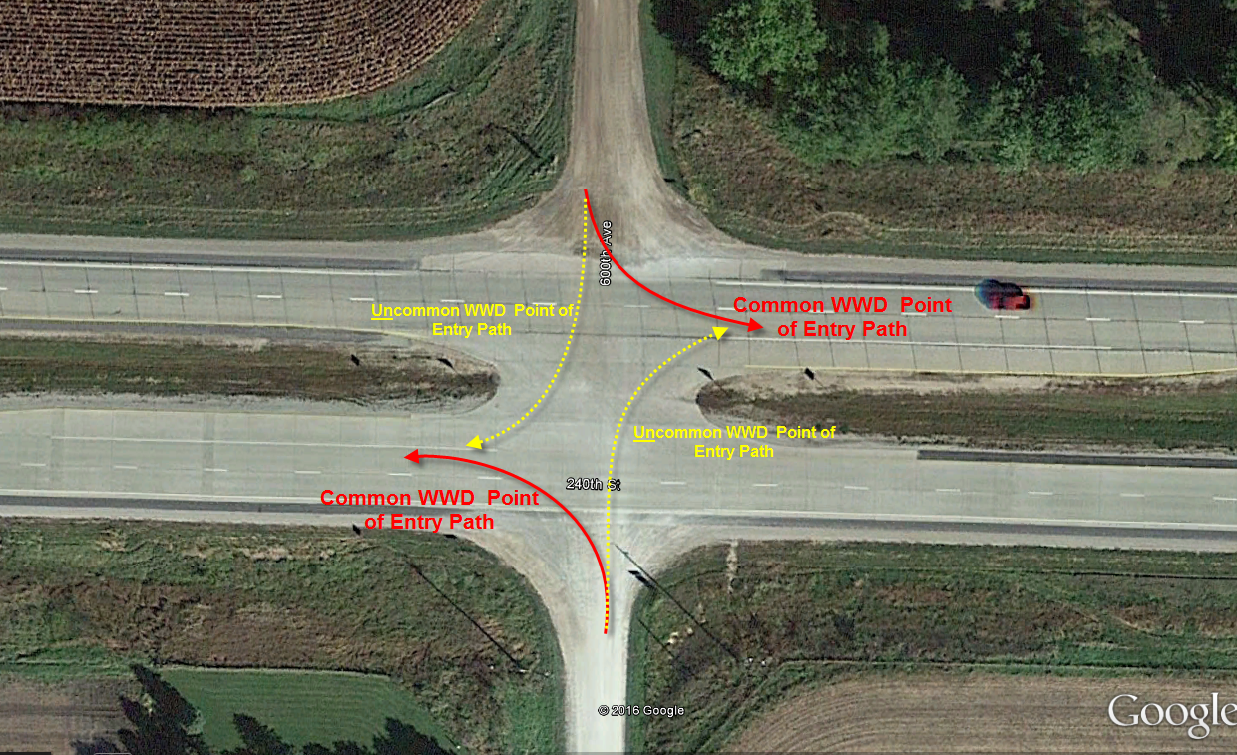
What have we learned?
At grade intersections
55% of WWD “known point of entry” (22/42) start here

Slide 36
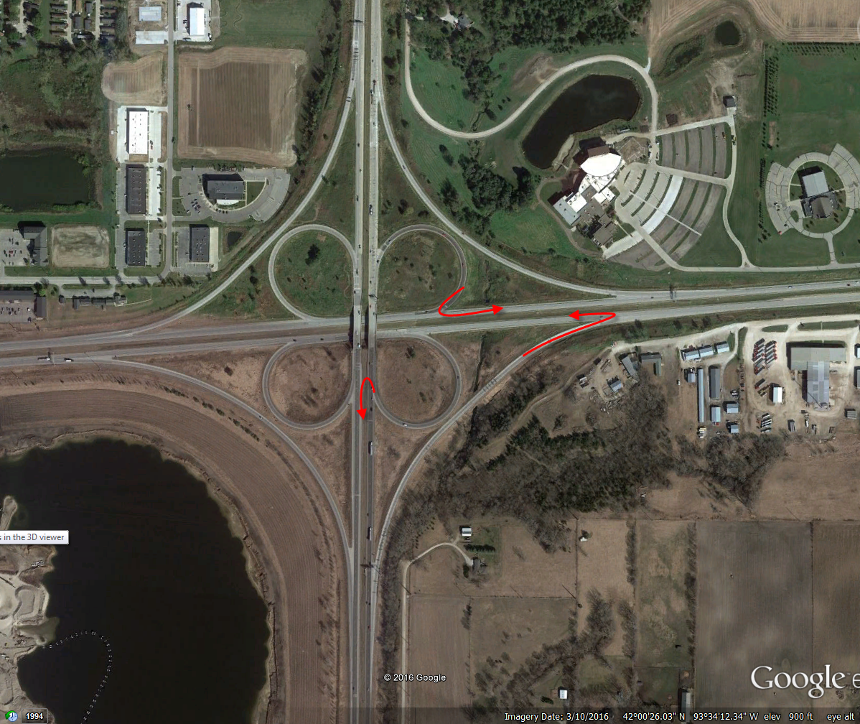
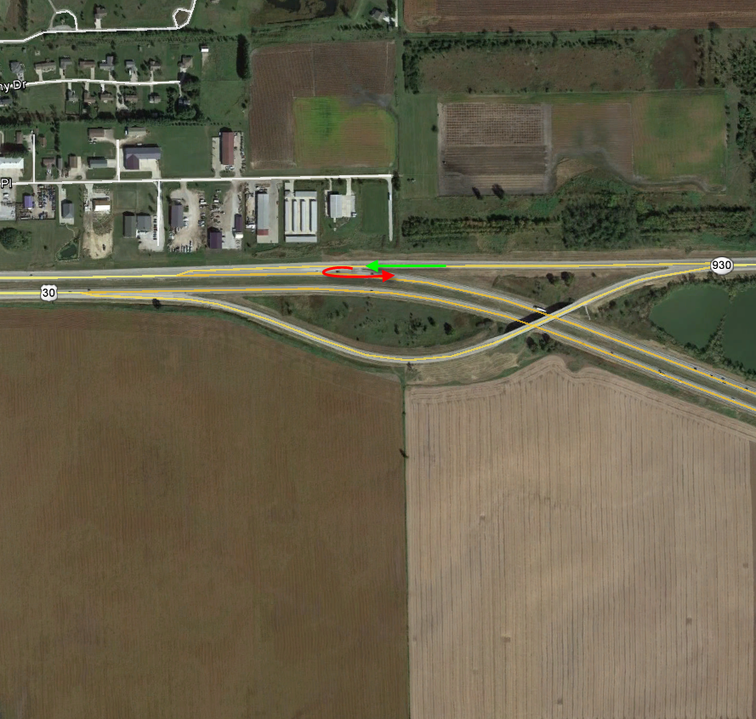
What have we learned?
At Ramp Merges
31% of WWD “known point of entry” (13/42) start here

Slide 37
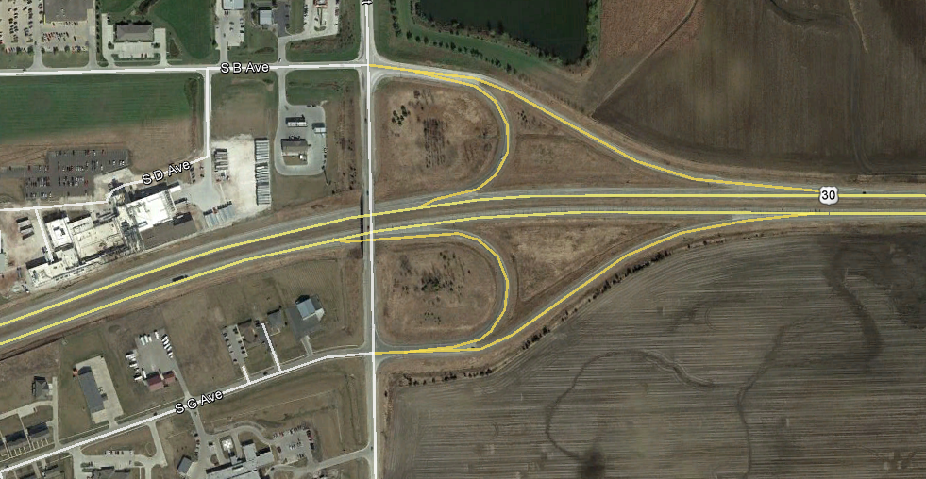
What have we learned
Yes, these can be a problem
But not these…. ;0)
Still don’t know about these

Slide 38
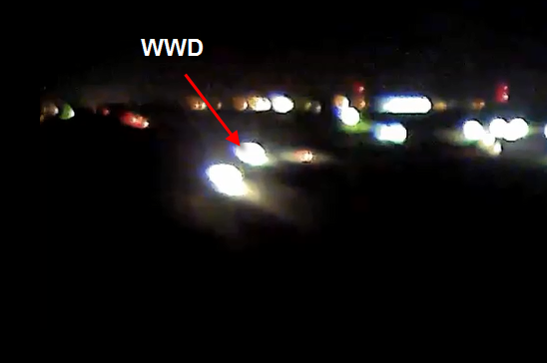
338+ documented “Pass-bys”

Slide 40
338 “Pass-bys” and no crashes??? WHY????
Traffic volume is about:
16,000 AADT (rural)
25,000 AADT (urban)
EVERY ONE of these 338 “Pass-bys” were in the right lane (so was the WWD, or what they think is the right lane)

Slide 41
What have we learned?
WWD can start anywhere
Free-flow ramps
At grade intersections
Ramps
Detection at Point of Entry is the best
Video Analytics is the way to go
Confirmation (Video Proof)
Where did they come from (Dayton example)
You can have a WWD Problem
without a Crash Problem

Slide 42
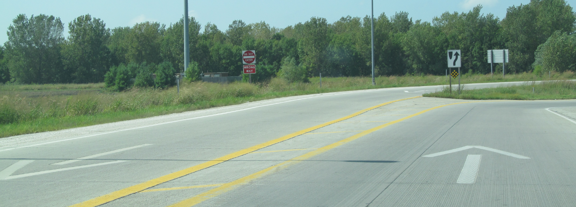
What have we learned?
Enhanced Signing & Painting DOES help!

Slide 43
Efforts Going on
TSIP Grant for WWD Arrows on all ‘unique’ interchanges
Panasonic ‘Test Camera’ near Boone
TapCo Sign at University and US 30
Review of WWD for Pleasant Hill (Hwy 163)
Possible outreach to Law Enforcement
National Review of WWD (InTrans)

Slide 45
Efforts Going on
Create a Master Plan to address WWD
Low Cost (at-grade) detection
Possible testing of Video Analytics vendors
RFP for long term WWD Vendor
InTrans TSIP application (submittal only) for deploying video analytics on existing cameras
TAS TSIP application (submittal only) for safety funds
ITS Service Layer/TSMO for WWD funds

Slide 47
What have we learned?
What are you going to do on your way home on any 4-lane road?

Slide 48
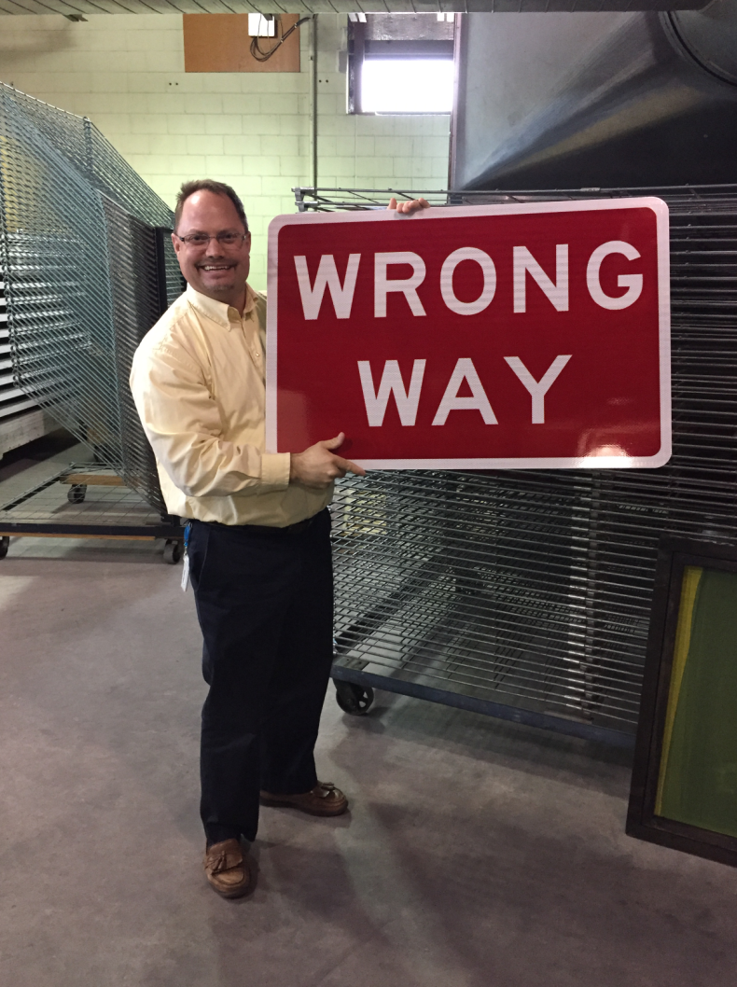
Any questions?

