Slide 1
i-PRO Image Traffic Counter
Introduction
April, 2016
Panasonic System Networks Co, ltd
Security System Business Division

Slide 2
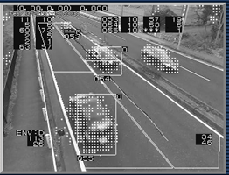
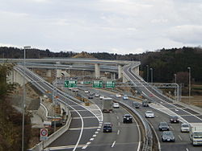
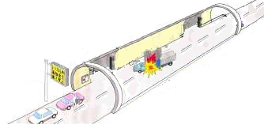
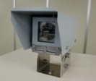
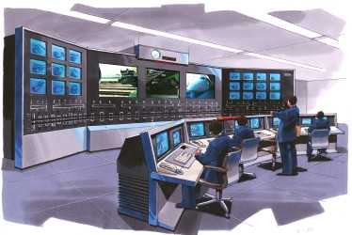
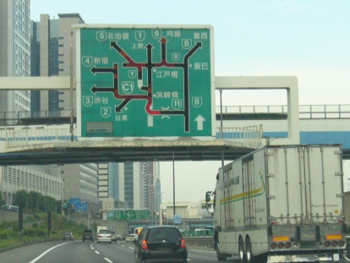
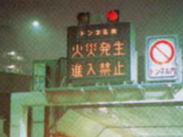
Overview
Safe and Smart road traffic management system with Video Intelligence
Traffic Counting
Incident Detection
Incident information
Caution!!
1) Stopped vehicle
2) Low-speed vehicle
3) Congestion
4) Avoid obstacles
5) Over speed
6) Reverse run
7) Driving in shoulder lane
Average speed of vehicle
Counting vehicle by type
Information Display
Traffic Control Center
Traffic Control Center
Information Display

Slide 3
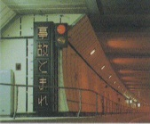
Solution benefit
Prevention of secondary accident
The accident in the tunnel early is detected by image processing, and provides a warning information of entry prohibition against subsequent vehicle, you will be able to prevent a secondary accident.
Fire
No entry
Prevention of accident in advance
As the target for over speed car and distance shortage car inter-vehicle, so that a warning display automatically on tunnel alarm plate, to encourage safe driving in the tunnel.
Caution!!
Reduce the operation
Detects the incident, it is possible to perform automatic alarm and monitoring screen switching, there is no need to perform constant monitoring operations of the monitor image.

Slide 4
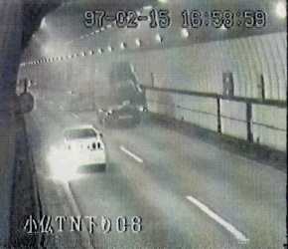
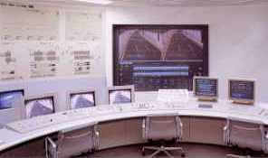
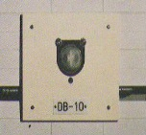
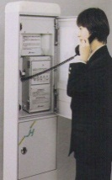
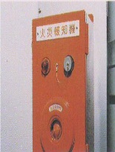
Solution benefit
Comparison of response time
The fire detection by fire detector
More than 2 min
Tunnel disaster prevention system
Tunnel Alarm display
Car Stop→ → → → → → → → →Fire
Several minutes
Fire detector
Fire
10 sec
60 sec
※Limited to fire
The report by Emergency telephone
More than 2 min
Tunnel Alarm display
Car Stop→ → → → → → → → →Fire
Tunnel disaster prevention system
60 sec
60 sec
60 sec
Emergency telephone
Detecting abnormal situation by image recognition
Approx. 1 min
Tunnel Alarm display
Car Stop→ → → → → → → → →Fire
Tunnel disaster prevention system
CCTV Camera
10 sec
60 sec

Slide 5
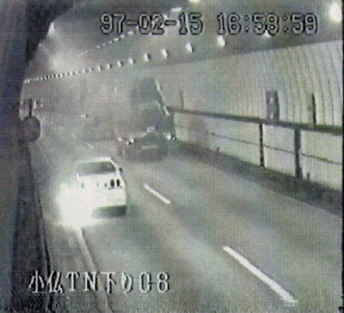
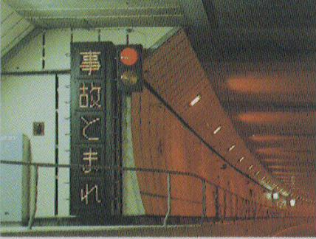
System Overview
Emergent
Event Video
(Video
switching)
Emergent
event
CCTV Monitor
CCTV Control Rack
Image Processing Unit
Accident
Video
New
i-Pro
Abnormal
detection
Camera
Display
control
Alarm
Display
at Entrance
[Normal time]
Speed ​​warning
etc
Alarm
Display
In Tunnel

Slide 6
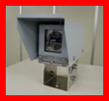
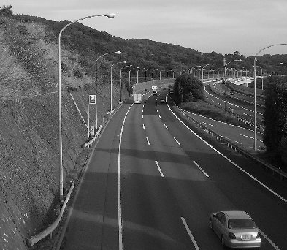


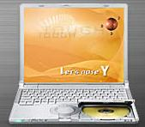

System Overview
We offer the Image Traffic Counter & Incident Detection APP/Firmware
System Configuration
:Panasonic Supply Application/Firmware
Unit
Road Condition・Traffic Counter
Center
Traffic Data server APP
Main Server
(Third Party)
Control Box
Network
<Traffic counter>
Average speed
Volume of traffic
<Incident>
1) Stopped vehicle
2) Low-speed vehicle
3) Congestion
4) Avoid obstacles
5) Over speed
6) Reverse run
7) Driving vehicle
in shoulder lane
Video
Data
H.264
Raw Video
Processing
Result
NVR
Maintenance PC App
ASM/VideoInsight

Slide 7

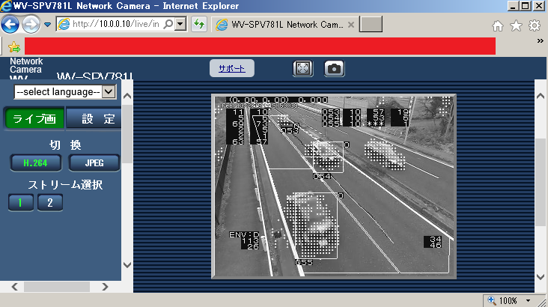
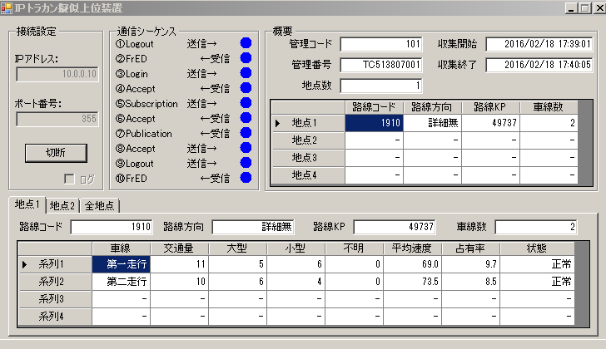
i-PRO Image Traffic Counter Feature
社外秘
7/14
Traffic Counter Feature(In JPN)
Feature
OSD Video
Traffic server
App image
Display of traffic in each lane
Notes:
7
7
郵政向け（アナログ＆アクセスＣ）
2Q販売について、
「アナログ：114百万＋アクセスＣ：76百万＝190百万」

Slide 8
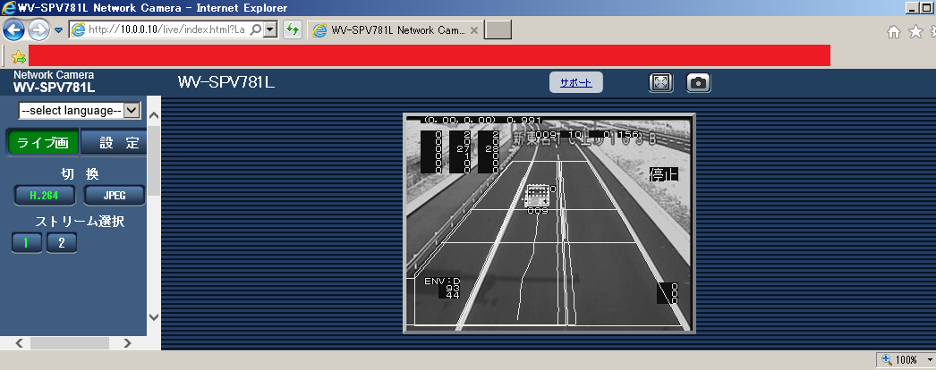
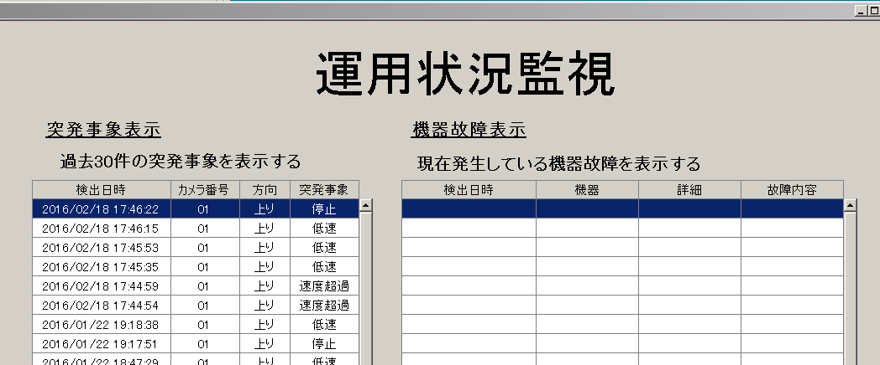
i-PRO Image Traffic Counter Feature
社外秘
8/14
Detecting abnormal situation Feature
Feature
OSD Video
Display of detecting abnormal situation
Traffic Data server
App image
Detecting abnormal situation Log
Notes:
8
8
郵政向け（アナログ＆アクセスＣ）
2Q販売について、
「アナログ：114百万＋アクセスＣ：76百万＝190百万」

Slide 9
Recommended Camera Installation
Camera
8 deg Angle of dip
38.2 deg
Angular field of view(V)
Pole height
8 m
Blind spot 7.6m
Measurement area 48.9m
48.9 m
Width of road
12m
65 deg
Angular field of view(H)
Measurement area
9.5m
Camera
12 m

Slide 10
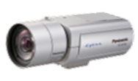


i-PRO Image Traffic Counter Merit
社外秘
10/14
Compared with the analog camera system,
realizing a reduction of equipment and installation cost
Comparison
Analog Camera system
Panasonic IP Camera System
NW Camera
with image processing
Analog Camera
Image processing Unit
【Merit】2 video stream
1. High-quality full HD
2. Processing result (QVGA)
Encoder
Item sample(Camera 10units)
Device | Qty
Analog Camera | 10
Rack(Large size) | 10
－Image processing Unit | 10
－Encoder | 10
－Media converter | 10
・Reduce the device
・Compact
Device | Qty
IP Camera | 10
Rack(Small size) | 10
－Image processing Unit | 10
－Encoder | 10
－Media converter(PoE) | 10
Notes:
10
10
郵政向け（アナログ＆アクセスＣ）
2Q販売について、
「アナログ：114百万＋アクセスＣ：76百万＝190百万」

Slide 11
Feature & Performance
社外秘
11/14
This i-PRO traffic counter App is for “High way” of one side 4 lane
 |  | Specification
Detection method |  | Image recognition Method
Product list |  | Imaging & Processing Unit ×1
Supported speed by car |  | 1～160km/h
Required distance between cars |  | More than 5.0m（Height of Imaging Unit: 8.0m, Following car height: Less than 1.6m）
Detection accuracy |  | Car count:95％, Average speed:90％
Output I/F |  | IP
Output data | Traffic flow measurement | Volume(two classification)/Speed average/Occupancy by 1 min or 5 min
 | Detecting abnormal situation | Motion detection of vehicle(Stop/Slow speed/Congestion/Avoid obstacles/wrong-way run) Falling object detection
Others : For “High way” of one side 4 lane
Notes:
11
11
郵政向け（アナログ＆アクセスＣ）
2Q販売について、
「アナログ：114百万＋アクセスＣ：76百万＝190百万」

Slide 12
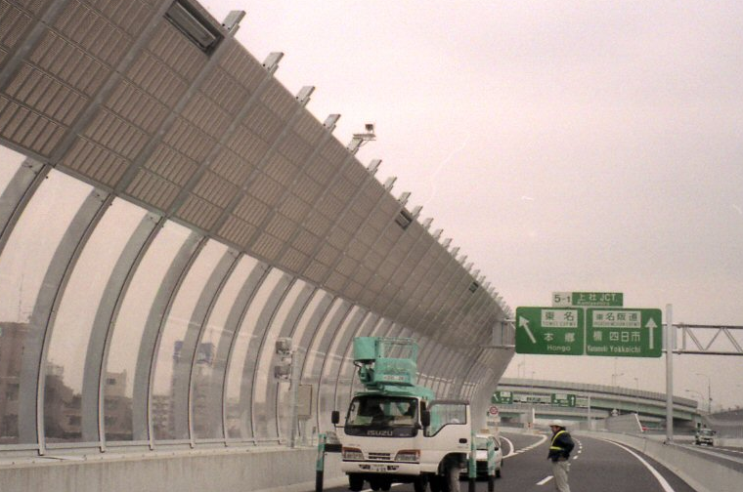
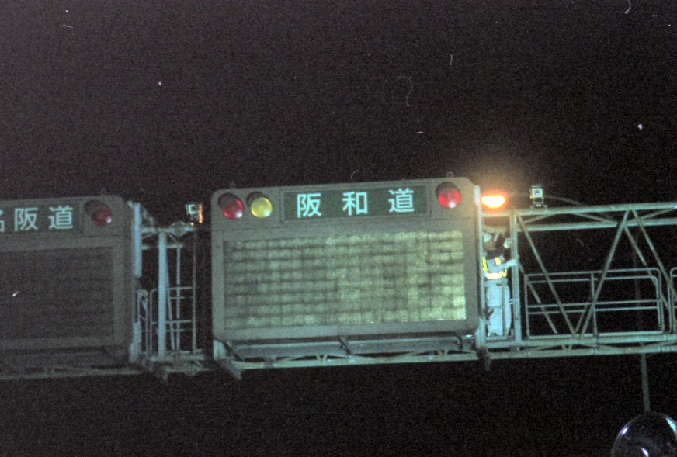
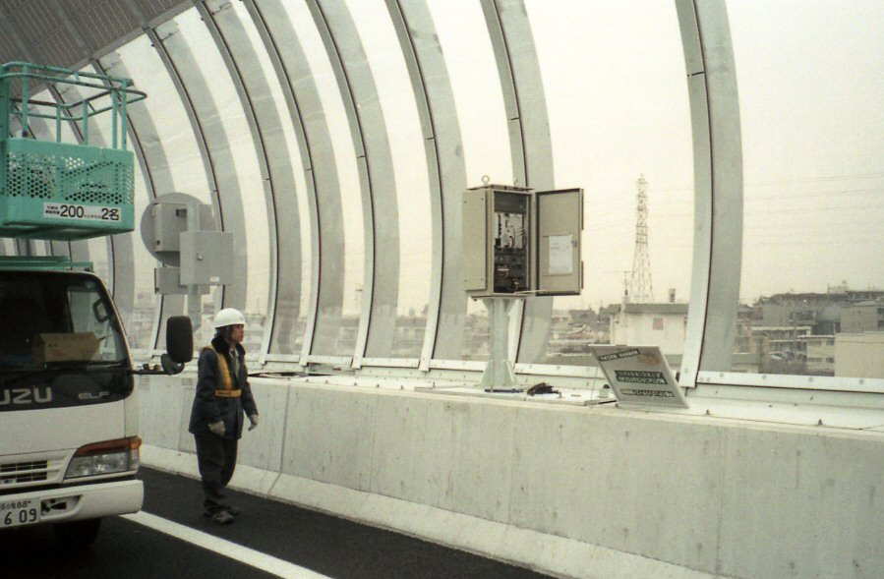
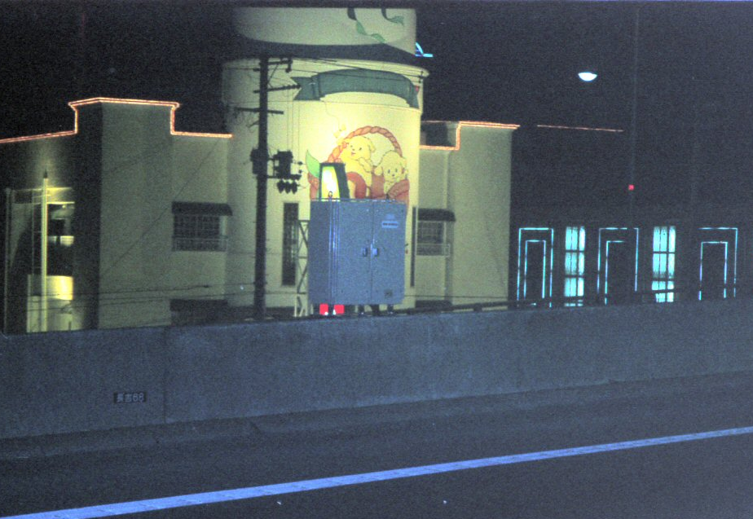
Installation Case Study in Japan
Imaging Unit
Processing Unit

Slide 13


Slide 14
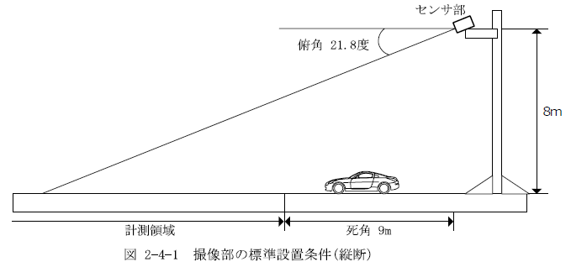
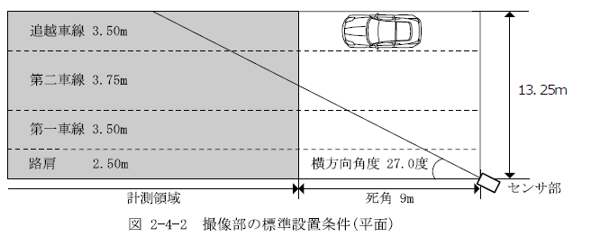
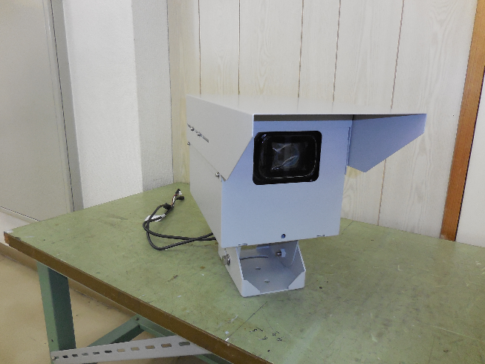
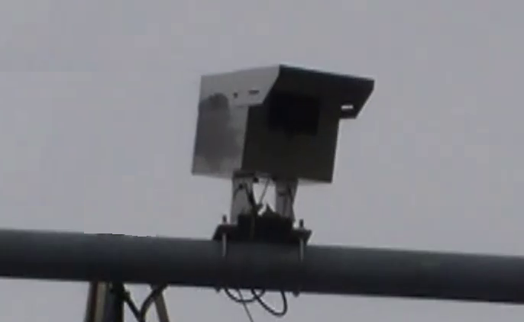
Installation condition
Imaging Unit
Angle of dip : 21.8 deg
Angle 27 deg
Measurement area
Blind spot: 9m
Measurement area
Blind spot: 9m
Imaging Unit

Slide 15
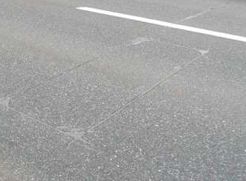
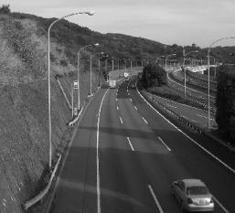
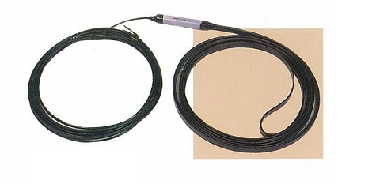

Benefit of image Processing Type
Image processing type can use the existing pole, and it can be active maintenance
Loop Coil Type
Image Processing Type
（Installation Image）
（Installation Image）
Demerit
● Requires construction work and high cost
● This type is not in use the bridge,
tunnel and overhead structure.
● Only traffic counter, no Incident detection
Benefit
〇 Use the existing pole
〇 Active maintenance
〇 Traffic counter and Incident detection
are available

Slide 16
Comparison to other method
 | Loop Method | Ultrasonic Method | Image recognition Method
Detection Method | Loop inductance change detection method | Ultrasonic pulse-echo method | Image processing method (monocular type)
Product list （Minimum） | Loop coil ×2 Processing unit ×1 | Ultrasonic sensor ×2 Processing unit ×1 | Imaging Unit ×1 Processing Unit ×1
Sensed target | Light car or more | Light car or more | Light car or more
Detected car lanes | 4 lanes | 4 lanes | 4 lanes
Supported speed by car | 1～160km/h | 1～120km/h | 1～160km/h
Required distance between cars | More than 2.3m （traveling direction loop length:1.5m） | Depend on the speed of car Sample) 120km/h -> 5.2m | More than 5.0m（Height of Imaging Unit: 8.0m, Following car height: Less than 1.6m）
Accuracy | More than 99% | More than 99% | More than 90%/Panasonic 97%
Power consumption | Less than 150VA | Less than 150VA | Less than 400VA
Output IF | IP, FS, Contact | IP, FS, Contact | IP
Operational Temperature ※Cold start separately | -20℃～+50℃ | -20℃～+50℃ | -20℃～+50℃
Relative humidity ※No condensation | 30%～85% | 30%～85% | 30%～90%
Power-supply voltage | AC100V±10% 50/60Hz | AC100V±10% 50/60Hz | AC100V±10% 50/60Hz
Size（mm） Width×Height×Depth | Sensor 1500*2000 Processing Unit 400×800×350 | Sensor Φ160*129*Φ111 Processing Unit 400×800×350 | Imaging Unit 108×114×355 Processing Unit 400×550×300
Weight | Sensor 3.5kg Processing Unit 70kg | Sensor 0.5kg Processing Unit 70kg | Imaging Unit Less than 5kg Processing Unit Less than 35kg
Others |  |  | Detection abnormal situation（Option）

Slide 17
Comparison to other method
 | Laser Method | Image recognition Method
Detection Method | Laser reflection method | Image processing method (monocular type)
Product list （Minimum） | Laser sensor ×2 Processing unit ×1 | Imaging & Processing Unit ×1
Sensed target | Light car or more | Light car or more
Detected car lanes | 3 lanes | 4 lanes
Supported speed by car | 1～160km/h | 1～160km/h
Required distance between cars |  | More than 5.0m（Height of Imaging Unit: 8.0m, Following car height: Less than 1.6m）
Accuracy | 99% | More than 90%/Panasonic 97%
Power consumption | Less than 500VA | Less than 400VA
Output IF | IP | IP
Operational Temperature ※Cold start separately | -20℃～+50℃ (Sensor:-30℃～+50℃) | -20℃～+50℃
Relative humidity ※No condensation | 30%～85% | 30%～90%
Power-supply voltage | Sensor DC24V±10% Processing Unit AC200V/460V | AC100V±10% 50/60Hz
Size（mm） Width×Height×Depth | Sensor 159×155×185 Processing Unit 500×700×350 | Imaging Unit 108×114×355 Processing Unit 400×550×300
Weight | Sensor 3.7kg Processing Unit 70kg | Imaging Unit Less than 5kg Processing Unit Less than 35kg
Others | Possible to check the status and area setting by remote | Detection abnormal situation（Option）

Slide 18
Comparison to Laser method
Laser method is superior to measuring performance and application.
Image recognition method can be used for both measurement and monitoring,
and superior to TCO.
 | Laser Method | Image recognition Method (IP Traffic Counting)
Merit | ・High accuracy because of high resolution （Possible to determine the type of car） ・Useful even in bad weather such as fog | ・Imaging unit can be used for both measurement and monitoring ・Efficient for both initial and maintenance ・Detected for 4 lanes
Demerit | ・High initial cost (1set:8-9KUSD ※included adjustment fee) ・Frequently maintenance required, like cleaning | ・Possible to determine just two types of car ・Impossible to use in bad weather such as fog
Other | ・Detected for Only 3 lanes ・Required processing unit separately

